Slide 1

Minnesota Historical Society House State Government Finance Committee MNHS Capital Budget / Historic Fort Snelling Request March 14, 2018

Slide 2

SCHEMATIC DESIGN CONCEPT
Minnesota Historical Society
2018 Capital Budget Priorities
Historic Fort Snelling Revitalization - $30,000,000
Historic Sites Asset Preservation $13,888,000
County and Local Historic Preservation Grants $750,000

Slide 3

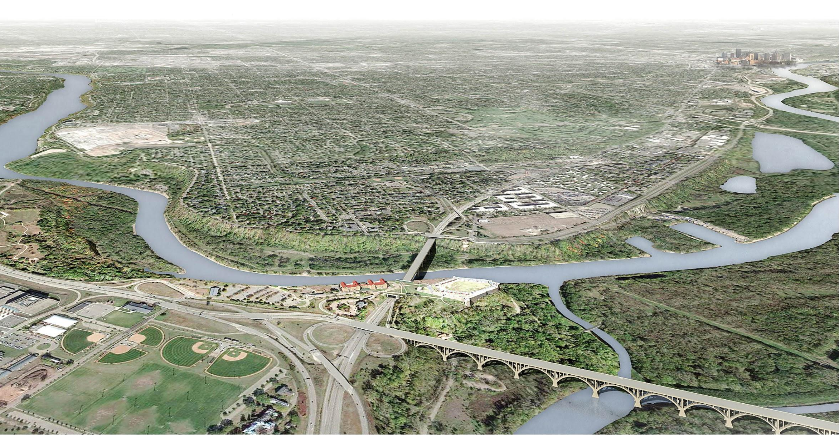
Historic Fort Snelling Area
Rendering by Leo A Daly Architects

Slide 4
SCHEMATIC DESIGN CONCEPT
Revitalizing Historic Fort Snelling
VISION:
Create a destination for discovery, learning, healing and a place of community connection.
Engage diverse communities in Minnesota and beyond. Many stories of the area’s history will be told in preserved historic buildings. People will draw inspiration from the natural beauty of the bluffs and rivers. Community groups will gather to share their histories.
Relate the site’s long history and stories to themes of the yearning for freedom and the defense of freedom; the struggle for human rights; and soverignty and power.

Slide 5
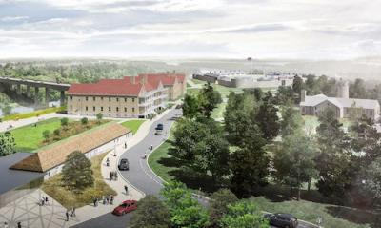
SCHEMATIC DESIGN CONCEPT
Revitalizing Historic Fort Snelling
KEY HIGHLIGHTS:
Funding to revitalize Historic Fort Snelling will:
Create a new visitor center and welcome area within renovated historic buildings
Create a park-like setting that is an integral part of the educational experience
Develop new programs, experiences and exhibits in concert with community partners
Enhance wayfinding
Demolish the outdated visitor center and landscape the vacated space along the river

Slide 6
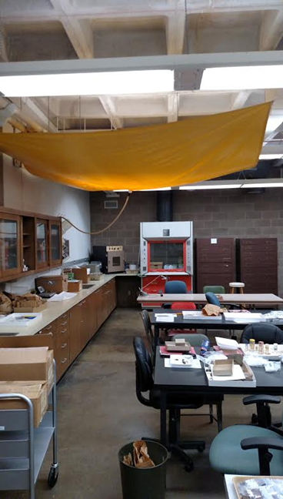
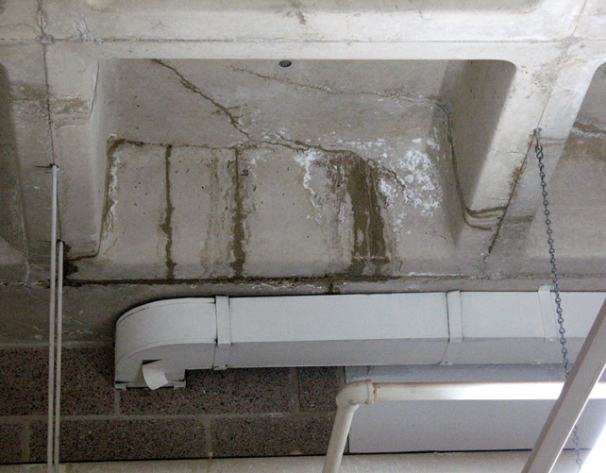
SCHEMATIC DESIGN CONCEPT
Revitalizing Historic Fort Snelling
Basement ceiling cracks
Tarp to collect leaking water
from ceiling

Slide 7
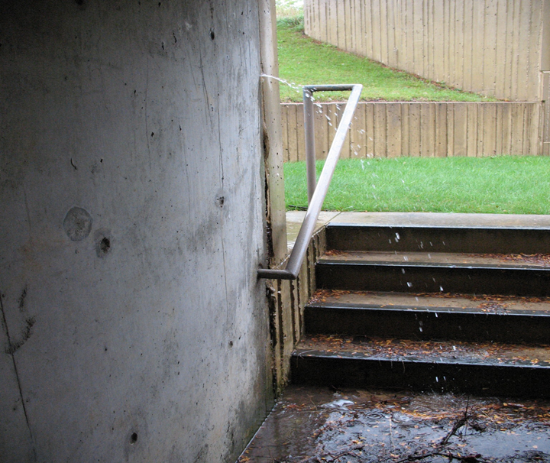
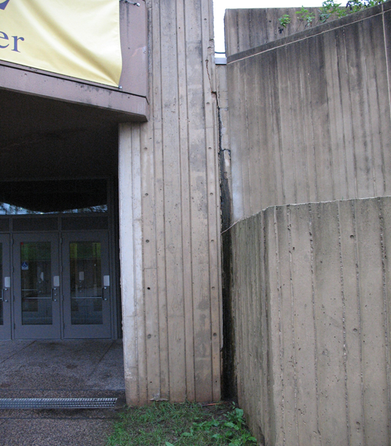


SCHEMATIC DESIGN CONCEPT
Revitalizing Historic Fort Snelling

Slide 8
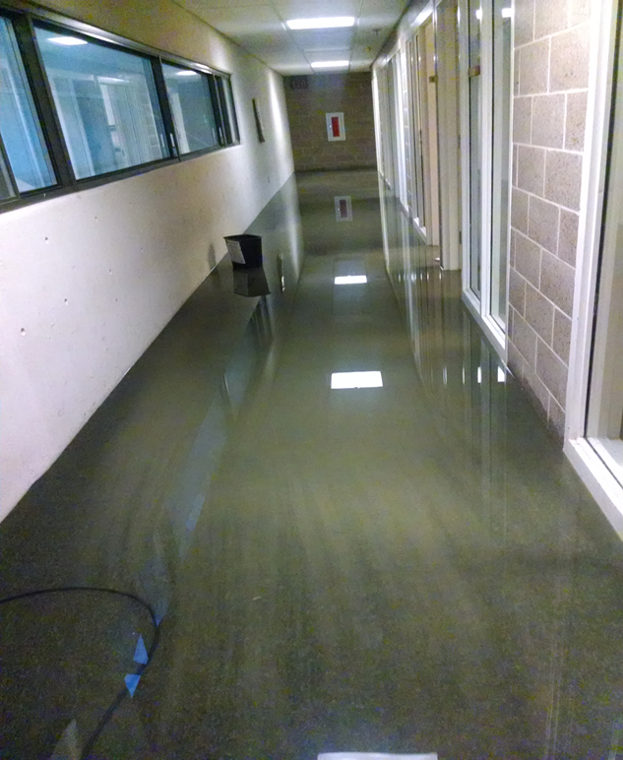
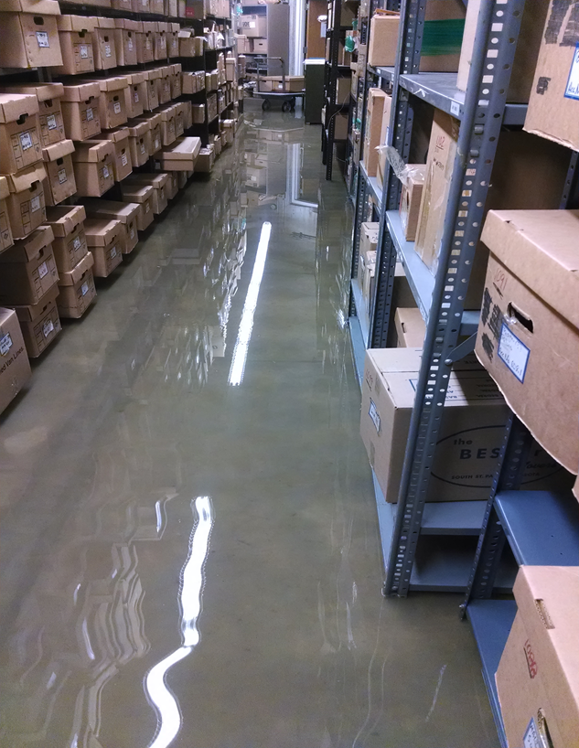
SCHEMATIC DESIGN CONCEPT
Revitalizing Historic Fort Snelling
Flooding in hallways

Slide 9
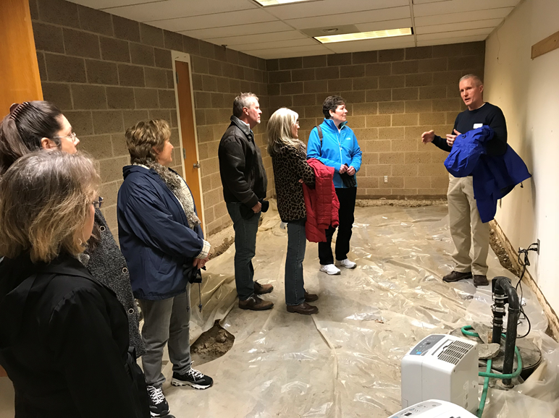
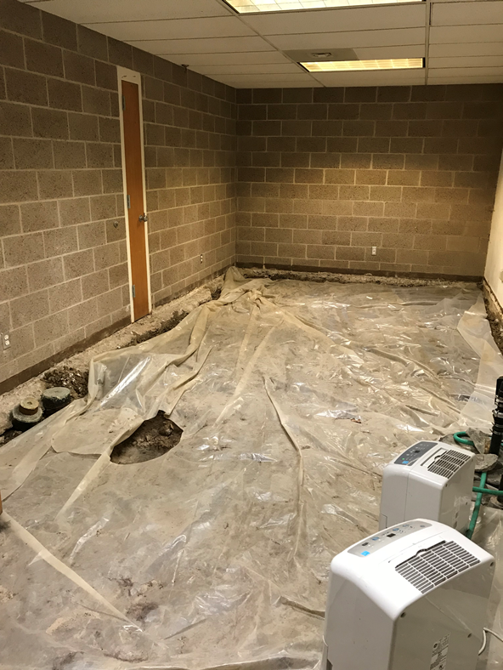
SCHEMATIC DESIGN CONCEPT
Revitalizing Historic Fort Snelling
Water damage in office

Slide 10
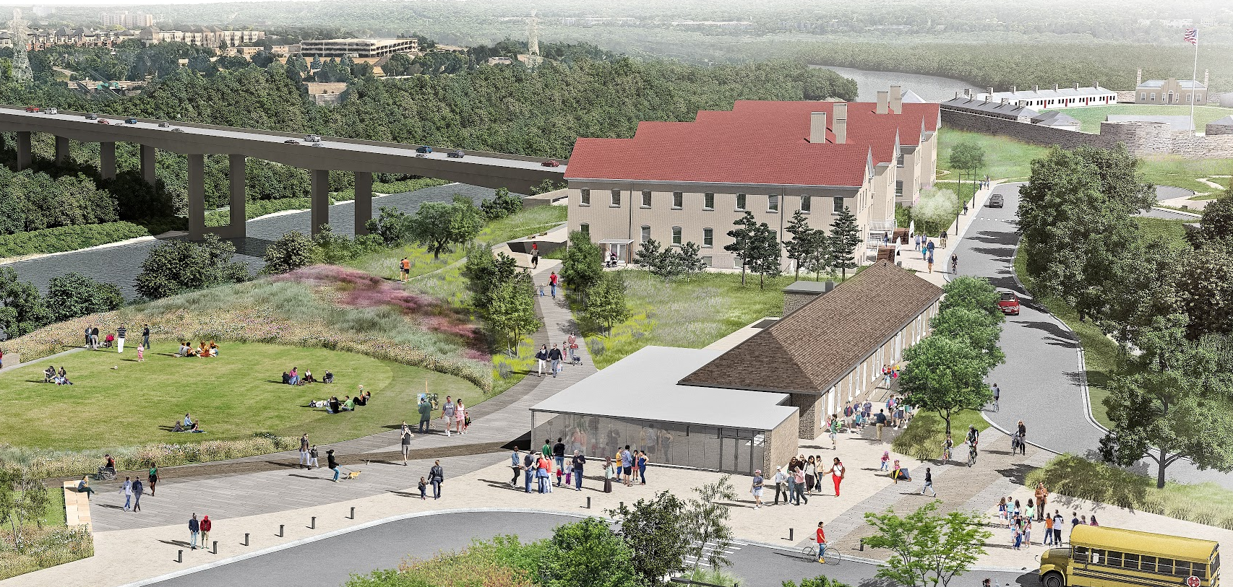
SCHEMATIC DESIGN CONCEPT

Slide 11
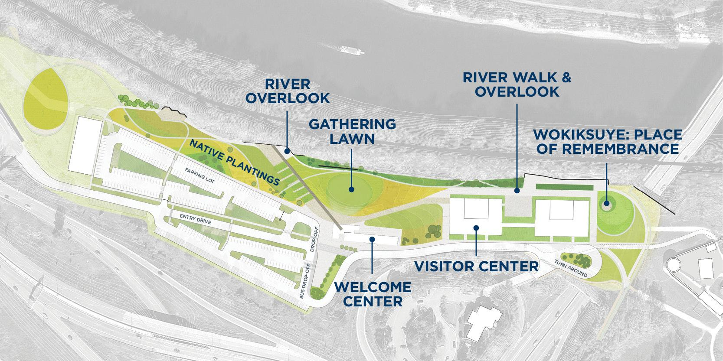
SCHEMATIC DESIGN CONCEPT

Slide 12
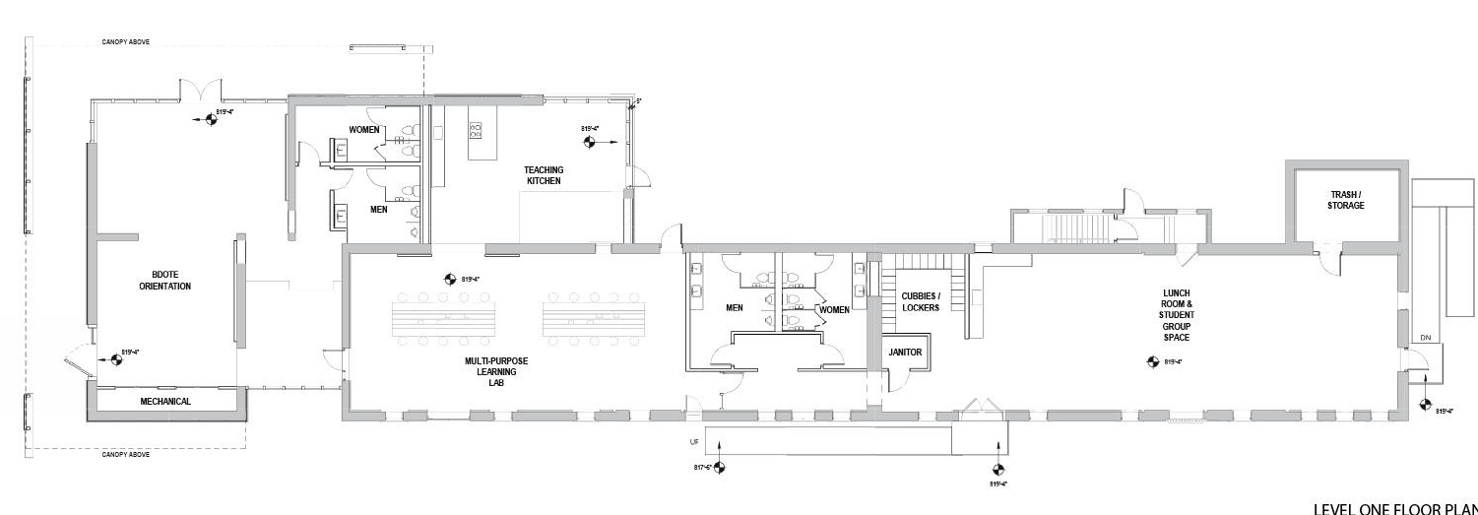
SCHEMATIC DESIGN CONCEPT
Welcome Center (Building 22)

Slide 13
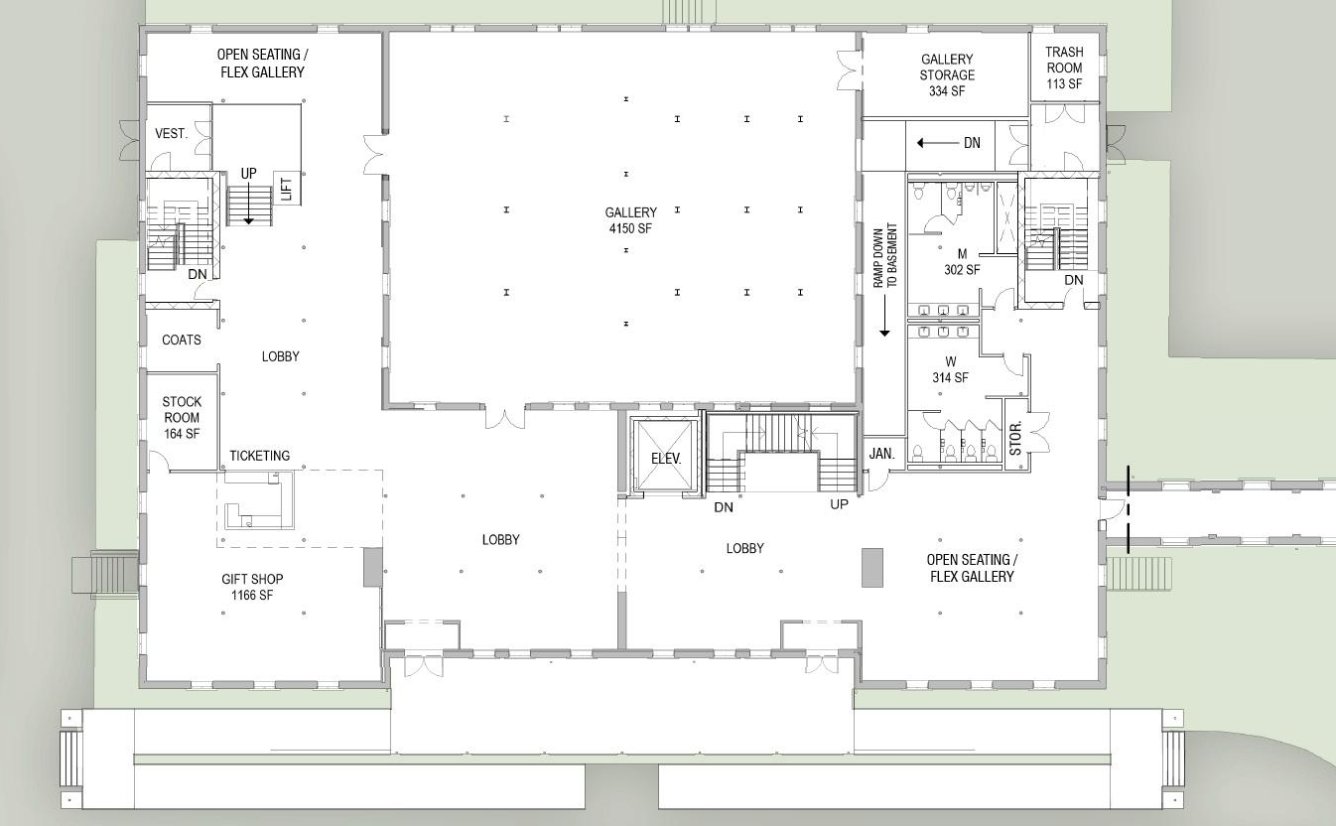
SCHEMATIC
DESIGN
CONCEPT
Visitor Center (Building 18) Level 1

Slide 14
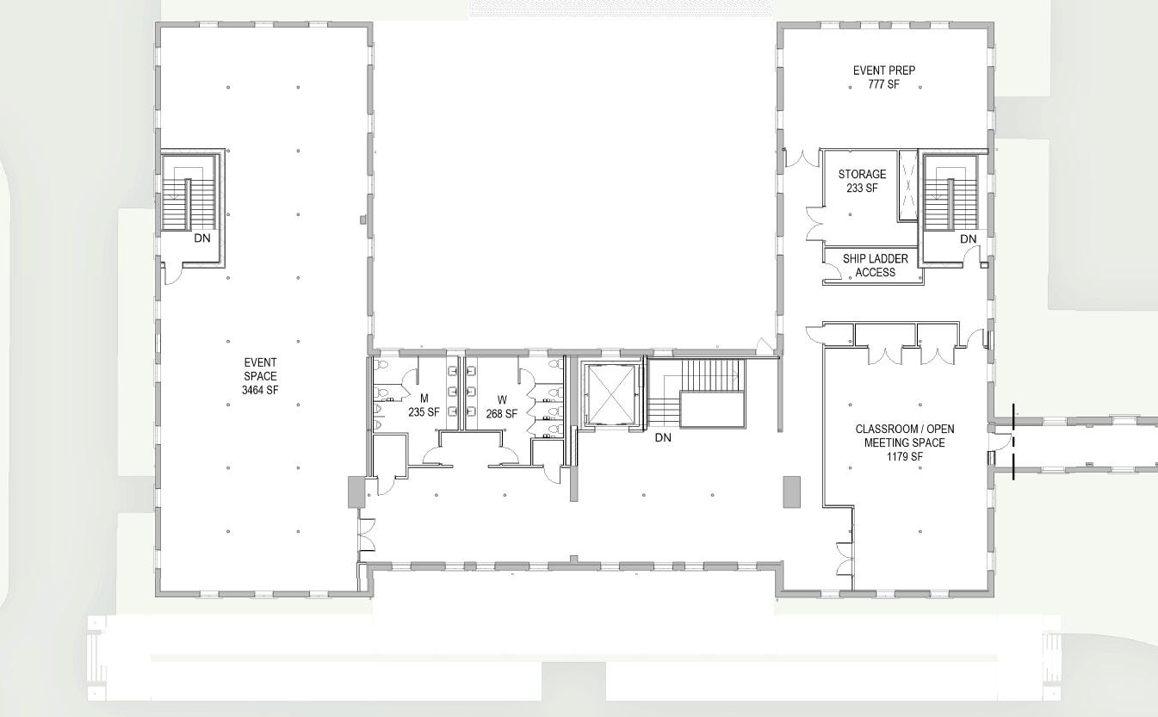
SCHEMATIC
DESIGN
CONCEPT
Visitor Center (Building 18) Level 2

Slide 15
SCHEMATIC DESIGN CONCEPT
Budget Summary
Project Costs (in thousands)
2015 Special Session Predesign Appropriation $500
2017 Design Appropriation $ 4,000
2018 State Funding Request for Construction $30,000
Non-state/Private Contributions $12,000
Total $46,500

Slide 16
SCHEMATIC DESIGN CONCEPT
MNHS Capital Budget Request Review
2018 Capital Budget Priorities
Historic Fort Snelling Revitalization
Historic Sites Asset Preservation
County and Local Historic Preservation Grants

Slide 17
SCHEMATIC DESIGN CONCEPT
Historic Sites Asset Preservation
MNHS Responsible for 154 buildings statewide
Nearly half of these structures are over 100 years old
Sites are part of statutorily defined Historic Sites Network – a state responsibility
Asset Preservation Projects for Historic Structures take specialized design and construction techniques
Modern visitor facilities are approaching life-cycle stages of significant repair or replacement

Slide 18
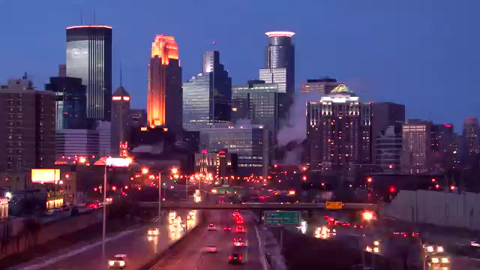
Historic Fort Snelling Video

Slide 19
SCHEMATIC DESIGN CONCEPT
Thank You

