Slide 1

Agricultural Marketing and Development
Dr. Mary Hanks, Director
The Ag Marketing and Development Division promotes the production and marketing of Minnesota food, fiber, feed and fuel. We work to create a climate conducive to profitable agricultural pursuits that protect our natural resources while meeting the demands of the marketplace.

Slide 2

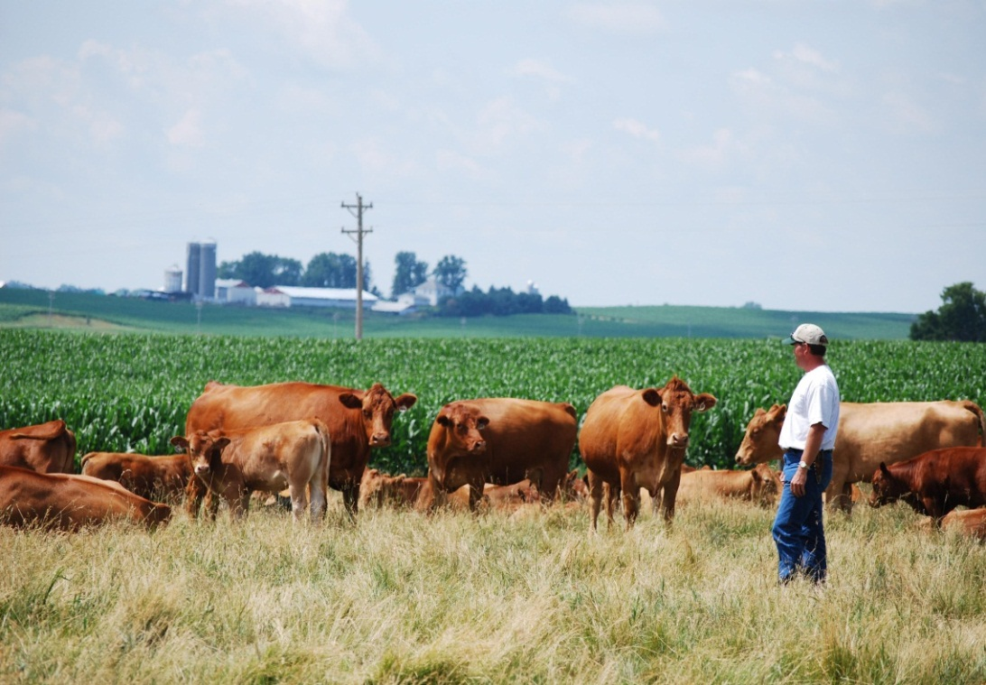
Agricultural Marketing & Development Division
Production Assistance
Access to Markets and Business Development
Education

Slide 3

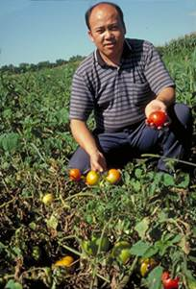
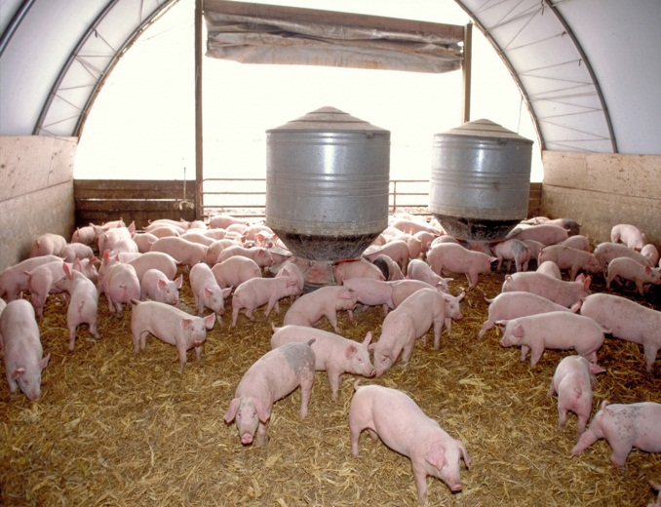
Production Assistance
Agricultural Marketing & Development Division
Livestock
Emerging ag water and conservation technology
Immigrant and underserved farmers
Biofuels
Local and organic foods
Crop research

Slide 4

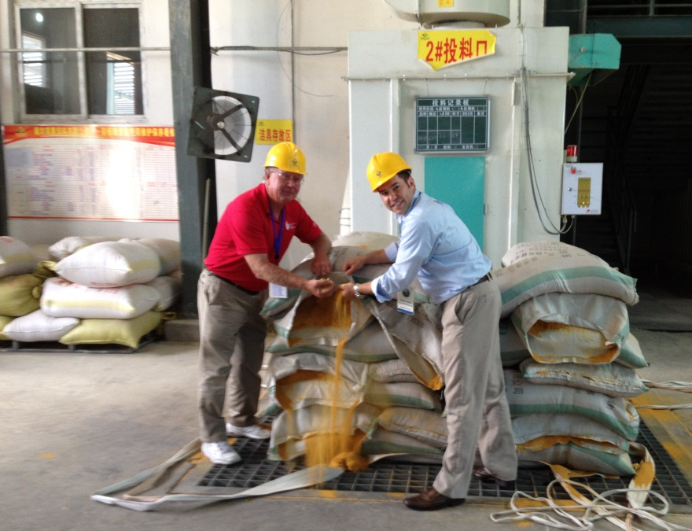
Access to Markets
Agricultural Marketing & Development Division
Minnesota Grown
International Marketing

Slide 5
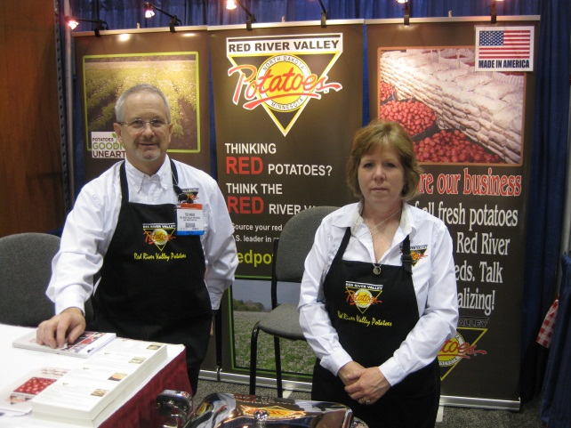
Business Development
Agricultural Marketing & Development Division
Information resource and support
AGRI
Organic Certification Cost Share
Livestock Investment
Value Added Business
Farm to School
Beginning and Transitioning Farmer
Food Company Promotions
Blender Pumps

Slide 6

Education
Agricultural Marketing & Development Division
Minnesota Agriculture in the Classroom

Slide 7
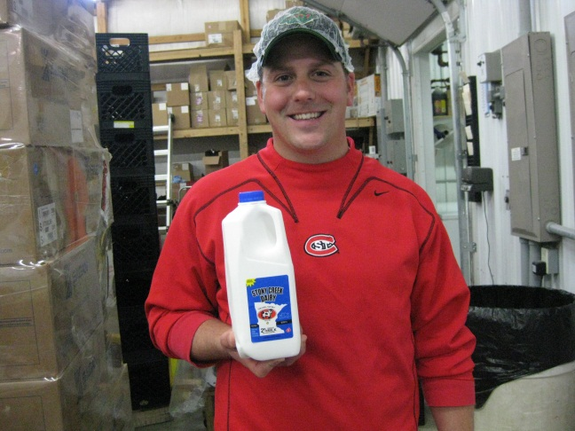
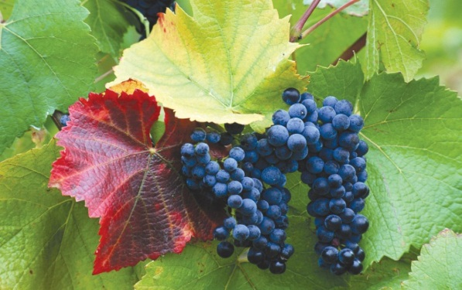
Performance Measures
Agricultural Marketing & Development Division
Unique visitors to the MN Grown Directory website increased from 240,000 in 2011 to 294,000 in 2014
Percent of elementary and middle schools using Ag in the Classroom’s Ag Mag increased from 40% in 2012/13 to 44% in 2013/14

Slide 8

Performance Measures
Agricultural Marketing & Development Division
Number of certified organic operations increased from 939 in 2011 to 1068 in 2013
Return on investment for trade missions/reverse missions increased from $199:$1 in 2011 to $423:$1 in 2013/14

Slide 9
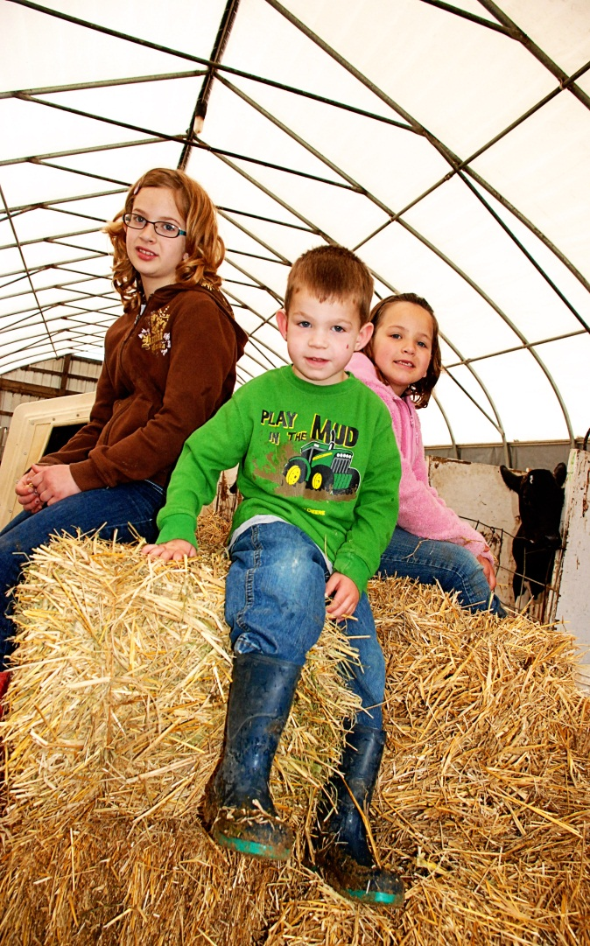
To Learn More
Agricultural Marketing & Development Division
Visit the MDA website at
www.mda.state.mn.us

