Slide 1
Treated Chronic Disease Cost in MN: A Look Back & a Look Forward
Stefan Gildemeister, Director Health Economics Program
House Health and Human Services Finance Committee, March 8, 2018

Slide 2
Is Minnesota Disease-Attributable Spending on the Right Track?
Identify health care spending directly attributable to select conditions (diabetes, hypertension, dementia, obesity, all chronic conditions for persons 60 years or older) and smoking exposure
Include spending for co-morbid conditions, e.g. hypertension for diabetes
Exclude spending unrelated conditions, e.g. the ED visit for influenza
Project how condition-attributable spending would rise after 2009 without changes in trends
Compare 2014 actual spending to baseline projections from 2009
Estimate share of the difference between actual & projected spending attributable to state-administered programs

Slide 3
About the Study & Key Findings

Slide 4
What Is Disease-Attributable Health Care Spending?
Diabetes – Hypertension -
Dementia - C/D among 60+ -
Obesity - Tobacco
Direct Medical Costs
(health care spending)
Persons w/condition
Related medical svcs & Rx
All other medical svcs. & Rx
Persons w/o
Any medical svcs. & Rx
Indirect Costs
(lost income/care giver)

Slide 5
About the Estimates
Based on treated prevalence for a 1-year period:
People with condition not presenting for care in time period are not counted in prevalence estimates
Adjusted to reflect uninsured/others
Focused on medical spending, not complete estimate of impact
Economic burden of income lost or life lost
Caregiver burden
Uses best available science & data, but:
Estimates are associated with statistical error
Science of “attributing spending” to conditions is evolving
Does not capture potentially sizable spill-over effects from condition/risk-factors on unrelated care
The final legislative report will include detailed information on data, methodology, and estimates in the literature. This information is largely already available in the status report update from July 2016: http://www.health.state.mn.us/divs/hpsc/hep/ChronicConditionsStatusRpt.pdf
Notes:
Re: last bullet, an example from Renee: Diabetes isn’t considered to cause hypertension so htn is not part of the attributed costs. However, diabetes can make hypertension worse and increase the probability of CVD problems, so there is an interaction term included in the models to include the costs attributed to diabetes making htn worse.

Slide 6
Key Findings
Spending on chronic conditions accounted for a considerable share of total health spending, particularly for the elderly
Health care spending for all conditions rose from 2009 to 2014
Per-person spending for a number of categories actually fell
Growth in prevalence beyond the impact of aging drove much of spending increase
Ten-year projections of spending show considerable growth (24.8% to 65.1%)
Compared to baseline projections, 2014 trends are lower for some and higher for other conditions

Slide 7
Estimates and Projections

Slide 8
1 - Treated Prevalence 2009 & 2014, Attributable to Selected Conditions & Smoking Exposure
Source: Mathematica Policy Research analysis of claims and encounter data from the Minnesota All-Payer Claims Database v. 19, the Medical Expenditure Panel Survey and Minnesota’s Behavioral Risk Factor Survey. Estimates are weighted to population and coverage estimates reported in the Minnesota population sample of the American Community Survey.

Slide 9
2 - Estimated Spending, 2009 & 2014 Attributable to Selected Conditions & Smoking Exposure
Source: Mathematica Policy Research analysis of claims and encounter data from the Minnesota All-Payer Claims Database v. 19 and the Medical Expenditure Panel Survey. Estimates are weighted to coverage reported in the Minnesota population sample of the American Community Survey.

Slide 10
3 - Projected Health Care Spending, 2014 to 2023 Attributable to Selected Conditions & Smoking Exposure
 | Total Cumulative Percent Change, 2014 to 2023
Smoking exposure (age 18-64) | 24.8%
Obesity (age 10 to 64) | 24.8%
Diabetes | 47.3%
Hypertension | 51.2%
Dementia (age 18 or older) | 59.3%
All chronic conditions (age 60 or older) | 65.1%
Source: Mathematica Policy Research; estimates reflect current dollars.

Slide 11
The Report Also Includes …
An analysis of the differences between 2014 actual and projected spending estimates:
By condition, and
For the group of conditions
The share of the difference between actual and projected spending attributable to state administered programs (Medicaid, MinnesotaCare and the State Employee Group Insurance Program)
The trigger for a transfer of $50 mill to the HCAF in 62U.04 was met
Notes:
Overall difference of $209 mill
Estimated PP portion: low of $54M and high of $71M

Slide 12
Conclusion
Multiple factors drive chronic disease spending, including
Health care cost inflation
Aging of the population
Of concern is the five-year growth in prevalence of treated disease in virtually all age groups
The solution may not lie solely in creating better treatment options or improving care delivery efficiency … we cannot treat ourselves out of this problem
Effort needs to increasingly be upstream, focusing on prevention, delay and early diagnosis

Slide 13
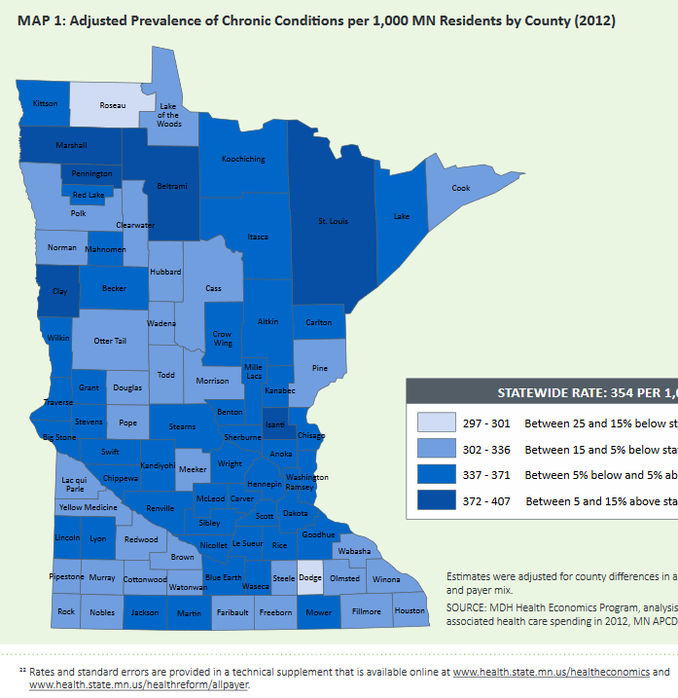
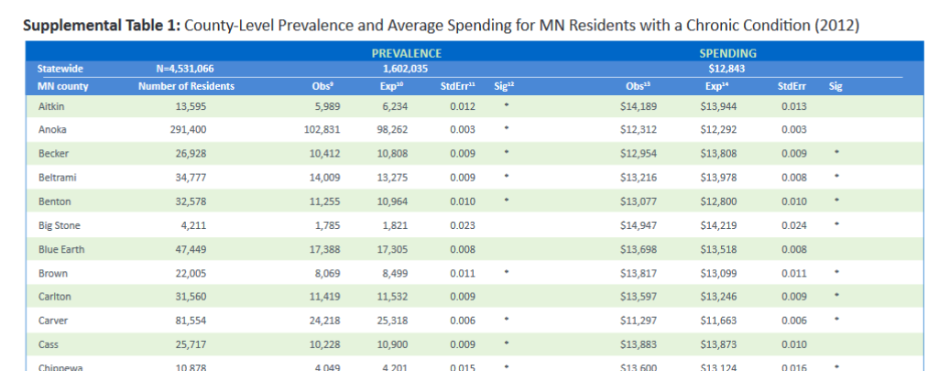
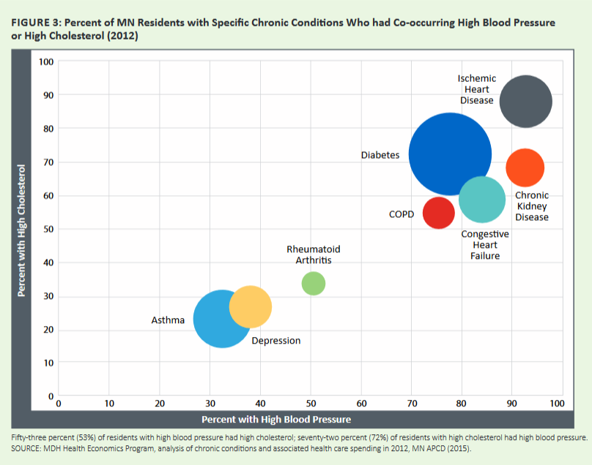
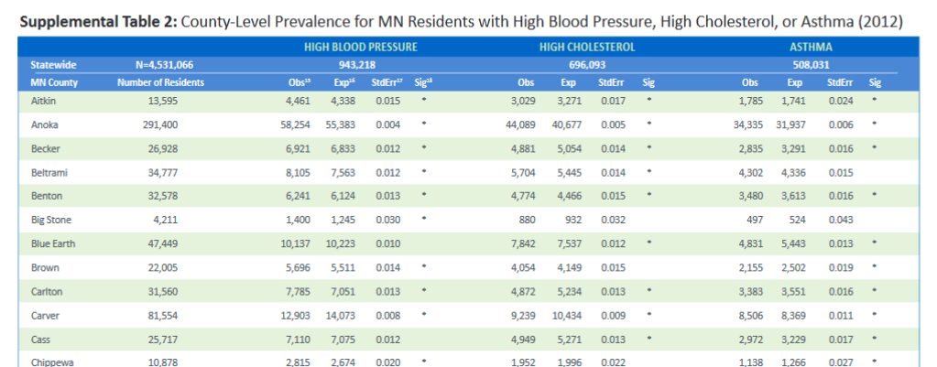
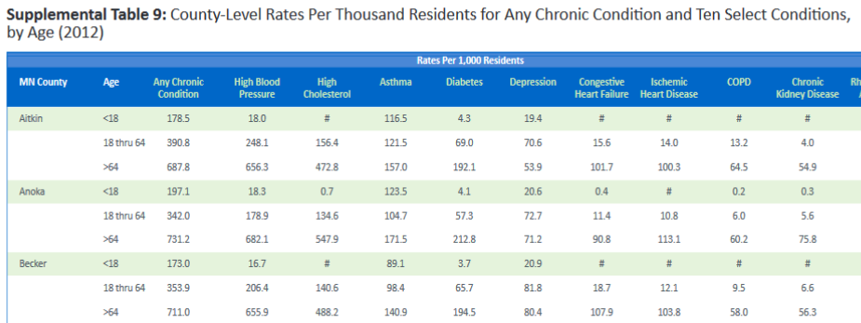
Spending for Minnesotans with Chronic Disease, 2012
Supplemental information at the county and age-level is available for ten select chronic conditions, including: high blood pressure, high cholesterol, asthma, diabetes, depression, CHF, ischemic heart disease, COPD, chronic kidney disease and rheumatic arthritis: www.health.state.mn.us/divs/hpsc/hep/publications/costs/20160127_chronicconditions.pdf & www.health.state.mn.us/divs/hpsc/hep/publications/costs/20160414_chronictechsupl.pdf

Slide 14
Discussion
Health Promotion & Chronic Disease: www.health.state.mn.us/divs/hpcd/
Office of Statewide Health Improvement Initiative: www.health.state.mn.us/divs/oshii/
Health Policy: www.health.state.mn.us/divs/hpsc/
Health Economics Program: www.health.state.mn.us/healtheconomics
MN All Payer Claims Data: www.health.state.mn.us/healthreform/allpayer

