Slide 1
Minnesota Department of Public Safety
FY2016-17
Biennial Budget
Presented by:
Mona Dohman, Commissioner
Mark Dunaski, Deputy Commissioner

Slide 2
Public Safety Mission A Safer Minnesota
To protect citizens and communities
Prevent, prepare, respond, recover, educate, and enforce
Focus on saving lives, providing efficient and effective services
Maintain public trust and develop strong partnerships

Slide 3
Department of Public Safety
Transportation
Policy and Finance Committees
Public Safety Policy and Finance Committee
Minnesota State Patrol
Alcohol and Gambling Enforcement
Fire Marshal Division
Office of Traffic Safety
Office of Justice Programs
Driver and Vehicle Services
Emergency Communication Networks
Office of Pipeline Safety
Homeland Security and Emergency Management
Administration and Related Services
Bureau of Criminal Apprehension

Slide 4
Total DPS Budget Base FY16-17
Transportation and Public Safety Divisions
(in thousands)
Total all funds = $650,657

Slide 5
FY16-17 Expenses By Category
Transportation and Public Safety Divisions
($ in thousands)
Total all funds = $650,657

Slide 6
Governor’s DPS Budget Recommendations
Transportation Policy and Finance Committees
Increase the State Trooper Escort Rate
One Fixed Wing Aircraft
Capitol Security
Increased Spending Authority for the Driver and Vehicle Services Division
International Fuel Tax Agreement (IFTA) Reinstatement Fee
Creating a Data Services Unit within DVS
Fine Increase for Second and Subsequent Offense for Texting While Driving
Increased Operational Support for the Department (1.8%)

Slide 7
Administration and Related Services
Minnesota Department of Public Safety

Slide 8
Administration and Related Services
Minnesota Department of Public Safety
Communications
Commissioner’s Office
Human resources
Fiscal and Administrative Services
Office of Technology and Support Services

Slide 9
Change Item
Operational Support for the Department (1.8%)
$117,000 for FY 16 (General Fund)
$236,000 for FY 17 ongoing (General Fund)
$3.041 million for FY 16 (Trunk Highway and Special Revenue Funds)
$6.164 million for FY 17 ongoing (Trunk Highway and Special Revenue Funds)

Slide 10
State Patrol
Minnesota Department of Public Safety

Slide 11
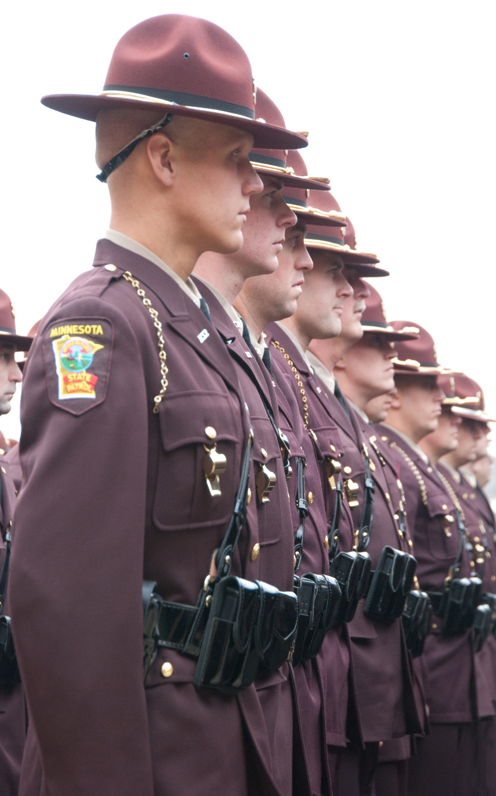
State Patrol
Minnesota Department of Public Safety
Mission
Protect and serve all people in the state through assistance, education, and enforcement; provide support to allied agencies; and provide for the safe, efficient movement of traffic on Minnesota’s roadways.

Slide 12
State Patrol
Minnesota Department of Public Safety
807 full-time, sworn and non-sworn personnel
Annual operating budget of $87.9 million
For the FY16-17 biennium:
$173,017,000 from Trunk Highway Fund
$1,594,000 from Highway User Tax Distribution Fund
$12,784,000 from the General Fund
$14,000,000 (approx.) federal funds

Slide 13
State Patrol
Minnesota Department of Public Safety
State Patrol Services
Aviation
Capitol Security
Executive Protection
Canine Program
Crash Reconstruction
Commercial Vehicle Enforcement
Vehicle Crimes Unit
DWI Enforcement
Fleet Management
Investigative Services
Public Information
Training Academy
Radio Communications
Special Response Team
Federal Programs

Slide 14
Change Item
Increase the State Trooper Escort Rate
Recommend changing the rate charged by the State Patrol to assist with the movement of oversized loads or traffic control.
Would allow the Commissioner to set an average rate based upon the actual cost per fiscal year.
Impacting the State Patrol’s budget approximately $145,000 per year.

Slide 15
Change Item
Capitol Security
Provide security based on need and risk assessments.
Eliminate the current Capitol Complex agency security contracts and provide a direct appropriation to the Department of Public Safety.
Enhanced security coverage for the Capitol Complex.
This is the recommendation of the Advisory Committee on Capitol Area Security.
$1.570 million/year (General Fund)

Slide 16
Change Item
Fixed Wing Aircraft
The State Patrol operates three fixed wing aircraft and three helicopters.
The State Patrol has sold three aircraft and one helicopter to help offset the cost.
The proceeds of those sales ($373,000), combined with this proposal will allow for the purchase of a new aircraft.
$975,000 (Trunk Highway)

Slide 17
Office of Traffic Safety
Minnesota Department of Public Safety

Slide 18
Office of Traffic Safety
Minnesota Department of Public Safety
Mission
To prevent traffic deaths and serious injuries by changing human behavior in Minnesota through policy development and support, stakeholder engagement, program delivery, leadership, and research and evaluation.

Slide 19
Office of Traffic Safety
Minnesota Department of Public Safety
OTS receives an annual appropriation from the Trunk Highway Fund of $435,000 - a required match which allows OTS to secure federal funds, grants, and one-time monies that annually amount to approximately $40,000,000.

Slide 20
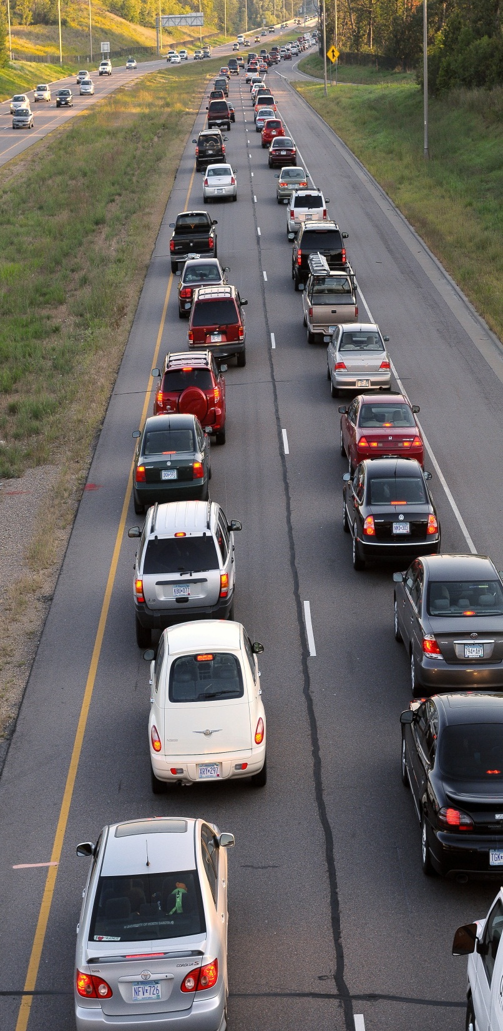
Office of Traffic Safety
Minnesota Department of Public Safety
OTS Services
Traffic Safety Outreach
Impaired Driving Prevention
Seat Belt Use
Child Passenger Safety
Traffic Records/Data Systems
Safe Road Coalitions
Motorcycle Safety
Teen Drivers
Illegal/Unsafe Speed
Distracted Driving
Traffic Safety Research and Analysis
Fatality Analysis Records System

Slide 21
Change Item
Fine Increase: Second Offense for Texting While Driving
Increase the current fine for second and subsequent offenses from $50 to $100.
Research shows that increased fines can be a deterrent.
Will ensure that Minnesota remains competitive for federal grant dollars.

Slide 22
Driver and Vehicle Services
Minnesota Department of Public Safety

Slide 23
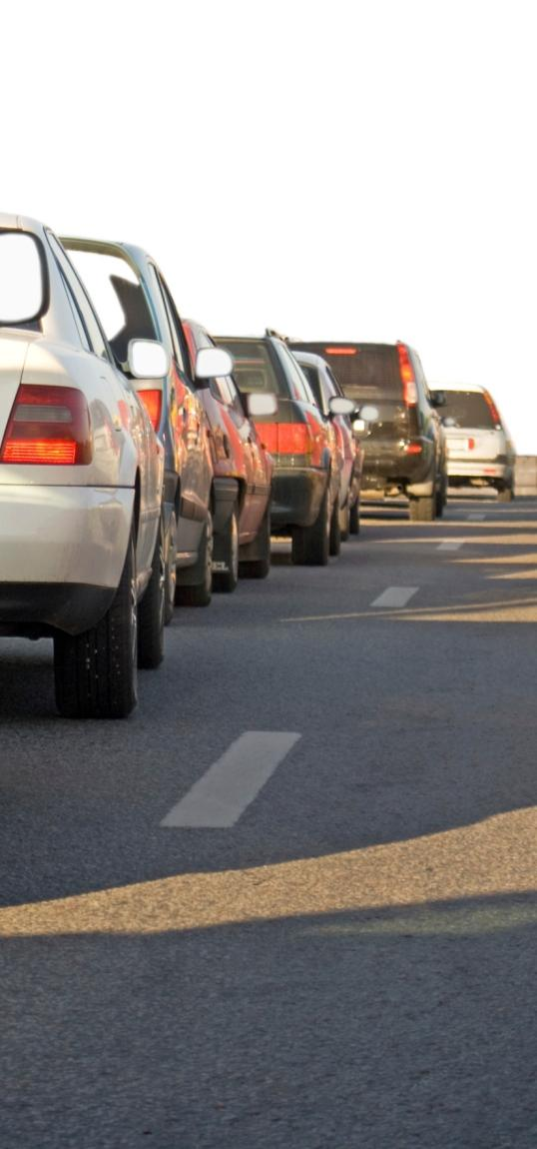
Driver and Vehicle Services
Minnesota Department of Public Safety
Mission
Committed to providing FAST (fair, accurate, secure, timely) service through effective service options, accurate collection of data, fraud prevention, efficient collection of state revenue, and quality information and technical support for staff and business partners.

Slide 24
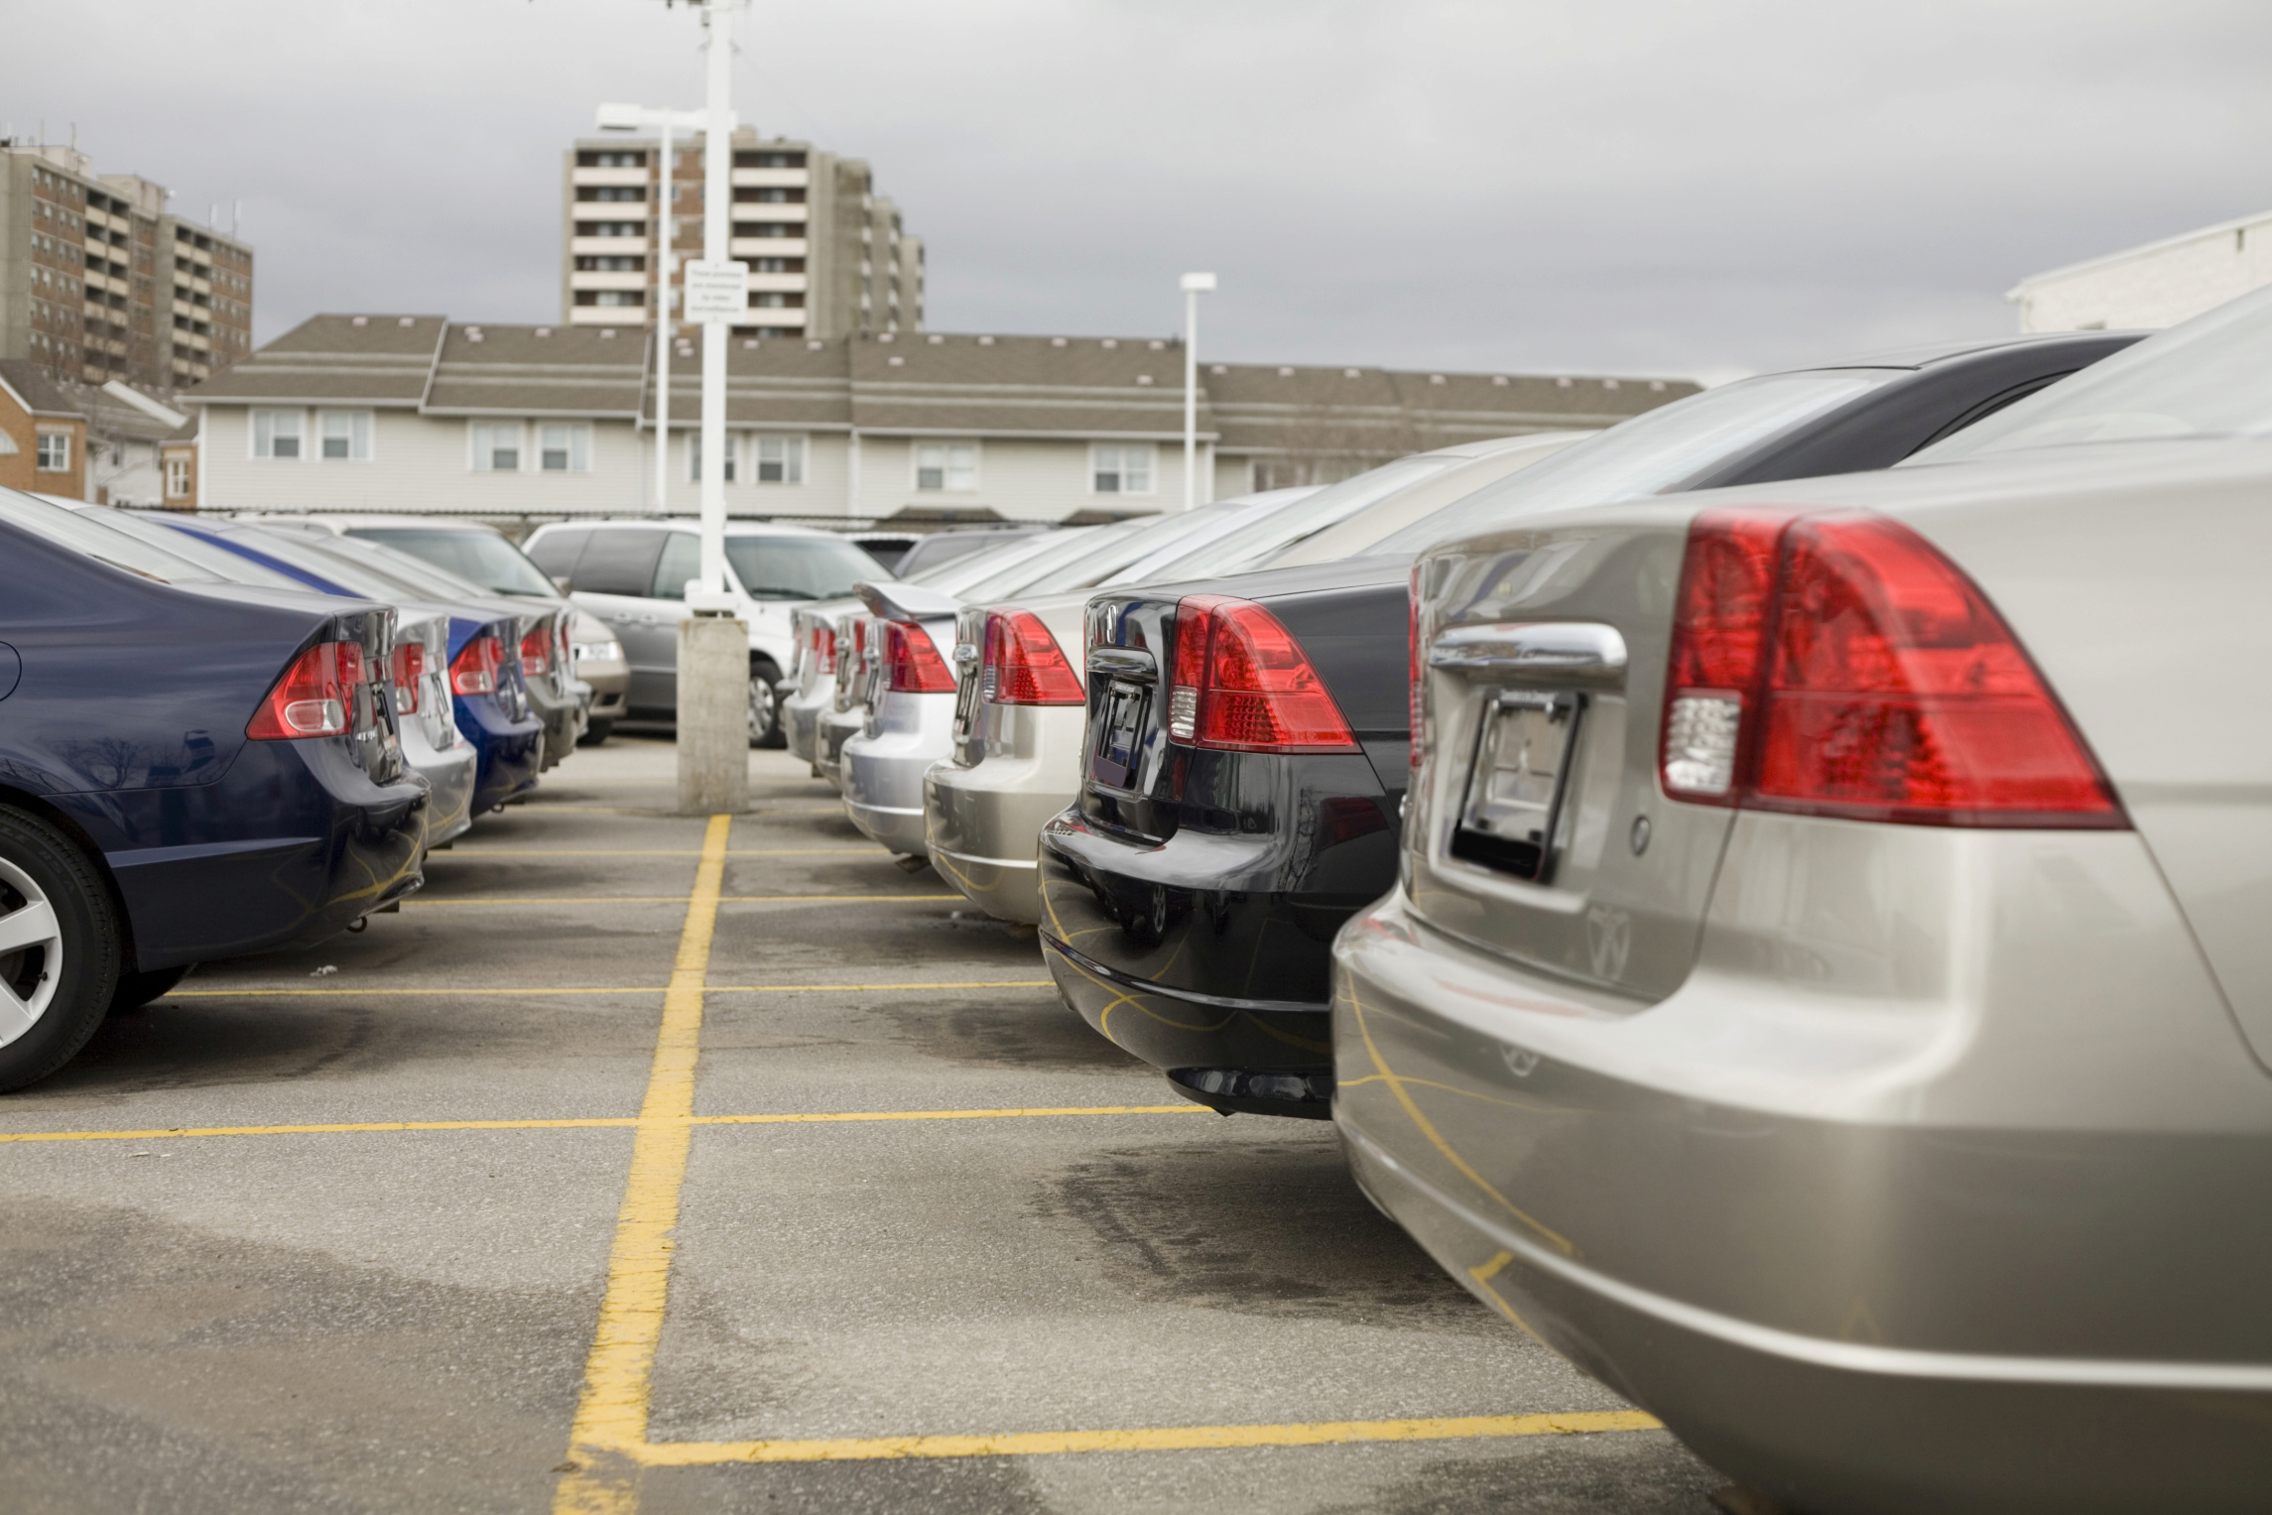
Driver and Vehicle Services
Minnesota Department of Public Safety
DVS has an annual budget of approximately $58 million.
538 employees working in 95 locations throughout the state.
More than $1.4 billion in state revenue is collected annually by DVS.
DVS is funded by the Special Revenue Fund and the Highway User Tax Distribution Fund.

Slide 25
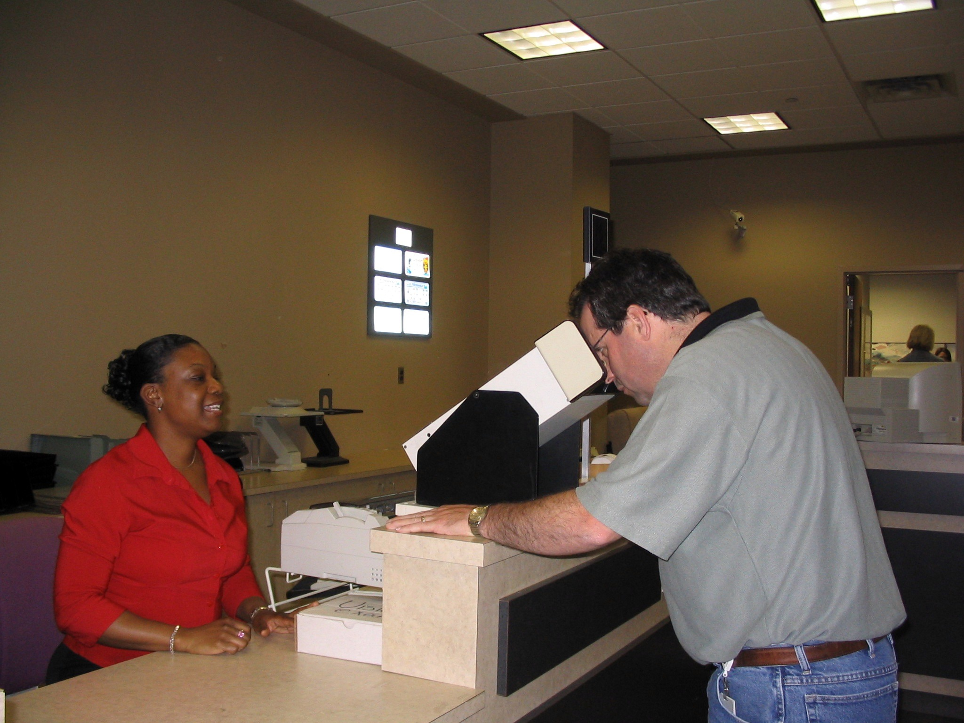
Driver and Vehicle Services
Minnesota Department of Public Safety
DVS Services
Title and Registration
Auto Dealer Licensing and Inspection
Prorate
Driver Exams
Driver Compliance
Driver’s License Issuing
Public Information Center
Operations Support
E-Business

Slide 26
Change Item
DVS Increased Spending Authority Division
Increased spending authority of $600,000 ongoing from the Driver Services and Vehicle Services accounts for staff salaries.
Increased spending authority of $1.2 million from the Vehicle Services Account to cover increased MINNCOR costs.

Slide 27
Change Item
International Fuel Tax Agreement Reinstatement Fee
IFTA - agreement between states and Canadian provinces to simplify the reporting of fuel use by motor carriers that operate in more than one jurisdiction.
Other IFTA jurisdictions collect a reinstatement fee from these carriers.
Establish a reinstatement fee of $100 to cover administrative costs.

Slide 28
Change Item
Creating a Data Services Unit within DVS
Conduct compliance audits, issue corrective action plans, and maintain and monitor user agreements.
One additional staff person to assist in providing legal advice and administration of the DVS data practices program.
$90,000/year

Slide 29
Office of Pipeline Safety
Minnesota Department of Public Safety

Slide 30
Office of Pipeline Safety
Minnesota Department of Public Safety
Mission
To protect lives, property, and the environment through the implementation of a program of gas and hazardous liquid pipeline inspections, enforcement, accident and incident investigations, and education.

Slide 31
Office of Pipeline Safety
Minnesota Department of Public Safety
$3.133 million per year total budget in Special Revenue and federal funds.
$1.35 million per year is direct appropriation Special Revenue derived from inspection fees.

Slide 32
Questions?

