Slide 1
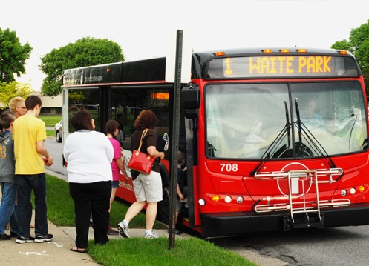
MnDOT Office of Transit
House Transportation Committee
March 9, 2015

Slide 2
Office of Transit Overview
Management Services Section
Direct planning and research
Manage federal grants
Grant writing, payments, closeouts, reporting
Financial administration
Biennial budget, encumbrances, payments
Technical assistance
Cooperative vehicle procurement, drug & alcohol monitoring and testing
Notes:
The Office of Transit has three sections:
Management Services Section
Program Management Section
Bicycle and Pedestrian Section

Slide 3
Office of Transit Overview
Transit Program Section
Manage Greater MN public transit and other operating and capital assistance programs
Contract management
Applications, negotiations, amendments, reports, oversight, audits, closeouts
Data management
Operations, facilities and vehicle data
Technical assistance
Performance monitoring, rideshare, technology, training/workshops

Slide 4
Office of Transit Overview
Bicycle Pedestrian Section
Direct planning and research activities
Coordinate statewide bicycle and pedestrian facility design training
Technical Assistance
Project plan reviews, design guidance
Develop Minnesota bikeways/U.S. bicycle routes
Safe Routes to School program management
Non-infrastructure grant management
ABC Parking Ramps management

Slide 5
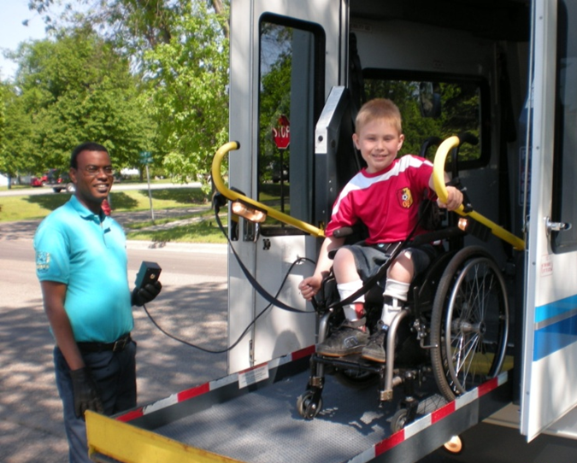
Public Transit Grant Programs
Public Transit Participation Program
Federal
Small Urban, Rural Transit, Bus & Facilities Formula Funds
Public Transportation on Indian Reservations
Enhanced Mobility for Seniors and Individuals with Disabilities
Metropolitan Planning Grants
State Planning and Research
State
General Fund
Bonding for Facilities
Greater MN Transit Account
Motor Vehicle Sales Tax
Motor Vehicle Lease Sales Tax
Notes:
Biggest program
MnDOT grants federal and state funds for public transit in Greater MN—everything outside the 7-county metro area
5307 $ 8.7 M
5311 $15.3 M of this 15% ($2.3 M) for intercity bus in rural and 10% ($1.5 M) for administration costs
Includes rural parts of the 7-county metro area
5311(c)$ 1.6 M to six tribes: Bois Forte, Fond du Lac, Grand Portage, Leech Lake, Red Lake, White Earth
5339 $ 1.9 M
GF $23.0 M: of this $6.5 M was a one time increase for FY 2015
$116,500 used for administration
$100,000 for MN Council on Transportation Access
MVST $28.0 M as of Feb 2015 forecast
$416,000 available for administration
MVLST $18.4 M as of Feb 2015 forecast reduced by ~ $13.3 M for FY 2015
Total $96.9 M
Bonding (from 2014 session)
St Cloud $1.10 M Bus storage addition and new roof (combined with leftover previous bond funds)
Kandiyohi County $0.40 M Bus maintenance and storage facility
Total $1.50 M
RTAP $0.23 M Training program
Enhanced Mobility (Sect 5310)
Mpls/St Paul $1.89 M
Small Urbans $0.60 M
Rural $1.17 M
Total $3.66 M 10% is available for administration costs, 29 total grantees in 2015
Metropolitan (5303) $1.54 M To MPOs
State Plan & Res (5304) $0.29 M Used by MnDOT for planning projects

Slide 6
Public Transit Coverage
Kittson
Roseau
Lake of the Woods
Marshall
Koochiching
Pennington
St. Louis
Lake
Cook
Red Lake
Beltrami
Polk
Clearwater
Itasca
Norman
Mahnomen
As of January 2015
1 county with no service
16 multi-county systems
14 single county systems
8 municipal only
7 urban systems
Hubbard
Cass
Clay
Becker
Crow
Wing
Aitkin
Carleton
Wadena
Wilkin
Otter Tail
Mille
Lacs
Pine
Todd
Morrison
Kanabec
T.C. Metro Area
Grant
Douglas
No County-wide Service
Traverse
Pope
Benton
Municipal Only
Stevens
Stearns
Sherburne
Isanti
Chisago
Big
Stone
Anoka
Urban
Swift
Wright
Kandiyohi
Meeker
Washington
Lac
Qui
Parle
Chippewa
Hennepin
Ramsey
Renville
McLeod
Carver
Yellow Medicine
Scott
Dakota
Sibley
Lincoln
Lyon
Redwood
Nicollet
LeSueur
Rice
Goodhue
Brown
Wabasha
Pipestone
Murray
Cottonwood
Watonwan
Blue Earth
Waseca
Steele
Dodge
Olmstead
Winona
Rock
Nobles
Jackson
Martin
Faribault
Freeborn
Mower
Fillmore
Houston
Notes:
Waseca County has no public transit service
Six counties have Municipal service only: Blue Earth, Freeborn, Le Sueur, Nicollet, Olmstead, and Wilkin
7 Urban Systems
8 Municipal Systems
30 Rural Systems—16 multi-county, 14 single county

Slide 7
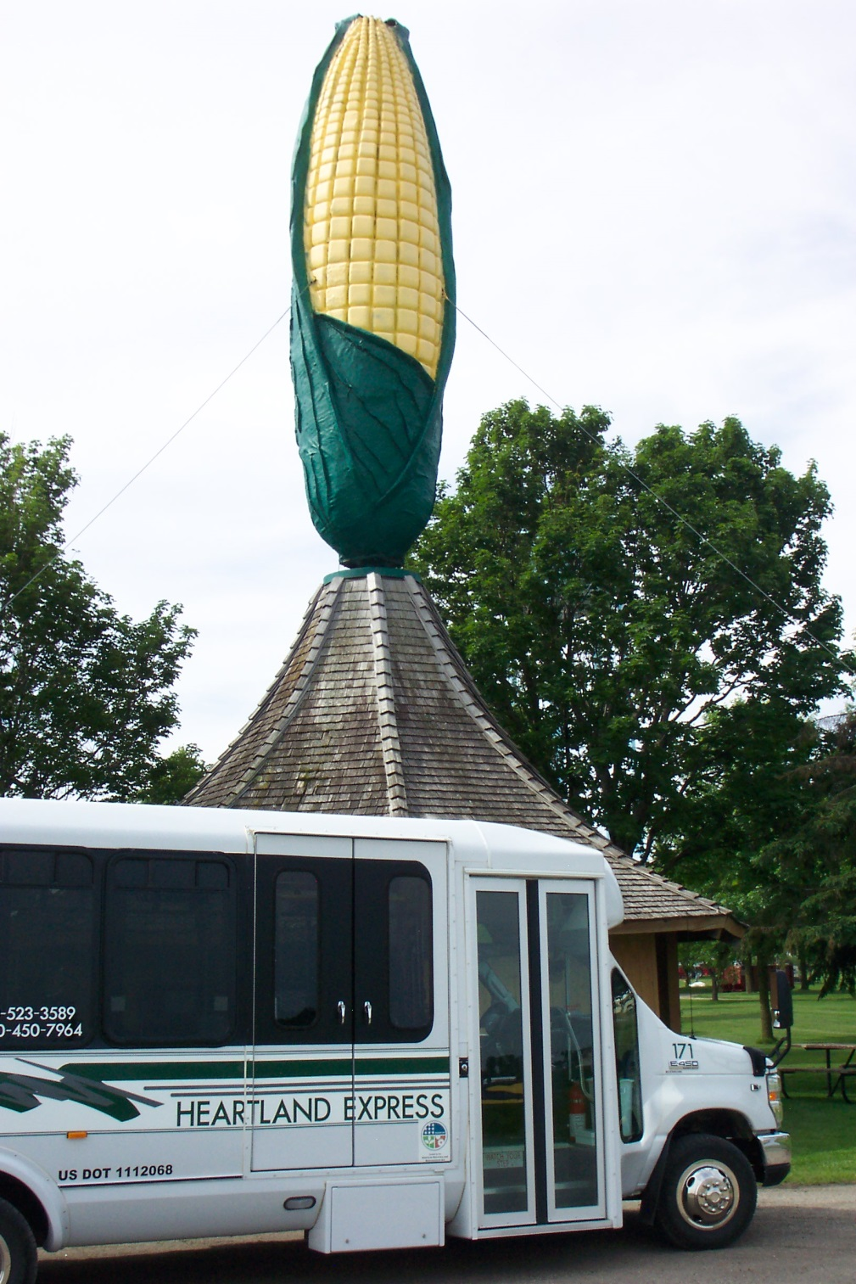
Public Transit Providers
Transit Authorities
Cities
Counties
Joint Powers Organizations
Non-profit Organizations
Notes:
Picture: Renville County Heartland Express

Slide 8
Who Rides Greater MN Transit?
33% are going to work
20% are going to school
50% use transit at least 5 days a week
86% ride at least twice a week
50% of users in rural counties are 65 years or older
76% of seniors are female
33% of senior trips are medical and basic shopping needs
Statistics from 2010 Greater MN Transit Plan
Notes:
Statistics above the line are for all Greater MN public transit
Statistics below the line are subsets

Slide 9
Greater MN Ridership
Notes:
After dropping a little from 2008 to 2009, ridership went back over 11.1 million in 2010 and has risen ever since, setting a new record with over 12.0 million in 2013.

Slide 10
Greater MN Service Hours
Notes:
After three years of being fairly steady, service hours jumped to 1.15 million hours in 2013.
This reflected the availability of more funds for Greater Minnesota transit operations.
Spending on operations increased from about $64 million in 2012 to $67.3 million in 2013.

Slide 11
Transit Activity
Transit For Our Future
Coordination
Cooperation
Consolidation
Greater MN Transit Investment Plan
Aligns with MnDOT’s 50 year vision and Statewide Multimodal Transportation Plan
Annual Transit Report
Notes:
Transit For Our Future
Improve customer access and service by establishing consistent State program policies that balance availability with efficiency in providing public transit service in Greater Minnesota.
Intended to result in expanded service coverage, more efficient management, and a higher level of compliance with existing and proposed federal regulations.
About 12 consolidations in the last 2 years and many examples of coordination and cooperation
Shared dispatching
Shared position for compliance
Transit System Restructuring Studies
Martin/Faribault Counties were first
2015 Greater Minnesota Transit Investment Plan
The Plan will align with MnDOT’s 50-yr. Vision and the Statewide Multimodal Transportation Plan.
The Investment Plan will update the Transit Vision, define goals and investment priorities and develop strategies to achieve the goals.

Slide 12
MnDOT Bicycle/Pedestrian, Safe Routes to School Programs

Slide 13
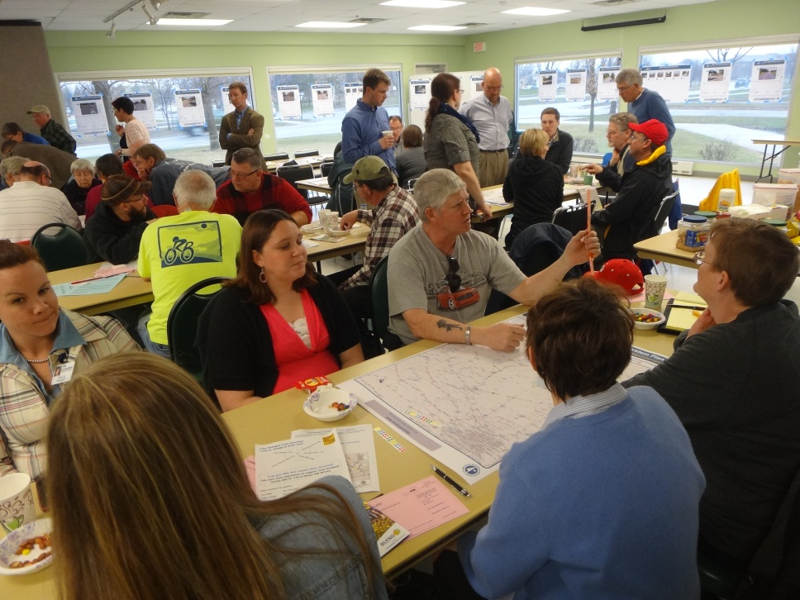
Bicycle and Pedestrian Programs - Planning
Statewide Bicycle System Plan
Will be completed early summer
Policy and investment guidance
Develop performance measures
Identify State Bicycle Route System

Slide 14
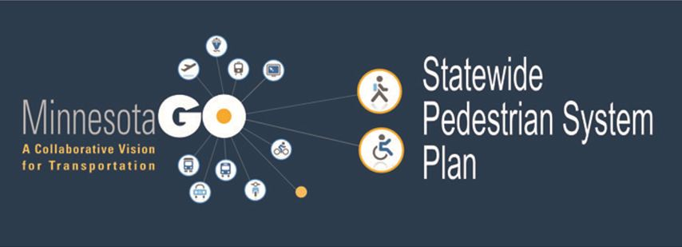
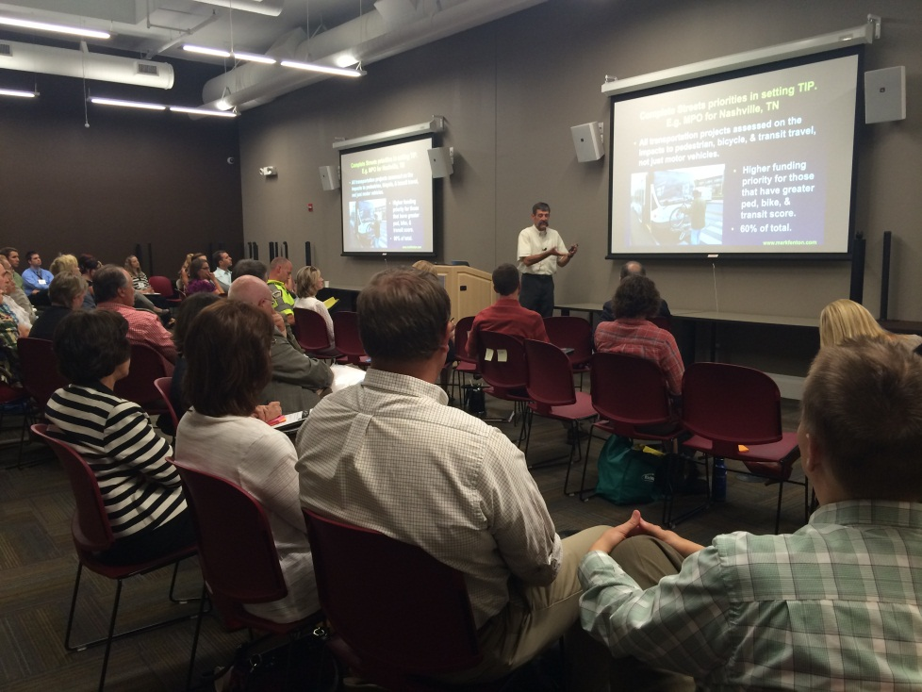
Bicycle and Pedestrian Programs - Planning
Statewide Pedestrian Plan
Interagency partnership with the Department of Health
Will be completed early summer of 2016
Policy and investment guidance
Develop performance measures
First for DOT at this scale

Slide 15
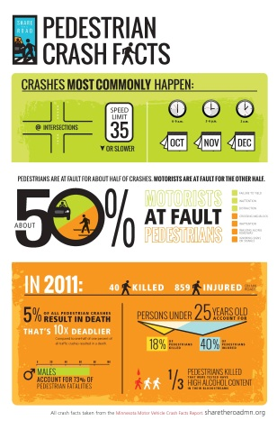
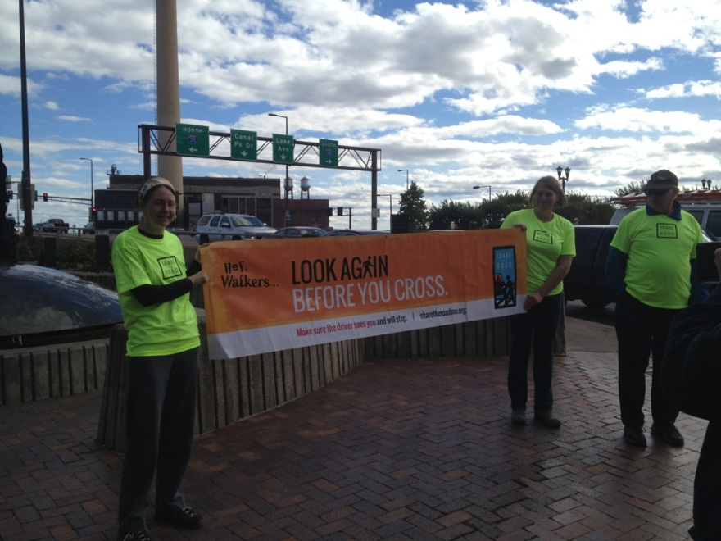
Bicycle and Pedestrian Programs – Safety/Education
Share the Road Programs
Messages based on crash information and trends
Pedestrian program created in 2012
Bicycle program renovated in 2013
Various implementation strategies in partnership with Public Safety

Slide 16
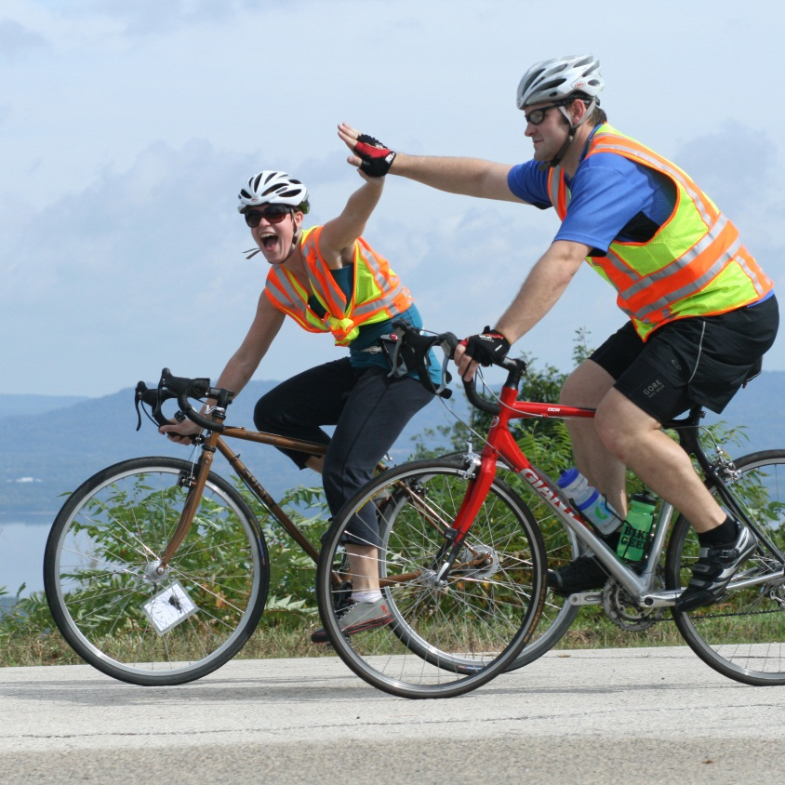
Bicycle and Pedestrian Programs – State Bikeways
Mississippi River Trail
First State Bikeway
Total route is over 800 miles
Uses existing roads and trails
Signage will be completed this summer
Also known as United States Bicycle Route 45

Slide 17
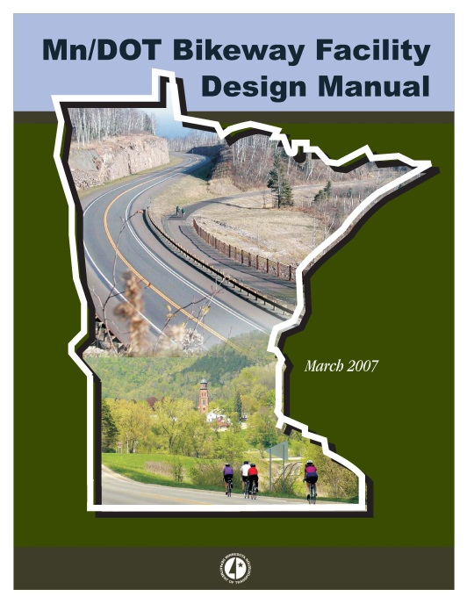
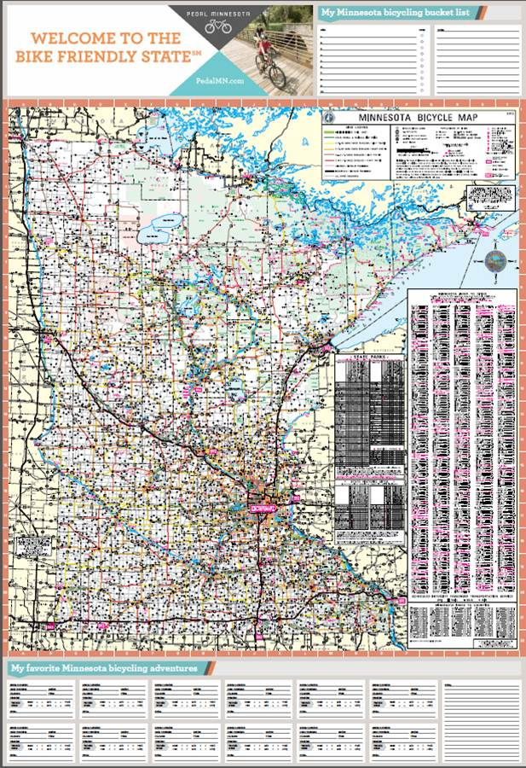
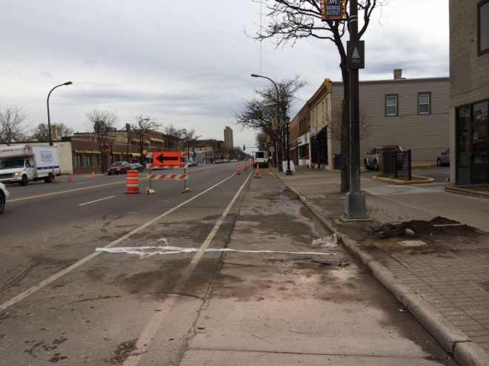
Bicycle and Pedestrian Programs – Other Efforts
State Bicycle Map
Bicycle and Pedestrian Counting Project
Bicycle Facility Design Manual
Economic Impacts of Bicycling Study

Slide 18
SRTS - About the Program
History
Reach
Began in 2006
State program created in 2012, funded in 2013
2015 vision:
Minnesota is a state where all students can walk and bicycle on routes that are safe, comfortable, and convenient.
Partnerships:
27 member steering committee
Collaboration with MDH SHIP program
$20 million awarded in grants and programs
Infrastructure- approx. $17 million awarded ($100 million+ requested)
Planning- 200 new schools reached since 2012
50 schools trained in Walk! Bike! Fun! since 2013
416 schools funded
student populations-- 360,000+

Slide 19
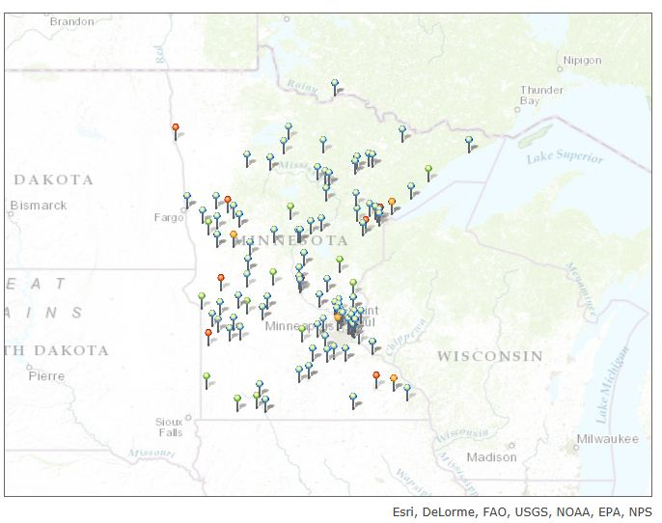
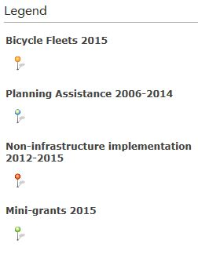
2006-2015 Funded Non-infrastructure Projects

Slide 20
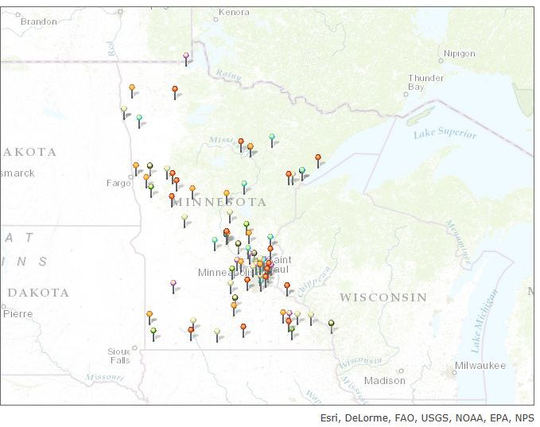
2006-2014 Funded Infrastructure Projects
Notes:
Funded projects (SAFETEA-LU, 2014 one-time MAP-21)
2015 state projects not yet announced

Slide 21
Statewide Programs & Solicitations
Walk! Bike! Fun! Pedestrian and Bicycle Safety Curriculum
Solicitations
Infrastructure
Mini-grants
Bicycle fleets
Planning assistance
5 year Strategic Plan
Brand & Awareness Campaign
Statewide Resource Center
Pierz- Walk to School Day event using new infrastructure project (2013)

Slide 22
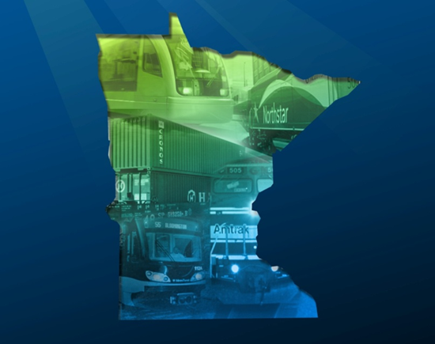
Passenger Rail Office Overview
House Transportation Committee
March 9, 2015
Notes:
I will provide a brief overview of the Passenger Rail Office including it’s history, accomplishments, and future priorities.

Slide 23
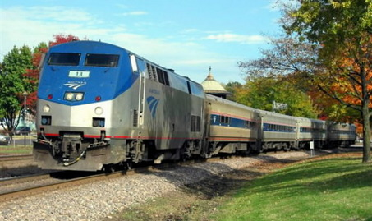
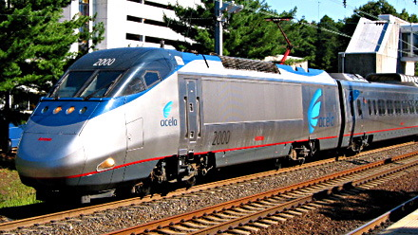
Intercity Passenger Rail is:
Conventional Rail
Less than 80 mph
Incremental Improvement
80 mph to 110 mph
High Speed Rail
110 mph and higher (150-220 mph)
Grade separation required above 124 mph
Electrified corridor
Notes:
Intercity Passenger Rail can operate at different speeds including: Conventional Rail, Incremental High-speed, and Ultimate High Speed

Slide 24
Passenger Rail Program
2009
Minnesota Legislature Appropriates a biennial operating budget from general funds @ $500K/year
MnDOT Passenger Rail Office Established to institute the Commissioner Duties per Mn Statute 174.632
Minnesota Legislature appropriates $26M G.O. Bond funds (Sec. 62. Laws 2009, chapter 93, article 1, section 11, subdivision 5)
Intercity Passenger Rail Forum Established
Notes:
Stakeholders need to remain collectively aware of ongoing passenger rail initiatives and be responsive to immediate funding opportunities. MnDOT established a group called the Intercity Passenger Rail Transportation Forum to:
Purpose:
1. Recommend and coordinate projects, through a consensus process, for which the Minnesota Department of Transportation should seek funding through the Federal Railroad Administration's state-level programs while a comprehensive statewide freight and passenger rail plan is being developed, and
2. Advise the Commissioner of Transportation in an ongoing process on implementation of the comprehensive statewide freight and passenger rail plan.

Slide 25
State Rail Plan
2010
Minnesota Comprehensive Statewide Freight and Passenger Rail Plan (“State Rail Plan”) adopted
Develop robust passenger rail system; enhanced connections and facility improvements in Twin Cities
High speed service between Twin Cities–Milwaukee-Chicago; Twin Cities and Duluth; Twin Cities and Rochester
Enhanced conventional passenger rail service (up to 90mph) from Twin Cities to St. Cloud, Moorhead, Mankato, Eau Claire, and between Minneapolis and St. Paul
Advance projects incrementally and simultaneously as demand warrants and funding is identified

Slide 26
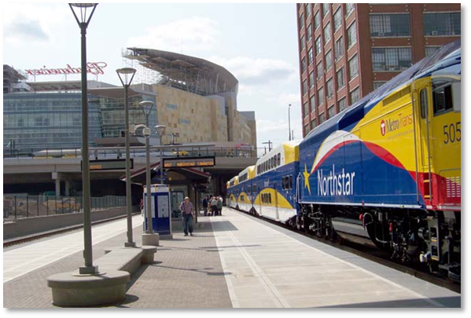
Passenger Rail Funding
$26 M G.O. Bonds invested in $66 M of infrastructure development and construction
Leveraged over $40M in federal aid
Invested in construction of two Twin Cities Rail Hubs (St. Paul Union Depot & Target Field) & project development for 4 corridors

Slide 27
Intercity Passenger Rail Funding Summary
2009 - $26 million G.O. Bond Status as of 1/28/15
Project | Total by Corridor
Saint Paul Union Depot | $ 9,767,500
Target Field Station | $ 5,054,500
Midwest- Twin Cities to Milwaukee HSR | $ 1,617,984
ZIP Rail- Rochester to Twin Cities | $ 2,170,000
NLX - Duluth to Twin Cities | $ 4,683,811
East Metro Capacity Study | $ 1,000,000
Second daily train to Chicago | -0-
Project Delivery - 2011-2015 | $ 1,444,236
Total committed | $ 25,738,031
Unspent | $ 261,969

Slide 28
Immediate Passenger Rail Priorities
Twin Cities to Chicago HSR Tier-1 EIS
2nd daily Twin Cities to Chicago train
Northern Lights Express PE and NEPA
ZIP Rail Tier 1 EIS
Target Field Station – planning for future passenger rail platforms
Panning for Phase 1&2 corridors identified in the updated State Rail Plan
State Rail Plan Update

Slide 29
2015 State Rail Plan Update
First FRA compliant State Rail Plan in 2010
Federal update cycle is every 5 years
New federal plan guidance issued in 2013
Update freight flows, add comprehensive projects list
Integrate 2010-2015 planning activities Integrate passenger terminals, commuter rail
Investigate new public/private business models
Notes:
First Plan adopted February 10, 2010. As of 2015, new applications for federal railroad funds must be referenced in updated State Rail Plan.
Plan reflects new commodity flows like Bakken crude oil, service problems of 2013-2014, and Twin Cities improvements including St. Paul Union Depot rehabilitation and Target Field Station expansion. Public/private business models include reports on state and private operating partnerships and private passenger rail initiatives including Florida, Texas, and Oklahoma.

Slide 30
What’s New
2015 Plan Update
Comply with Federal Guidance
Investigate funding methods
Complete February 2015
Address new trends
Continue to promote safety
Update priorities & project list
Notes:
Update Rail Plan to be in compliance with most recent Federal Guidance
Address new trends in freight traffic, including Bakken crude, agricultural products, coal and gas, and containerized shipments
Add comprehensive, financially unconstrained list of all proposed private and public capital projects in state (incl. Wilmar Wye, grade crossing safety, passenger rail)
Continue to work on enhancing rail safety and developing additional funding streams, both public and private
Particularly grain & crude oil
Continue to promote safety
Review and update priorities and project list
Investigate new funding methods, i.e. public/private partnerships, private operators, or others options

Slide 31
What’s New
Federal Guidance
Plan Contents:
Chapter 1: Role of Rail in Statewide Transportation
Chapter 2: The State’s Existing (2015) Rail System and Issues
Chapter 3: Proposed Passenger Rail Improvements and Investments
Chapter 4: Proposed Freight Rail Improvements and Investments
Chapter 5: The State’s Rail Service and Investment Program
Chapter 6: Outreach, Coordination and Review
Notes:
Federally compliant format includes specific data requirements, chapters, report on public outreach, and future directions. Policy and processes are consistent with larger Minnesota GO vision.

Slide 32
Notes:
Since 2010, four passenger rail projects have moved into advanced planning but have not yet reached FRA qualified project status (red lines). NLX and Second Empire Builder frequency will have advanced planning results later in 2015. Milwaukee to Twin Cities High Speed Rail (110 mph) and ZIP Rail (Rochester to Twin Cities, true high speed at 150+ mph) will finish advanced planning in 2017-2018. Re-evaluation of 2010 corridors and very high levels of grass roots support, including input and coordination with neighboring state DOT’s, resulted in decisions to retain Eau Claire intercity corridor and add Twin Cities to Des Moines corridor to Phase 1 status (dark blue lines).

Slide 33
Project Summaries
http://www.dot.state.mn.us/passengerrail/

