Slide 1
MN Scope of Practice Evaluation Tools
Sponsored by the National Governors Association (NGA) & National Conference of State Legislators (NCSL)
Nitika Moibi
Minnesota Department of Health
January 24th 2017
Office of Rural Health & Primary Care

Slide 2
Today’s Focus
-Project Overview
-Scope of Practice Tools
Office of Rural Health & Primary Care

Slide 3
#1: Develop a consensus framework to evaluate Scope of Practice (SOP) proposals #2: Review recently enacted SOP changes to assess barriers
Project Overview
Office of Rural Health & Primary Care

Slide 4
Project Core Team
Barbara Brandt
Director, National Center for Interprofessional Practice and Education, UMN
Shirley A. Brekken
Executive Director, Board of Nursing
Senator Greg Clausen
Co-chair, Legislative Health Care Workforce Commission
Valerie DeFor
Executive Director, HealthForce Minnesota, Minnesota State Colleges and Universities
Lauren Gilchrist
Health Policy Advisor, Office of Governor Mark Dayton
Representative Tara Mack
Chair, Health and Human Service Reform Committee and Co-chair, Legislative Health Care Workforce Commission, Minnesota House of Representatives
Ruth Martinez
Executive Director, Board of Medical Practice
Nitika Moibi
Supervisor, Health Workforce Planning and Analysis,
Minnesota Department of Health
Mark Schoenbaum
Director, Office of Rural Health and Primary Care, Minnesota Department of Health
Senator Kathy Sheran
Chair, Health Human Services and Housing Committee, Minnesota Senate
Cody Wiberg
Executive Director, Board of Pharmacy
Representative Nick Zerwas
Health and Human Services Finance & Reform Committees, Minnesota House of Representatives
Leon Assael
Connie Delaney
Julie Johnson
Sheila Riggs
Mark Rosenberg
Marilyn Speedie
University of Minnesota Academic Health Deans

Slide 5
#1: Develop a consensus framework to evaluate SOP proposals
Developed a 3-part framework to evaluate SOP proposals
2 parts, 8 domains with questions
Potential for use for bill proposers & policy makers
http://www.health.state.mn.us/divs/orhpc/scope.html
Office of Rural Health & Primary Care

Slide 6
SOP Evaluation Framework Domains
Public Safety & Well Being
Access, Cost, Quality, Care Transformation Implications
Regulation
Education and Professional Supervision
Finance Issues
Workforce Impacts
Proposal Supporters/Opponents
Reporting
Office of Rural Health & Primary Care

Slide 7
Stakeholder Engagement & Input
Stakeholder meeting – 68 attendees @ Normandale Community College
Held on August 30th 2016
Legislators
Licensing boards
Professional associations
Educators
Employers
Lobbyists
Legislator panel
Office of Rural Health & Primary Care

Slide 8
Legislative Healthcare Workforce Commission says…
In it’s final 2016 report, the Commission recommended the following:
“Commission members agreed the legislature should adopt the common framework for evaluating scope of practice proposals developed by the 2015/16 National Conference of State Legislators/National Governors’ Association-sponsored scope of practice project.
The Commission recommends that 2017 incoming chairs use the framework and edit it as necessary after the close of next session based on user feedback and experience.
There was also support for encouraging use of the tool developed by the 2015/16 National Conference of State Legislators/National Governors’ Association-sponsored scope of practice project for assessing progress made following scope of practice changes and assessing barriers that remain to achieving the change’s goal.”

Slide 9
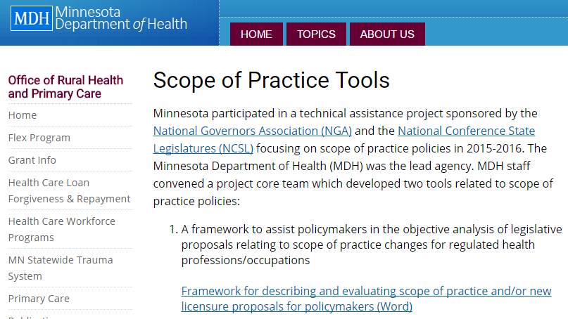
Publicly Available on MDH Web
http://www.health.state.mn.us/divs/orhpc/scope.html

Slide 10
#2: Review recently enacted SOP changes to assess barriers
Developed tool to assess SOP barriers & identify mitigating strategies
Can be used before/after SOP law changes
Office of Rural Health & Primary Care

Slide 11
Questions, please contact: Chelsea Magadance Legislative Liaison 651-201-5808 Chelsea.Magadance@state.mn.us
Office of Rural Health & Primary Care

