Slide 1
^{MINNESOTA}
^{MEDAL of HONOR}
^{MEMORIAL}

Slide 2
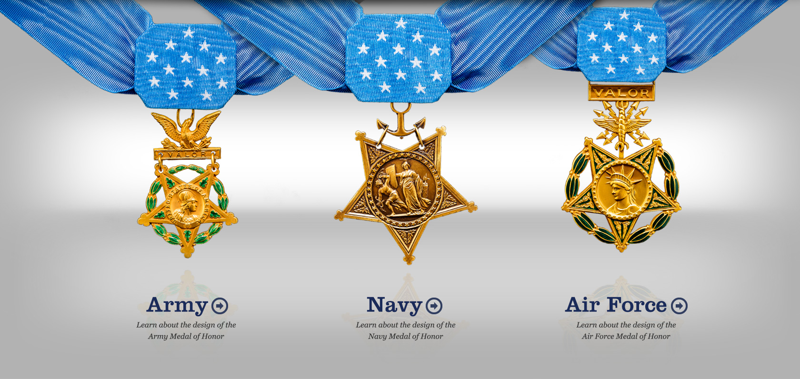
^{about the}
^{MEDAL of HONOR}

Slide 3
Courage
Commitment
Sacrifice
Integrity
Patriotism
Citizenship
6 Characteristics of the Medal of Honor

Slide 4
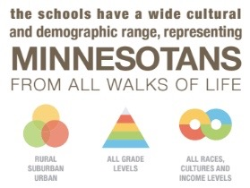
To date, in the State of Minnesota…

Slide 5
MN Medal of Honor Memorial
Picture Styles give you great looking “frames” in a single click.
The Minnesota Medal of Honor Memorial is committed to educating and inspiring our youth and future generations with the character virtues and values that our Medal of Honor recipients and veterans leave with us as their legacy.

Slide 6
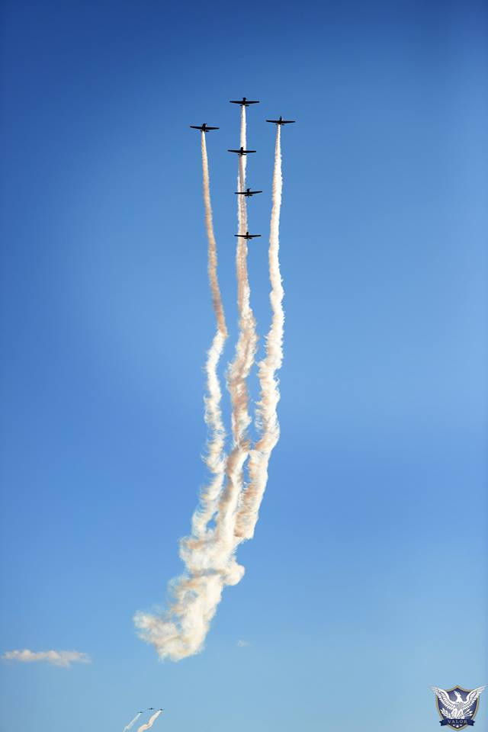
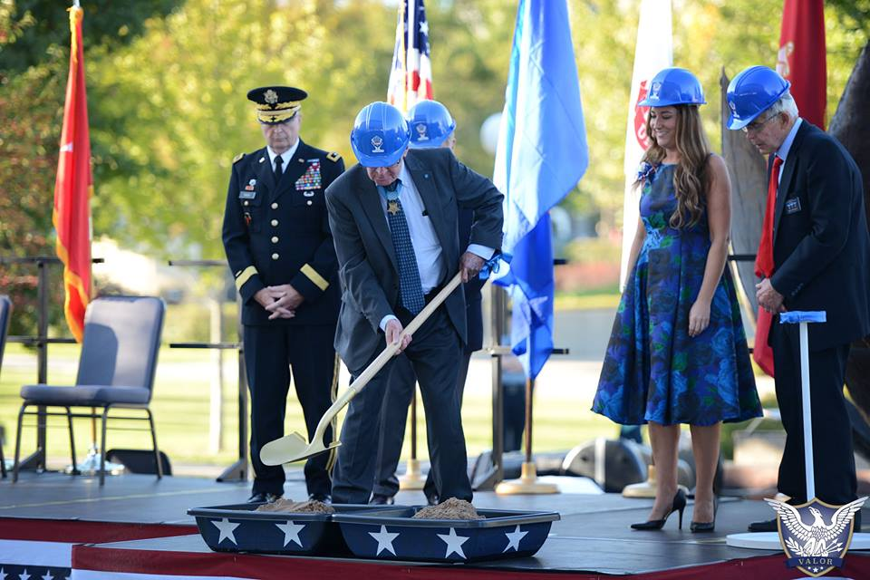
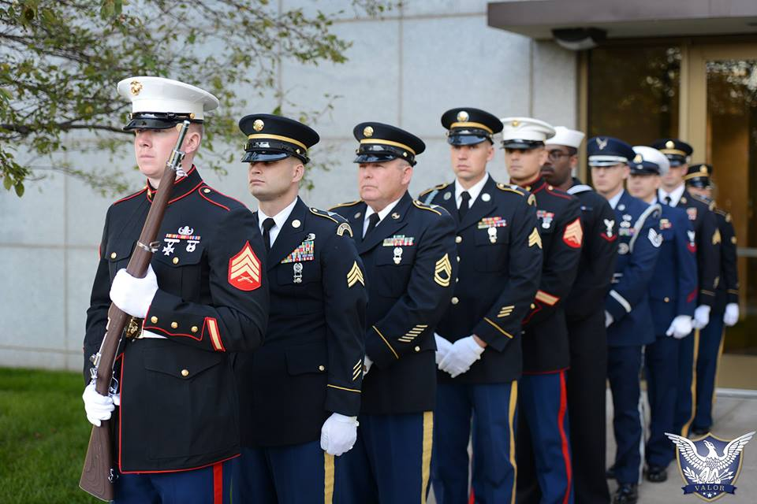
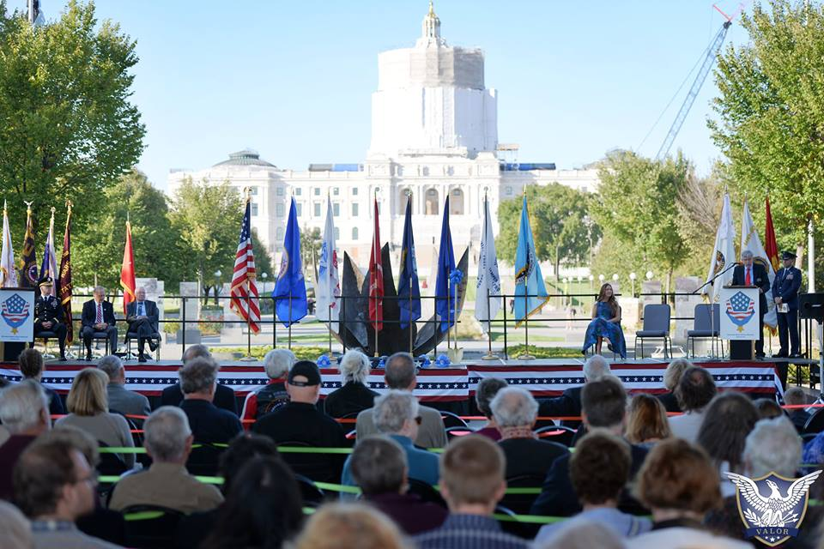

Slide 9
Thank You

