Slide 1
Overview of the
Board of Animal Health
William L. Hartmann, DVM, MS
Beth S. Thompson, JD, DVM
Kris Petrini, DVM

Slide 2
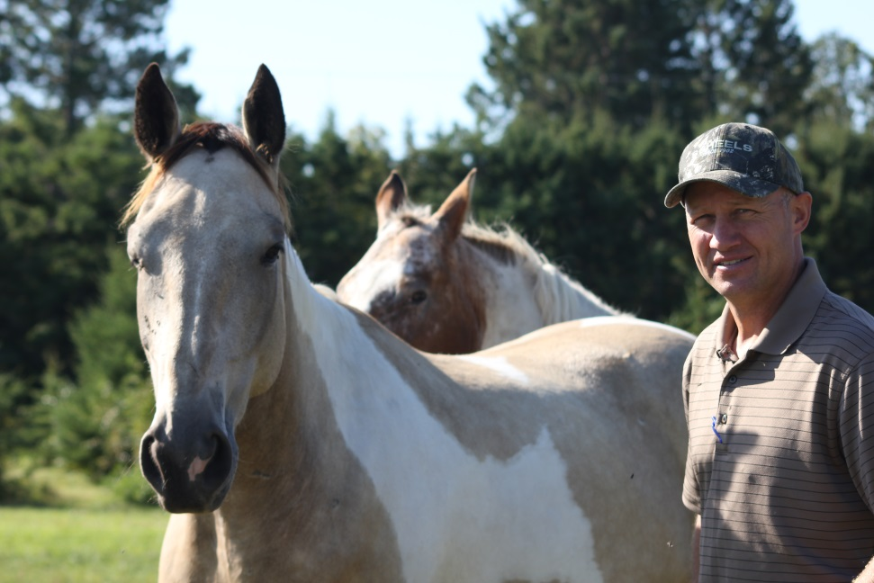
35.03 POWERS, DUTIES, AND REPORTS
“The board shall protect the health of Minnesota domestic animals and carry out the provisions of this chapter.”

Slide 3






Public Health Team

Slide 4
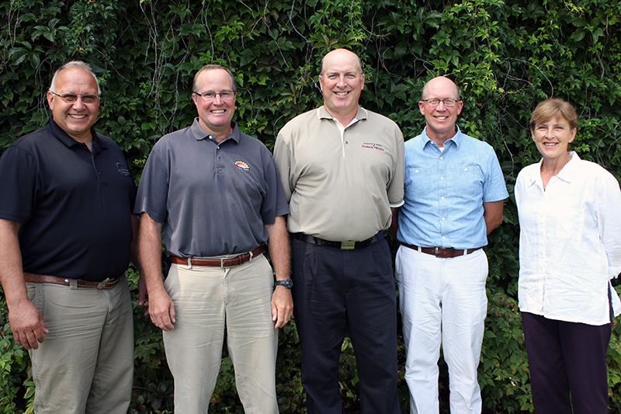
Board Members

Slide 5
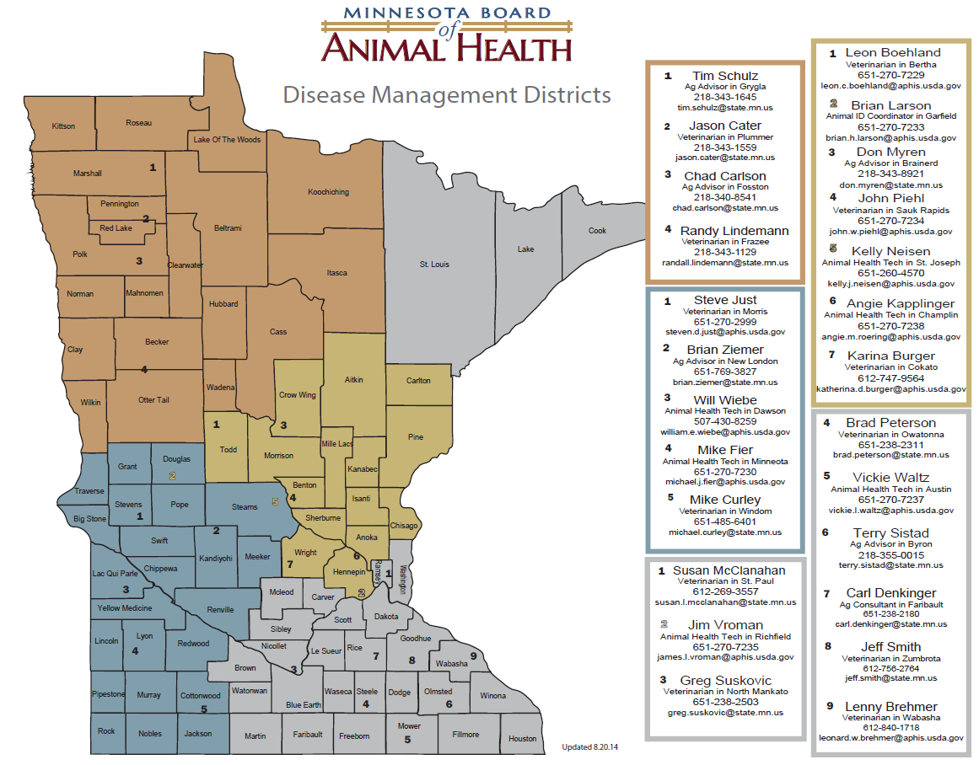

Slide 6
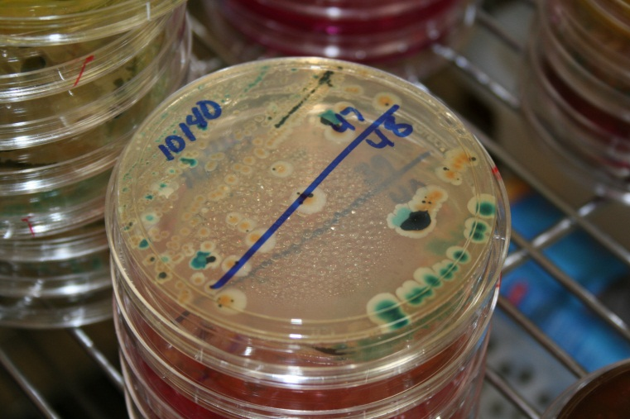
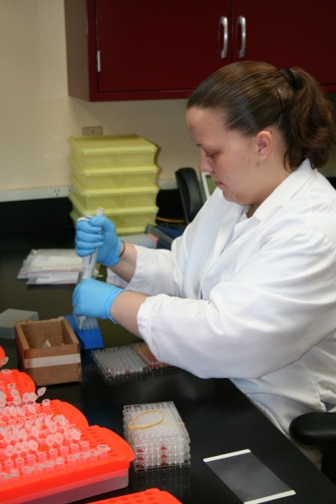
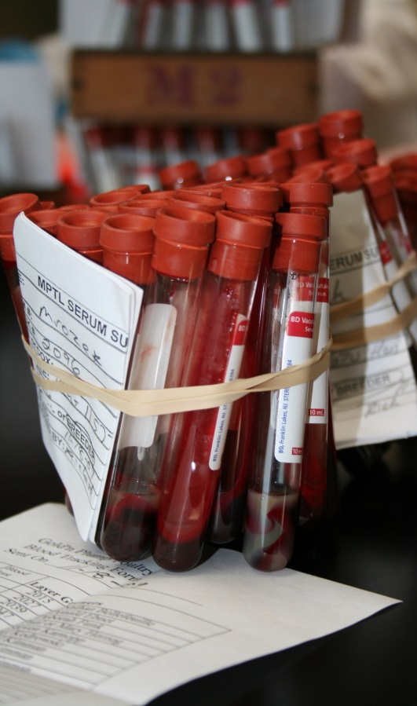
In-State Testing

Slide 7
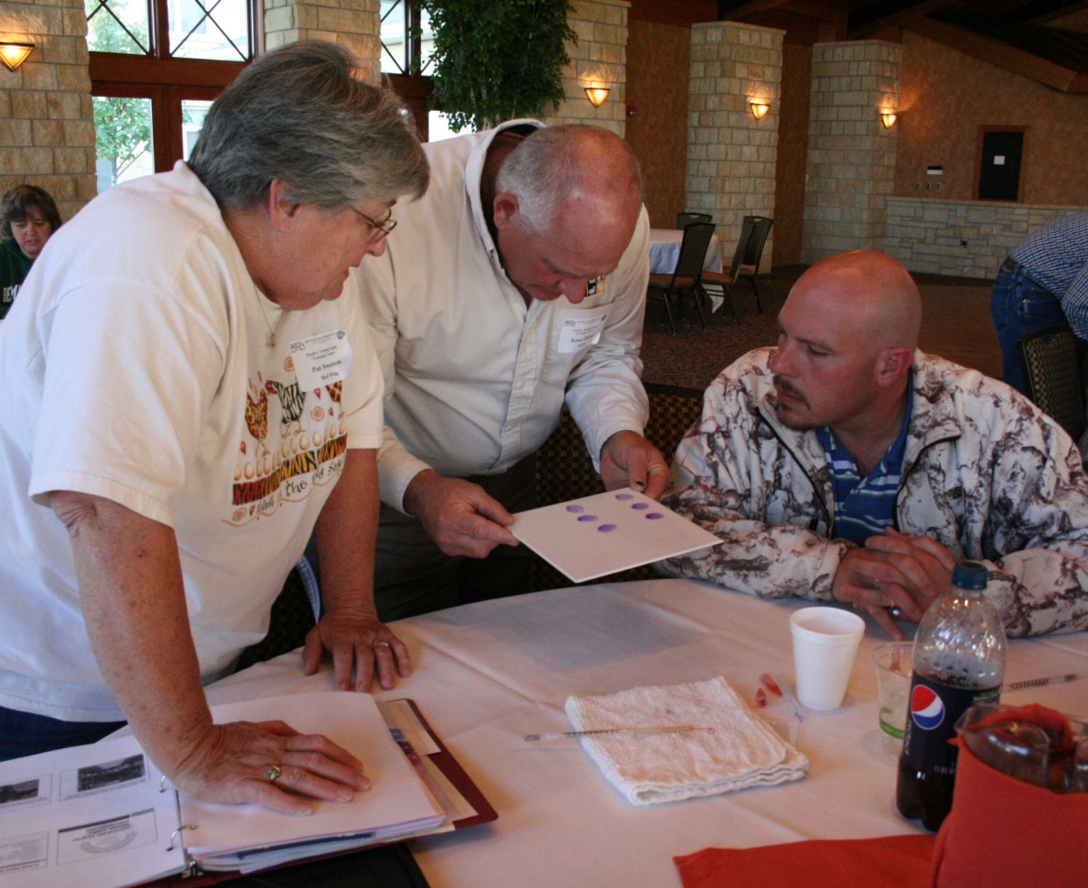
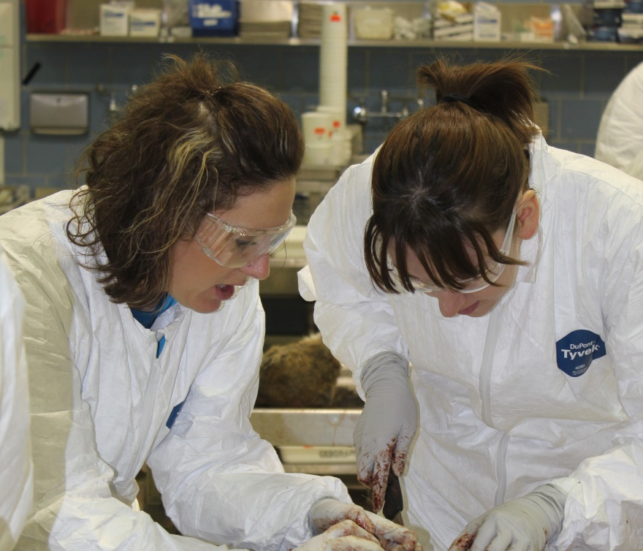
Teaching
Notes:
We spend time teaching livestock producers and our stakeholders to help themselves. For example, teaching deer and elk farmers to properly collect and submit samples for CWD testing saves them money. We host a poultry testing agent course each year. This allows individuals to become authorized to test poultry for pullorum-typhoid, a disease that would be devastating to MN’s poultry industry. While the producers benefit from learning to do these things, the BAH also benefits. We consider developing relationships with the people we serve to be of the utmost importance.

Slide 8
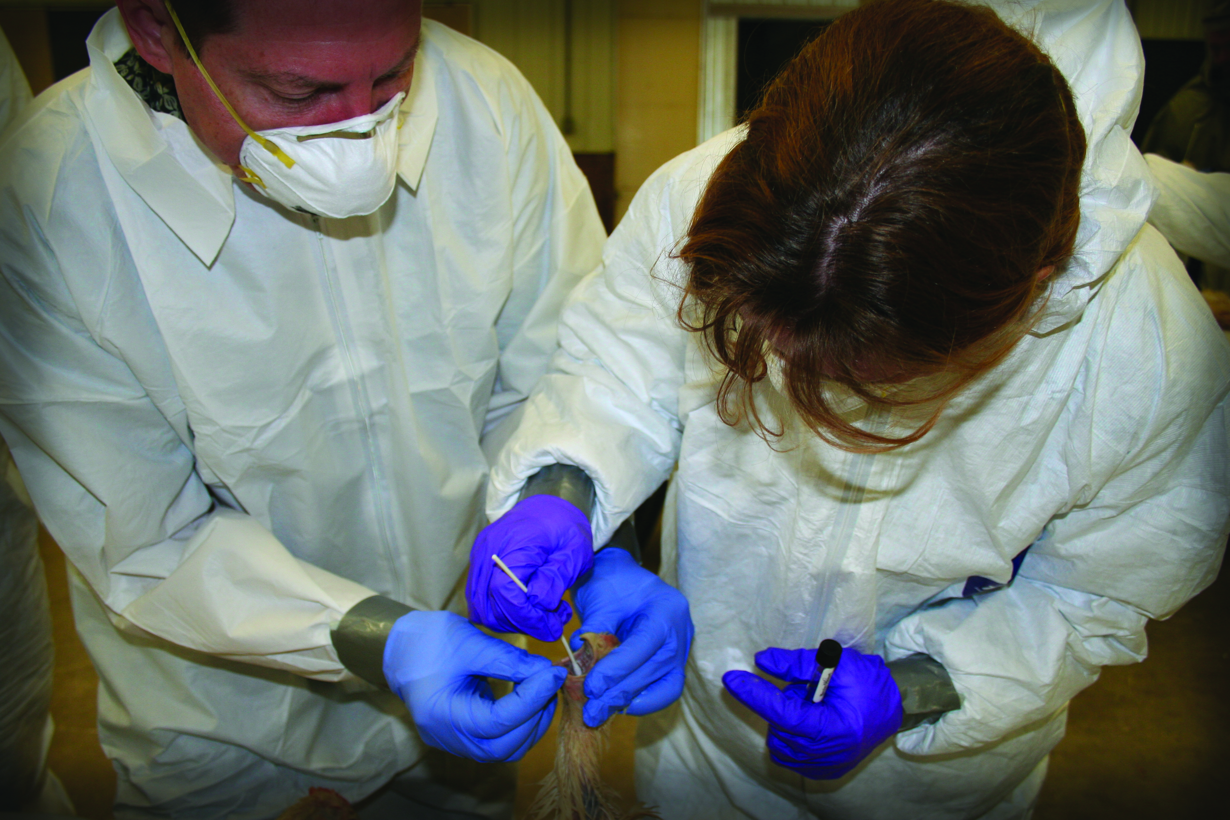
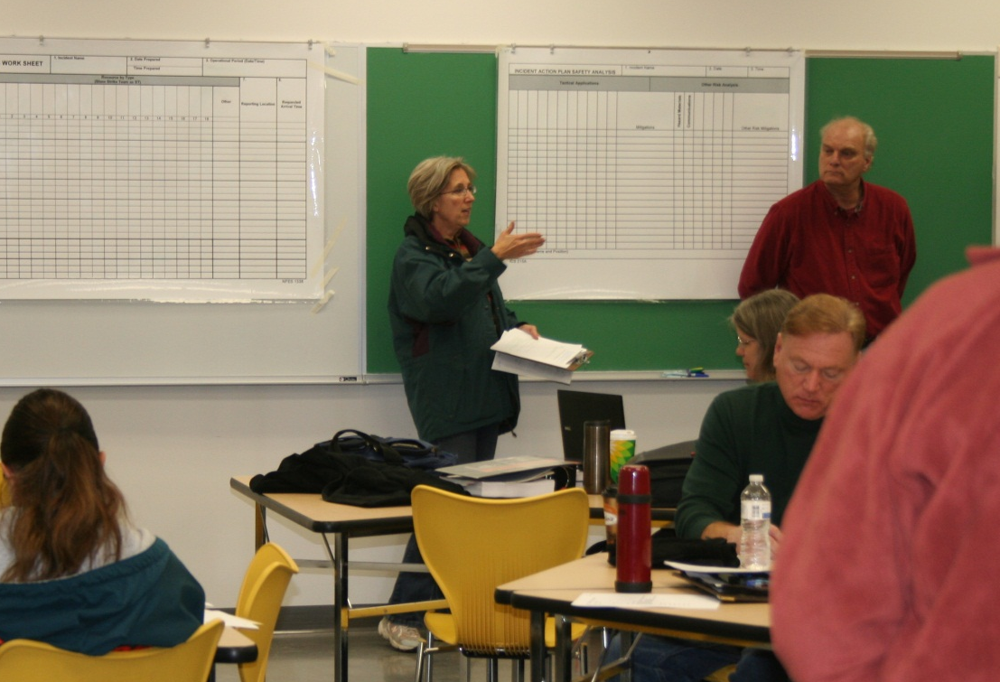
Preparing to Respond

Slide 9
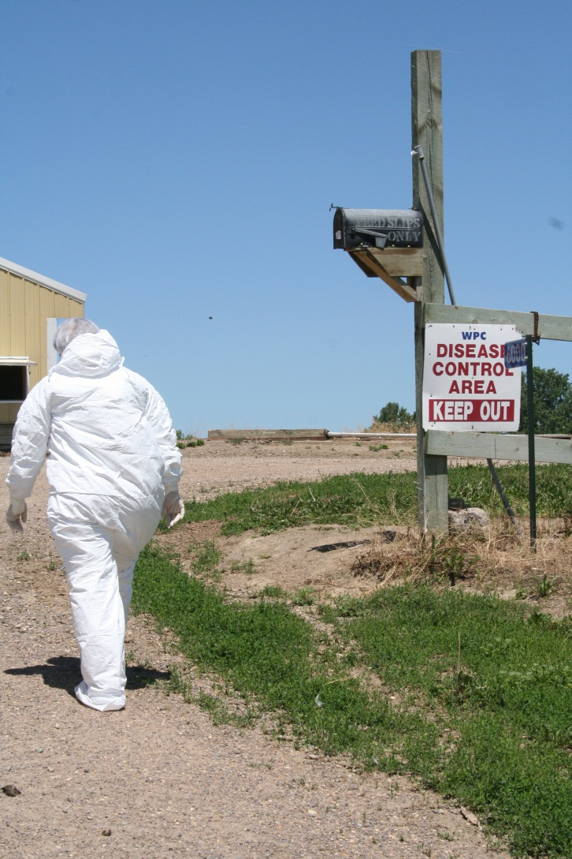
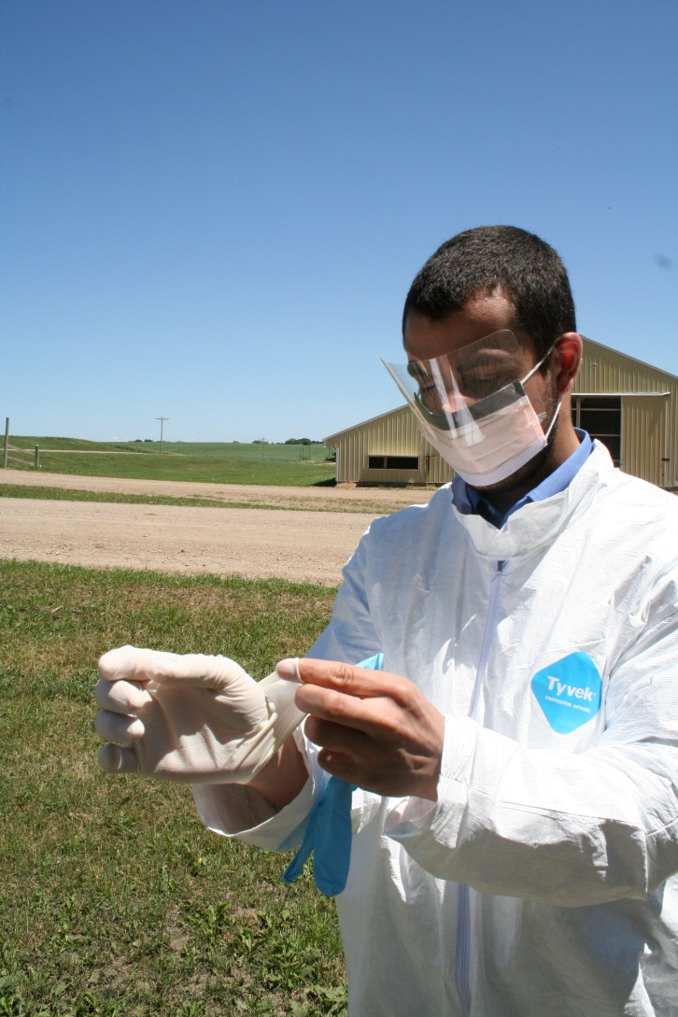
Foreign and Emerging
Disease Investigations

Slide 10
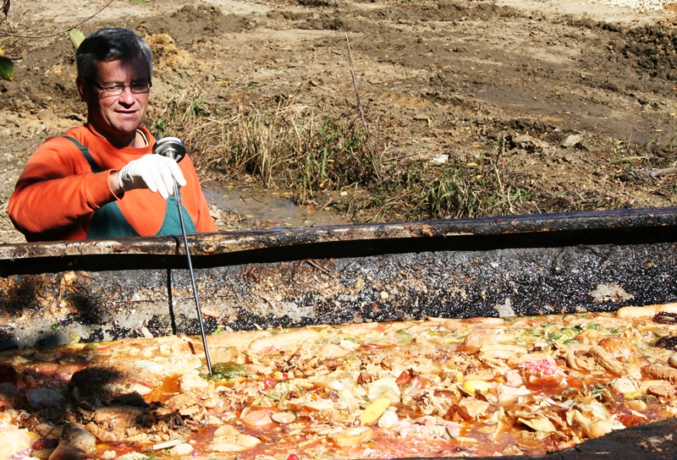
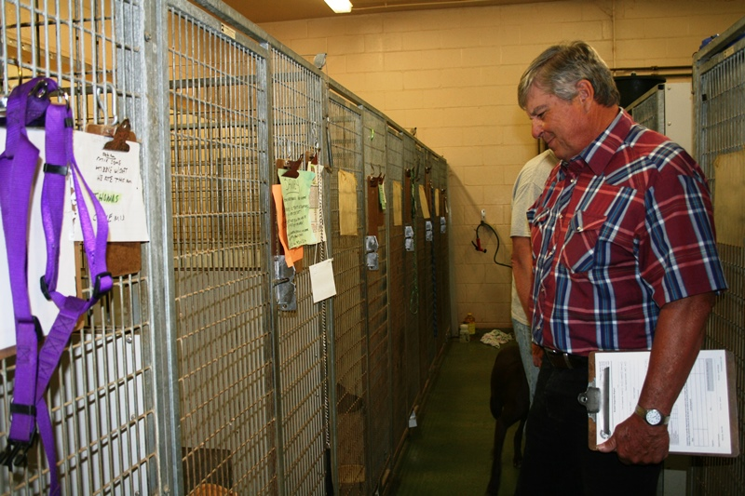
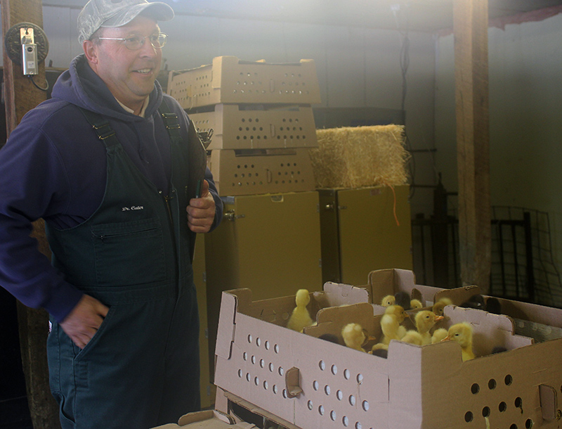
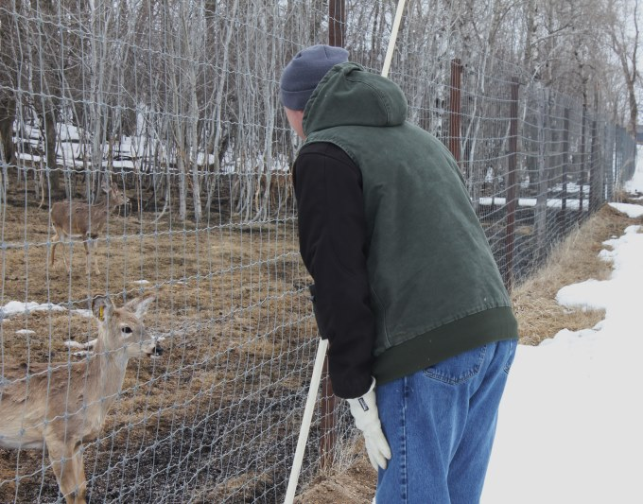
Inspecting
Notes:
Farmed Deer and Elk
Kennels
Commercial Dog and Cat Breeding Facilities
Poultry Dealers, Hatcheries and Processing Plants
Garbage Feeding Facilities

Slide 11
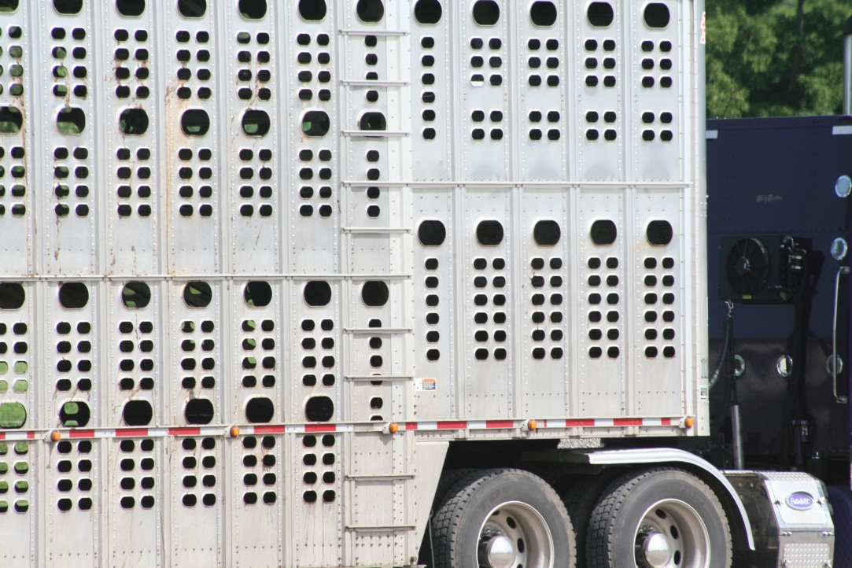
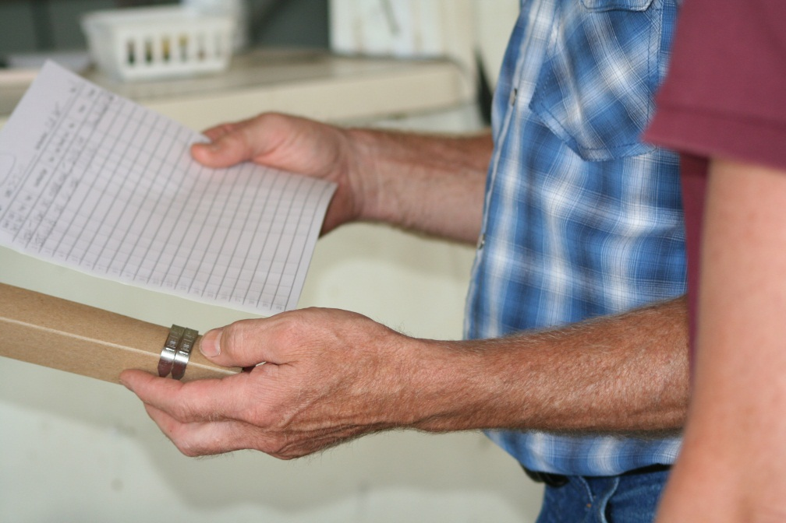
Import Standards

Slide 12
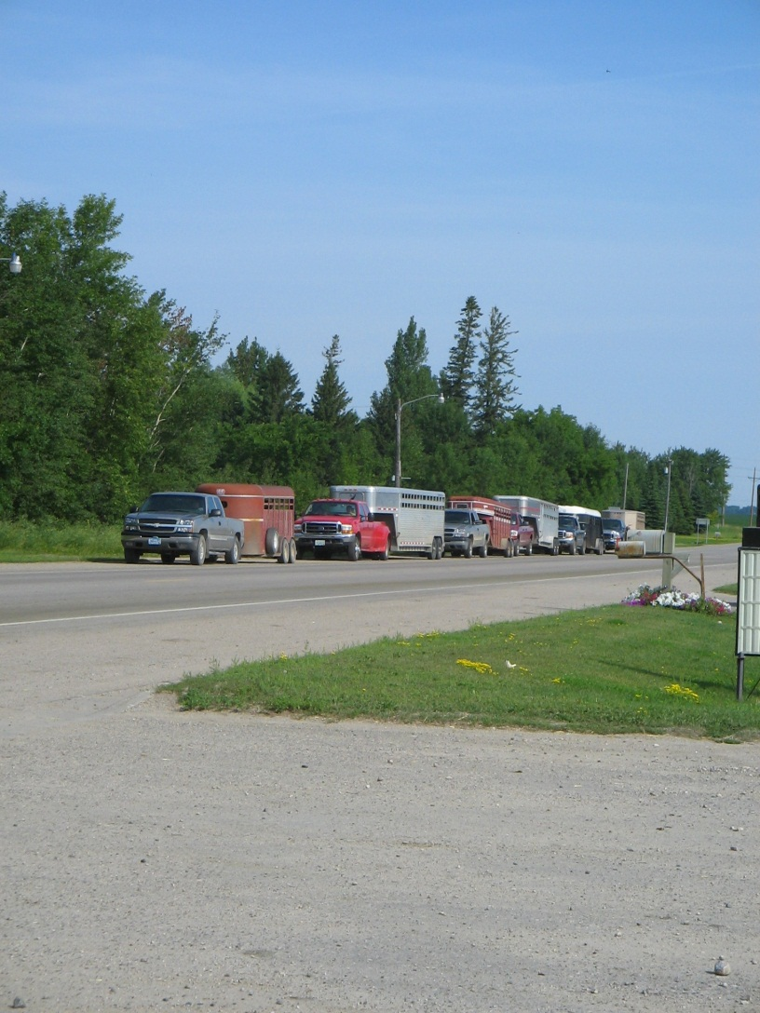
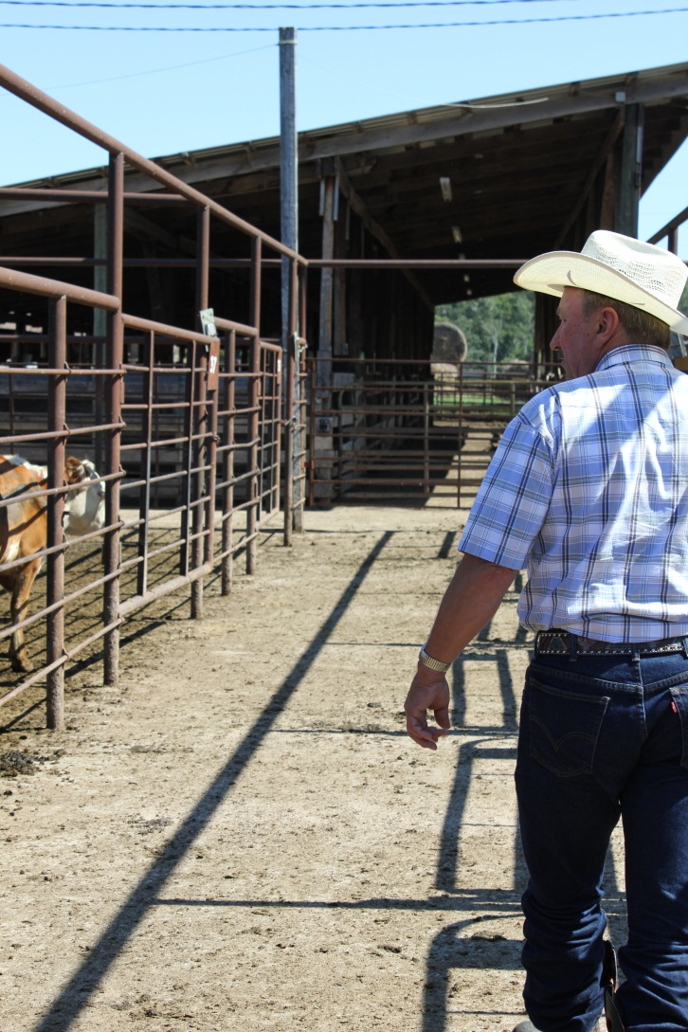
Monitor Livestock Movement

Slide 13
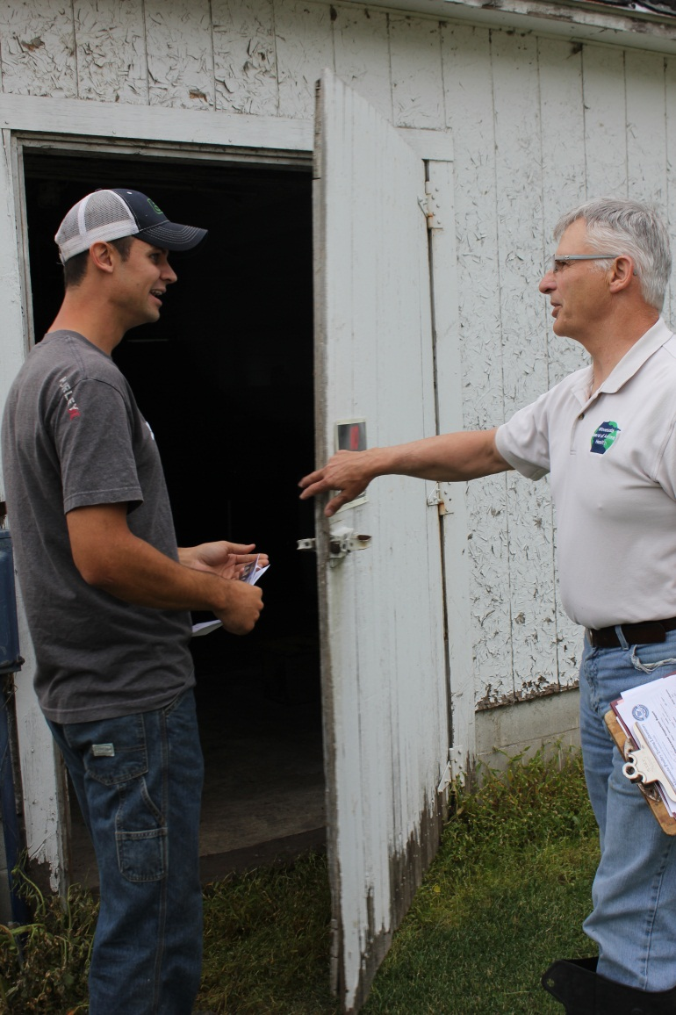
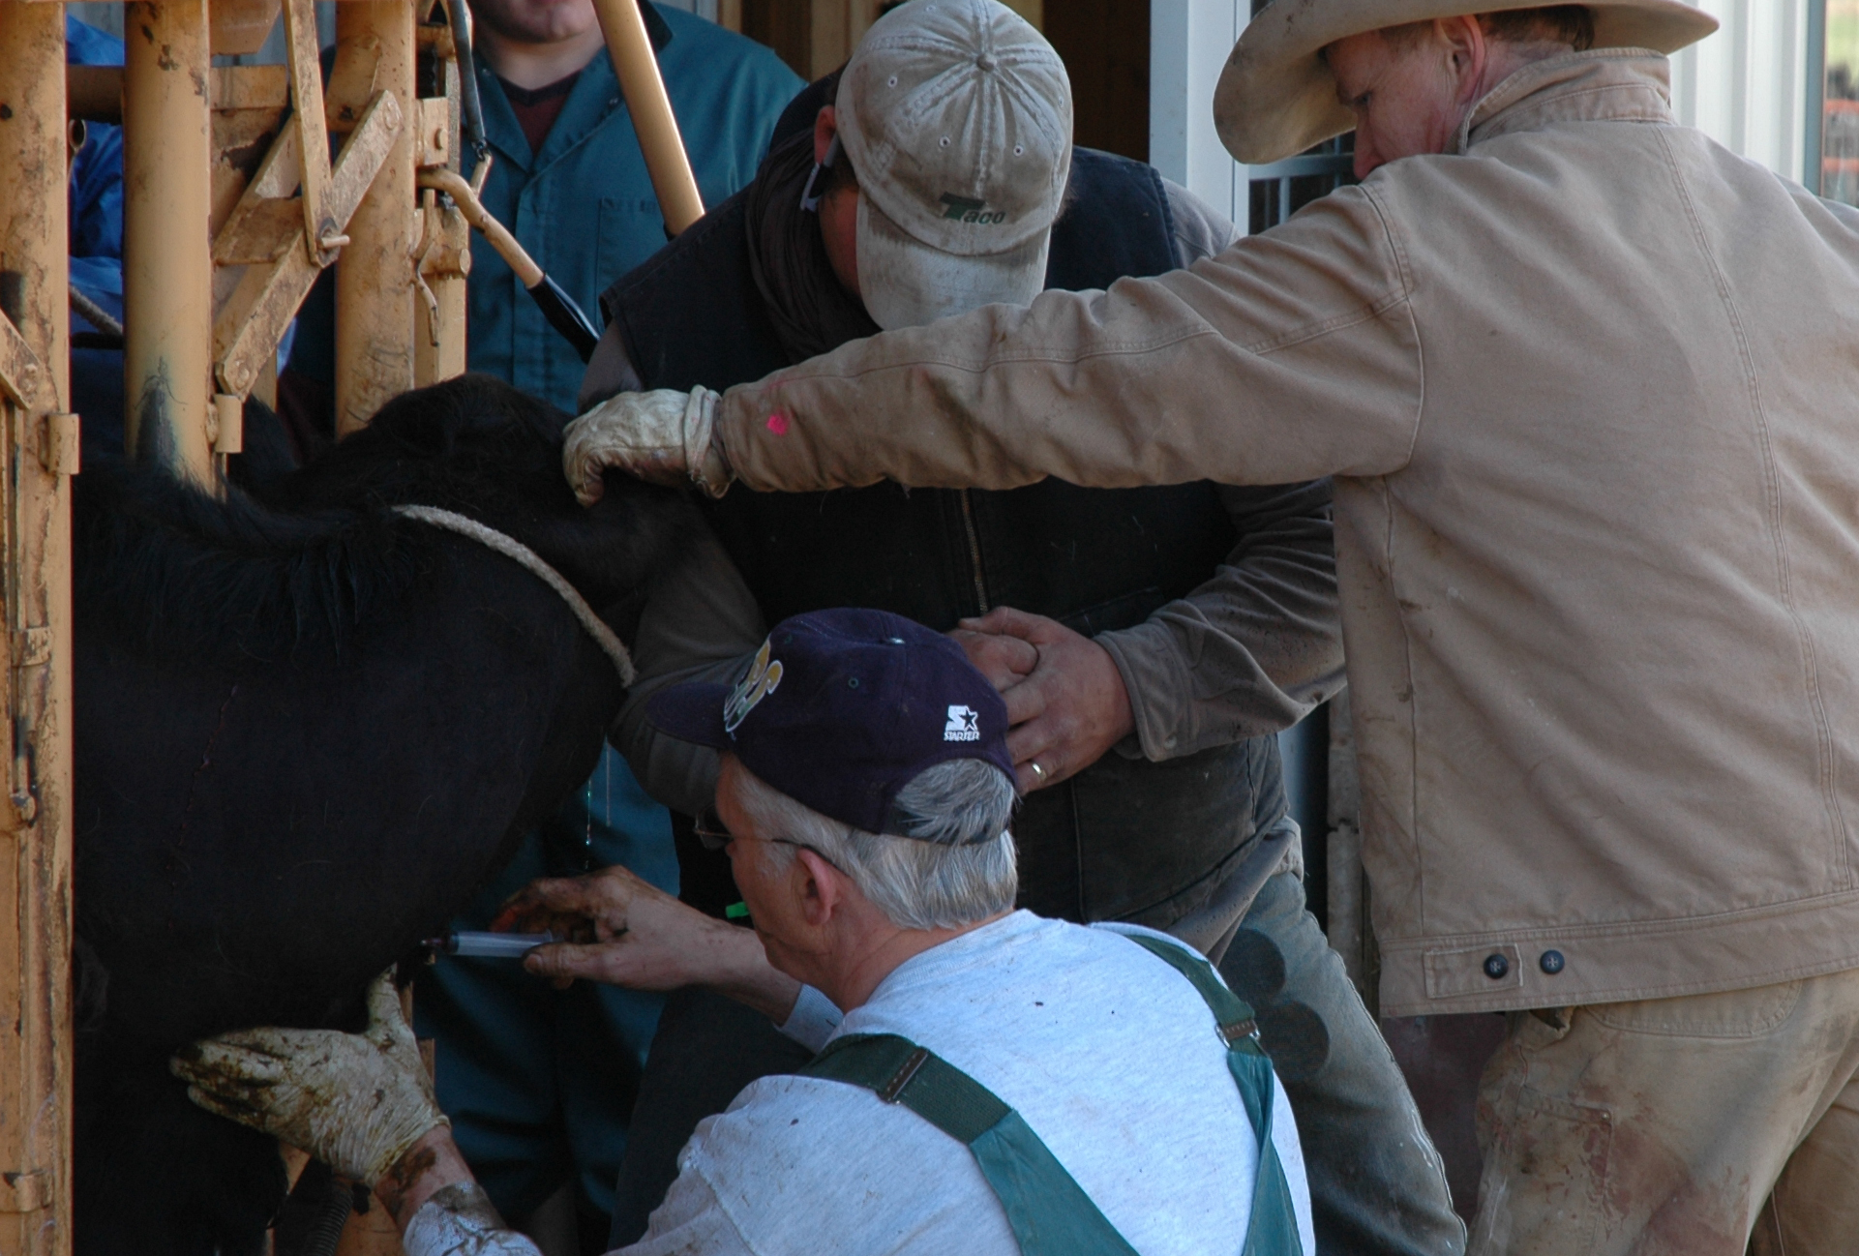
Relationship Building
Notes:
1,200 poultry
437 market
1,859 deer/elk
340 veterinary clinic
289 kennel

Slide 14
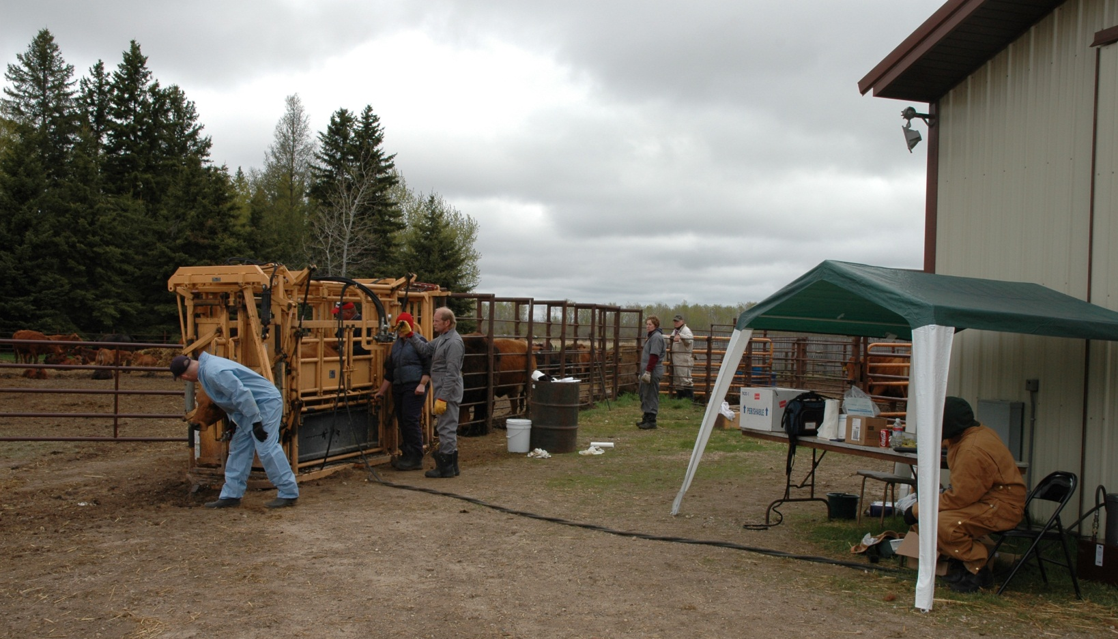
Detect, Control and Eradicate

Slide 15
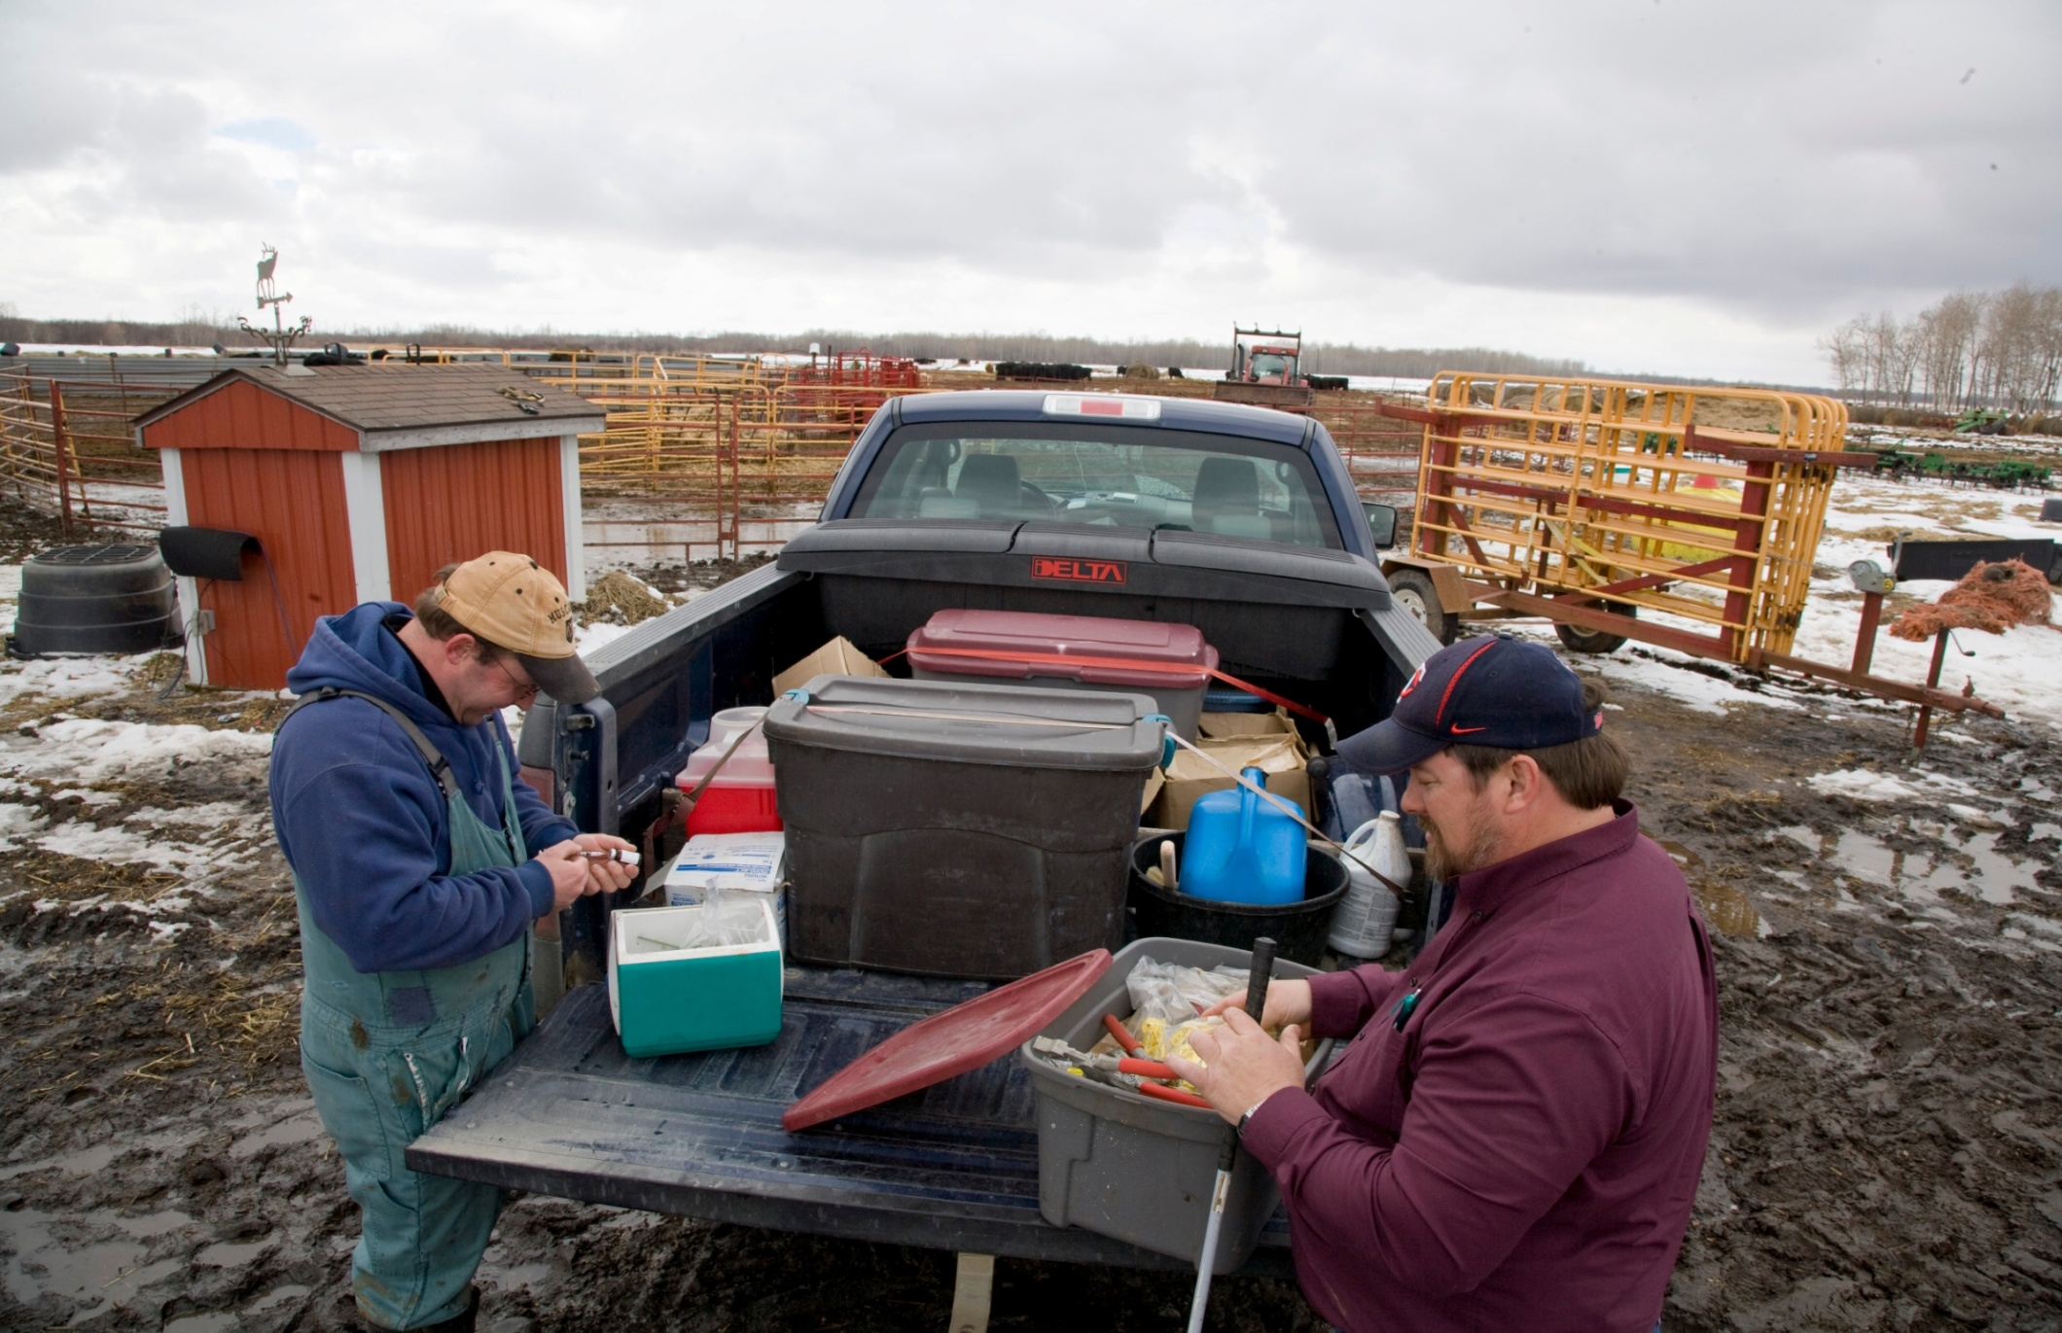
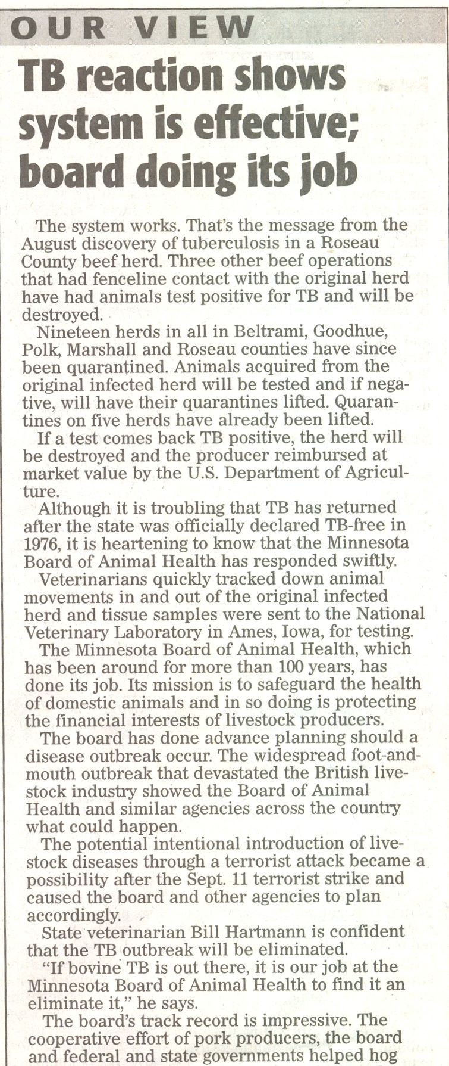
Disease-Free Status

Slide 16
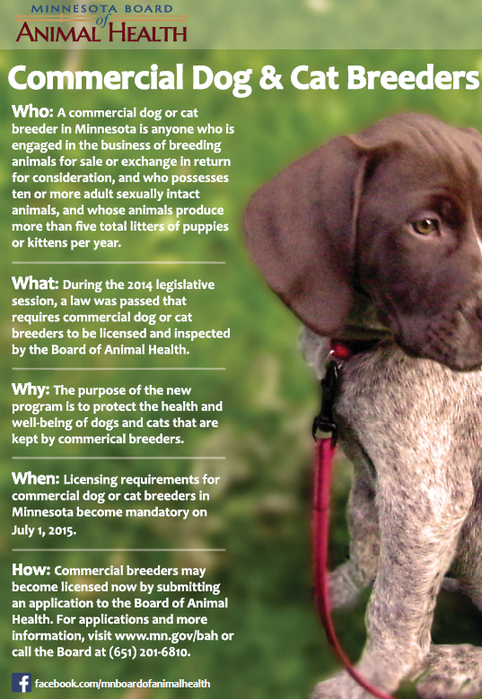

Commercial Dog and Cat Breeder Inspection Program
Notes:
Veterinary Protocol
Inspection Report Form
Advisory Committee
FY 2015 Registration
FY 2016 Inspected and Licensed
Logo
Strategies to locate Breeding Facilities

Slide 17
Other Responsibilities
Anthrax
Brands
Chronic Wasting Disease
Dead Animal Disposal
Garbage Feeding
Rabies Investigations
Kennels
Livestock Auction Markets
Mycoplasma
Rendering Plants
Salmonella
Equine Infectious Anemia
Cattle Brucellosis
Influenza

Slide 18
FY14 Budget: $5.36 million
Source
General 86%
Federal 12%
Other 2%

Slide 19
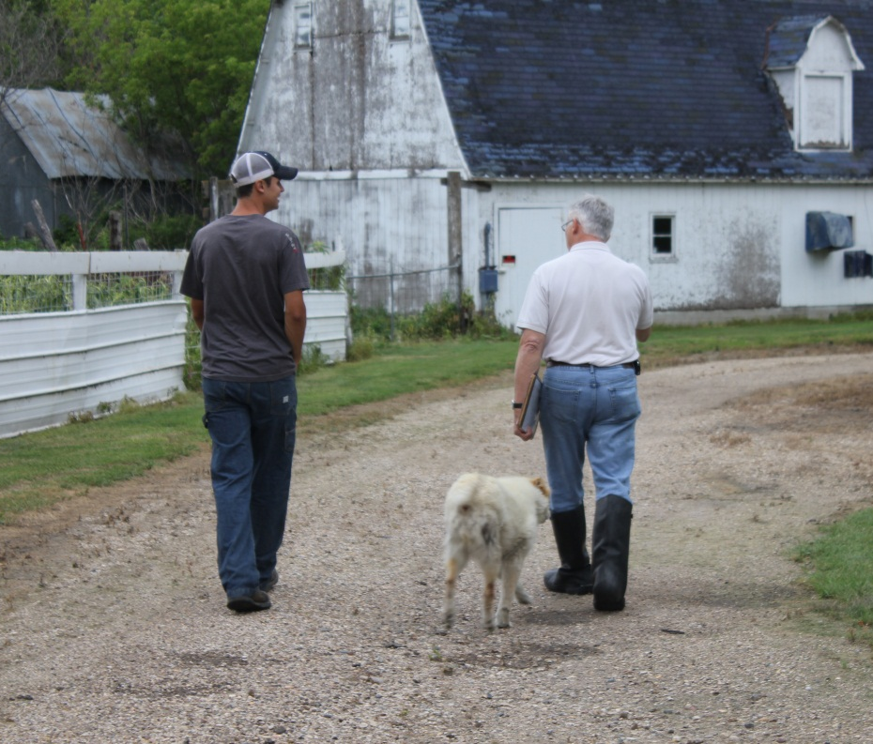
Questions?

