Slide 1
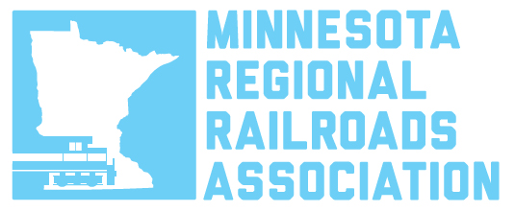
State of Freight – Minnesota railroads House Transportation Committee January 26, 2017 John Apitz, Legislative Counsel

Slide 2
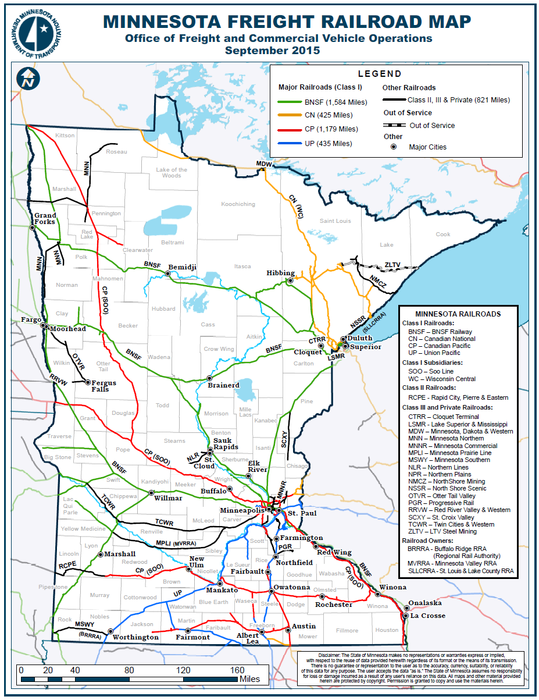
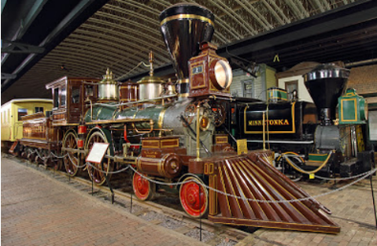
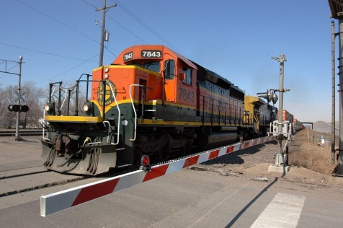
Minnesota Freight Rail
4 Class I railroads BNSF, CP, UP, CN
18 Short-line railroads
4,485 route miles - 8th in U.S.
Two major truck to rail intermodal container terminals
Railcar = 3.5 truck trailers 1 ton – 435 mi – 1 gal.
First train in MN ran from St. Paul to St. Anthony in 1862
Notes:
.

Slide 3
Economic impact of FREIGHT RAIL
“Freight Rail: How an ‘ordinary’ industry helps make the Minnesota economy extraordinary” (Phillip Romero, University of Oregon, Feb. 2016)
The history of the Minnesota & Midwest was profoundly shaped by railroad access
Railroads enabled agriculture and industry to flourish and communities to grow because exporters could ship products to distant markets and import an abundance of goods at competitive prices
Freight rail is responsible for at least 7% of Minnesota employment — a quarter of a million jobs — and $40 billion of state GDP
Freight rail adds about $2,000 to the average Minnesotan’s income, more than $5,000 per household
Freight rail fosters enough statewide income for families and businesses to generate about $7 billion in state and local tax revenue

Slide 4
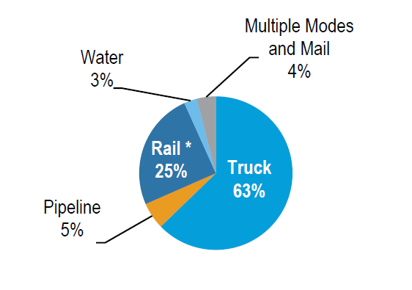
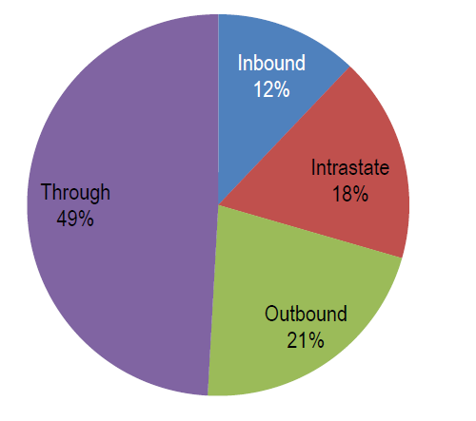
Rail Freight in Minnesota
26% of freight tonnage in MN transported by rail (2012)
Minnesota is ranked 4th in the U.S. in tonnage originating by rail and ranked 6th in tonnage terminating by rail
In 2012, 253 million tons of freight moved over Minnesota’s rail system – 3,837,000 carloads
By 2040 - projected to rise to 649 million tons valued at $34.1 billion – 250% increase

Slide 5
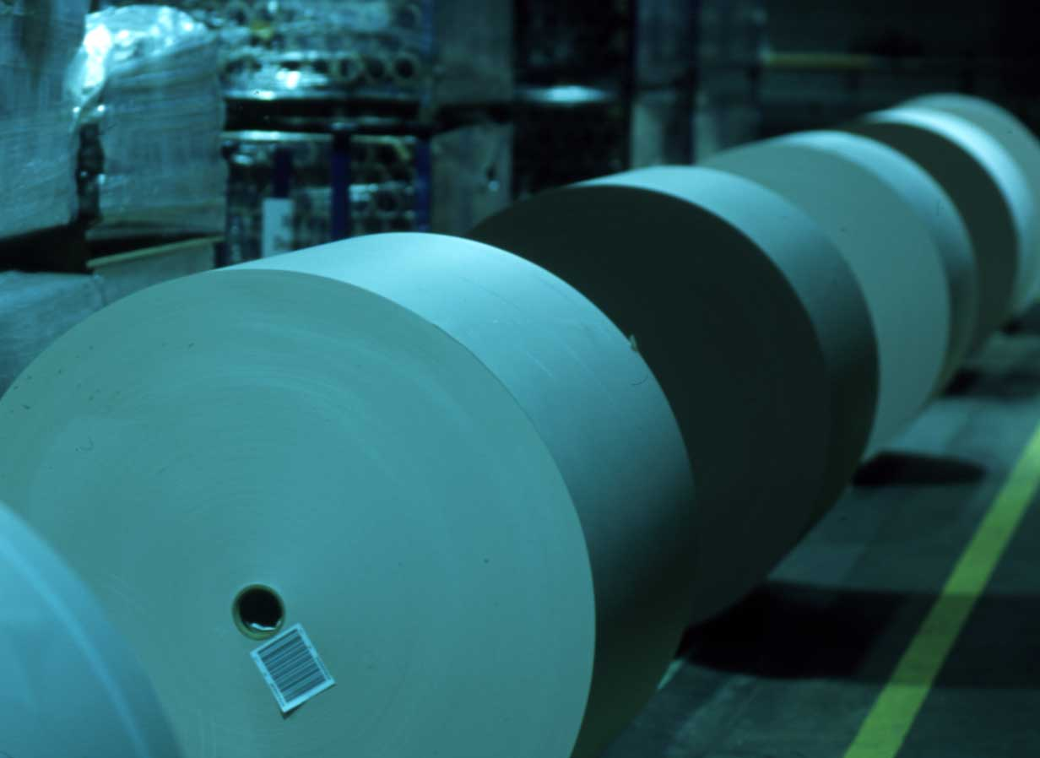
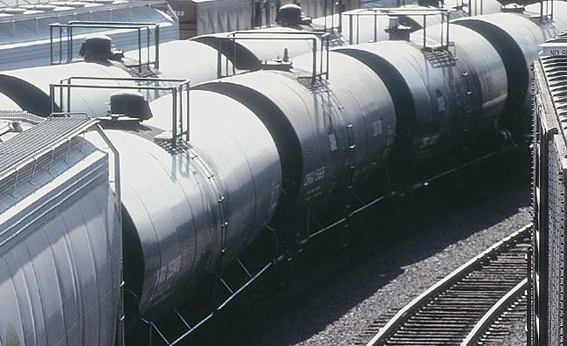
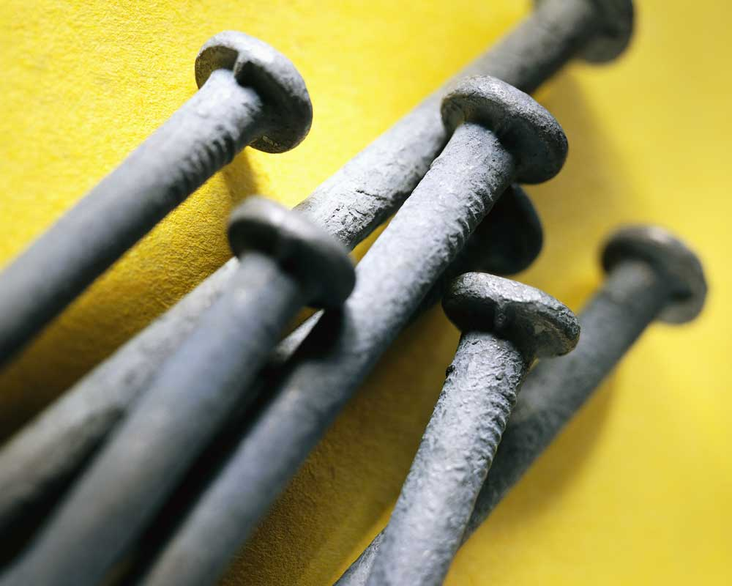
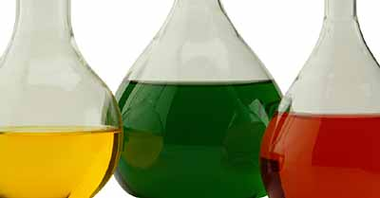
Railroads Haul nearly everything!
Notes:
The work our employees have been doing every day for the past 150 years affects the lives of nearly everyone in this country.
Think about this for a minute. When you woke up this morning and turned on the lights, the electricity you used probably came from coal or wind turbines that moved on one of our trains. Before you could use your computer or television to get the news this morning, it probably moved on one of our trains. The automobile you rode in to come here today, probably rode on a Union Pacific train before you ever laid eyes on it. The food you ate for lunch, most likely was on a train, before it was on the table.
Many people don’t realize the variety of products we haul.

Slide 6
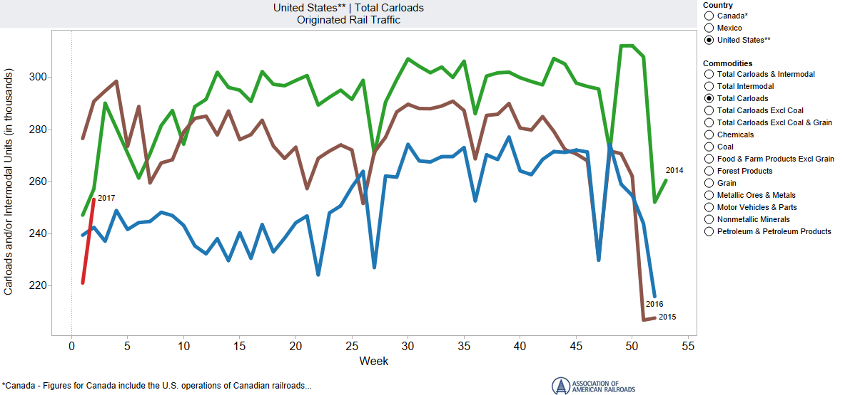
Movements Down over past 2 years

Slide 7
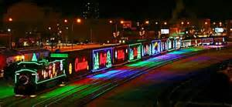
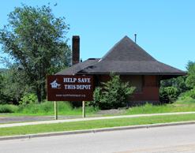
CONNECTIONS WITH OUR COMMUNITIES
Freight railroads work with communities where they operate – 4,500 employees, 14,518 retirees live in towns across MN
UP Foundation provided $650,000+ to MN organizations over the past decade like “Save the Northfield Depot,” Neighborhood House, Habitat for Humanity, Mankato Faith in Action
BNSF’s Foundation has given more than $1 million in the last three years to non-profit groups throughout the state. (2014-2016)
CP Holiday Train has raised nearly $12 million and over 3.9 million pounds of nonperishable food donations for food banks across North America, since 1999. 21 stops in Minnesota last Christmas.

Slide 8
Rail is safe and getting safer
Freight railroads are “common carriers” required by federal law to carry all legal cargo, including crude oil and other hazardous materials
99.997% of hazmat carloads are moved without a train accident-related release
Rail accidents have dropped by 45% since 2000 and 80% since 1980, along with employee injuries, and grade crossing collisions, as private rail investment has increased steadily

Slide 9
Railroad Safety Improvement

Slide 10
INVESTMENTS IN SAFETY & INFRASTRUCTURE
In 2015 & 2016, Minnesota’s railroads invested approximately $700 million in private capital improvements
UP invested $108 million in track, bridge and equipment upgrades in Minnesota
CP made $136 million investments in upgrading and improvements to its Minnesota operations
BNSF will have spent $535 million in MN between 2015–2017 ($85mm in 2017
Across the US, freight railroads have invested $600 billion in their network since 1980 and spend nearly 18% of their revenue on capital expenditures, 6 times more than the average manufacturer

Slide 11
Prevention and mitigation
Increased Track Inspections - FRA requires that tracks and main routes are inspected twice weekly. Certain HAZMAT routes inspected at least three times weekly. Railroads often exceed standards - BNSF inspects oil corridors daily.
Increased Trackside Safety Technology
Lower Speeds through HTUA’s - 50 mph or 40 mph if older-model DOT-111 cars carrying flammable liquids are present
During a train meet, a Key Train is given priority handing when possible
Certain trains carrying HAZMAT must be inspected following an every emergency braking application. Oil trains are required to have rear-end braking

Slide 12
Prevention and mitigation
Rail Risk-Based Traffic Routing Technology Use PHMSA’s Rail Corridor Risk Management System, 27 risk factors defining the “most safe and secure” routes
Safer Tank Cars
New tank car standards in effect for new tank cars built after Oct. 1, 2015: Increased thickness, thermal protection, full-height head shield
Unattended Trains
Crude oil trains left unattended require specific job safety briefing between train crew and train dispatcher
Locomotive Cab Securement: Key Trains left unattended have reverser removed and cab doors locked

Slide 13
Mitigation - New Tank Car Standards
Tank Cars for High-Hazard Flammable Trains (HHFT)
New tank cars built after Oct. 1, 2015, must meet enhanced DOT 117 design or performance criteria
Increased thickness from 7/16” to 9/1” steel
Thermal protection required
Jacketing with minimum 11-gauge steel and weather-tight
Full-height Head Shield - ½” thick

Slide 14
TRAINING & LOCAL Coordination
Railroads have provided 1st first responder training for decades: 5375 MN 1st responders trained by railroads in 2014-15; 2016 =1,700+
Railroad also pay Minnesota DPS $1.25 million/year to provide similar training
Traditionally, 1st responders provided with hazmat manifests upon request, but railroads now offer new technology…
AskRail app for first responders, desktop format in testing now

Slide 15
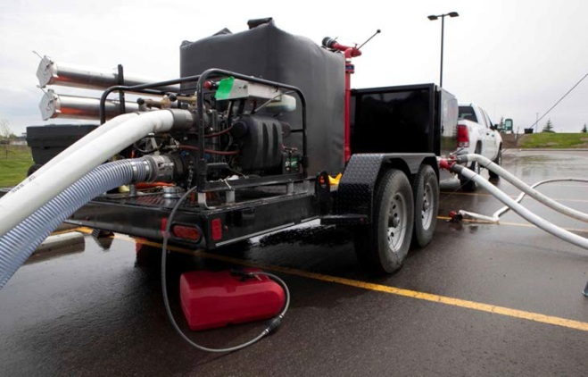
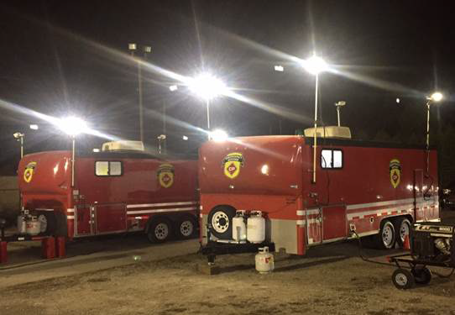
Response & remediation

Slide 16
LEGISLATIVE ISSUES
Governor Dayton proposes a dramatic increase the $50 million of property taxes railroads pay annually. Courts have repeatedly ruled similar taxes violate federal law that prohibits taxing railroads differently. Funds not designated for rail improvements
A proposed grade crossing tax would cost railroads $33 million/year though less than 1% of derailments happen at crossings and railroads already share in costs of project construction
Certification of Railroad Police Officers – only 2 state do not allow railroad officers to have police powers
Railroads helped craft legislation to improve communication, training and information sharing with 1st responders and emergency managers - failed last session; currently in Senate File 210 (bonding bill)

Slide 17
Questions?
Thank- you…
“Stay on Track!”
Mnrailroads.com

