Slide 1
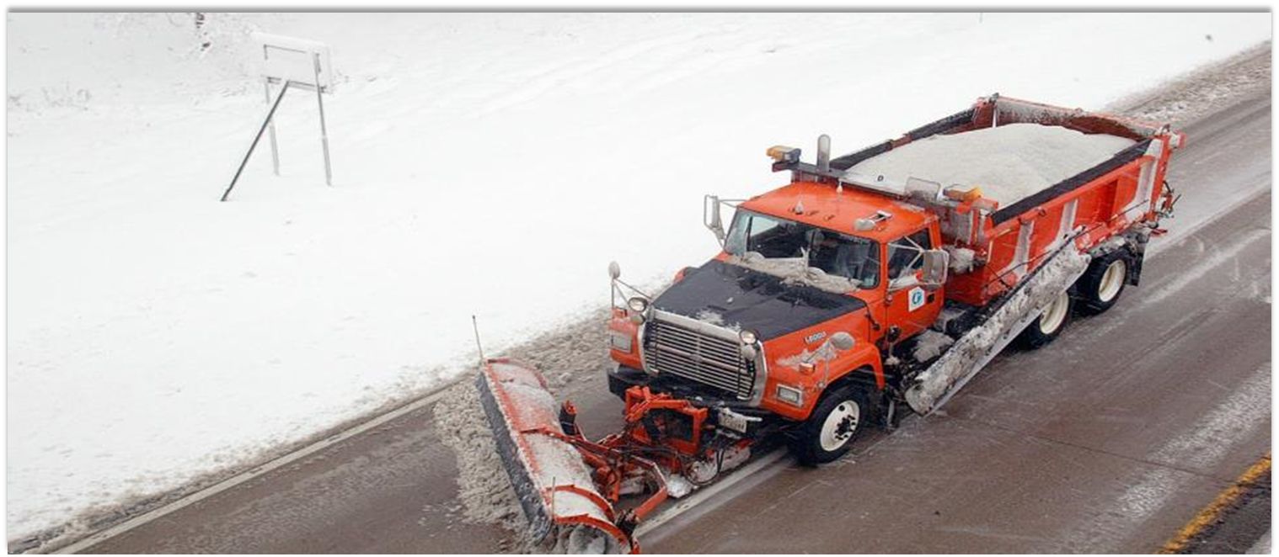
MnDOT November 2022 Forecast Update
Sam Brown
MnDOT Agency Budget Director
January 17, 2023

Slide 2
Forecast Overview
MMB prepares forecast for state General Fund
Overall estimated FY 2024-25 surplus = $17.6B balance (+$5.5B)
MnDOT prepares forecasts for 6 transportation funds:
Highway User Tax Distribution (HUTD)
Trunk Highway
County State Aid Highway (CSAH)
Municipal State Aid Street (MSAS)
State Airport
Transit Assistance

Slide 3
HUTD Sources and Uses Based on FY 2022 Actuals
5% Set Aside
95% Distribution
Highway User Tax Distribution Fund
MVST
$592M
(24%)
Gas Taxes
$893M
(35%)
State Sales Tax
$198M
(8%)
DNR Transfers
CSAH
(29%)
THF
(62%)
MSAS
(9%)
Town Roads
(30.5%)
Flexible Highway Account
(53.5%)
Town Bridges
(16%)
Tab Fees
$823M
(33%)
Other
$4M
(0%)

Slide 4
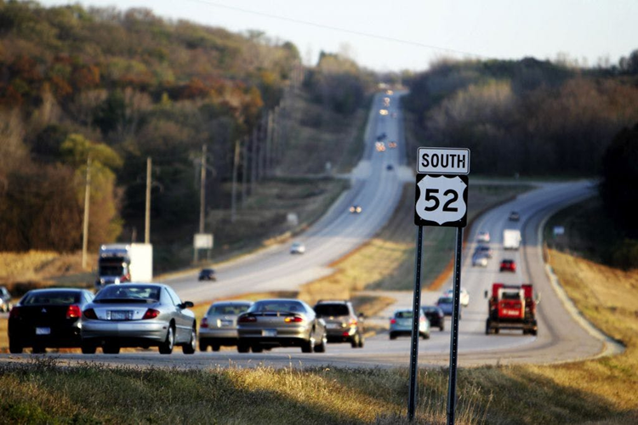
Gas Tax Forecast

Slide 5
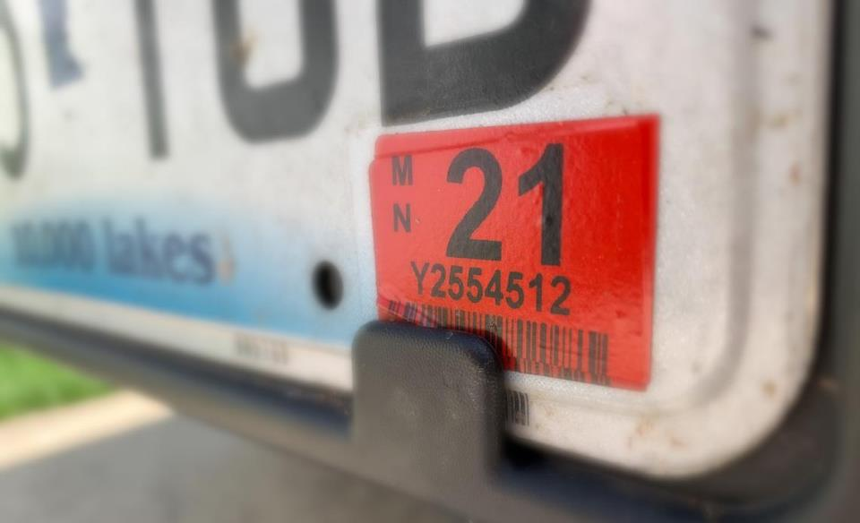
Registration Forecast

Slide 6
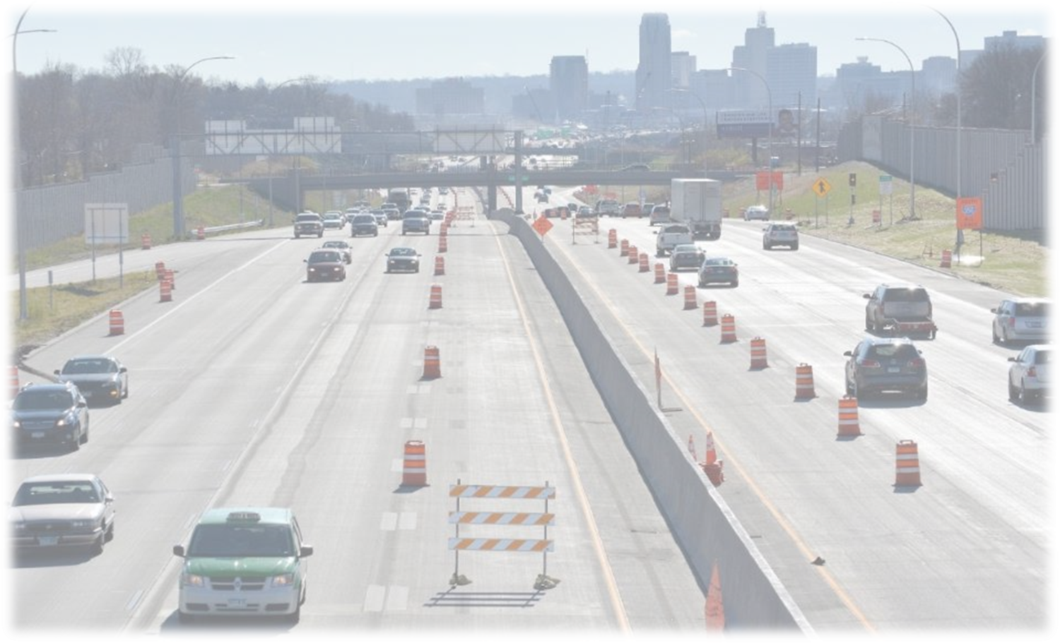
MVST Forecast

Slide 7
HUTD Revenues
FY 2022-23 biennial revenues decreasing -$184M (-3.5%) compared to Feb. ‘22
FY 2024-25 revenues decreasing -$209M (-3.8%) compared to Feb. ‘22

Slide 8
HUTD Revenues Year-Over-Year Growth Rates
Revenue | FY 20 (act) | FY 21 (act) | FY 22 (act) | FY 23 (fcst) | FY 24 (fcst) | FY 25 (fcst) | FY 26 (fcst) | FY 27 (fcst)
Gas tax | -6.2% | -3.8% | 5.5% | 1.8% | 0.3% | -0.7% | -0.7% | -0.7%
Tab fees | 1.1% | 5.1% | -3.6% | 2.0% | 4.0% | 4.0% | 4.0% | 4.0%
MVST | 0.0% | 21.2% | 0.4% | 4.1% | -1.4% | 1.4% | 2.9% | 3.2%
State sales taxes | 119.0% | -8.4% | 9.3% | 1.6% | 0.7% | 0.9% | 1.1% | 1.1%
Other | -26.1% | -15.5% | 18.6% | 61.6% | 29.7% | -16.7% | -16.6% | -1.6%
Total | 2.4% | 3.9% | 1.5% | 2.5% | 1.2% | 1.4% | 1.9% | 2.0%
Feb ‘22 |  |  | 4.8% | 3.2% | 1.0% | 1.9%

Slide 9
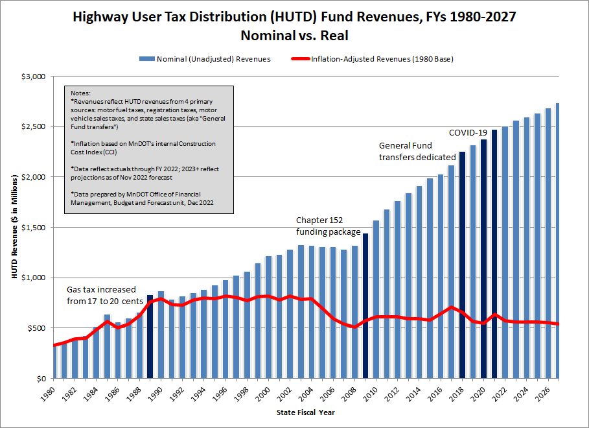
Minnesota Highway User Tax Revenue History of Annual Revenues
Notes:
20 years: 2003-2022: Rev growth +3.4%, CCI +5.2%. Real growth -1.7%
10 years: 2013-2022: Rev growth +3.5%, CCI +4.0%. Real growth -0.5%
5 year CCI: +8.5%

Slide 10
Key Fiscal Issues: $18B funding gap over 20 years ($900M/year)
20 year Transportation Needs identified in current State Highway Investment Plan
Transportation needs = $39B
Available revenue = $21B

Slide 11
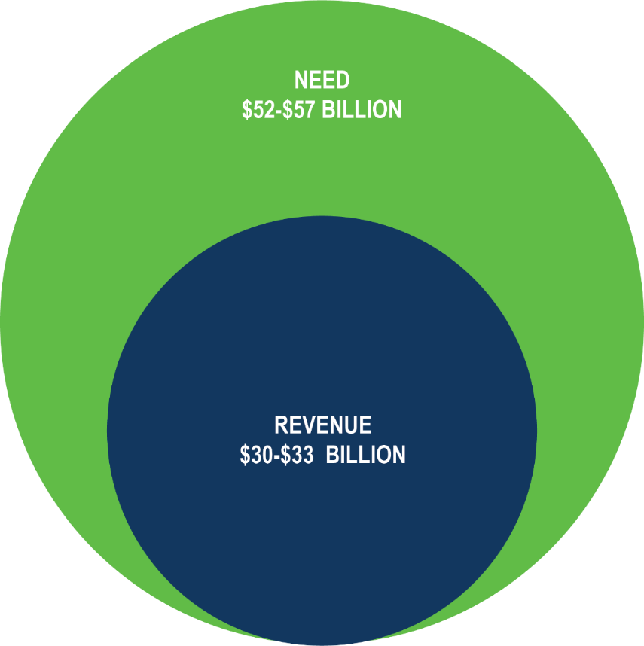
Revenue vs. Need
MnDOT is projecting a funding gap of between $19 – $27 billion
Increase due to several factors
Projected costs of inflation
Refined and more thorough planning processes
New state goals in areas such as pedestrian and bicycle facilities and freight
Low end of estimated need reflects Minnesota successfully achieving preliminary goals of reducing per capita Vehicle Miles Traveled (VMT)
In addition to the needs identified by MnDOT, cities and counties have identified $5-6 billion in priority investments on the state highway system

Slide 12
MnSHIP Timeline
New plan is currently being updated
Public Engagement for Draft Investment Direction: February – May 2023
Anticipated completion: Fall 2023

Slide 13
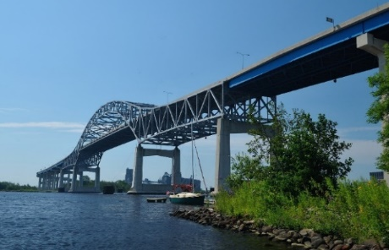
Bridge Condition
National Highway System Bridges | Current (2021) | Target | End of STIP (2026) | End of CHIP (2032)
Good Condition | 30.4% | ≥ 55% | 40.8% | 43.7%
Poor Condition | 6.3% | ≤ 5% | 3.7% | 11.3%
Other State Highway Bridges | Current (2021) | Target | End of STIP (2026) | End of CHIP (2032)
Good Condition | 30.5% | ≥ 50% | 31.3% | 31.2%
Poor Condition | 4.4% | ≤ 8% | 4.4% | 12.1%
*MnDOT has increased the accuracy of bridge condition data over the past 4-5 years through improved training, quality control and quality assurance of bridge inspections.

Slide 14
Pavement Condition (Ride Quality)
Interstate Pavements | Current (2021) | Target | End of STIP (2026) | End of CHIP (2032)
Good Condition | 93% | ≥ 70% | 87% | 84%
Poor Condition | 0.4% | ≤ 2% | 0.6% | 2.9%
National Highway System (Non-Interstate) Pavements | Current (2021) | Target | End of STIP (2026) | End of CHIP (2032)
Good Condition | 82% | ≥ 65% | 73% | 70%
Poor Condition | 0.5% | ≤ 4% | 1.4% | 3.0%
Other State Highway Pavements | Current (2021) | Target | End of STIP (2026) | End of CHIP (2032)
Good Condition | 77% | ≥ 60% | 61% | 48%
Poor Condition | 2% | ≤ 8% | 3.5% | 6.2%

Slide 15
Trunk Highway Fund Balance $ in millions All activity reflects TH Fund
 | FY 22 | FY 23 | FY 24 | FY 25
February ‘22 Forecast | $178 | $268 | $272 | $291
HUTD Revenues (TH portion) | -49 | -58 | -57 | -65
Federal Revenues | 32 | - | 180 | 149
Other TH Revenues | 21 | 17 | 25 | 12
Prior Year Adjustments | 9 | 5 | 5 | 5
MnDOT Spending | -157 | 211 | 6 | 6
DPS Spending | -10 | 17 | -0.8 | -0.8
Debt Service | -0.4 | -14 | -12 | -32
Other Transfers | - | - | - | -
November ‘22 Forecast | $359 | $200 | $364 | $511
Reserved | $114 | $108 | $105 | $102
Unreserved* | $245 | $92 | $259 | $409
*Note: unreserved available balance net of additional federal funds = ~$23M/year

Slide 16
Trunk Highway Debt Policy
*Roughly $225M in additional bonding capacity

Slide 17
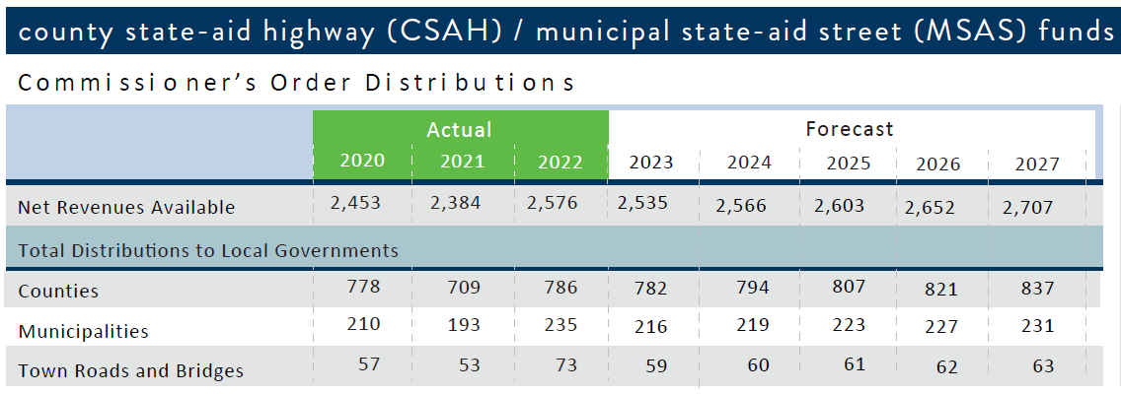
CSAH/MSAS Expenditures $ in millions

Slide 18
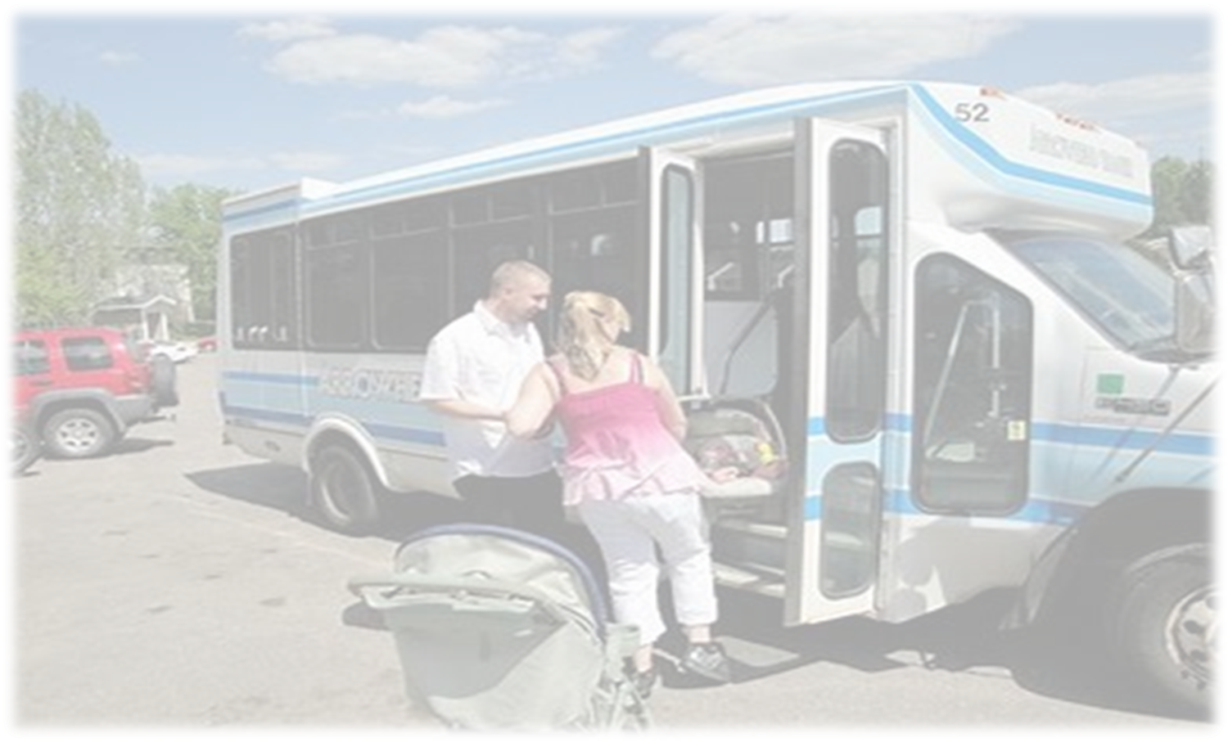
Transit Assistance Fund Based on FY 2022 Actuals
MVST
$394.4M
Transit Assistance Fund
Met Council
(90% of MVST)
$355.0M
MnDOT
(10% of MVST & 100% MVLST)
$65.4M
MVLST*
$26.0M
*38% of MVLST is allocated to TAF

Slide 19
Transit Assistance Fund $ in thousands
 | 2022 Nov | 2022 Nov | 2022 Nov | 2022 Nov | 2022 Nov | 2022 Nov | 2022 Nov | 2022 Nov
 | Close | Close | Close | Budget | Budget | Budget | Planning Est | Planning Est
 | FY 2020 | FY 2021 | FY 2022 | FY 2023 | FY 2024 | FY 2025 | FY 2026 | FY 2027
ACTUAL & ESTIMATED RESOURCES
Balance Forward From Prior Year | 47,064 | 46,313 | 54,009 | 42,903 | 26,639 | 25,371 | 24,125 | 24,235
Prior Year Adjustments | 5,365 | 2,813 | 7,162 | - | - | - | - | -
Adjusted Balance Forward | 52,429 | 49,126 | 61,171 | 42,903 | 26,639 | 25,371 | 24,125 | 24,235
Receipts: |  | 69,178.99 | 65,396.65 | 64,106.80 | 62,602.00 | 62,623.60 | 63,979.60 | 65,540.40
Metropolitan area transit account | 291,607 | 353,426 | 354,976 | 369,367 | 364,374 | 369,356 | 380,192 | 392,530
Greater Minnesota transit account | 32,402 | 39,270 | 39,442 | 41,041 | 40,486 | 41,040 | 42,244 | 43,614
Total Motor Vehicle Sales Tax | 324,009 | 392,696 | 394,418 | 410,408 | 404,860 | 410,396 | 422,436 | 436,144
Leased Vehicle Sales Tax (Greater MN transit account) | 32,704 | 29,909 | 25,955 | 23,066 | 22,116 | 21,584 | 21,736 | 21,926
Total Receipts | 356,712 | 422,605 | 420,373 | 433,474 | 426,976 | 431,980 | 444,172 | 458,070
Other Income | - | - | - | - | - | - | - | -
Net Receipts | 356,712 | 422,605 | 420,373 | 433,474 | 426,976 | 431,980 | 444,172 | 458,070
Transfers from Other Funds:
Total Transfers | - | - | - | - | - | - | - | -
Total Resources Available | 409,141 | 471,731 | 481,544 | 476,377 | 453,615 | 457,351 | 468,297 | 482,305
ACTUAL & ESTIMATED USES
Expenditures:
Metropolitan Council | 291,630 | 353,449 | 355,077 | 369,367 | 364,374 | 369,356 | 380,192 | 392,530
Transportation Department | 71,198 | 64,273 | 83,564 | 80,370 | 63,870 | 63,870 | 63,870 | 63,870
Total Expenditures | 362,828 | 417,722 | 438,641 | 449,737 | 428,244 | 433,226 | 444,062 | 456,400
Total Uses | 362,828 | 417,722 | 438,641 | 449,737 | 428,244 | 433,226 | 444,062 | 456,400
Balance before Reserves | 46,313 | 54,009 | 42,903 | 26,639 | 25,371 | 24,125 | 24,235 | 25,905
Less Carryforward for Leased Sales Tax (1) | 32,704 | 29,909 | 25,955 | 23,066 | 22,116 | 21,584 | 21,736 | 21,926
Less Met Council Balance | - | - | - | - | - | - | - | -
Budgetary Balance | 13,609 | 24,099 | 16,948 | 3,573 | 3,255 | 2,541 | 2,499 | 3,979
Fund Balance Reserve (10% of RFW) | 4,706 | 4,631 | 5,401 | 4,290 | 2,664 | 2,537 | 2,413 | 2,423
Unreserved Fund Balance | 8,903 | 19,468 | 11,547 | (717) | 592 | 4 | 86 | 1,556
*Base spending in FY24 and beyond $63.87M/year. Forecast is down from $73M/year in Feb ’22 (-$9.1M, -12.5%)

Slide 20
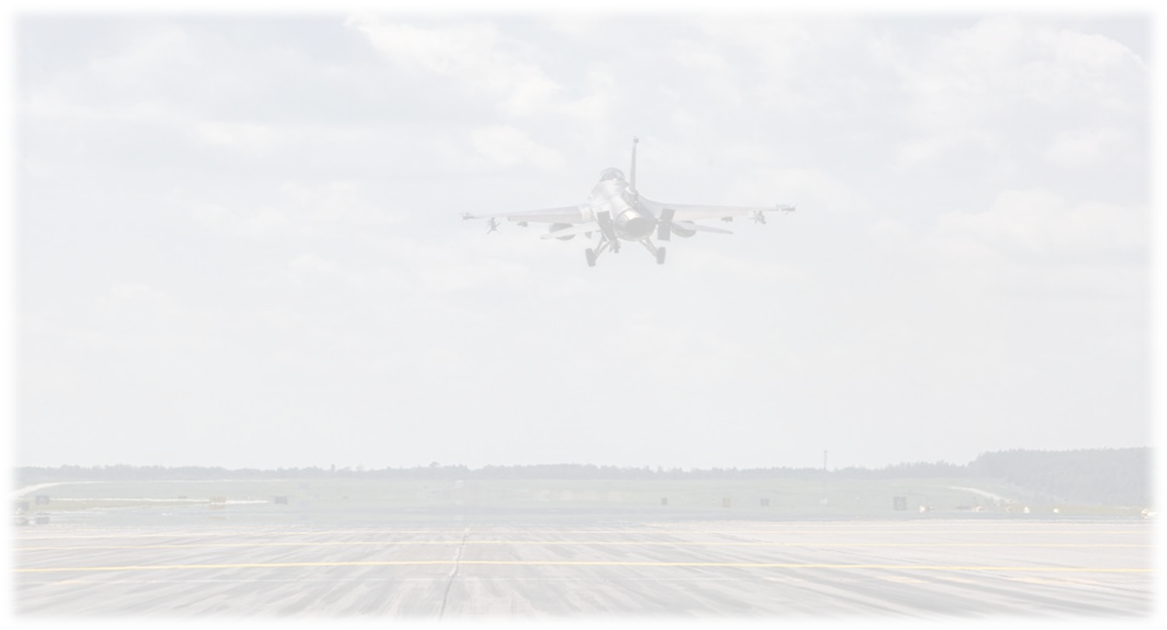
SAF Revenues Based on FY 2022 Actuals
Sales Tax on Aircraft
$12.8M
Airline Flight Property Tax
$7.0M
Aircraft Registration Tax
$3.4M
Aviation Gas and Special Fuel Tax
$7.1M
State Airport Fund
Hangar Revolving Loan Fund
Air Transportation Services Revolving Fund

Slide 21
State Airports Fund $ in thousands
 | November 2022 Forecast
($ in thousands) | Close | Close | Close | Budget | Planning Est | Planning Est | Planning Est | Planning Est
 | FY 2020 | FY 2021 | FY 2022 | FY 2023 | FY 2024 | FY 2025 | FY 2026 | FY 2027
Balance Forward from Prior Year | $15,566 | $21,880 | $18,101 | $19,495 | $21,284 | $24,296 | $26,836 | $29,041
Prior Year Adjustments | 3,633 | 3,752 | 3,636 | 500 | 500 | 500 | 500 | 500
Adjusted Balance Forward | 19,199 | 25,632 | 21,737 | 19,995 | 21,784 | 24,796 | 27,336 | 29,541
Net Revenue and Transfers-In
Transfer from General Fund | - | - | - | - | - | - | - | -
Sales Tax on Aircraft | 9,906 | 12,330 | 12,806 | 10,000 | 10,000 | 10,000 | 10,000 | 10,000
Airline Flight Property Tax | 7,025 | 7,008 | 7,004 | 7,000 | 7,000 | 7,000 | 7,000 | 7,000
Aircraft Registration Tax | 3,573 | 3,866 | 3,382 | 3,600 | 3,600 | 3,600 | 3,600 | 3,600
Gasoline & Special Fuel Tax | 4,467 | 3,090 | 7,092 | 5,000 | 5,000 | 5,000 | 5,000 | 5,000
Other Income | 1,253 | 1,279 | 1,330 | 4,224 | 2,917 | 2,445 | 2,110 | 2,090
Total Net Revenue and Transfers-In | 26,224 | 27,573 | 31,613 | 29,824 | 28,517 | 28,045 | 27,710 | 27,690
Expenditures and Transfers-Out
Transportation Department | 23,929 | 35,400 | 34,127 | 28,835 | 26,305 | 26,305 | 26,305 | 26,305
Transfer Out (General Fund | - | - | - | - | - | - | - | -
Total Expenditures and Transfers-Out | 23,929 | 35,400 | 34,127 | 28,835 | 26,305 | 26,305 | 26,305 | 26,305
Net Change in Loan Fund | 387 | 296 | 272 | 300 | 300 | 300 | 300 | 300
Balance Before Reserves | 21,880 | 18,101 | 19,495 | 21,284 | 24,296 | 26,836 | 29,041 | 31,226
Less Appropriation Carryforward | 2,217 | 2,169 | 2,259 | 2,770 | 3,281 | 3,792 | 4,303 | 4,814
Ending Balance | $17,504 | $14,160 | $15,464 | $16,742 | $20,243 | $22,272 | $23,966 | $25,640
Reserved Balance | 1,080 | 1,697 | 1,586 | 1,397 | 1,271 | 1,271 | 1,271 | 1,271
Unreserved Fund Balance | 16,424 | 12,463 | 13,878 | 15,345 | 18,973 | 21,001 | 22,696 | 24,369

Slide 22
Questions?
Sam Brown
MnDOT Agency Budget Director
Samuel.brown@state.mn.us

