Slide 1

2017 Budget Recommendations State Government Finance & Veterans Affairs Division
Thomas A. Baden Jr | Commissioner & State CIO
February 14, 2017

Slide 2
Our Mission
We partner with Minnesota state agencies to deliver technology solutions that transform how government provides services for the people of Minnesota.

Slide 3

Our History
Prior to 2011, state agency IT was largely decentralized, with each agency managing their own set of IT services and staff
In 2011, bipartisan legislation consolidated all executive branch IT staff and functions under Minnesota IT Services and the leadership of the State CIO
The newly-formed agency, renamed as MN.IT Services, was comprised of over 2,000 staff with an annual budget of over $450 million

Slide 4
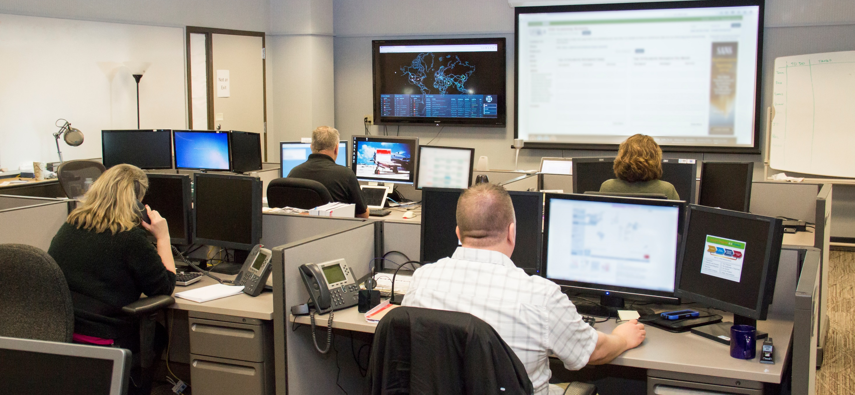
Who We Serve
70 executive branch agencies, boards and commissions
90 physical locations
Diverse lines of business that serve Minnesotans

Slide 5
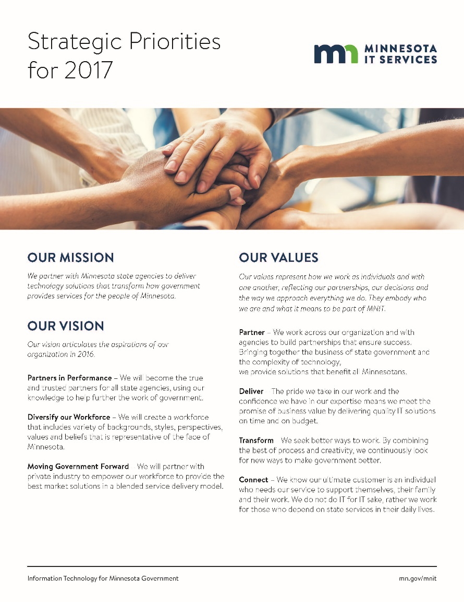
2017 Strategic Priorities

Slide 6

Minnesota IT Services – By the Numbers
Support over 35,000 end users
Secure private data of 5.5 million Minnesota Citizens
Secure and manage over 2,800 agency applications at over 1,300 locations
Oversee and deliver over 350 projects with major IT components

Slide 7
Governance Structure
Key

Slide 8
Historical IT Spend

Slide 9
Hybrid IT Model
Actual
Budget
Budget
$96M
This chart depicts the shift of siloed operations services to enterprise services

Slide 10

Local Services
Set by Agencies working with Chief Business Technology Officer
FY18-19 IT Budget set for planning purposes
Billed on actual consumption each month
Agencies control costs - budget can be adjusted up or down through-out year
Cost is a direct pass-through to the agency – they pay the exact expense
Increase or decrease to meet Agency demand

Slide 11

Enterprise Services
Set by cross-agency services governance steering team
Benefits
Leverage economy of scale
Consistent delivery
Better services and predictable costs
FY18-19 IT Budget set for planning purposes
Billed on actual consumption each month
Agencies control volumes - budget can be adjusted up or down through-out year

Slide 12

Enterprise Services
Secure Services
Connectivity
End User Support
Infrastructure
as a Service (IaaS)
Software
as a Service (SaaS)
Platform
as a Services (PaaS)

Slide 13
Progress on Enterprise Services

Slide 14
Progress on Enterprise Services
Will be completed by 7/1/17 | # of Agencies Migrated Into Enterprise Services | % Completion across Enterprise (Executive Branch)
LAN | 69 of 69 | 100%
WAN | 69 of 69 | 100%
Firewall | 69 of 69 | 100%
Voice | 69 of 69 | 100%
Service Desk | 52 of 69 | 75.36%
Hosting | 52 of 69 | 75.36%
Workstation Management | 52 of 69 | 75.36%

Slide 15

Changes in the 18-19 Rates Package
Driven by cross-agency governance process
Resolving audit finding on over/under-recovery costs for enterprise services
Two-year rate package
Historically unbudgeted replacement costs for network, desktop, servers, and telephones will be brought into a normal, budgeted refreshment cycle that will maintain IT standards and improve security

Slide 16

Rates Package Cost Savings
Over $2 million in efficiencies savings
$4 million in reduced software costs ($15 million annually across the enterprise through contract renegotiation)
$5 million reduction in Federal liability from rebalancing efforts

Slide 17

Agency Controls in Rates Package
Accurately manage usage
Ex. Shut down unused email boxes
Tiered service options
Choose the level of service that best meets their budget and business IT needs
Reduce equipment usage
Targeted reductions in equipment usage that carry limited impact to service levels and quality

Slide 18
Independent Rate Study
FY18-19 rates comparison – performed by Science Applications International Corporation (SAIC)
Compared to 31 States
Compared to a National Benchmark Service for the Private Sector

Slide 19
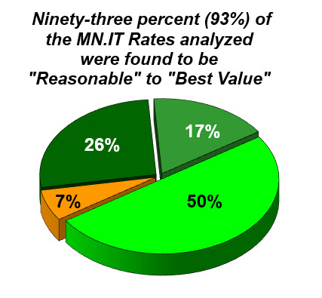
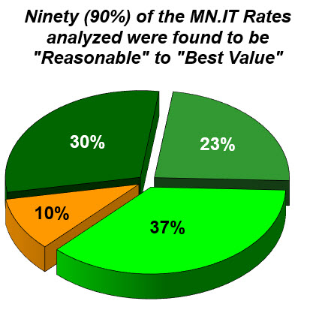
Independent Rate Study
All services assessed* against state benchmarks
All services assessed* against both state + private vendor benchmarks
Value Legend
 | Best Value |  | Very Reasonable Value |  | Reasonable Value |  | Less Reasonable Value
*Included if at least two comparable benchmarks discovered.
Results based on available benchmark data from 31 state government peers representing multiple sizes and consolidation levels as well a private industry benchmark analysis tool. Benchmarks representative of organizations with similar constraints and challenges inherent to MN.IT.
19
Notes:
July 2007
19

Slide 20
Independent Rate Study
Advanced online service
catalog portal
Level 6
Leading
Predicting
Automated sftwe provisioning
Integrated w/ Asset Mgt, Demand Mgt, Fiscal Mgt, etc.
Bus Customer Metric Reporting
Service Manager Metric Reporting
SLA’s tracked via Event Mgt
Service catalog
Level 5
Online ordering (advanced end user experience)
Online statusing
Value statement
Transparency
Level 4
Online ordering (basic end user experience)
Level 3
Customer descriptions
Bundling
SLA’s
Owner/mgr ID
T&C’s
Bus & tech
Level 2
Standardized service description
Rates included
Level 1
A la carte list of services (usually in technical terms)
Service Catalog Maturity Spectrum
Notes:
July 2007
20

Slide 21

Public / Private Partnerships
Mainframe as a Service
Purchased ‘As a Service’ in lieu of owning
Option to increase or decrease based on need
Cloud Hosting
Menu of service providers
Network
95% procured from private vendors

Slide 22

Public / Private Partnerships
Leased Tier 3 Enterprise Data Center
Enterprise Email
Subscription based
Uplift – Partnered with Genesis10
Uplift recruits, trains and mentors entry-level talent for IT
Low-cost consultant with option to hire between 6-18 months with no fee

Slide 23



Priority #1: Cybersecurity
Attacks
More Frequent
More Sophisticated
More Targeted
Outdated Technology
Unsupported by Vendors
Impossible to Properly Secure
Underinvestment
Less than 2% of IT Budget

Slide 24

The Threat Landscape
On average, state systems that are accessible from the internet are probed over 3 million times daily from over 150 countries
Systems with exploitable vulnerabilities are often compromised within minutes. Once compromised, hackers almost always move laterally to exploit other targets within the first 24 hours.
Approximately 50% of software vulnerabilities discovered by hackers now become full exploits within 30 days

Slide 25




Consequences
Minnesota Courts:
Numerous State DDOS Attacks
Federal Government:
21.5 Million People Compromised
5.6 Million Sets of Fingerprints
State of South Carolina:
3.7 Million People Compromised
Our Public Schools:
Ransom Attack Closes Schools

Slide 26


Cybersecurity Foundation
Service Delivery Model
Policies & Standards
Strategic Plan
12 Core Services
Deliverables and Tools
Delivery Approach
Over 200 Requirements
Risk-based Applicability
5 Year Vision
2 Year Tactical Milestones
18 Core Strategies

Slide 27
Secure the State: Key Components
STRATEGY | BENEFITS
Secure Datacenters | Physical space that is fault tolerant Reduced attack surface for hackers Simpler technology footprint to manage Consistent and secure application hosting Advanced security tools by default More robust patching and IT hygiene
Information Security Program Enhancements | Faster security anomalies detection Faster incident response times Expanded vulnerability management 24*7*365 monitoring of state networks Robust security testing of new business systems Improved disaster recovery capabilities Ongoing penetration testing of state networks Better protection against denial of service attacks Continuous risk assessments of state systems Cybersecurity insurance

Slide 28

Secure the State: Key Numbers
Secure Datacenters: Consolidate footprint with built-in, robust security services
Information Security Program Enhancements:
Deploy tools to combat increasingly complex hacker attacks and procure services for continuous security monitoring, penetration tests, and independent security audits
Staff state forensics and disaster recovery teams
Fiscal Impact ($000s)
FY18 | FY19
$22,168 | $4,778

Slide 29
Application Accessibility Assessment
External assessment of state agency technology applications to determine level of accessibility and priority for upgrade / replacement
Aging applications hinder citizens and state government workers with disabilities from conducting business effectively
Resulting study will aid in long-term system modernization planning
Fiscal Impact ($000s)
FY18 | FY19
$500 | $0

Slide 30

Cash Flow Assistance
Renews current MMB cash flow assistance authority up to $110 M to address the lag between MN.IT incurring expenses on behalf of agencies and MN.IT receiving payment for those expenses
Authority requires repayment by the end of the biennium and results in no net costs to the general fund
Enables centralized procurement and associated cost savings/avoidance
Fiscal Impact ($000s)
 | FY18 | FY19 | FY2020
Expenditures | (110,000) | 0 | (110,000)
Revenues | 110,000 | 0 | 110,000
Net Fiscal Impact = $0

Slide 31

Operating Adjustment
MNIT’s general fund appropriation is used to deliver computer forensics to state agencies and local governments, as well as to provide IT and geospatial leadership and oversight
Operating adjustment will help maintain current level of service delivery amidst growing demand
Fiscal Impact ($000s)
FY18 | FY19
96 | 154

Slide 32
Thank you!

