Slide 1

Minnesota Department of Public Safety
Agency Overview

Slide 2
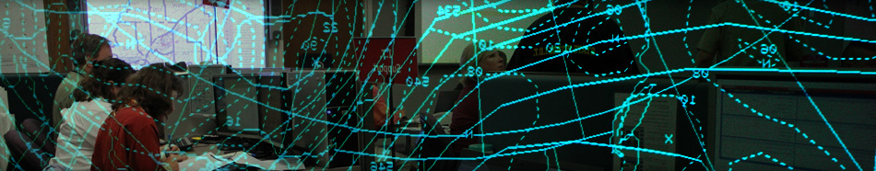

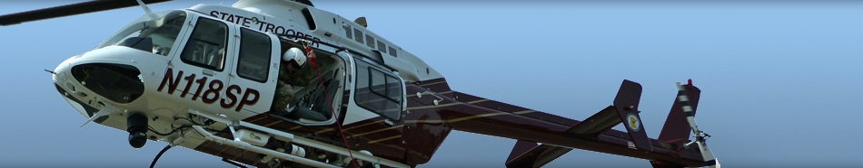
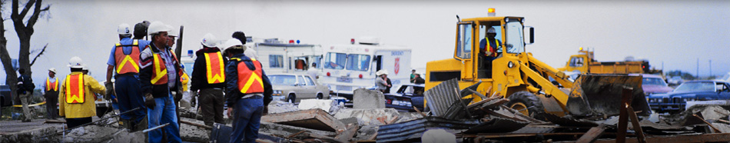
Public Safety Mission
A Safer Minnesota
  To protect citizens and communities
  Prevent, prepare, respond, recover, educate, and enforce
  Focus on saving lives, providing efficient and effective services
  Maintain public trust and develop strong partnerships

Slide 3
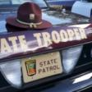

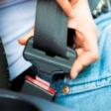


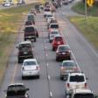
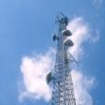
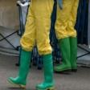

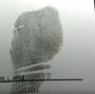
Department of Public Safety
Transportation
Policy and Finance Committees
Public Safety
Policy and Finance Committee
Minnesota State Patrol
Alcohol and Gambling
Enforcement
Fire Marshal Division
Office of Traffic Safety
Office of Justice Programs
Driver and Vehicle Services
Emergency Communication
Networks
Office of Pipeline Safety
Homeland Security and
Emergency Management
Administration and Related Services
Bureau of Criminal
Apprehension

Slide 4
Department of Public Safety
1905 The position of State Fire Marshal is created
Fire Marshal Department is created
The BCA is created
Minnesota Highway Patrol is created. The first force consists of nine men
Patrol is authorized to enforce speed limits on trunk highways
BCA lab becomes operational
Minnesota creates its Department of Civil Defense
Highway Patrol purchases two fixed-wing aircraft
The Office of Traffic Safety (OTS) is created under the Federal Highway Act
1969 The Department of Public Safety is created
The Driver’s License Division of the Highway Department joins DPS
Highway Patrol is reorganized; official name changed to “Minnesota State Patrol.”
The Minnesota Office of Pipeline Safety (MNOPS) is created
BCA establishes one of the first DNA laboratories in the nation
First drug detection dog begins work for the State Patrol
The Alcohol and Gambling Enforcement Division (AGED) is created
The Office of Justice Programs (OJP) is created
Division of Homeland Security and Emergency Management (HSEM) is created
2004 OTS and the Minnesota Departments of Transportation and Health establish the Toward Zero Deaths (TZD) Program

Slide 5
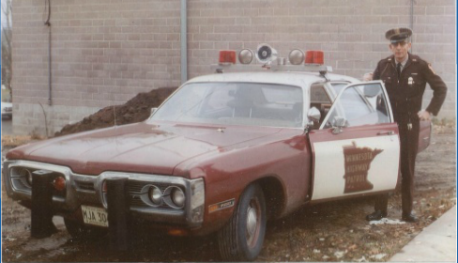
Department of Public Safety
In 1969, Troopers drove Fury Pursuit Sedans

Slide 6
State Patrol
Minnesota Department of Public Safety

Slide 7
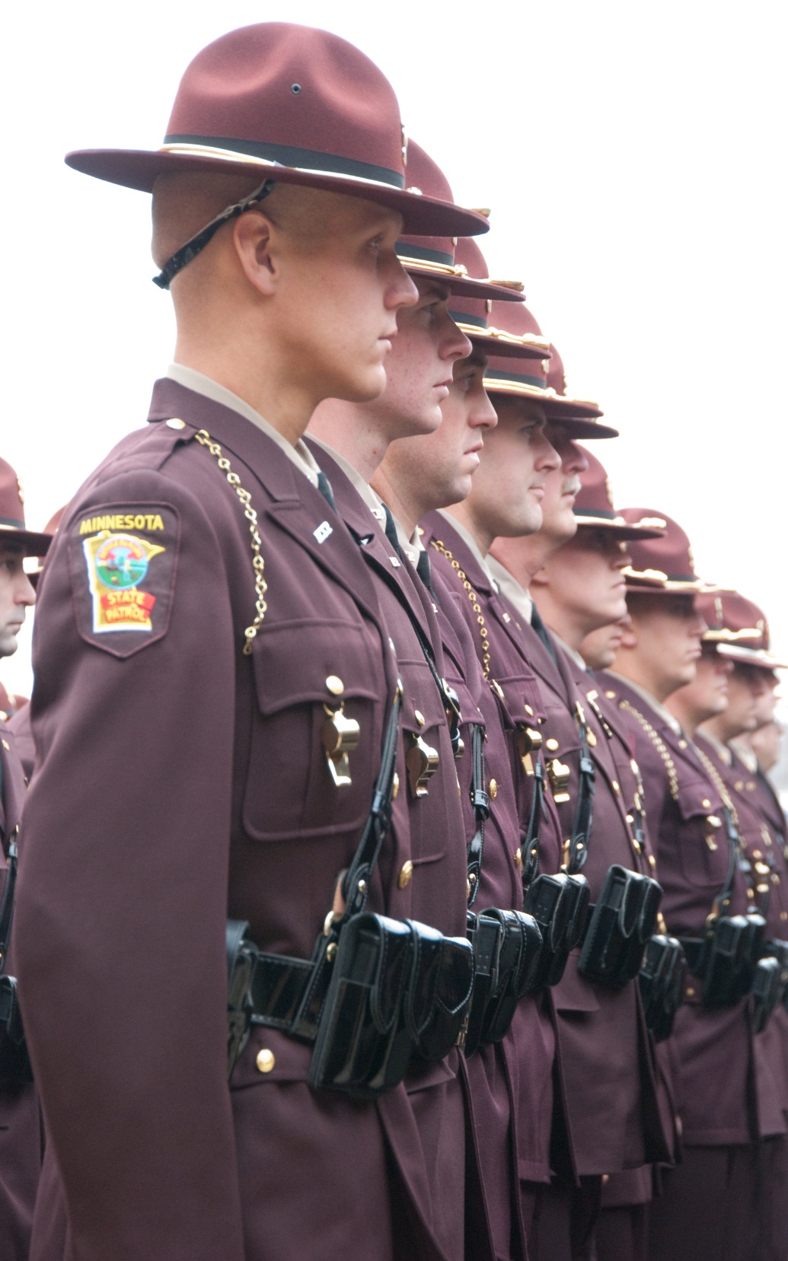


State Patrol
Minnesota Department of Public Safety
Mission
  Protect and serve all people in the state through assistance, education, and enforcement; provide support to allied agencies; and provide for the safe, efficient movement of traffic on Minnesota’s roadways.

Slide 8
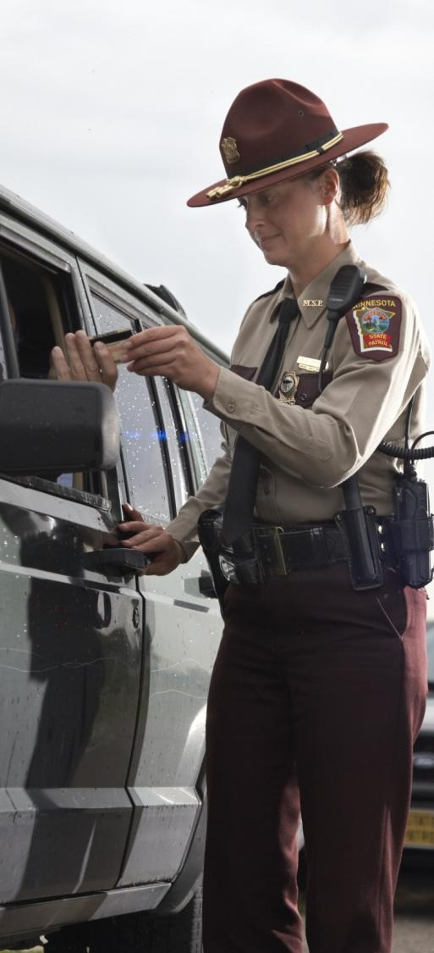
State Patrol
Minnesota Department of Public Safety
State Patrol Services
Aviation
Capitol Security
Executive Protection
Canine Program
Crash Reconstruction
Commercial Vehicle Enforcement
Vehicle Crimes Unit
DWI Enforcement
Fleet Management
Investigative Services
Public Information
Training Academy
Radio Communications
Special Response Team
Federal Programs

Slide 9
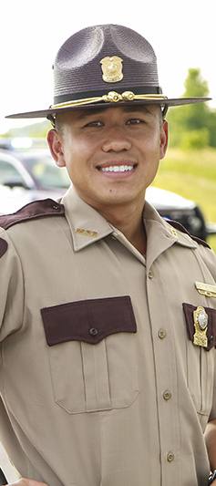
State Patrol
Minnesota Department of Public Safety
The State Patrol includes 895 full-time, sworn and non-sworn personnel
The State Patrol receives an annual appropriation of $112.7 million.
  $103.2 million from Trunk Highway Fund
  $876,000 from Highway User Tax Distribution Fund
  $8.6 million from the General Fund
The State Patrol received $8 million in federal funds in FY19.

Slide 10
Office of
Traffic Safety
Minnesota Department of Public Safety

Slide 11


Office of Traffic Safety
Minnesota Department of Public Safety
Mission
  To prevent traffic deaths and serious injuries by changing human behavior in Minnesota through policy development and support, stakeholder engagement, program delivery, leadership, and research and evaluation.

Slide 12
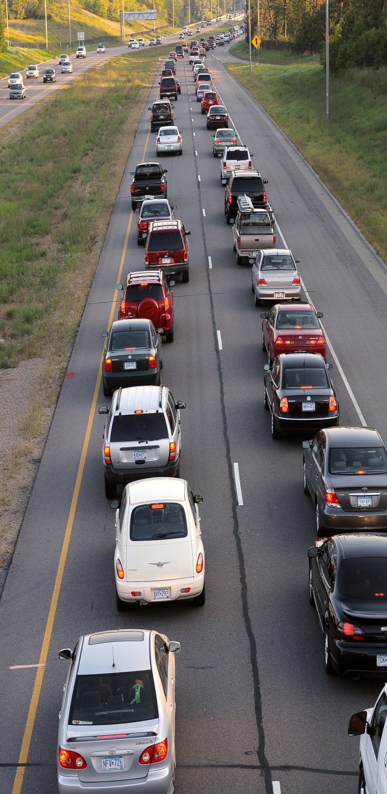
Office of Traffic Safety
Minnesota Department of Public Safety
OTS Services
Traffic Safety Outreach
Impaired Driving Prevention
Seat Belt Use
Child Passenger Safety
Traffic Records/Data Systems
Safe Road Coalitions
Motorcycle Safety
Teen Drivers
Illegal/Unsafe Speed
Distracted Driving
Traffic Safety Research and Analysis
Fatality Analysis Records System

Slide 13

Office of Traffic Safety
Minnesota Department of Public Safety
OTS receives an annual appropriation from the General Fund of $470,000.
OTS receives an annual appropriation from the Trunk Highway Fund of $493,000 - a required match which allows OTS to secure federal funds, grants, and one-time monies that annually amount to approximately $32.8 million.

Slide 14
Driver and Vehicle Services
Minnesota Department of Public Safety

Slide 15
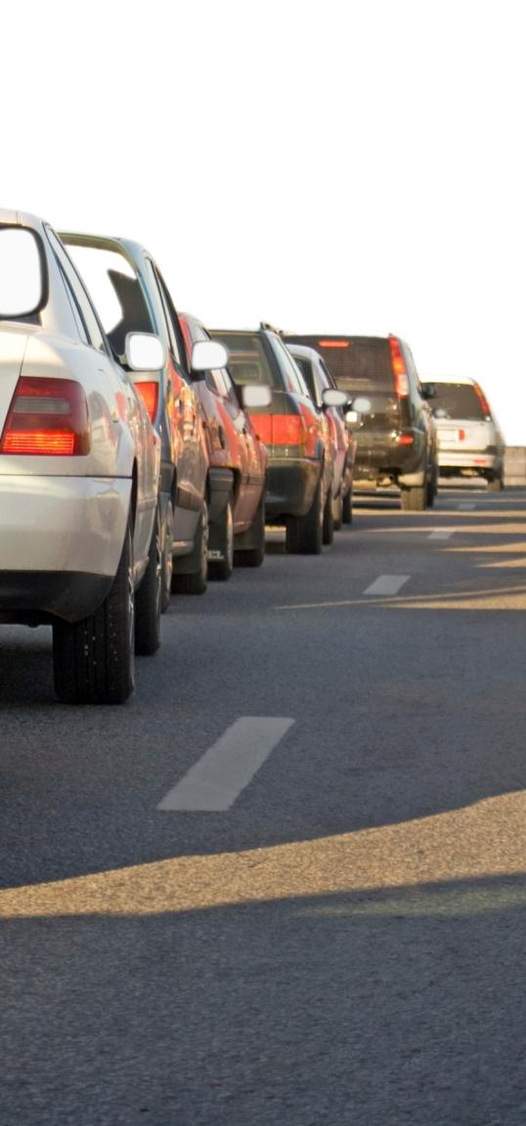

Driver and Vehicle Services
Minnesota Department of Public Safety
Mission
  Committed to providing FAST (fair, accurate, secure, timely) service through effective service options, accurate collection of data, fraud prevention, efficient collection of state revenue, and quality information and technical support for staff and business partners.

Slide 16
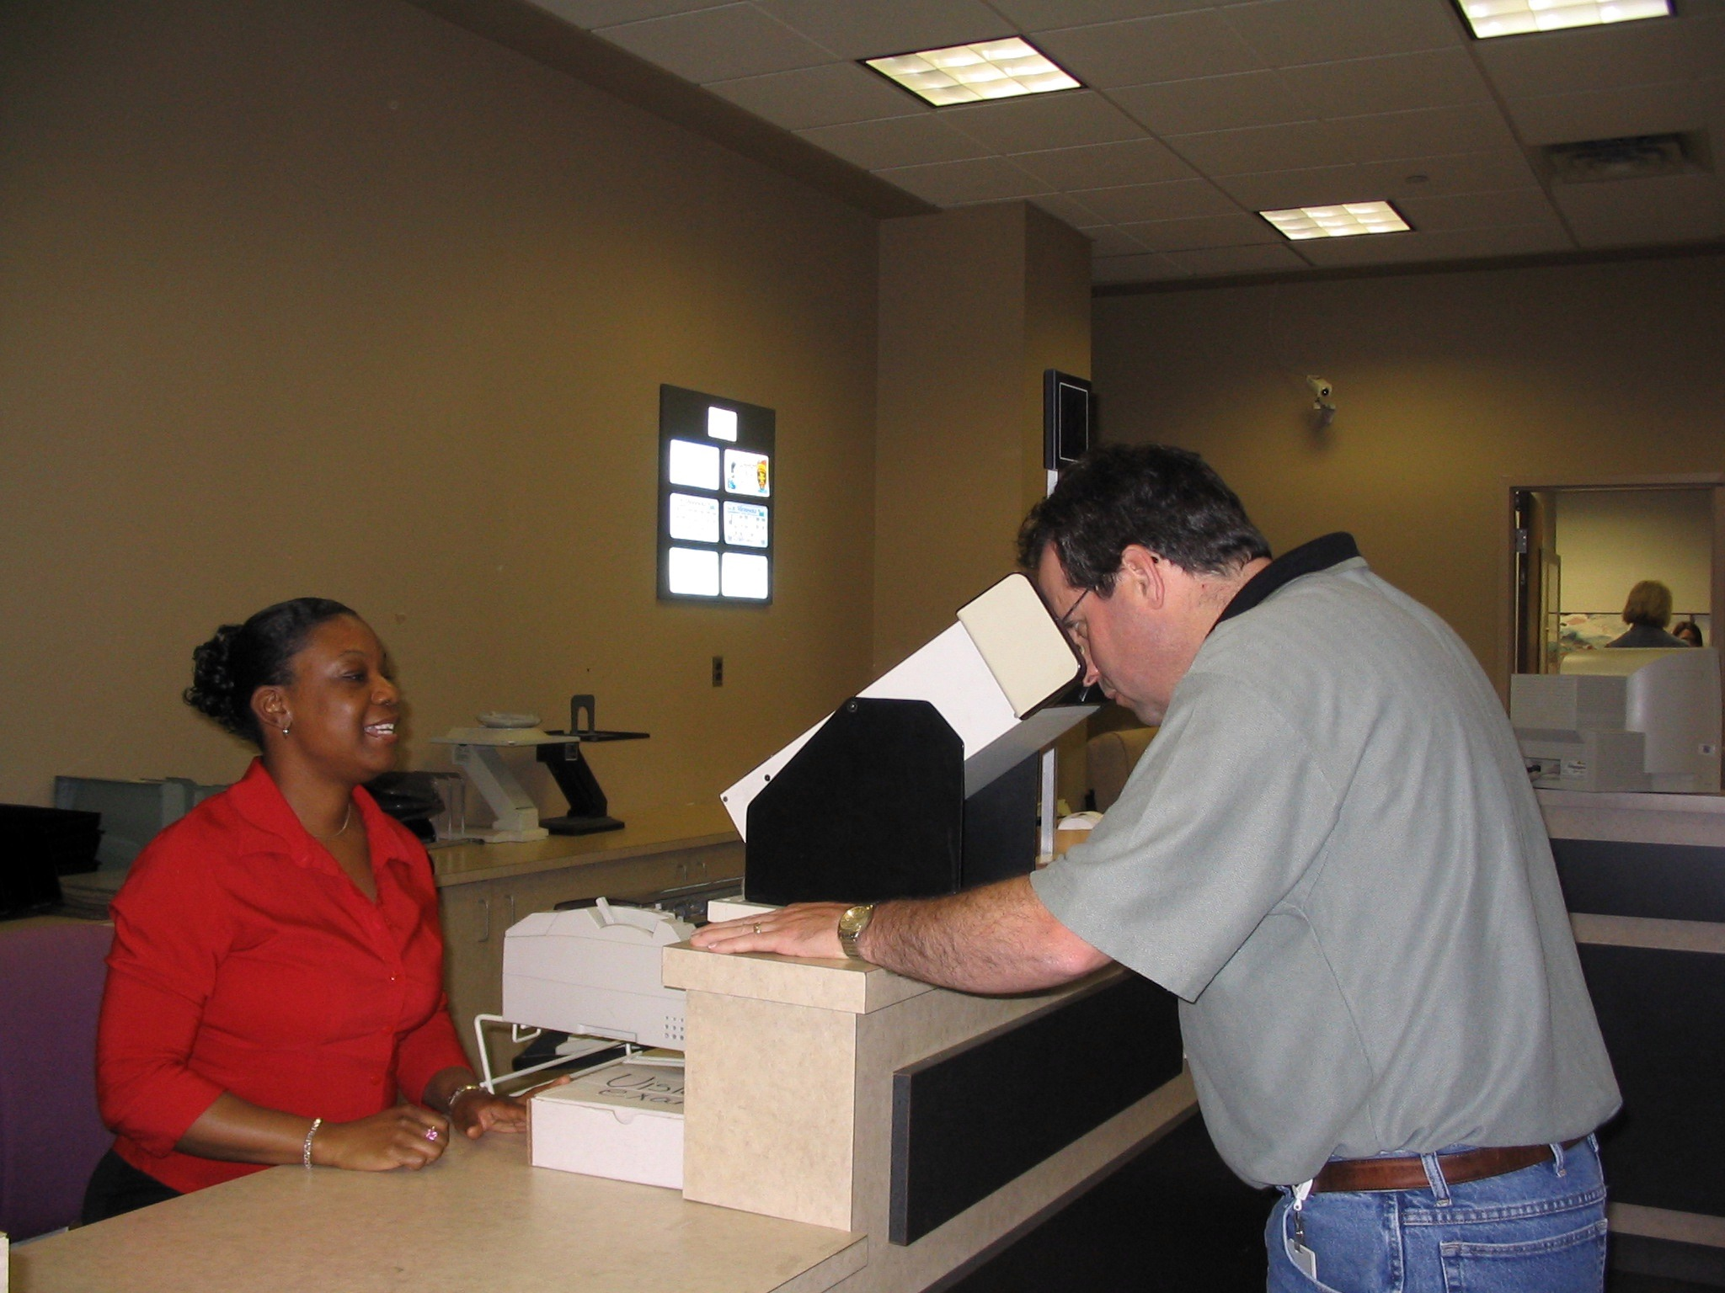

Driver and Vehicle Services
Minnesota Department of Public Safety
DVS Services
Title and Registration
Driver License issuing
Driver Examinations
Driver Compliance
Interstate Trucking and Registration
Auto Dealer Licensing and Inspection
Public Information Center

Slide 17
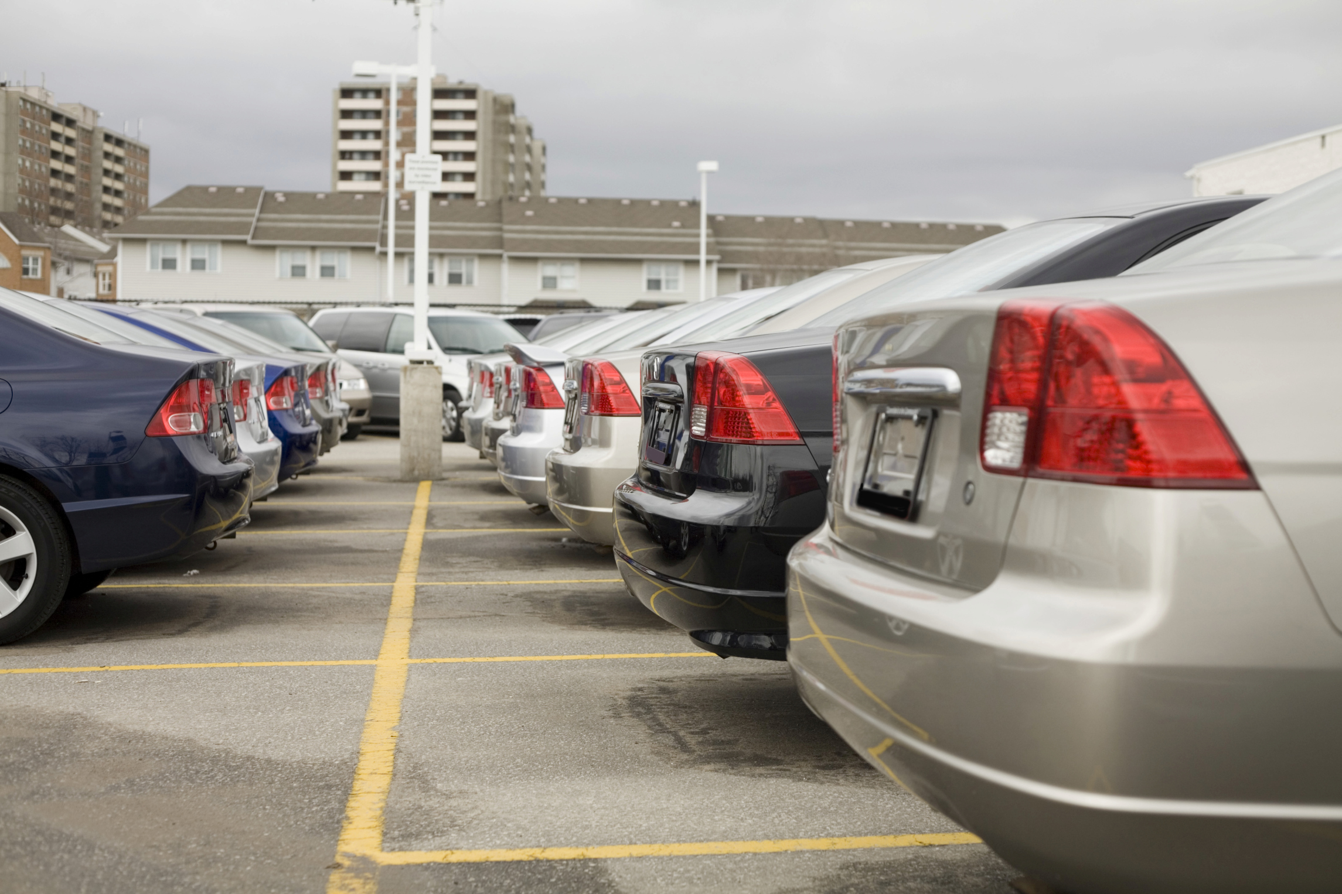
Driver and Vehicle Services
Minnesota Department of Public Safety
DVS has 493 employees working in 95 locations throughout the state.
DVS receives an annual appropriation of approximately $75 million from the Special Revenue Fund and the Highway User Tax Distribution Fund.
DVS collects more than $1.4 billion in state revenue annually.

Slide 18
Office of Pipeline Safety
Minnesota Department of Public Safety

Slide 19
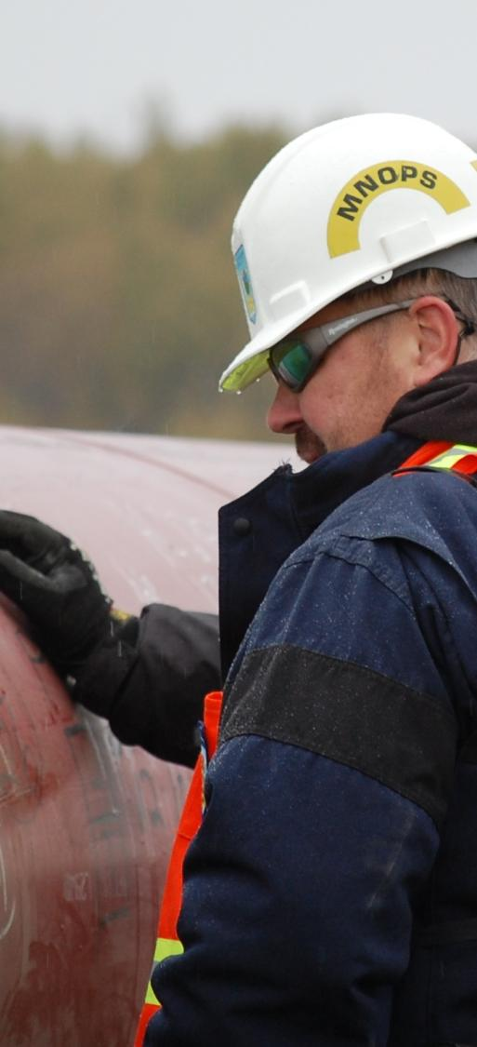

Office of Pipeline Safety
Minnesota Department of Public Safety
Mission
  To protect lives, property, and the environment through the implementation of a program of gas and hazardous liquid pipeline inspections, enforcement, accident and incident investigations, and education.

Slide 20
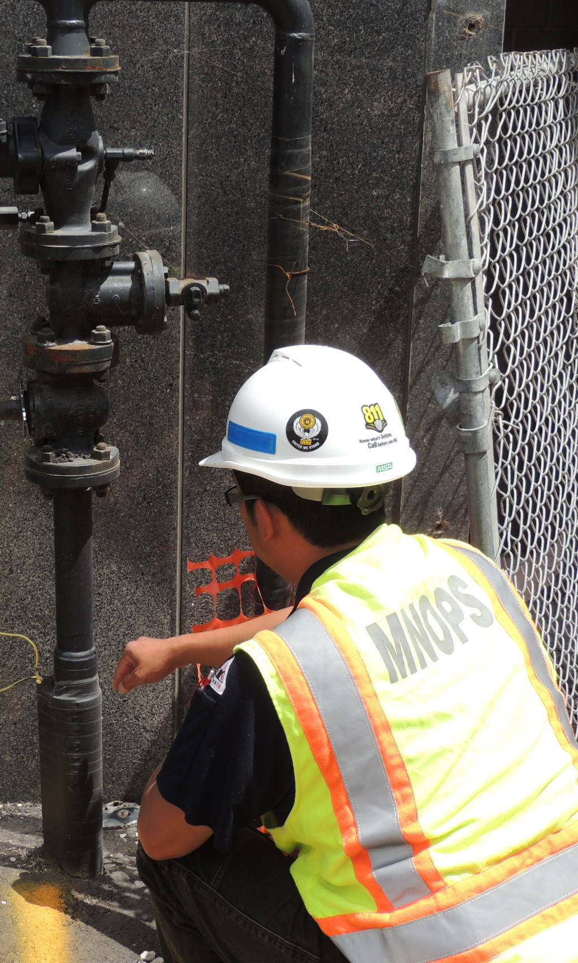
Office of Pipeline Safety
Minnesota Department of Public Safety
MNOPS has annual resources of $3.8 million from Special Revenue and federal funds.
  $1.44 million per year is a direct appropriation derived from inspection fees.
  $2.3 million in federal funds.
  $80,000 in receipts from “One Call” fines.

Slide 21
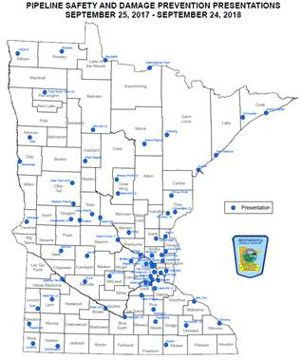
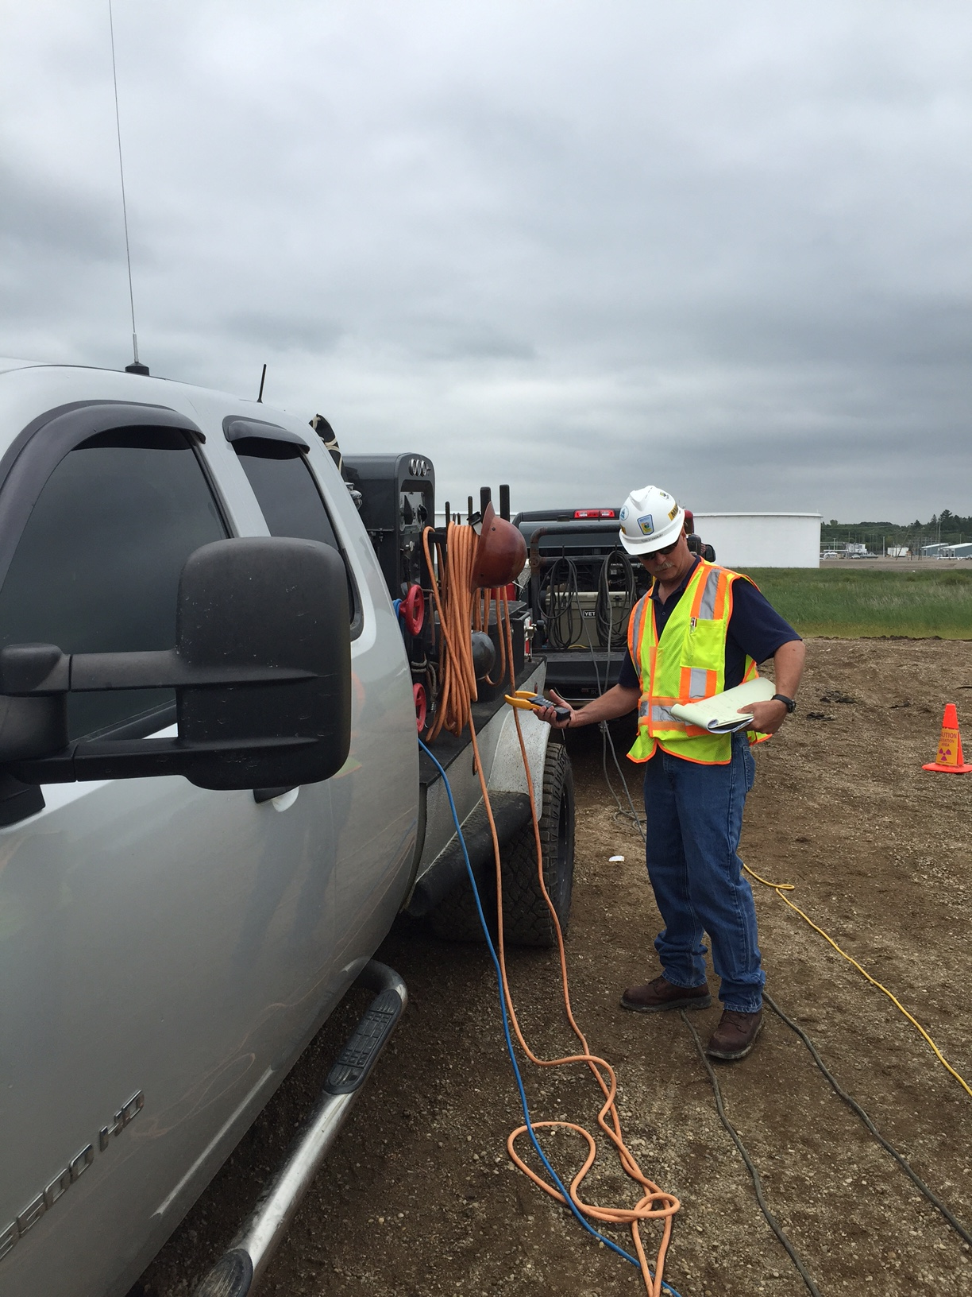
Office of Pipeline Safety
Minnesota Department of Public Safety
MNOPS 2018 Stats:
  “Call-Before-You-Dig” Education provided to over 6,000 individuals
  Over 7,000 hours of pipeline safety inspections, investigations and training.

Slide 22
Questions?

