Slide 1
Governor’s Budget Presentation
Charles A. Zelle, Commissioner
House Transportation Policy and Finance Committee
February 11, 2015

Slide 2
Governor’s Budget Proposal

Slide 3
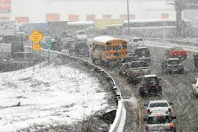
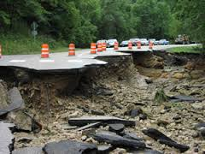
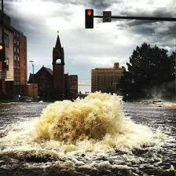
Harsh climate, heavy use
50% state highway pavements over 50 years old; 20% have <3 years useful life
35% of MnDOT bridges over 50 years old
Minnesota weather extremes

Slide 4
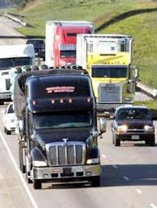
Age and use of system
Tourism has risen 54% since 2000 and is growing
Truck freight projected to increase 30% by 2030
Rail traffic will continue to increase
Nearly 1 million new Minnesotans by 2040

Slide 5
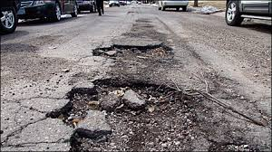
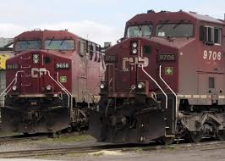
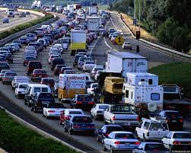
What’s in store
State Highway miles in poor condition will steadily increase from 671 to 1,176 by 2024 - a 75% increase
Traffic congestion and trip reliability will get worse
Millions lost and quality of life suffer due to traffic jams, restrictions on bridges

Slide 6
Funding Scenarios
Description | 10-year Additional Funding Level | Key Outcomes
“Status Quo” MN State Highway Investment Plan | $0 | Manage deterioration on the system 75% more miles in poor condition by 2024 Est. 640+ bridges (20%) in poor condition Limited expansion; spot mobility and safety projects Existing Corridors of Commerce construction projects only Several MnPASS lanes will not be built
“Maintenance” (TFAC Scenario 2) | $2.5B | Maintain current condition of pavements and bridges No expansion beyond what is currently programmed
 | $6B | Preservation / Modernization ($4B) including: Improve 2,200 additional miles of pavement; 330 state bridges Structural enhancements extending service life; improving safety, access and performance Strategic expansion ($2B) including: Expand MnPASS system Construct Corridors of Commerce projects Complete strategic projects; such as TH14, TH53, TH23, I-94 reconstruction
“Economically Competitive” (Governor’s Recommendation)

Slide 7
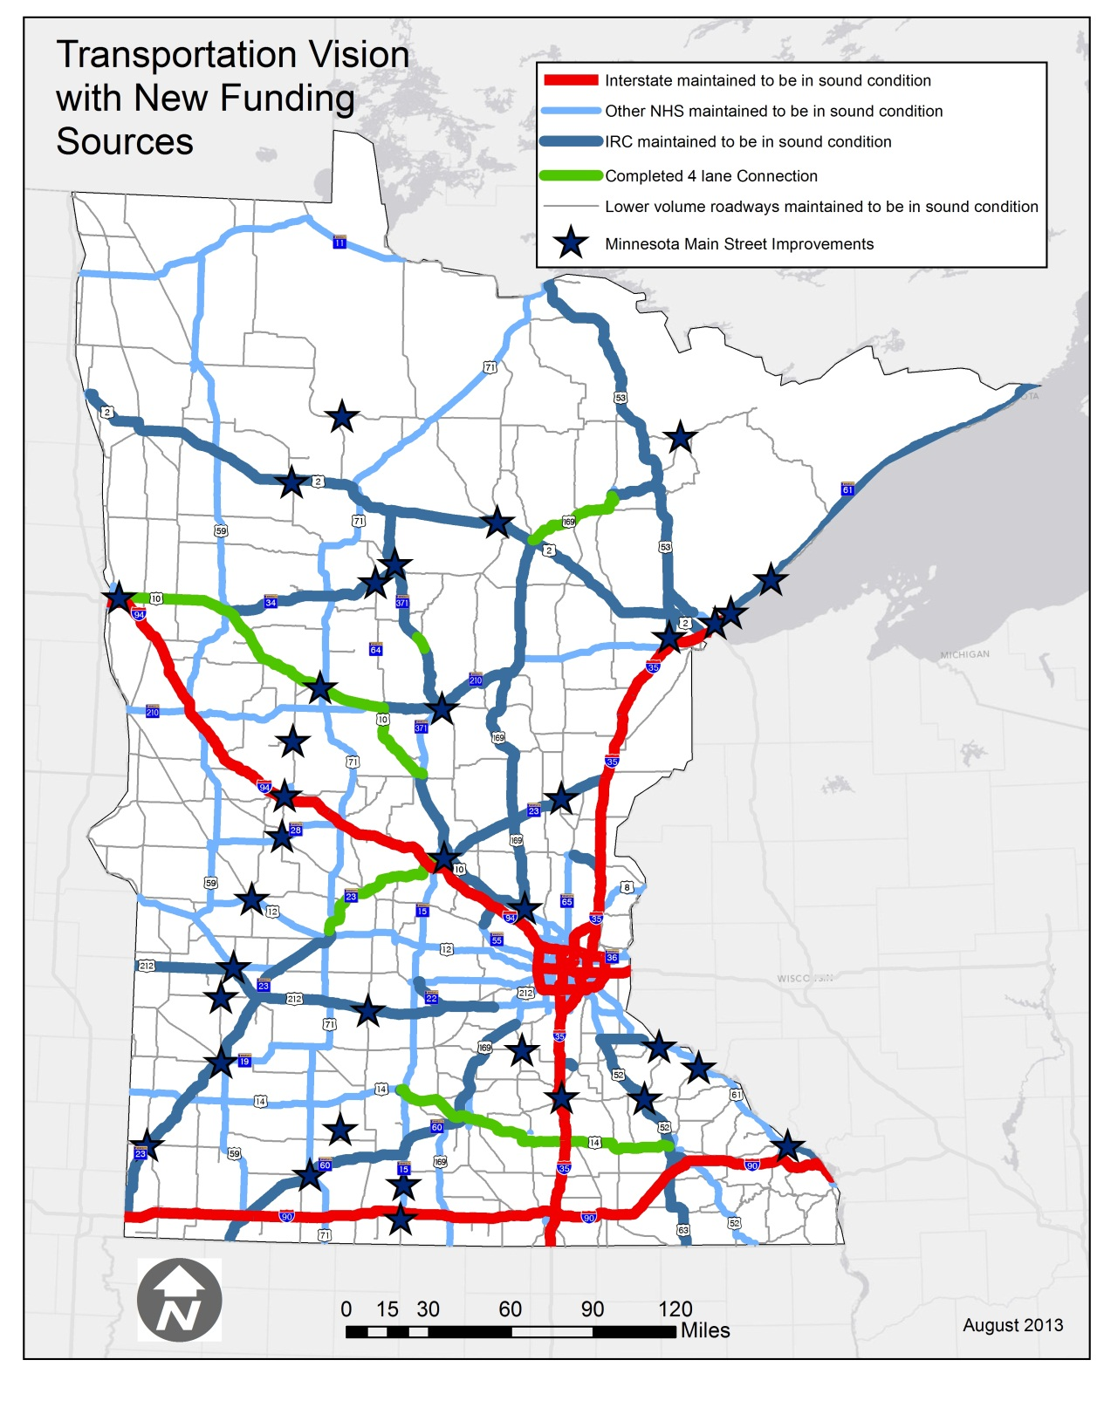
With new funding sources ….
Improve Asset Management
Preserve and modernize the existing system
Expand MnPASS
Strategic expansion on key corridors through Corridors of Commerce
Main Street improvements

Slide 8
NexTen Strategies
Pavements –Increase longer term improvements targeting investments on segments with no remaining service life while increasing investment in preventive maintenance
Bridges – Accelerate planned improvement program while expanding preventive maintenance program
Twin Cities Mobility- Prioritize expansion of MnPASS system and strategically add capacity through improvements to intersections, interchanges, and lane additions to address continuity
Greater Minnesota Mobility – Increase the capacity of the Interregional Corridor (IRC) network

Slide 9
NexTen Strategies
Safety – Focus investment on low to mid cost improvements along corridors and at intersections
Bicycle Infrastructure – Expand in-town network via solicitation program or local planning assistance; expand state bikeway network; focus on separated bicycle facilities (still on trunk highway ROW)
Pedestrian Infrastructure – Address sidewalk deficiencies; fill gaps in sidewalk network; expand sidewalk network

Slide 10
NexTen Strategies
Roadside Infrastructure – Meet recommended condition targets for aging roadside infrastructure, (e.g. culverts, overhead signs, signals)
Facilities – Renovate or replace aging rest areas, weigh stations, and other MnDOT support buildings (truck stations, offices, etc.)
Local Partnerships- Increase partnerships with local communities, establish “Main Street” solicitation program to address both statewide and local objectives, support transfer of road ownership where agreements are in place.

Slide 11
NexTen for Transportation 10 year Investment Plan
Commit to a long term investment plan for roads and bridges
$6 billion gap estimated between funding needs and revenues for roads and bridges over the next ten years
Funding Components:
New revenues dedicated to roads and bridges
Implement a 6.5% gross receipts tax on fuel with a $2.50 wholesale price floor
Increase registration fees for motor vehicles from 1.25% to 1.50% and base tax from $10 to $20 over four years
Authorize $2 billion in bonds over the next 10 years
Leverage MnDOT efficiencies (up to 15% of the new revenue)
Governor recommends appropriating existing fund balance for roads and bridges and to restore purchasing power to MnDOT’s operation

Slide 12
NexTen for Transportation 10 year Investment Plan
$6 billion for state roads and bridges
$5.38B from new revenue and bonding
$.62B in efficiencies
Outcomes include:
2,200 miles of roadway repaired/replaced
330 bridges
$1.6 billion Corridors of Commerce
$2.356 billion for counties, cities, and townships

Slide 13
Gross Receipts Tax on Fuel
Adheres to language in Minnesota’s Constitution dedicating revenue to highways
Charged at wholesale level - % of average wholesale price of fuel over 12-month period
Revenue amount converted to a Per-Gallon Equivalent
Keeps pace with construction costs – similar to sales tax
12 other states have implemented similar funding solutions

Slide 14
NexTen for Transportation 10 year Investment Plan
$120M in General Fund investment for Greater Minnesota Transit
90% of forecast need for Greater MN transit
Integrated transportation system that improves movement across the state
$75M for bike and pedestrian infrastructure
Including Safe Routes to School

Slide 15
NexTen for Transportation SFY16-17 Trunk Highway Fund Investment
$699.984 million total new Trunk Highway Fund Investment for SFY16-17
$650.984 million for state road and bridge funding.
$49.0 million to offset increased costs due to inflation.
Of the $699.984 million, $168 million is from the existing fund balance.

Slide 16
NexTen for Transportation SFY16-17 General Fund Investment
Increase Greater Minnesota transit - $10 million for the biennium
$10 million base increase for subsequent years.
Increase bike and pedestrian infrastructure, including Safe Routes to School
$2.5 million base increase

Slide 17
Additional Investment at a Glance
$11.351B
$8.356B
Roads and Bridges
$.075B
Bike and Ped
$2.92B
Transit
$6B State road
$5.38B investment
$.62 efficiencies
$2.356B County, City, Townships
$2.8B Twin Cities Metro
$.120B Greater MN Transit

Slide 18
Snap Shot of New Revenue Estimates
($1,000s) | FY 2016 | FY 2017 | FY 2018 | FY 2019
Net Wholesale Gross Receipts Tax | 326,154 | 470,230 | 464,857 | 462,942
Registration Taxes | 40,775 | 86,258 | 112,866 | 165,385
Total, HUTD Fund | 366,929 | 556,488 | 577,722 | 628,327
Trunk Highway | 211,244 | 320,740 | 333,327 | 363,162
County State Aid | 98,808 | 150,024 | 155,911 | 169,866
Municipal State Aid Streets | 30,665 | 46,559 | 48,386 | 52,717
5% Setaside (CSAH) | 17,932 | 27,228 | 28,296 | 30,829
DNR | 8,280 | 11,938 | 11,801 | 11,753
Total Distributions | 366,929 | 556,488 | 577,722 | 628,327

Slide 19
Additional Governor’s Budget Requests
SFY 16-17

Slide 20
MnDOT Change Items at a Glance
Change Item | Fund | FY 16-17 Total
NexTen for Transportation | Trunk Highway | $699,984
NexTen for Transportation | General – Expend | $15,170
NexTen for Transportation | General – Revenue | $(4,220)
State Road Construction Appropriation | Trunk Highway | -
Rail Grade Crossing Safety Improvements | Special Revenue | -
Airports Appropriation | State Airports | $11,000
State Plan Purchase | General | $9,960
Civil Air Patrol | State Airports | -
Land Conveyance Funding | Trunk Highway | -
Environmental Management Funding | Trunk Highway | $2,000
Appraisal Waivers | Trunk Highway | -
Utility Relocation | Trunk Highway | -
Snow and Ice Contingency | Trunk Highway | -
2012 Flood Appropriation Date Changes | Trunk Highway | $7,804
2014 June floods – local roads FHWA match | General | -
Software Development | Trunk Highway | -
Tort Claims | Trunk Highway | -
Aeronautics Network Approp Transfer | State Airports | -

Slide 21
Rail Grade Crossing Safety Improvements
Minnesota has experienced increased rail traffic in various regions of the state primarily due to hauling crude oil and the increase is expected to grow by 25-40% by 2030
The Governor recommends an annual assessment on the four class 1 rail companies operating in Minnesota of $32.5 million a year to fund safety improvements
The “Improvements to Highway – Rail Grade Crossings and Rail Safety” study identifies $240 million in priority grade rail separations and other types of improvements on 100 other crossings
The 10-year capital improvement program is estimated to cost $325 million, or $32.5 million each year

Slide 22
Federal Funding Authority (SRC)
Increase the appropriation of federal funds for State Road Construction by $46.995 million in FY16 and $50.295 million in FY17
The funds are already programmed for projects in the 2015-18 STIP (Statewide Transportation Improvement Plan)

Slide 23
Airports Appropriation
$11 million one-time appropriation from the State Airports Fund ($5.5 million each in FY16 and FY17)
Provides additional funding for construction, pavement maintenance, other improvements at state’s 135 airports
In FY14 the State Airport Fund was repaid $15 million from the State’s General Fund
In FY14 and FY15 the Airport Development and Assistance appropriation was increased a total of $4 million
This appropriates the remainder

Slide 24
Airports Appropriation
To ensure this increase in spending authority is fully utilized we propose:
The State continues to contribute 5% toward the local match for 90% federally funded projects - 90/5/5 instead of 90/10
The State continues increases in the state share established for FY 2014 and FY 2015 state-funded projects
A change in statute to allow flexibility of the state participation rate in the future – match requirements were suspended temporarily last year

Slide 25
State Plane Purchases
Purchase two newer aircraft by using $9.96 million in general funds combined with the proceeds from the sale of two King Air aircraft - 33 and 21 years old
The age of the current aircrafts causes high down time for repairs and maintenance and increased operating expense
Nationally recognized aviation consultant examined our operation and recommended a fleet replacement plan

Slide 26
Civil Air Patrol
Increase the rider appropriation to the MN Civil Air Patrol (CAP) from $65,000 to $80,000 annually from the Aeronautics operating appropriation; net $0 change to the fund
The last increase was in 1987
CAP is the official civilian auxiliary of the United States Air Force – a volunteer organization. This is their only source of funding
CAP’s Minnesota mission: search and rescue, emergency services, aerospace education, cadet training
Advances MnDOT’s statutory responsibility of aviation education

Slide 27
Land Conveyance
Authority to use non-dedicated trunk highway revenue in account for property sales and leasing of surplus right of way
Use to fund a land conveyance shared services unit
It is estimated that property sales revenue would increase by $1 million and lease revenue by $300,000 annually

Slide 28
Environmental Management Funding
$1 million dollar appropriation from the Trunk Highway fund to be used for management of contaminated soil and regulated material on MnDOT owned property

Slide 29
Appraisal Waivers
Allow the use of appraisal waivers for parcels purchased under $25,000 in lieu of a full appraisal
Land owners would retain the right to request a full appraisal
Currently this would impact about 64 parcel purchases a year with the money savings going to other needed right of way services

Slide 30
Utility Relocation
Statute Revision to not require the state to pay for the relocation of an existing utility within the interstate right-of-way. This would apply only to utilities installed after passage of this change
The number of permits to locate utilities within the interstate right-of-way is increasing; the number is approximately double in 2014 from 2011
Removal costs can be a material part of a construction project, and are often placed back in an interstate right- of-way after construction

Slide 31
Snow and Ice Contingency
Establish a snow and ice contingency open appropriation that would allow the agency to draw from the fund balance once annual agency costs exceed 110% of the annual beginning budget
Winter snow and ice costs vary from year to year and managing the uncertainty of costs compromises other maintenance activities
It is a priority to provide a consistent level of service to the 12,000 miles of state highways, but it is expensive and labor intensive
In “bad” winters a contingent appropriation would allow service to continue at the level expected and summer maintenance –including preventative and preservation work - to continue at planned levels

Slide 32
Snow and Ice Costs

Slide 33
2012 Flood Appropriation Date Change
Extend the expiration date of the Trunk Highway funds appropriated in 2012 for damage sustained in flooding from June 30, 2015 to June 30, 2018
Jay Cooke State Park is the primary reason for the extension. Design issues and construction seasons have caused delays in the start of this project
The project has a planned letting date in March of 2015

Slide 34
Software Sales and Licensing Revenue
Require that the proceeds from the sale or licensing of any software developed with Trunk Highway funds be deposited into the Trunk Highway fund rather than deposited in the MN.IT services revolving fund
No sales are currently pending, but MnDOT spends substantial trunk highway dollars on software development
Minnesota Pollution control agency currently has a similar law

Slide 35
Tort Claims
The amount appropriated to Minnesota Management and Budget to pay MnDOT’s tort claims be appropriated directly to MnDOT for the same purpose - $600,000 per year
Aeronautics Network Appropriation Transfer
Transfer $25,000 from the Agency Management budget activity in the State Airports Fund to the Aeronautics budget activity to be used for the same purpose

Slide 36
Questions?
Tracy Hatch
Deputy Commissioner
Chief Financial Officer
Chief Operating Officer
651.366.4811
tracy.hatch@state.mn.us

