Slide 1

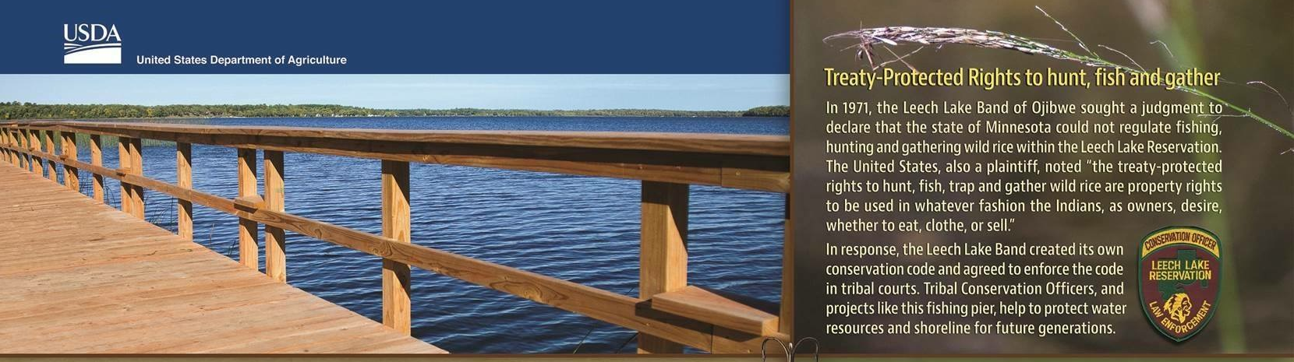
MnDOT Office of Tribal Affairs and Indian Country
Office of Tribal Affairs

Slide 2
Who Are The Tribal Governments
Why Do We Have A Relationship With Tribes
What Do We Do To Facilitate Better Working Relationships With The Tribes

Slide 3
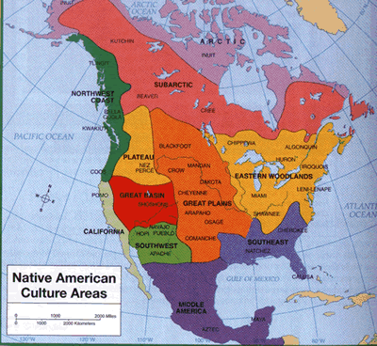
Indian BeforeColonization
Indian Lands Before 1492

Slide 4
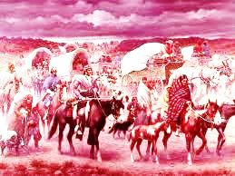
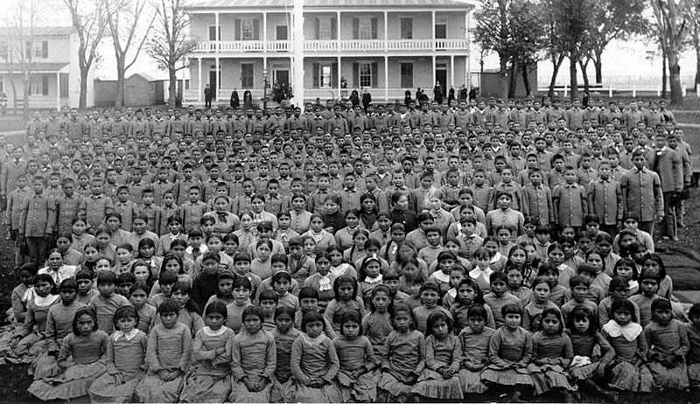
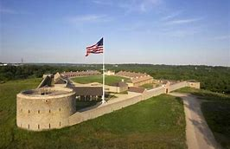
Federal Indian Policy
Establishes relationship between the United States Government and Indian Tribes
U.S. Constitution (Art. VI) gives the federal government responsibility for dealing with tribes
Seven time periods of federal Indian policy
  1492-1787: Tribal Independence
  1787-1828: Agreements Between Equals
  1828-1887: Relocation of the Indians
  1887-1934: Allotment and Assimilation
  1934-1953: Indian Reorganization
  1953-1968: Termination
  1968- Present: Tribal Self-Determination

Slide 5
Federal Recognition of Tribes
In the legal-political sense, tribal existence results from recognition under federal law
US Constitution
Binding Treaties
Acts of Congress
Presidential Executive Orders

Slide 6
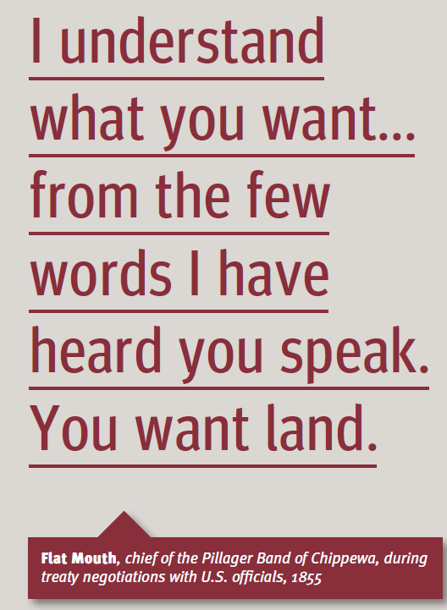
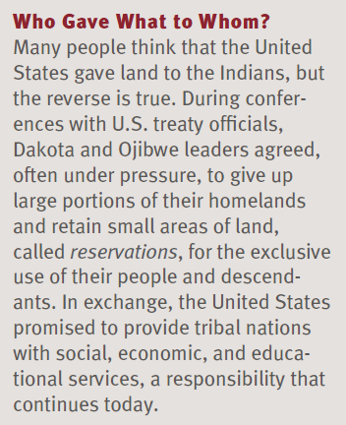
Source: Why Treaties Matter – Banner 6
http:Treaties Matter.org/exhibit

Slide 7
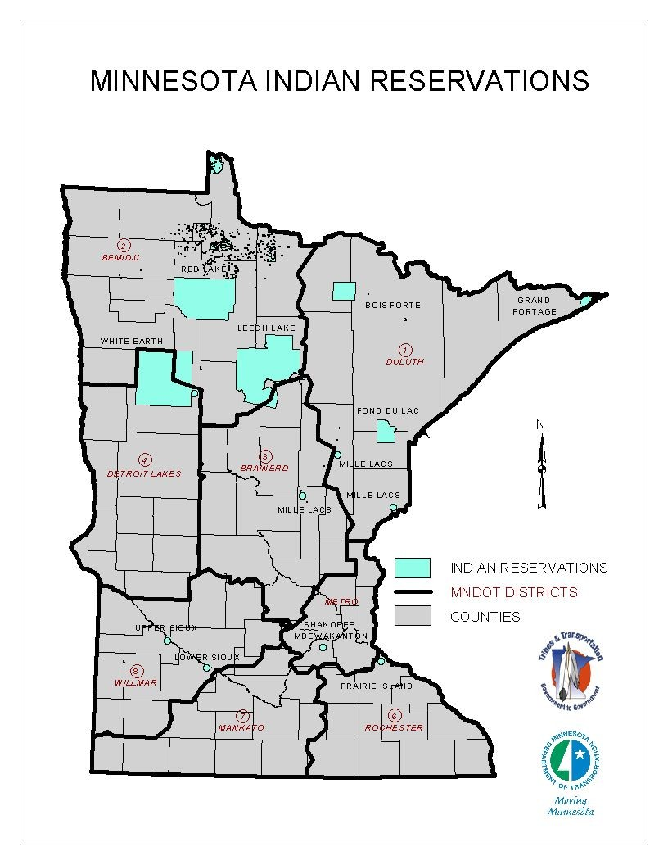
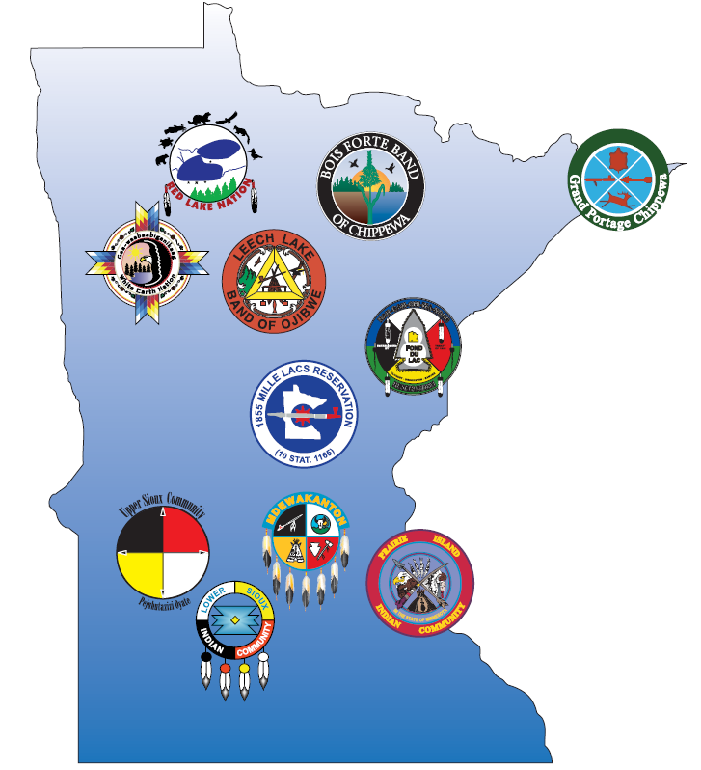
Tribal Governments in Minnesota
Bois Forte
Fond du Lac
Grand Portage
Leech Lake
Mille Lacs
White Earth
Red Lake
Lower Sioux
Prairie Island
Shakopee Mdewakanton
Upper Sioux
Notes:
7 Ojibwe Tribes: Red Lake, Bois Forte, Grand Portage, White Earth, Leech Lake, Fond du Lac and Mille lacs
4 Dakota Tribes: Upper Sioux, Shakopee Mdewakanton, Prairie Island, and Lower Sioux

Slide 8
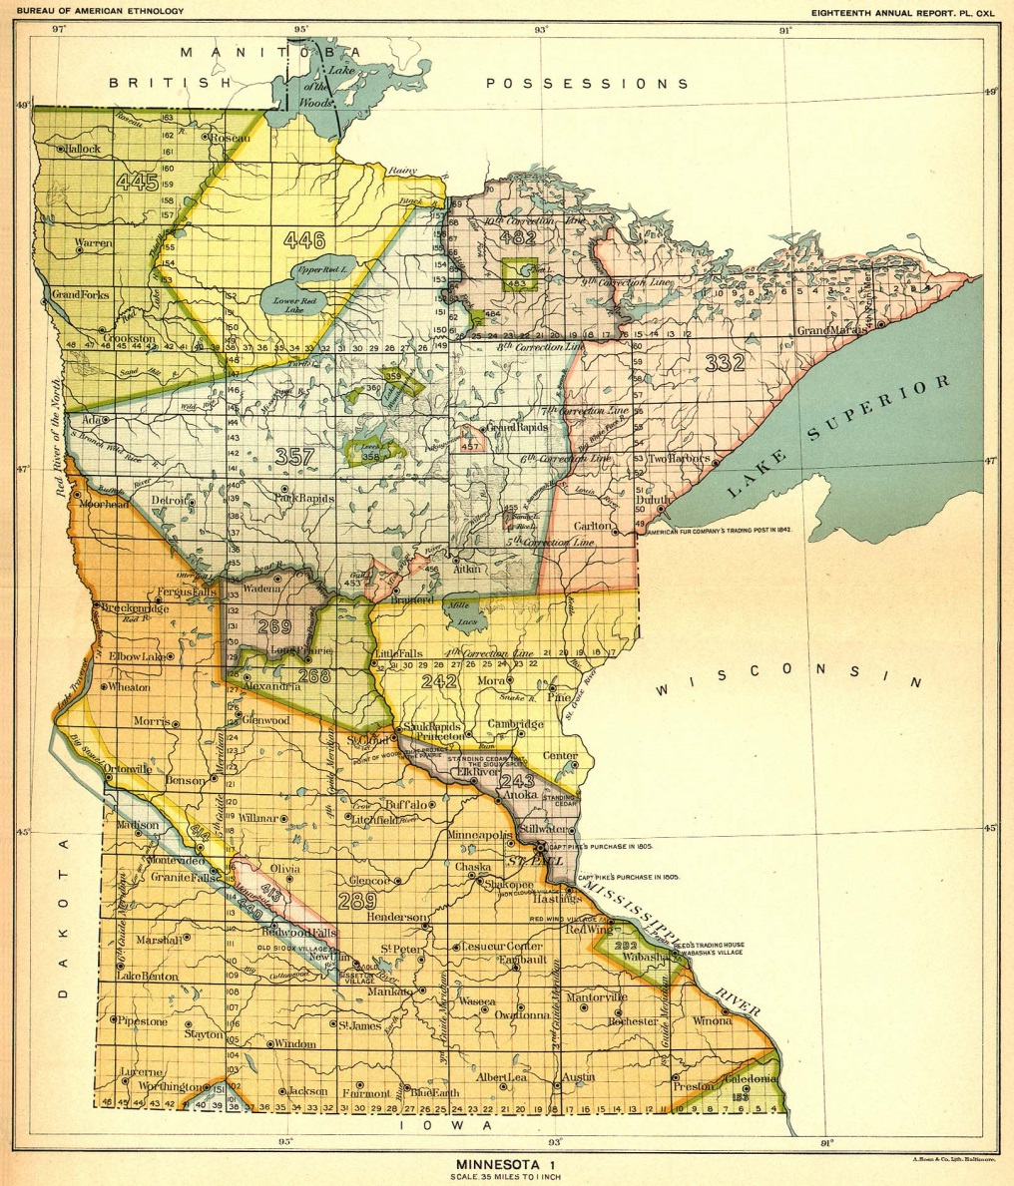
Indian Country
“Indian Country”
is a legal term of art
It is generally within these areas that tribal sovereignty applies and state power is limited
  Indian reservation
  Tribal trust lands
  Indian allotments
  Dependent Indian Communities
Notes:
The ceded territories are lands once owned by the Ojibwe & the Dakotas
The ceded territories includes all of MN
Certain rights & privileges have been retained by American Indians either expressly included in treaties or never given up in a treaty.

Slide 9
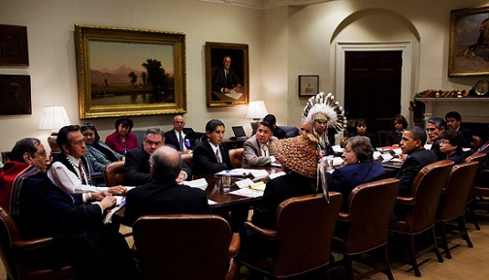

Things to Remember
Sovereignty, Federal Indian Law and Indian Country
Tribes are established governments with significant authority and a responsibility to their constituents.
Tribes have retained sovereignty, they were not granted anything. U.S. Supreme Court.

Slide 10
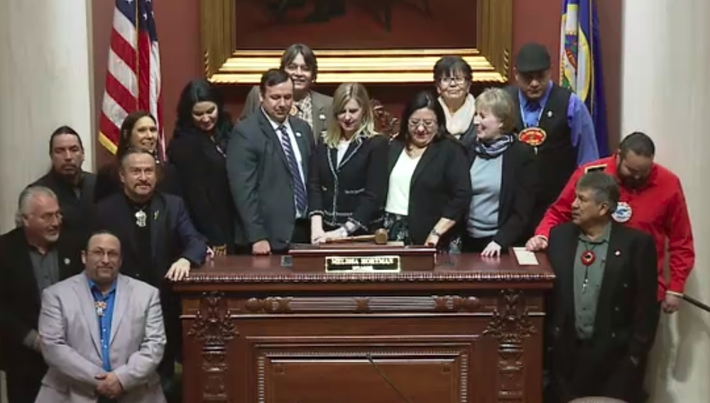
Tribal Sovereignty – Rights and Power of Tribal Nations
Form its own government
Self-governed
Adjudicate legal cases within its borders
Levy taxes within its borders
Establish its membership
Decide its own future fate
Nation to nation relationship with the U.S.
The federal government has a
trust responsibility to protect
tribal lands, assets, resources and treaty rights

Slide 11
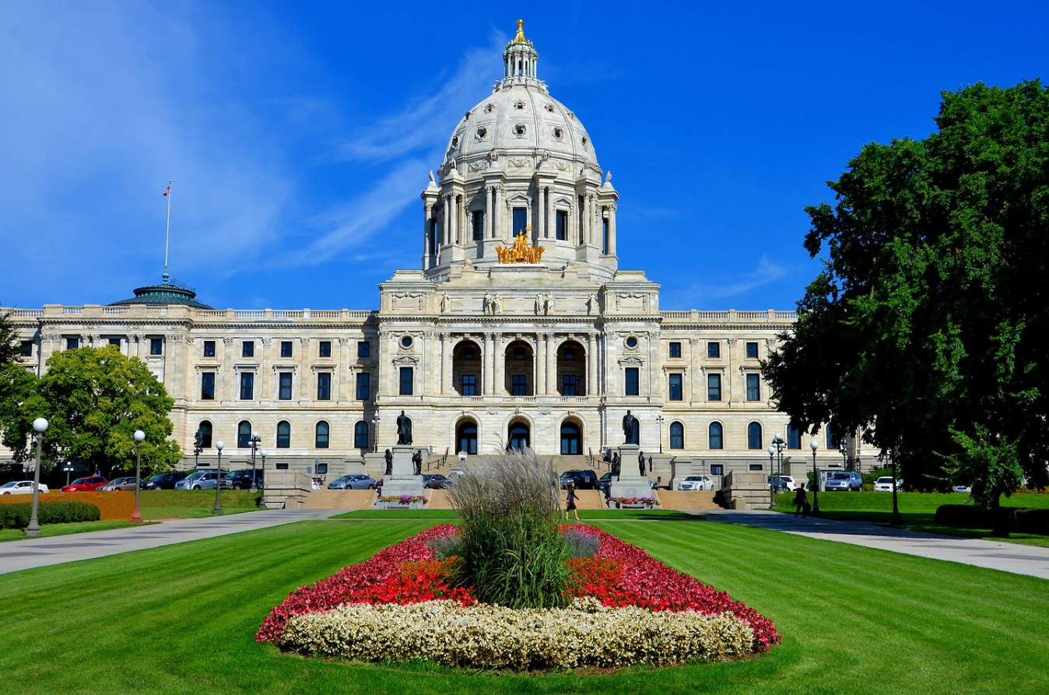
Minnesota Statute §10.65
“…(c) Consultation is a duty of an agency to consult with the governing body or bodies of each individual Minnesota Tribal government. Coordination with groups or entities that have representation on some or all of the governing bodies of the Minnesota Tribal governments, such as the Minnesota Indian Affairs Council or the Minnesota Chippewa Tribe, is encouraged but does not satisfy an agency's duty to consult with individual Minnesota Tribal governments on matters that have Tribal implications …”
“… An agency must update the Tribal consultation policies as often as required in order to facilitate timely and meaningful consultation, but no less than biannually.…”
“… "matters that have Tribal implications" means rules, legislative proposals, policy statements, or other actions that have substantial direct effects on one or more Minnesota Tribal governments … “

Slide 12
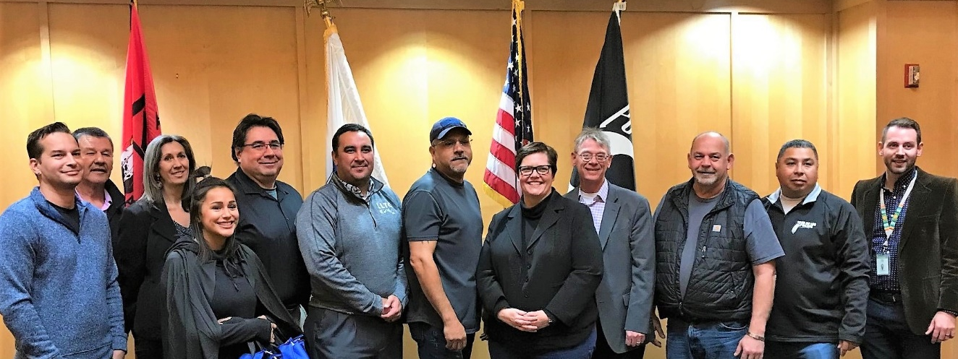
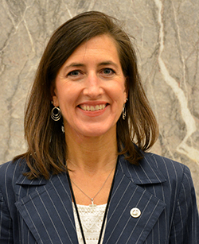
Strong Policies Ensure Meaningful Consultation with Tribal Governments
Consultation: Government to government
  Governor/Commissioner and Tribal Nation Leaders
  Must be “meaningful” and “timely”
Coordination: Implementation at technical level
  Planning, Partnerships, Projects
  11% of our transportation infrastructure is within Indian Country
Notes:
Governor Mark Dayton signed Executive Order 13-10 affirming the Government-to-Government relationship between the State of Minnesota and the Minnesota Tribal Nations: Providing for Consultation, Coordination and Cooperation.
This resulted in the establishment of 11 Minnesota State Agency policies on Consultation with Minnesota Tribal Nations in order to promote successful consultation and collaboration between tribal governments and the state. The purpose of the policy is to develop, improve, and maintain collaborative relationships between the Department and Minnesota Tribal Nations.

Slide 13
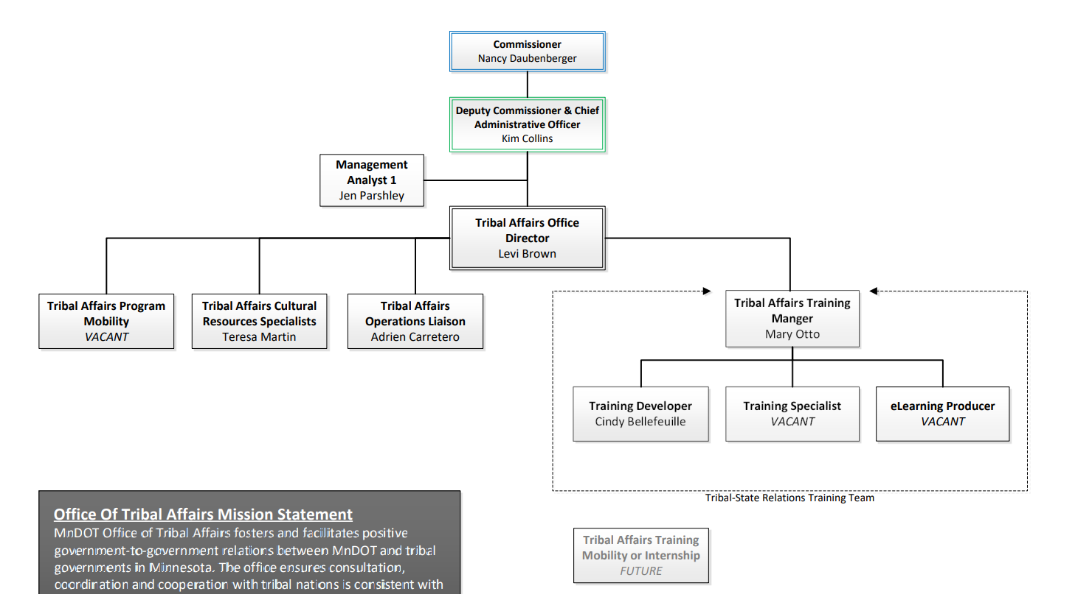
MnDOT Tribal Affairs Office Organizational Chart

Slide 14
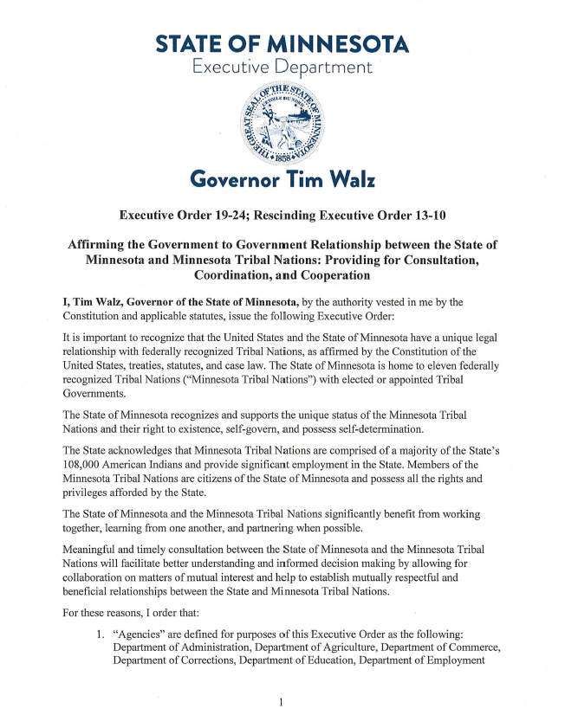
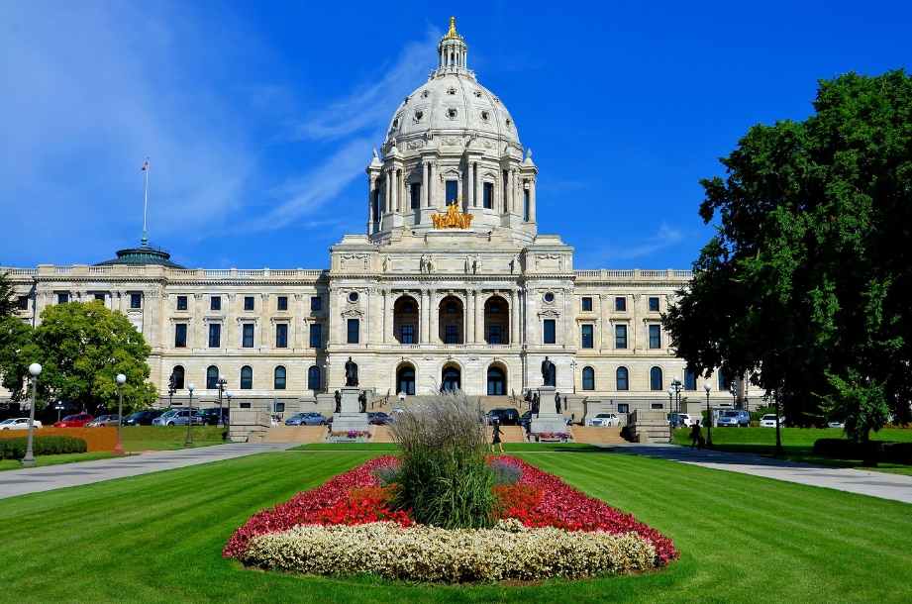
What do we do to facilitate better working relationships with Tribal Nations?
Tribal Liaison Role
Comply with Minn. Stat. 10.65
Comply with MnDOT Tribal Policy
Build Relationships
  Tribes & Transportation Conference
  Advocacy Council for Tribal Transportation
  Meeting with tribal governments and staff
Create Partnerships
  Employment, Safety, Construction Projects, Roadside Vegetation
  Management, Environmental
Education on tribal issues

Slide 15
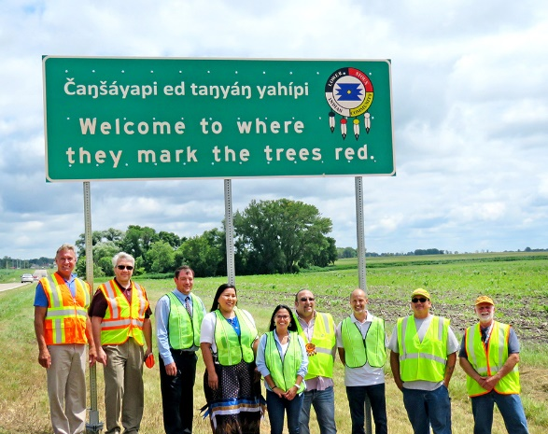
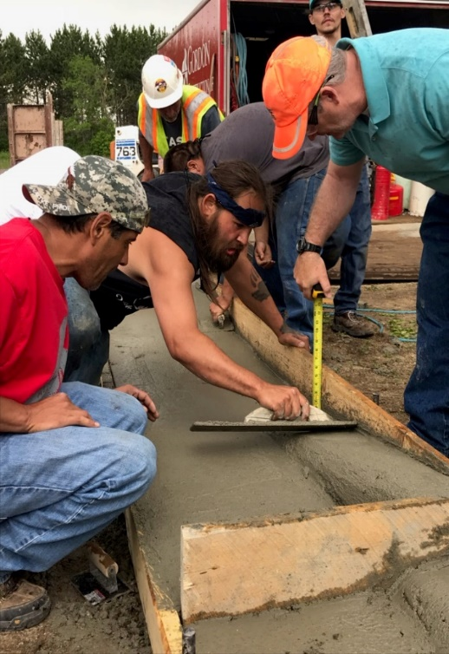

MnDOT policies and programs directly affect
Indian tribes and their members
Trust Lands: Rights-of-Way
Indian Employment on/near reservations (Workforce and businesses)
Historic & Cultural Preservation
Road Safety
Reservation Road Signs
Transportation Planning
Partnering on Highway projects

Slide 16
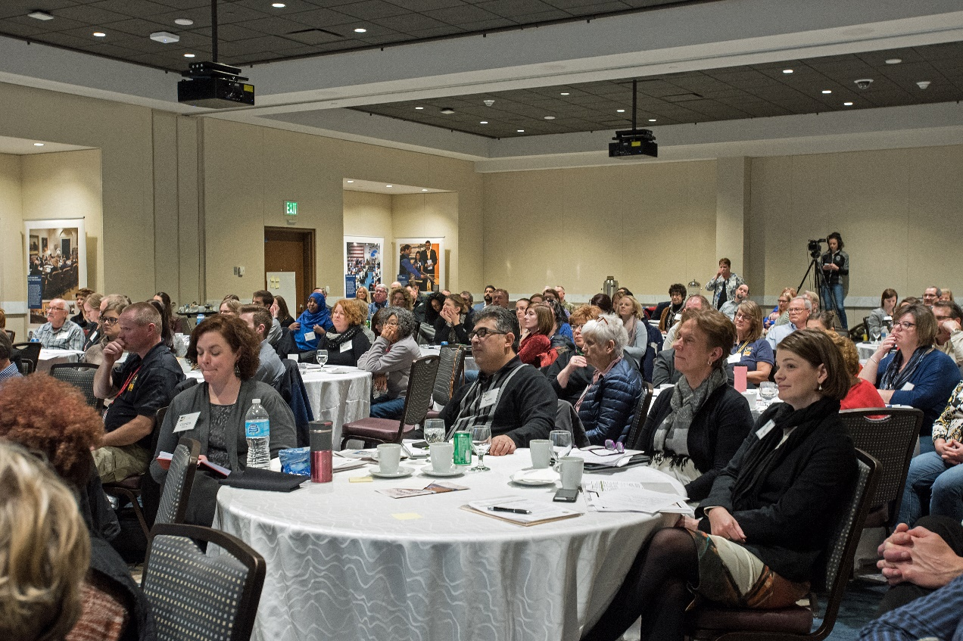
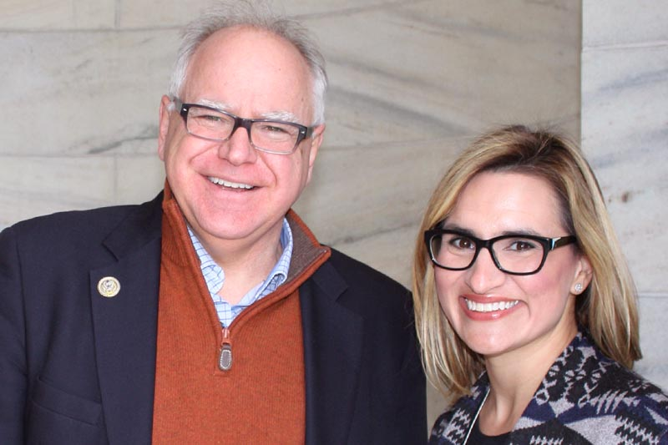
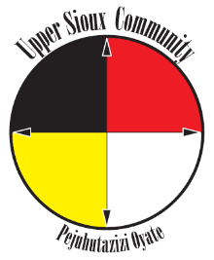
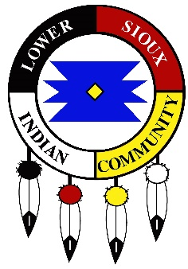
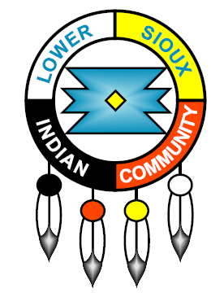
Tribal State Relations Training
Over 5,000 state employees trained

Slide 17
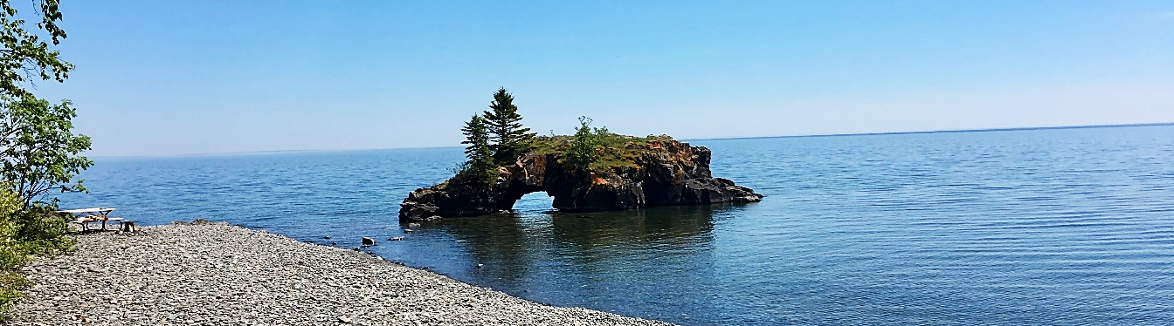
Miigwech! Thank you!
Levi Brown
MNDOT Director of Tribal Affairs
Levi.Brown@state.mn.us

