Slide 1
Workforce Housing Is Big News Today
For Polaris firm in Roseau, providing housing for workers is one way to address regional shortage
Low rents in rural Minnesota stymie new housing
Polaris tackles housing, worker shortage in Roseau
Northwest Minnesota struggles with labor, housing shortages
Legislative Session 2015: Seeking Solutions to the Workforce Housing Shortage
Roseau’s economic expansion hampered by housing shortage
Rural Housing Shortage, Catch – 22
Rural America’s Silent Housing Crisis
Northwest Minnesota manufacturer provides housing for workers to address regional shortage
KANSAS

Slide 2
Insufficient Workforce Housing a major problem in Roseau County
Local economy has rebounded from recession and significant hiring of new employees is occurring, many from outside of the Roseau County
Local employers and new employees find rental housing harder and harder to obtain
Adequate housing availability becomes a major factor in the ability to attract new employees for growing businesses across Roseau County and NW Minnesota
Local industry and community leaders begin to discuss the issues surrounding the lack of housing for new employees and housing industry experts are brought into the discussion.
The magnitude and causes of the housing shortage are not immediately understood.

Slide 3
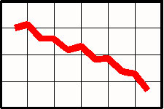
2012 Roseau County Market Study Commissioned
FINDINGS
Rapidly declining unemployment rate in the County and heavy importation of new workers
Extremely low vacancy rates for market rate rental housing (0-2%) with the addition of no new stock
Low rental rates across the county with a median rental rate of $555
Projected demand for 153 new market rate rental units by 2020
Projected demand for 67 new affordable rental units by 2020
Projected demand for 147 new owner-occupied housing units by 2020

Slide 4
Market Not Meeting Workforce Housing Demand
Premise:
If there is such a strong demand for workforce housing, than developers will be attracted to supply new housing units to meet that demand.
Reality:
A multitude of economic factors in small rural communities lead to inefficiencies in the housing market, ultimately limiting the ability to supply new housing units to meet the growing workforce housing need.

Slide 5
Rural Housing Market Obstacles
Small rural populations are limited markets (e.g. Apartment Complexes are general only efficiently constructed at 24 or more units – a high threshold to meet for a small community).
Construction costs have increased at levels that far exceed the average wage increases in most rural communities.
Market valuation gaps between construction cost and market value are common in small rural areas, particularly at the high end.
Market rents in most small rural communities are far lower than those necessary for new construction again creating financing issues for new projects.
Lack of capital, professional developers and contractors in rural areas limit capacity for new housing construction.
No programs/incentives for market rate housing.

Slide 6
Workforce Housing Example
30 Unit Parkland Place Workforce Housing Apartment Project -$3.277 million (Projected Rents $850/mo.)

Slide 7
Workforce Housing Example
30 Unit Parkland Place Workforce Housing Apartment Project -$3.277 million (Projected Rents $850/mo.)

Slide 8
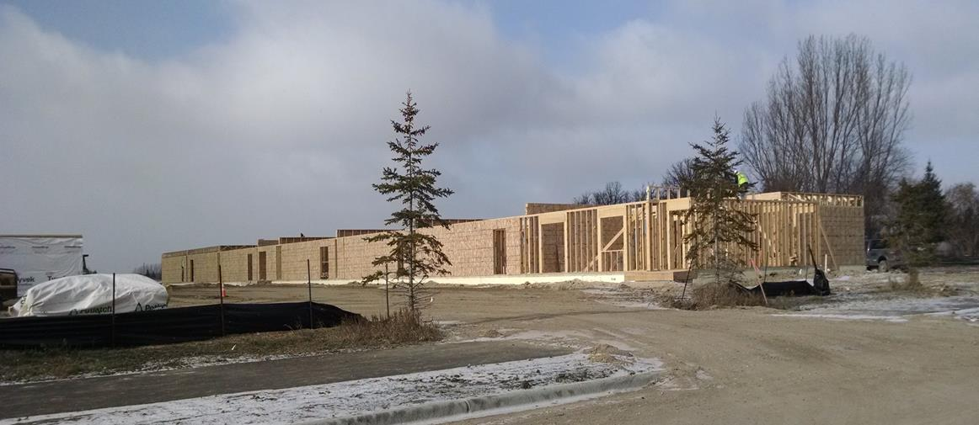
Multi-Family Workforce Housing Initiatives
Parkland Place Apartments (30 units) and Tamarack Place Apartment (41 units) are two new apartment projects underway in Roseau. Both projects have been assisted with Workforce Housing funding from the State of Minnesota. The City of Warroad is also contemplating a new apartment project as part of the State DEED pilot project grand funding.
Proposed Tamarack Place Apartments
24 Market Rate Units/17 Income Restricted Units Projected Spring 2015 construction start
The barriers to new apartment construction has resulted in few new market rate apartment units added in the last 20 years.
Parkland Place Apartments
30 Market Rate Units

Slide 9
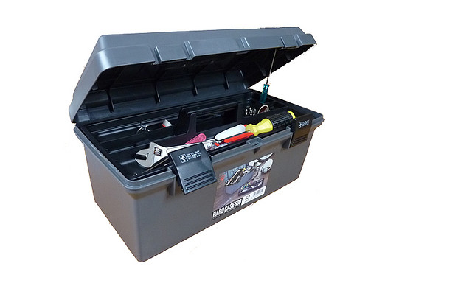
Initiatives to Promote Construction of Workforce Housing
In the 2014 Legislative session a coalition of communities including Roseau, Perham, Duluth and Worthington approached the League of Minnesota Cities to help create new Tax Increment Financing (TIF) legislation to assist in the construction of market rate workforce housing. A TIF bill was sponsored by Rep. Fabian and Sen. Stumpf. A TIF bill did not pass, but a $2 million workforce housing pilot grant program was created for Roseau & Pennington Counties.
Goal:
Get some tools in the toolbox to assist workforce housing projects

Slide 10
2015 Legislative Efforts
Extensive publicity of the rural Workforce Housing problems has lead to considerable interest at the State Capitol to address rural Workforce Housing shortages. Considerable legislations has been drafted and supported by Senators and Representatives across the State.
A new Economic Development TIF bill for market rate rental housing has been developed by the League of Minnesota Cities and is authored by Senator Stumpf (SF 468). The bill would create a Workforce Housing Grant program, based on the Roseau/Pennington Pilot Program passed in 2014.
Senator Stumpf and Rep. Fabian have also introduced a Workforce Housing TIF bill that would allow cities to use economic development TIF districts to help finance workforce housing (SF 668/HF 684)
The Coalition of Greater Minnesota Cities is proposing a number of incentives for rural workforce housing, authored by Senator Sparks (SF 764): developing a program and funding for public infrastructure in support of workforce housing and the establishment and funding of a State Workforce Housing Tax Credit program to attract investment in workforce housing.

Slide 11
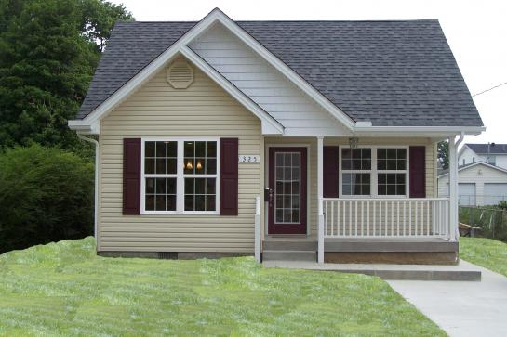
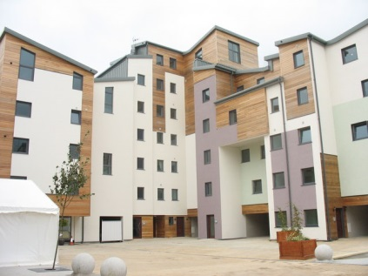
Conclusion
The Workforce Housing problem is not just a Roseau County problem, but one facing all economically vibrant rural communities.
We must recognize that an ample supply of workforce housing is vital basic infrastructure for a healthy community.
The State must become more involved in developing a set of tools to foster the creation of workforce housing in rural areas.

