Slide 1
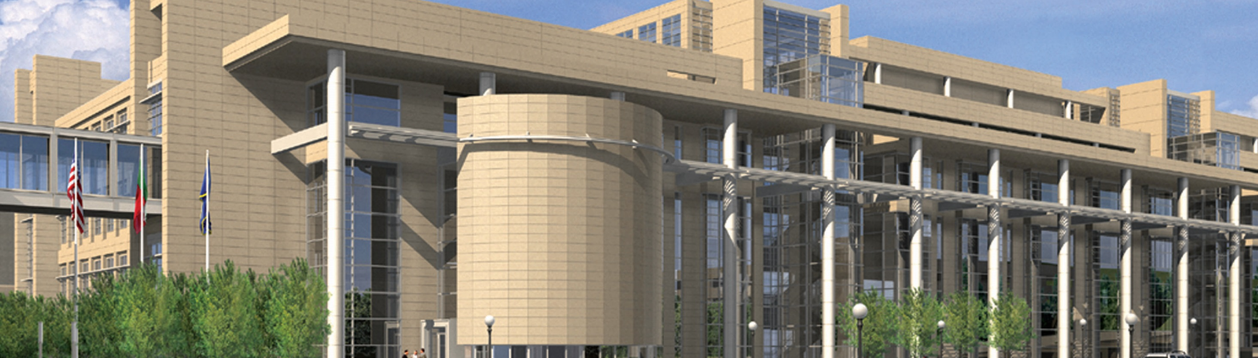
MDA Overview
Thom Petersen | Commissioner
February 12, 2019

Slide 2
Minnesota Department of Agriculture
Our mission is to enhance Minnesotans’ quality of life by ensuring the integrity of our food supply, the health of our environment, and the strength of our agricultural economy.
Notes:
At the Department of Agriculture our mission is to enhance Minnesotans’ quality of life by ensuring the integrity of our food supply, the health of our environment, and the strength of our agricultural economy.

Slide 3
Minnesota Department of Agriculture
Our 450 employees provide many services that impact Minnesota residents every day:
We promote Minnesota farm products in local, state, national, and international markets.
We respond to diseases and pests that threaten agriculture and natural resources.
We inspect all grocery stores and convenience stores, as well as all dairy farms and processing plants.
We regulate feed mills and fertilizer plants.

Slide 4
Minnesota Department of Agriculture
We have two main areas of responsibility:
We are the primary state agency responsible for protecting the state’s food supply and a key player in protecting the state’s natural resources.
We are the primary agency responsible for supporting and promoting the state’s ag industry and economy.

Slide 5
Minnesota Department of Agriculture
We carry out our responsibilities through six main program areas:
Pesticide and Fertilizer Management
Agricultural Marketing and Development
Plant Protection
Dairy and Meat Inspection
Food and Feed Safety
Laboratory Services

Slide 6
Agriculture’s Contributions to MN’s Economy
Minnesota’s ag industry:
73,200 farms
Generates $112 billion in economic activity
$17.1 billion crop sector
$6.9 billion livestock sector
Supports more than 430,000 jobs
#1 nationally in turkeys raised, sugar beets, green peas for processing
#3 in hogs, soybeans, spring wheat

Slide 7
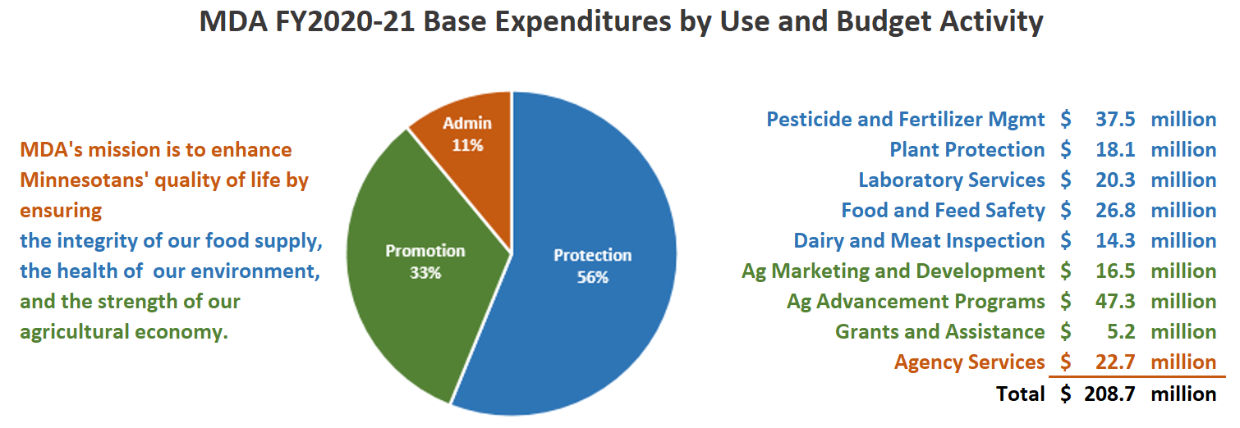
MDA Budget Overview
Notes:
Ag Advancement Program – AGREETT and AGRI

Slide 8
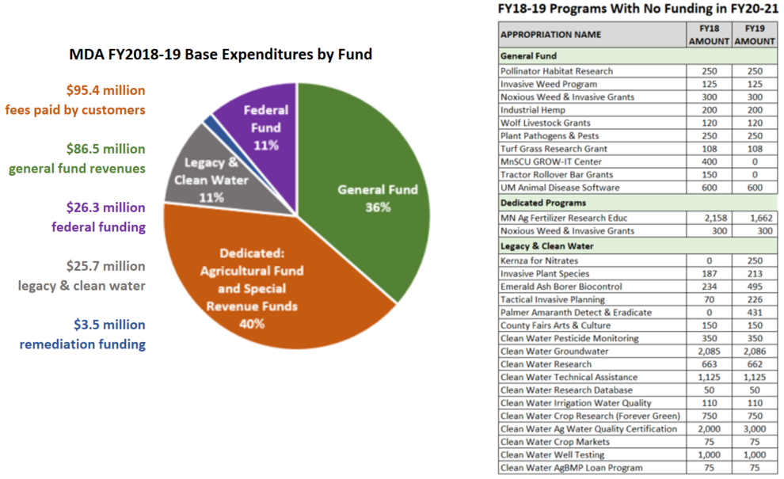
MDA Budget Overview

Slide 9
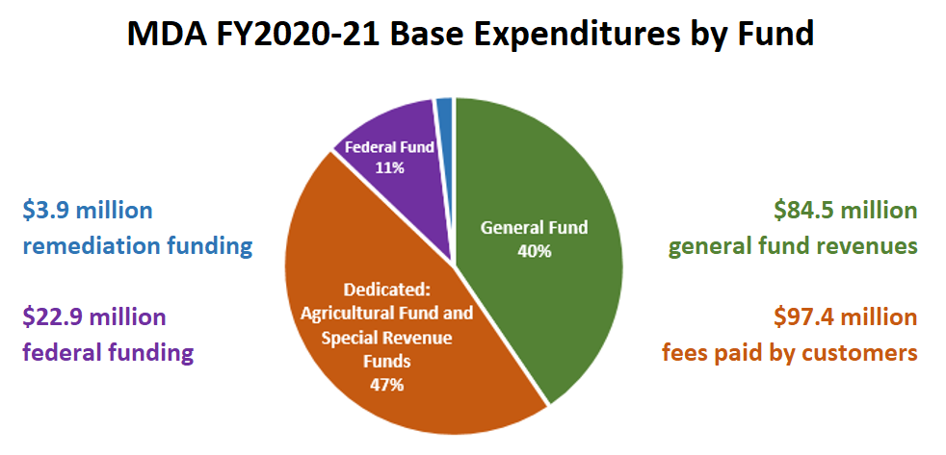
MDA Budget Overview
Notes:
Remediation – MERLA funds

Slide 10
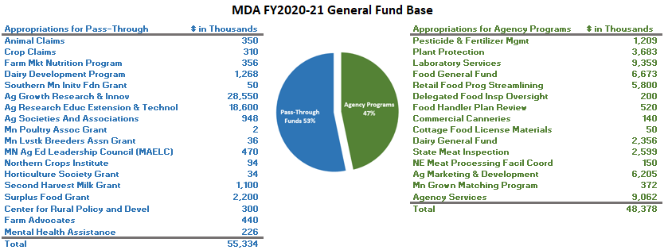
MDA Budget Overview

Slide 11
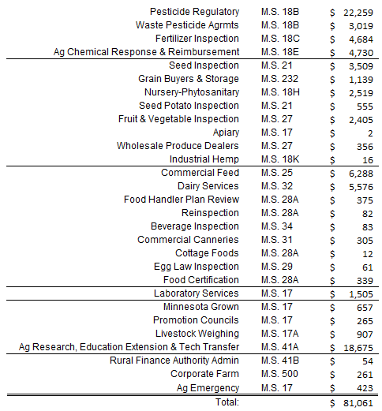
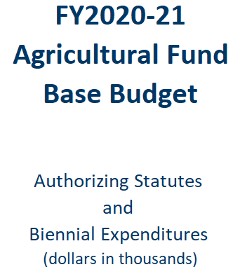
MDA Budget Overview

Slide 12
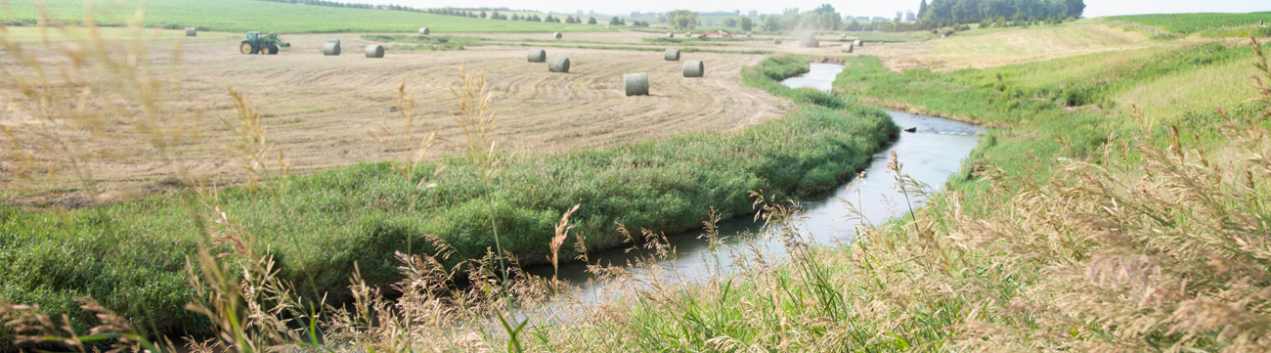
Pesticide and Fertilizer Management
Joshua Stamper, Director

Slide 13
What We Do
Pesticide & Fertilizer Management Division
We are the lead state agency for:
Pesticide regulation
Fertilizer regulation
Protection of groundwater from ‘ag chemicals’
Emergency response
Spills and clean-up
Waste pesticide collection
Minnesota Agricultural Water Quality Certification Program (MAWQCP)

Slide 14
How We Do This
Pesticide & Fertilizer Management Division
We work with farmers, regulated industry, and interested parties on the front end, as much as possible
We employ 123 agronomists, soil scientists, and hydrologists (40% in greater MN)
Many staff have graduate degrees, a farm background, and some still farm
PFMD Budget ~$30 million/year, mostly from fees and Clean Water Fund

Slide 15
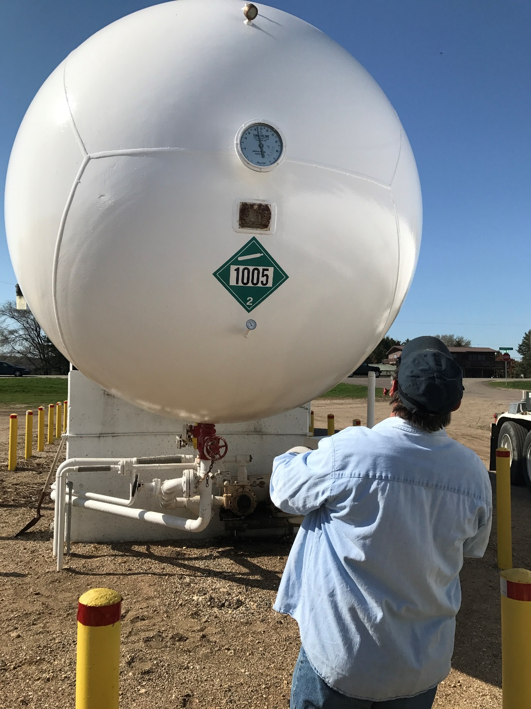
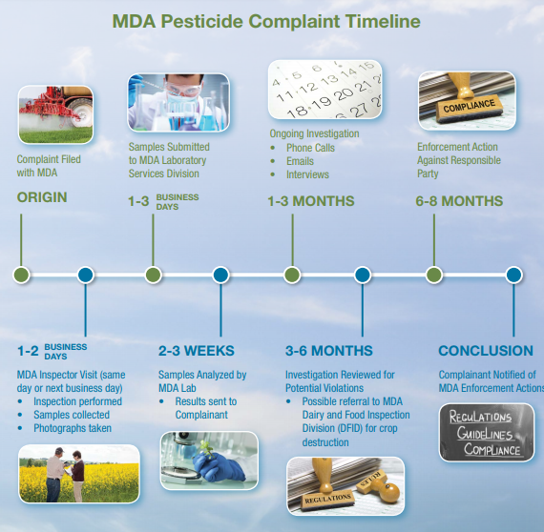
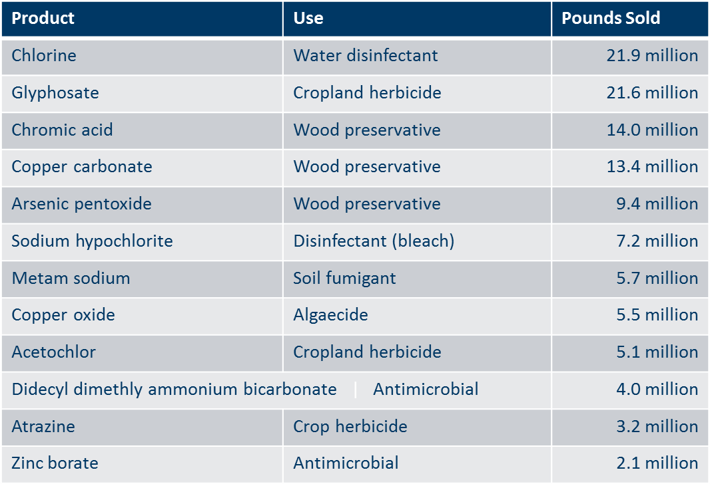
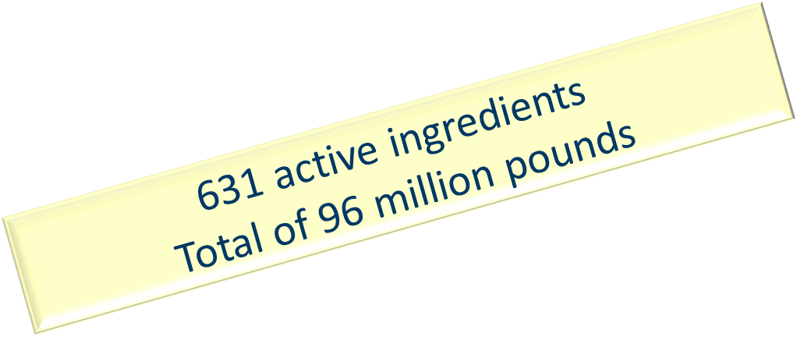
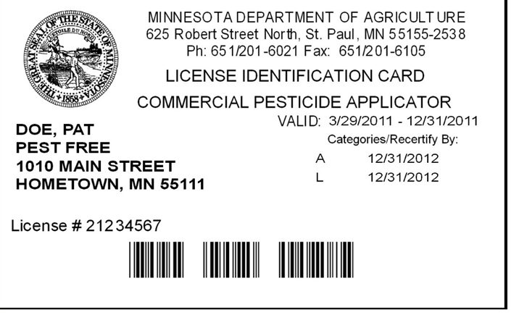
Regulatory Activities
Pesticide & Fertilizer Management Division
Pesticide/fertilizer product registration
Applicator licensing
Complaint response
Facility inspection
Emergency response
Anhydrous ammonia regulation

Slide 16
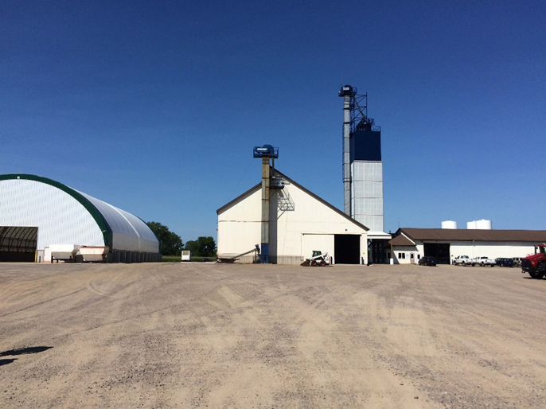
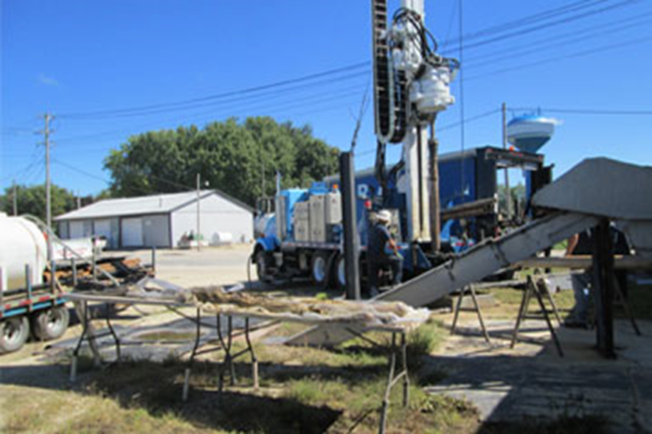
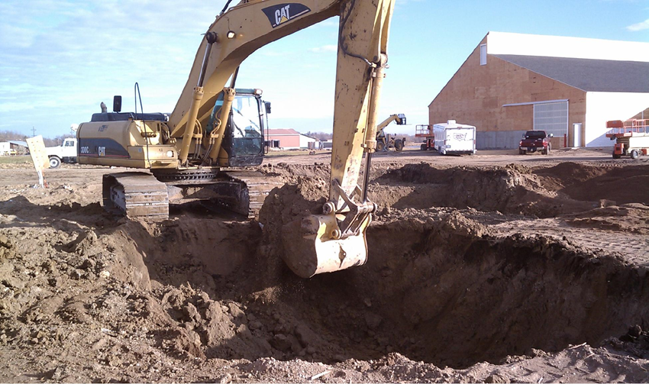
Incident Response Activities
Pesticide & Fertilizer Management Division
Emergency site clean-up
Long-term site clean-up
Voluntary clean-up
Agricultural Chemical Response Reimbursement Account (ACCRA)
Superfund

Slide 17

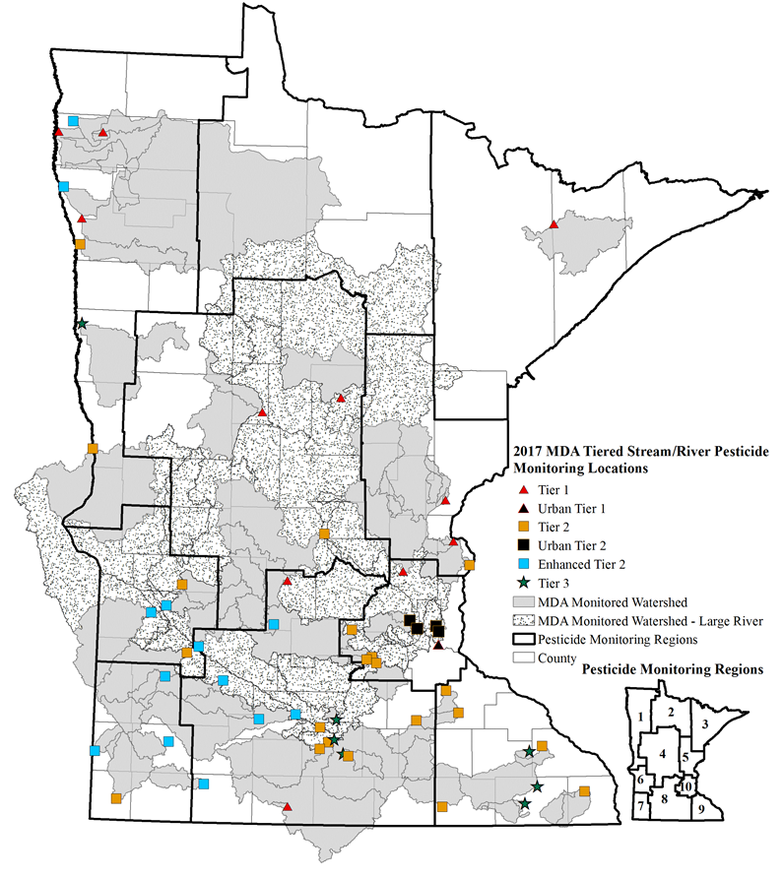
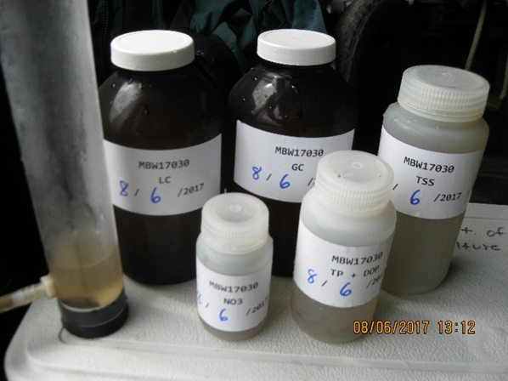
Non-Point Source Programs
Pesticide & Fertilizer Management Division
MDA is responsible for addressing:
Non-point source impacts to groundwater from nitrate from fertilizer
Non-point source impacts to surface water and groundwater from pesticides
Other health or environmental risks from pesticides
Water quality monitoring for pesticides and nitrate

Slide 18
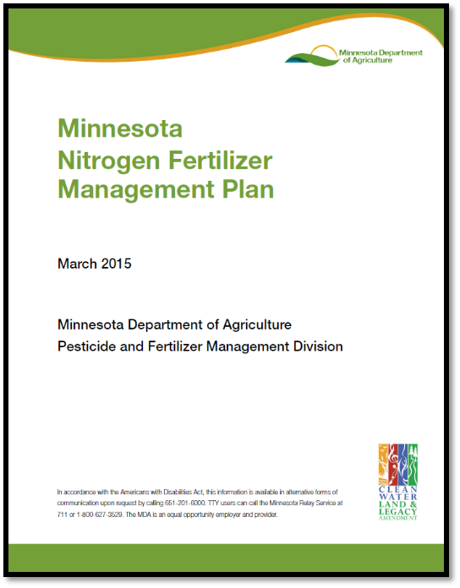
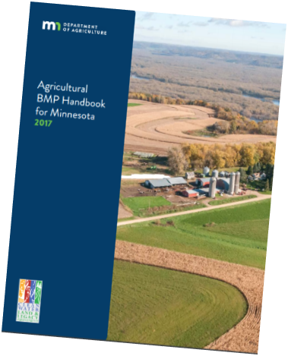
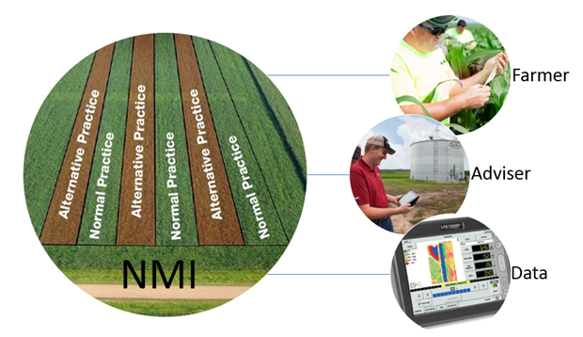
Non-Point Source Programs
Fertilizer non-point activities:
Nitrogen Fertilizer Management Plan for nitrate in groundwater
Fertilizer best management practices (BMPs)
Technical assistance for impaired waters
Funding priority research
Certification of soil and manure testing labs
Pesticide & Fertilizer Management Division

Slide 19
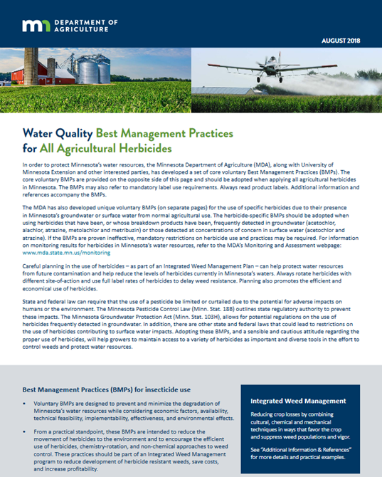
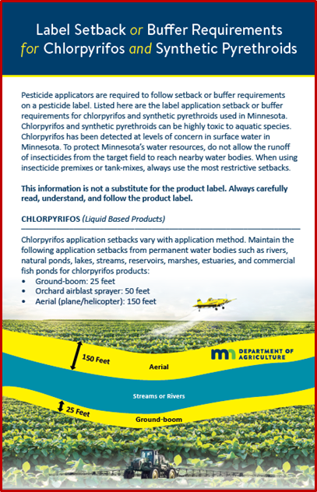
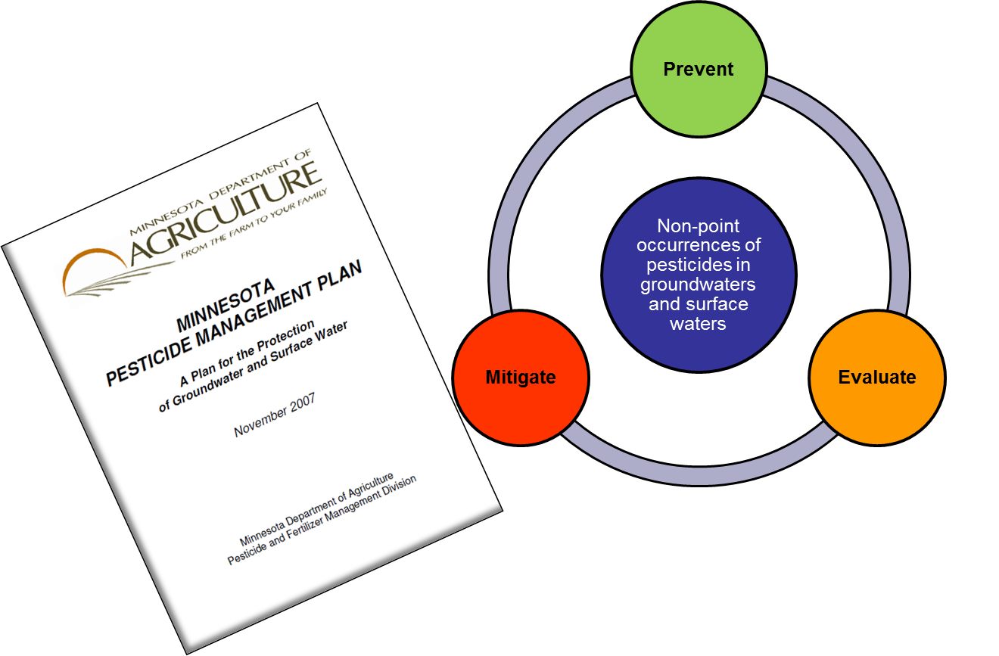
Non-Point Source Programs
Pesticide & Fertilizer Management Division
Pesticide non-point activities:
Pesticide Management Plan for water resource protection
Pesticide best management practices
Assist sister agencies on pesticide issues

Slide 20
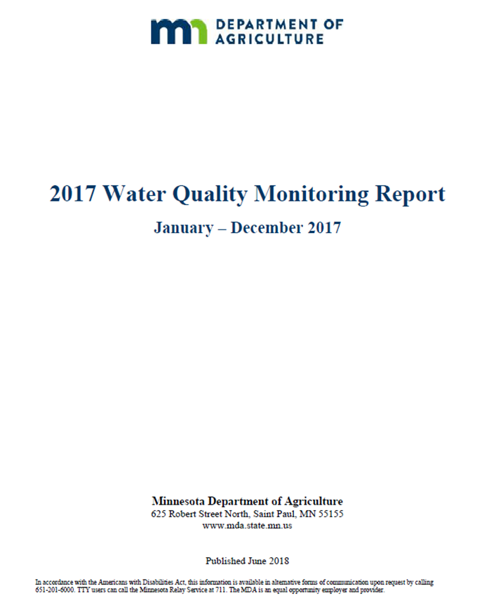
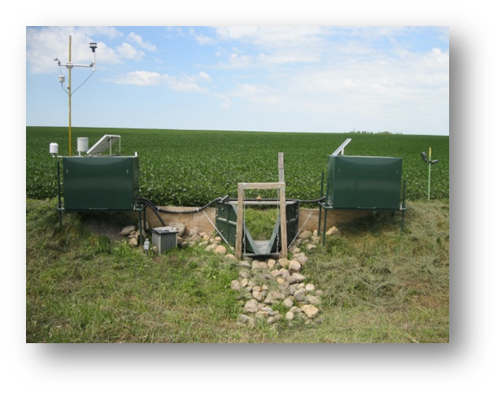
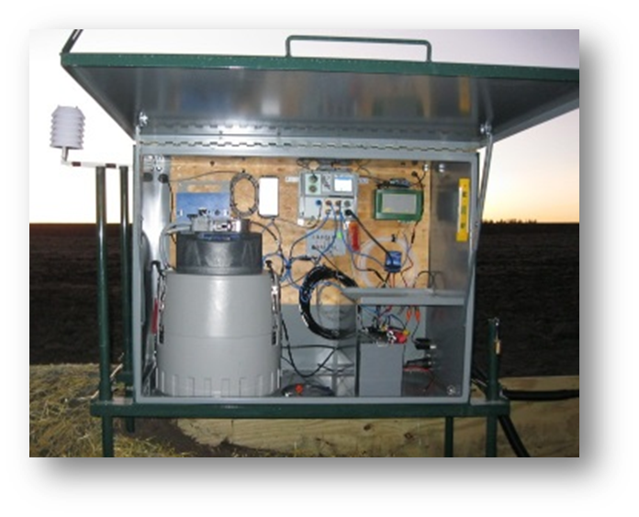
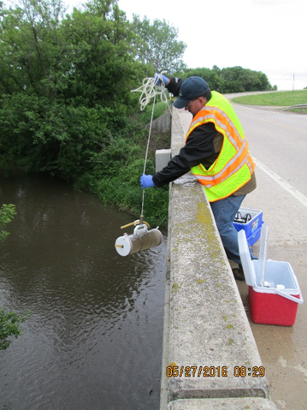
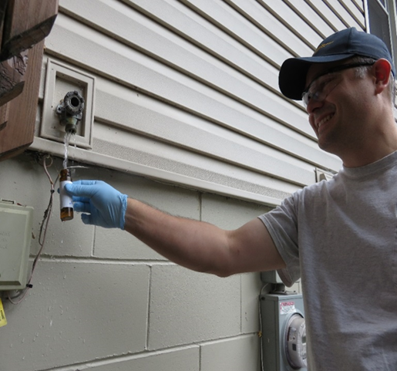
Non-Point Source Programs
Pesticide & Fertilizer Management Division
Water monitoring activities:
Long-term pesticide monitoring (25 years)
Edge-of-field and tile line monitoring
Monitoring for Discovery Farms Minnesota
Monitoring private wells for nitrate
Coordinate with other monitoring programs
Annual monitoring reports

Slide 21
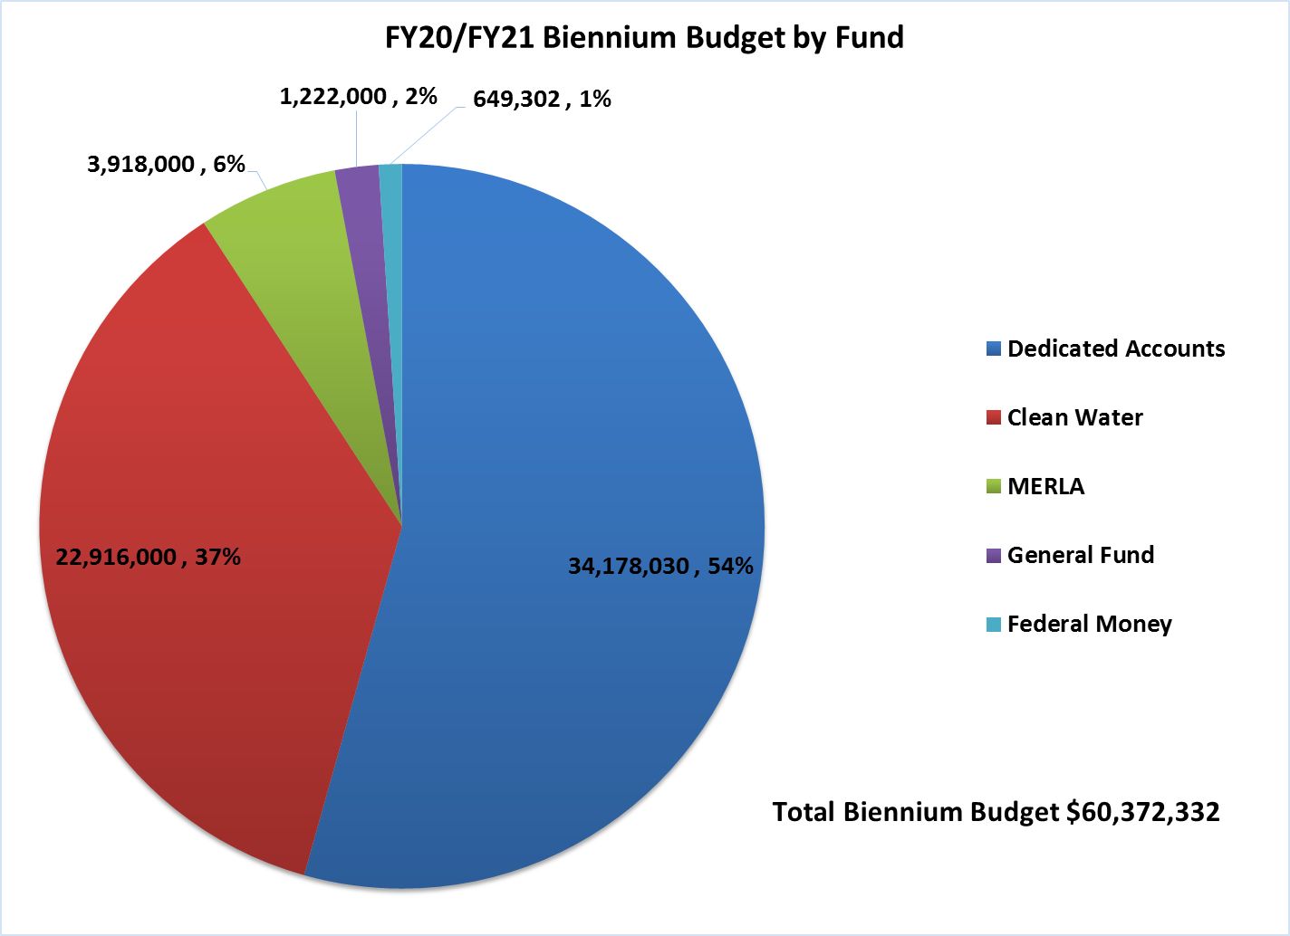
Division Budget

Slide 22
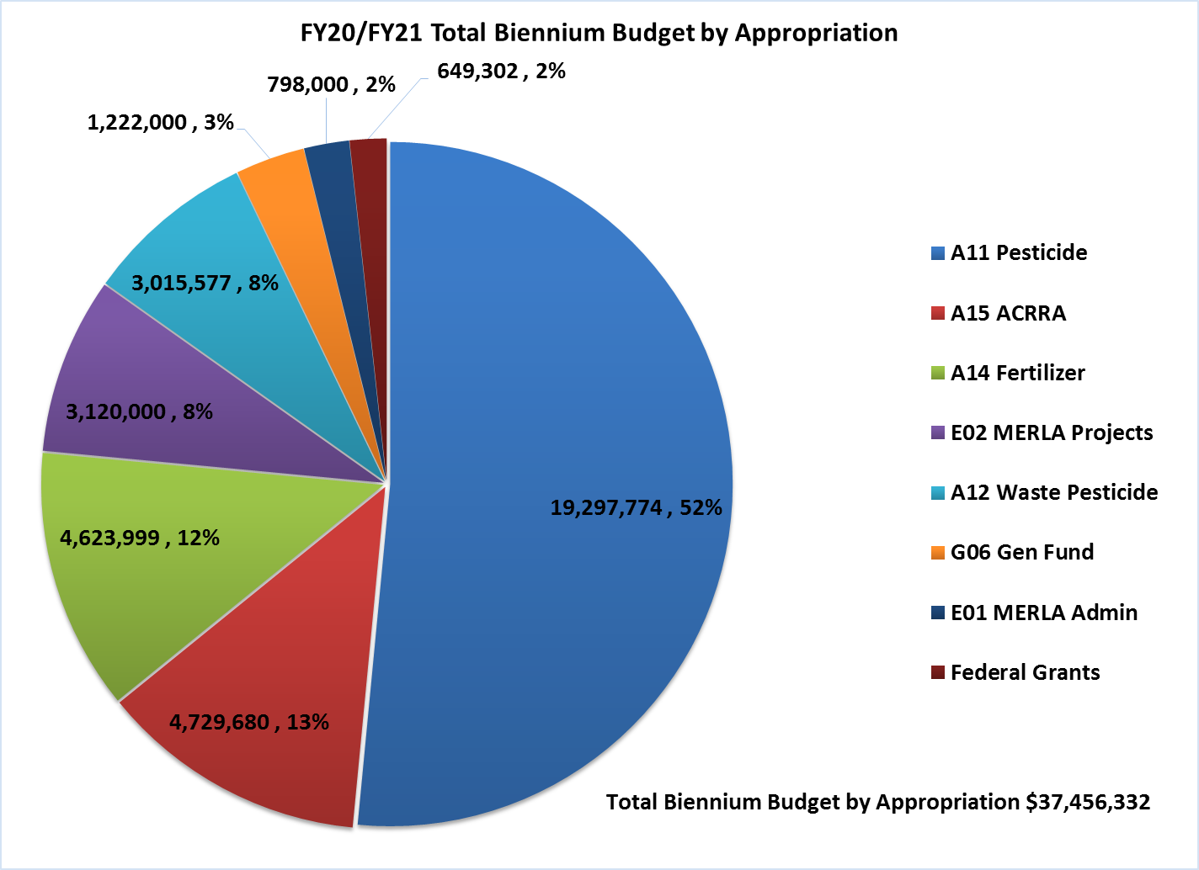
Dedicated Accounts

Slide 23
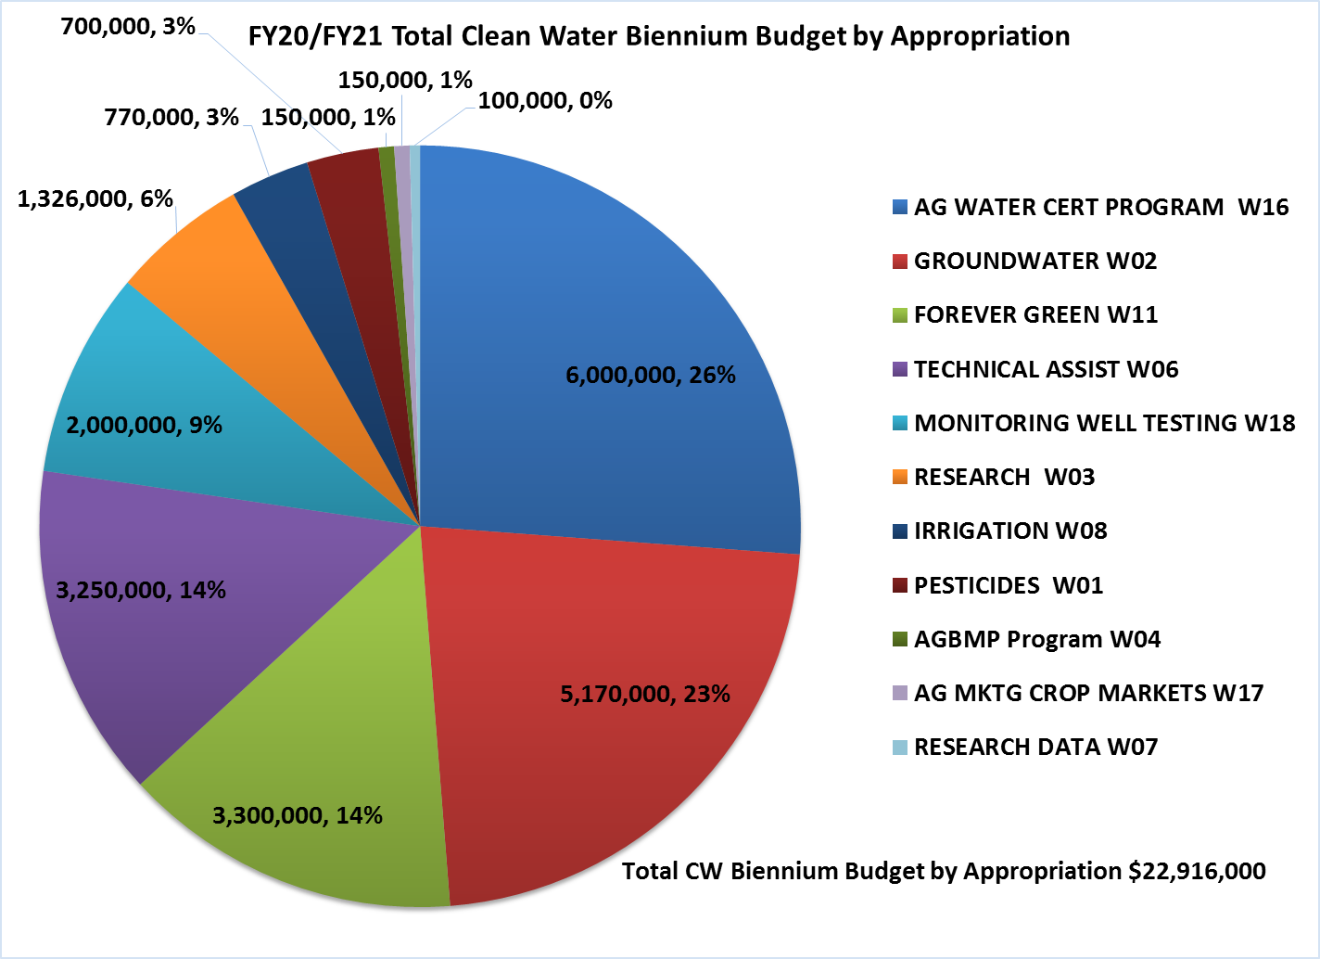
Clean Water Fund

Slide 24

Ag Marketing and Development
Paul Hugunin, Director

Slide 25


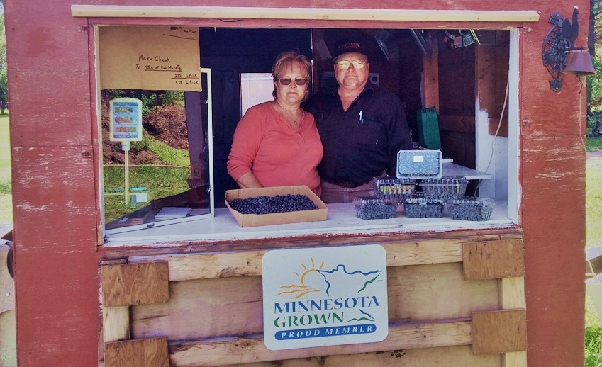
Ag Marketing and Development
Access to Markets - Local

Slide 26

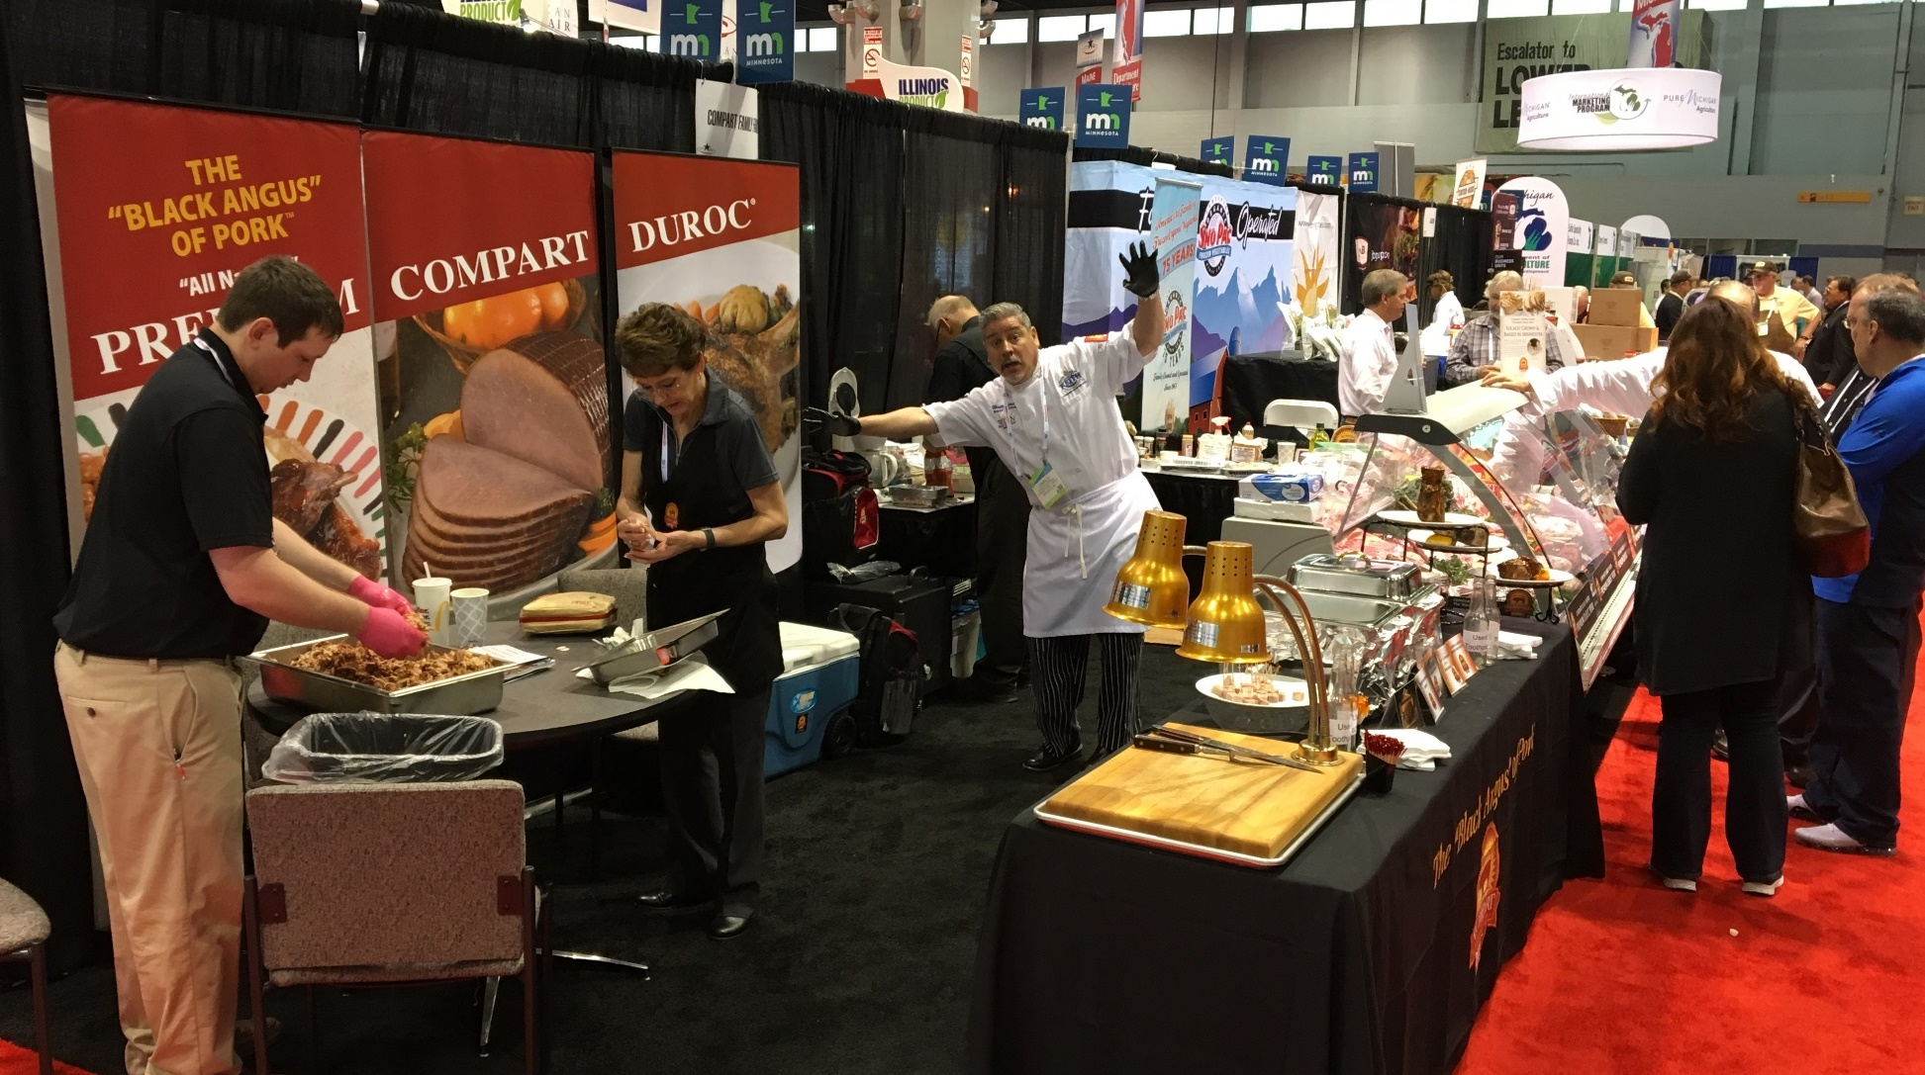
Ag Marketing and Development
Access to Markets - National

Slide 27

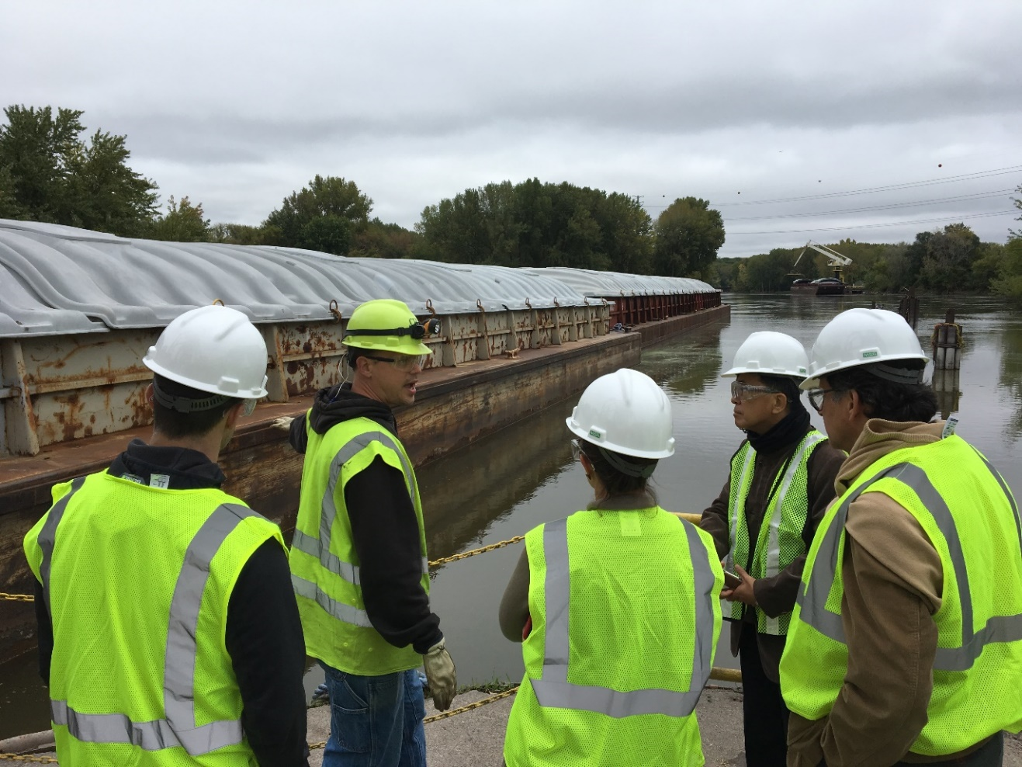
Ag Marketing and Development
Access to Markets - International

Slide 28
Ag Marketing and Development
AGRI - Overview
$13.256 million in FY 18 $13.311 million in FY 19
Livestock Investment Grants Value Added Grants
Crop Research Grants Sustainable Ag Demo Grants
Bioincentive payments County Fair Grants
Urban Ag Grants Good Food Access Program
FBM Scholarships Farm to School Grants
Trade Show Assistance GAP Cost Share

Slide 29
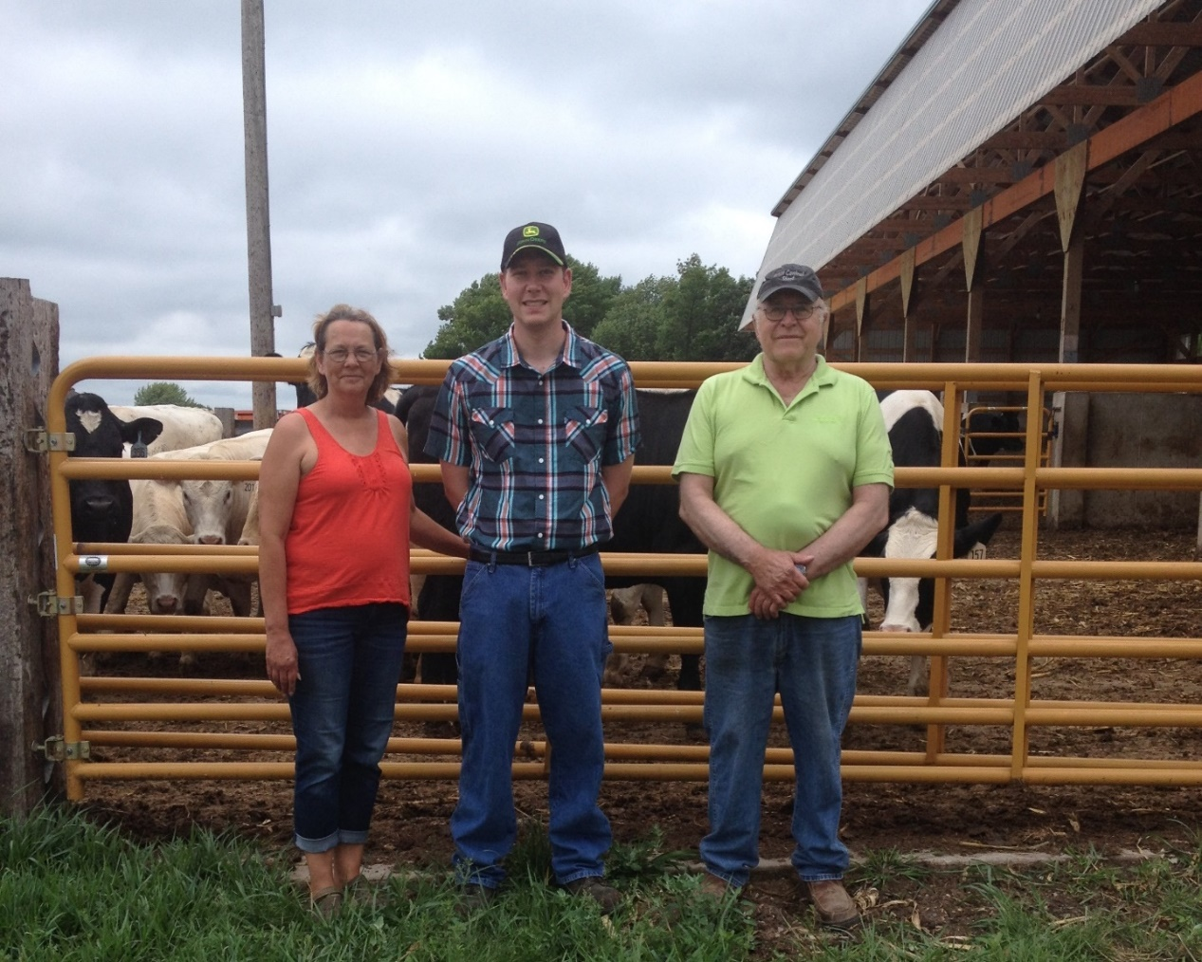
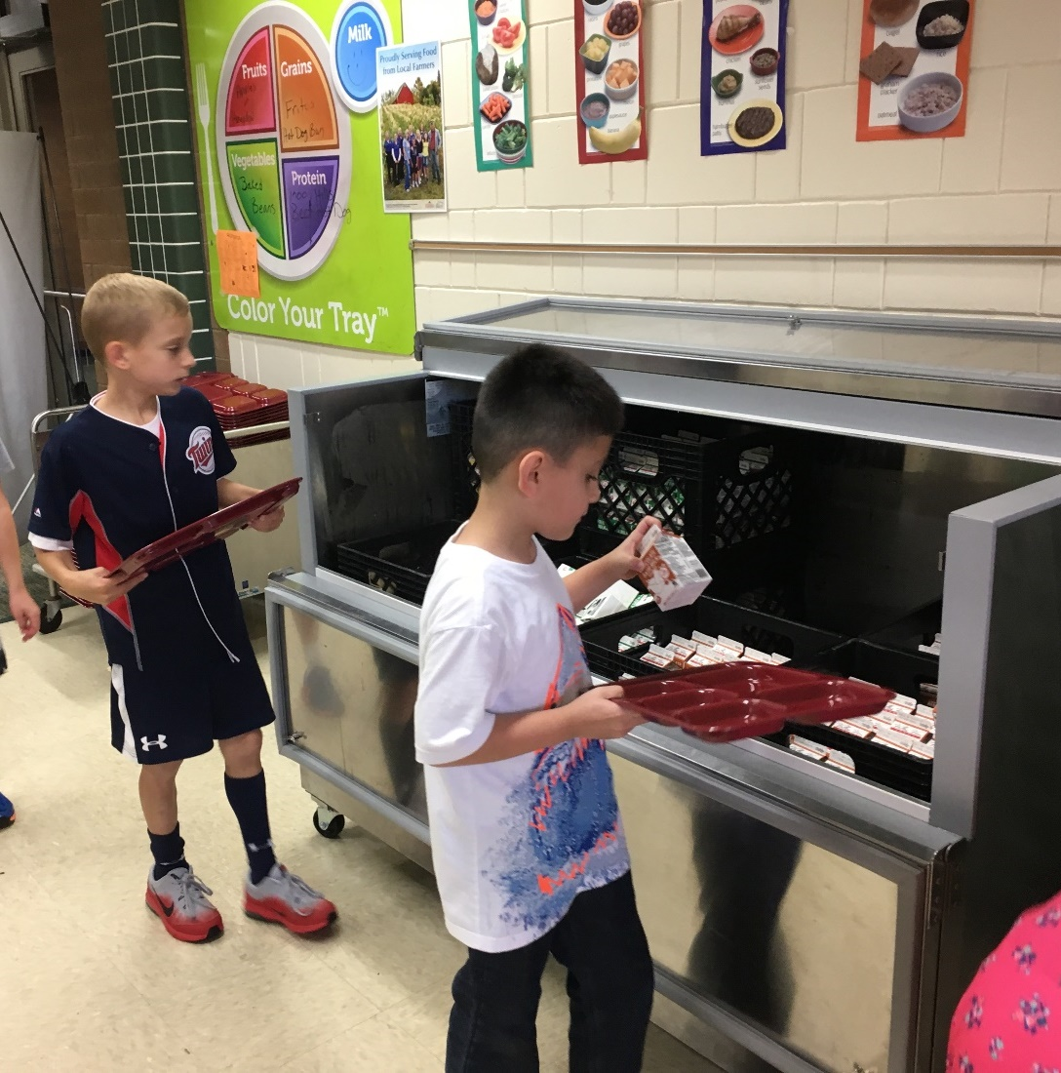
Ag Marketing and Development
AGRI – Livestock Investment and Farm to School Grants

Slide 30
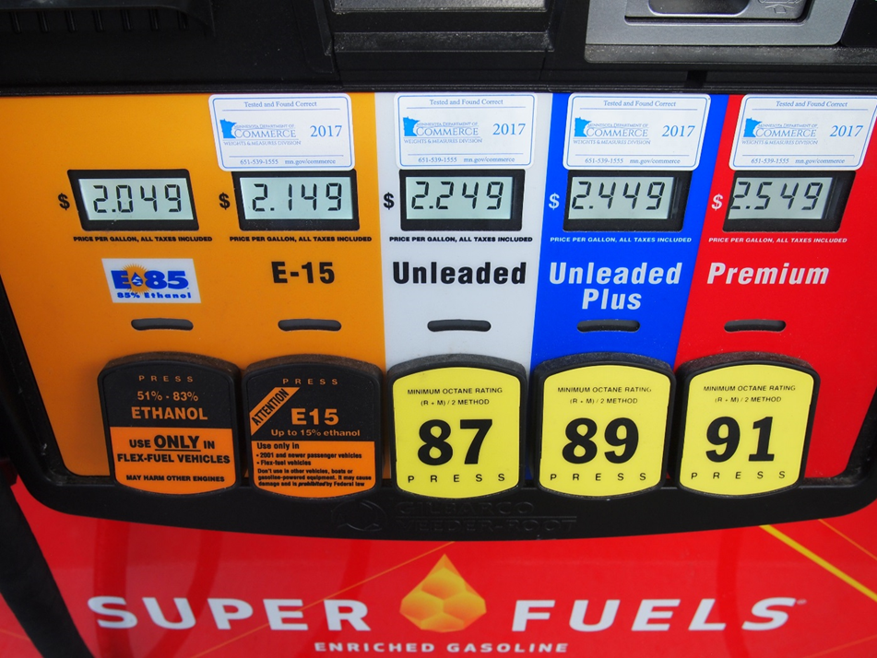
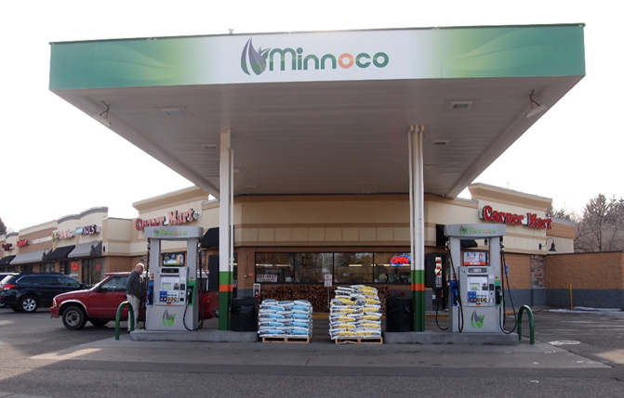
Ag Marketing and Development
AGRI – Biofuels Infrastructure Grants
$8 million from USDA

Slide 31
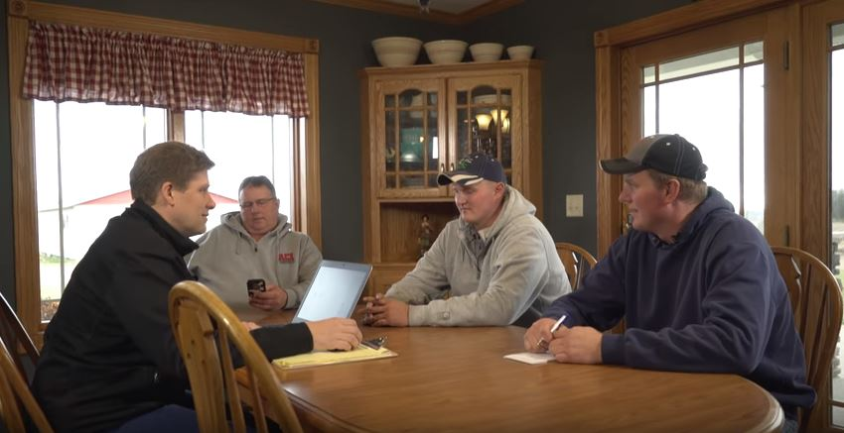
Ag Marketing and Development
AGRI – Farm Business Management Scholarships

Slide 32


Ag Marketing and Development
Education/Ag Literacy
MN Ag in the Classroom

Slide 33
Ag Marketing and Development
AGREETT
Commodity Council Oversight
Technical Assistance to Livestock Producers
Ag Land Preservation
ROPS Grant Program
Farm and Rural Mental Health

Slide 34
Ag Marketing and Development

Slide 35
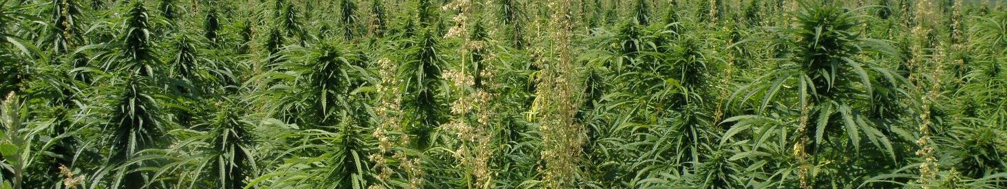
Plant Protection
Mark Abrahamson , Director

Slide 36

Plant Protection Division
PPD biennial budget ~ $18.7 million
Fees ~ $9.6 million
General funds ~ $5 million
Federal ~ $3.5 million
ENTRF ~ up to $600k

Slide 37
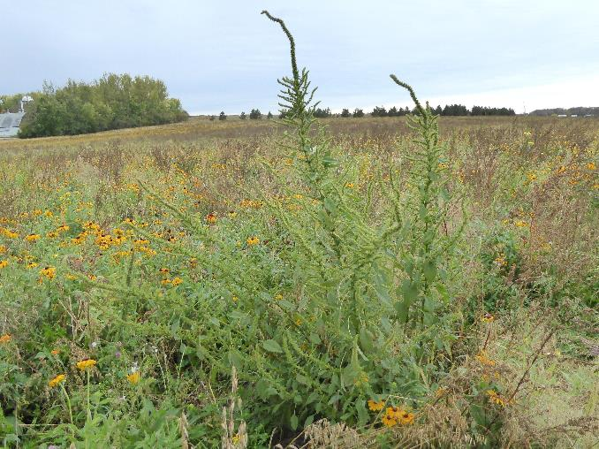
Plant Protection
Noxious and Invasive Weed Program
Maintains the state noxious weed list and works with local governments to ensure control of designated weeds
One time grant program initiated in FY 2018-2019 funded weed control projects in 30+ counties each year
Grant funding from Environment and Natural Resources
Trust Fund has enabled control of highest
priority species (eradicate list)
Palmer amaranth, an eradicate species

Slide 38
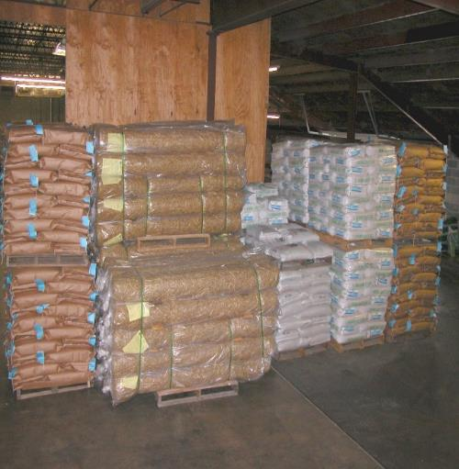
Plant Protection
Seed Inspection Program
Ensure accurate labeling of seed offered for sale in Minnesota and prevent the spread of noxious weeds through seed
MDA works closely with County Ag Inspectors and
Analyzes 1,500+ seed samples every year for
germination and purity
Sponsored development of a genetic test for Palmer
amaranth

Slide 39
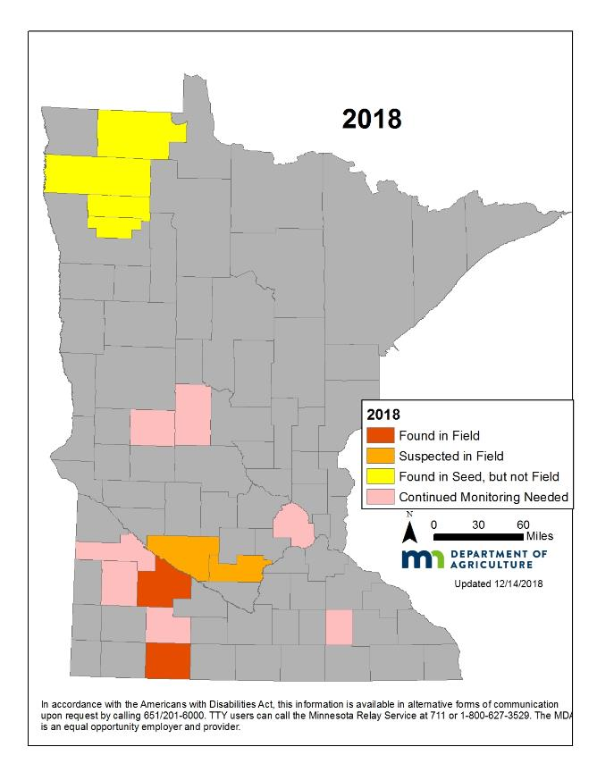
Plant Protection
Palmer Amaranth
Eradication efforts on CRP sites appears to be successful
Ability to detect contamination and prevent spread in seed has increased dramatically
Found at low levels in cropping situations in 2018 and regional efforts are underway to slow the spread

Slide 40
Plant Protection
Industrial Hemp
Recognized as an agricultural crop
with passage of 2018 Farm Bill
Interest in production is increasing
rapidly
Farm Bill does not change FDA regulation of ingestible and topical hemp products
Fees collected are not yet sufficient to support the required oversight
160 and counting

Slide 41
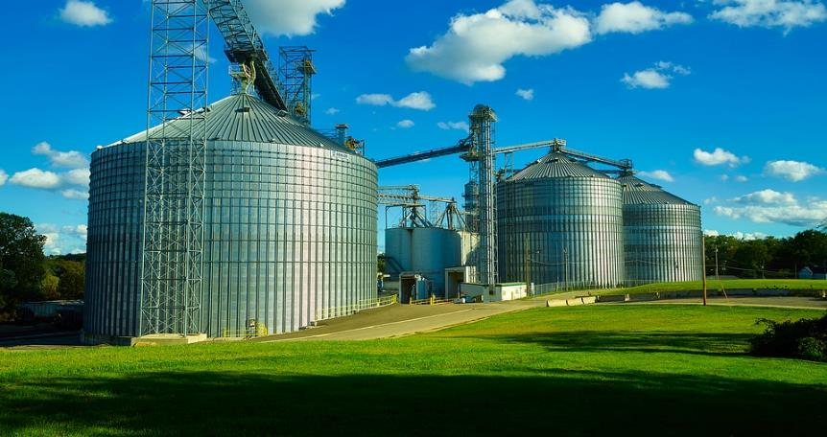
Plant Protection
Grain Licensing
Requires buyers of grain and storage facilities to have sufficient resources to meet obligations
Recent failures (Porter 2015, Ashby 2018) have had dramatic impacts
on producers
Grain Advisory Group formed to address
the issue and has been working to
identify opportunities for better
protections

Slide 42
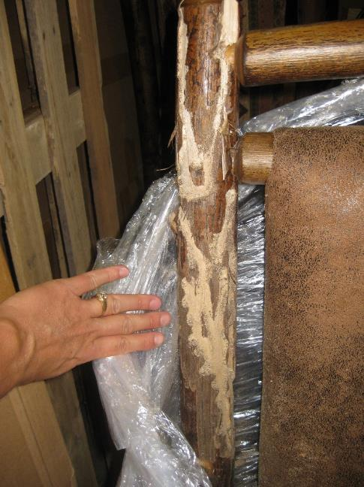

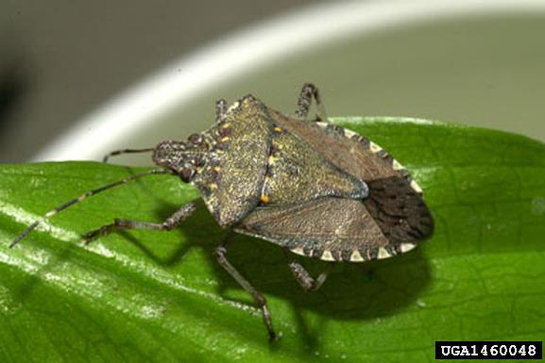
Plant Protection
Invasive Species One time funding appropriated in 2018-2019:
Significantly increased diagnostic capacity from 54 organisms monitored in 2016 to 84 in 2018
Allowed monitoring of state priority pests: brown marmorated
stink bug, Swede midge, velvet longhorned beetle
Addressed rustic wood product pathway

Slide 43
Plant Protection
Invasive Pests – Emerald Ash Borer
Federal deregulation likely
Spread is inevitable but rate of spread can be slowed
Spread in Minnesota has been relatively slow, but could increase rapidly

Slide 44
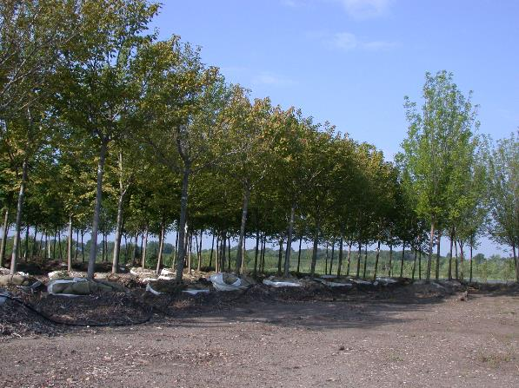
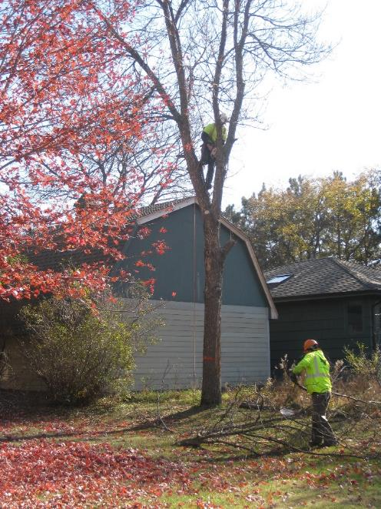

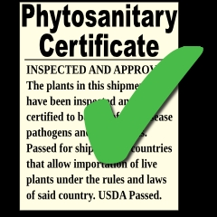
Plant Protection
Other Programs
Nursery Inspection
Ensure that clean nursery stock is produced and sold in Minnesota
Tree Care Registry
Provide communication with tree care industry regarding invasive pests and particularly regulations on movement of wood
Firewood Certification
Provide consumers with pest-free firewood that can be safely moved
Phytosanitary Certification
Provide required certification for plants or plant products moving to other states or countries

Slide 45



Plant Protection
Potato Inspection
Provide disease-free seed potatoes for growth or sale
Determine grade for processing operations in Park Rapids
Fruit and Vegetable Inspection
Determine grade for fruit and vegetable transactions
Provide grading for Northern Star Plant in Chaska
Wholesale Produce Dealer Licensing
Protect sellers through requirements for bonds

Slide 46

Plant Protection
Wolf and Elk Depredation
Compensate producers for losses caused by wolves or elk
Wolf Claims assisted by Conservation Officers, USDA trappers, U of M Extension
One-time grant program appropriated for 2018-2019 biennium
Elk Claims assisted by MDA Approved Agents
(Crop adjusters trained for elk damage)

Slide 47

Dairy and Meat Inspection
Dr. Nicole Neeser, Director

Slide 48
Dairy and Meat Inspection
What we do:
Ensure the safety of the food supply by conducting regulatory-based inspection work for dairy, meat, poultry, and egg products
Ensure dairy and meat products and our associated regulatory programs meet the standards necessary for commerce
Interstate commerce of dairy products
Intrastate commerce of meat and poultry products
Respond to emergencies and outbreaks

Slide 49
Dairy and Meat Inspection
How we do this:
Ensure safe food handling practices are used from the farm to manufacturer during on-site inspections
Collect samples to monitor product safety
Conduct outreach and educational activities with farmers and manufacturers
Certify industry personnel to conduct temporary or cooperative inspection work
Provide guidance to prospective or new operators on how to meet the requirements
Issue certificates to Minnesota dairy and meat companies so that they can sell their products internationally

Slide 50
Dairy and Meat Inspection
Dairy and Meat Inspection are major program areas
Major funding sources are General Fund, Fees and Federal
51.4 FTEs (55 employees), many support functions cross programs
Dairy: 13.25 Field Inspection FTEs conducted over 8,000 inspections
Meat: 16.5 Field Inspection FTEs conducted over 9,000 inspections
Compliance officers, operations, outreach, audits, supervision, veterinarian

Slide 51
Dairy and Meat Inspection
Dairy Inspection
Dairy farms
As of 2/1/2019: 2,596 Grade A, 190 Grade B
Manufacturing (67) and Grade A (49) plants
Tankers and haulers (about 900 licensed)
FY 20-21 Biennial Budget:
$2,356 General Fund (31%): $5,185 Agricultural Fund - Fees (69%)
Current Trends:
Fewer dairy farms
Increased numbers of small dairy manufacturing plants
Goat milk production increasing (>100 Grade B farms during peak season)
Inspection for Safety, Required for Interstate Commerce
Inspection Type | Number of Inspections CY 2017 | Number of Inspections CY 2018
Dairy Farm | 6909 | 6338
Dairy Plant | 957 | 973
Tankers | 351 | 355
Haulers | 470 | 369
Total | 8687 | 8035

Slide 52
Dairy and Meat Inspection
Meat and Poultry Inspection
State ‘Equal To’ Meat Inspection Program
Small plants can wholesale product in MN
Requirements similar to USDA Food Safety Inspection Service
Daily Inspection (Continuous) per the Federal Meat Inspection Act
Custom Exempt (Not for Sale, for Farmers, Direct Marketing)
Budget FY 20-21
$2,652 General Fund, $3,409 Federal
Approximately 50%/50% split due to calculations of in-kind indirects
Trends – result in more outreach needs and activities:
More ethnic/nontraditional slaughter and processing
Federal regulations are more complex
More compliance issues (those not complying with inspection requirements, not under inspection)
Inspections for safety, required to wholesale products
Inspection Type | Number of Inspections Federal FY 2018
Equal To Processing inspections | 7654
Slaughter Inspection Days | 1237
Custom Exempt | 533
Total | 9424

Slide 53
Dairy and Meat Inspection
Other Programs | Source of Funding | FY 20-21 Amount (1,000’s)
Northeastern Regional Correctional Institute, Butcher Training Pilot Program Coordination | General Fund | 150
USDA Shell Egg Surveillance | Rest. Special Revenue, 100% Reimbursement Program | 21
State Egg Inspection | Agricultural Fund, Fees | 61
Drug Residue Prevention Outreach | Federal, FDA Cooperative Agreement (Sept 2019 -June 2020) | 310
Venison Donation | Misc Agency (Transfer from DNR) | 171

Slide 54

Food and Feed Safety
Katherine Simon, REHS | Interim Director, Food and Feed Safety Division

Slide 55
Food and Feed Safety
Regulatory Programs
Feed Program
Manufactured Food Program
Retail Food Program
Produce Safety Program
Purpose
Product Safety
Consumer/Animal Protection
Orderly Commerce
License / Permit / Registration | Number
Commercial Feed | 1974
Wholesale Food Processor/Manufacturer | 1063
Wholesale Food Handler | 754
Food Broker | 17
Retail Food Handler | 5901
Retail Mobile Food Handler | 1040
Cottage Food Producer | 3539
TOTAL: | 14288

Slide 56

Food and Feed Safety
Feed Program
Commercial Feed Inspection
Mill and distribution facilities and vehicles
Inspections based on risk of activities
Product sampling
Production record verification
Pet Food Monitoring
Pet food manufacturer inspection
Product listings
Review of labels
Federal Contract Inspections

Slide 57

Food and Feed Safety
Manufactured Food Program
Food Processor Licensing and Inspection
Inspections based on risk of food activities
Beverages, canneries, bakeries, prepared foods and ingredients
Sampling of product and the environmental
Certification for free sale / Export of products
Food Distributor Licensing and Inspection
Packaged food and raw ingredient warehouses
Federal Contract Inspections

Slide 58

Food and Feed Safety
Retail Food Program:
Facility Plan Review
Review of planned retail facilities and equipment
Required prior to opening retail food business
Retail Facility Licensing and Inspection
Inspections based on risk of food activities
Grocery, bakery, meat, deli, convenience and packaged food stores and stands
Support of Delegated Agency Programs
Oversight and assessment of 7 local city and county retail food programs

Slide 59

Food and Feed Safety
Produce Safety Program
Federal Cooperative Agreement Program
Implementation of Food Safety Modernization Act
On-Farm food safety practices
Outreach to Growers
Establishing stakeholder relationships and collaboration
Provide access to education and training materials
Produce Safety Inspections
Inspections based on risk of handling activities
Growing, harvesting, packing and holding

Slide 60
Food and Feed Safety
Additional Division Roles
Governor's Food Safety and Defense Task Force
Maintain Rapid Response Team
Oversight of Cottage Food Registration
Conformance with National Regulatory Program Standards

Slide 61
Food and Feed Safety
Trends and Challenges
Continued increase in new businesses and inquiries
Industry innovation for products and processes
Increase in complexity of operations and sales structures
Changes in food product handling and consumption patterns
Advancements in food safety knowledge and outbreak response

Slide 62
Food and Feed Safety
Fund Type | Amount
1000 General | 6,505
2000 Special Revenue | 1,186
2019 Dedicated | 2,954
3000 Federal | 2,028
TOTAL | 12,673

Slide 63
Thank you!
Thom Petersen
Thom.petersen@state.mn.us
651-201-6219

