Slide 1
Farm to Food Shelf
Update for the House Agriculture Committee

Slide 2
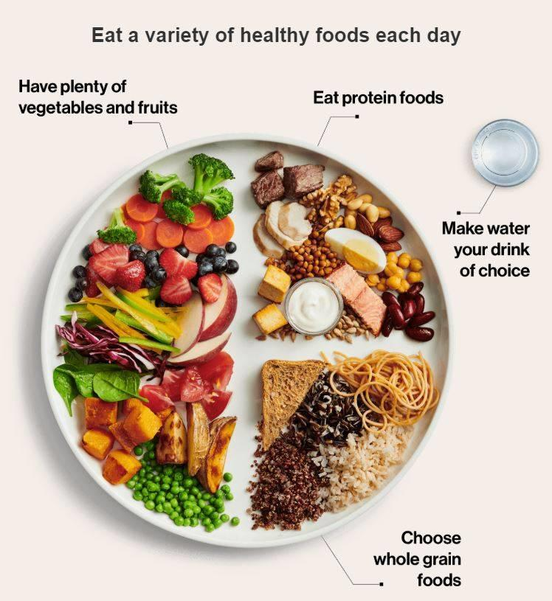
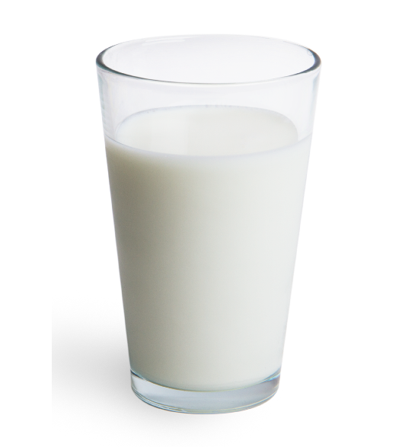
Sourcing, storing & distributing food 1 in 11 Minnesotans need

Slide 3
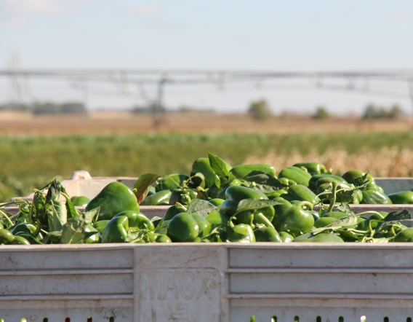
Produce
Fresh fruits and vegetables are the largest untapped source of healthy meals.
We’re working with farmers and growers to provide edible crops that would otherwise go unharvested or unsold.

Slide 4
Farm 2 Food Shelf
Purpose
$1.1mm in FY18 and $1.1mm in FY19 used to reimburse Minnesota agriculture producers and processors for costs incurred to harvest and package surplus fruits, vegetables and other agricultural commodities that would otherwise go discarded or sold in the secondary market.
Requirements
Produce must be distributed statewide
Produce must be sourced from Minnesota growers
Results (2018)
7.7 million pounds of fruits and vegetables donated to hunger relief across all 87 Minnesota counties (20% of total produce used in hunger relief)
48 growers participated
25 varieties of surplus produce donated

Slide 5
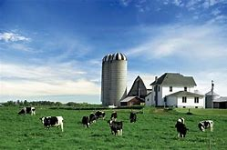
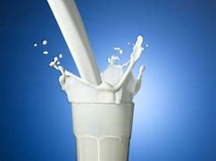
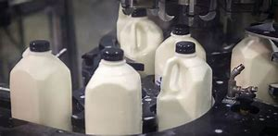
Milk
Minnesotans want access to healthier food at their local food shelf.
Milk is the second most requested food item.
Current grant funding allows us to meet roughly half the demand from food shelves and meal program partners.

Slide 6
MN Milk Grant
Purpose
$550,000 in FY18 and $550,000 in FY19 used by Feeding America food shelves serving MN to purchase fresh, fluid milk from local processors and make available to agency food shelf and meal program partners in the state.
Requirements
Milk must be purchased from a Minnesota milk processor
Food banks conduct a competitive bid or request verbal quotes
Grant funding allocated based on food bank’s TEFAP allocation % (i.e. represents number of food insecure people)
Results (2017/2018)
674,000 ½ gallons of milk (2.9 million pounds) purchased for and distributed to food shelf/meal programs in 87 MN counties
An estimated ½ of fresh, fluid milk client demand was met

Slide 7
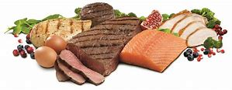
Protein
Minnesotans want access to healthier food at their local food shelf.
Meat/Poultry/Fish are the most requested and in-demand food items at food shelves.
Lean meat protein is a scarcely donated commodity in the Feeding America network and costly for food shelves to purchase.
We’re trying to double the amount of lean meat protein distributed to food shelf and meal program partners in the next five years.

Slide 8
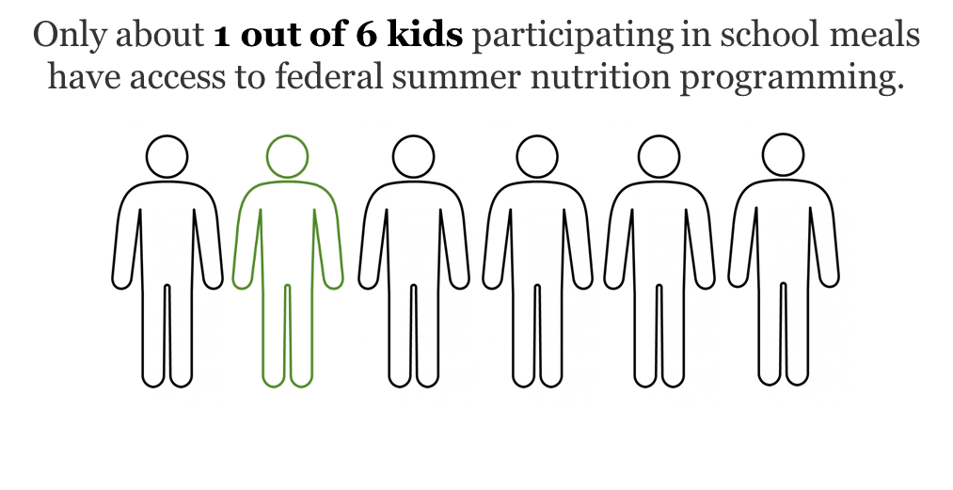

Slide 9
