Slide 1
2019 Special Education Overview: Presentation to the Minnesota House Education Policy Committee
Daron Korte | MDE Assistant Commissioner
Robyn Widley | MDE Director of Special Education
Marikay Canaga Litzau | MDE Director of Compliance and Assistance

Slide 2
Special Education Overview
Robyn Widley
Director of Special Education

Slide 3
Individuals with Disabilities Education Act
IDEA
Federal legislation to ensure that students with disabling conditions receive a free and appropriate public education to meet their unique needs.
Last reauthorized in 2004.
Federal law that includes accompanying regulations to provide guidance to state.
Citations:
20 USCS §§ 1400 et seq.
34 C.F.R.§ 300 et seq.
30 C.F.R. §§ 303 et seq.

Slide 4
IDEA Part B and Part C
Part B
Includes educational funding and guidelines for children with disabilities ages 3 to 21.
Part C
Provides guidelines concerning funding and services for children with disabilities and/or at risk conditions from birth to 3 years of age.

Slide 5
Part B Services
Part B includes requirements related to child find, eligibility, and development of an Individualized Education Program that provide:
Free Appropriate Public Education (FAPE)in the least restrictive environment (LRE), also known as most integrated setting.
Instruction to enable students with disabilities to be involved in and make progress in grade level curriculum.

Slide 6
Part C Services
Programming and services for infants and toddlers with disabilities ages birth to 3 and their families.
Doctors or parents can make referrals through Help Me Grow MN.
Specific services can be provided through an Individualized Family Service Plan (IFSP).

Slide 7
Students with Disabilities
13 categories are used to identify children with disabilities ages birth through 21 in Minnesota as required in IDEA and Minnesota Rules 3525.1325 – 3525.1352.
Children are served from Birth – age 2 (Part C) and from 3 – 21 (Part B).

Slide 8
13 Categorical Disabilities by Percent of Child Count
Primary Disability Classification | 2018-19 Count | Percent of 2018-19 Child Count
Specific Learning Disability | 33,834 | 22.9%
Speech or Language Impaired | 22,857 | 15.5%
Autism Spectrum Disorder | 20,485 | 13.9%
Other Health Disabilities | 20,056 | 13.6%
Developmental Delay | 19,390 | 13.1%
Emotional or Behavioral Disorders | 16,814 | 11.4%
Developmental Cognitive Disability – Mild/Moderate | 5,481 | 3.7%
Deaf or Hard of Hearing | 2,544 | 1.7%
Developmental Cognitive Disability – Severe/Profound | 1,900 | 1.3%
Physically Impaired | 1,635 | 1.1%
Severely Multiply Impaired | 1,527 | 1.0%
Blind or Visually Impaired | 502 | 0.3%
Traumatic Brain Injury | 462 | 0.3%
DeafBlind | 118 | 0.1%

Slide 9
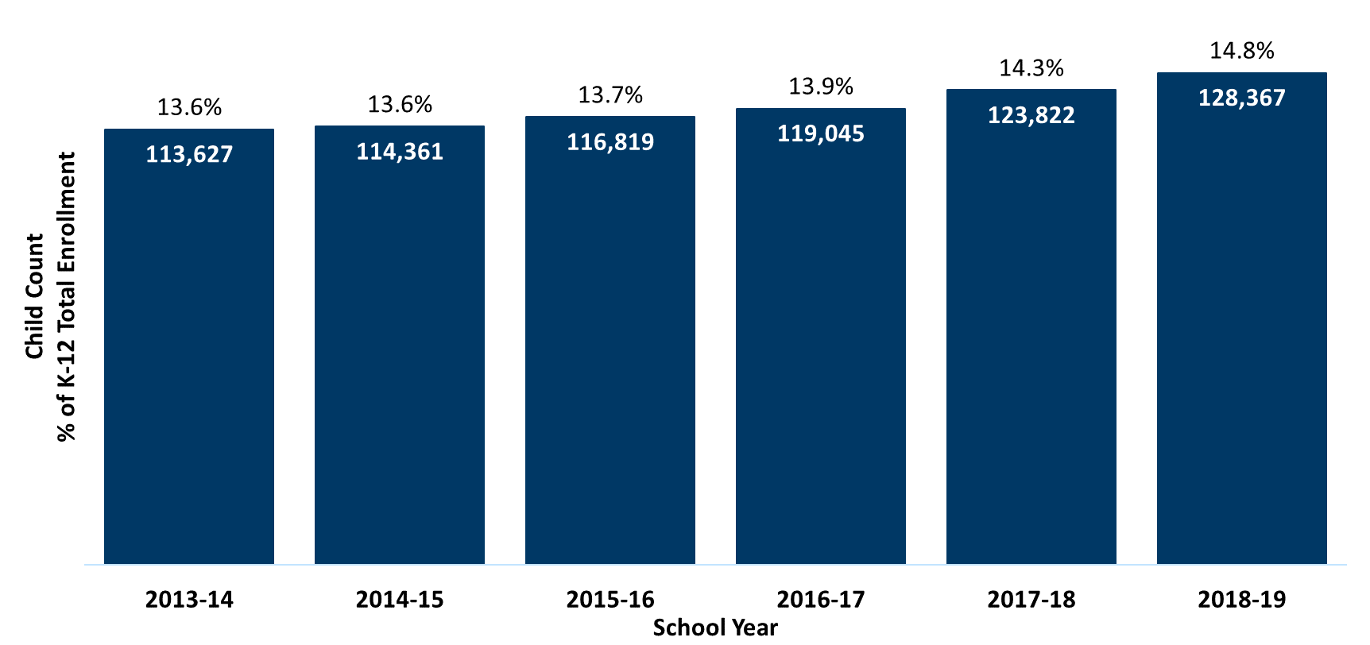
Students with Disabilities as Percent of K-12 Enrollment 2014-2018
Notes:
Year Special Ed % All Enrolled
2006-07 107,534 13.0% 829,184
2007-08 108,810 13.2% 825,603
2008-09 109,419 13.3% 823,234
2009-10 110,560 13.4% 823,826
2010-11 111,794 13.6% 824,333
2011-12 112,236 13.6% 825,873
2012-13 112,683 13.6% 831,419
2013-14 113,627 13.6% 837,154
2014-15 114,361 13.6% 842,932
2015-16 116,819 13.7% 849,599
2016-17 119,045 13.9% 856,687
2017-18 123,822 14.3% 862,970
2018-19 128,367 14.8% 865,573

Slide 10
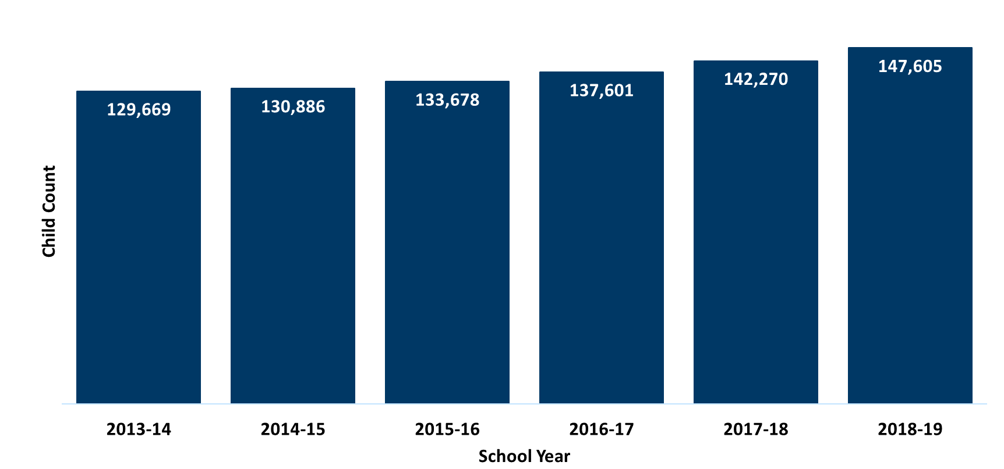
Students with Disabilities—Total Child Count, Birth to 21 2014-2018
Notes:
Year Enrolled
2006-07 121,503
2007-08 123,241
2008-09 124,560
2009-10 126,091
2010-11 127,863
2011-12 128,430
2012-13 128,812
2013-14 129,669
2014-15 130,886
2015-16 133,678
2016-17 137,601
2017-18 142,270
2018-19 147,605

Slide 11
Child Count by Area of Disability—Birth to 21 2014-2018

Slide 12
MDE Special Education Division
Each of the current units in the Special Education Division provide training, information and resources, policy development and technical assistance to districts and other stakeholders through a variety of projects and grants. These activities help with local planning and service delivery, program implementation, program evaluation and problem solving centered around positive outcomes for students and improved results.

Slide 13
Key Activities
Regional Low Incidence Facilitator Projects and Statewide Low Incidence Grant Activities
Special Education Workforce Planning and Coordination
Assistive Technology Teams
Minnesota DeafBlind Project
State Personnel Development Grant (SPDG)
Minnesota Olmstead Plan
Third Party Funding with Medical Assistance and Private Insurance for Health Related Services
For students on IEPs
Coordinated with Department of Human Services
Federal Reporting
State Systemic Improvement Planning and Reporting:
Focusing on graduation rates for student with disabilities who are American Indian and/or Black
Positive Behavioral Interventions and Supports (PBIS) initiative
Alternative Delivery of Specialized Instructional Services (ADSIS) program
Dyslexia Technical Assistance and Support

Slide 14
Stakeholders
State agency partners including:
Department of Human Services (DHS)
Department of Health (MDH)
Department of Corrections (DOC)
Minnesota Rehabilitation Services
Professional Educator Licensing and Standards Board (PELSB)
Minnesota Olmstead Implementation Office and Subcabinet
Legislators and staff
MN school superintendents, business officials and transportation directors
Special education directors and special education teachers
School board members (districts, charter schools, cooperatives)
Education organization directors and staff (MN School Boards Assoc., Education MN, MN Rural Education Assoc., Assoc. of Metropolitan School Districts)
MN Administrators for Special Education (MASE) and MN Association of School Administrators (MASA)
Advocacy organizations (PACER, ARC, NAMI)
Students and parents
General public

Slide 15
Individualized Education Program and Due Process
Marikay Canaga Litzau
Director of Compliance and Assistance

Slide 16



The Purpose of the Individuals with Disabilities Education Act (IDEA)
The purpose of IDEA is to ensure that all children with disabilities have available to them a free and appropriate public education (FAPE) that emphasizes special education and related services designed to meet their unique needs and prepare them for further education, employment and independent living.
34 C.F.R. § 300.1(a)
Notes:
Carolyn

Slide 17
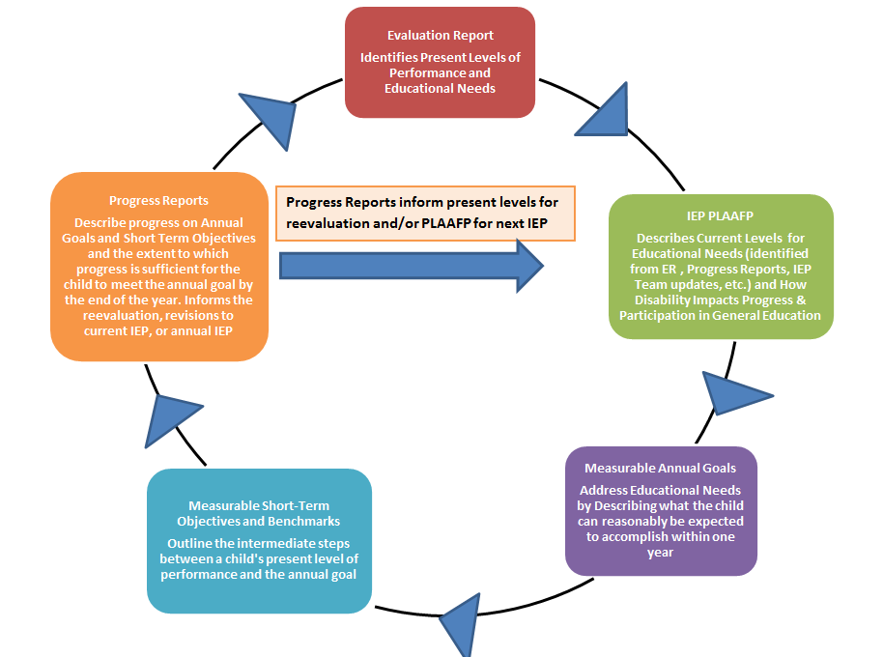
Special Education Process

Slide 18
Initial Eligibility for Special Education
The evaluation team determines if the student is a “child with a disability,” as described in federal and state law, and identifies the student’s educational needs.
34 C.F.R. §§ 300.306 through 300.311
Minn. R. 3525.1325 through 3525.1354
A student must meet the specific criteria for one (or more) of the disability categories outlined in law.
Notes:
Rachael
The evaluation team is comprised of a group of qualified professionals and the parents of the student. The eligibility determination is made upon the completion of assessments and other evaluation measures that documented in the student’s evaluation report. For initial eligibility, a student must meet criteria for one or more disability categories described in MN law.
Remember, if a student does not qualify for special education, the student may still qualify for services under Section 504. Each district must have a designated Section 504 Coordinator!

Slide 19
The IEP Process and Due Process Requirements
Determining Eligibility:
Parent and district discuss the results and then an individualized education program (IEP) team meeting is held (it can be held at same time as the eligibility meeting).

Slide 20
IEP Team membership
IEP Team
General Education teacher, special education teacher, administrative designee, parent, others invited as appropriate, including the student.
The members have the knowledge and expertise to explain the assessment information, understand the general education curriculum, and have expertise in the area of special education. An administrative designee is required and that person must have the authority to commit district resources.
Notes:
Parent(s). General education teacher(s). Special education teacher(s). Representative of the public agency (district). Student (when appropriate).

Slide 21
Due Process Requirements
IEP Team Meeting and Membership:
The District must schedule the meeting at a mutually agreed upon time and place and inform parents of the meeting to ensure that at least one parent is able to participate.
The IEP team must meet the state and federal requirements for membership.
Notes:
District would have to agree to mediation for facilitated team meeting.

Slide 22
Major IEP Components
A description of the student’s present levels of academic achievement and functional performance.
This must include a statement of how the student’s disability affects the student’s involvement and progress in the general education curriculum.
Measurable annual goals and short term objectives/benchmarks (academic and functional).
They must be designed to meet the student’s needs to enable the student to be involved in and make progress in the general education curriculum.
Notes:
Present Levels: for preschool students – how it effects the child’s ability to participate in appropriate activities.

Slide 23
IEP Components
Progress Reporting
Description of when and how progress reporting will occur,
Description of how progress on IEP goals will be measured, and
Describe the special education and related services the student will receive.

Slide 24
Major IEP Components Continued
Supplementary Aids and Services (program modifications, accommodations and supports).
Least Restrictive Environment (LRE): How often will the student not be with nondisabled peers during general education curriculum, and extracurricular and nonacademic activities.
When services are projected to begin, and the anticipated frequency, location and duration of the services and modifications.

Slide 25
IEP Components included if appropriate for the student
State and districtwide assessment - appropriate accommodation(s) needed for or a statement of why a student is unable to take the regular state or district wide assessment and why particular selected alternative assessment is appropriate.
Transfer of Rights by age of majority (not later than one year before the student reaches the age of majority under state law) - inform the student of their rights under IDEA Part B.
.

Slide 26
Transition Services Component
Transition services – to be provided during grade nine.
Produce a results-oriented IEP process;
Focus on improving the academic and functional achievement of the child;
Facilitate movement from school to post-school activities;
Based on child's needs.
Notes:
Rachael
One of our handouts includes a link to online training available from MDE. We will also be sharing some resources to support secondary transition requirements and students’ post-secondary needs.

Slide 27
Due Process Requirements: Prior Written Notice
The District provides the parent with a prior written notice and proposed IEP - the parent must consent to an initial IEP. If it is a revised IEP, the notice informs the parent the IEP will go into effect 14 calendar days from the date it was sent to the parent.
If the parent objects to the proposed IEP – the District must set up a conciliation conference unless the parent refuses. Parent may request mediation, facilitated team meeting or another IEP meeting.

Slide 28
In what areas do Minnesota rules and statutes exceed Federal IDEA Requirements?
See Handout: Section 608 Memorandum

Slide 29
Thank you!
Daron Korte
daron.korte@state.mn.us
651.582.8215
Marikay Canaga Litzau
marikay.litzau@state.mn.us
651.582.8459
Robyn Widley
robyn.widley@state.mn.us
651.582.1143

