Slide 1
3M™ Connected Roads Enabling Intelligent Infrastructure
Minnesota House Transportation Finance Committee Testimony
March 8, 2018

Slide 2
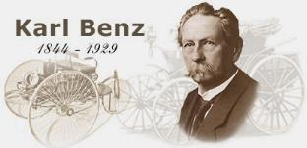
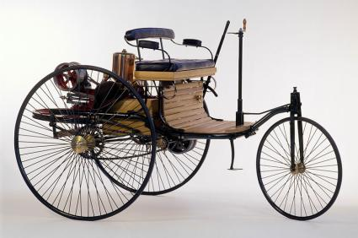
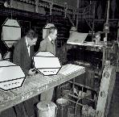
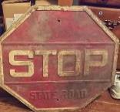
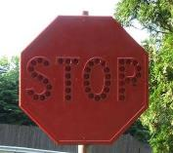
Intelligent Systems Enabling Intelligent Infrastructure
130 years of Stronger, Safer and NOW SMARTER & SAFER
First Automobile
Karl Benz 1885
First Stop Signs

Slide 3
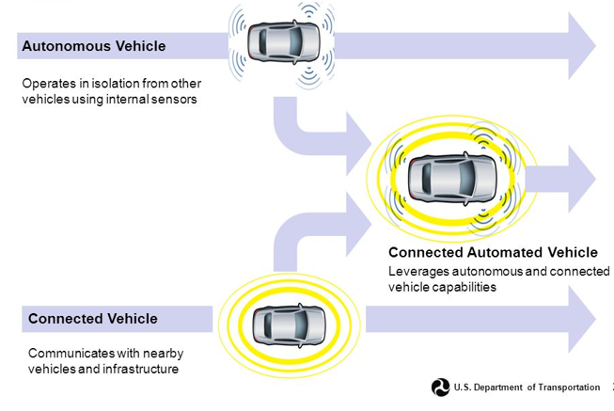
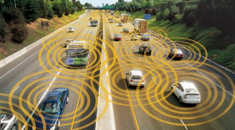
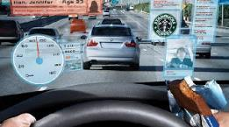
Autonomous Vehicles are the Future of Driving
Infrastructure will play a key role in autonomous driving advancement

Slide 4
Vehicle Development driving Infrastructure need
Yonge-Dundas Square, Toronto Ontario Canada

Slide 5
Pavement Markings Challenges for Optical Camera Systems
1.78
Challenges:
Poor or worn markings
Markings disappearing at night in the rain
Marking disappearing in dry glare conditions
Yellow lines disappearing on concrete or light colored roads
False identification of crack seals, seams, and scars as lane markings

Slide 6
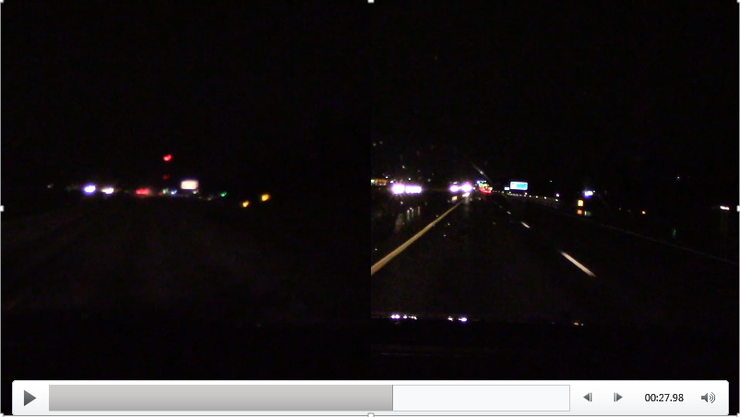
3M Durable Pavement Marketing with All Weather Optics

Slide 7
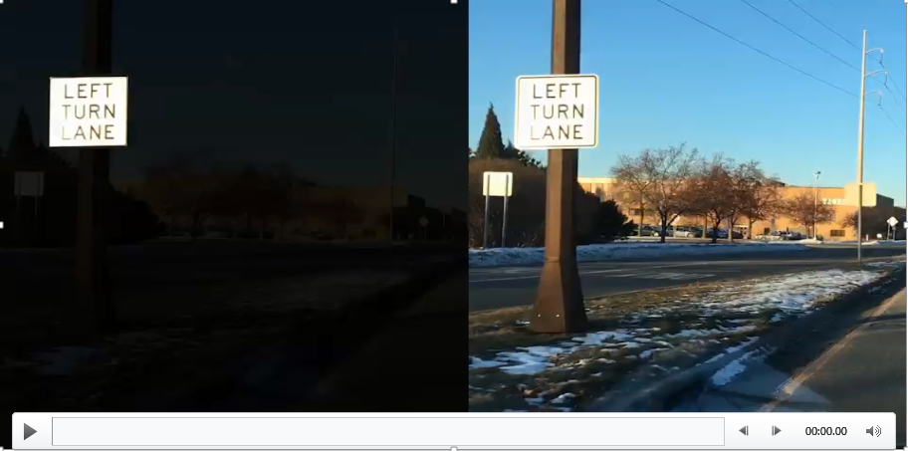
Finding the Sign: Selective sensors, IR vs Optical Camera

Slide 8
Trusting Machines: False Classification Example¹
¹ “Robust Physical World Attributes on Machine Learning Models;” Evtimov etal https://arxiv.org/pdf/1707.08945.pdf
Input Image
Classification Result
Any signing solution needs to address security concerns re: physical “hacks” to road signs that confound AVs.

Slide 9
Optimized Messaging: Machine Readable Signage
Solutions that may enable more reliable sign detection and classification
Human Optimized
Visible Spectrum Image
Computer Vision Image and Associated Meta-Data
Signing Performance Goals
Embeddable digital information
Encoded error recovery
Digitally certain results
Encryptable
Authenticatable
Redundant classification confirmation
Dynamically changeable
Maintains visible light performance

Slide 10
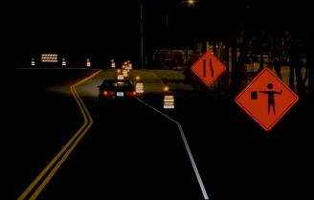
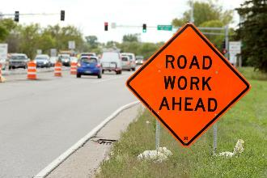
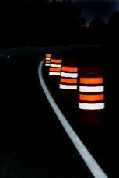
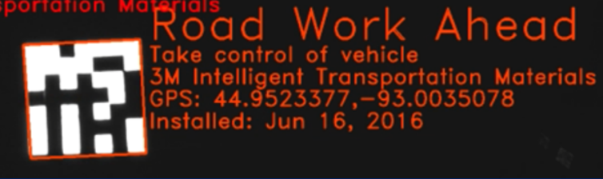
Machine Readable Work Zone Materials
Solutions that may enable accurate work zone object detection and classification
Current Signing
Fluorescent technology
Returns up to 58% of light to all drivers
Maintains superior human readability
Future Signing Performance Goals
Embedded digital information
In development
Quick discernment vs. worker
Embedded metadata
Dynamically changeable
Digital certainty
Sign class redundant
Diamond Grade™ Fluorescent
Machine Vision Optimized with Decoded Metadata

Slide 11
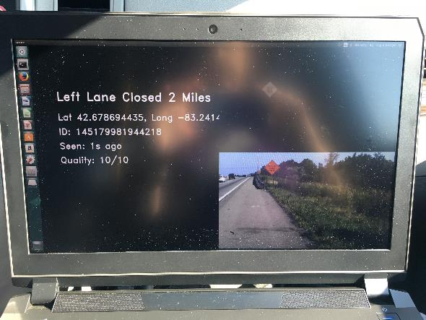
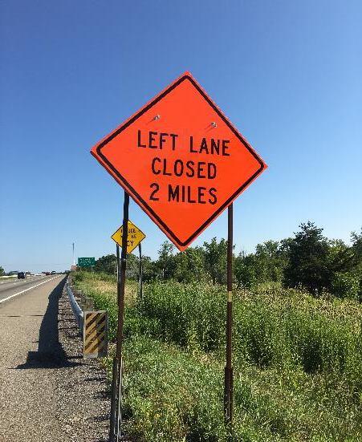
Optimized Messaging, Message Confidence
Machine Readable Sign, MI Corridor, Summer 2017
Performance Metric:
Current read distance is ~ 100 meters at 60mph,
highway conditions

Slide 12
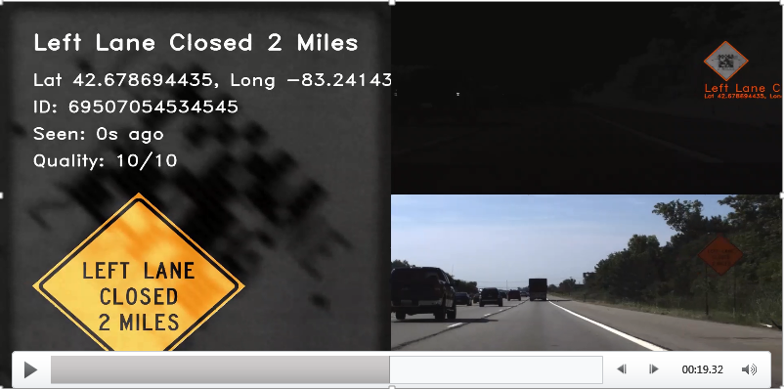
3M Smart Codes, Michigan I-75 Corridor, day (Aug 2017)

Slide 13
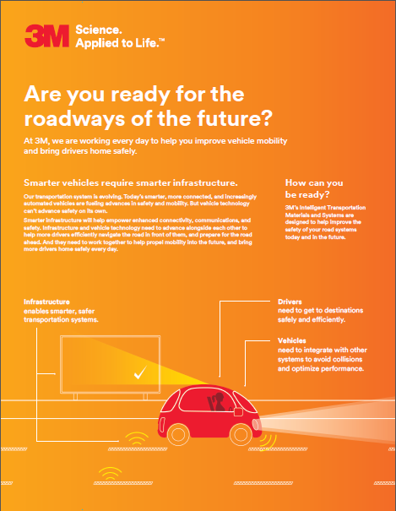
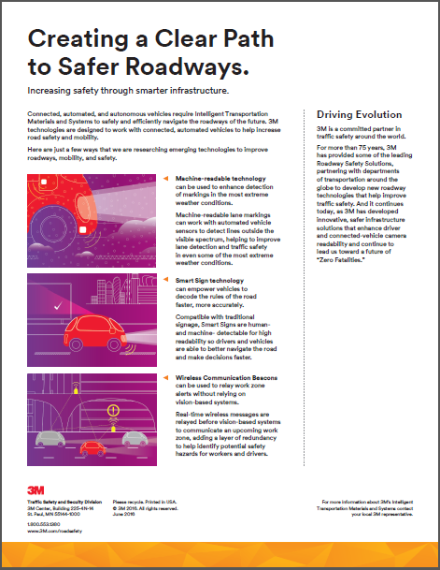
Recommendations to prepare for Roadways of the Future

