Slide 1
Department of Health
House Health and Human Services Finance
House Health and Human Services Reform
Edward P. Ehlinger, MD, MSPH
Commissioner of Health
January 13, 2015
Notes:
[Introduce yourself and others of your team who are there.]
Thank you for inviting us to provide an overview of the Minnesota Department of Health.
I’ll start by providing a brief description of public health.
Then, I’ll describe some of the important areas of work at the Minnesota Department of Health.

Slide 2

“Prevention first, cure if you must; capacity to do in both directions.”
Charles Nathaniel Hewitt
Secretary, MN State Board of Health
1872-1897
Notes:
That began to change with the arrival of this man, Charles Nathaniel Hewitt. As an Army surgeon in the civil war, Hewitt clearly saw that poor sanitation and hygiene were related to disease and death among the troops. After the war, he found transition to civilian medical practice difficult.
He accepted an invitation to come to red Wing, bringing with him his convictions born during the war that improving and restoring health was about more than medical practice, it was also about social change and environmental engineering.

Slide 3
“Public Health is what we, as a society, do collectively to assure the conditions in which people can be healthy.
Institute of Medicine

Slide 4
Determinants of Health Model based on frameworks developed by: Tarlov AR. Ann N Y Acad Sci 1999; 896: 281-93; and Kindig D, Asada Y, Booske B. JAMA 2008; 299(17): 2081-2083.

Slide 5
Necessary conditions for health (WHO)
Peace
Shelter
Education
Food
Income
Stable eco-system
Sustainable resources
Health Care
Equity
World Health Organization. Ottawa charter for health promotion. International Conference on Health Promotion: The Move Towards a New Public Health, November 17-21, 1986 Ottawa, Ontario, Canada, 1986. Accessed July 12, 2002 at <http://www.who.int/hpr/archive/docs/ottawa.html>.

Slide 6
Public health = longer lives
Life Expectancy at Birth,
United States, 1900 - 1996
25 of the 30 years of life gained in the 20th Century resulted from public health accomplishments
Notes:
This slide highlights the huge changes in average life expectancy—an increase of 30 years—that occurred during the 20th century. The Centers for Disease Control and Prevention—one of our key national partners—has estimated that 25 of the 30 years of life gained in the 20th century were the result of public health accomplishments. These accomplishments included such things as: immunizations, food safety, motor vehicle safety, sanitation, and control of infectious diseases.
________________________________________________________________
You may notice a big dip around 1918—that’s because of the 1918 influenza pandemic—more than 10,000 Minnesotans died that winter. National estimates for the impact of a worst-case pandemic influenza today mean an estimated 33,000 deaths and 1,500,000 sick people in Minnesota alone. The slow but steady increase in longevity from the 1970's forward has come from improvements such as mammography, pap tests, shorter emergency response times, blood pressure and cholesterol screenings, nutrition guidelines and tobacco cessation.

Slide 7
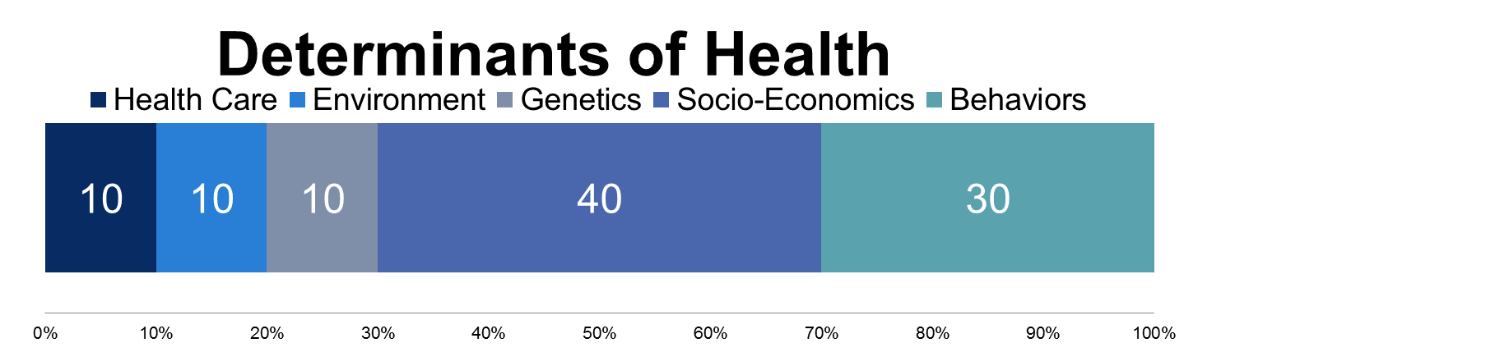
Our investments in health
95
5

Slide 8
Minnesota’s Health Care Spending
Minnesota 48th nationally in per capita public health spending

Slide 9
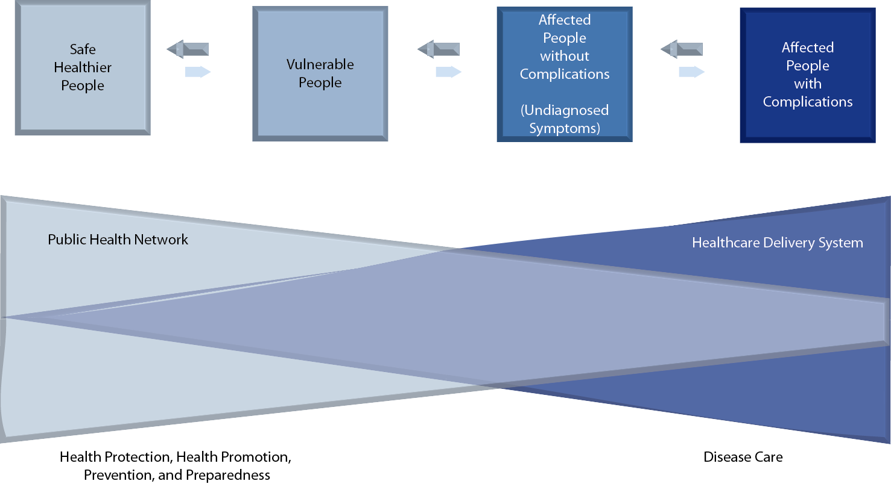
Healthy Healthcare System
Balances Treatment and Prevention

Slide 10
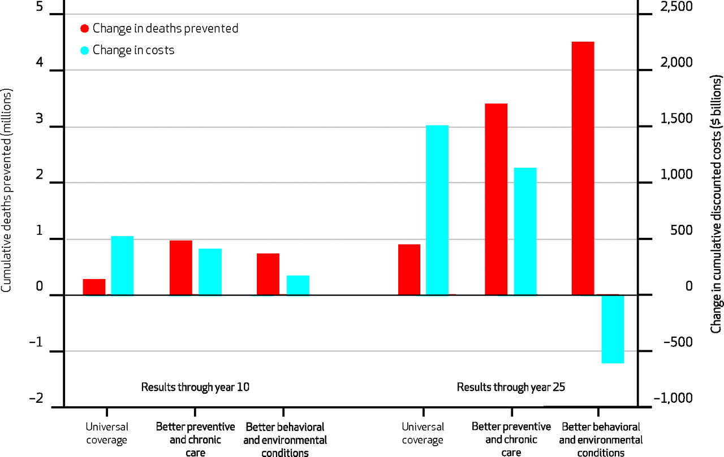

Deaths Prevented And Change In Health Care Costs Plus Program Spending, Three Intervention Scenarios, At Year 10 And Year 25.
Milstein B et al. Health Aff 2011;30:823-832
Notes:
Deaths Prevented And Change In Health Care Costs Plus Program Spending, Three Intervention Scenarios, At Year 10 And Year 25

Slide 11
Deaths Prevented And Change In Health Care Costs Plus Program Spending, Three Intervention Scenarios, At Year 10 And Year 25.
Milstein B et al. Health Aff 2011;30:823-832
©2011 by Project HOPE - The People-to-People Health Foundation, Inc.
Notes:
Deaths Prevented And Change In Health Care Costs Plus Program Spending, Three Intervention Scenarios, At Year 10 And Year 25

Slide 12
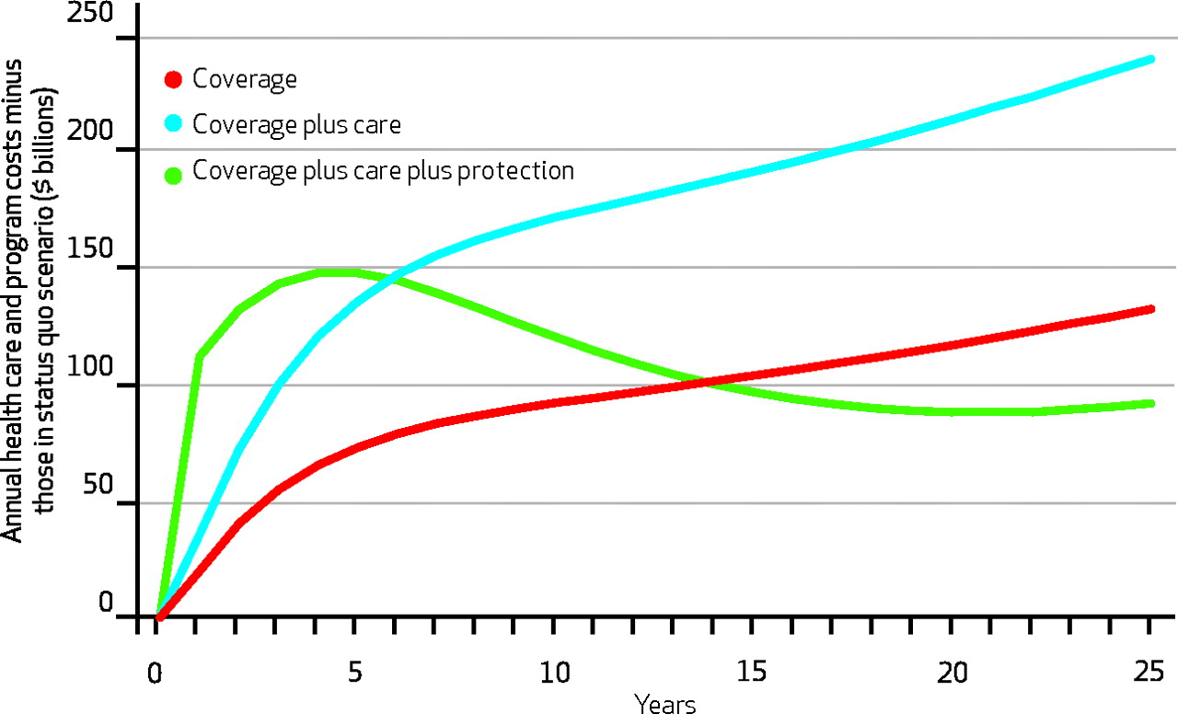
Cost Benefits of Treatment and Prevention
Milstein B et al. Health Aff 2011;30:823-832

Slide 13

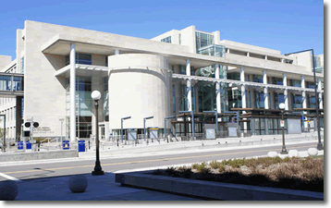
MDH Mission
To protect, maintain and improve the health of all Minnesotans
One of first 5 State Health Departments to be Accredited
Notes:
Both the state and federal constitution include references to government’s role in protecting the public’s health. Minnesota law authorizes a shared role with local government for public health
At MDH, we’re responsible for considering all Minnesotans, and we approach our responsibilities in three main ways:
We require certain actions of entities that play a role in determining people’s health (how restaurants handle food safety; how nursing homes provide care for their residents).
We work with many partners to create the conditions in society (through policies, initiatives, public education) that will enable all people to achieve optimal health.
We encourage people to do things that benefit their health (get regular physical activity, eat nutritious foods, wear seat belts)

Slide 14
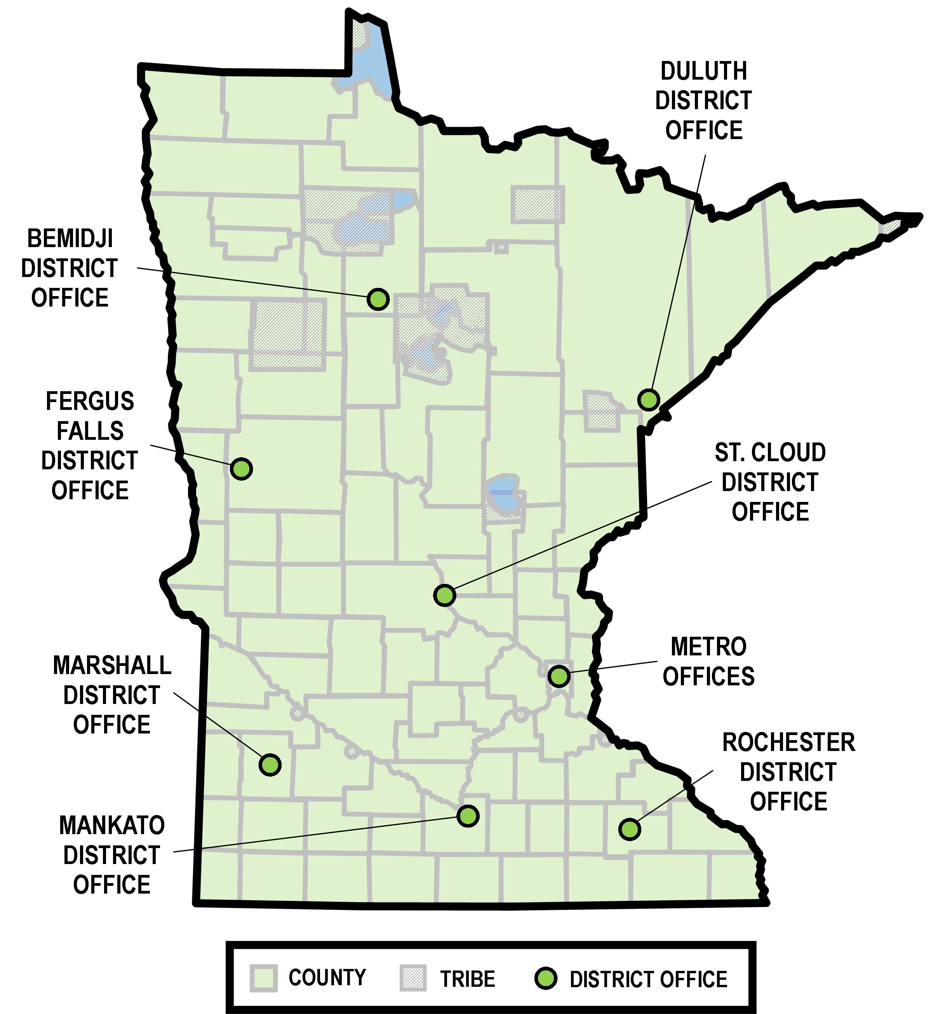
MDH
District Offices
Notes:
MDH doesn’t just exist in St. Paul. We have district offices across the state that are connected to the specific needs of their regions.

Slide 15
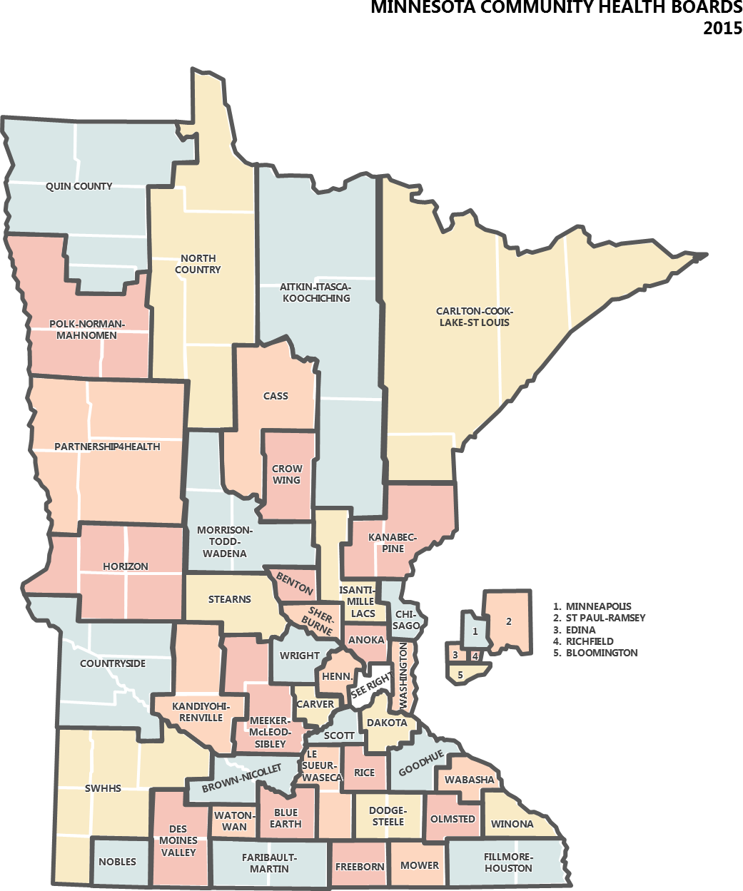
State and Local Public Health Partnership
Notes:
Minnesota’s public health system is known as one of the best in the nation
It is built upon a strong partnership between MDH and local public health agencies, tribal governments and the federal government.
Community Health Boards and Tribal Health Directors cover all counties and tribal governments in the state
The 1976 Community Health Services Act established a framework and reorganized several hundred local public health agencies into what is now 52 county/city health departments that cover the entire state. We share responsibility with tribal governments and public health agencies in acting together to identify and address public health issues. Approximately 21 million dollars annually is distributed under the Local Public Health Grant to 48 Community Health Boards and 11 Tribal Governments. These funds leverage considerably more funds at the local area.
________________________________________________________________
We partner with many organizations as we carry out our public health responsibilities. Partners include:
Local public health agencies
Tribal governments
Policy makers at all levels
Health plans and providers
Businesses
Community organizations
Non-profit organizations
Schools
Faith communities

Slide 16
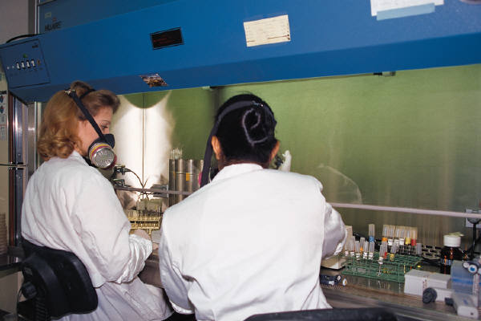
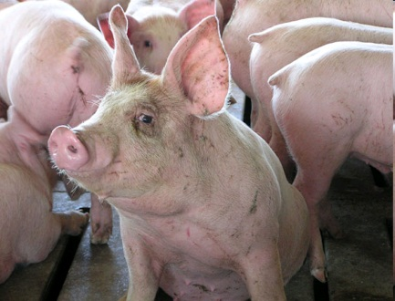
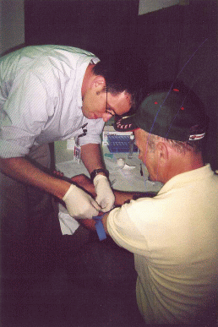
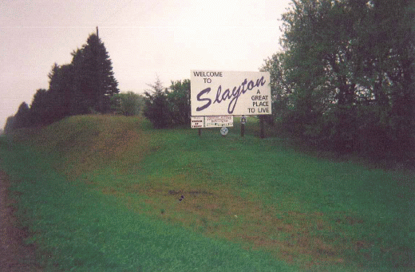
Infectious Disease
Around-the-clock monitoring of infectious diseases, like Ebola
Investigation into novel illnesses through close work with partners
A swift, effective response to disease outbreaks and public health emergencies
(MPR photo/Mark Steil)
Notes:
1. Epidemiologists and laboratory workers work together to monitor disease reports and laboratory specimens to quickly identify disease outbreaks.
The public health laboratory and our infectious disease epidemiologists have developed a working relationship that is the envy of many other states. Here’s one example. Because of our pioneering work in developing the DNA fingerprinting process to compare cases of infectious disease, we are able to quickly identify a disease outbreak in the early stages.
___________________________________________________________________________
For example, we have a comprehensive system in place for tracking where cases of West Nile virus occur in our state. As a result of this kind of monitoring, we’ve been able to determine that more cases occur in the western and central parts of the state. This knowledge helps us target our prevention efforts where they are most needed.
2. MDH scientist were responsible for determining that the cause of an outbreak of salmonella in 2008 was actually due to peppers, not tomatoes, as everyone had originally thought.
In 2008 an outbreak of a very unusual neurologic illness was detected among workers at a swine processing plant in southern Minnesota. The condition was named Progressive Inflammatory Neuropathy or PIN. With close cooperation from plant management and worker groups, MDH investigated the cause of this novel debilitating illness. The use of compressed air to remove swine brain resulting in aerosolization of brain material was identified as the cause of the illness.
A worldwide investigation was initiated to identify additional cases of the illness finding 2 other plants in the United States using this technique to remove swine brain. The close collaborative work coordinated by MDH, including the Minnesota Departments of Agriculture and Board of Animal Health; Indiana, Illinois, South Dakota, and Nebraska state departments of health; multiple federal agencies including CDC, USDA, OSHA, and NIOSH; international agencies including the World Organization for Animal Health, the World Health Organization, Health Canada, and Mexican Department of Health and Hygeine; and the academic institutions of the University of Minnesota, Mayo Clinic, and Columbia University was necessary to understand the cause of this novel illness. Following our investigation and recommendation that the use of compressed air to remove swine brain be discontinued, no additional cases of this illness have been detected.
This type of collaborative effort is critical for the rapid identification of novel illnesses, and it demonstrates MDH’s capacity to identify, investigate, and control emerging health threats.
3. In May of 2007, more that 2,280 people in Slayton, MN received immune globulin following a hepatitis A outbreak at a restaurant that sickened eight people, one of whom required a liver transplant and subsequently died. This highlights the close relationship with local pubic health I mentioned earlier. The investigation and clinics combined the efforts of state and local health departments.
Finding outbreaks early and preventing further cases means fewer people getting sick and needing more expensive health care services.

Slide 17
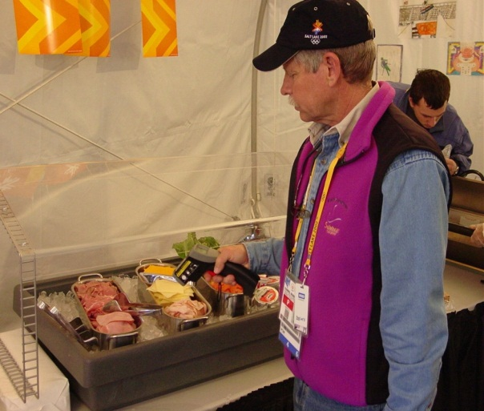
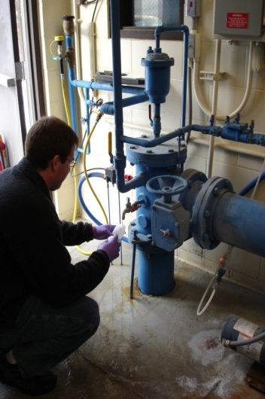
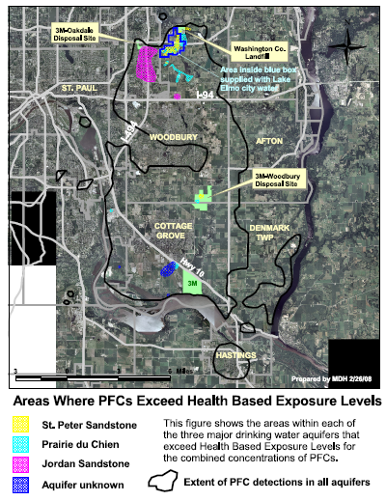
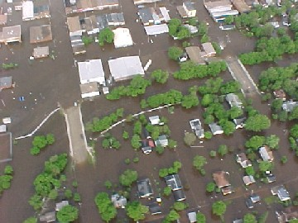
Environmental Health
Assurance that the water you drink is clean and the food you eat is safe
Advice about reducing risks
Notes:
I’d like to highlight a few environmental health issues. In 2006 Minnesota was recognized by the National Groundwater Association for sealing more than 200,000 wells, cumulatively Minnesota seals more abandoned wells to prevent groundwater contamination than all other states combined—an important point because of our dependency on ground water for drinking water throughout the state.
We collect and analyze more than 150,000 drinking water samples each year to assure the public receives safe drinking water. All newly constructed private wells are sampled for the presence of bacteria, nitrates and arsenic.
We‘re working with restaurant managers to develop food safety protocols and systems—not just inspections--to protect food safety. There are more than 20,000 licensed establishments in MN.
2. Unfortunately, chemicals have been released into the air, water and soil. MDH works closely with MN communities, the MN Pollution Control Agency and the MN Department of Agriculture to investigate and understand risks associated with chemical exposure, and ultimately, to assist in setting clean up standards for contaminated areas.
Floods and tornados are a fact of life in Minnesota. The health department quickly moves into action with services such as testing well water for contamination [a free service] and providing advice about molds and food safety and immunizations for things such as tetanus.
Flooding occurs almost every year in Minnesota and we work with local communities to assist them in safeguarding the public’s health, by making sure that well water test kits are ready and water samples are quickly analyzed.

Slide 18
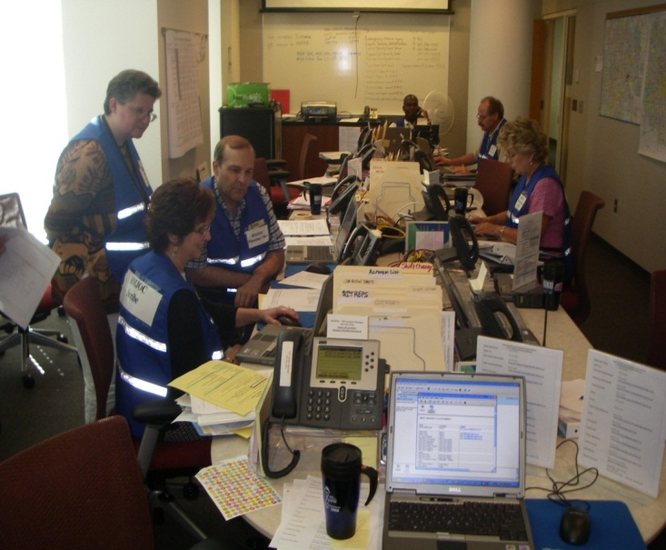
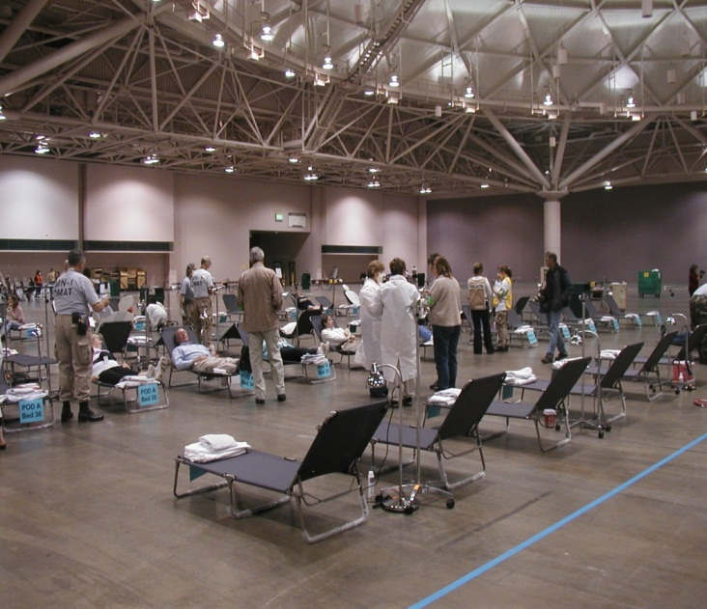
Emergency Preparedness
Statewide preparations for responding to public health emergencies, including a possible pandemic
Planning with hospitals and health care systems to rapidly care for large numbers of injured or ill victims
Notes:
A major activity since 9-11 has been state and local public health preparedness. Federal funding supports 24/7 communication tools, training in emergency response activities, planning and tabletop exercises. This picture shows our Department Operations Center where staff are coordinating local and state activities during the Republican National Convention. We have responded in coordination with local health departments to floods, tornadoes, chemical spills, school bus crashes, disease outbreaks, Ham Lake fire, and other similar incidents.
Mention Ebola activities
___________________________________________________________________________
In Emergency Preparedness, we have also:
Worked with the Legislature to develop a legal framework for responding to terrorism and natural disasters
Developed response plans with local communities and tribal governments for emergency preparedness and response.
Share information, plans and exercises with neighboring states and Canada. Public health emergencies don’t stop at borders or boundaries—it is critical for all communities to be prepared.
Participated in hundreds of local, regional and statewide exercises to practice our response roles
Established a stockpile of antiviral medications and healthcare supplies for use during a pandemic
In expanding hospital and healthcare system preparedness we have:
Launched “Minnesota Responds,” a database of volunteers willing to respond in the event of an emergency
Developed a hospital bed availability, patient tracking, and resource management web-based system to rapidly communicate about scarce resources
Clarified responsibilities of local, regional and state facilities and agencies
Developed guidance for managing healthcare in the face of resource shortages of medications, oxygen, staffing, and ventilators

Slide 19
Office of Medical Cannabis
2014 law creates a new process to allow 5,000 seriously-ill Minnesotans to acquire and use medical cannabis to treat certain specified conditions
Registered two manufacturers by 12/1
Development of a patient registry
Published review of medical
Cannabis studies
Adopted administrative rules

Slide 20
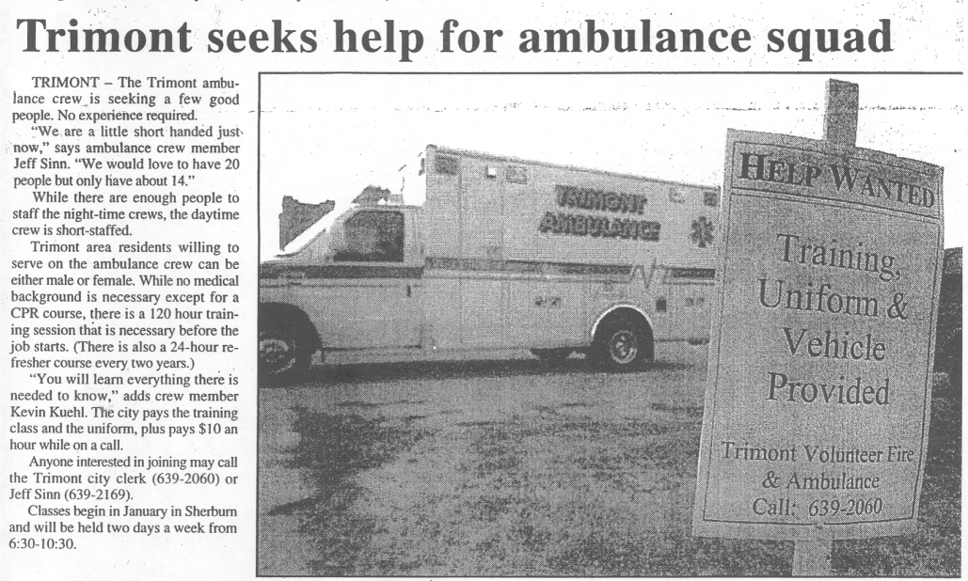
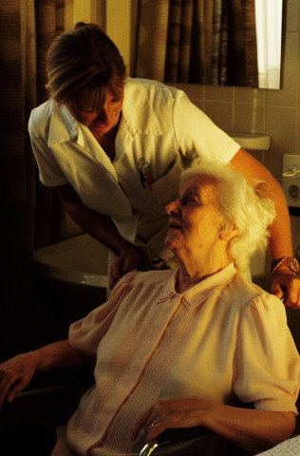
Rural Health, Workforce, & Vulnerable Adults
Planning to help ensure rural Minnesotans have access to care
Assuring adequate health/health care workforce
Assurance that abuse or neglect in nursing homes, hospitals and other care facilities will be corrected
Notes:
Our Office of Rural Health provides a forum for addressing rural health care issues across the state.
The office distributes grants to maintain and improve the rural health infrastructure and workforce.
The office also helps coordinate discussions about – and assist in developing policy directions for – issues such as workforce shortage, access to certain types of providers, facilities and technology.
Finally, the office also administers the Statewide Trauma System, which aims to ensure that severely injured people are promptly transported and treated appropriate to the severity of injury. ___________________________________________________________________________
2. Approximately 687,000 Minnesotans receive care during the year from a nursing home or hospital.
We inspect over 1000 licensed and certified health care facilities annually
We receive over 1600 complaints about care in hospitals or nursing homes
We investigate 400-500 of those complaints by on-site visits
We issue correction orders and penalties
We make the results available to the public, and include it in the Nursing Home Report Card
__________________________________________________________________________
We’ve also been working diligently on improving how we monitor and assure quality care in long-term care facilities. The nursing home report card shows how Minnesota nursing homes scored in seven quality measures. Consumers have been quite interested in accessing this information when researching and choosing a nursing home; approximately 1575 queries are made to the Nursing Home Report Card each month.

Slide 21
Health Economics
Trends in health care costs and economic indicators
Health care cost is MN privately insured spending on health care services per person, and does not include enrollee out of pocket spending for deductibles, copayments/coinsurance, and services not covered by insurance.
Sources: Health care cost data from Minnesota Department of Health, Health Economics Program; per capita personal income from U.S. Department of Commerce, Bureau of Economic Analysis; inflation data from U.S. Bureau of Labor Statistics (consumer price index); workers’ wages from MN Department of Employment and Economic Development
Notes:
This chart shows how health care cost growth in Minnesota has outpaced growth in some other key economic measures over time. It is just one example of the kinds of information and statistics available from MDH. Information like this was invaluable to policy makers in developing last year’s health reform bill, and it will also be important to understanding the impact of reforms.
Additional examples of information that MDH produces include:
Statistics on health insurance in Minnesota, including the number of uninsured people, disparities in insurance coverage (for example by race/ethnicity or by region within Minnesota), trends in insurance coverage and the reasons why coverage is changing;
Information on total health care spending in Minnesota over time, by source of funds and by type of service;
Analysis of health care system capacity and utilization;
Reporting of adverse events in hospitals and surgery centers;
Best practices and technical support for advancing e-health;
Information on the impact of policy decisions on rural and safety net health care providers
---------------------------------------------------------------------------------------------------------------

Slide 22

Health Care Homes & State Innovation Model
Health reforms to:
Reward value, not volume of services (Health Care Homes)
  Care coordination
  Quality incentive payments
Create transparency of quality and cost (State Innovation Model)
  Quality measurement and reporting
  All Payer Claims Database

Slide 23
Health Promotion and Chronic Disease
Firearms
Toxic Agents
Microbial Agents
Alcohol
Diet/Physical Activity
Attributable Causes of Death

Slide 24
Statewide Health Improvement Program (SHIP)
Locally-controlled, research-based strategies include:
• “Farm to School” - kids get healthy produce while benefiting local farmers
• Support employers with comprehensive workplace wellness (ROI up to 6:1)
• “Complete Streets” - sidewalks and crosswalks for to physical activity
• Healthier eating and physical activity in childcare settings
• Colleges and apartment buildings
going tobacco-free
SHIP
Schools
Businesses
Communities
Providers

Slide 25
SHIP – Washington County
Improving Water Access in Forest Lake Schools
3,100 Forest Lake-area students will have access to water bottle filling stations in schools.
Water access based on Alliance for a Healthier Generation’s assessment and planning tool
Increasing student access to water proved to be an early and quick strategic success for the District.

Slide 26
SHIP – Goodhue County
Safe Biking in Zumbrota
Zumbrota Bikeabout used a 90-minute ride to determine safety & improvement needs in the community
Discussion of findings at 11/14 Park Board will be used for Zumbrota Master Bicycle Plan

Slide 27
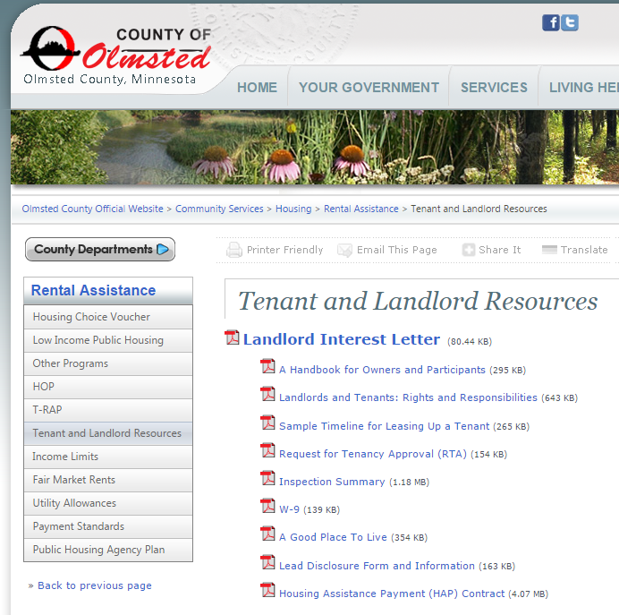
SHIP – Olmsted County
Tobacco-free housing
County spent 2+ years developing Smoke-Free Multi-Housing policy and passed a smoke-free grounds policy
Improves quality of life for seniors, children, minority community and those in poverty
300 affordable housing units will now smoke free effective May 1, 2015

Slide 28
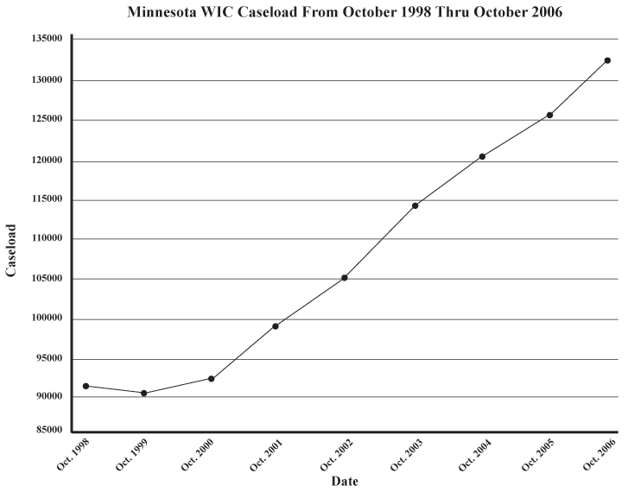
Community & Family Health
An immunization program for preventable diseases
WIC Services providing access to nutritious food.
Pneumococcal Vaccine
Licensed
Notes:
The rates of invasive pneumococcal disease, including meningitis, used to be highest in young children. A new pneumococcal vaccine was licensed in 2000; it protects against most types of pneumococcus that cause these serious infections. Through education and coordination with health care providers and parents, the number of cases in children under age 5 has been drastically reduced, from an average 197 cases/per year in 1997-1999, to about 53 cases per year in 2006-2008 (in the Twin Cities area alone).
2. The WIC Program provides a healthy start for pregnant women, infants and children up to age five through nutritional assessment and key nutritious foods. WIC is providing services to almost 145,000 Minnesota mothers and children. WIC is also an important gateway program for other public health intervention efforts, connecting high risk, vulnerable populations to needed services.
___________________________________________________________________________
We also administer programs that support healthy families. We:
Assure a healthy start for young children through programs such as Newborn Hearing Screening, Family Home Visiting, FAS prevention and the Follow-Along Program
Provide pre-pregnancy education, counseling, and services to prevent or delay pregnancy
Provide services that assist women in carrying their pregnancies to term and improving birth outcomes
Provide leadership so that children with special health care needs and their families receive comprehensive coordinated care within a health care home
Provide information to professionals, health care providers, parents and others on maternal and infant mortality, safe sleep for infants, child and adolescent health and other key health issues impacting mothers and children.

Slide 29
Advancing Health Equity
50 years of growing diversity
Source: mncompass.org
Notes:
To put things into perspective: Here in Minnesota we look much different than we did 50 years ago. In 1960 the percent of the population that were people of color was close to zero. Today we have a much larger percentage of people of color – both statewide and in the metro. But we are much less diverse than many other metros nationally and the country overall.
In the Twin Cities metro about 25%, or 1 in 4 residents is a person of color, compared with about 36 percent nationally. When we include Greater MN in these figures, 17% of the state is made up of people of color.

Slide 30






The Center for Health Equity
A focus on Health Equity
Notes:
In 2014 MDH released a groundbreaking report on Advancing Health Equity in Minnesota (explain report and what it focused on and the attention it has received)
Eliminating Health Disparities Initiative (EHDI) is an important initiative
As a result of EHDI grants, community-based capacity and leadership have strengthened within communities of color and American Indians.
Rates for infant mortality, immunizations, diabetes, cardiovascular health among populations of color and American Indians are improving but there is more to be done.
Will focus more on:
Understanding of policy and social determinant interventions
Delivering measurable outcomes

Slide 31
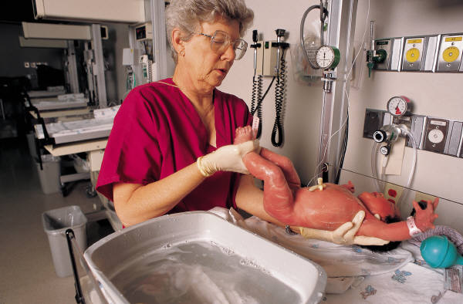


Vital Records and Mortuary Science
Birth and death certificates
Assurance that the dead are disposed of safely
Notes:
The Minnesota Department of Health’s Office of Vital Records registers all births and deaths in Minnesota through a secure centralized electronic system.
Together with funeral homes, medical examiner and coroner offices, hospitals, and hundreds of physicians throughout Minnesota, OVR expects to register over 75,000 births and 38,000 deaths for Minnesota this year. In addition, OVR and local registrar staff in city and county offices use this system to issue over 750,000 birth and death certificates and process over 35,000 corrections, amendments to, and replacements of records each year.
Thanks to LEAN processing, Minnesota Department of Health reduced the time it takes to process requests for duplicate birth certificates by more than 80 percent, from six days to less than one.
2. We work with funeral homes, crematories, morticians, and funeral directors to assure that there is a timely and appropriate disposition of the dead in a manner that protects the health and safety of those working in the profession and the general public.

Slide 32
MDH Budget
Notes:
Federal funds are undercounted in the graph. Approximately half of the MERC amount and a portion of the Special Revenue come from federal sources.
SGSR revenue comes from fees assessed on health care providers and facilities, service providers and for public health services to cover the cost of the services provided. MDH has 32 fee programs which generate approximately $41 million per year in revenue. Fee revenue is deposited into the SGSR as nondedicated revenue. Fee amounts are set in Statute and the amounts spent from the SGSR are appropriated by the Legislature. State law requires that over time, revenues and costs for a fee program must balance out.
MERC comes from tobacco tax revenue ($3.787 million per year) and an amount carved out of the rates paid to PMAP plans ($18.372 million per year). Those funds are matched by the feds and are distributed by MDH to health care training sites through a formula in statute. Total cost to the state of restoring previous MERC reductions is $9.616 million per year. This amount would be matched by the feds.
Special revenue represents funds generated by MDH through contracts to provide public health services with other government agencies and priviate entities.

Slide 33
How the General Fund Budget is Spent

Slide 34
Staffing
Base FY 2016-17 MDH Staffing Levels
Total FTEs: 1,309
General Fund FTEs: 128 (9.8%)
Notes:
Nonpayroll operating costs for FY 2014-15 include:
$47 million for consolidated IT services
$29 million for building rental
$58 million for professional and technical contracts
Staffing levels have been declining since FY 2006
FY 2006-07: 1,359
FY 2008-09: 1,305
FY 2010-11: 1,300
FY 2012-13: 1,271
FY 2014-15: 1,264

Slide 35
Largest Sources of Federal Funding
2016-17
Federal Agency | Amount
US Department of Agriculture (WIC) | $240 million
Centers for Disease Control (CDC) | $119 million
Centers for Medicare and Medicaid Services (CMS) | $41 million
Health Resources and Services Administration (HRSA) | $38 million
Department of Health and Human Services (other) | $34 million
Environmental Protection Agency (EPA) | $20 million
Notes:
USDA represents the WIC program. These are dollars that flow through to local governments
The CDC pays for public health programs that address specific conditions including:
Cancer
Diabetes
Arthritis
Asthma
Stroke
The CDC also funds health promotion activities such as tobacco cessation. The CDC is an important source of operating revenue for the department.
Health Resources and Services Administration (HRSA) funds services related to health care delivery:
Activities to increase the capacity of the health care system to respond to public health emergencies
Grants to support the rural health care system
Grants to support efforts to address health care workforce shortages.
Administration for Children and Families (ACF): Pays for evidence based early childhood home visiting and grants to address health disparities
EPA pays for environmental health functions including water and air quality, lead and asbestos, etc

Slide 36
MDH Sections Most Reliant on
Federal Funds
Section | % of Funding from Federal Sources
Office of Emergency Preparedness | 98%
Infectious Disease Epidemiology Prevention and Control | 85%
Community and Family Health | 81%
Health Promotion and Chronic Disease | 63%
Notes:
Several areas of the department are particularly dependent on federal funds
OEP is the area that responds when there is a pubic health emergency, such as the flood in Duluth and the tornado in Minneapolis. They also provide training and acquire and store supplies to provide for greater capacities to respond.
Community and Family Health. This sections administers the WIC program as well early childhood home visiting and pre-pregnancy family planning
Health Promotion and Chronic Disease operates a number of programs to address specific health conditions. They provide cancer screening for low-income women.
Infectious Disease Epidemiology Prevention and Control. This is the area that works to prevent, investigate and respond to infectious disease outbreaks. These are the people who responded to the current flu pandemic and the recent outbreaks of fungal meningitis and swine flu .
Office of Statewide Health Improvement works on efforts like tobacco cessation and improving nutrition and physical exercise.
Federal funding has been declining for a number of years, including lead, epidemiology, and lab work. Additional potential cuts include the elimination of the Preventive Block Grant.
MDH would be significantly impacted if went over the fiscal cliff.

Slide 37
“Public health is what we, as a society, do collectively to assure the conditions in which (all) people can be healthy.”
-Institute of Medicine (1988), Future of Public Health
Edward P. Ehlinger, MD, MSPH
Commissioner, MDH
P.O. Box 64975
St. Paul, MN 55164-0975
Ed.ehlinger@state.mn.us

