Slide 1


Slide 2
Minnesota House of Representatives Transportation Committee Minnesota Section of the American Society of Civil Engineers January 29, 2019
Notes:
GOOD AFTERNOON MR. CHAIRMAN AND COMMITTEE MEMBERS

Slide 3

Report Card Presenters:
Seth Spychala, PE Nick Turner, PE
Steve Olsen, PE Darwin Yasis, PE
Notes:
MY NAME IS SETH SPYCHALA AND I AM A CIVIL ENGINEER.
I AM THE LEGISLATIVE COMMITTEE CHAIR FOR THE MINNESOTA SECTION OF THE AMERICAN SOCIETY OF CIVIL ENGINEERS
MY COLLEAGUES AND I ARE PLEASE TO PRESENT TO THE COMMITTEE THE FINDINGS OF THE TRANSPORTATION CATEGORIES OF THE 2018 REPORT CARD FOR MINNESOTA’S INFRASTRUCTURE

Slide 4

The American Society of Civil Engineers represents more than 150,000 members of the civil engineering profession in 177 countries.
Founded in 1852, ASCE is the nation’s oldest engineering society.
ASCE is a non-profit organization
Notes:
THE AMERICAN SOCIETY OF CIVIL ENGINEERS REPRESENTS MORE THAN 150,000 MEMBERS OF THE CIVIL ENGINEERING PROFESSION ACROSS THE WORLD
ASCE WAS FOUNDED IN 1852. IT IS THE OLDEST ENGINEERING SOCIETY IN THE COUNTRY
ASCE IS A NON-PROFIT ORGANIZATIONS

Slide 5

The Minnesota section of ASCE is made up of over 1700 men and women volunteers.
Our Section celebrated it centennial in 2014
ASCE stands at the forefront of a profession that plans, designs, constructs, and operates society’s economic and social engine – the built environment
Notes:
THE MINNESOTA SECTION OF ASCE IS MADE UP OF OVER 1700 MEN AND WOMEN VOLUNTEERS IN THE ENGINEERING PROFESSION
OUR SECTION CELEBRATED ITS CENTENNIAL IN 2014
OUR MEMBERS ARE THE DESIGNERS, CONSTRUCTORS, OPERATORS, AND MAINTAINERS OF MINNESOTA’S INFRASTRUCTURE.
THE BACK BONE OF OUR SOCIETY – THE BUILT ENVIRONMENT

Slide 6

First ASCE National Report Card 1998
Society release National Report Card every 4 years
2017 National Infrastructure GPA D+
Notes:
THE FIRST ASCE NATIONAL INFRASTRUCTURE REPORT CARD WAS RELEASED IN 1998
YOU MAY HAVE HEARD THE REPORT CARD REFERENCE IN THE PRESIDENT’S OF THE UNITED STATES, STATE OF THE UNION ADDRESSES
THE SOCIETY RELEASES A NATIONAL REPORT CARD EVERY 4 YEARS
IN 2017 ASCE GAVE THE NATIONAL OVERALL INFRASTRUCTURE GPA D+

Slide 7
MINNESOTA REPORT CARD
Start 2016
Release finding October 2018
Report Card Committee
Chairman Jason Staebell
9 Authors
9 Supporting members
Notes:
WE STARTED RESEARCH AND PLANNING OF THE MINNESOTA REPORT CARD BACK IN 2016
JASON STAEBELL IS THE REPORT CARD COMMITTEE CHAIR
WE HAD 9 LEAD AUTHORS
AND 9 ADDITION SUPPORTING MEMBERS ALL WERE VOLUNTEERS
WE RELEASED THE FINDINGS OF THE REPORT CARD IN OCTOBER 2018 18 MONTHS AFTER OUR START

Slide 8
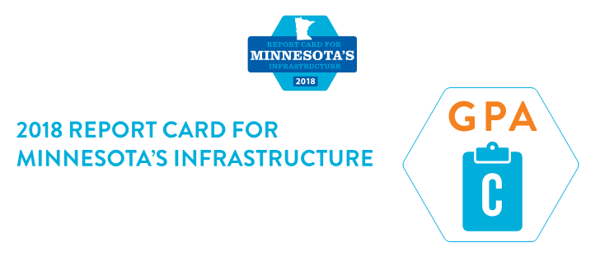
2018 Minnesota’s Infrastructure GPA is C
Minnesota Report Card grades 9 infrastructure categories
Notes:
THE 2018 MINNESOTA INFRASTRUCTURE REPORT CARD GIVES THE STATES INFRASTRUCTURE A CUMULATIVE GPA GRADE OF C
YOU HAVE ALL BEEN GIVEN REPORT CARD PAMPHLET AN EXECUTIVE SUMMARY OF THE REPORT CARD
A GRADE OF C MEANS MEDIOCRE AND REQUIRES ATTENTION

Slide 9
INFRASTRUCTURE GRADES BASED ON EIGHT CRITERIA
Capacity
Condition
Funding
Future Need
Operation and Maintenance
Public Safety
Resilience
Innovation
Notes:
THE GRADES FOR EACH OF THE CATEGORIES IS BASED ON EIGHT CRITERIA
CAPACITY
CONDITION
FUNDING
FUTURE NEED
OPERATION AND MAINTENANCE
PUBLIC SAFETY
RESILIENCE
INNOVATION

Slide 10

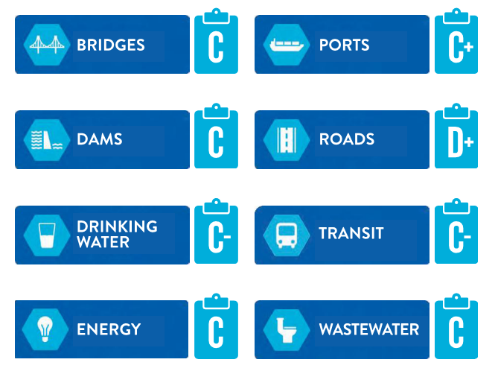
Notes:
THE 9 INDIVIDUAL CATEGORY GRADES ARE ALSO GIVEN IN THE PAMPHLET
THE HIGHEST GRADE WAS A B FOR AVIATION
THE LOWEST GRADE WAS D+ FOR ROADS
THE FULL 82 PAGE REPORT CAN BE FOUND AT WWW.INFRASTRUCTURE REPORT CARD.ORG / MINNESOTA
WITH THAT I WILL TURN IT OVER TO MY COLLEAGUE NICK TURNER WHO WILL FURTHER DISCUSS ROADS

Slide 11
Minnesota House of Representatives Road Topic Slides Nick Turner January 29, 2019

Slide 12

Minnesota has the 5th highest number of public roadway miles in the U.S.
The Minnesota State Highway Investment Plan (MnSHIP) estimated that roads are underfunded by $17.7 billion over the next 20 years
Current primary funding sources are fuel, registration, and vehicle sales tax
Congestion is a major problem in the Twin Cities
The average driver spends 41 hours in traffic , averaging a cost of $1,332/ driver or $2.3 billion
Notes:
GOOD AFTERNOON.
MR. CHAIRMAN THANK YOU FOR THE OPPORTUNITY TO TESTIFY BEFORE YOUR COMMITTEE.
MY NAME IS NICK TURNER. I AM A LICENSED PROFESSIONAL CIVIL ENGINEER THAT FOCUSES IN TRANSPORTATION DESIGN.
MY MISSION THIS AFTERNOON IS TO ARTICULATE THE CONDITION AND THE FUNDING NEEDS FOR THE PUBLIC ROADS IN MINNESOTA.
THE AMERICAN SOCIETY OF CIVIL ENGINEERS, MINNESOTA CHAPTER, HAS ASSIGNED A LETTER GRADE OF D+ TO THE ROADS OF MINNESOTA. THAT IS A POOR GRADE AND DEPICTS THAT THEY REQUIRE IMMEDIATE ATTENTION.

Slide 13
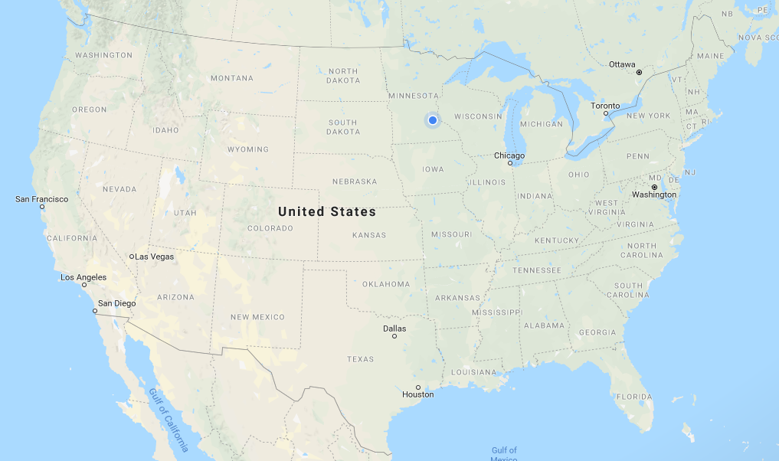
Minnesota has over 140,000 miles of roadway
>50 Trips from
L.A. to New York
16% Urban
~116,000 miles
of rural roadway
Fatality rate on urban MN roads = 0.29 per 100 million vehicle miles
Fatality rate on rural MN roads = 1.12 per 100 million vehicle miles
Notes:
MINNESOTA HAS OVER 140,000 MILES OF ROADWAY. THIS IS NOT THE MEASUREMENT OF LANE MILES, THIS IS THE NUMBER OF CENTERLANE MILES. ACTUAL MILES OF PAVEMENT IN MINNESOTA. THIS PUTS MINNESOTA WITH THE 5TH MOST MILES OF ROADWAY IN THE UNITED STATES.
140,000 MILES IS MORE THAN 50 TRIPS FROM LAS ANGELES TO NEW YORK, ALL PACKED INTO OUR ONE STATE.
OF THESE MILES, 16% ARE CONSIDERED URBAN, LEAVING AROUND 116,000 MILES OF RURAL ROADS IN MINNESOTA. I WANTED TO BREAK THIS DOWN BECAUSE OF THE SAFETY DIFFERENCE NOTICED IN THIS STATE BETWEEN URBAN AND RURAL ROADS. ON THE 16% THAT ARE URBAN, MINNESOTA HAS A FATALITY RATE OF 0.29 DEATHS PER 100 MILION VEHICLE MILES. ON THE RURAL ROADS, THERE IS NEARLY A 4 TIMES INCREASE IN THIS FATALITY RATE TO 1.12 DEATHS PER 100 MILLION VEHICLE MILES. WHEN COMBINED WE ARE AT 0.63 FATALITIES PER 100 MILLION VEHICLE MILES, BETTER THAN THE NATIONAL AVERAGE OF 1.16 FATALITIES PER 100 MILLION VEHICLE MILES, BUT STILL MEANING 358 DEATHS OCCURRED ON MINNESOTA ROADS IN 2017.

Slide 14
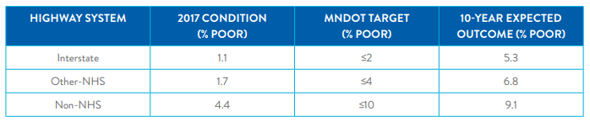
State owned trunk highway system is 12,000 miles
13% Interstate
41% NHS Highways
46% Non-NHS Highways
Notes:
OF THE 140,000 MILES, 12,000 MILES ARE THE STATE OWNED TRUNK HIGHWAY SYSTEM. CURRENTLY, THE MINNESOTA TRUNK HIGHWAY SYSTEM MEETS EACH OF THE MNDOT TARGETS FOR % OF POOR ROADWAYS. I CHOSE TO SHOW THE POOR RATING, AS ANY ROAD WHICH FALLS FAR ENOUGH TO BE LABELED POOR WILL REQUIRE A FULL RECONSTRUCTION. MNDOT’S 10-YEAR PROJECTION SHOWS THESE FAVORABLE CONDITIONS DISAPPEARING. THESE PROJECTIONS SHOW NEARLY 5 TIMES MORE INTERSTATE MILES WILL BE POOR, NEARLY 4 TIMES MORE OTHER-NHS MILES WILL BE POOR AND MORE THAN 2 TIMES MORE NON-NHS MILES WILL BE POOR. IN 10 YEARS, WE ARE EXPECTED TO NOT MEET MNDOT’S TARGET FOR 2 OF THESE 3 CATEGORIES.

Slide 15
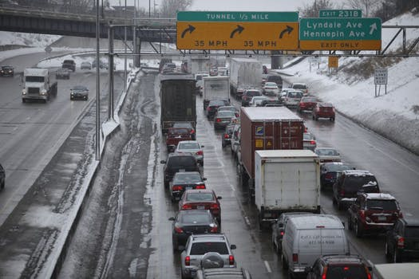
The Twin Cities is the 17th worst level of congestion for urban areas in the United States
The average driver spends 41 hours in traffic, averaging a cost of $1,332/ driver or $2.3 billion
The Twin Cities hosts 5 of the worst 100 trucking bottlenecks in the United States. Only Houston and Atlanta have more.
I-94 at US 52
I-35W at I-494
I-35W at I-94
I-35E at I-94
I-35W at I-694
Notes:
WHEN REVIEWING CONGESTION LEVELS IN MINNESOTA WE NOT ONLY FOUND THAT THE TWIN CITIES AREA HAS SOME OF THE WORST CONGESTION IN THE STATE, BUT THAT THIS AREA IS RECOGNIZED NATIONALLY FOR IT’S CONGESTION. WITH AN AVERAGE DRIVER LOSING 41 HOURS IN TRAFFIC EACH YEAR, IT IS ANTICIPATED THAT CONGESTION COSTS MINNESOTANS MORE THAN $2.3 BILLION EACH YEAR. THAT MAKES THE TWIN CITIES THE 17TH WORST URBAN AREA IN THE UNITED STATES
WE ALSO FOUND THAT THE TRUCKING INDUSTRY HAS IDENTIFIED 5 INTERSECTIONS IN THE TWIN CITIES WHICH FALL INTO THE WORST 100 BOTTLENECKS IN THE UNITED STATES. THE ONLY URBAN AREAS WHICH HAVE MORE THAN THE TWIN CITIES ARE HOUSTON AND ATLANTA.

Slide 16
From the 2017 MnSHIP report (20-year plan, excluding bridges)
Projected Investment = $18.7 billion
Investment need = $36.4 billion
Unfunded shortfall = $17.7 billion
Annual funding gap = $885 million
From the 2013 MnSHIP report (20-year plan, excluding bridges)
Unfunded shortfall = $13.9 billion
Annual funding gap = $695 million
Minnesota has the 5th most miles of roadways in the United States
Minnesota has the 22nd highest motor fuels tax in the United States
Notes:
EVERY 4 YEARS MNDOT UPDATES THEIR 20-YEAR MINNESOTA STATE HIGHWAY INVESTMENT PLAN (MNSHIP). MOST RECENTLY THIS REPORT WAS RELEASED IN JANUARY OF 2017. THIS REPORT SHOWED THAT THE PROJECTED INVESTMENT OVER THE NEXT 20 YEARS FALLS $17.7 BILLION DOLLARS SHORT OF THE INVESTMENT NEED. THAT LEAVES AN $885 MILLION ANNUAL FUNDING GAP.
IN 2013, THE LAST TIME THE REPORT WAS PRODUCED, THIS ANNUAL FUNDING GAP WAS IDENTIFIED AS $695 MILLION. THIS GAP GREW $190 MILLION OVER THOSE 4 YEARS. IF THAT SAME GROWTH SHOWS UP AGAIN IN THE 2021 REPORT, THE ANNUAL FUNDING GAP WILL BE MEASURED IN BILLIONS RATHER THAN MILLIONS.

Slide 17
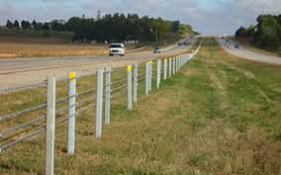
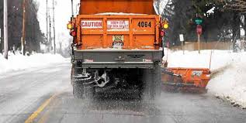
Maintenance costs have seen increases.
Salt has increased in cost 235% since 2001
Maintenance crews have seen increased demands.
In 2010 cable median barrier in Minnesota averaged 5 hits/mile
Notes:
ROADWAY COSTS IN OUR STATE ARE NOT SOLELY ABOUT REPARING AND REPLACING THE PAVEMENT. KEEPING ROADS CLEAR AND SAFE IS ALSO A PRIORITY. MAINTENANCE CREWS WORK ALL WINTER TO KEEP ROADS CLEAR OF ICE AND SNOW, AND ALL SUMMER TO KEEP THEM CLEAR OF DEBRIS AFTER MAJOR STORMS. THESE MAINTENANCE COSTS ARE ALSO SEEING A RISE IN PRICES. SALT PRICES ALONE HAVE MORE THAN DOUBLED SINCE 2001. MAINTENANCE CREW DEMAND HAS ALSO INCREASED. IN 2010 CABLE MEDIAN BARRIERS IN MINNESOTA AVERAGED 5 HITS/MILE ANNUALLY.

Slide 18
RAISE THE GRADE (D+)
Solidify an increased dedicated funding source to close the funding gap
Index revenue sources to inflation to create a more long-term funding source
Promote innovative practices that reduce cost
State and local agencies should seek out public-private partnerships
Notes:
AS MENTIONED EARLIER BY STEVE, ONE TIME FUNDING IS VERY MUCH APPRECIATED. HOWEVER OUR DEMAND HAS GROWN TO A POINT WHERE THIS WON’T SOLVE OUR GROWING PROBLEM. AN INCREASED SOURCE OF FUNDING THAT IS DEDICATED TO ROADS COULD ALLOW OWNERS TO MORE COMFORTABLY PLAN AHEAD FOR MAINTENANCE PROJECTS, EXTENDING THE OVERALL LIFE OF OUR ROADS.

Slide 19
Minnesota House of Representatives Bridge Topic Slides Steve Olson January 29, 2019

Slide 20


I-35W bridge collapse illuminated the state of our bridge infrastructure
19,776 bridges in Minnesota
5.4% of bridges in Minnesota are structurally deficient
Due to congestion, a number of interchanges in the Twin Cities will need to be upgraded soon
$5.4 billion is needed in funding over the next 20 years
Only $3.22 billion has been identified
Notes:
GOOD AFTERNOON.
MR. CHAIRMAN THANK YOU FOR THE OPPORTUNITY TO TESTIFY BEFORE YOUR COMMITTEE.
MY NAME IS STEVE OLSON. I AM A LICENSED PROFESSIONAL ENGINEER WITH OVER 30 YEARS OF BRIDGE ENGINEERING EXPERIENCE. I AM ALSO A PAST PRESIDENT OF THE MN SECTION OF ASCE
MY TASK THIS AFTERNOON IS TO ARTICULATE THE CONDITION AND THE FUNDING NEEDS FOR PUBLIC BRIDGES IN MINNESOTA
THE BRIDGE EVENT LOCKED INTO MOST MINNESOTAN’S MINDS IS THE 35W COLLAPSE 11 YEARS AGO.
THERE ARE NEARLY 20,000 BRIDGES IN MINNESOTA (THIS STATISTIC USES THE 10’ LENGTH TO DEFINE A BRIDGE)
5.4% OF THE HIGHWAY BRIDGES ARE STRUCTURALLY DEFICIENT OR IN POOR CONDITION

Slide 21
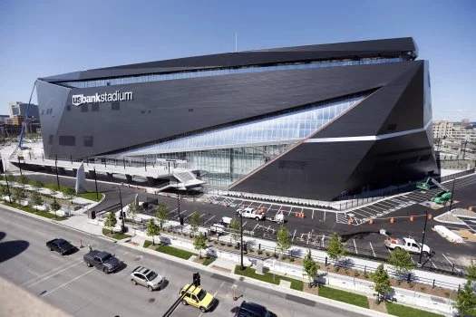
Minnesota has over 88,000,000 square feet of bridge deck area
>50 x
Image from TwinCities.com
Notes:
A LOT OF FUNDING NUMBERS ARE TIED TO THE DECK AREA OF A BRIDGE.
THE DECK AREA IS SIMPLY THE LENGTH OF A BRIDGE MULTIPLIED BY ITS WIDTH.
ADDING UP THE PUBLIC BRIDGES ACROSS MINNESOTA ONE FINDS THAT THERE IS OVER 88,000,000 SQUARE FEET OF BRIDGE DECK AREA.
THAT NUMBER DOESN’T MEAN MUCH TO A LOT OF PEOPLE. 3.16 SQUARE MILES MIGHT MEAN A LITTLE BIT MORE.
MORE THAN 50 US BANK STADIUMS IS PROBABLY EVEN MORE TANGIBLE.
THINK OF 50 US BANK STADIUMS HAVING AN MEDIAN AGE OF 30 YEARS OLD

Slide 22
Three bridge systems were assessed as part of the report card effort
State System (Interstates/US Routes/Trunk Highways
Local Highway System (Counties/Cities/Townships)
Parks and Trails
Notes:
STATE SYSTEM IS THE BACKBONE OF THE HIGHWAY NETWORK
LOCAL GOVERNMENT AGENCIES OWN ABOUT ¾ OF THE BRIDGES
THERE ARE HUNDREDS AND HUNDREDS OF BRIDGES IN PARKS AND ON TRAILS ACROSS THE STATE
WE DID NOT LOOK AT PRIVATE BRIDGES SUCH AS RAILROAD BRIDGES AND SKYWAY BRIDGES.

Slide 23
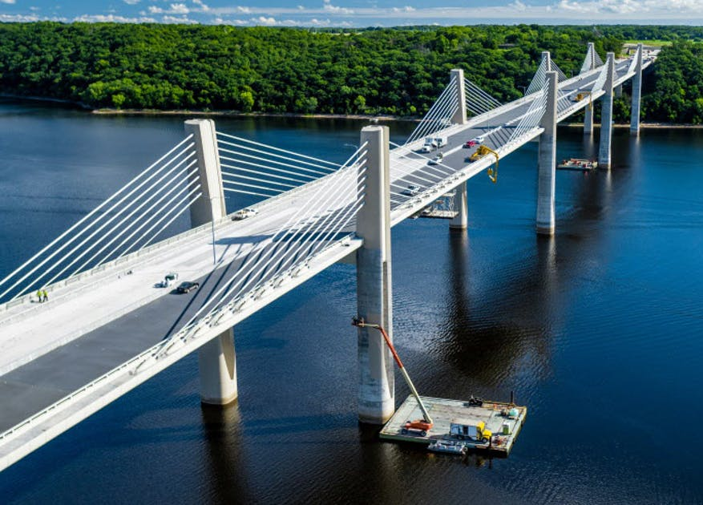
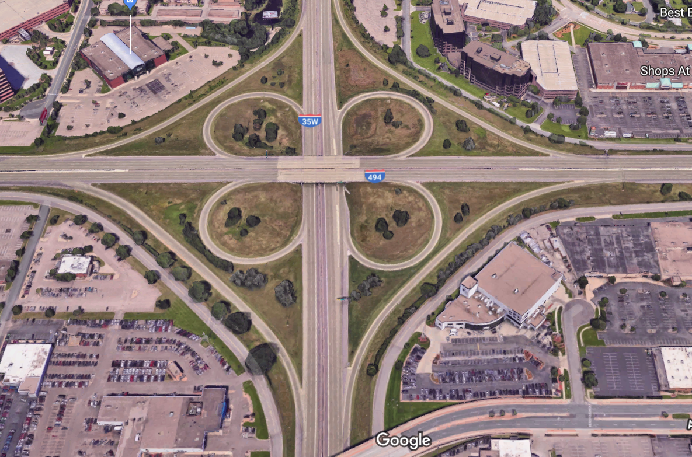
State System – Interstate era bridges are reaching the end of their service life. About 80 bridges a year to be replaced @ $2 million each. $160M/year
Notes:
State projects would include big bridges such at the St. Croix crossing on the left.
There are a number of Metro interchanges in need of updates (that will require significant bridge structures) such as the 494/35W interchange shown on the right.
IT SHOULD BE NOTED THAT THE $160M/YEAR IDENTIFIED IN OUR REPORT CARD IS LESS THAN THE $200M/YEAR PROVIDED DURING THE CHAPTER 152 PROGRAM

Slide 24
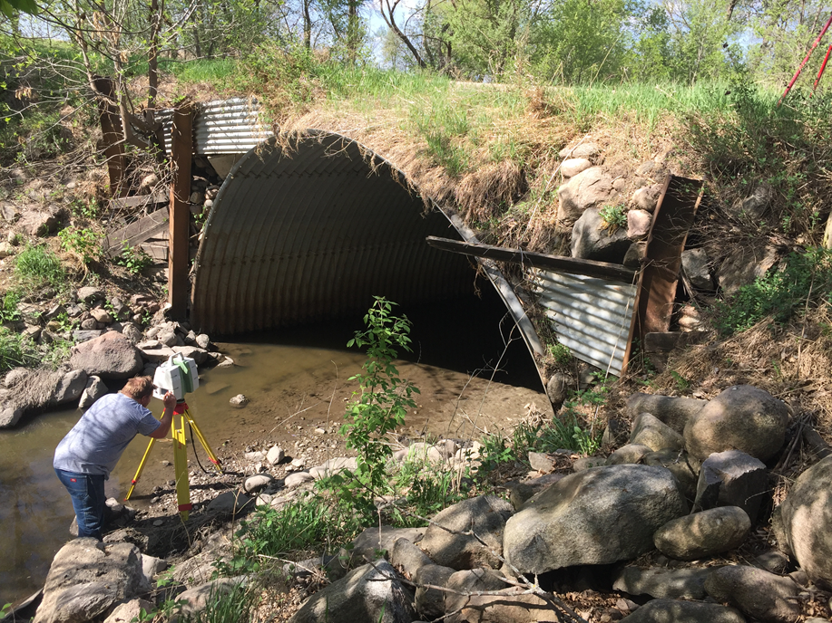
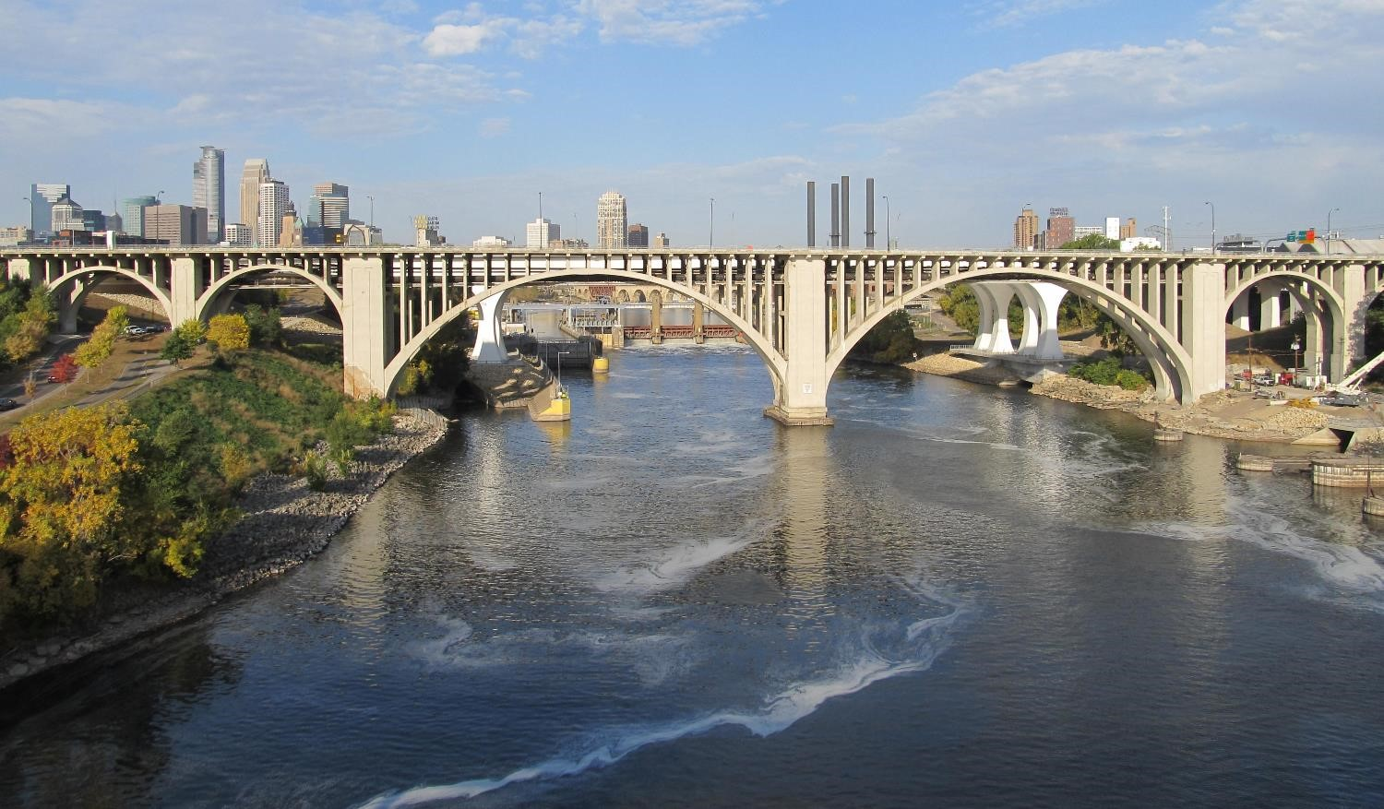
Local System – Needs are about $100 million per year
Notes:
The local system can have large project needs such at the 10th Avenue Bridge in Minneapolis to more modest structures such as metal culverts with distortion and “non-conventional” details for embankments.

Slide 25
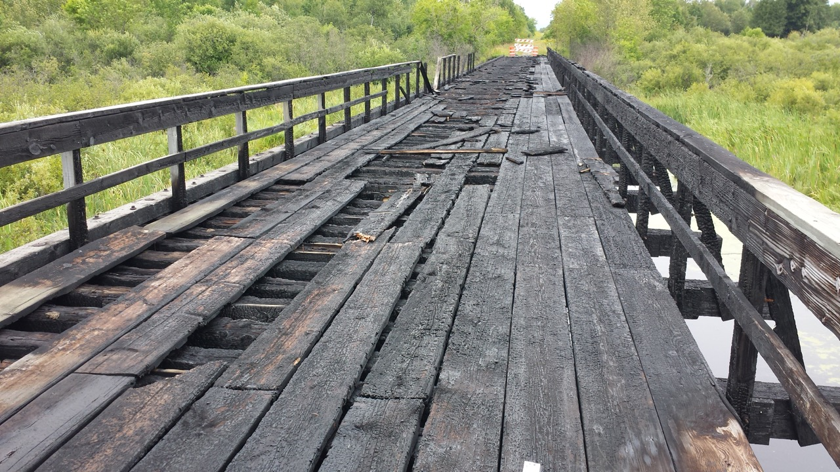
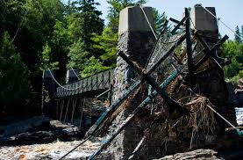
Parks & Trails – No dedicated funding source – estimated to be over 800 bridges in this system
Notes:
The DNR has roughly 500 to 600 bridges on their system.
The City of Minneapolis has about 100 park bridges.
There is no dedicated funding source to address the needs for these bridges.
On the left you see the BlackDuck Bridge that has been out of service for several years after an arson evenT.
On the right is the damage to the Jay Cooke State Park suspension bridge after the large floods in the NE a few years ago. The Jay Cooke bridge has been repaired.
THER MESSAGE HERE IS THAT THERE ARE FAR MORE TRAIL BRIDGES THAN MOST PEOPLE REALIZE AND THEY OFTEN ONLY GET THE SCRAPS OF FUNDING THAT AGENCIES HAVE AFTER OTHER ITEMS ARE ADDRESSED.

Slide 26
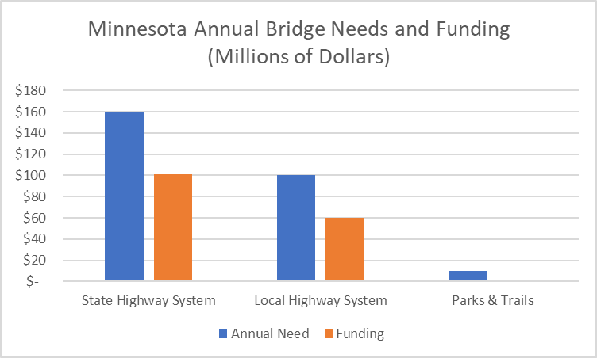
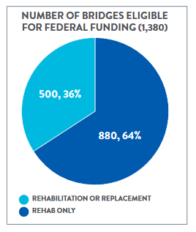
Notes:
EXPECTED FUNDING IS SIGNIFICANTLY BELOW THE IDENTIFIED NEED
FOR THE STATE OWNED SYSTEM - $160M/YEAR IS NEEDED. $100M/YEAR IS EXPECTED. SHORTFALL IS $60M/YEAR
FOR THE LOCAL BRIDGE SYSTEM - $100M/YEAR IS NEEDED. $60M/YEAR IS TYPICALLY PROVIDED. SHORTFALL IS $40M/YEAR
EXPECTED SHORTFALL IS AT LEAST $10M/YEAR FOR THE PARKS AND TRAILS SYSTEM
ON THE RIGHT IS A GRAPHIC. IT SIMPLY SAYS THAT OF THE VEHICULAR BRIDGES IN MINNESOTA, THERE ARE ABOUT 1400 BRIDGES THAT WOULD BE ELIGIBLE FOR REPAIR OR REPLACEMENT PROJECT DOLLARS FROM THE FHWA.

Slide 27
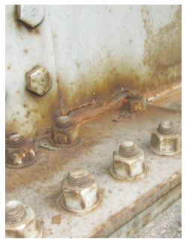
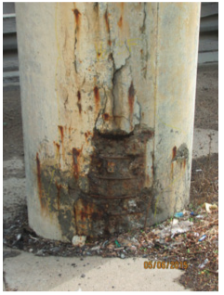

RAISE THE GRADE (C)
Provide a reliable funding stream for bridges
Identify a source of dedicated funding for Park and Trail bridges
Perform research on the state and local bridge systems to identify the “sweet spot” for investments in:
Operation and maintenance
Minor projects with deck overlays
Major rehabilitation projects
Total bridge replacements
Notes:
ONE TIME FUNDING IS VERY MUCH APPRECIATED, HOWEVER IT MAKES IT DIFFICULT TO MANAGE THE INVENTORY OF BRIDGES.
OWNERS, FEEL THAT THEY MAY BE ABLE TO REDUCE THE OVERALL COSTS FOR BRIDGES IF THEY WERE ABLE TO SPEND DOLLARS ON MINOR AND MAJOR REHABILITATION PROJECTS AT KEY POINTS IN A BRIDGE’S SERVICE LIFE. THEY WOULD WELCOME SOME RESEARCH TO HELP THEM IDENTIFY THE SWEET SPOT FOR THESE ACTIONS.
OFTEN OWNERS END UP OPERATING IN A FEAST OR FAMINE PARADIGM. PEOPLE LET THINGS GO FOR A WHILE BECAUSE ALL LOOKS OKAY TO THE GENERAL PUBLIC. THESE WORK ITEMS BACK UP UNTIL THERE IS A LOT TO DO AND THE CONDITION OF THE BRIDGES IS QUITE POOR. AT THIS POINT THE OWNERS ARE ABLE TO CONVINCE OTHERS TO DEDICATE SOME FUNDING FOR BRIDGES. THEY TAKE CARE OF THEIR “WORST” BRIDGES – OFTEN AS REPLACEMENTS. FUNDING DRIES UP. THE OWNERS THEN CAN ONLY DO MINOR MAINTENANCE ACTIVITIES UNTIL THE NEXT “FEAST”

Slide 28
MN House of Representatives Darwin Yasis January 29, 2019

Slide 29

Annually, 111 million rides in MN are delivered on public transit
99 million in the Metro Area
12 million in Greater MN
50 transit systems in the state
43 systems in Greater MN
7 systems in Metro Area
$450 million is needed over the next 5 years to keep our current system working
$5 billion over the next 20 years
Current funding levels are not sufficient to maintain our system
Notes:
MN population – 5.577 million (2017)
Twin Cities population – 3.601 million (2017). Largest increase by 43,000 residents in 2017 since 2000.
Other metropolitan regions:
Duluth – 278,782 (2017)
St. Cloud – 197,759 (2017)
Rochester – 218,280 (2017)
Mankato – 100,939 (2017)

Slide 30
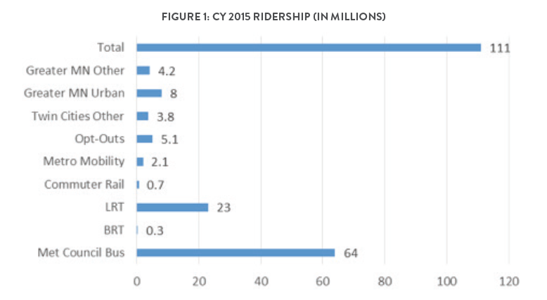
Notes:
MetCouncil/Metro Transit constitutes single largest ridership approx. 81% of statewide ridership in 2015. In 2015, achieved record highs of 12.2 million rides and 1.24 million hours of revenue service.

Slide 31
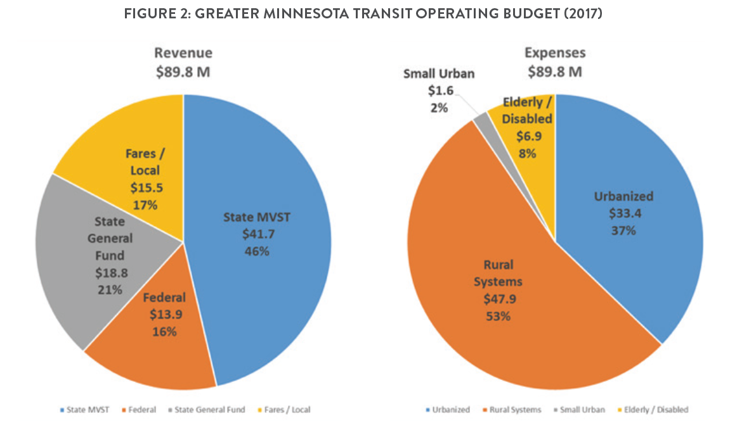

Slide 32
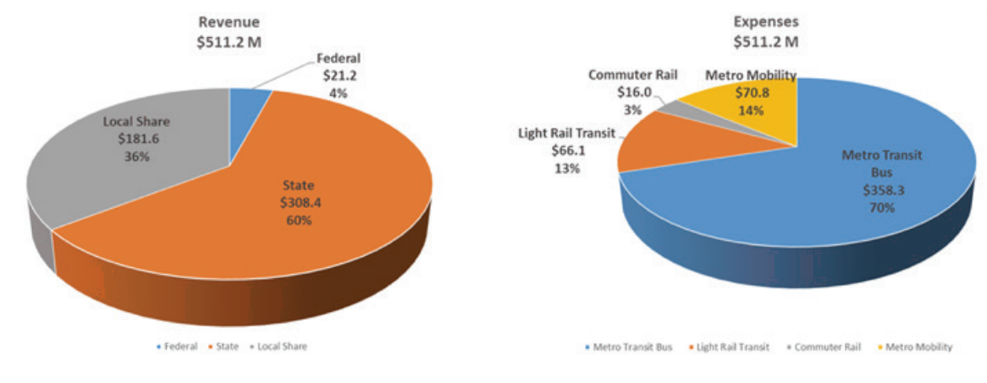
FIGURE 3: TWIN CITIES METRO AREA
METROPOLITAN TRANSIT OPERATING BUDGET (2017)

Slide 33
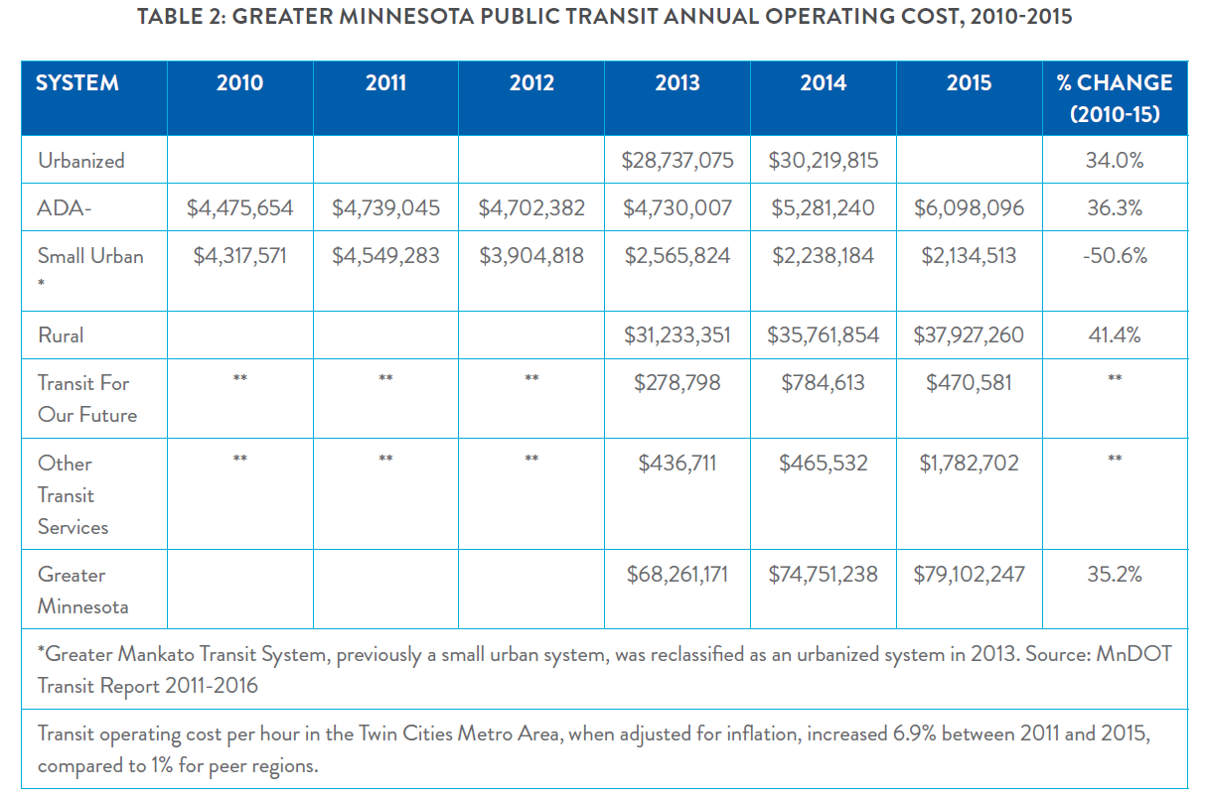

Slide 34
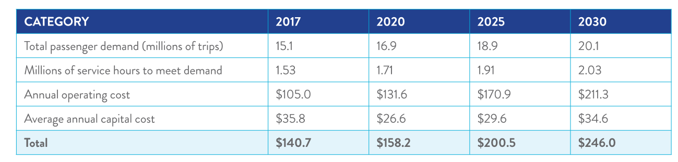
Projected Transit Need and Cost (in millions) to meet 100% of Need, 2017-2030

Slide 35
RAISE THE GRADE (C-)
Establish a sustainable funding sources for public transit similar to how the gas tax funds roads and bridges
Adequately fund maintenance of transit vehicles and facilities to keep systems in a state of good repair and improve life cycle costs
Increase access to transit in urban, suburban, and rural communities so that citizens have better transportation choices
Continue developing comprehensive transportation plans to address transit needs in urban, suburban, and rural communities in Minnesota

Slide 36
SOLUTIONS TO RAISING THE GRADES
Recognize that there has been a multi-decade, profound shift from federal funding to state and local funding for systems like highways
End the stop and go transportation funding by providing sustainable long-term revenue and encourage dedicated local option transportation taxes
Citizens must be able to monitor levels of deferred maintenance.
Implement robust asset management programs to that entities may better prioritize limited available funding and make informed decisions
Balance the infrastructure needs of divers communities
Notes:
RECOGNIZE THAT THERE HAS BEEN A MULTI- DECADE PROFOUND SHIFT FROM FEDERAL FUNDING. THIS MAY CONTINUE. AS YOU MAY KNOW THE FEDERAL HIGHWAY TRUST FUND IS PREDICTED BY THE CBO TO BE INSOLVENT IN 2021.
PROVIDE SUSTAINABLE LONG TERM REVENUE. JUST LIKE WE ALL LIKE TO KNOW OUR SALARIES SO WE CAN PLAN FOR THE FUTURE. WE NEED TO KNOW LONG TERM FUNDING SO WE CAN ADEQUATELY PLAN FOR OUR INFRASTRUCTURE FUTURE NEEDS. DEDICATE MORE LOCAL OPTION TRANSPORTATION TAXES. A COUNTY SALES TAX IS BEING USED FOR FUNDING TRANSIT IN THE METRO.
GOVERNMENTS SHOULD COMMUNICATE STATUS OF INFRASTRUCTURE SYSTEMS TO CITIZENS. IT IS THEIR DOLLARS THAT PAY FOR THE INFRASTRUCTURE.
TO BETTER INFORM CITIZENS WE RECOMMEND IMPLEMENTING A ROBUST ASSET MANAGEMENT SYSTEM. THE STATE SHOULD AID IN THE ESTABLISHMENT OF AN OFFICE(S) DEDICATED TO DISPERSING ASSETS MANAGEMENT ASSISTANCE TO LOCAL GOVERNMENTS. AS YOU MAY KNOW THAT STATE AUDITOR HAS DEVELOPED AN INFRASTRUCTURE STRESS TRANSPARENCY TOOL FOR WATER AND WASTEWATER INFRASTRUCTURE. THE GOAL OF THE TOOL “TO CREATE THESE MAPS IS TO BETTER INFORM THE DECISION MAKING PROCESS AT ALL LEVELS OF GOVERNMENT TO IMPROVE LONG TERM FINANCIAL PLANNING OF OUR CIVIL INFRASTRUCTURE NEEDS”
BALANCE THE INFRASTRUCTURE NEEDS OF DIVERSE COMMUNITIES. WE KNOW THAT SOME OF OUR OLDEST COMMUNITIES HAVE SOME OF THE LOWEST INCOME RESIDENCE. IN GREATER MINNESOTA WE HAVE AN AGING POPULATION MANY ON FIXED INCOMES. FLEXIBLE FUNDING SOLUTIONS WILL ENSURE THAT THE NEEDS OF EACH COMMUNITY ARE MET FAIRLY AND EFFECTIVELY

