Slide 1
Health and Human Services Finance Committee
Laura Kramer and Weston Merrick, Results First Coordinators, MMB

Slide 2
Overview
Overview of Minnesota’s Results First Initiative
Defining evidence
Results First projects
Tools for finding evidence-based information
Minnesota Inventory
Research clearinghouses
Use of evidence-based services in Minnesota

Slide 3
Minnesota’s Results First Initiative

Slide 4
What is Results First?
Results First partners with agencies, counties, providers, and other stakeholders to answer:
What services do we offer in a programmatic area?
If we deliver the service effectively, what outcomes can we anticipate?
How can we use this information to inform decision-making?

Slide 5
Our Goal
Goal: Produce evidence-based information that is understood, trusted, and used by policy-makers at the state and local level.
Results First Projects
Stakeholders
Complete:
Adult Mental Health
Adult Criminal Justice
Substance Use
Juvenile Justice
Child Welfare
Higher Education
Underway:
Children’s mental health
Health
Advisory Committee
Executive branch
Legislative branch
Tribal representation
County representation
Judicial branch
Key Partners
Community groups
Service providers

Slide 6
Defining evidence

Slide 7
Correlation or Causation
Before
After
Better
Program
Worse

Slide 8
Correlation or Causation
Before
After
Better
Program
No Program
Worse

Slide 9
Correlation or Causation
Before
After
No Program
Better
Program
Worse

Slide 10
Sources of causal evidence
Randomized control trial
Quasi-experimental

Slide 11
Culture and Evidence-Based Practices
Worldview and Cultural Perspectives
Cultural Competence (Culturally-Informed)
Culture-Informed Practices
Evidence-Based Practices
Impact evaluation

Slide 12
Levels of evidence
Proven Effective | A Proven Effective service or practice has a high level of research on effectiveness, determined from of multiple rigorous evaluations (such as randomized controlled trials) or rigorous local evaluations.
Promising | A Promising service or practice has some research demonstrating effectiveness, such as a single randomized controlled trial or evaluation with a comparison group design not contradicted by other such studies.
Theory Based | A Theory Based service or practice has no research on effectiveness or less rigorous research designs that do not meet the above standards. These services and practices typically have a well-constructed logic model or theory of change. This ranking is neutral.

Slide 13
Levels of evidence
Mixed Effects | A Mixed Effects service or practice offers a high level of research on the effectiveness of multiple outcomes. However, the outcomes have contradictory effects. Research methods include rigorous evaluations, such as randomized controlled trials or rigorous local evaluations.
No Effect | A service or practice with No Effect has no statistically significant impact on the measured outcomes. Research methods include rigorous evaluations, such as randomized controlled trials or rigorous local evaluations.
Proven Harmful | A Proven Harmful service or practice offers a high level of research that shows program participation adversely affects outcomes of interest. Research methods include rigorous evaluations, such as randomized controlled trials or rigorous local evaluations.

Slide 14
Results First Projects

Slide 15
Cost-effectiveness work and example

Slide 16
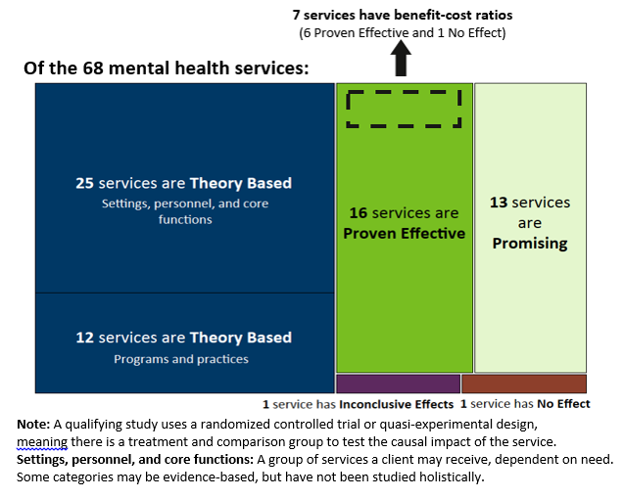
Program inventory

Slide 17
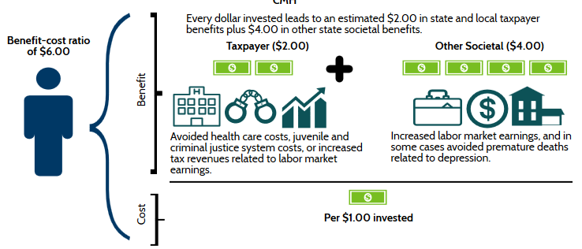
Return on investment
$2.00

Slide 18
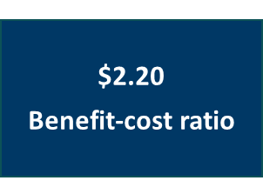
Example BCA: Parent-Child Interaction Therapy

Slide 19
Tools for finding evidence-based information

Slide 20
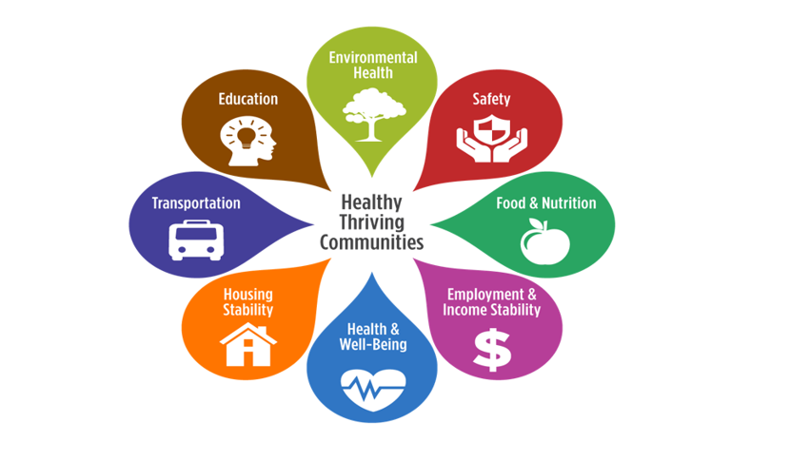
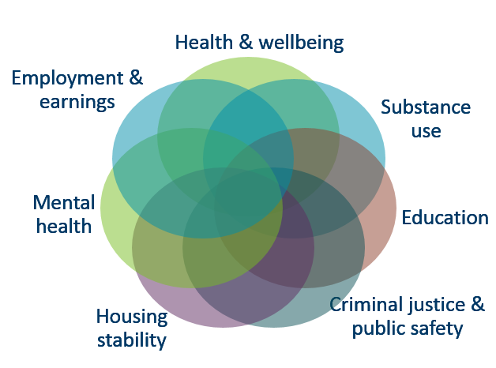
Minnesota Inventory
The combined inventory pulls together:
7 programmatic areas
420 services
17 outcome measures
3 years of research from across the state
https://mn.gov/mmb/results-first/inventory

Slide 21
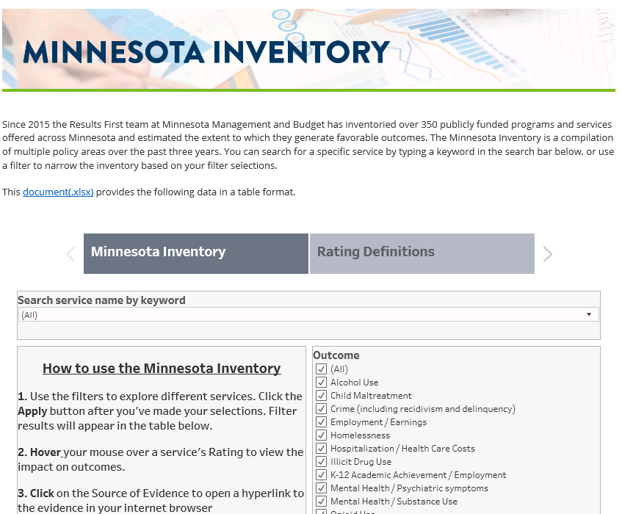
Minnesota Inventory - Tutorial
mn.gov/mmb/results-first/inventory

Slide 22
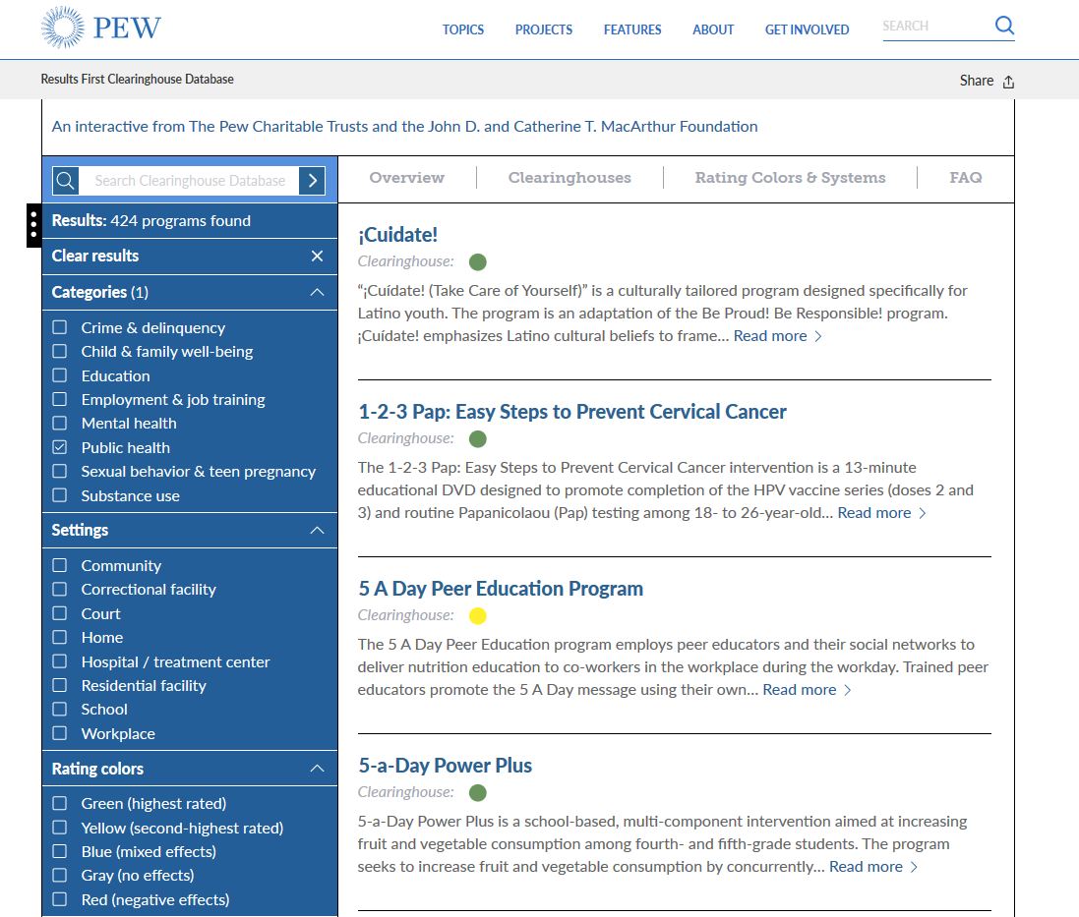
Results First Clearinghouse
Results First Clearinghouse

Slide 23
Evidence website
MMB’s Using Evidence in Policymaking website: https://mn.gov/mmb/evidence/
Definitions of evidence
Resources for finding quality evidence
Trainings

Slide 24
Use of Evidence-Based Services

Slide 25
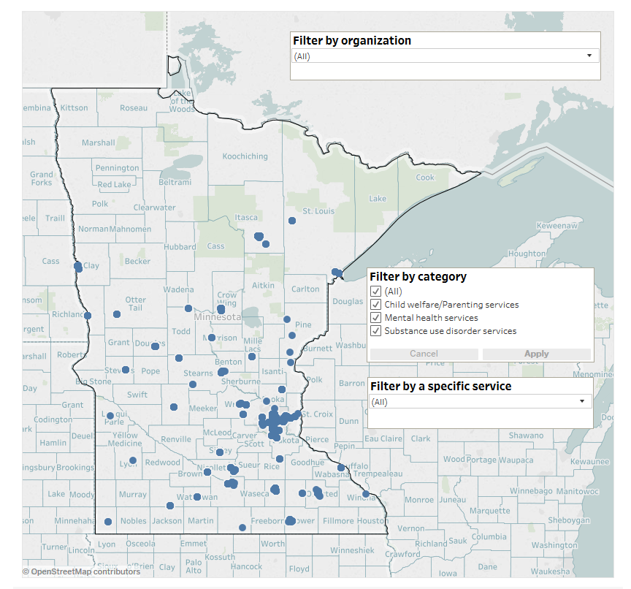
Use of evidence-based services
Service provider survey currently in the field to understand where evidence-based behavioral health and parenting skills services are offered

Slide 26
Demand for evidence-based services
Initial survey responses suggest:
Approximately half of providers indicate demand exceeds capacity to deliver at least one evidence-based service
Generally providers refer clients elsewhere or delay services but may provider a substitute service or turn them away

Slide 27
Expanding capacity of evidence-based services

Slide 28
Questions?
Laura Kramer and Weston Merrick
Laura.Kramer@state.mn.us | Weston.Merrick@state.mn.us
651-201-8035

