Slide 1
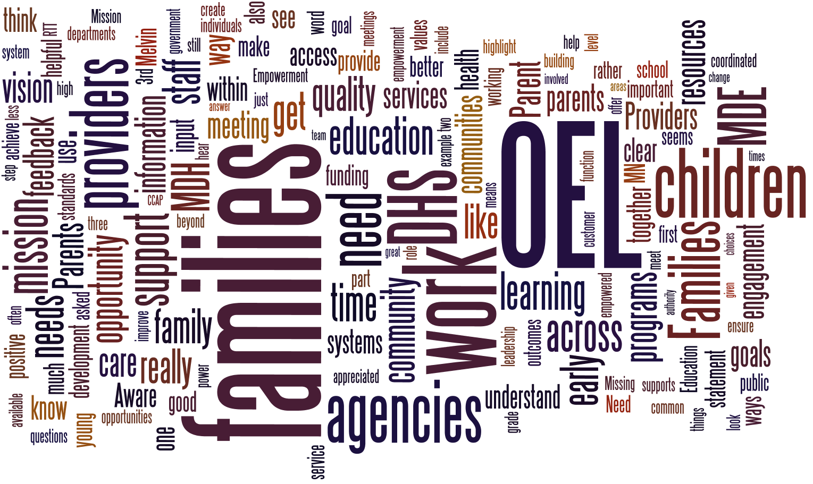

Slide 2
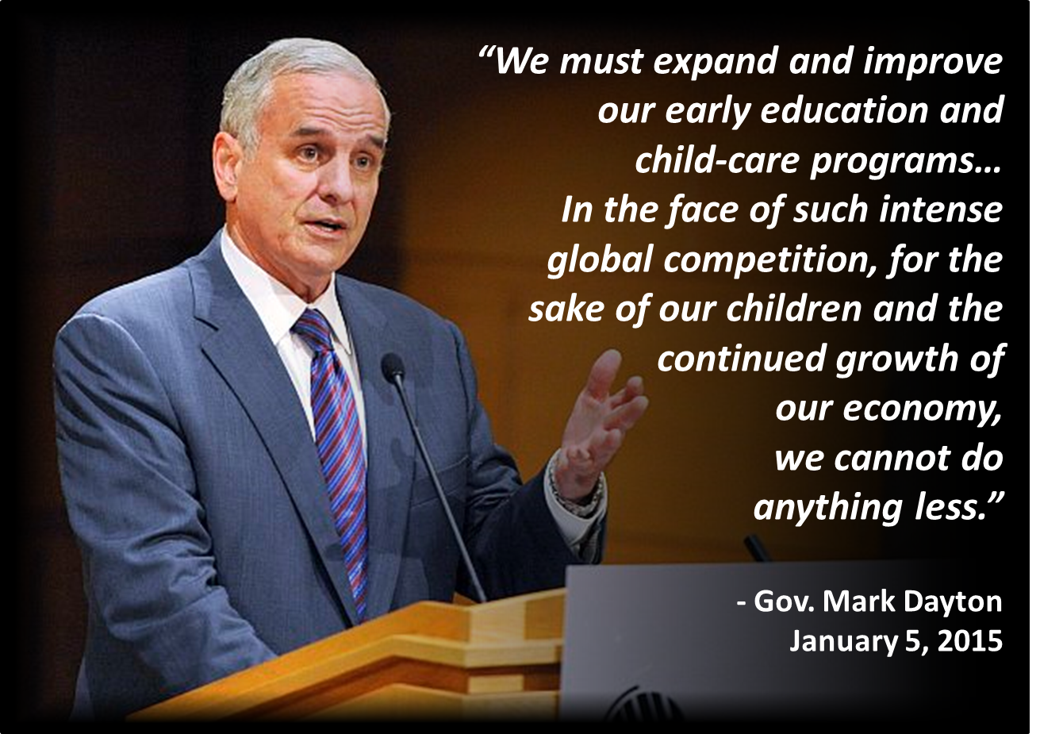
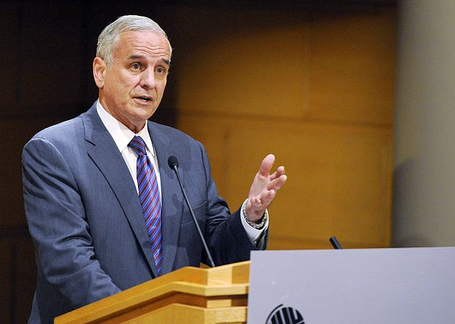
“We must expand and improve our early education and
child-care programs…
In the face of such intense
global competition, for the
sake of our children and the continued growth of
our economy,
we cannot do
anything less.”
- Gov. Mark Dayton
January 5, 2015
Notes:
The Governor has clearly articulated the value he places on making investments in early childhood, as a lever to transform the future of our state; this budget proposal strongly reflects that value.

Slide 3

Office of Early Learning
Mission:
Partner with families & communities across the state, and align human & financial supports across agencies, to promote healthy child development from prenatal through grade 3.
Vision:
All Minnesota children get the great start they need to succeed in school and life.
Notes:
Our Charge: Do better for MN children and families, working together, than we can working separately.

Slide 4
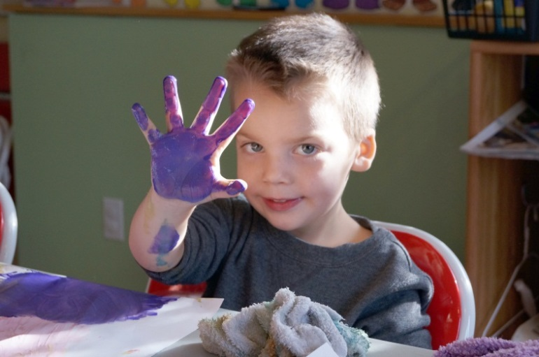
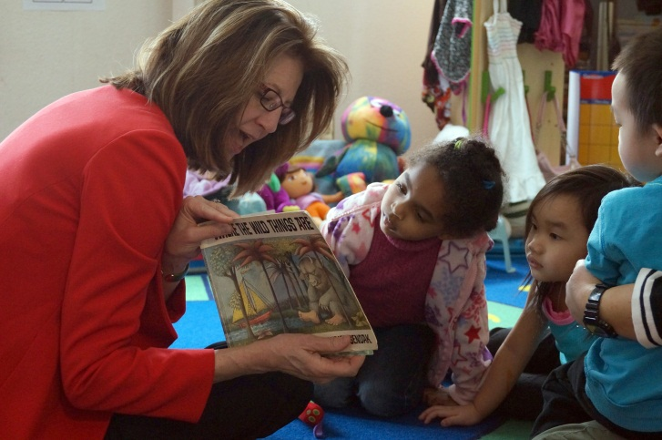
Progress by the Numbers
5,700+ | children receive EL Scholarships!
1,892 | Parent Aware rated providers statewide!
80% | of PW-I scholarship children choose 4-stars!
29% | of CCAP children under 5 choose quality!
Notes:
From 2013 to 2014, the number of rated non-accredited Family Child Care programs increased by nearly 150%, and the number of rated non-accredited Child Care Centers increased by nearly 100%.
We’ve invested a lot in recent years, and we’ve developed some amazing momentum for children and families!
We’re well poised to continue! …

Slide 5
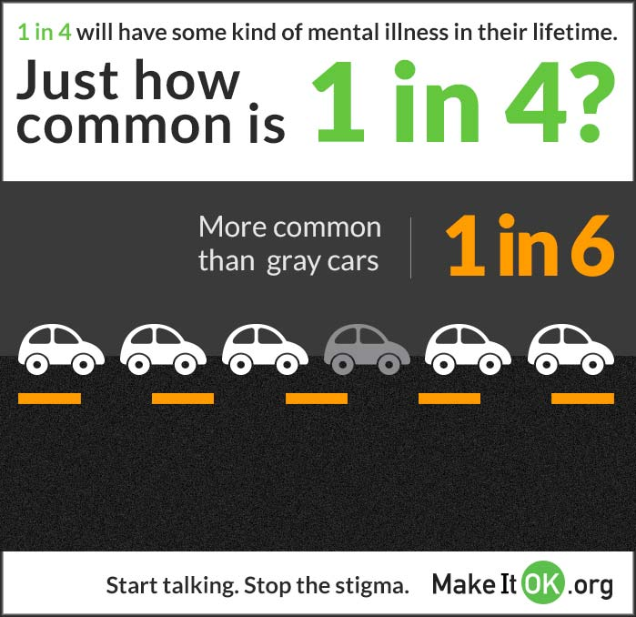
Challenges: Mental health capacity

Slide 6
Challenges: Access to care
Notes:
Only 30 percent of children enrolled in MHCP received preventive dental services during FFY 2012 compared with 43 percent of Medicaid enrolled children nationwide aged 1-20

Slide 7
Challenge: Children and housing
Current issues: The number of homeless children and their families has almost quadrupled per one-night shelter counts

Slide 8

Challenges that still exist
In Minnesota:
5 in 10 Black children
4 in 10 American Indian children
3 in 10 Hispanic children
2 in 10 Asian children and
1 in 10 White children …
LIVED IN POVERTY IN 2012
Source: U.S Census Bureau, 2012 American Community Survey
Notes:
The problem really isn’t any one of those challenges I just showed you, but the cumulative effect they have on each other…
The foundational understanding behind the proposals we’re about to present to you to day is that:
The impacts of economic disparities and education disparities in our state form a vicious cycle that threaten our state’s future economic vitality and can only be reversed through a robust portfolio of coordinated, interagency, interdisciplinary investments.

Slide 9


Common Agenda
Healthy development & well-being contribute to early learning success and a successful trajectory throughout school and life.
S
afe
table
ecure
Learning
Healthy
Safe
Stable
Secure
Notes:
What we desire/ envision for MN children:
Access to high quality early care environments that are using research-based best practices to ensure that children are learning and on track to be ready for Kindergarten and reading by third grade;
A safe, stable & secure home and community environment; and
Every opportunity possible to grow up healthy, so they can stick around to enjoy the long, productive life we’re putting them on the path towards!
These all must work together – if we seek to “educate” our children we must also build a system that addresses whether or not those children have eaten today, or go home to a homeless shelter after school.
Because these are such overlapping and interdependent goals, you’ll see we have trouble cleanly fitting our proposals neatly into ONLY one bucket or another – that’s a good thing. Everything we do must promote all of these goals; that’s the thinking behind this portfolio of investments.

Slide 10
P-3 Alignment Must Exist Within Each Age/Grade Level and Across Levels
0-2
2nd Grade
3rd Grade
1st Grade
Full Day K
PreK
0-3
2nd Grade
3rd Grade
1st Grade
Full Day K
PreK
Within
Within
Within
Within
Within
Within
Across
Kauerz, 2011
Notes:
Alignment is a continuous process and requires shared vision, philosophy, values, and outcomes; collaboration and efficient use of resources; leadership and implementation teams at multiple levels; ongoing feedback and communication loops; data systems and supports; learning communities; and community engagement.
Demonstrating alignment between assessments, standards, instructional practices and curriculum requires the identification of the purpose of each assessment and the population for which the assessment is being administered. For instance, purposes could include: establishing a baseline; measuring growth and development; or demonstrating mastery.
When appropriately aligned, standards and assessments provide common expectations for students and educators.
State agency coordination – State agency staff meet regularly about Early Learning Scholarships, Parent Aware, Child Care Assistance and other tools that provide families with information and resources to access high-quality early care and education programs, in order to make sure these tools are aligned and to facilitate coordination at the local level.
Coordination of Early Learning Scholarships and Parent Aware – DHS works with Child Care Aware agencies across the state to let programs and families know how participation in Parent Aware helps them access Scholarships.
Coordination of Early Learning Scholarships and Child Care Assistance – Because Early Learning Scholarships can be used together with Child Care Assistance to meet the needs of low-income families trying to access high-quality early care and education programs, DHS provides information to county staff administering Child Care Assistance describing how scholarships may be used to help a family receiving Child Care Assistance.

Slide 11
Pathways to Readiness
Grades 1-3: Foundation for Lifelong Learning
High-Quality PreK: Foundation for K-12 Education
Birth to 3: Crucial Brain Development
Full-day K: Universal Transition Year
Transition Plans in Place
6-8yrs
Before / After / Summer School Programs
5yrs
3/4yrs
0-2yrs
Notes:
Now more than ever, leaders, educators, and policy makers understand the significance of early childhood education and the need to support a seamless continuum of learning for children coming from a high-quality early childhood learning setting to the early grades, or from prenatal through grade three (P-3).
Building successful prenatal through grade three (P-3) alignment of learning and developmental systems that interface with comprehensive programs and services is an essential investment to ensure that children who are at risk of beginning their primary education years behind their peers have a chance to learn on equal footing.
P-3 alignment can be effectively supported by “linked” policies that help forge connections between the infant and toddler and early childhood community and K-3 systems to address the common goal of closing the readiness gap before it comes an achievement gap, which often persists throughout a child’s learning or academic career.
Meeting the developmental and social-emotional needs of young children is as much about building a strong foundation for lifelong physical and mental health as it is about enhancing school readiness. The first 1100 days of life (and even before birth) are critical with 80 percent of brain development occurring before age three. Brain growth is highly dependent on a child’s early relationships and environmental experiences.

Slide 12




Help Me Grow ($2M)
Comprehensive, collaborative system for improving access to existing resources and services for children (birth →age 8) and their families;
Builds on existing in-state structure, with help from Help Me Grow National Center;
Four Core HMG Components:
Provider Outreach
Centralized Access Point
Community Outreach
Data Collection
Notes:
More comprehensive than Minnesota’s current Help Me Grow initiative
Upstream focus: Connect to services that promote healthy development – even if not eligible for special education services-get children and families services before they need special education or more costly interventions in child

Slide 13
High Quality Early Learning Opportunities

Slide 14
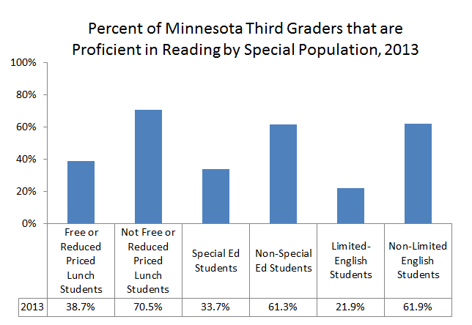
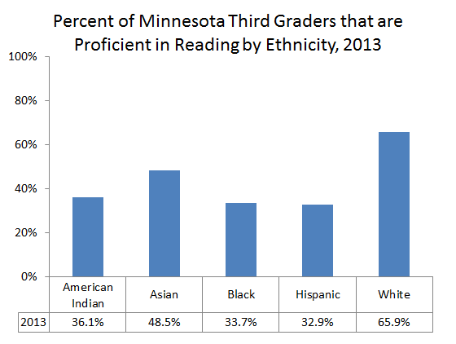
Early Learning
Children of color and children from low-income families consistently demonstrate lower proficiency rates on key indicators such as third grade reading.⁵

Slide 15
High Quality Early Learning
Statewide Pre-Kindergarten for 4 year olds ($109M)
Provide voluntary, full day, high quality pre-Kindergarten early learning opportunities for every 4-year old, statewide. (n = 31,000 children)
Eliminate Head Start Waiting List ($19.4M)
Promote school readiness, family support, and education for low-income children. (n = 2,485)
MN Reading Corps ($10M)
Provide trained tutors for students who struggle with literacy skills.

Slide 16
High Quality Early Learning, cont.
Invest in Quality Child Care
Simplify child care assistance requirements to reduce complexity for participants and counties ($1.6M in FY16/17)
Reduce the Basic Sliding Fee Child Care Waiting List - currently at 6,157 ($12.5M in FY16/17)
Sustain Parent Aware Quality Rating System ($3.5M in FY16/17)
Add Flexibility for Early Learning Scholarships
Enhance portability and family choice.

Slide 17
PHYSICAL & MENTAL HEALTH

Slide 18
Physical/ Mental Health
Free Breakfasts for Pre-K through Grade 3 ($28.1M)
Ensure every child, from Pre-K to grade 3, has access to a well-rounded, nutritious meal to start their day.
Oral Health ($8.4M in FY16/17)
Reform the way Oral Health services are provided in Medical Assistance and MinnesotaCare.

Slide 19
Physical/ Mental Health
Child protection ($2.5M in FY16/17)
Support best practices;
Increase accountability for county and tribal child welfare agencies.
Mental Health: Prevention
Build community capacity to reduce the incidence of Adverse Childhood Experiences (ACEs) ($796K in FY18/19);
Expand respite care ($847K in FY16/17) to keep children healthy in the community.

Slide 20
Physical/ Mental Health
Mental Health: Early Intervention
Mental health consultation for early childhood providers ($922K in FY16/17)
School-based diversion pilot for students with co-occurring disorders ($65K in FY16/17)
Mental Health: Treatment
Begin to establish Psychiatric Residential Treatment capacity in the state ($6.6M in FY16/17).
Notes:
INTERAGENCY: MDH certifies the Psychiatric Residential Treatment Facilities (PRTFs)

Slide 21
Evidence-based Family Home Visiting
$650,000 FY 2016, $2M each FY thereafter
Awarded competitively
To Community Health Boards and Tribal Nations
Expanding evidence-based programs already implemented in Minnesota (Nurse-Family Partnership, Healthy Families America, and Family Spirit (culturally tailored for American Indian families)
Provide home visiting services to another 200-300 pregnant or parenting teens and women

Slide 22

Family Home Visiting
Develops parent knowledge of child development;
Enhances parenting behaviors and parent-child relationships;
Increases parenting confidence & skills;
Screens for risk factors;
Refers to other needed services and supports;
Connects to preventive health services;
Educates on home safety and injury prevention.

Slide 23
Home Visiting Results
Improves healthy birth outcomes;
Improves use of preventive health services; reduced ER visits;
Reduces child abuse and neglect;
Improves school readiness;
Reduces use of government assistance programs;
Increases employment for mothers;
Increases intervals between pregnancies;
Reduces juvenile arrests (child);
Reduces maternal convictions (mother).

Slide 24
COMMUNITY PARTNERSHIPS

Slide 25
Community Partnerships
Provide wrap around services for children and families within the Northside Achievement Zone and St. Paul Promise Neighborhood, who partner with families and community to permanently eliminate education disparities. ($4M)
Support expanded tribal administration of human services programs for WEN ($2.8M in FY16/17) and Red Lake TANF ($284K in FY16/17)

Slide 26
Community Partnerships
Establish American Indian Family Early Intervention Program to families who are at risk for possible child maltreatment ($2M in FY16/17)
Invest in targeted, coordinated, culturally-specific care for pregnant mothers at high risk of poor birth outcomes from drug use ($272K in FY16/17)

