Slide 1
Agriculture and Food Finance and Policy Division

Slide 2
2019 Challenges
Poor prices, trade woes follow MN farmers to the field
Sugar Beet Growers have to Repay Company $343 per Unharvested Acre
Barns collapse, farmers lose cows
FARM WOES DEEPEN IN MIDWEST
Propane shortage another headache for farmers
Big changes needed to improve water quality
Dean Foods files for Chapter 11 bankruptcy
FARM INCOME HITS HISTORIC LOW
Dairy Farmer's Tearful Video Shares Industry Troubles
Farm states slammed by double whammy
Del Monte Closes Sleepy Eye plant
363 Lose Jobs
Suicide Prevention Trainings Draw Crowds
Future of family farms bleak in Midwest

Slide 3
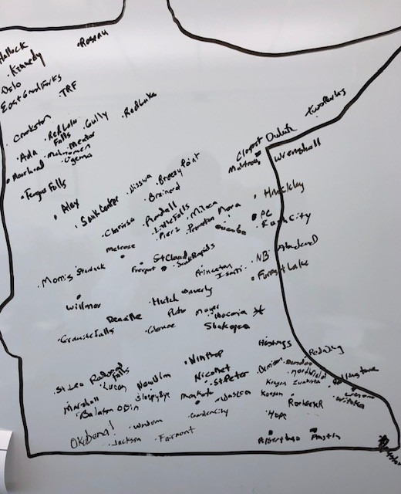
Listening to Farmers & Rural Residents
Traveled the State in 2019 to hear concerns and address issues
Hallock to Two Harbors / Okabena to Preston

Slide 4
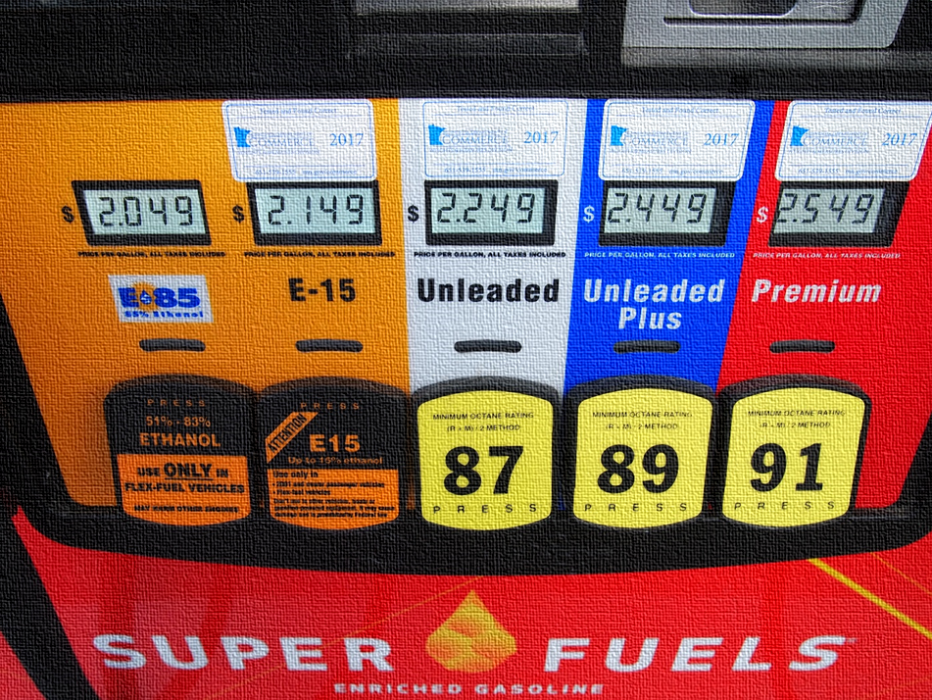
Biofuels
Biofuels
MN is the 5th largest producer of biofuels in the nation, including ethanol and biodiesel.
In 2018, we became the first state in the U.S. to mandate a 20 percent biodiesel blend, adding value to one of our state’s most-produced commodities.

Slide 5
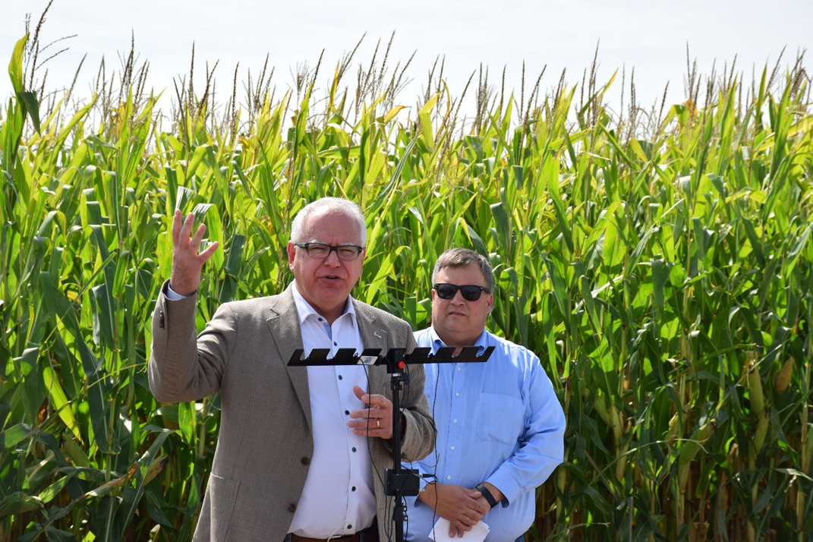
Biofuels
Governor’s Biofuels Council
Established in 2019 to foster growth of Minnesota’s biofuels industry.
The 15-member Council will advise Governor and Cabinet on:
how to best expand the use of biofuels
how to increase the carbon efficiency of biofuels
implement biofuels as part of larger goal to reduce greenhouse gasses in the transportation sector
Notes:
The Council will be made up of 15 members including representatives of agriculture, biofuels, and transportation industries, as well as environmental, and conservation groups. The Executive Order mandates that the report be completed by November 2020.
Governor Walz is the Chair of the Governors’ Biofuels Coalition.

Slide 6
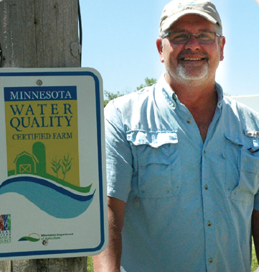
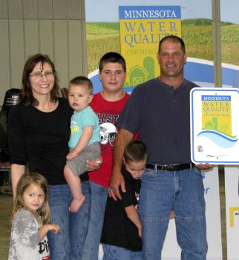
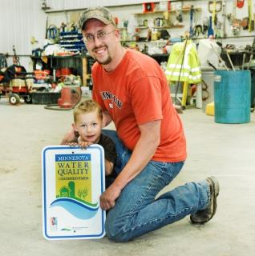



Certifying that Minnesota’s farms and waters can prosper together
Minnesota Agricultural Water Quality Certification Program

Slide 7
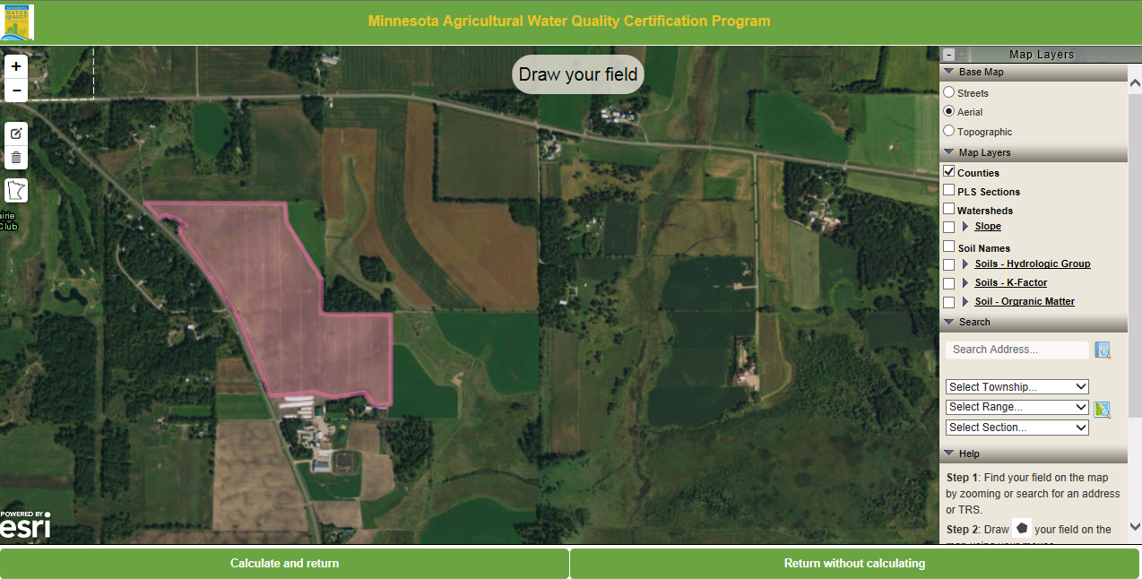
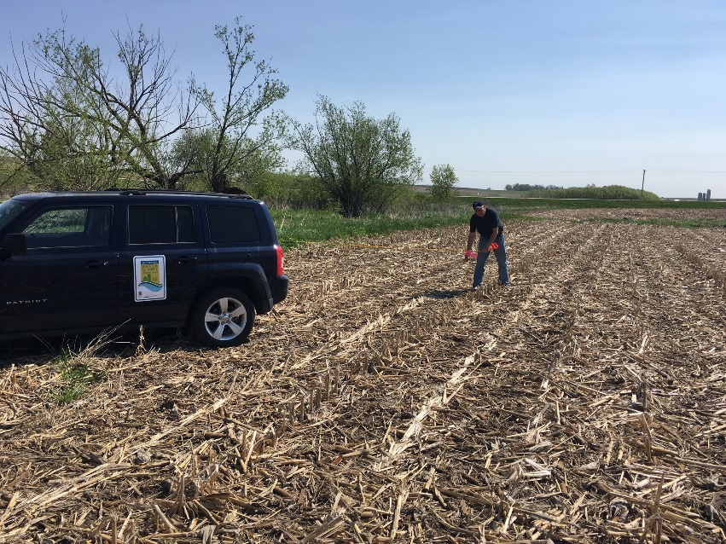
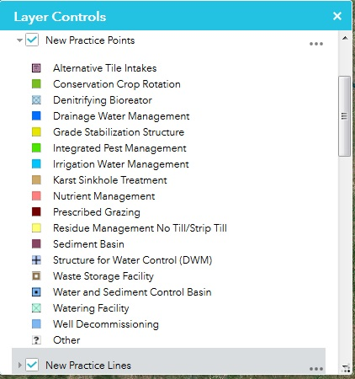
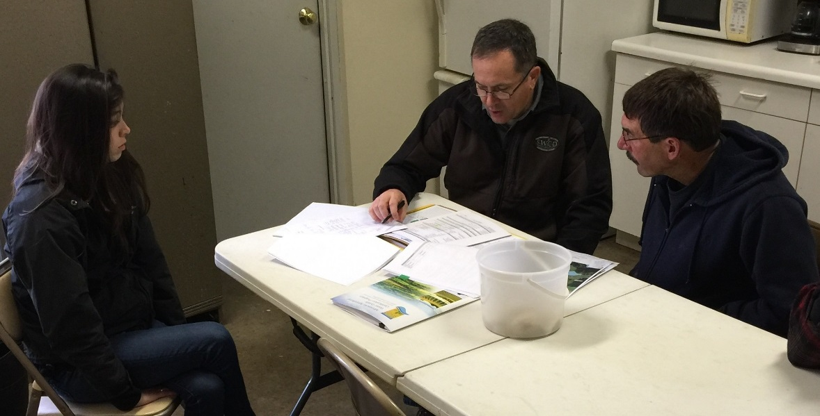
Minnesota Agricultural Water Quality
Certification Program
Risk Assessment: every field/parcel and every crop; site specific.
Term: 10 year contract with State of Minnesota (MDA,MPCA,BWSR,DNR)
Physical field properties
Nutrient management
Tillage management
Pest management
Irrigation management
Drainage management
Conservation practices

Slide 8











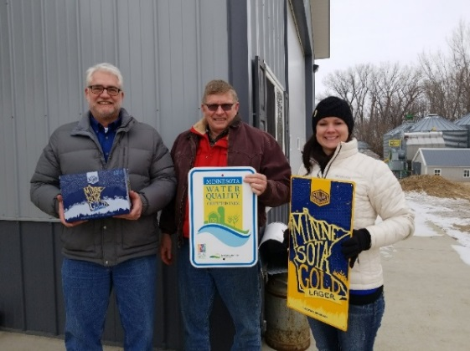
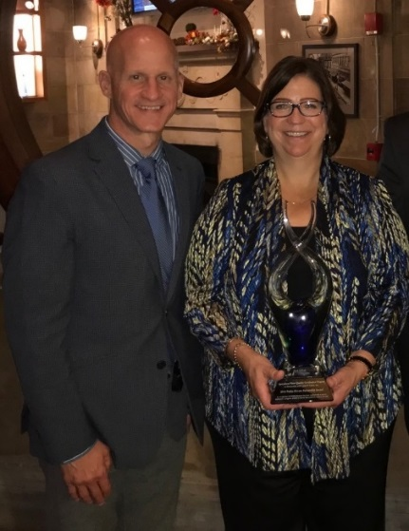
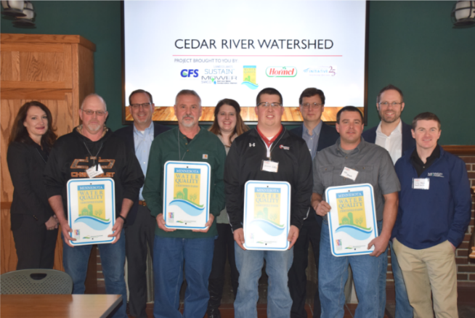


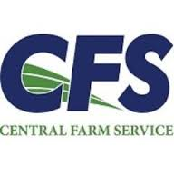

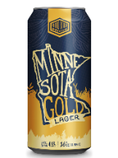



We’re About Partnerships
Public partners
Field to
Market® partner
Ag retailer, consultant and NGO agreements
$9 million 5-yrs Renewed
Land O’ Lakes MOU
Regional partnerships
Free 12-packs to certified farms

Slide 9
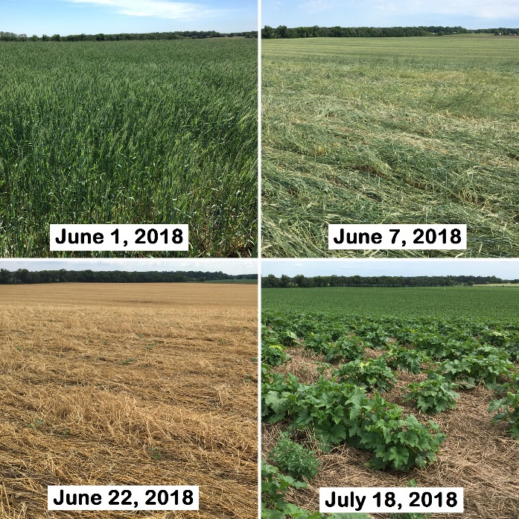
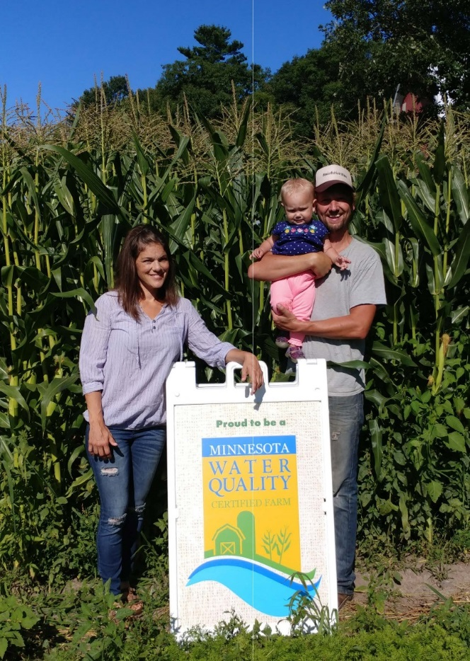
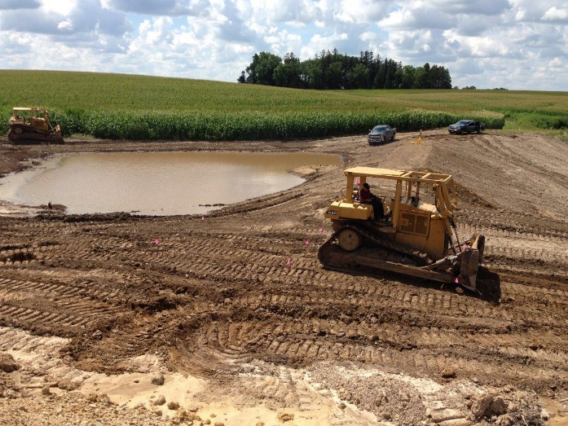
We Are Implementation
access control | no till
ag waste | strip till
alternative tile intake | nutient management
close intakes | pasture management
CNMP | perennnial crop rotation
conservation cover | pollinator habitat
contour buffer strip | prescribed grazing
cover crop | residue management
critical area planting | riparian forest buffer
crop rotation: perennial | roof runoff system
cross wind traps | saturated buffer
diversion | sediment basin
drainage water management | septic system
erosion control | side inlets
field border | sink hole treatment
fitler strip | streambank protection
forage and biomass planting | terrace
grade stabilization structure | underground outlet
grassed waterway | waste management system
grazing management | waste storage facility
integrated pest management | water and sediment control basin
integrated pest mgmt CAP 114 and 595 | watering facility
irrigation water management | wetland (constructed, treatment)
livestock pipeline | wetland resoration
manure management | windbreak

Slide 10
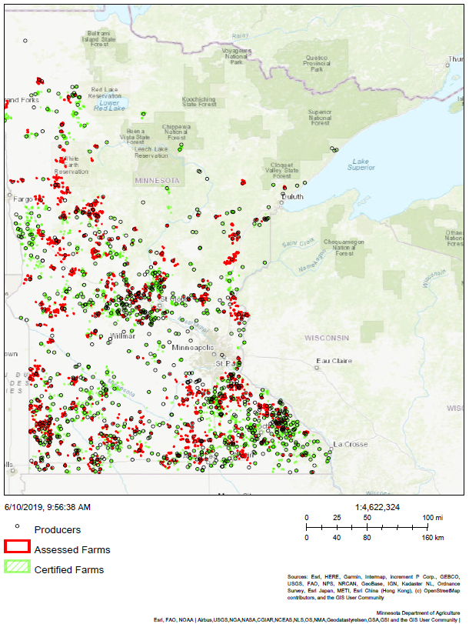
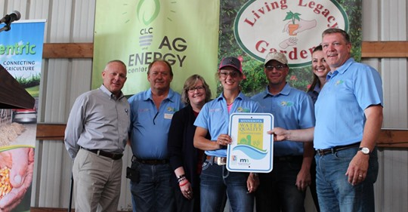
We Get Results
January 20, 2020
826 certified producers
564,482 certified acres
1,754 new practices:
  208,096,000 pounds of soil saved per yr
  74,616,000 pounds of sediment reduced per yr
  46,128 pounds of phosphorus prevented per yr
  As much as 49% reduction in nitrogen loss

Slide 11
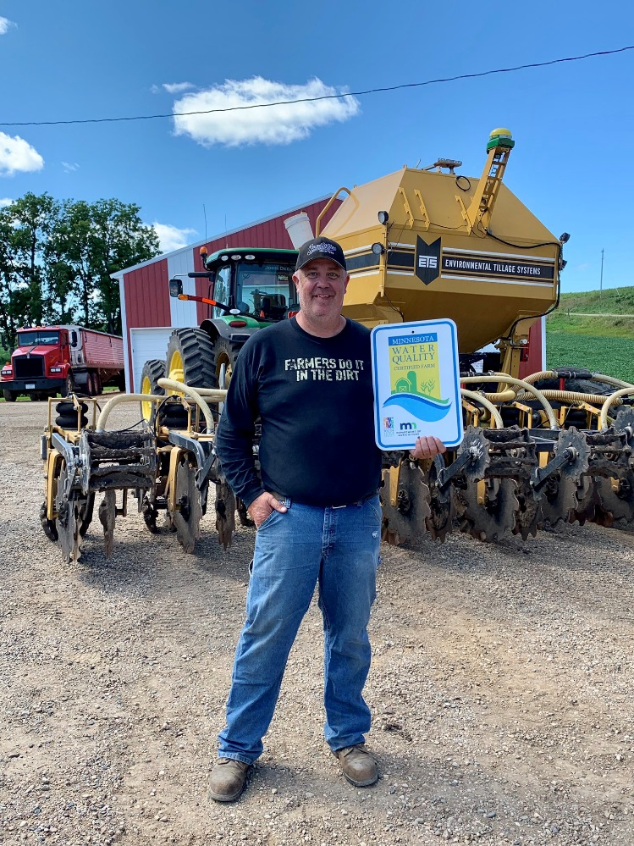
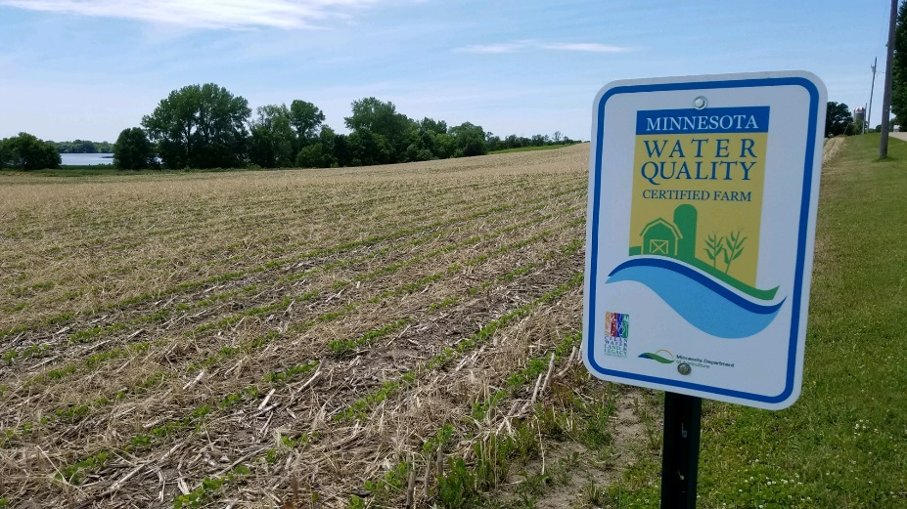
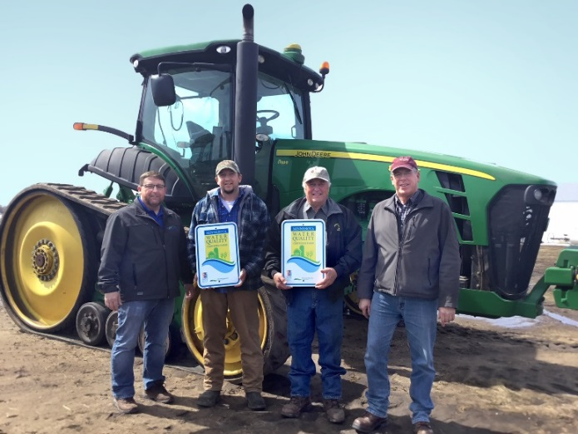
We’re Looking Forward
Identify and value multiple benefits of actions:
  IPM practices and management
  Wildlife habitat practices and management
  Soil health practices and management
  Climate practices and management

Slide 12
We Produce Mitigation
Climate Emissions Reductions
MPCA: 21 BMPs’ emissions avoidance
Between 50% and 60% of MAWQCP new practices correspond to MPCA table
  37,054 CO2-e tons per year
  Avg. 37 CO2-e tons per practice per year

Slide 13


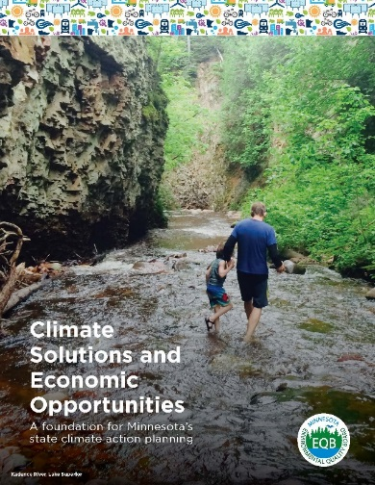
We Provide Adaptation
MAWQCP: Climate Resiliency
Soil Health
Water Infiltration
Drought Mitigation
Risk Management
Carbon Storage

Slide 14

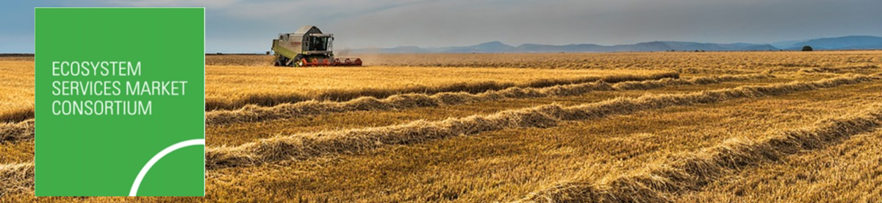


We’re Ready, Already
MAWQCP is a comprehensive structure for credit or ecosystem services trading, pay-for-performance, etc. payment mechanisms:
Baseline: Risk Assessment establishes baseline
Additionality: New practices establish & track additionality (under 10yr contract)
Threshold: Certification provides threshold (social license)
Transparent,
Real (reductions),
Accountable,
Defensible, and
Enforceable.

Slide 15
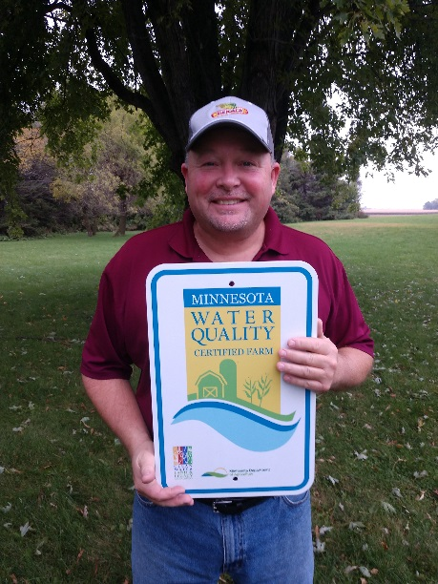
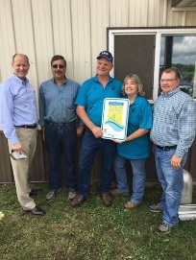
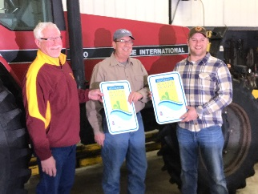
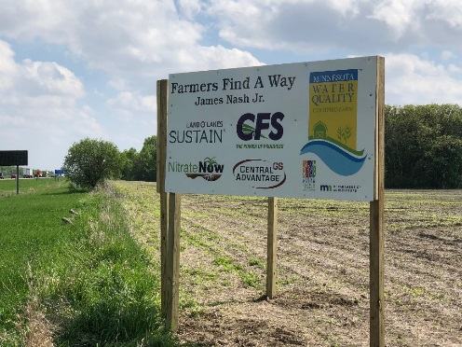
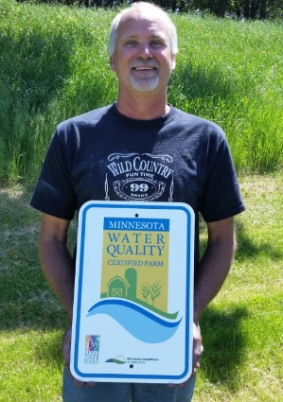
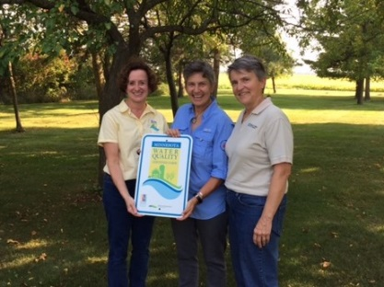
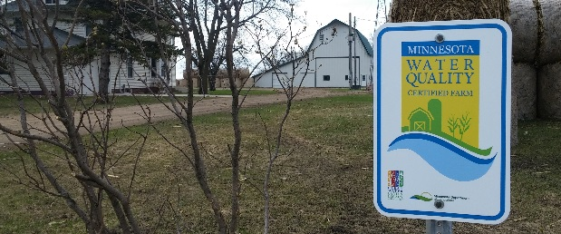
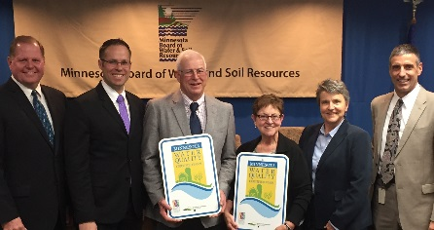
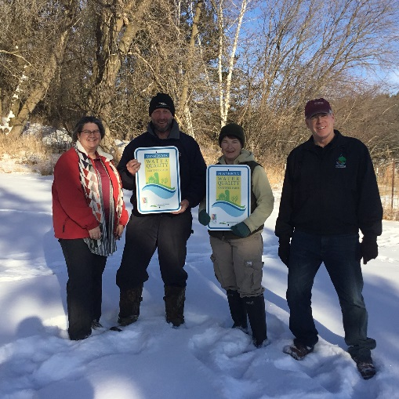
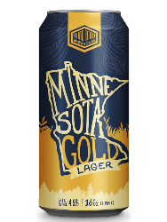
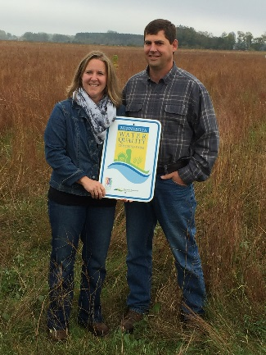
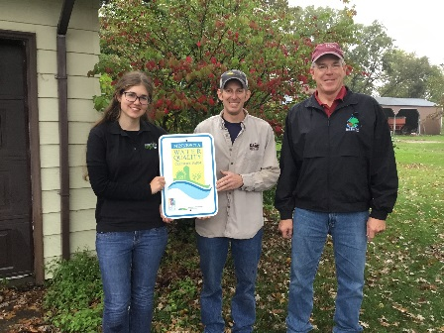
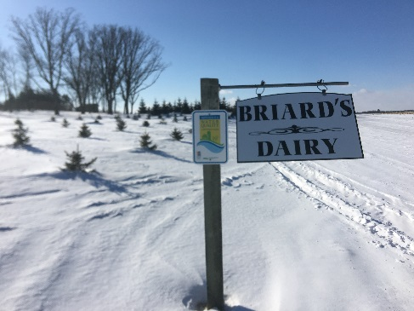
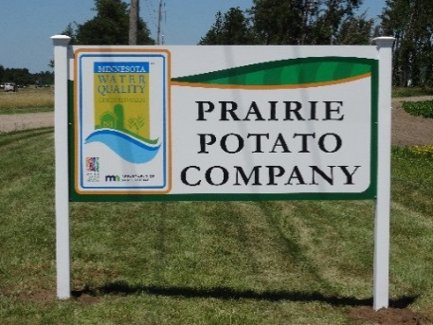
Thank You

Slide 16
Prevent Plant Acres
2019 Record Year for U.S. Prevent Plant Acres at nearly 20 Million:
Minnesota farmers reported a total of 1.17 million prevented plant acres, placing them at sixth in the nation for prevent plant acreage.
Minnesota ranked third in corn prevented plant acres, following South Dakota and Illinois.
Minnesota farmers also reported the following as prevented plantings: soybeans, 161,528 acres; wheat, 7,608 acres; sugarbeets, 1,457 acres; and oats, 355 acres.

Slide 17
Agricultural Best Management Practices (AgBMP) Program
Provides low-interest loans to farmers, rural landowners, and ag business to implement practices that prevent or reduce water pollution.
Revolving loan framework is used to address environmental problems:
  10-year term
  Up to $200,000
  3% interest
Project review and approval is by local government units
Loans are underwritten and guaranteed by local lenders
MDA handles administrative work

Slide 18
Agricultural Best Management Practices (AgBMP) Program
Created in 1995. Loan Activity to Date:
$83 Million received from state and federal sources ($23M state/$60M federal)
16,000 loans issued
$14 Million from Clean Water Fund (CWF) improved the program's capacity to help solve pollution problems
Clean Water Fund dollars supported 849 loans

Slide 19
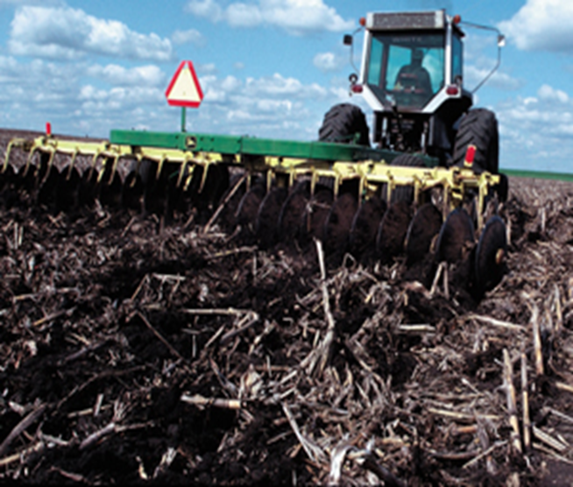
Agricultural Best Management Practices (AgBMP) Program
AgBMP Practices that Address Climate:
1) Carbon sequestration in soils
Conservation tillage
Precision ag/variable rate technologies
Manure and livestock management
Cover crops
Buffers
Perennial cover and harvestable crops

Slide 20
Agricultural Best Management Practices (AgBMP) Program
2) Greenhouse Gas (GHG) Reduction:
Increase efficiency and effectiveness of fertilizers
Reduce waste from leaching and runoff
Improve storage
Better metering and timing technologies
Practices to improve soil health

Slide 21
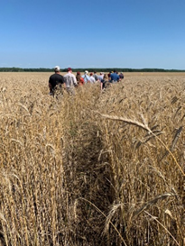
AGRI Sustainable Ag Development Grants
  On-farm research and demonstrations
  Farmer applications receive priority
  Projects explore the profitability, energy efficiency, and environmental benefits of innovative production or marketing practices
  Approximately $200,000 available in FY20
  Maximum award of $50,000
Notes:
farm diversification using traditional and non-traditional crops and livestock; cover crops and crop rotations; conservation tillage; input reduction strategies, including nutrient and pesticide management;
on-farm energy production, such as wind, methane, or biomass; developing/refining marketing opportunities, season extension, and post-harvest storage and handling; and other creative ideas that focus on environmental benefits, energy savings or production, profitability.

Slide 22
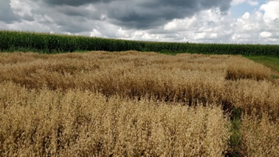
AGRI Crop Research Grants
  Applied crop research to improve quality, quantity, or value
  Near term (3 to 7 years) benefits
  Approximately $1 million available in FY20
  Maximum award is $250,000
  Up to 3 year projects

Slide 23
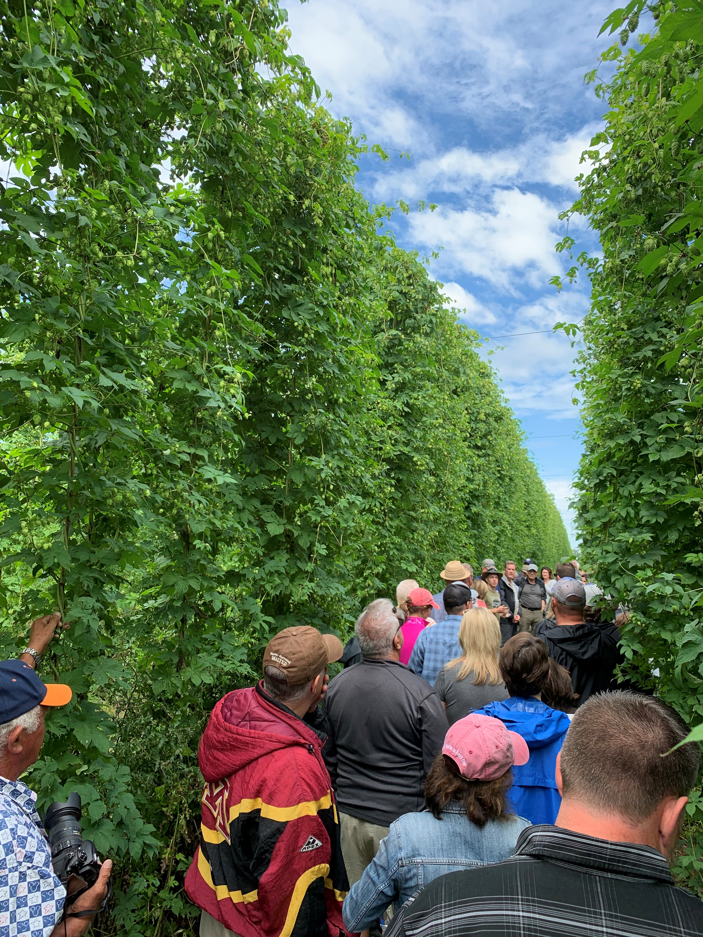
USDA Specialty Crop Block Grants
Administered by MDA
Research and market development are both eligible
About $1.3 million awarded each year
Grants up to $100,000
Must benefit an industry – not individual farms

Slide 24
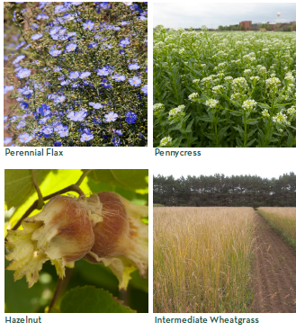

Forever Green Initiative
Led by the University of Minnesota
Strong partnership with the Minnesota Department of Agriculture (MDA) and other public and private entities.
Focused on the development of new perennial and winter annual crops and new markets and supply chains for these crops

Slide 25
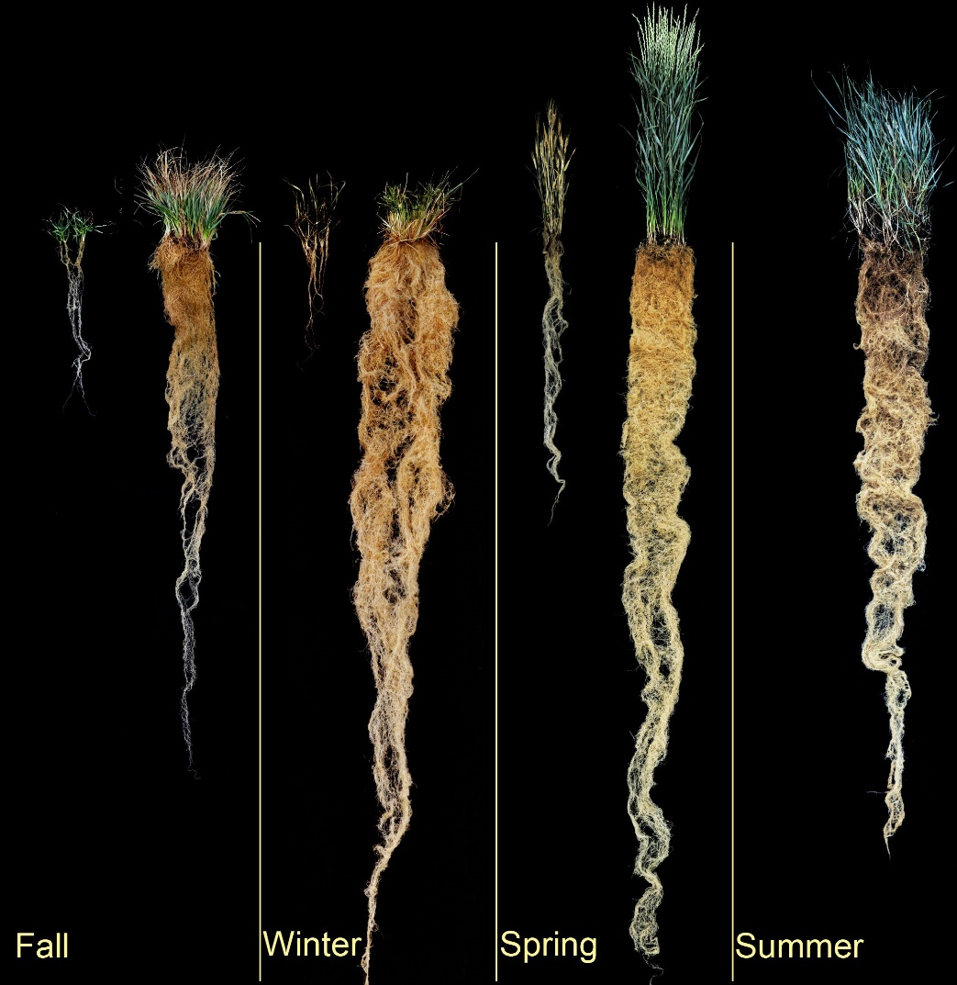
Forever Green Initiative
Perennials and winter annuals:
Increase vegetative cover on the landscape
Enhance water quality, improve soil health and help farmers mitigate and adapt to climate change
Deep rooted perennials such as Intermediate Wheatgrass (Kernza ®) have multiple environmental benefits
Photo Credit : The Land Institute

Slide 26
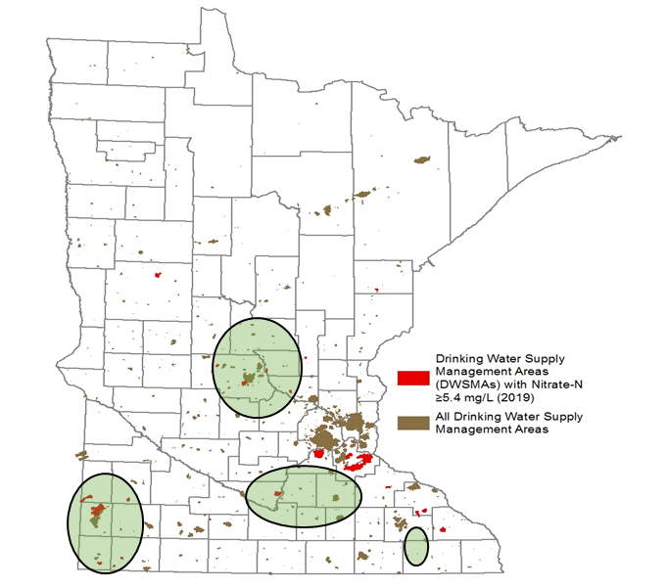


Forever Green Initiative: Clean Water Fund Investments
Research
Research related to crop breeding, genetics, genomics, agronomy, food science, and economics aspects of Forever Green crops.
Implementation
New in FY20-21
Targeted plantings in areas with vulnerable groundwater
Focused on growing, harvesting, storing, marketing and scaling-up production of Kernza in partnership with growers and land managers in agricultural areas.
Targeted Regions for Kernza Implementation

Slide 27
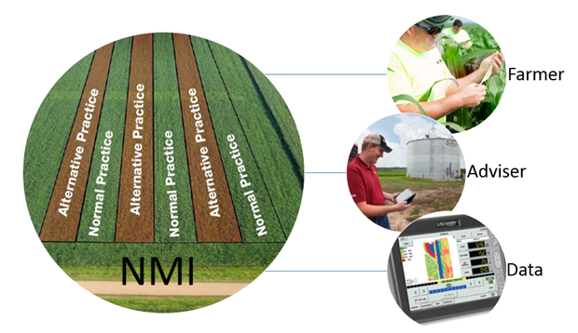

Nutrient Management Initiative (NMI)
NMI brings farmers and advisers together to evaluate nitrogen management through on-farm field trials.
Improved nutrient management results in less nitrogen loss in both runoff and emission of N₂O gas.

Slide 28
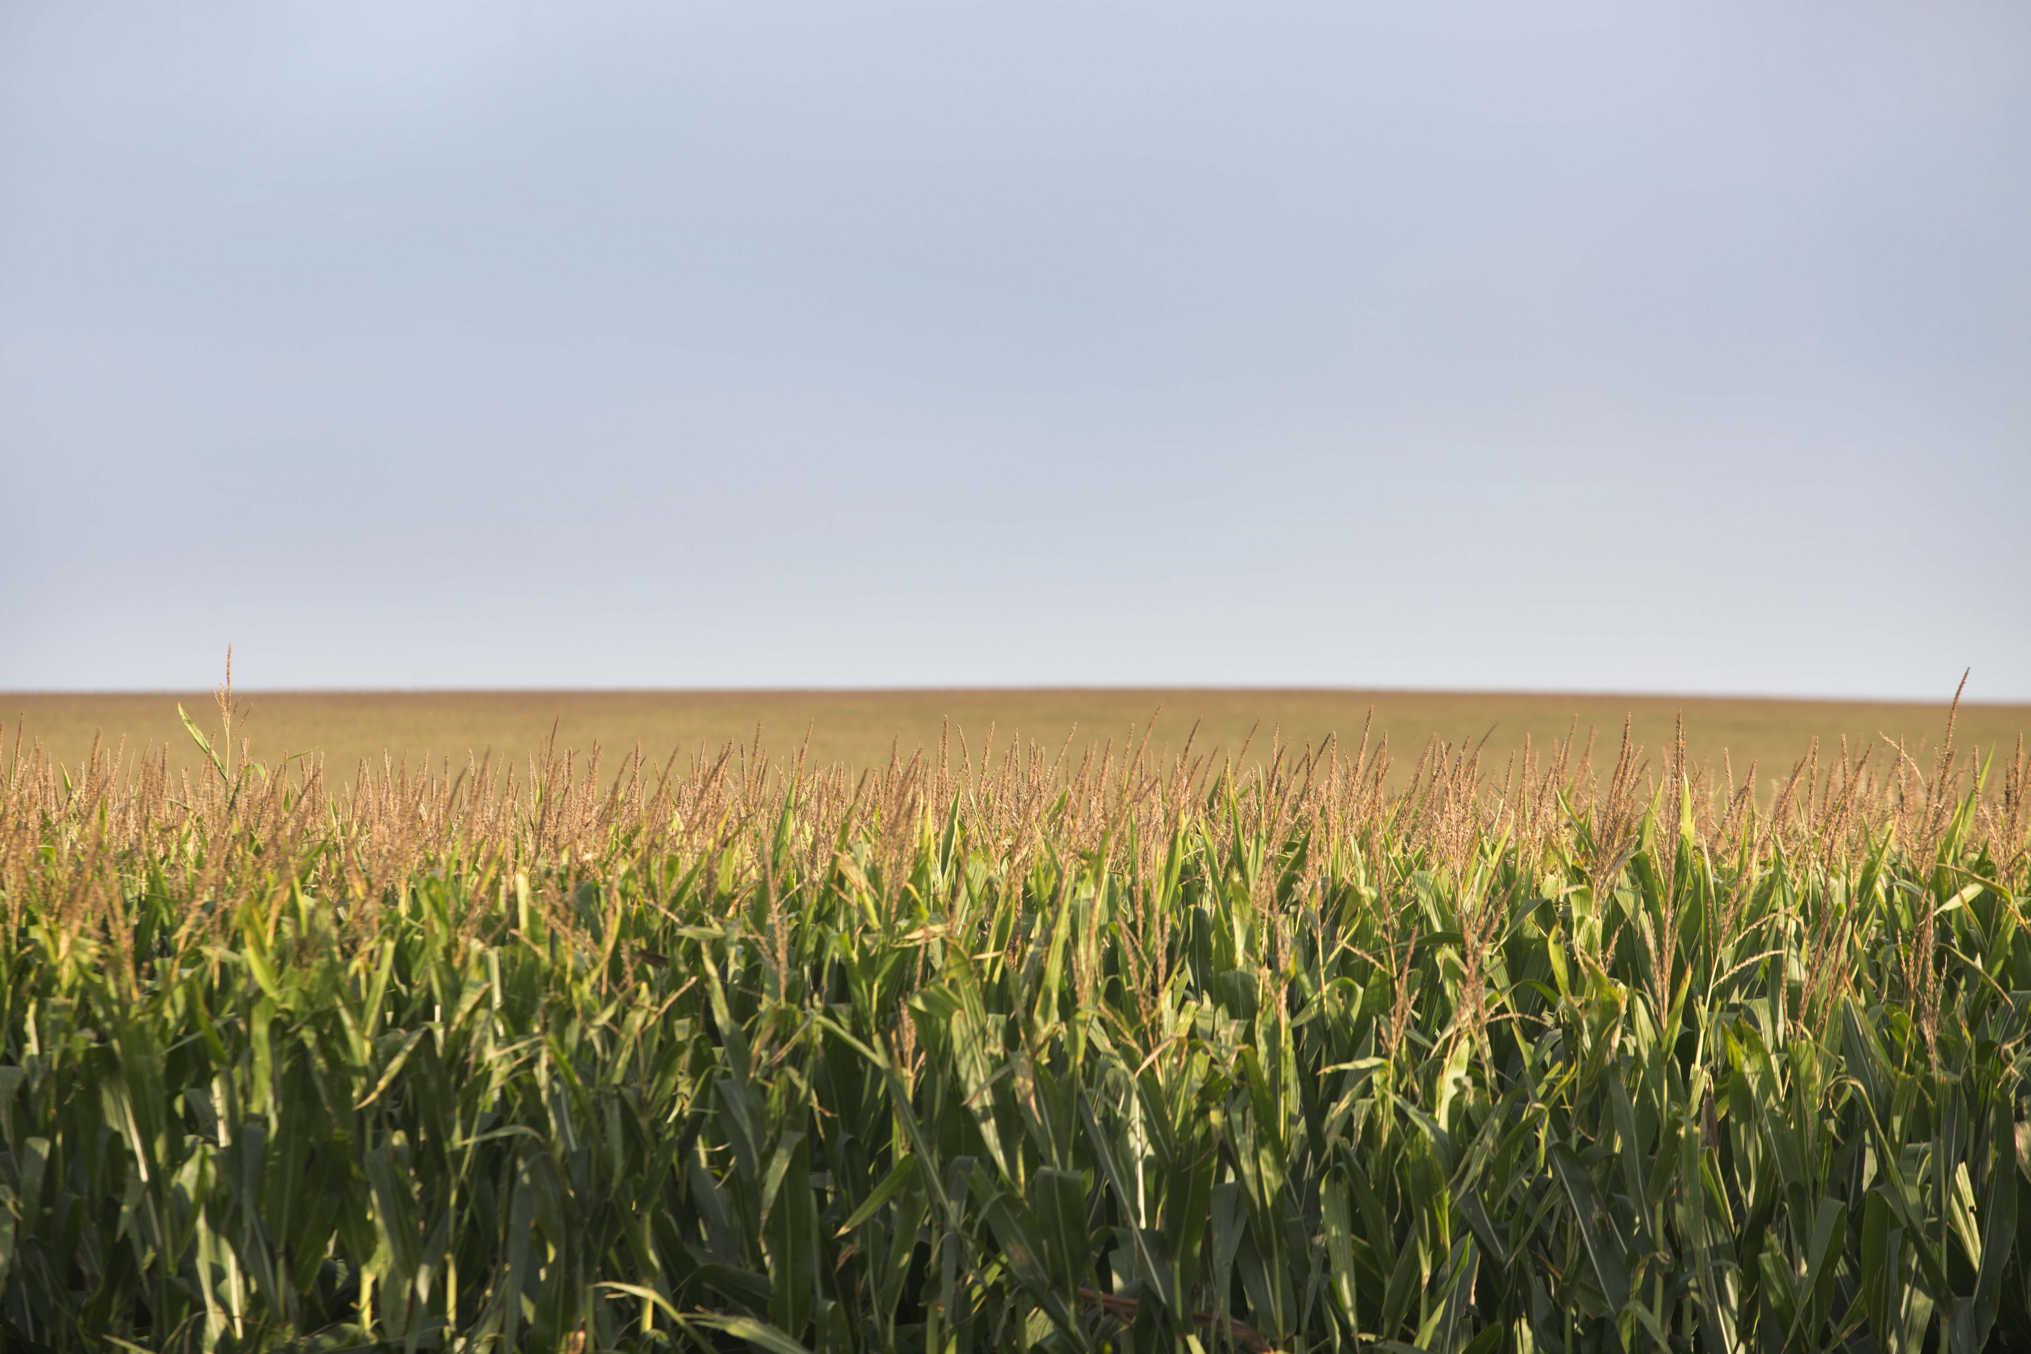
Nutrient Management Initiative (NMI)
"The program has helped me adopt the practice of side-dressing N on the whole farm, and see the immediate benefits of less N used, better yield, and more money in my pocket at the end of the season. I hope this practice also leads to better water quality on my farm.“
- Freeborn County farmer

Slide 29
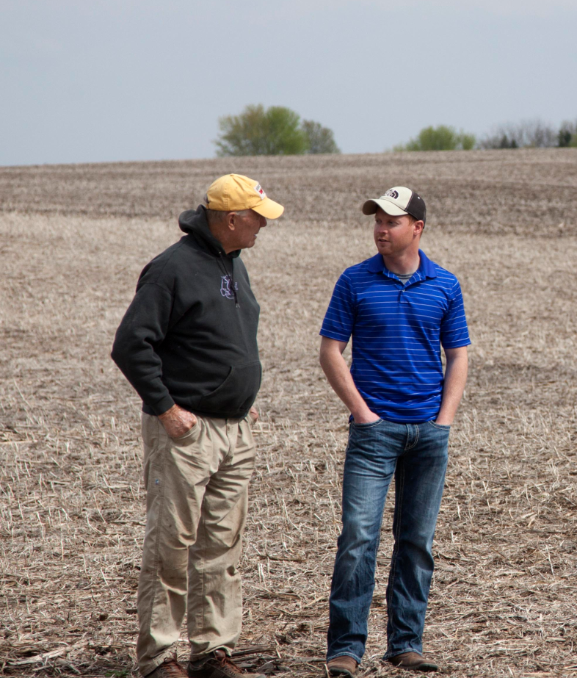

Nutrient Management Initiative (NMI)
Value of the NMI Program
Conversations about nutrient management
Working directly with farmers and crop advisers
Local data and learning from results
Low cost

Slide 30
Thank you!

