Slide 1
Agency Overview and Budget
Dr. Beth Thompson | Executive Director Morgan Grelson | Business Manager

Slide 2
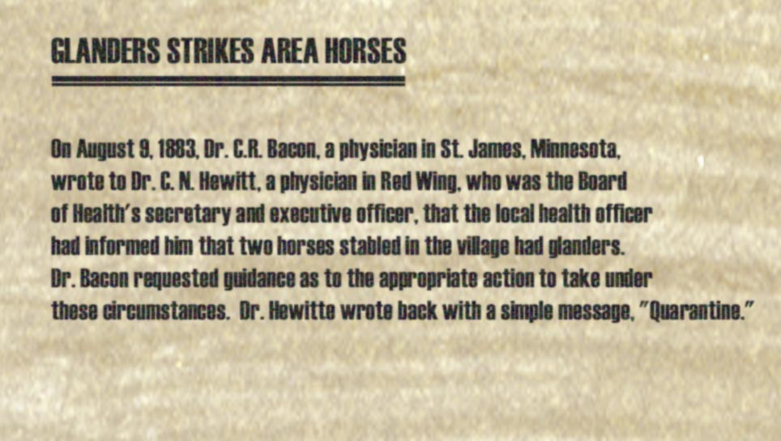
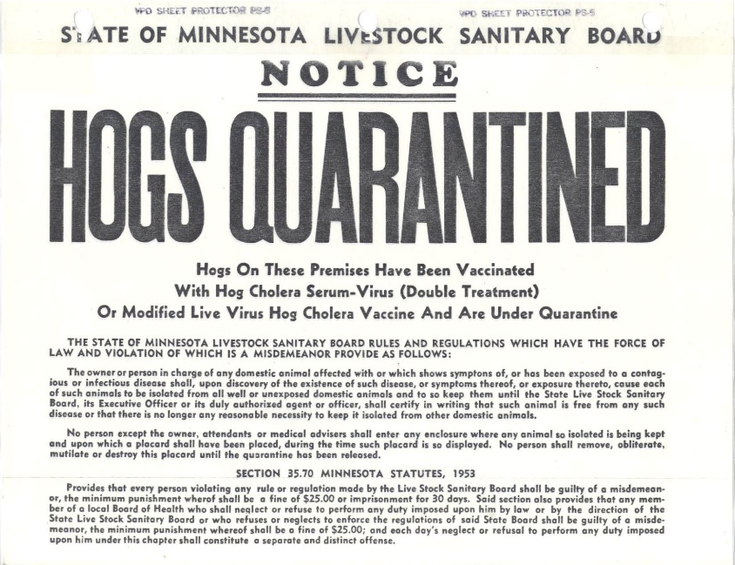
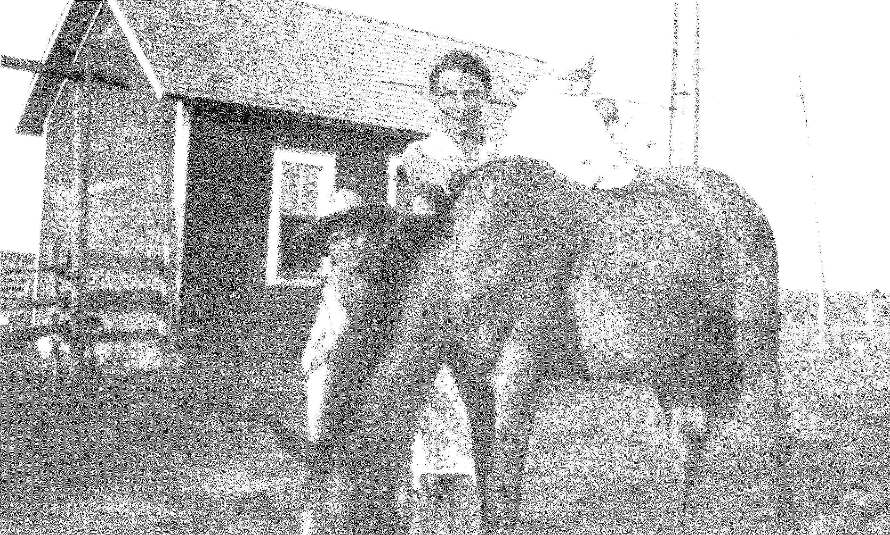
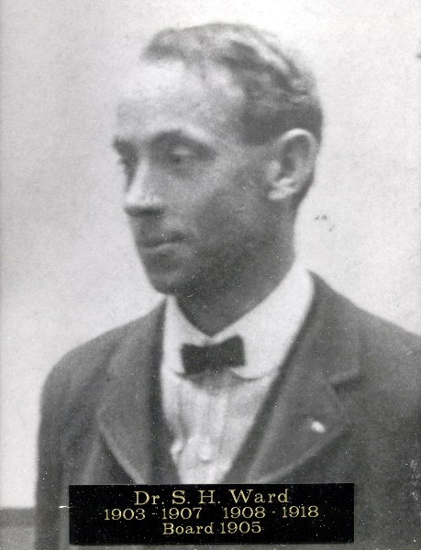
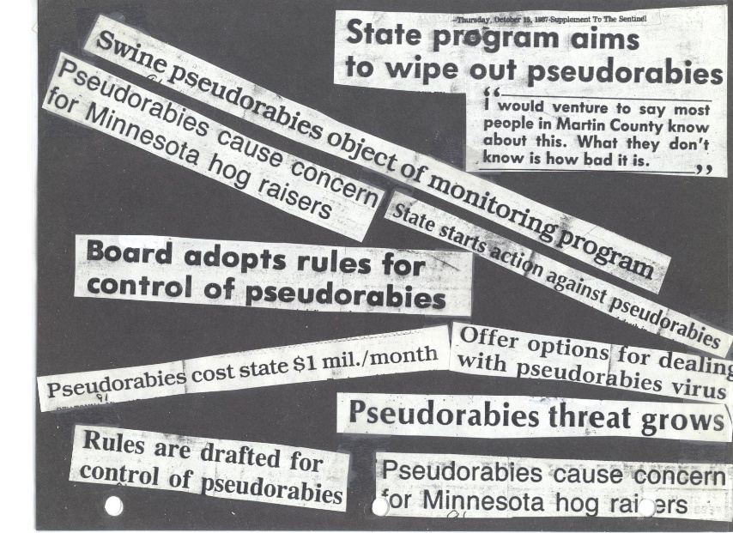
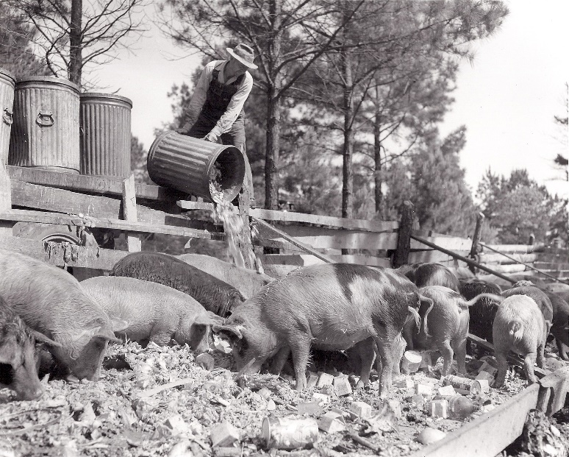
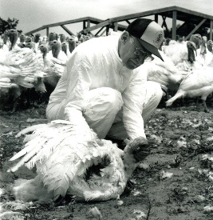
History

Slide 3
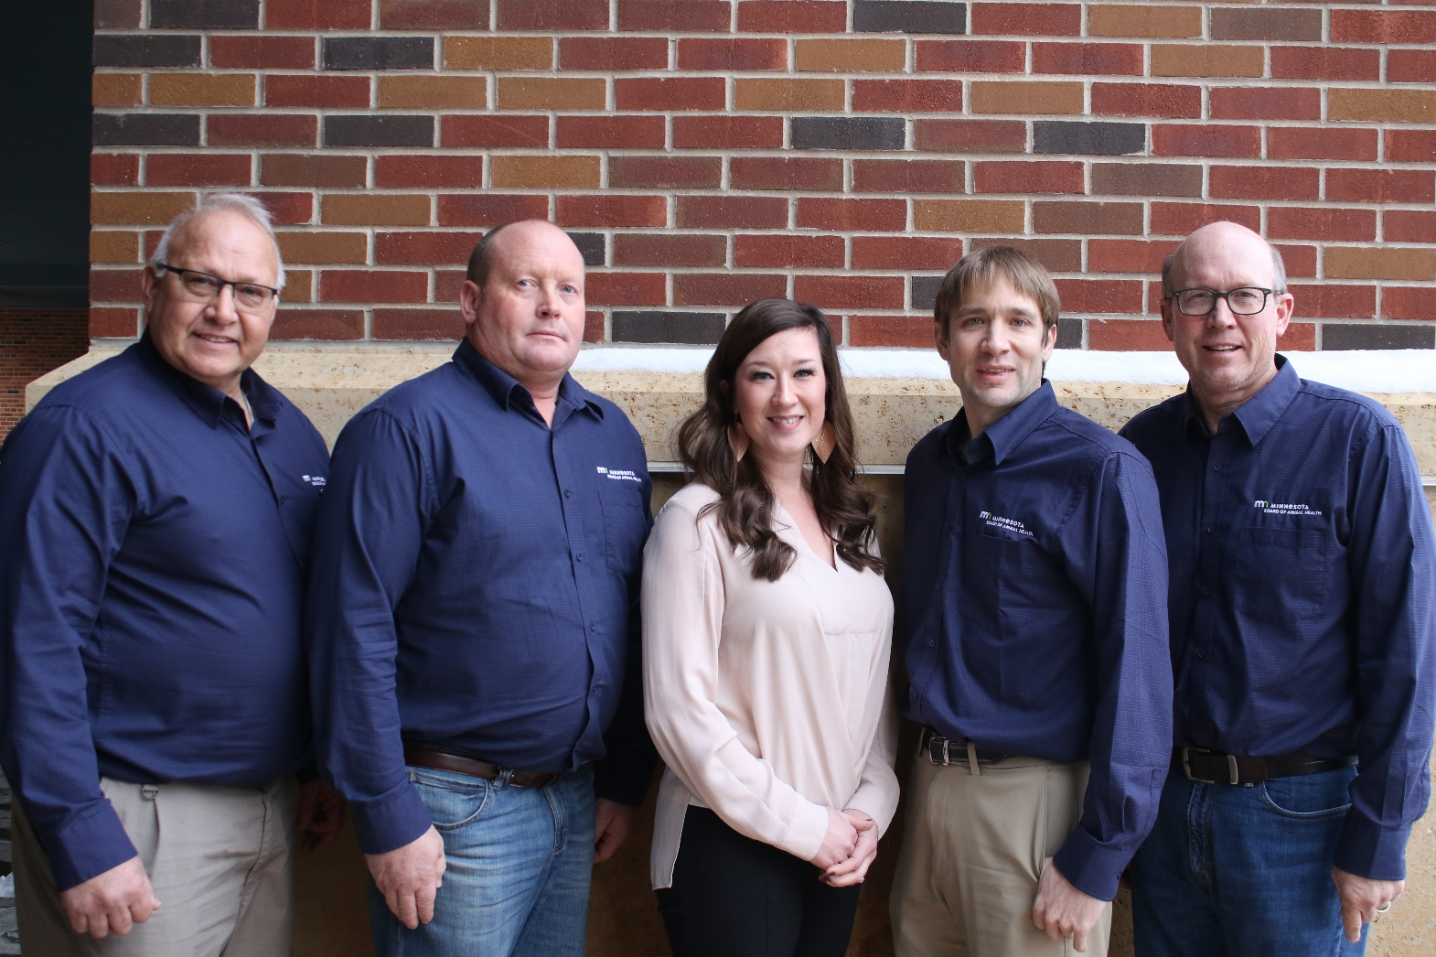
Board Members

Slide 4
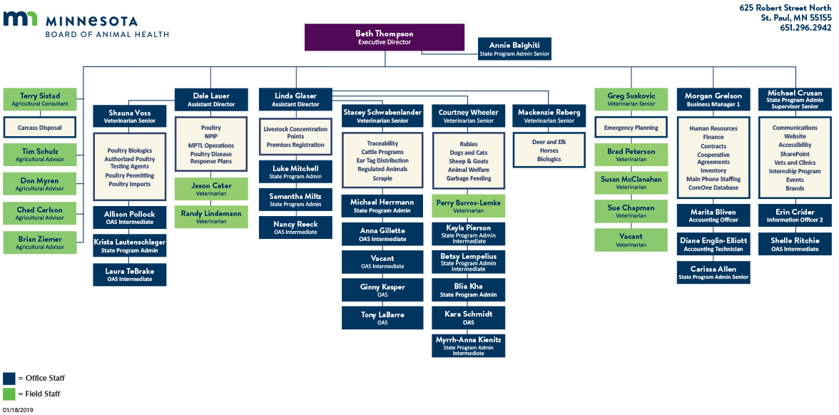
Organizational Chart

Slide 5
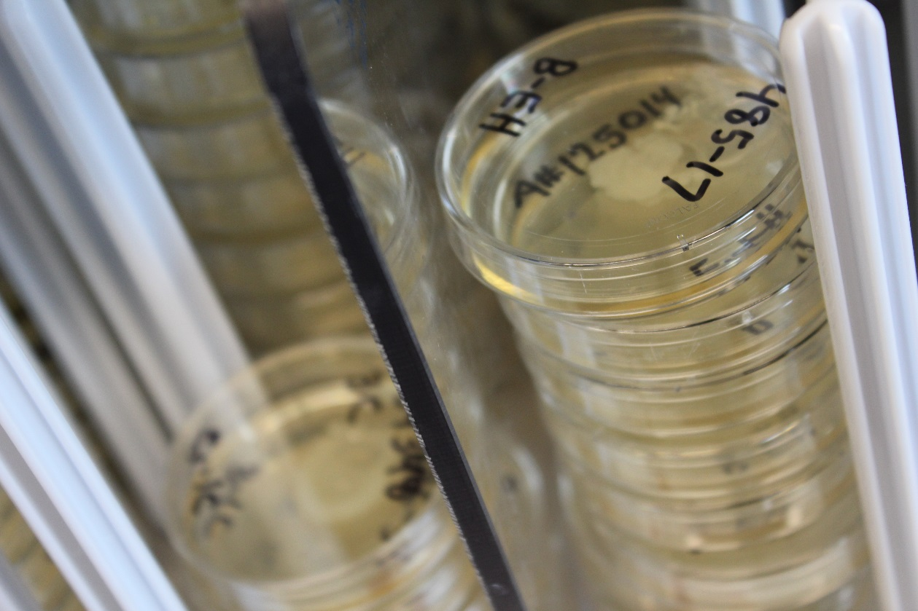
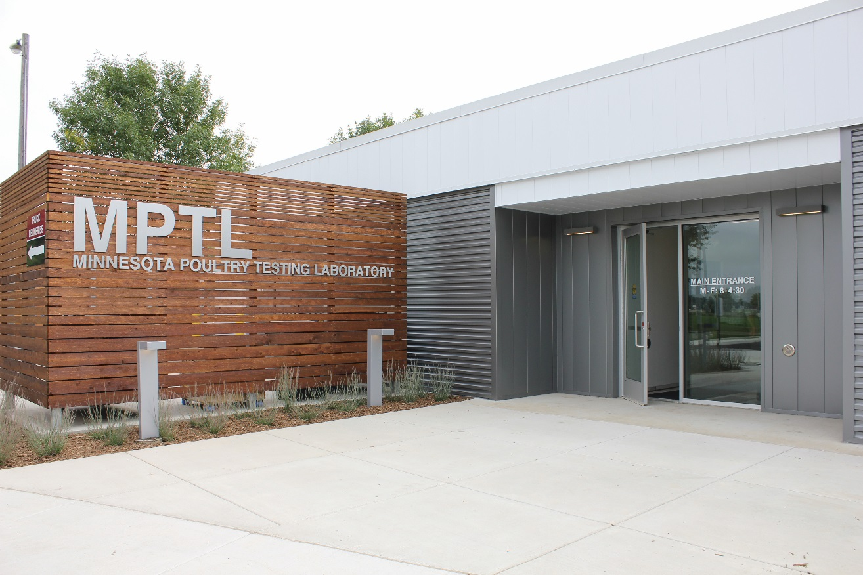
In-State Testing

Slide 6
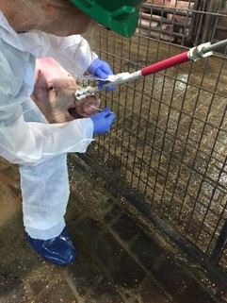
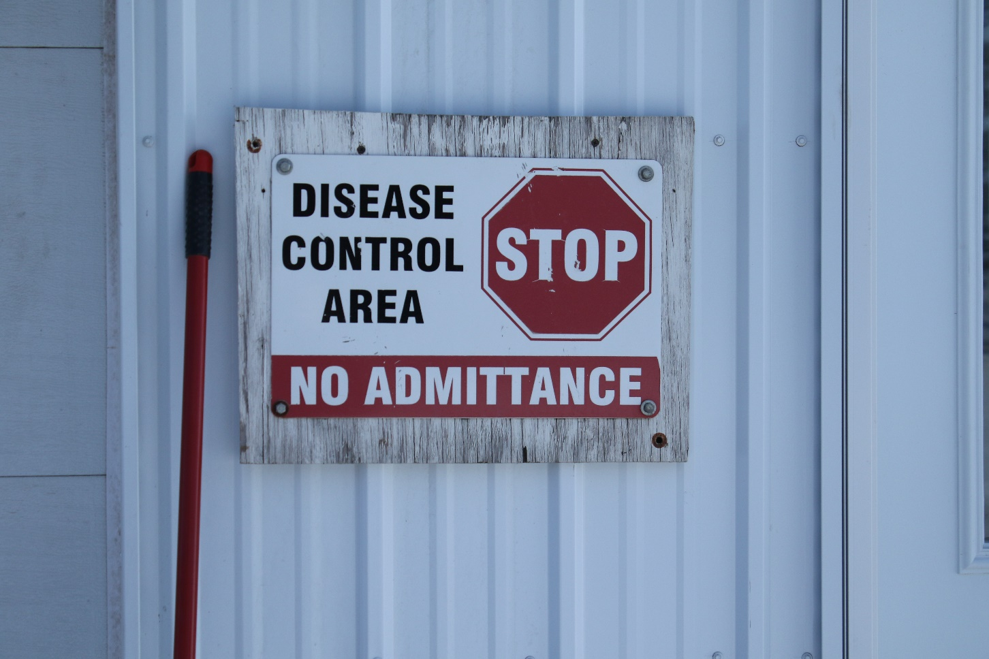
Detect, Control, Eradicate

Slide 7
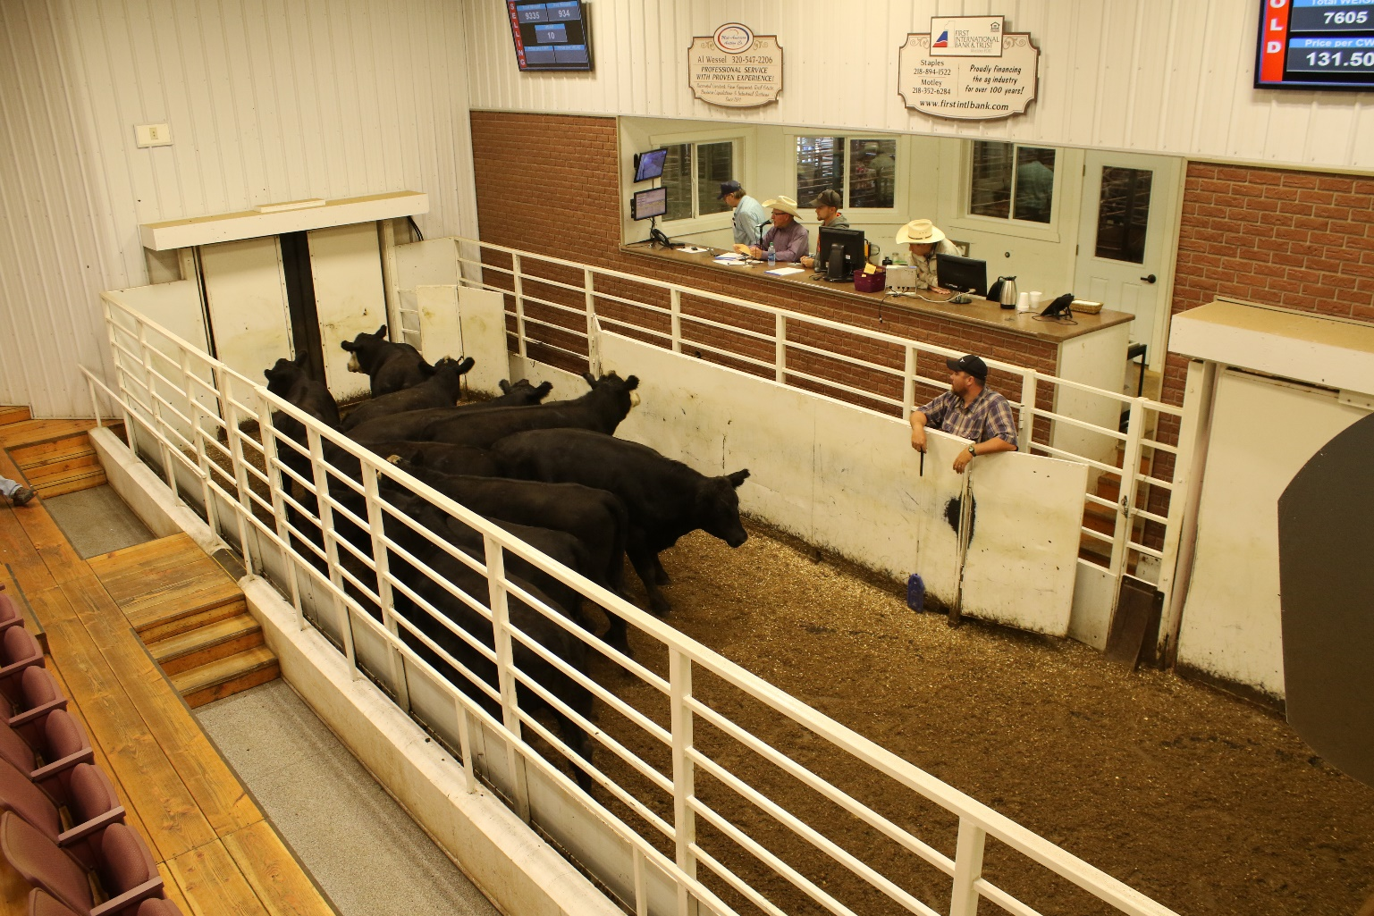
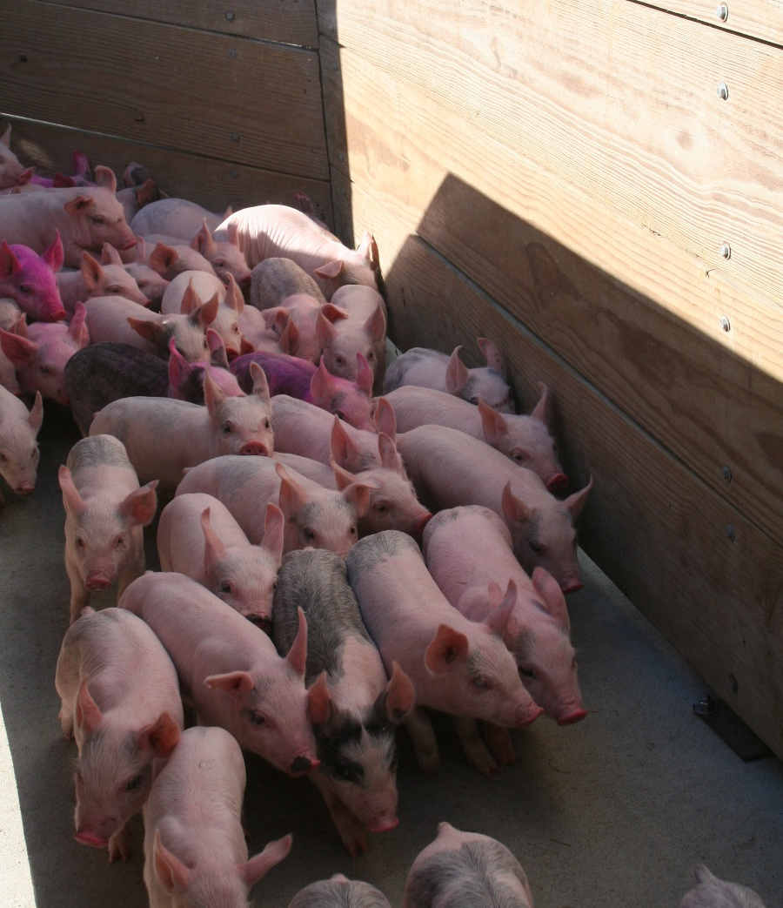
Import Standards and Animal Movement

Slide 8
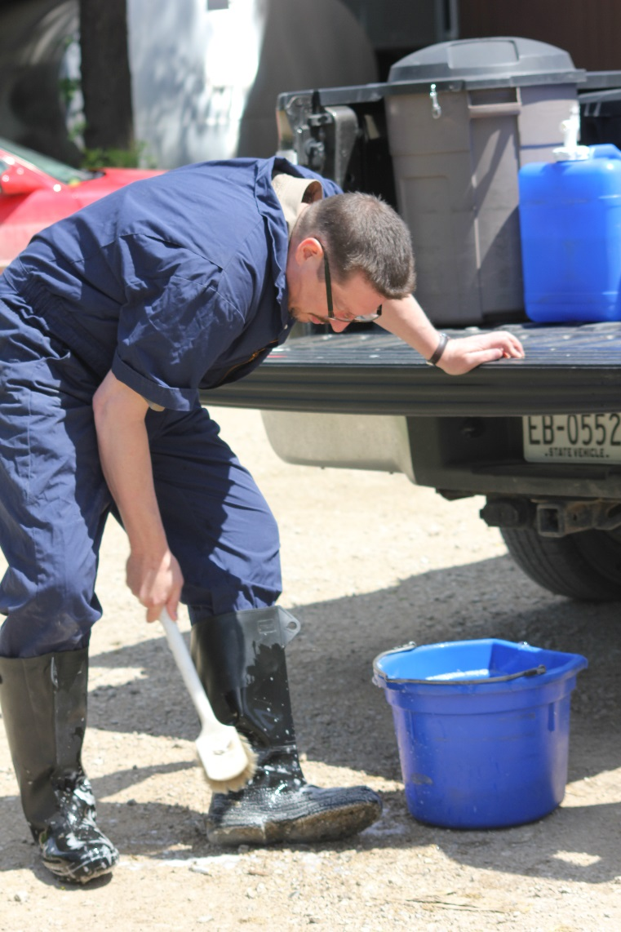
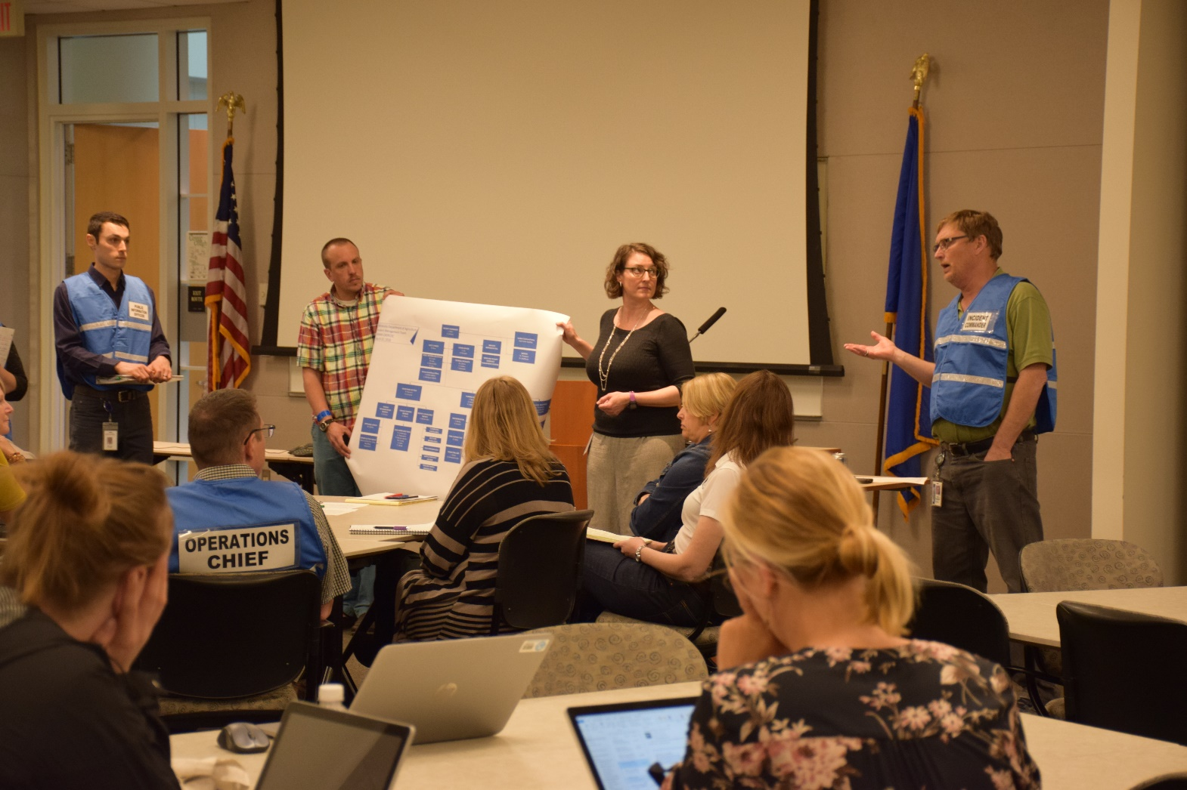
Emergency Planning and Preparedness

Slide 9
Secure Supply Plans
Voluntary programs to increase the value of livestock by incorporating biosecurity and protecting herd health during a disease outbreak.
Secure Pork Supply: Currently wrapping up a series of workshops around the state to help producers learn the program and its benefits.
Secure Milk Supply: Actively working on the Minnesota plan with the Minnesota Department of Agriculture and dairy industry.
Secure Beef Supply: Efforts underway to engage producers through meetings.
Secure Poultry Supply: Active plan in place with demonstrated benefits for producers shown during poultry disease outbreaks.

Slide 10
Current Events
Working with livestock groups on secure food supply plans.
Teaming up with the Department of Health on the Longhorned Tick.
Responding to Low Pathogenic Avian Influenza.
Monitoring African Swine Fever outbreaks in foreign countries.
Carrying out legislative audit recommendations in cervid program.

Slide 11
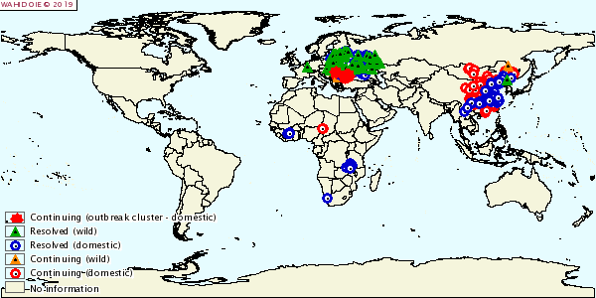
African Swine Fever
Coordinating national exercises to test response plans.
State and industry coming to the table together to prepare.
World Organisation for Animal Health reports latest outbreaks.
Europe, Asia, Africa
Map as of 01/17/2019

Slide 12
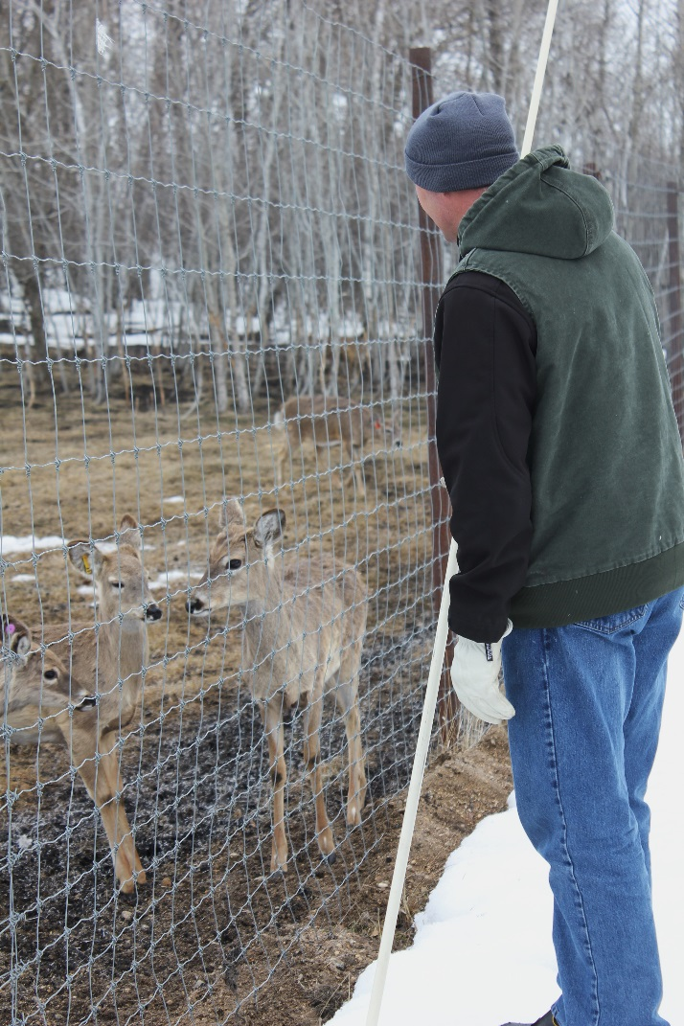
Farmed Cervid Program
Minnesota state law directing Board involvement with farmed cervids: January 2004
Farmed cervids are considered livestock.
Include all species in the family Cervidae – Deer, Elk, Moose, Reindeer

Slide 13
Regulations for the program
MN Statutes, Ch. 35
Mandatory registration
Annual Inspection
Response to escaped farmed cervids
Wild cervids in an enclosure
Fencing
Animal Identification
CWD surveillance
Importation of farmed cervids
MN Rules effective April 2013 (1721.0370 – 0420)
Herd Inventories
Sales of farmed cervids for slaughter
Record keeping – producer has 10 year requirement
Quarantine procedures for infected herds
Defining a CWD Endemic area

Slide 14
Mandatory CWD Surveillance
100% surveillance required by law.
Samples can be taken by:
Producer
Veterinarian
Regulatory staff
Head submitted to Veterinary Diagnostic Laboratory
If eligible animals not tested, surveillance period is advanced.
If samples do not provide successful results, surveillance period is advanced.
Disregard for sampling can lead to producer’s CWD herd status being dropped.
2019 training program to authorize sample collectors.

Slide 15
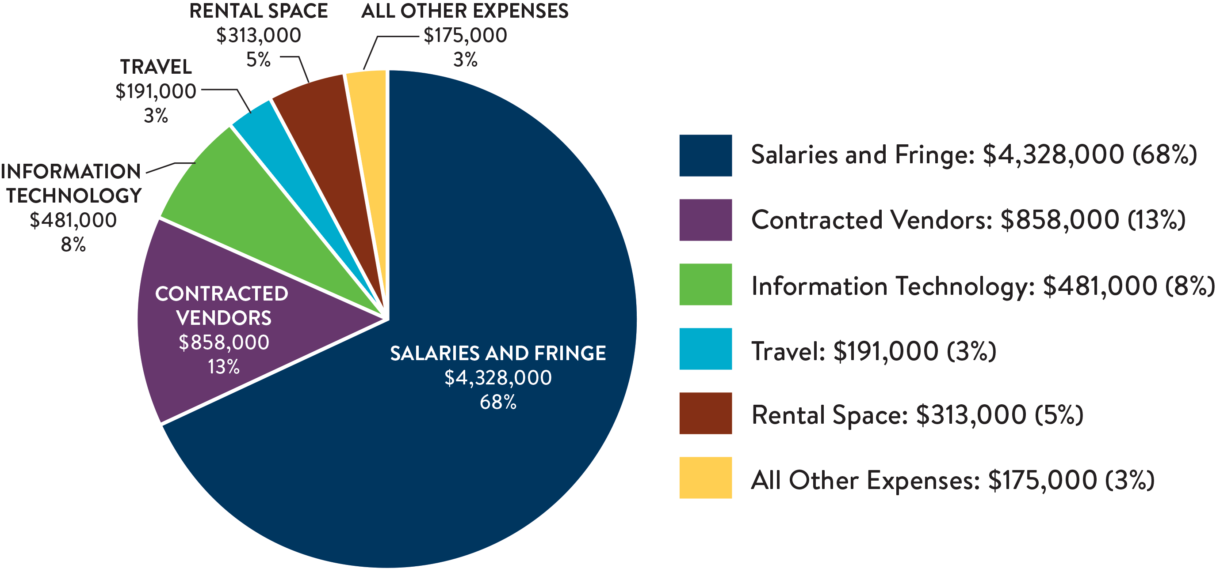
Board of Animal Health's Proposed Budget FY20 Expenses in the Budget Planning & Analysis System (BPAS)--$6,346,000

Slide 16
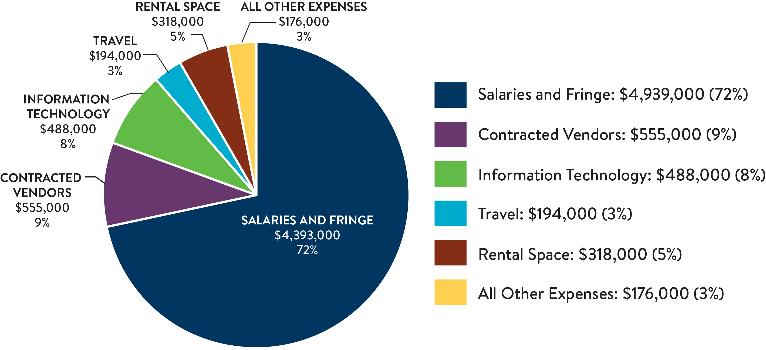
Board of Animal Health's Proposed Budget FY21 Expenses in the Budget Planning & Analysis System (BPAS)--$6,124,000

Slide 17
Thank you!
Dr. Beth Thompson
beth.thompson@state.mn.us
651-201-6844
Morgan Grelson
morgan.grelson@state.mn.us
651-201-6846

