Slide 1
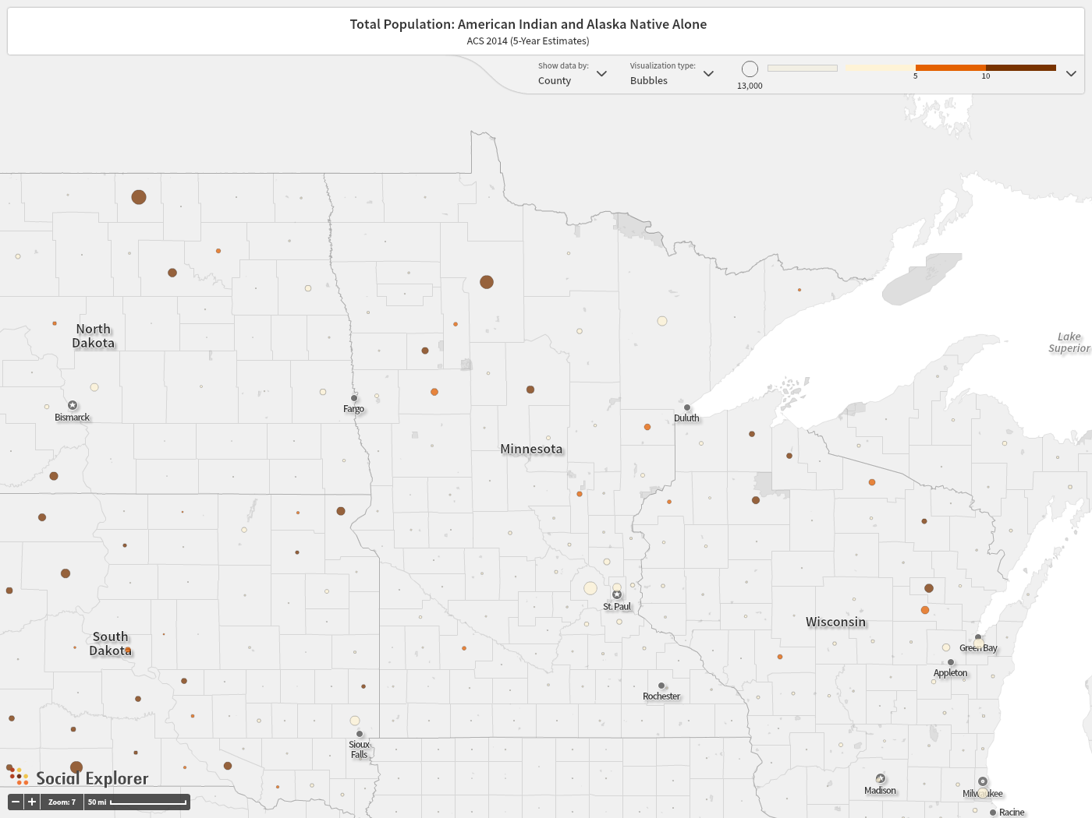
American Indian Population By County
(Note: Color shows percent, size of dot shows number)

Slide 2
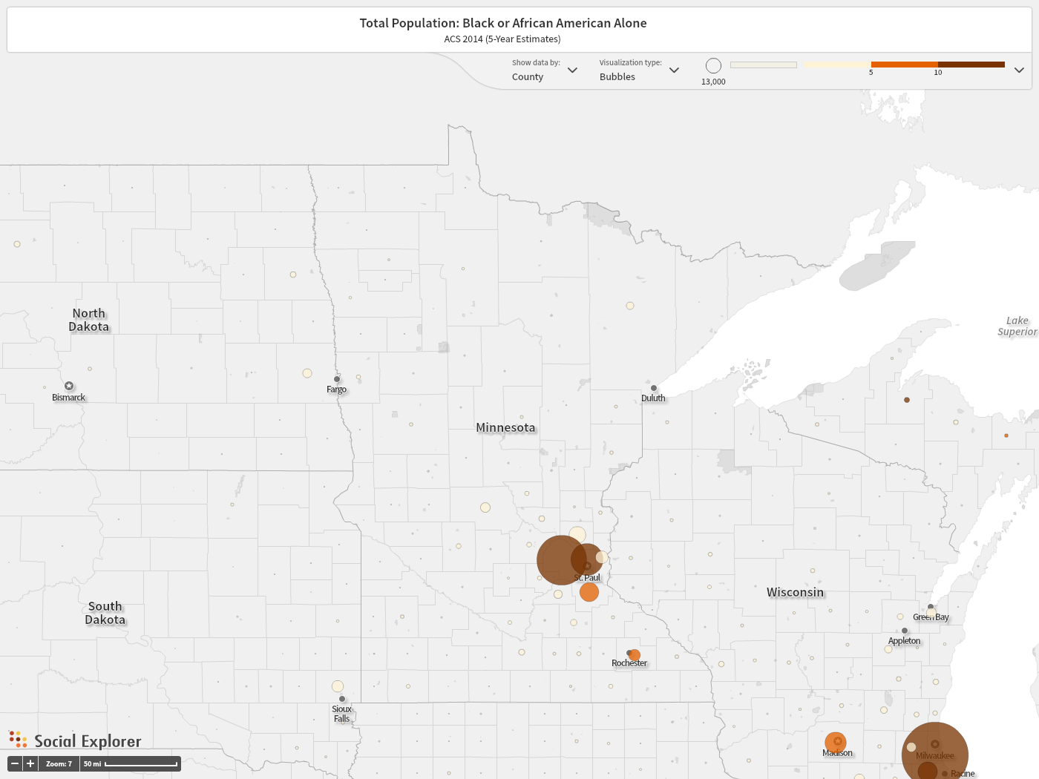
Black Population By County
(Note: Color shows percent, size of dot shows number)

Slide 3
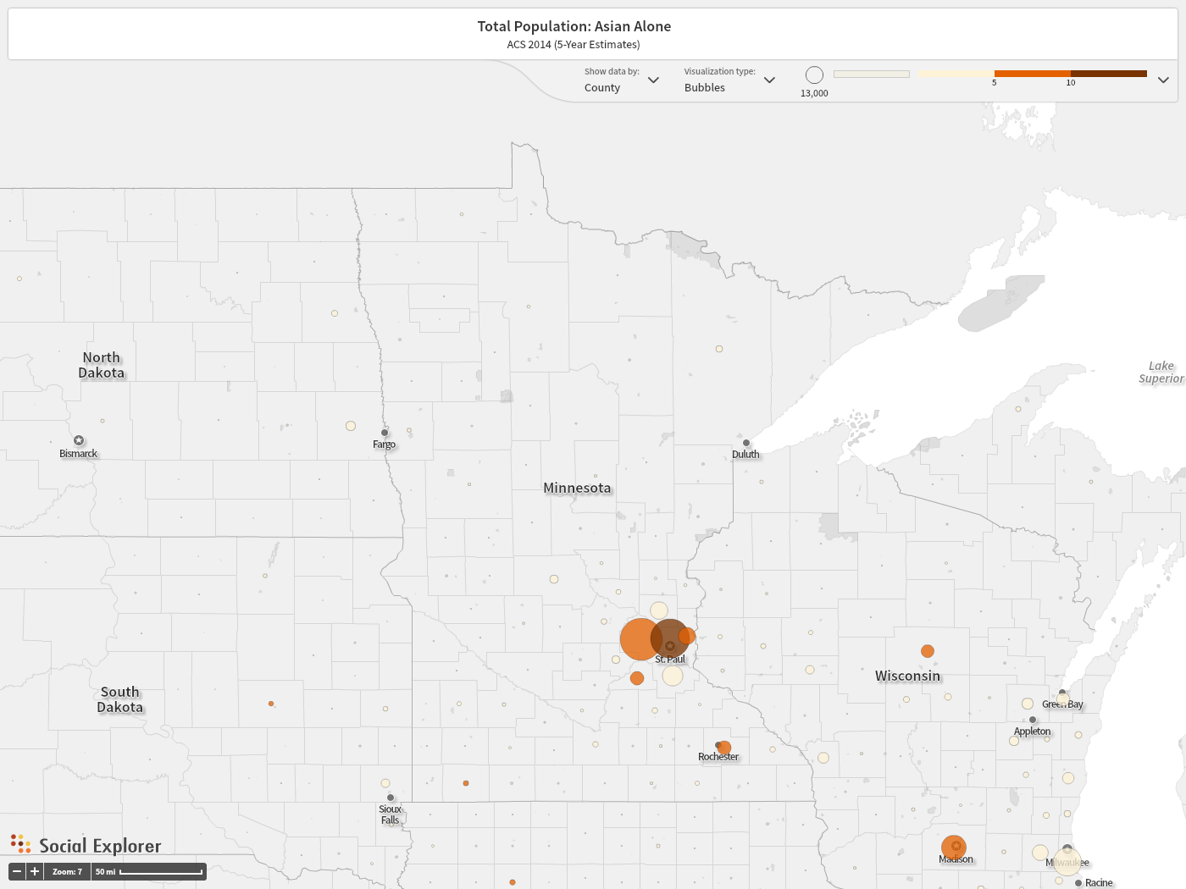
Asian Population By County
(Note: Color shows percent, size of dot shows number)

Slide 4
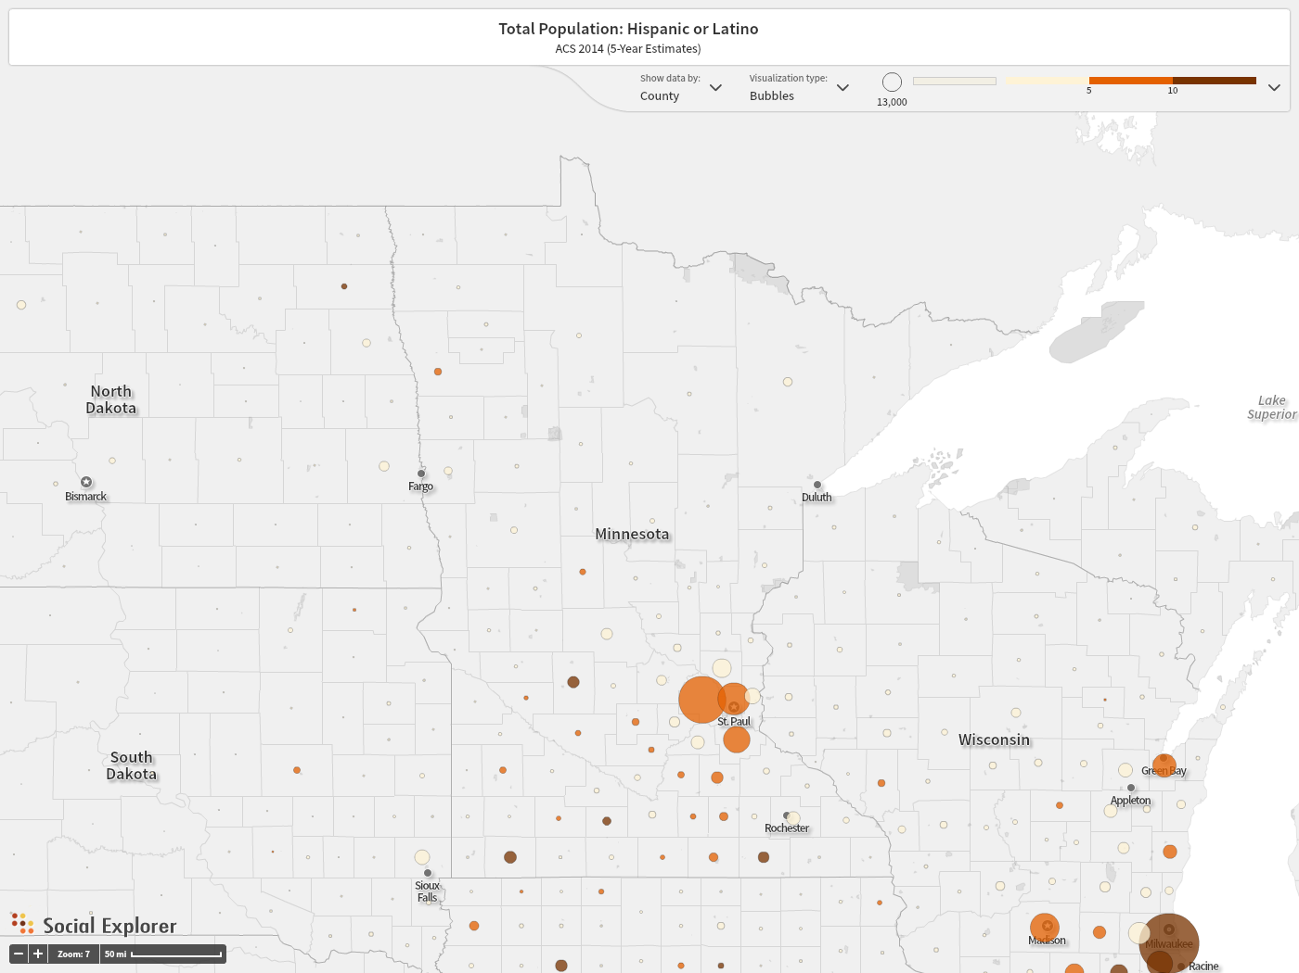
Hispanic/Latino Population By County
(Note: Color shows percent, size of dot shows number)

