Slide 1
Federal Shutdown Impacts
Angie Becker Kudelka, Assistant Director
January 22, 2019

Slide 2
Scope of Federal Shutdown
BWSR partnerships:
United States Army Corps of Engineers
United States Department of Agriculture
Natural Resources Conservation Service (NRCS)
Farm Service Agency (FSA)
United States Environmental Protection Agency

Slide 3
USDA - NRCS
2 Regional Program (RCPP) Grants from NRCS
Still operating as of January 22, 2019
Small Feedlots Grant in SE MN
Project dollars to Landowners in 5 watersheds (EQIP)

Slide 4
USDA - NRCS
3 Program Agreements with NRCS
Still operating as of January 22, 2019
Conservation Planning program in 7 watersheds
Technical Training and Certification Program statewide
Small communications project

Slide 5
USEPA
3 Projects with EPA
Not in operations
Functional Stream Assessment in NE -- on hold
Wetland Banking Review oversight – on hold (but smaller risk)
Long-term monitoring study – working with resources; cannot invoice

Slide 6
USDA - FSA
1 Project Agreement with FSA
Not in operations
MN CREP on hold since August 17.

Slide 7
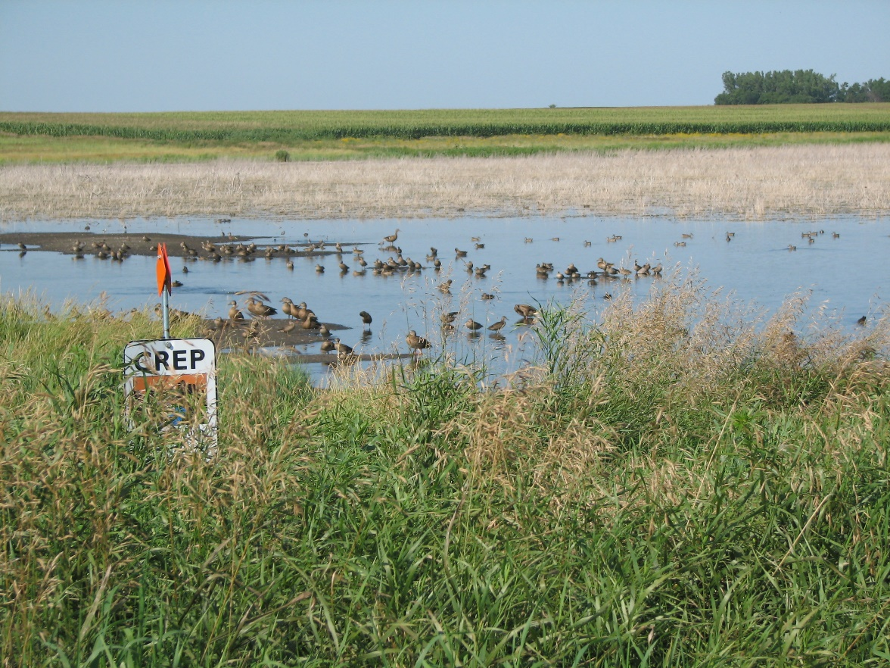
Minnesota CREP

Slide 8
Minnesota CREP
Minnesota CRP Status
Acres expiring over next 5 years | - 598,000
Expected acres retained based on recent average | + 299,000
Minnesota CREP | + 60,000
Projected net loss of acres* | - 239,000
* 2015 - 2019
Notes:
Minnesota is losing hundreds of thousands of protected acres due to expiring federal Conservation Reserve Program acres. The MN CREP will help slow that loss but there are still a lot of acres that will no longer be protected.

Slide 9
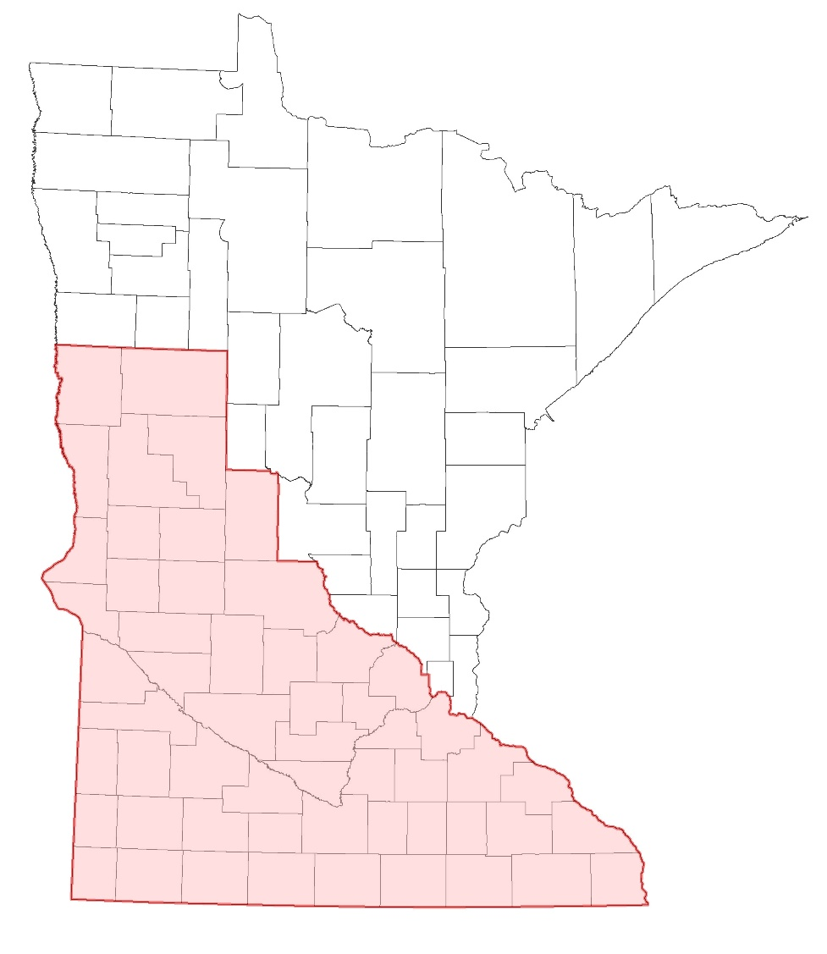
CREP Scope
60,000 acres
Voluntary approach
+ env sensitive land
+ permanent
Targeted:
buffers,
wetlands,
wellhead prtection for drinking water

Slide 10
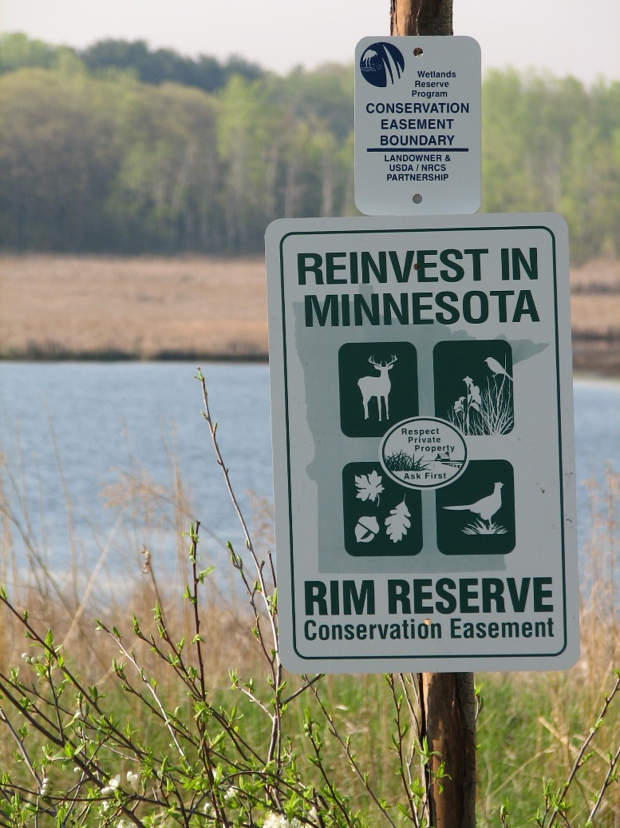
State - Minnesota CREP
ReInvest in Minnesota (RIM) Reserve
State program - authority MS103F.515
Established: 1986
Voluntary perpetual protection

Slide 11
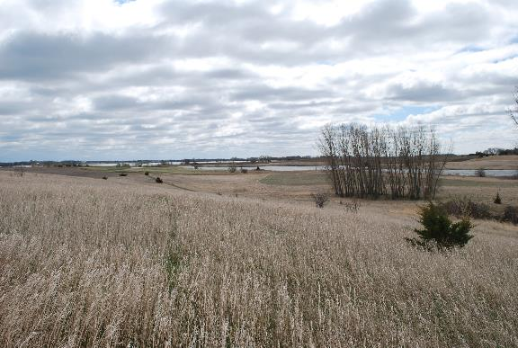
Federal - Minnesota CREP
Conservation Reserve Program (CRP)
Federal program
Established in 1985 (and reauthorized since)
10-15 year contracts
Notes:
Transition into talking about how CRP works.
Largest conservation program in the Nation
Size of program has varied from approx. 38 m acres (max) to current 24 m acres (nationally)

Slide 12
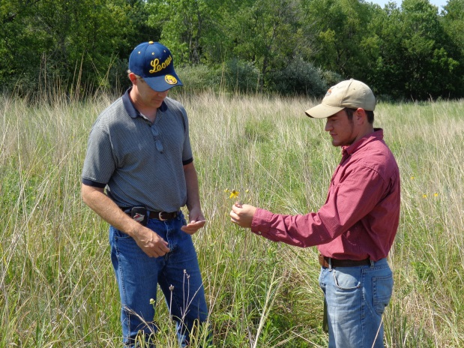
Minnesota CREP
RIM
CRP
Landowner payments
Practice payments
Technical assistance
Easement acquisition/ engineering
Easement roundouts
Landowner payments
Practice payments
Notes:
HOW CREP works. (state vs. federal payments support).
We’ll start with the federal – their resources cover primary landowner payments (and restoration payments
State is responsible for (read slide)
That means, if we look at it as a big bucket, pour in the state contribution; pour in the federal contribution – the state contributes more of certain things – but the two can’t exist independently without each other

Slide 13
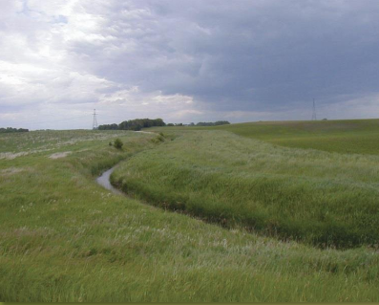
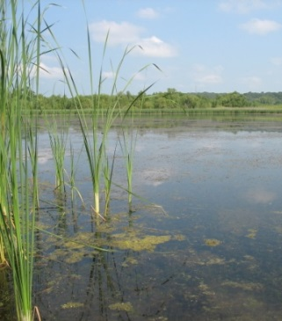
Benefits to Minnesotans
Keeps soil on the land
Provides places to temporarily store water
Protects vulnerable drinking water
Enhances grasslands and wetlands for habitat

Slide 14
Minnesota CREP applicants
“In addition to enjoying the habitat benefits, it also made sense for us financially. We really like that the payment was spread out over 15 years compared to a onetime payment.”

Slide 15
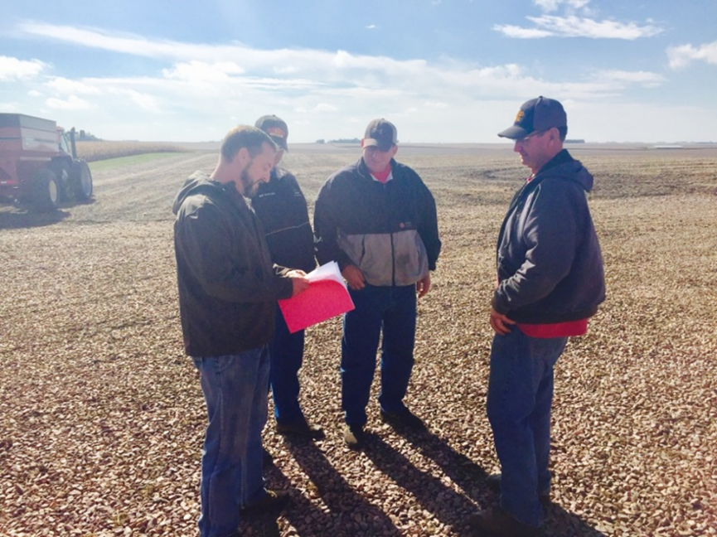
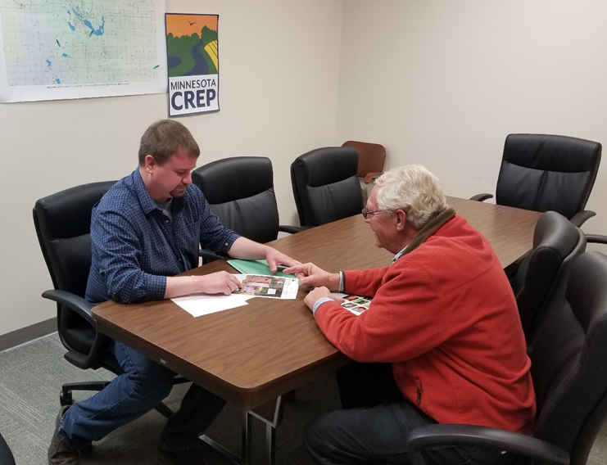
Minnesota CREP

Slide 16
Minnesota CREP Results to Date
 | Submitted | Funded
Acres | 13,856 | 12,441
Investment | $117M | $104M

Slide 17
Minnesota CREP Status
August 17, 2018 Processing hold
September 30, 2018 Farm Bill hold
December 20, 2018 Farm Bill signed
December 22, 2018 Shutdown
January 22, 2019 Shutdown continues
5 months – no sign-ups
Lost momentum
More lag time anticipated

