Slide 1
State
Disaster Assistance
Contingency Account –
Deficiency Funding Request

Slide 2
What We Do
Mission and Vision
Help Minnesota prepare for, respond to, and recover from emergencies and disasters.
A resilient Minnesota – prepared to respond and recover.

Slide 3
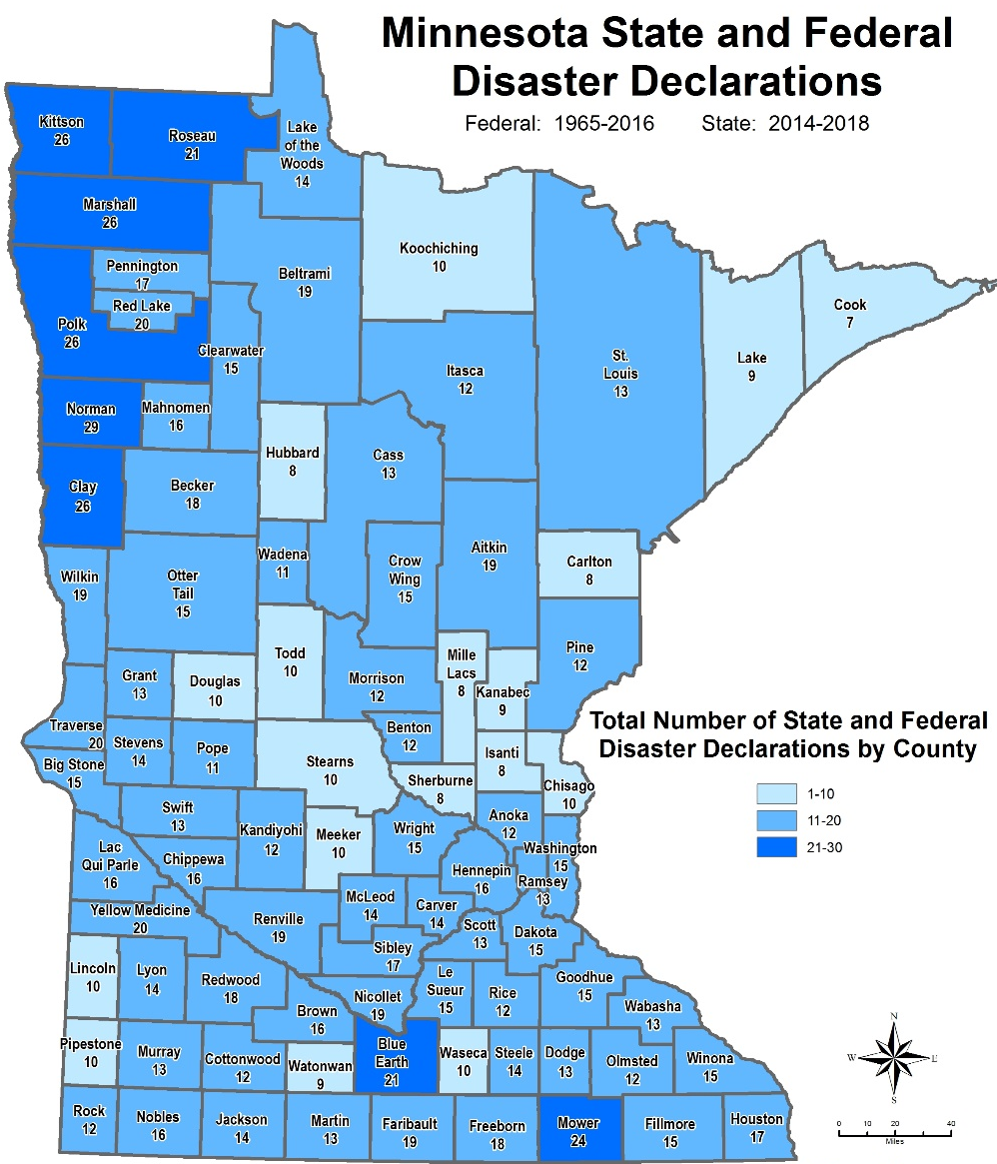
Why We Do It
Disasters Happen in Minnesota

Slide 4
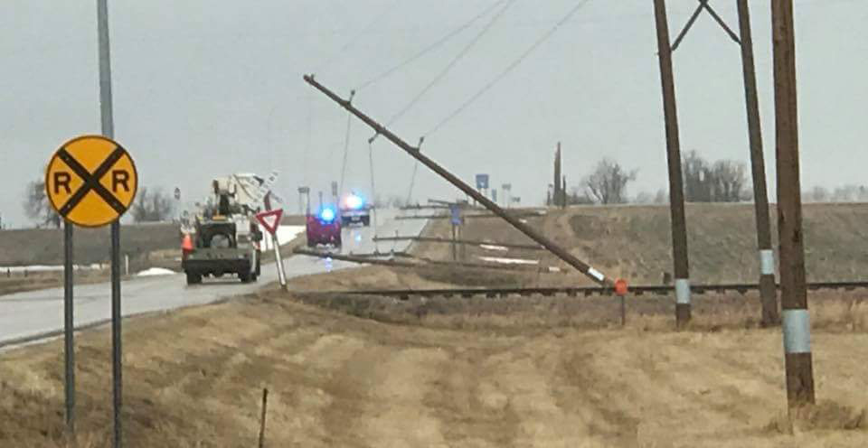
Why We Do It
Nobles, Rock & St. Louis Counties – April 13-4 May, 2018

Slide 5
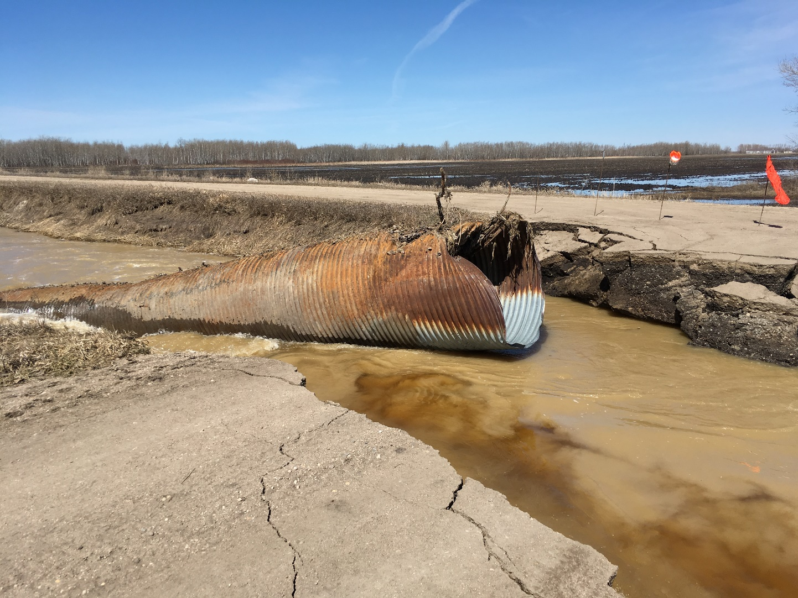
Why We Do It
Lac qui Parle and Marshall Counties –April 21-May 17, 2018

Slide 6
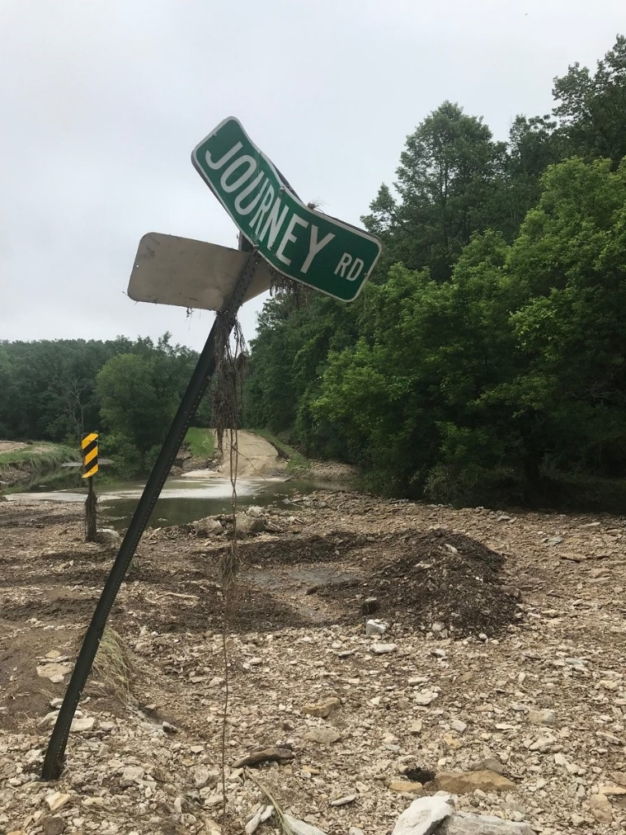
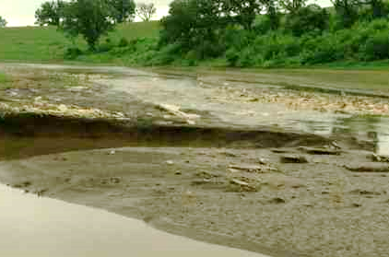
Why We Do It
Fillmore & Red Lake Counties –
June 9-10, 2018

Slide 7
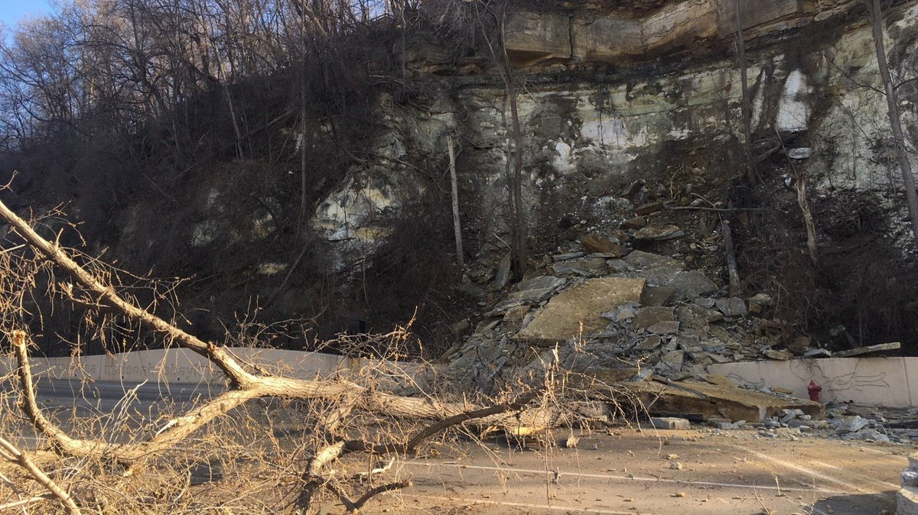
Why We Do It
Ramsey County – April 28, 2018

Slide 8
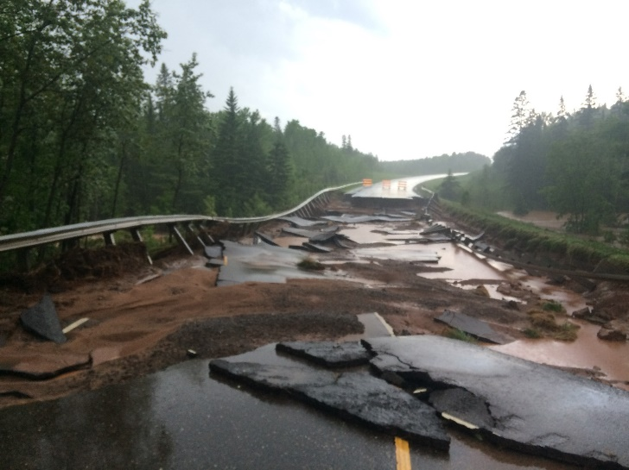
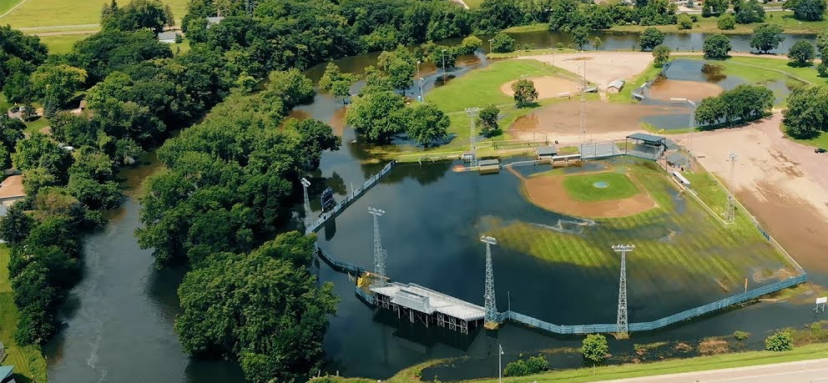
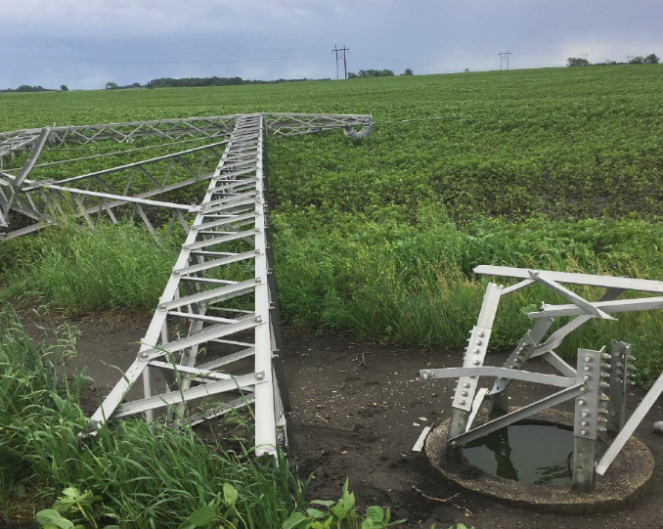
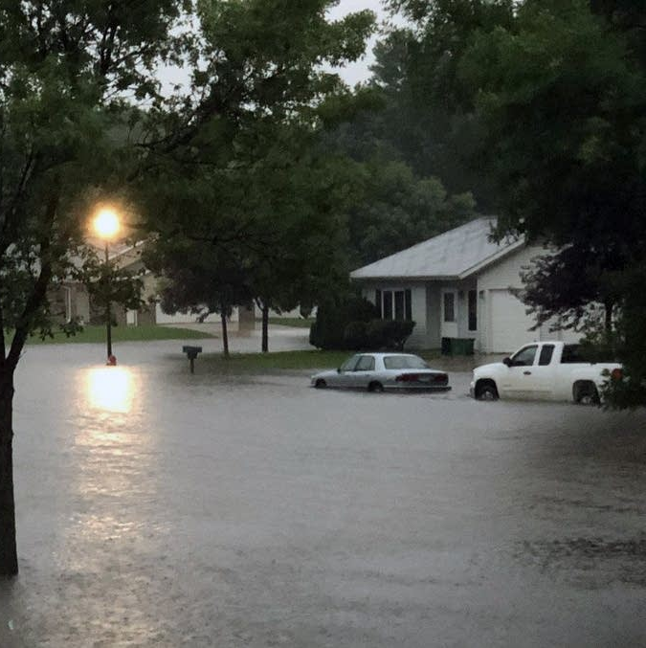
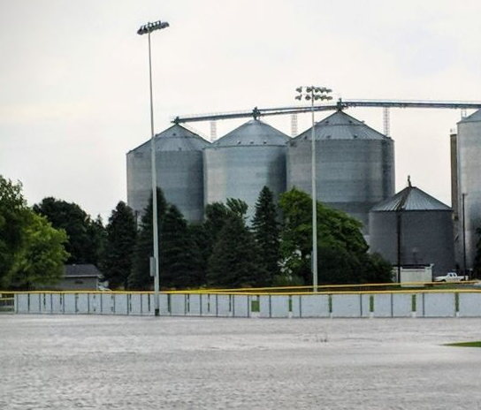
Why We Do It
June 15-July 12, 2018
FEMA DR-4390

Slide 9
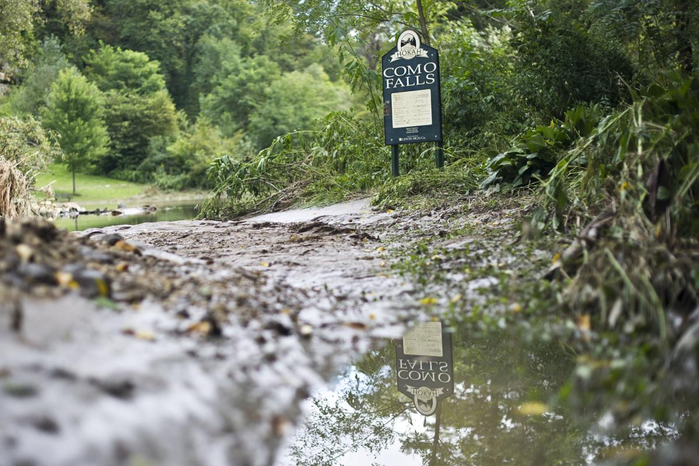
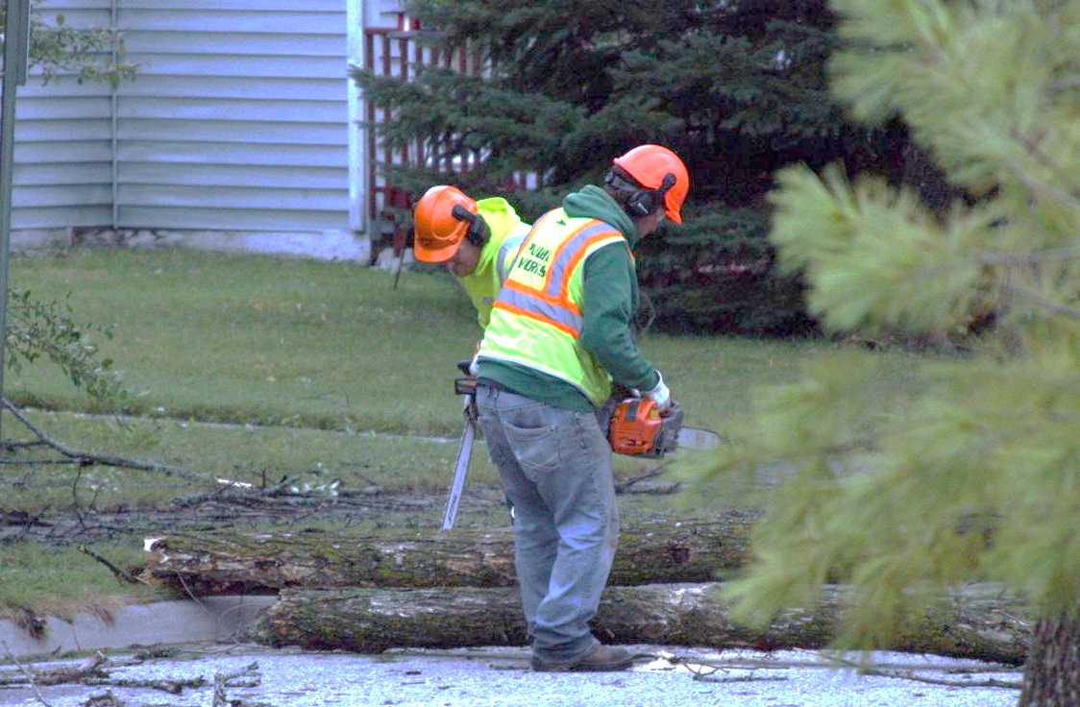
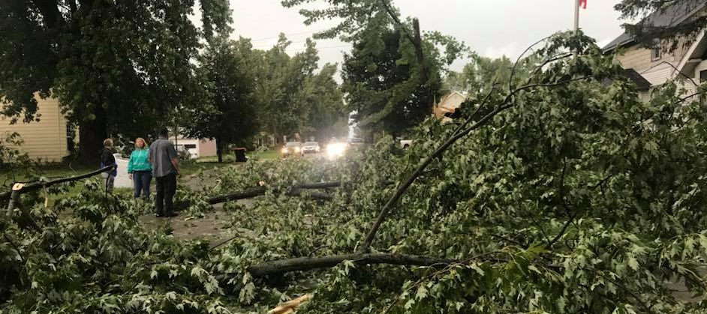
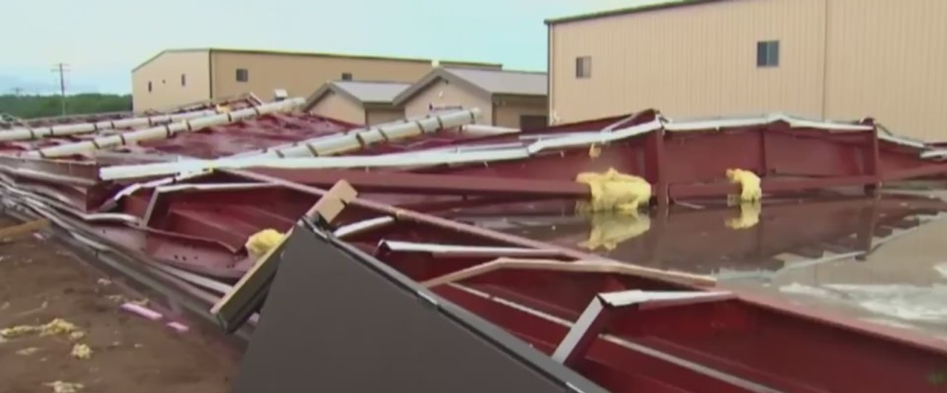
Why We Do It
Aitkin, Houston & Koochiching Counties – August 26-September 2, 2018

Slide 10
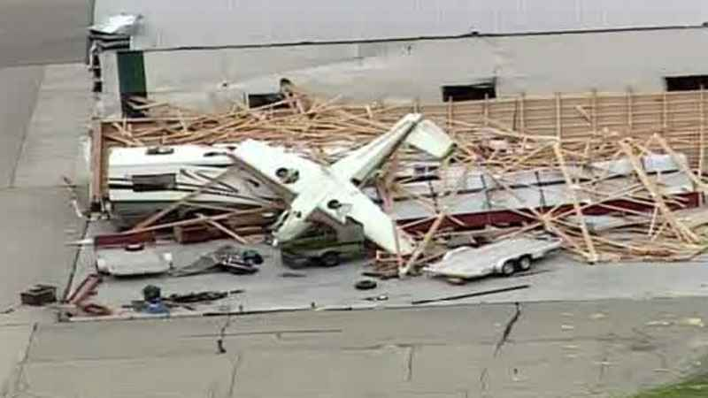
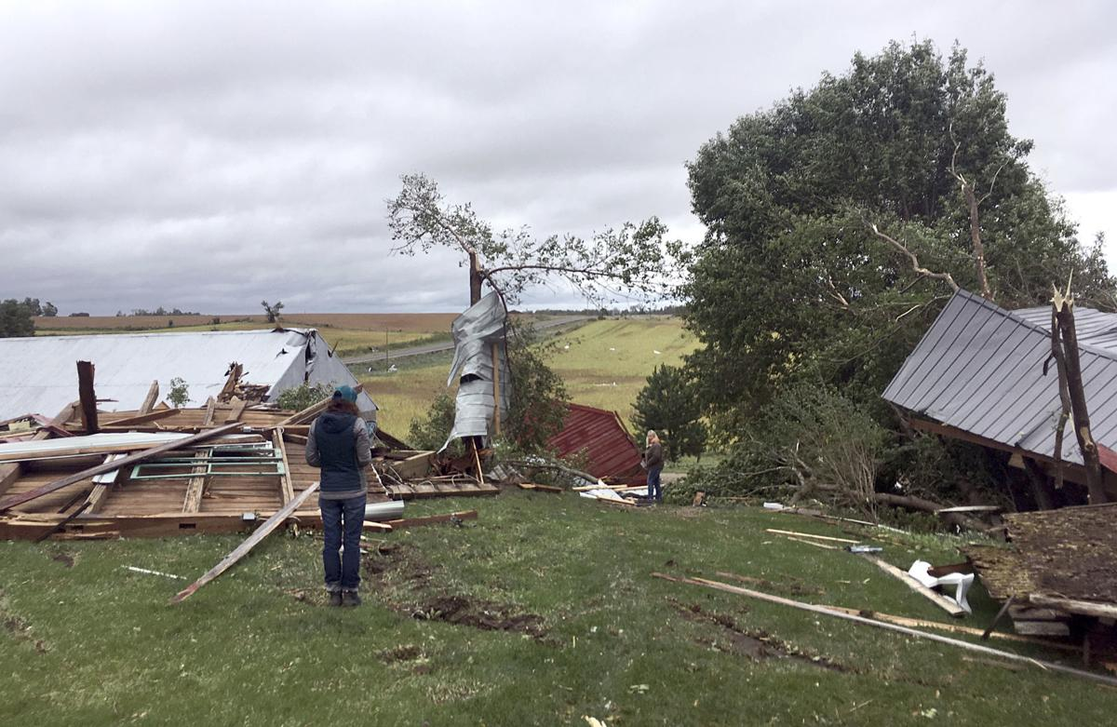
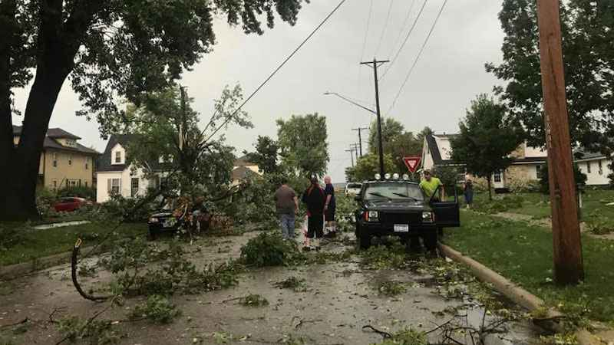
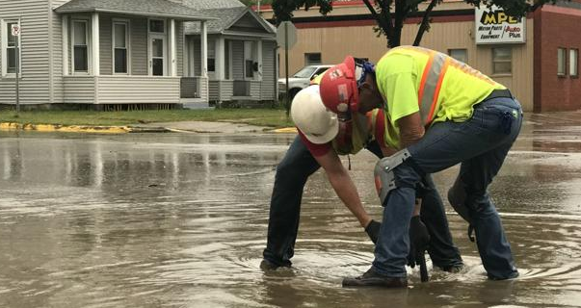
Why We Do It
Southern Minnesota –
September 20, 2018

Slide 11
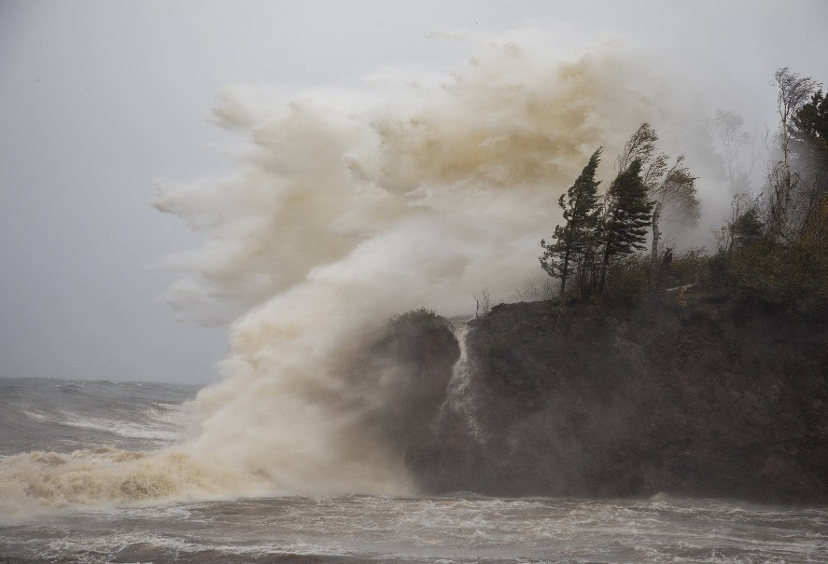
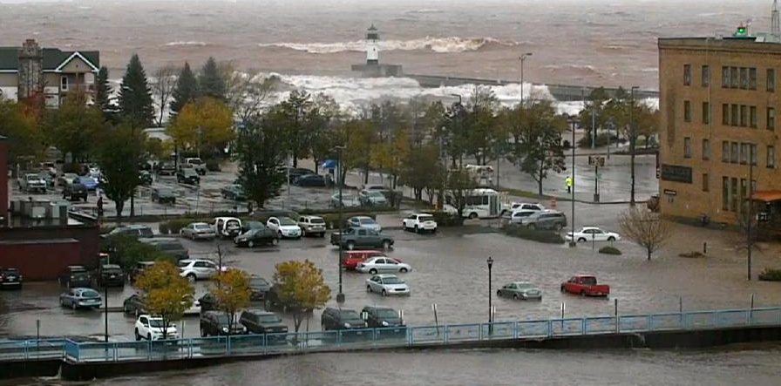
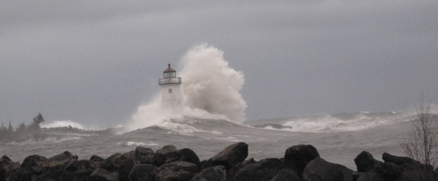
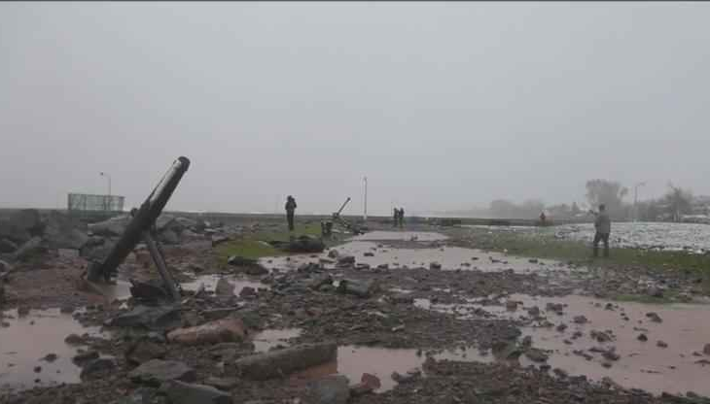
Why We Do It
NE Minnesota – October 3 & 10, 2018
FEMA DR-4414

Slide 12
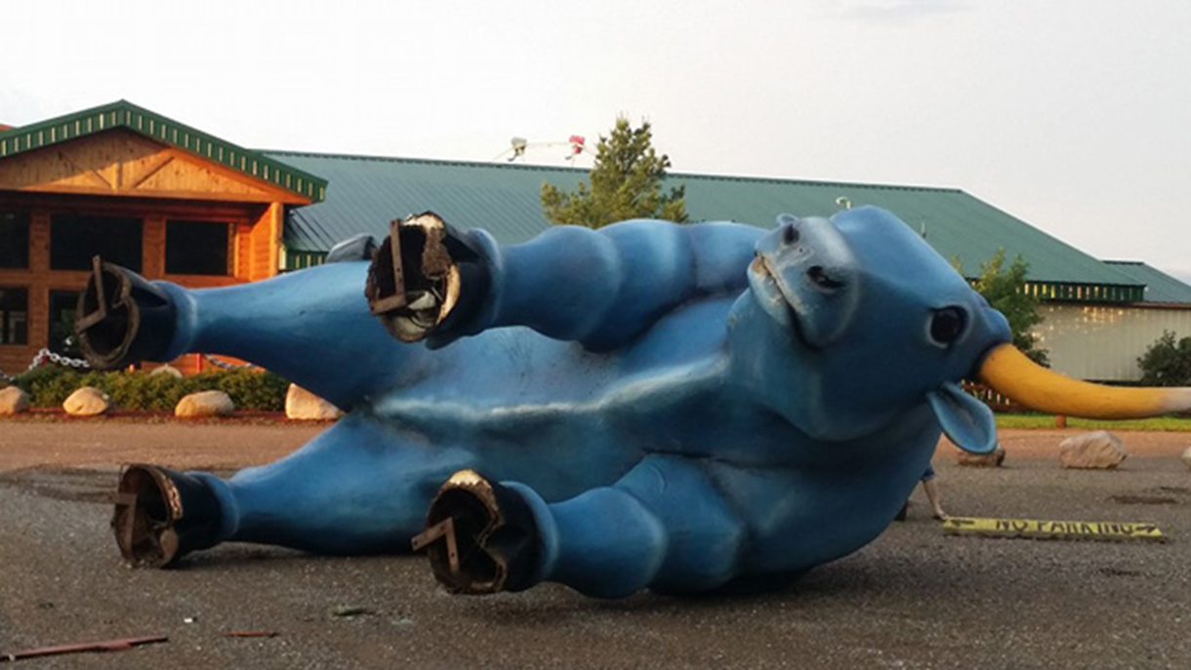
Why We Do It
Disasters Happen in Minnesota
10
$40M
49 + 4
436

Slide 13
Disaster Assistance
Federal & State Programs for Public Assistance (PA) for Infrastructure
Federal “Stafford Act” assistance (FEMA):
  2019 state indicator: $7,955,887.50
    $1.50 per capita
  County/Tribal indicator: $3.78 per capita
  75/25 federal/state cost share
State “Chapter 12B” assistance (DPS):
  2019 county indicator: $1.89 per capita
  75/25 state/local cost share
&

Slide 14
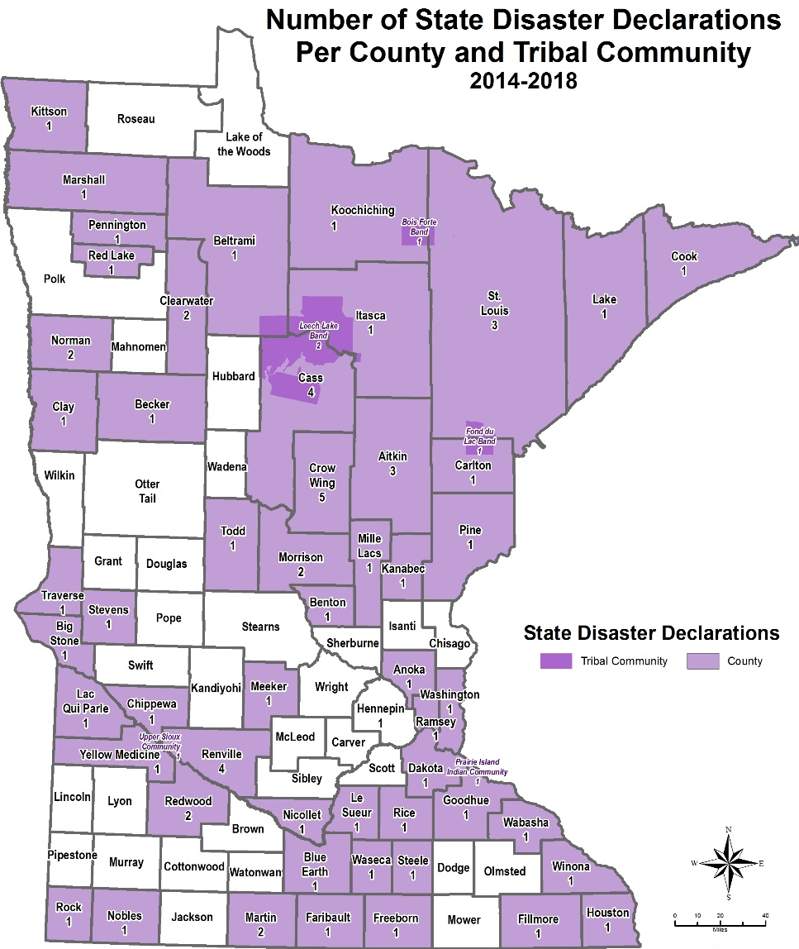
Disaster Assistance
State “Chapter 12B” Public Assistance (PA)
Gubernatorial
disaster declarations
for counties and tribes

Slide 15
Disaster Assistance
State Disaster Assistance Contingency Account
Established under Chapter 12 in 2014, along with Chapter 12B (State Assistance; Absent Federal Aid).
$52M appropriated into the account.
$51.5M transferred out to provide assistance.
Pays non-federal share (25%) of presidential declarations.
Funds state share (75%) of gubernatorial declarations.
Contingency account spending has split roughly 50/50 between federal and state declarations.

Slide 16
Disaster Assistance
State Disaster Assistance Contingency Account
The contingency account is recognized as a “best practice” nationwide.
Since the account was established the legislature has not met in special session to provide disaster assistance.
Also avoided need to cancel disaster-specific appropriations and fund deficiencies.
With adequate funding, it has worked as the legislature intended.

Slide 17
Disaster Assistance
State Disaster Assistance Contingency Account
Current unobligated balance is around $500,000.
Initial state share of latest federal declaration for St. Louis County and Duluth is $2.9 million, creating a deficiency of $2.4 million.
Governor’s Request: $10 million in FY19 deficiency funding

Slide 18
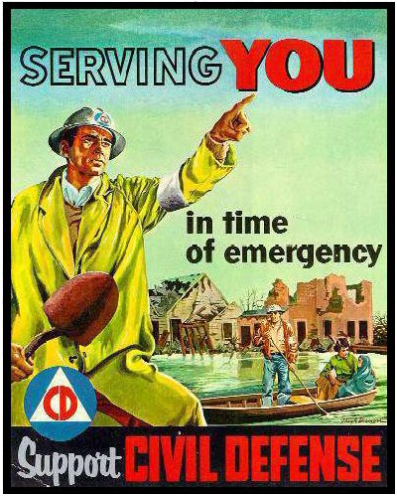
Closing
Questions and Thanks!
Joe Kelly
Director
Homeland Security & Emergency Management
Minnesota Department of Public Safety
651-201-7404
joseph.kelly@state.mn.us

