Slide 1
Race and the Law: How We Can Improve Equity in the Minnesota Criminal Justice System
Race, Pretrial and Trial
Minnesota House
Public Safety and Criminal Justice Reform
and Judiciary Committees
January 29, 2020
Perry Moriearty
Associate Professor
University of Minnesota Law School

Slide 2
SCOPE OF PRESENTATION
Brief Overview of the Pretrial and Trial Stages
Evidence of Racial Disparities in Bail and Plea Bargaining

Slide 3
The Minnesota Criminal Justice Process
Entry into System
Prosecution and Pretrial
Sentencing and Sanctions
Adjudication
Corrections
Crime?

Slide 4
SOME FACTS ABOUT Bail in Minnesota
Purposes are to protect the public and ensure re-appearance
A constitutional right (except in first-degree murder)
May not be “excessive” but can be “unaffordable”
Defendants often rely on bail bond companies to make bail, which charge 10% of the total
Low-wealth defendants and persons of color are disproportionately detained pretrial
BUT because we lack state-wide data, we do not know the extent of disparities in Minnesota
“[I]n our society, liberty is the norm, and detention prior to trial or without trial is the carefully limited exception.”
U.S. v. Salerno,
481 U.S. 739 (1987)
Minneapolis Foundation, 2018

Slide 5
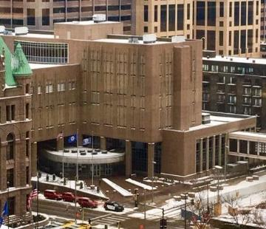
SOME FACTS ABOUT PRETRIAL DETENTION
A national study found that those who are detained pretrial are…
4 times more likely to receive jail time
3 times more likely to go to prison
More likely to commit a new crime following release
Less likely to appear for court if held longer than 24 hours
Hennepin County Jail
Harvard University Study

Slide 6
RACIAL DISPARTIES IN HennEpin County JAIL POPULATION
HENNEPIN COUNTY
POPULATION(ages 15-64)
HENNEPIN COUNTY
JAIL POPULATION
“African Americans make up 12% of the Hennepin County population, but 53% of jail admissions.”
Hennepin County Public Defender
Vera Institute of Justice, 2018

Slide 7
Some BAIL STUDIES IN OTHER STATES
Nebraska
ACLU of Nebraska, 2016

Slide 8
Some BAIL STUDIES IN OTHER STATES
New York City
Vera Institute, 2014

Slide 9
SOME BAIL STUDIES IN OTHER STATES
“In large urban areas [in the U.S.], Black felony defendants are over 25% more likely than white defendants to be held pretrial.”
Prison Policy Initiative, 2019

Slide 10
SOME FACTS ABOUT PLEA BARGAINING
Approximately 95% of criminal cases end in pleas.
Defendants detained pretrial were 25% more likely to plead guilty than those who were released.
Studies in other states reveal that white defendants were offered more favorable deals than defendants of color.
BUT because we lack state-wide data, we do not know the extent of disparities in Minnesota.
Hennepin County Public Defender

Slide 11
SOME plea bargaining STUDIES IN OTHER STATES
Wisconsin
A recent study of Wisconsin Circuit Courts revealed that “[w]hite defendants are 25 percent more likely than black defendants to have their most serious initial charge dropped or reduced to a less severe charge.”
Criminalizing Race: Racial Disparities in Plea Bargaining, B.C. L. Rev. (2017)

Slide 12
SOME plea bargaining STUDIES IN OTHER STATES
New York City
Vera Institute, 2014

