Slide 1
The Pharmaceutical Market:
Market Failures, Fixes & the Future
Health & Human Services Finance Committee
Minnesota Legislature, House
St. Paul, MN
February 5, 2019
Stephen W. Schondelmeyer
Professor and Director
PRIME Institute
University of Minnesota

Slide 2
Overview
Understanding the Pharmaceutical Market:
Demand for Prescription Drugs
Drug Markets: Brands & Generics & Specialty
Drug Coverage: Medicare, Medicaid, Commercial, Individual
Extraordinary Prices & Price Changes
Pharmacy Benefit Managers: Role & Issues
Competition & Market Power→ Reverse & Perverse Economics
Finding Fixes for the Future
Legislation, Regulation, Litigation & Indignation

Slide 3
Is there anyone who has not needed (or used) a prescription drug?
Is there anyone who has never been sick a day in their life?
Virtually everyone needs, has used, or will use drugs in their lifetime.
Notes:
35

Slide 4
Disruptive Issues
New Things We Aren’t Expecting Will Disrupt:
Drug Spending (Hidden Expend., Hidden Prices)
Rebates (Blamed for High Prices, Admin Cost, Wall Street)
Copay Coupons & Patient Assistance
Generics (Authorized Generics, Single Source Generic)
PBM Behavior (PBM Spread, Gag Orders, Mail, Specialty, Preferred Networks)
Opioid Use & Adherence → Over-Use

Slide 5
Features of U.S. Drug Market
FDA Approves Drugs That Are Better Than Placebo
Medicare & Medicaid Must Cover FDA Approved Drugs
Drug Firms Set Any Price They Want (a blank check)
Coverage Has Been Broadened to Include Most
(> 90% of U.S. Residents)
Medicare Can Not Negotiate Drug Prices
Increased Cost-Sharing for Rx Coverage
Drug Cost is Paid by Individuals, Employers, or Govt.
Insurers Process Claims But Don’t Pay for Healthcare
Insurance Does Not Increase Resources
Insurance Cost Shifts → Income Re-Distribution
Notes:
15

Slide 6
The Market for Drugs Is Unique
Supply side factors:
Monopoly for Pharmaceuticals
(Patents & Exclusivity prevent competition)
High Barriers to Market Entry
Resources Not Easily Transferable
Reverse & Perverse Incentives
Access Requires “Prescription”
Asymmetric Market→ Imperfect Information
Nobel Prize (Patents & Exclusivity prevent competition)

Slide 7
$/EpiPen (2-pak) for Self-Insured Health Plan: 2005-2016
$ / Month
NEWS FLASH:
Competitor Auvi-Q will re-enter market
Price: $4,500 (2-pak)*
* 623% Increase In 2005-2016
* 305% Increase In 2011-2016
* 2011-2016:
↑ Spending $1,000,000
Due to Price ↑ Alone
Based on data from self-insured drug benefit 2004 to 2016 & compiled by PRIME Institute, University of Minnesota.
* Reported in Karlin-Smith, Sarah, “EpiPen competitor to cost seven times more”, Politico, January 19, 2017 as found at:
https://www.politicopro.com/health-care/whiteboard/2017/01/kaleo-to-undercut-epipen-price-with-upcoming-alternative-082511

Slide 8
Humulin U-500: Average $/Month for Commercial Insurance: 2005-2013
$ / Month
* 361% Increase In 8 Years
$ 10,375/Year
100% Increase
In 2 Years:
2012 to 2014
75% Increase
In 2 Years:
2010 to 2012
$ 5,172/Year
13% Increase
In 4 Years:
2006 to 2010
$ 2,954/Year
$ 2,248/Year
Based on data from self-insured drug benefit 2004 to 2013 & compiled by PRIME Institute, University of Minnesota.

Slide 9
Weighted Average Retail Price Paid per Day for Older Cohort (1980-2003) of Most Widely Used Generic Prescription Drugs: 2005 to 2015
$1.26
$1.07
$0.71
$0.61
163% ↑
$0.48
n=115 top generic drugs
Schondelmeyer S, Purvis L, Trends in Retail Prices of Generic Prescription Drugs Widely Used by Older Americans 2006 to 2015. AARP Public Policy Institute, Rx Price Watch Report June 2017. Prepared by the AARP Public Policy Institute and the PRIME Institute, University of Minnesota, based on data from Truven Health MarketScan® Research Databases.

Slide 10
When a drug has a
100% increase in price
does the patient’s
diabetes get 100% better?
NO ! ! !
Are We Getting Our Money’s Worth? Is the Market Really Working?
This Is Not an Efficient Market
Or Value-Based Pricing !

Slide 11
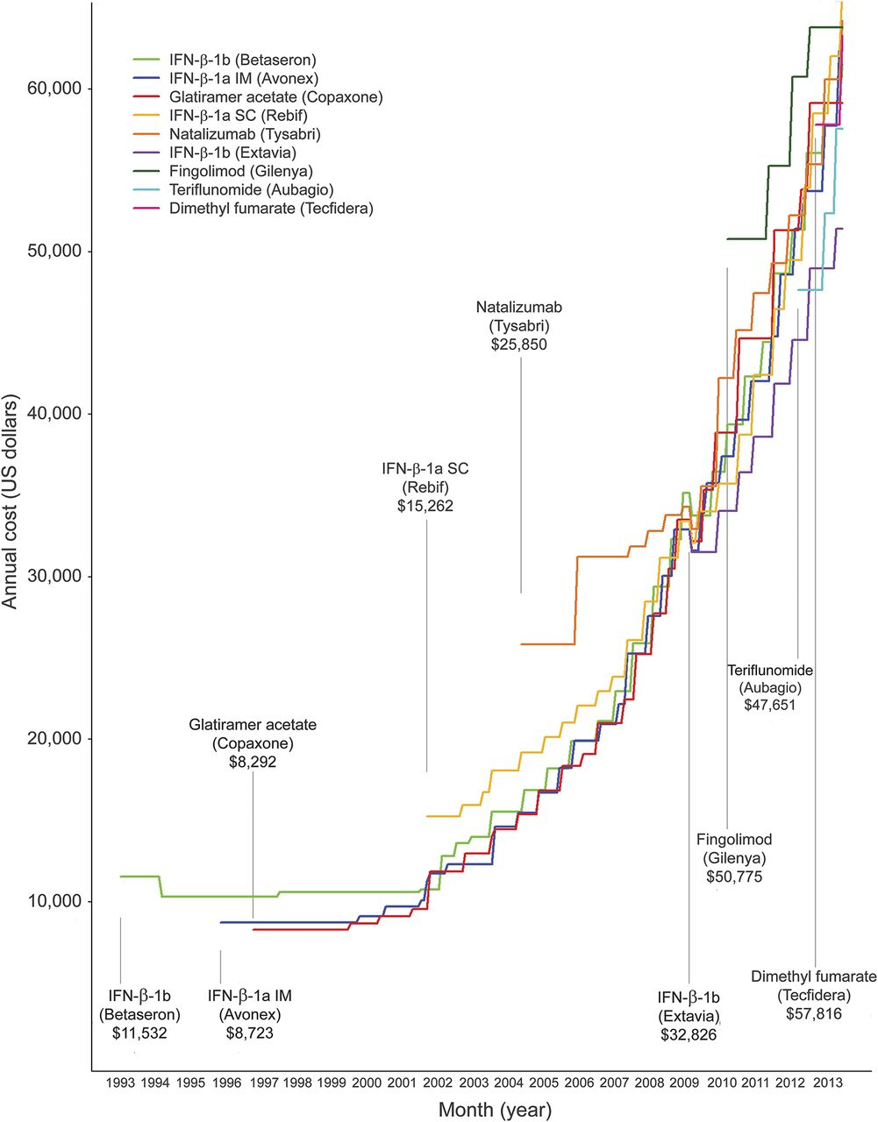
Annual Cost of Multiple Sclerosis Therapies
in the U.S. from 1993 to 2013
We Assume That
More Competitors
Will Make the Market
Work !
BETASERON
$61,848 (2016)
What Happened With
MS drugs as more
competitors entered
the market?
↑ 436%
$11,532 (1993)
MS Therapy Prices
↑ 500% to 1,000%
When 9 Competitors
Entered Over 20 Years.
COPAXONE
Is This Market
Economically Efficient?
$84,132 (2016)
↑915%
Source:
The cost of multiple sclerosis drugs in the US and the pharmaceutical industry: Too big to fail?
Daniel M. Hartung, PharmD, MPH
Dennis N. Bourdette, MD
Sharia M. Ahmed, MPH
Ruth H. Whitham, MD
Neurology, 84 May 26, 2015, pp.1-8
$8,292 (1997)

Slide 12
Monthly Median Cost of Cancer Drugs
at the Time of FDA Approval: 1965-2013
Monthly Cost (2014 $)
NOTE:
This is a
log scale.
Source: Price & Value of Cancer Drugs, Center for Health Policy & Outcomes, Memorial Sloan Kettering Cancer Center, found at: https://www.mskcc.org/research-areas/program -centers/health-policy-outcomes

Slide 13
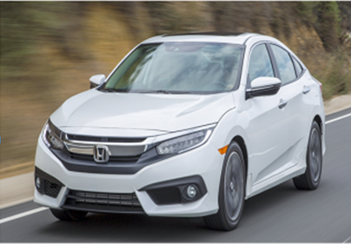
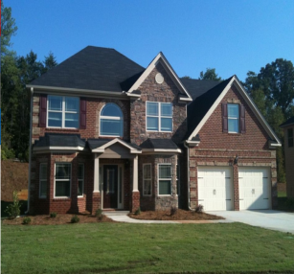
Some New Drugs Enter the Market at the Cost of:
A Week’s Vacation ($1k to $5k)
(copaxone (1 month) for Multiple Sclerosis)
A New Economy Car ($10k to $25k)
(Insulin, PCSK9s for cholesterol)
A New Luxury Car ($30k to $100k)
(Harvoni & Hep C drugs, Gilenya & MS drugs)
A New House ($200k to $500k)
(Yervoy, Cancer & orphan drugs)
Notes:
15

Slide 14
Drug Pricing Issues
Fewer Generic Firms & Industry Consolidation
Teva acquired Actavis; Teva acquired Allergan; Teva acquired Anda
Most Generic Firms Have Broad Line of Products
Most Brand Name Firms Have Generic Divisions
Pfizer → Greestone & Hospira; Novartis → Sandoz; Teva → Allergan.
Authorized Generics Not Really Generics
NDA-authorized, not ANDA; Pre-empt & may dampen ‘true” generic entry over time
Bundling & Tying Arrangements in Contracts
e.g., Must buy firm’s generics to access firm’s discounts & rebates on brands
PBMs Sometimes Add “Spread” Onto Generics
Generic spread for mail, specialty, preferred networks, may be higher than retail
Some PBMs charge full copay even when actual generic prescription costs less

Slide 15
U.S. Annual Income: 2014
$ / Year
Income per Family / Household
Income per Person
Specialty $53,364
Are Prescription Drugs Affordable
---Even at the Societal Level?
Average Annual
Drug Cost for
Elderly $28,728
Brand $ 4,896
Generic $ 480
U.S. Bureau of the Census, 2015; AARP Report, 2015; Compiled by PRIME Institute, University of Minnesota .

Slide 16
Transparency “map” needed
Employer
Employer
9
Payment for Product
Manufacturer
Rebates
1
Payer
2
Formulary Contract
Fee-for-Service Contract
Rebate Share
7
5
6
Pharmacy Benefit Manager
Drug Wholesaler
Physician, hospital, home care, infusion provider
Contract
8
Physician, hospital, home care, infusion provider
3
Specialty Pharmacy
Reimburse PBM
Specialty Pharmacy
Mail Order Pharmacy
Prescription Reimbursement
Product Shipment
Pharmacy
4
Network Membership
Payment for Product
PBM Preferred Pharmacy Network
(Often PBM-Owned Chain)
Dispense Product
Copayment
Patient
Product Movement
Financial Flow
Contract Relationship
Adapted from Pembroke 2013-14 Economic Report on Retail, Mail, and Specialty Pharmacies; Drug Channels Institute
© Minnesota Health Action Group; confidential – do not copy or distribute without permission

Slide 17
PBM Practices
Gag Rule: Pharmacists Cannot Tell Patient
About Lower Cost Alternatives
MAC Pricing Spread on Generics
Rebates & Rebate Admin. Fees & Other Fees
PBM-Owned Pharmacies (Mail, Specialty, & Limited Distr.)
Preferred Network (Chain) & Exclusive Dealing
Utilization Management (Qty, PA, Step Therapy, Pt. Mgmt.)
Payment Parity Across Providers

Slide 18
Proton Pump Inhibitors $ Cost/Unit for Self-Insured Employer*: 2016
$ / Day
omeprazole & esomeprazole
lansoprazole &
dexlansoprazole
pantoprazole
rabeprazole
NEW GENERIC GAMES
The “Purple” Pill
* New Combination:
Zegerid (omeprazole & sodium bicarb.)
Price: $17,000/Rx ($95 / tab)
(Valeant. 90-day supply)
Brand:Generic
$/Unit Ratio
= 92:1
Brand:Generic
$/Unit Ratio
= 37:1
Brand:Generic
$/Unit Ratio
= 97:1
Brand:Generic
$/Unit Ratio
= 26:1
* Generic Version of Zegerid
(Oceanside, 90-day supply)
$12,000/Rx (30% discount off brand)
Brand
* Generic Version of
Omeprazole & Sod. Bicarb.
$17/Rx (90-day supply)
* Brand to Generic Ratio
(1,000 : 1)
OTC
Generic
BENEFIT DESIGN ISSUES
What Should You Do With
Drugs Like Zegerid?
---Cover Them? or
---NDC Block Them?
---GPI Block Them?
Should You Cover OTCs?
Should You Cover Brands
With Price Ratios > 25:1 ?
* Compiled by the PRIME Institute, University of Minnesota from actual claims data for total amount paid by a self-insured employer for calendar year 2016.

Slide 19
5 Common Generic Prescriptions at Different Pharmacies: 2016
Often in Excluded from
Preferred Networks
Often in Preferred Networks
* Compiled by the PRIME Institute, University of Minnesota from data found in Consumer Reports January 2016.

Slide 20
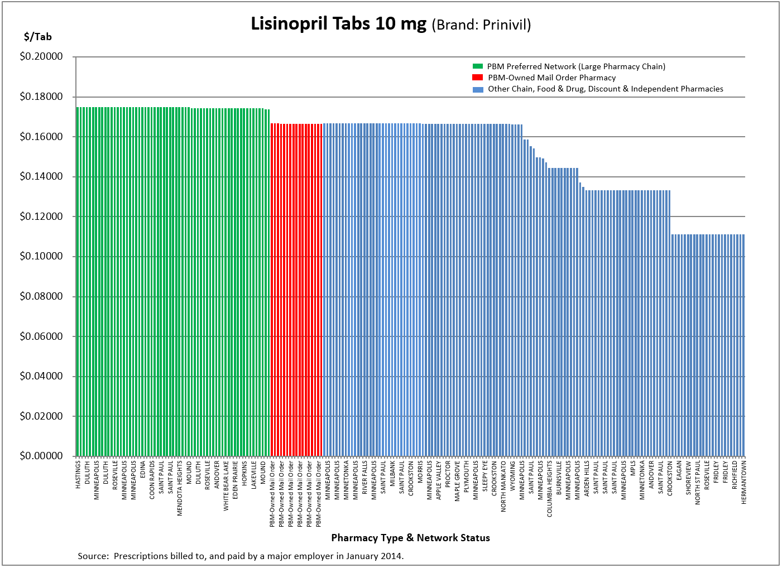
Amount Paid/Unit for Generic Prescription Drug by Pharmacy Type & Network Status
BENEFIT DESIGN ISSUES
Is the Preferred Network
---Less Expensive? or
---More Expensive?
Is Mail Order Saving
Money Compared to
Retail Pharmacies?
---If Not, Why Should You
Allow a Different Copay?
Preferred
Network
PBM’s
Mail
Order
Other Retail Pharmacies
n=399 top generic drugs

Slide 21
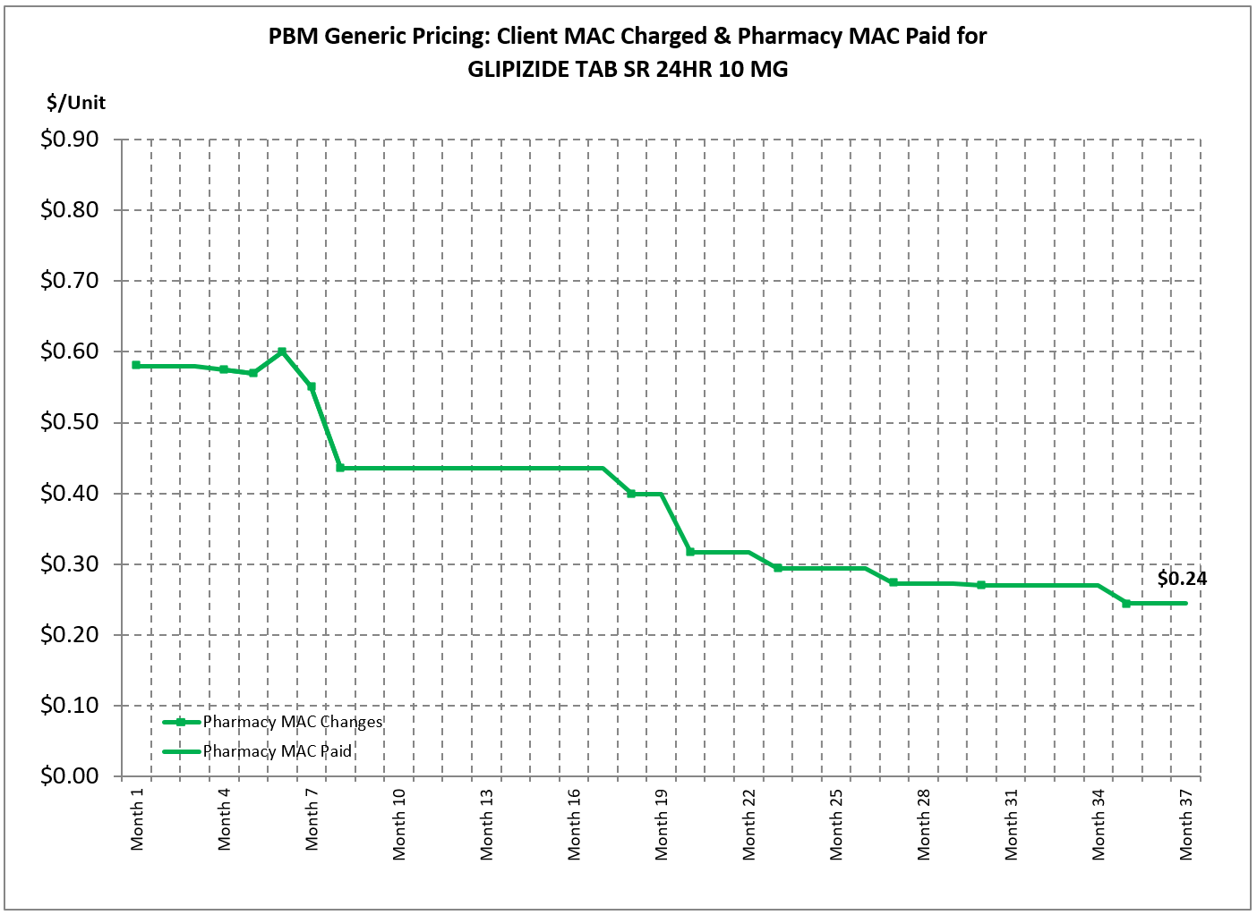
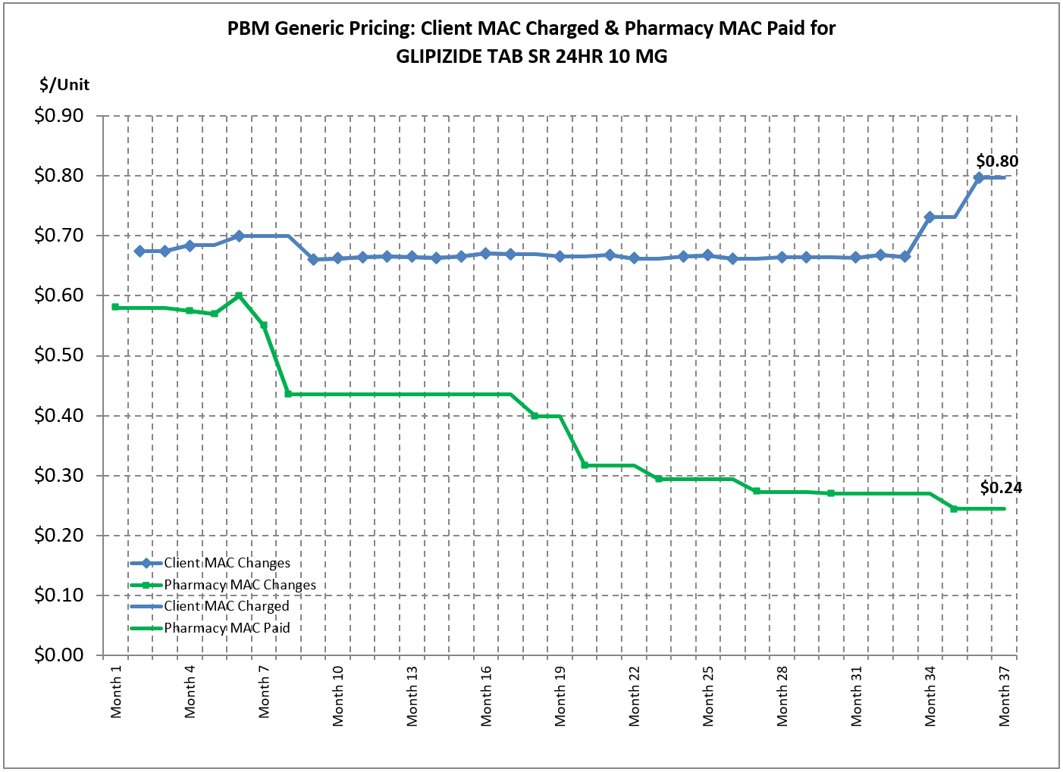
Generic MAC Amount Paid/Unit to PBM to Pharmacy & by Employer to PBM
BENEFIT DESIGN ISSUES
Does Your PBM Use a
Pharmacy MAC?
Does Your PBM Use a
Client MAC?
How Does the Client MAC
Compare to the
Pharmacy MAC?
Client MAC:
Amount Paid by Employer to PBM
Who Benefits from the
MAC Spread on Generics?
---PBM? or Employer?---
Who Benefits When the
Pharmacy MAC is Reduced?
Is Mail Order Pharmacy
Paid the Same MAC as
Retail Pharmacies?
-Or Is Mail Order Paid the
Client MAC?
-If Mail Order Is Paid
More than Pharmacy MAC
Is Mail Order a Good Deal?
MAC Spread on Generics
Pharmacy MAC:
Amount Paid by PBM to Pharmacy
Pharmacy MAC:
Amount Paid by PBM to Pharmacy
n=399 top generic drugs

Slide 22
Levothyroxine Sodium 75 mg Tablets Brand & Generic Prices (May 2015)
$/tablet
(AWP)
Repackaged or
Re-labeled Brand
or Generic Products
(Set their own AWP & WAC)
(Often used by:
Mail Order Pharmacies,
Chain Pharmacies,
Specialty Pharmacies &
Physician Dispensers)
How Do Brands & Generics Compare?
Why are some generics higher than brands?
Does the biggest discount always get the lowest price?
Brand Name
(Reference Products)
Generic Equivalents
Source: Compiled by the PRIME Institute, University of Minnesota from data found in Micromedix RedBook, May 2015.
Notes:
31

Slide 23
Price Disparity Across Therapeutic Alternatives: 2017

Slide 25
The Drug Market is Broken !
Lack of Price Transparency
Information Asymmetry
Inelastic Demand
Lack of Negotiation
High Barriers to Entry
Excessive IP Expansion
Notes:
15

Slide 26
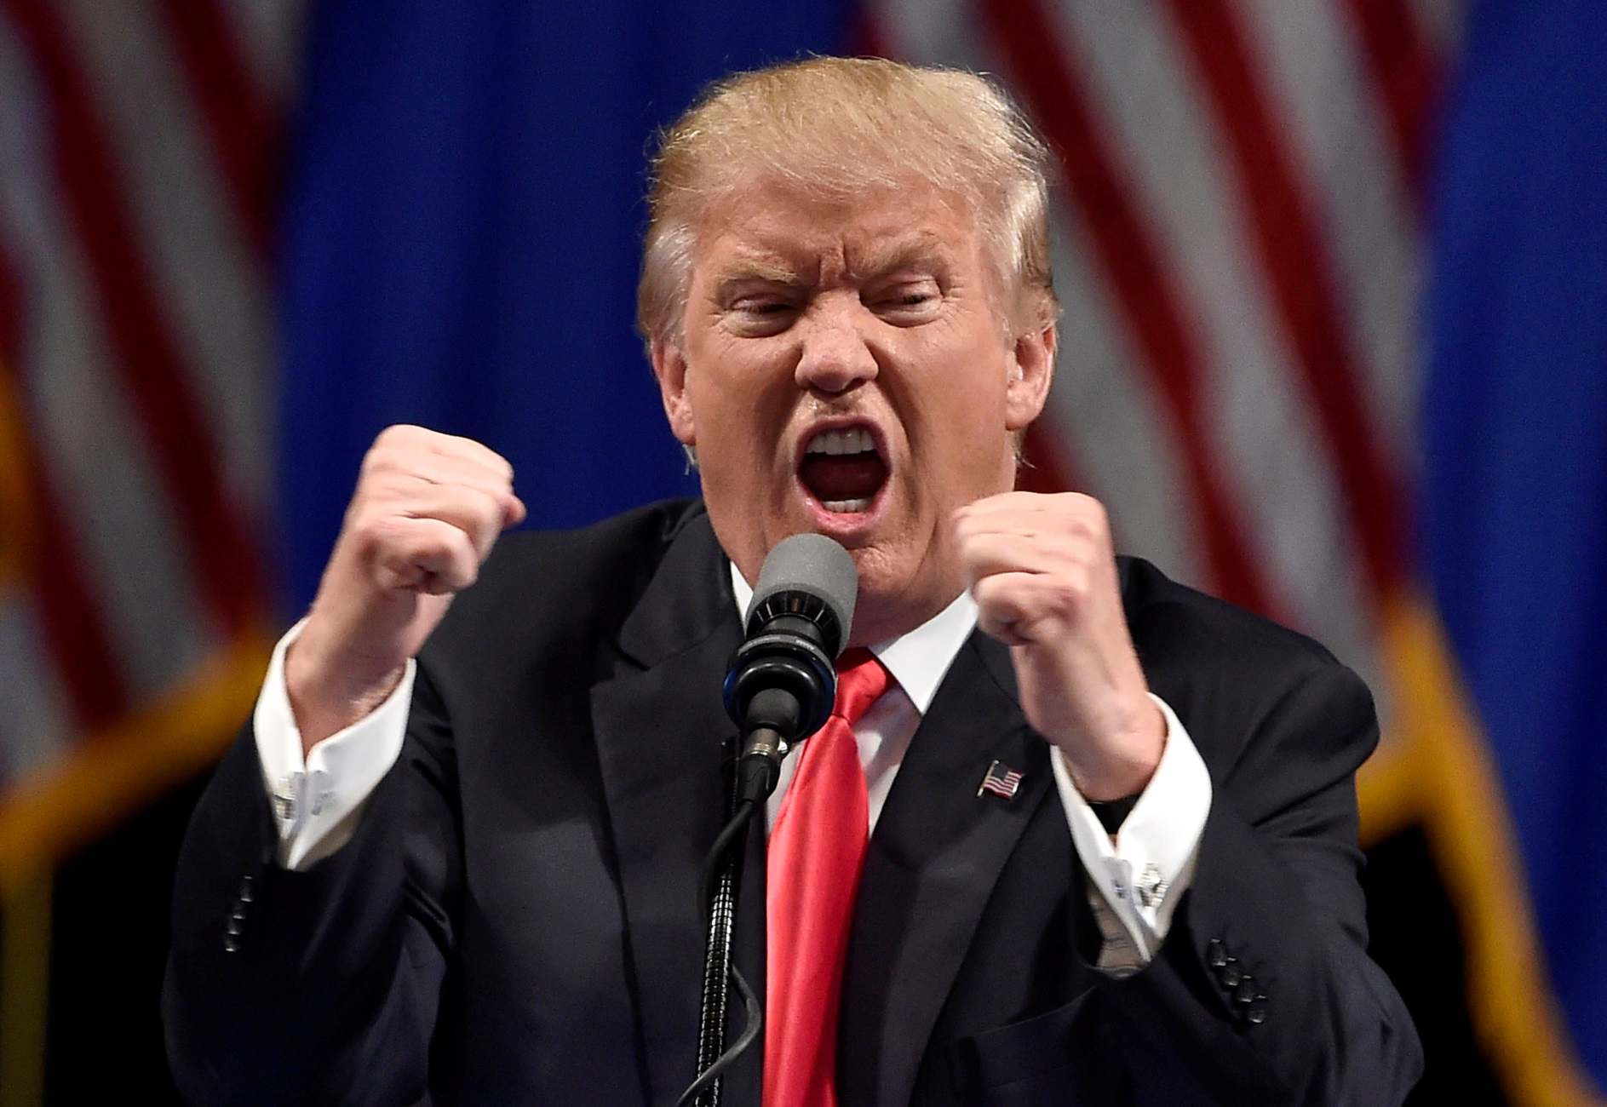
President Trump on Drug Prices
U.S. drug prices have been “outrageous.” ^{*1}
Pharmaceutical firms are “getting away with murder.” ^{*2}
¹ President Donald J. Trump, March 21, 2017, http://fortune.com/2017/03/21/trump-pharma-stocks-drug-prices/
² President Donald J. Trump, January 11, 2017, http://fortune.com/2017/01/11/donald-trump-press-conference-biopharma-stocks/

Slide 27
Trump on Prescription Drugs
Cutting Prescription Drug Prices is a Top Priority
Donald J. Trump, Jan. 30, 2018 State of the Union Address
Asked Congress to Pass “Right to Try” Bill
Lets terminally ill patients access experimental treatments before FDA approval
New HHS Secretary is Alex Azar
Former Eli Lilly (drug company) executive

Slide 30
Finding Fixes for the Future
Make Drug Prices Transparent & Accountable
Systematically Monitor for Extraordinary Drug Prices
Screen for prices & price changes that are ‘unconscionable’ & ‘unreasonable’
Single point price changes >10%, >25%, >50% & >100%
Link Transparent Prices, Accountability & Coverage
Quasi-governmental commission reviews & evaluates prices & price changes
Price behavior not justified, drug not covered by Medicare, Medicaid, commercial
Prohibit Market Distorting Behaviors
Copay Coupons, Undisclosed Rebates, Patents for Product Hopping & Combinations
HHS OIG has declared copay coupons as ‘kickbacks’ & prohibited them in govt. plans
Recognize Economic Impact of FDA Policy & Actions
Enable Value-Based Decisions→Requires Actual Price

Slide 31
Medical Benefit Drugs
What Are We Trying to Do:
Claims Level Data Reporting at NDC Level
Medical Benefit Drug Formulary (Drug Value Assessment)
Utilization Management (Qty, PA, Step Therapy, Pt. Mgmt.)
Payment Parity from Providers (Reference pricing)
Coordination of Pharmacy & Medical Benefit
→ Need Vendors to Do This !

Slide 32
2017/2018 State Rx Legislation by the Numbers
2018 Session: 171 Bills (up from 100 bills in 2017)
28 States Enacted 45 New Laws on Drug Costs
Major Categories of Legislation:
PBMs – 92 Bills (31 laws in 20 states)
Transparency – 26 Bills (7 laws: OR, VT, ME, NH, CT, CA*, NV*)
Price Gouging – 13 Bills (1 law: MD*)
Wholesale Importation – 9 Bills (1 law: VT)
Bulk Purchasing – 4 Bills
Drug Affordability Review Boards – 3 Bills: MD, NJ, MN
(*= enacted in 2017)

Slide 33
Disruptive Actions
New Things We Aren’t Expecting Will Disrupt:
New Alignments of Players
PBM (+Mail + Spec) + Pharmacy Chain + Insurer
Caremark CVS Aetna
Prime Therapeutics Walgreens Blues
Next Move → PBM-Insurer + Generic Manufacturer
Non-Profit Generic Manufacturer (InterMountain Health→Project Rx)
“Waste-Free” Formulary Across Employers/Payers (PBGH)
Amazon + Berkshire-Hathaway + JP Morgan
→ Disintermediation + Value to Payer/Patient

Slide 34
Regulatory & Legal Influences on Generics
FDA Review Time for ANDAs Getting Better
Has been a rate-limiting step for ANDA approval & has limited competition
Make Sure the ‘Total Time’ to Market Is Managed
Should not just shift ANDA review time from FDAs clock to firm’s clock.
Unapproved Drugs Initiative → Competition Worse
Colchicine (Colcrys) reduced competitors and ↑ price from $.09 to $4.85
Multiple unapproved drugs → 1 high-priced brand instead of more competitors
Cost Medicare about $1.2 billion from 2011-2015 (total national effect ~$3.7 billion)
Pay-for-Delay Invites Gaming & Delayed Competition
Authorized Generics Confuse Consumers
Trade Agreements Expand IP & Limit Generics
TPP would have taken length of biologics exclusivity out of Congress’ hands

Slide 35
Economics of Prescription Drugs
“A drug that
one can not afford is
neither safe nor effective.”
-- Stephen W. Schondelmeyer

