Slide 1
Historic Pioneers and Soldiers Cemetery Fence Restoration
A National Historic Landmark

Slide 2
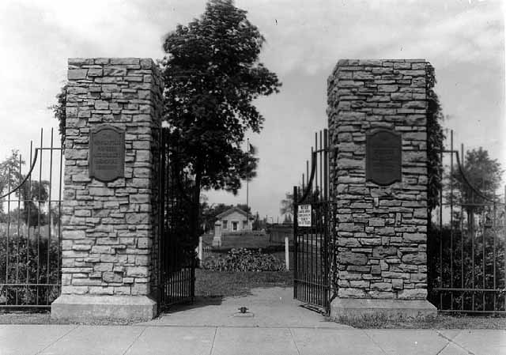
Pioneers and Soldiers Cemetery Fence:
Minnesota’s History
Originally established in 1853, originally known as Layman’s Cemetery
Oldest surviving cemetery in Minneapolis
Final resting place for over 20,000 individuals
Only cemetery in Minnesota listed as an individual landmark on the National Register of Historic Places
In 1928, Minneapolis took over ownership due to the Cemetery’s poor condition and has continued to manage the property

Slide 3
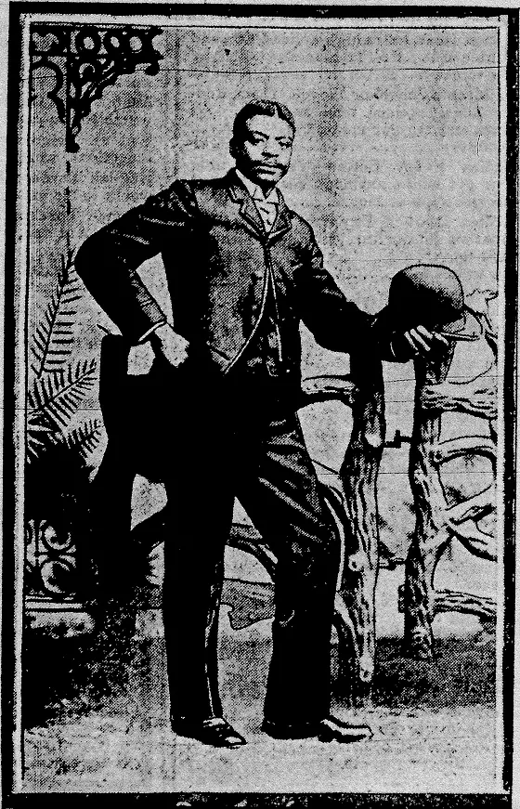
A History of Diversity
Ethnically diverse and contains a cross section of early Minnesotans whose efforts contributed to the early development
Cemetery was never segregated
Direct ties to Minnesota’s anti-slavery movement
Layman family members of First Baptist Church of Minneapolis, synonymous with the anti-slavery movement in Minnesota
Native American, waves of immigrants, early settlers all buried together

Slide 4
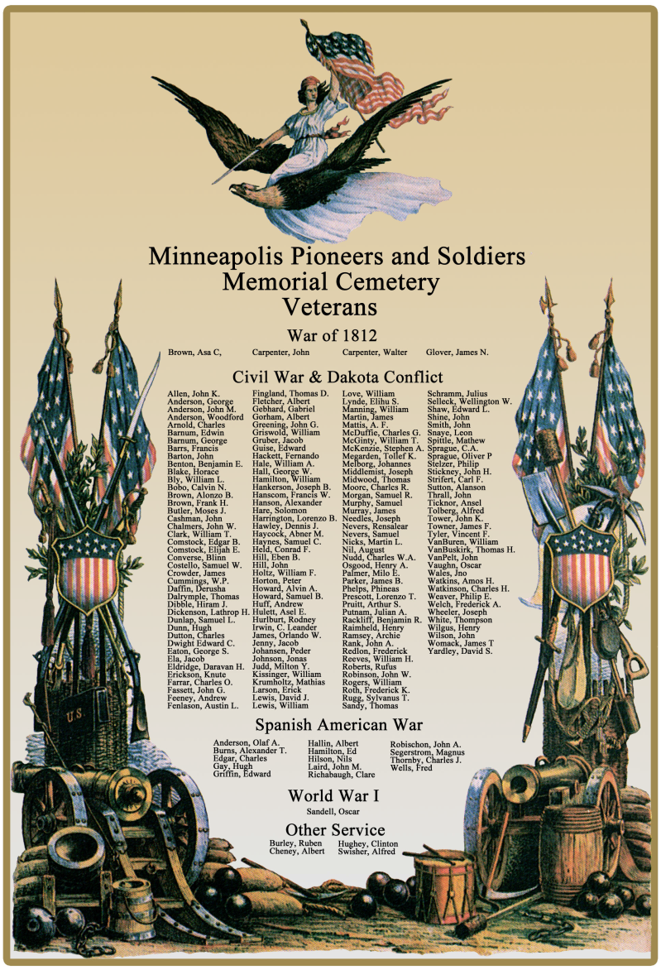
The Pioneers and Soldiers of Minnesota
Contains the graves of soldiers from the War of 1812, Civil War, and Spanish-American War
Estimate up to 60 percent buried are infants or children under the age of 10
Grand Army of the Republic purchased graves for indigent or “family-less” veterans to prevent any from being buried in the Potters Field

Slide 5
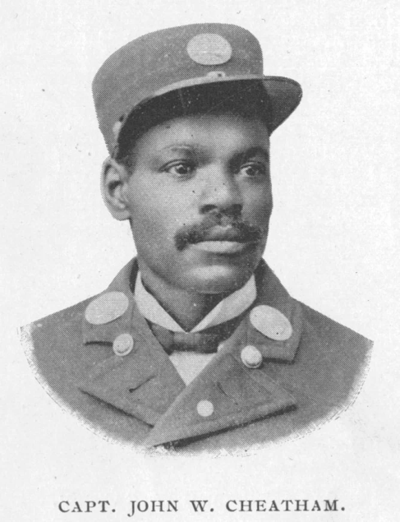
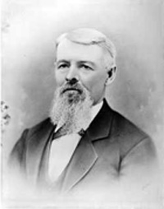
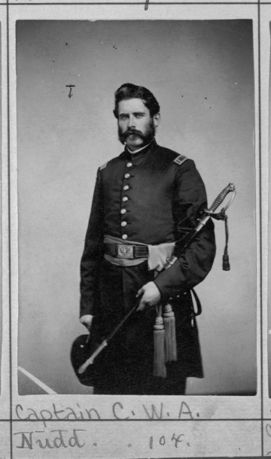
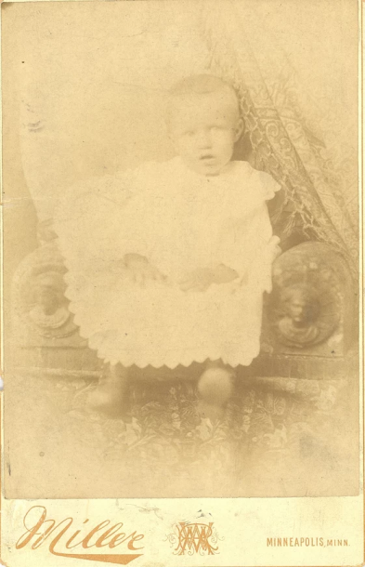
Pioneers and Soldiers Cemetery: The History of Minnesota
Capt. John Cheatham - likely the first African American firefighter in Minneapolis
Martin Layman, Cemetery founder, anti-slavery movement
Cpt. Charles Nudd—one of approximately 170 Civil War veterans
Skjol Rasmussen – one of the thousands of children buried here

Slide 6
Restoration Project
80+ year old fence and pillars in need of rehabilitation
2006 started the rehabilitation to restore to former fence:
  Large project: 1,953 linear feet steel fence, 3510 pickets, 65 pillars
  Secured funding for most steel restoration
Completed = All metal fence sections (except 21st Ave.)
Remains =
  Metal fence along 21st Ave.
  Masonry of 65 pillars
Pink, purple & green = Fence completed
Orange = Fence need remains
Black dots = 65 pillars need remains

Slide 7
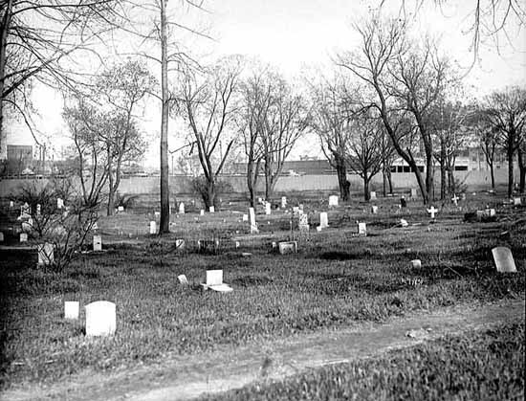
What Remains?
$1.029 million request to complete $2.584 million project
Restore 65 historic piers
  Structural assessment is needed
  Repoint/tuck point, rebuild waterproof, new base
  Currently: water getting into top of piers and freeze thaw comprise condition
New fence along 21st Avenue
  Currently chain link
  Greater protection against vandalism, than chain link
1925, prior to Minneapolis ownership

Slide 8
Financial Breakdown
Total project cost = $2,584,000
Total state contribution so far = $504,188
Total city contribution so far = $1,000,000
Total other contributions so far = $70,000
____________________________________
Request to state for bonding = $1,029,000

Slide 9
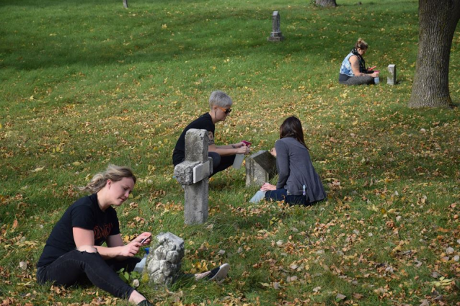
Generations of Volunteers
“Friends of the Cemetery”
Friends of the Cemetery is an all-volunteer organization dedicated to the restoration and preservation of Minneapolis Pioneers and Soldiers Memorial Cemetery.
Activities focus on community outreach and education.
To date, they have raised over $50,000 to support the cemetery

