Slide 1
House State Government Finance and Elections Committee February 9, 2021

Slide 2
Statute and scope of work
The Minnesota Council on Latino Affairs (MCLA) was established in 1978.
Statute 15.0145: the Council works for the implementation of social, economic, political and legal equality of Latino Minnesotans with the state legislature and government.
Non-partisan state agency. 15 Council Members (11 appointed by the Governor and 4 legislators).
MCLA adds value and is an asset to state government. The Council is a bridge in each legislative district to communities that are not always well understood.
Three main policy/legislative areas: Education, Health, and Economic Development/Taxes, integrating the immigration experiences of our diverse constituents (32% foreign born, 2019 ACS)

Slide 3
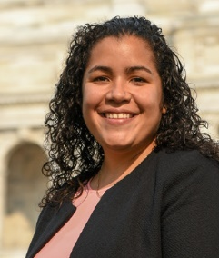
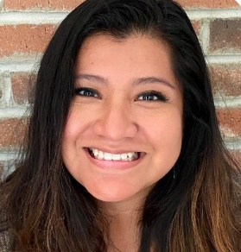
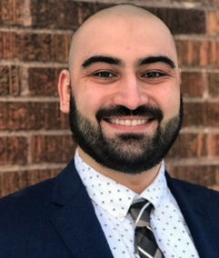
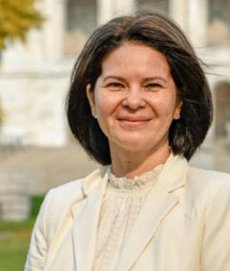
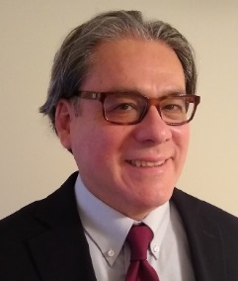
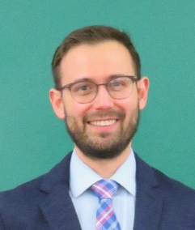
MCLA’s Staff
SAMANTHA N. DIAZ
Legislative and Policy Director
-Education-
ROSA TOCK
Executive Director
ADRIÁN MAGAÑA *
Legislative and Policy Director
-Health-
DAVID CAMPANA *
Legislative and Policy Director
-Econ. Development-
CECILIA ROING
Administrative Assistant
2 Interns
–Policy Fellows-
Estefania Jauregui
Marleny Huerta-Apanco
SAMUEL ESTES
Student Worker
-Policy Fellow-
* Temporary hires

Slide 4
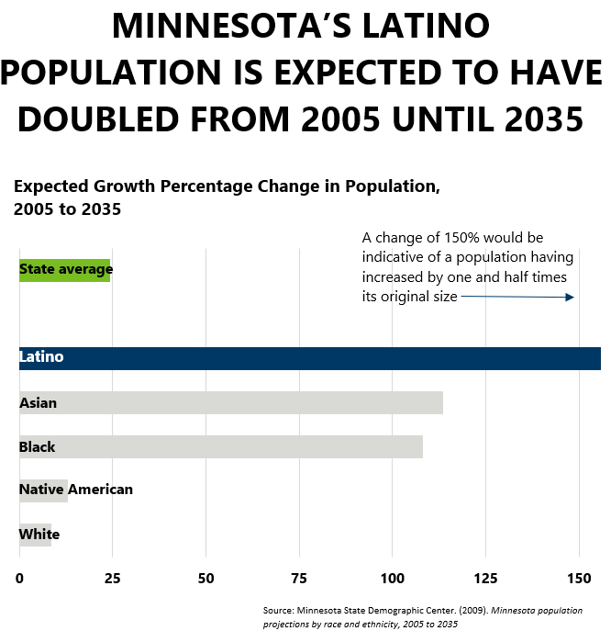
Our constituents and implications
Despite representing 5.6% of the total population, Latinos were responsible for one-fifth of the total growth experienced in the state population since 2010.

Slide 5
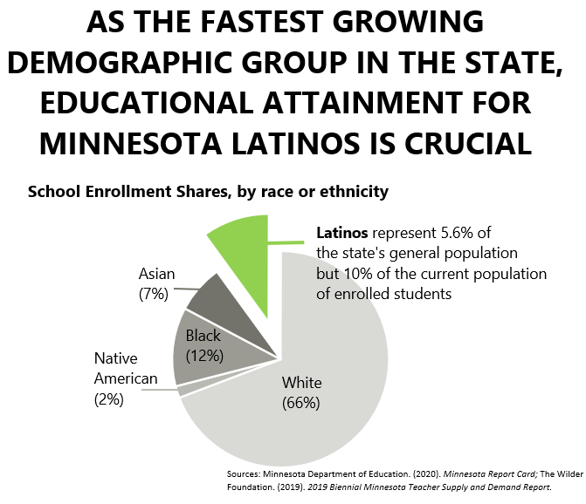
Our students and Latino contributions
Minnesota’s economic competitiveness and socioeconomic outcomes depend on the educational attainment of Latino Minnesotans. Progress has been made in closing the achievement and opportunity gaps that disproportionately impact Latinos, but much work remains to further narrow them.

Slide 6
Connect-Advise-Influence: 2019-2020 Achievements
We produce in-house research to inform you and
state agencies:
2020 Community Listening Sessions Bilingual Report
Listening sessions inform our legislative priorities
State of Latinx Housing in Minnesota
Fact sheets with key socio-economic indicators
Equity Impact notes to analyze bills and policies
Legislative summaries and end of session presentations
https://tinyurl.com/y4ucs3qh

Slide 7
Connect-Advise-Influence: COVID-19 Response

Slide 8
Connect-Advise-Influence: 2019-2020 Achievements
Work in coalition to support and advance impactful bills:
2019 and 2020 Increase of Teachers of Color Act
2020 Bonding bill -Regenerative poultry industrial park
Medical interpreters bill
Consumer protection bills
Tax credits for low-income families

Slide 9
Connect-Advise-Influence: Key priorities in 2021
Education
*In the Increase Teachers of Color and Indigenous Teachers legislation, address the need for districts and charter schools to be required to provide for a welcoming environment and have an inclusive curriculum
*Advocate for improved classroom experiences (virtual and in person) and investments in English Language Learners (ELL) programming.
*Advocate for programming that emphasizes Social and Emotional Learning (SEL) which is critical to student academic achievement.
Economic Development
Help families achieve financial stability by securing tax credits that align with the state’s agenda on economic equity.
Health Equity
The top priority for Latinx Minnesotans is the health and safety related to and beyond COVID-19, especially when it comes to essential workers.
https://tinyurl.com/y5vg6d4d

Slide 10
FY21 Agency Budget
$525,000 annual budget
4.8 FTE
64% employees’ compensation
30 % operating expenses
6% other expenses (financial transactions and lease)
For the next biennium, the Governor recommends an operating adjustment of $9,000 in FY 2022 and $19,000 in FY 2023 from the General Fund to maintain current level of service delivery

Slide 11
Thank you! Questions: rosa.tock@state.mn.us

