Slide 2

Minnesota has an opportunity build on its diverse industry strengths this decade
Manufacturing
Food and agriculture
Mining, energy and clean-tech
Life sciences

Slide 3
U.S. manufacturing construction surged by 70% in 2023
Source: U.S. Census Bureau retrieved from FRED, Federal Reserve Bank of St. Louis

Slide 4
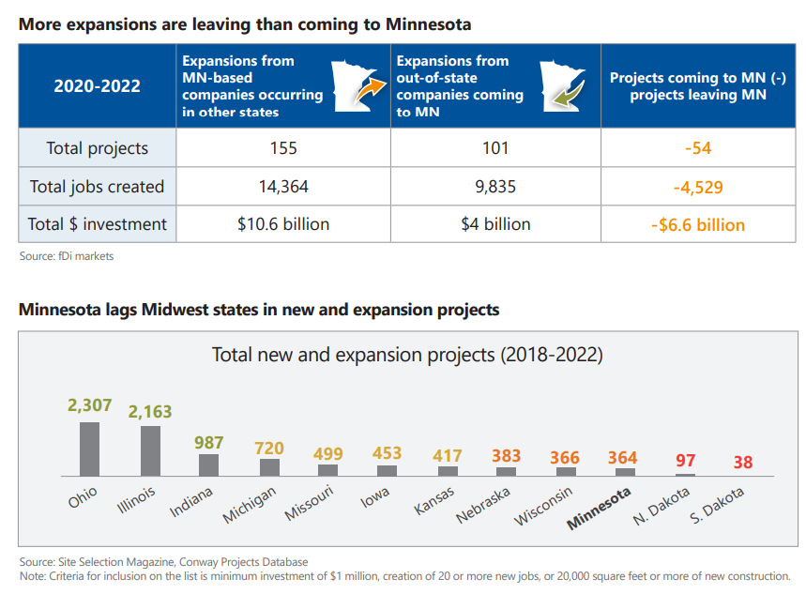

Slide 5
Minnesota is 43rd in manufacturing GDP growth this decade
MN GDP growth in selected sectors (Q4 2019 – Q2 2024):
Manufacturing:
-0.6%; Ranked 43rd
Construction:
-1.0%; Ranked 35th
Mining, quarrying and oil and gas extraction:
-1.5%; Ranked 25th
Utilities:
-2.2%; Ranked 39th
Source: Minnesota Chamber analysis of BEA data

Slide 6
Make it easier to invest for companies who want to build and expand in Minnesota
Time, cost and certainty matter for capital investment projects
High-profile economic development projects have left in Minnesota due to permitting challenges
Businesses, site selectors and environmental consultants report delays and challenges
Minnesota’s environmental regulations aim to protect the environment and human health, while also enabling economic development

Slide 7
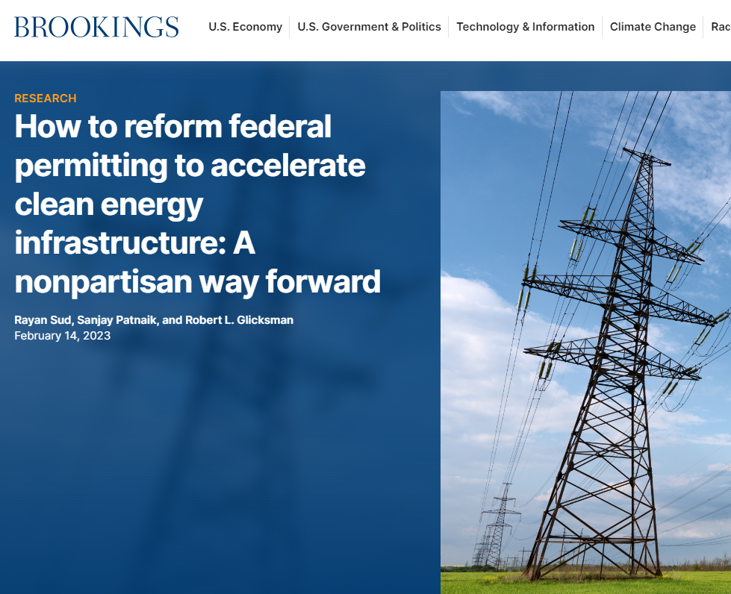
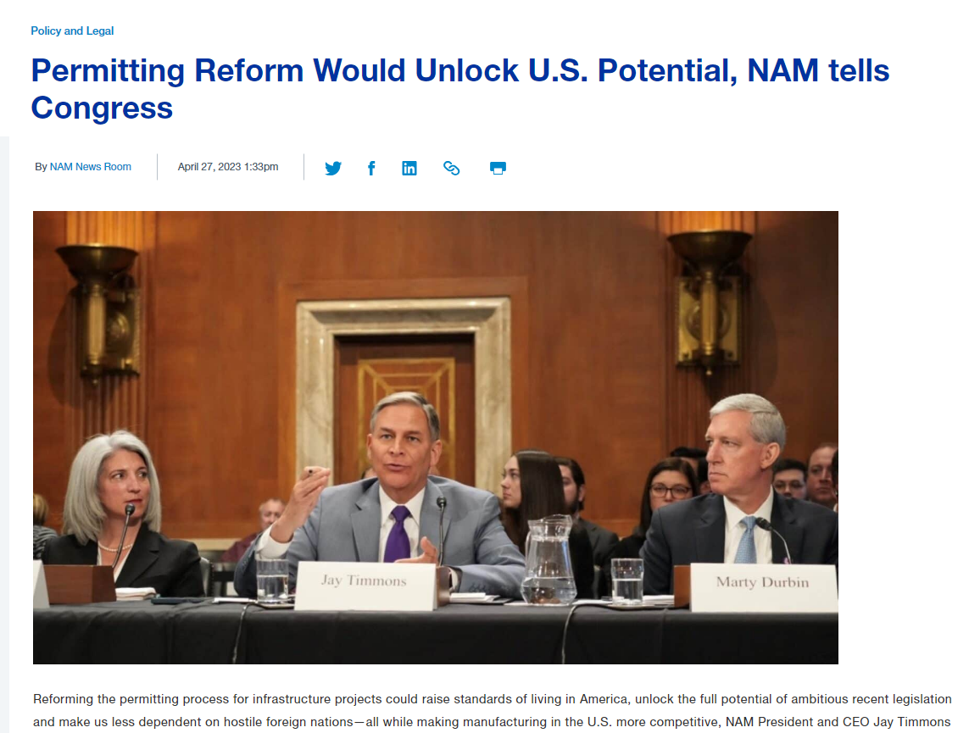
Growing interest in federal and state permitting reforms
“Congress should approach federal permitting reform in a way that maximizes efficiency in government decisionmaking through shorter timelines for regulatory approvals without sacrificing the value of the current process in protecting the environment and local stakeholders.”
– Brookings Institution
“Permitting delays can increase costs and uncertainty for communities and businesses. That’s why today, I am signing an executive order aimed at speeding up state permitting and refunding permit application fees for missed deadlines whenever possible.
Those applying for a state permit must know how long the process will take and that when the state commits to a deadline, we will meet it.”
– Governor Whitmer of Michigan
“Ultimately, permitting reform effects every part of the American supply chain—from modernizing energy projects to building new manufacturing facilities.”
– National Association of Manufacturers

Slide 8
How is Minnesota balancing these priorities?
How long does it take to get an air or water permit in Minnesota?
How does permitting timeframes compare to other states?
What is the economic cost of permitting delays?
What factors influence delays and transparency issues?
What can be done to streamline our permitting and environmental review programs and make them more transparent?

Slide 9

Full report contents
Literature review –summary of prior reports on Minnesota permitting and review what other states are doing to streamline
Economic analysis – economic assessment of Minnesota’s environmental processes
Environmental permitting and review –technical and procedural comparison of Minnesota’s environmental processes to select benchmark states (Air, Water, Wetlands and Environmental Review)

Slide 10
Breaking down MPCA permitting programs
Air, Water and Land Permits
Priority or non-priority
Priority = “Defined as needing some sort of construction at the site.”
Non-priority = “generally routine permit re-issuances that do not require substantive changes or involve construction and, therefore, are typically less time-sensitive to permittees.”
Tier 1 or Tier 2
Tier 1 = Permits that do not require individualized actions or public comment periods; 90-day issuance goal
Tier 2 = Permits that require individualized actions and public comment periods;150-day issuance goal
– MPCA Annual Permitting Efficiency Report

Slide 11
Tier 1 air permits are typically issued in around 1 month;
Tier 2 permits are typically issued in 1.5 – 2 years
Tier 1 air permits (90-day goal)
Capped Permit
Registration Permit
Part 70 General Permit
State General Permit
Tier 2 air permits (150-day goal)
Individual Part 70 Operating Permit
Individual State Operating Permit
Reissuance of expiring individual Part 70 or State Operating permit
Amendment (administrative, minor, moderate, or major) to an individual permit
Applicability determination

Slide 12
Between 5% - 17% of priority Tier 2 air permits met 150-day goal
Source: Minnesota Chamber Foundation analysis of Minnesota Pollution Control Agency data

Slide 13
Median timeline to issue priority Tier 2 air permits is 351 days, with the average being 586 days
Source: Minnesota Chamber Foundation analysis of Minnesota Pollution Control Agency data
N = 151

Slide 14
Tier 2 permits that don’t involve construction can face years-long backlogs
Source: Minnesota Chamber Foundation analysis of Minnesota Pollution Control Agency data
N = 339

Slide 15

How does Minnesota compare to peer states?
Policy Navigation Group conducted a quantitative comparison of the air permitting review times for new facility construction or modification projects for Minnesota and for other states. The analysis has two objectives:
Explore differences between Minnesota’s air permitting review times and those of other selected states; and,
Estimate the economic gains and economic impacts if Minnesota reduces permitting times to those of other selected states.

Slide 16
Minnesota’s review times are 1.5 to 6 times longer than other states evaluated in this study
Source: Policy Navigation Group

Slide 17
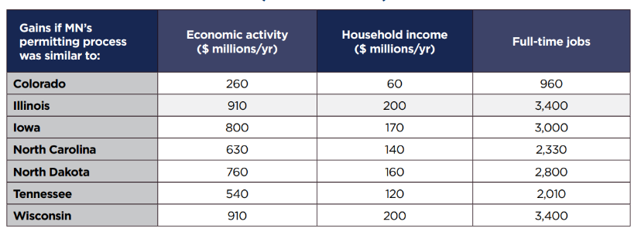
Minnesota would achieve meaningful economic gains if permit issuance timeframes were similar to peer states
Source: Policy Navigation Group

Slide 18
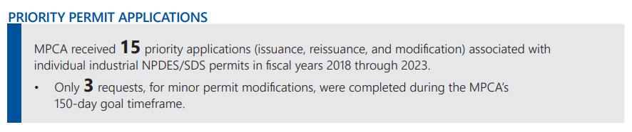
Individual industrial water permits are needed less frequently, but face similar timelines as Tier 2 air permits
New individual industrial NPDES/SDS permit = 476 days
Major modification to individual industrial permit = 377 days

Slide 19
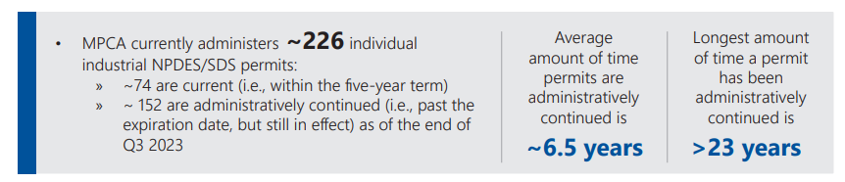
High share of individual industrial NPDES/SDS permits are administratively continued in Minnesota

Slide 20
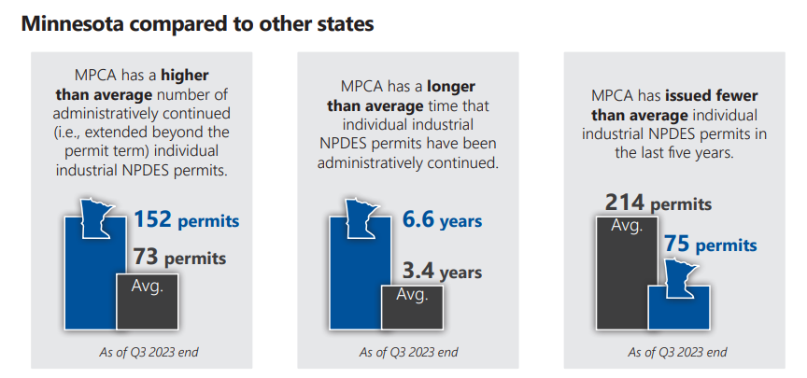

Slide 21
Priorities for permitting improvements
Reduce the length of time it takes to issue Tier 2 air and water permits.
The state’s goal is to issue priority permits within 150 days. But the median for priority Tier 2 air permits is 351 days and the average is 586 days. Similar timeframes exist for Tier 2 industrial water permits.
Address backlogs of permit renewals and minor facility changes for air and water permits
Average timeframe to issue non-priority Tier 2 air permits is 1,263 days, with renewals for Title V permits taking an average of nearly 1,500 days. 280 permit applications have been awaiting assignment for over year.
Of the 226 NPDES/SDS permits currently administered by the MPCA, 152 are administratively continued (i.e. past the expiration date, but still in effect) as of the end of Q3 2023.
Increase transparency, certainty and collaboration
Reduce the variability in timeframes and provide more support to help companies understand the process and expected milestones.
Continue making improvements to permit and environmental review dashboards and reports to increase transparency.

Slide 22
Considerations for improvement: Air permitting
Separate construction and operating permits
Revise approach to completeness evaluations
Enhance expedited permitting process
Data on air permit processing timelines
Support resources for permit applicants
This has the potential to help improve permit issuance times. Nearly all states included in this study have separate construction and operating permits.
Could get permits assigned to engineers in a more timely manner and prevent applications from being rejected for minor, non-technical reasons.
Consider reviewing and revising the expedited permitting process and include relevant statistics in reporting tools. Ex. Utilize 3rd party permit professionals
Improved data could benefit the MPCA, the public and applicants with increased transparency
Consider expanding small business ombudsman to assist companies of any size, or enhance the Business First Stop program to serve more applicants.

Slide 23
Considerations for improvement: Water permitting
Further prioritize commitment to timeliness
Provide leadership support for timely issuance and reissuance of permits, while preserving the ability to modify schedules as appropriate to work through complicated issues with permittees
Reduce regulatory complexity
Develop additional general permits for similar operations and types of discharges
Clarify and streamline antidegradation procedures
Develop guidance and tools to navigate Minnesota’s complex water quality criteria and large number of impaired waters
Increased schedule certainty for permittees, especially for those that need a permit action prior to new or expanded activities
Increased options for streamlined and efficient permitting, while achieving the same environmental protection goals
Increased ease of navigating permitting process, while achieving the same environmental protection goals

Slide 24

Considerations for improvement: Environmental Review
Update the EQB’s Environmental Review Projects Database to include additional statistics that would provide transparency regarding the actual timelines to complete an environmental review.
Narrow the focus of EAW content to focus more specifically on those questions where the impacts would not require permits (i.e., subject to the mitigation of an ongoing authority) or those impacts subject to permits that do not have public comment/engagement as part of the process
Revise the scoping requirements for a mandatory EIS to provide project proposers more certainty regarding the time it takes to complete the process.

Slide 25
Considerations for improvement: Wetlands
Complete the 404 assumption to reduce duplication between the Wetland Conservation Act and
the U.S. Army Corps of Engineers.
Expand the Board of Water and Soil Resources annual Local Government Units report to further
evaluate effectiveness of specifically administering the WCA, such as timing of completeness review and
decisions to understand the actual decision timeframes, and to help identify areas for improvement.
Revise Minnesota Statute 15.99 Subdivision 3(f) to be clear about the maximum number of
times a Responsible Governmental Unit (RGU) can extend the initial 60-day decision timeframe for
WCA determinations.

