Slide 1
Federal Infrastructure Funding: Infrastructure Investment and Jobs Act & Inflation Reduction Act
January 4, 2023

Slide 2
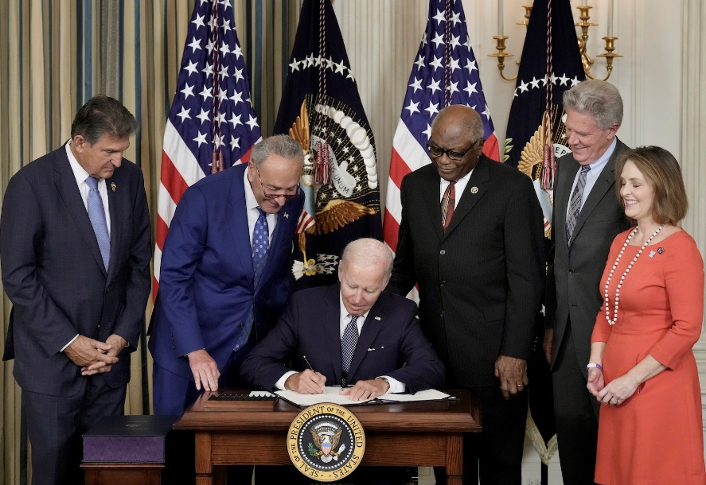
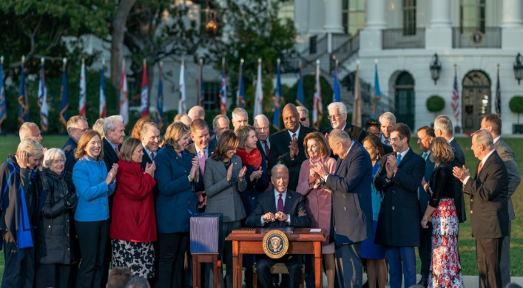
IRA vs. IIJA
Inflation Reduction Act (August 2022)
Tax Credits, Research, and some direct spending
Bipartisan Infrastructure Law (Nov. 2021)
Existing Programs have existing processes
Individual projects
Spend in 5-10 years (IIJA) vs. spend over long-term (IRA)

Slide 3
Infrastructure Investment and Jobs Act: Overview

Slide 4
IIJA: New vs. Existing Funding

Slide 5
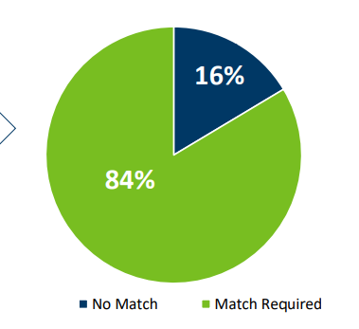
Infrastructure Investment and Jobs Act: MN Specific
Percent of Requiring State Match
Estimates by State Agency

Slide 6
Transportation : Federal Aid Highway Program
Federal Aid Highway Program | $270 Billion
Significant increases for ALL states:
20%+ 2021 -> 2022
30%+ 2021 -> 2026
Programs Include:
National Highway Performance Program, $148 billion
Surface Transportation Block Grant Program , $72 billion
Highway Safety Improvement Program, $15 billon
Feb. 2022 - Updated guidance, more flexibility
Congestion Mitigation and Air Quality Improvement Program, $13 billion
National Highway Freight Program - $7.1 Billion
Ongoing Federal Action:
Dec. 2021: Apportionment of FY 2022 Funds
Oct. 2022: Apportionment of FY2023 Funds

Slide 7
Transportation: Other State Eligible Programs
Additional State Eligible Programs | $26 Billion
PROTECT – $7.3 Billion
May 2022: FY 2022 Apportionment Tables
July 2022: PROTECT Guidance
Carbon Reduction Program – $6.4 Billion
May 2022: FY 2022 Apportionment Tables
April 2022: CRP Guidance
Ferry Boats & Facilities - $912 Million
Aug. 2022 – FY 2022 Distribution
Bridges| $40 Billion
Bridge Formula Program - $27.5 Billion (Formula)
Jan. 2022: FY2022 BFP funding and guidance
June 2022: NOFO for FY2022 BIP funding
Oct. 2022: FY2023 BFP funding
Bridge Investment Program - $12.5 Billion (Competitive)
BIP FY2022 planning grant recipients funding.

Slide 8
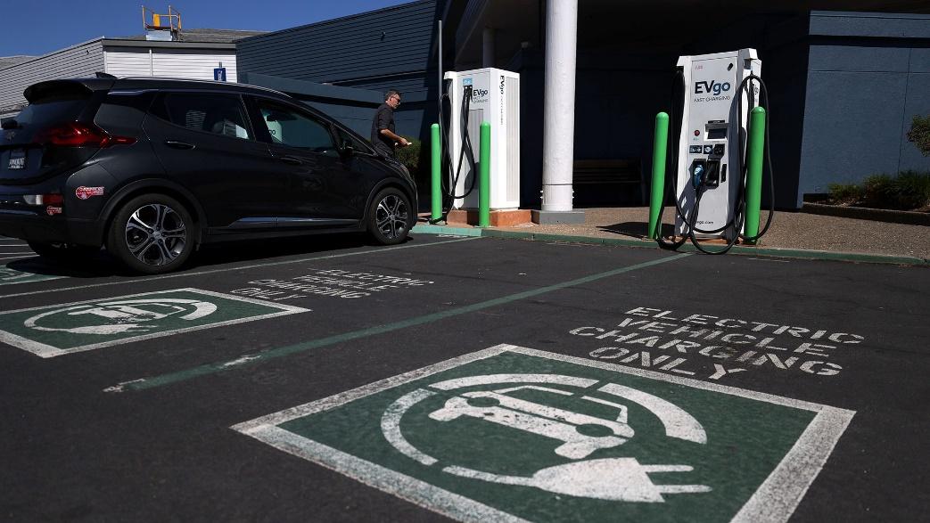
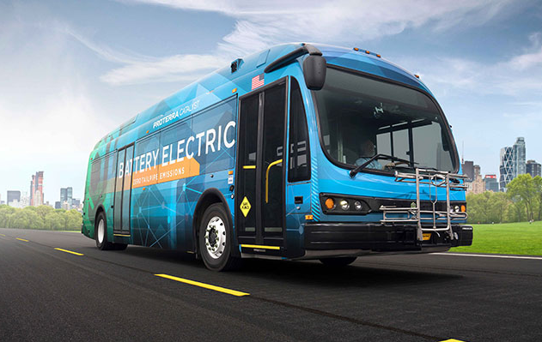
Transportation: Electric Vehicles, Busses & Ferries
Electric Vehicle Infrastructure:
National EV Infrastructure – $5 Billion
February 2022: FY2022 Apportionments, Guidance and Nomination Request for NEVI
June 2022: NPRM for NEVI
October 2022: NEVI FY 2023 Apportionment
Discretionary Grant Program for Charging and Fueling Infrastructure - $2.5 Billon
Electric Vehicle Transition:
Clean School Bus Program - $5 Billion
Low-and No-Emission Transit Bus Program - $5.6 billion
NOFO closed May 2022, FY 2022 grants awarded September
Electric or Low Emitting Pilot Program - $250 million
NOFO closed September 2022

Slide 9
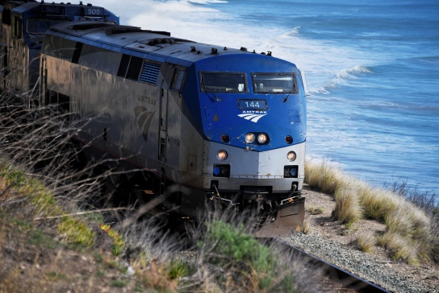
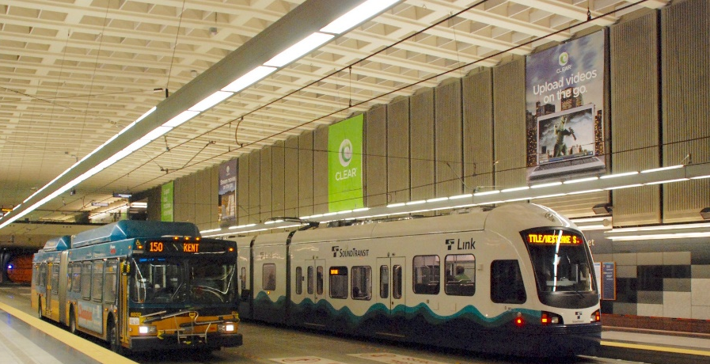
Transportation: Public Transit & Amtrak / Rail
Public Transit | $91 Billion
Emphasis on federal-local funding stream
Urbanized - $33.5 Billion
State of Good Repair - $23.1 Billion
State Formula Funds
Rural - $4.5 Billion
Seniors & Individuals with Disabilities - $2.2 Billion
Bus & Bus facilities - $3.1 Billion
Amtrak & Rail | $66 Billion
Amtrak - $22 Billion
National Network - $16 Billion | Northeast Corridor - $6 Billion
FRA State-Federal Partnership Grants - $36 Billion
Competitive (state, local & Amtrak)
CRISI - $5 Billion
Corridor Development Program
FY22 NOFO closed Oct. 2022

Slide 10
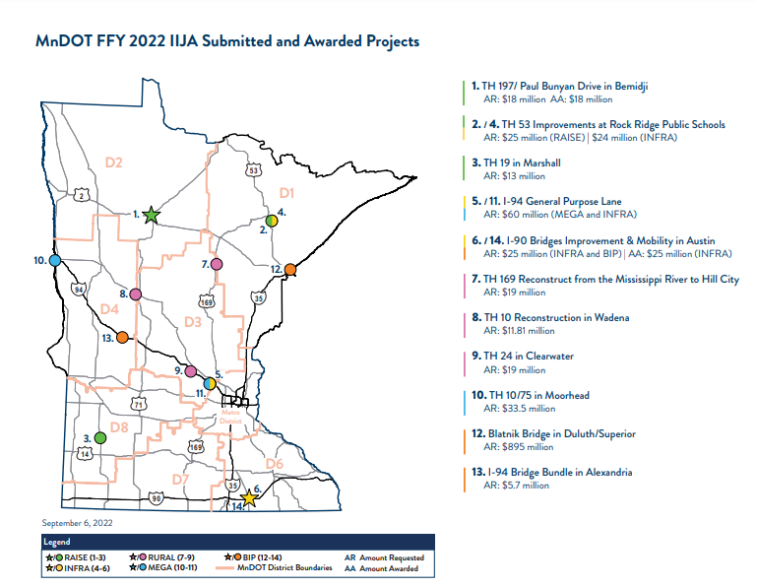
Minnesota Funding Totals FY22 – 26
Highway & Motor Carrier Funding
MDOT Status Update
Bridge Formula Program | $325,832,690
Bridge Investment Program | $269,600
Carbon Reduction Program | $106,713,242
Congestion Mitigation and Air Quality Improvement | $182,728,875
Construction of Ferry Boats and Ferry Terminal Facilities | $16,125,265
Highway Safety Improvement Program | $246,530,964
Metropolitan Transportation Planning | $31,389,996
National Electric Vehicle Formula Program | $68,164,918
National Highway Freight Program | $117,686,377
National Highway Performance Program | $2,457,028,931
Nationally Significant Freight and Highway Projects (INFRA) | $35,000,000
PROTECT Program | $121,340,603
Railway-Highway Crossings (HSIP set-aside) | $32,427,757
Rural Surface Transportation Grant Program | $26,309,600
Surface Transportation Block Grant | $1,196,784,024
Technology and Innovation Deployment Program | $312,000
MnDOT FFY2022 IIJA Submitted and Awarded Projects

Slide 11
Minnesota Funding Totals FY22 – 26
Other Transportation Funding
Resources for Transportation Funding
Airport Infrastructure Grants | $296,610,115
Airport Terminal Program | $23,057,500
Motor Carrier Safety Assistance Program | $52,069,795
Bus and Bus Facilities Competitive Grants | $17,506,139
Bus and Bus Facilities formula grants | $53,777,849
Capital Investment Grants | $263,618,283
Enhanced Mobility Grants | $31,999,528
Metropolitan Planning | $11,530,845
Rural Area Formula Grants | $117,073,641
Rural Transportation Assistance Program (set-aside of Rural Area Formula Grants) | $1,849,823
State of Good Repair Grants | $161,799,426
Statewide Transportation Planning | $2,191,485
Urbanized Area Formula Grants | $479,365,877
Clean School Bus Program | $1,610,000
Federal Resources:
IIJA
USDOT Competitive Grant Funding Matrix
USDOT Authorizations & Formula Funding
USDOT Grant Navigator
Minnesota DOT Resources:
MnDOT FFY 2022 IIJA Submitted and Awarded Projects
MnDOT BIL IIJA Discretionary Grants List
MN IIJA Grant Tracking Form

Slide 12
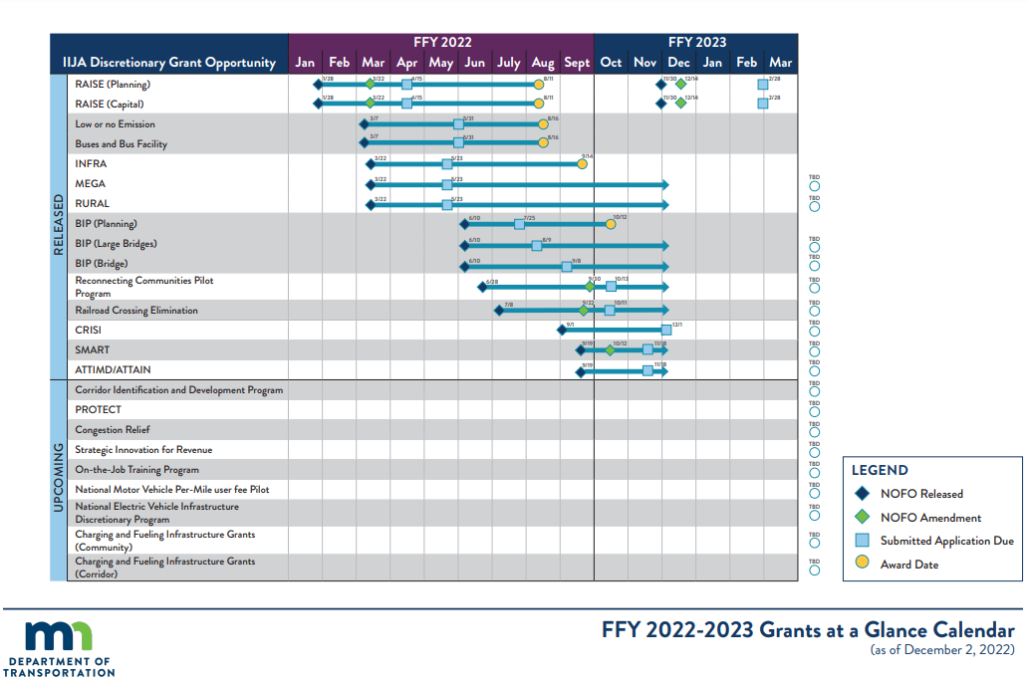

Slide 13
Energy: State Eligible Programs
Formula Funds
Preventing Outages and Enhancing the Resilience of the Electric Grid, Grants to States and Tribes (Grid Resiliency) | $2.3 Billon
Weatherization Assistance Program | $3.5 billion
State Energy Program | $500 Million
Energy Efficiency Revolving Loan Fund Capitalization Program |$250 Million
Competitive Grants
Research and Supply Chains
Batteries - $6 billion
Carbon Capture - $6 billion
Hydrogen - $8 billion
Advanced nuclear - $3 billion
Existing Nuclear - $6 billion

Slide 14
Energy: Formula Funds to States
Grid Resiliency | $2.3 Billion
Weatherization Assistance | $3.5 Billion
July 2022: Application open for Preventing Outages and Enhancing the Resilience of the Electric Grid formula grant program
January 2023 – Year 2 allocation amounts posted
March 2023 – Application closes.
Improve grid resilience against disruptive weather events & natural disasters
15% required state match for formula program
March 2022 – Program notice to states to develop a Weatherization Assistance Program Grantee Plan, and issued allocations (closed July 2022)
$76 million to MN for FY 2022-2026
Minnesota received $99.9 million between 2010 and 2021

Slide 15
State Energy Program Funding - $500 Million FY22-FY26
Rundown of SEP Funding Process
IIJA Intent of Funds & Additional Details
August 2022 – SEP Formula grant application instructions and state allocations released. No match.
Develop & implement clean energy programs and projects.
Past SEP Funding & Projects in Minnesota
$12.5 million since 2010
Projects have included:
Creation of a Guaranteed Energy Savings Program
Implementation of Electric Utility Infrastructure Efficiency
Minnesota’s 2025 Energy Action Plan

Slide 16
Minnesota Funding Totals FY22-26
Energy Funding
Energy Efficiency and Conservation Block Grant | $7,119,150
Energy Efficiency Revolving Loan Fund Capitalization Program | $1,854,610
Preventing Outages and Enhancing the Resilience of the Electric Grid, Grants to States and Tribes | $30,290,400
State Energy Program (expanded use) | $7,734,210
Weatherization Assistance Program | $76,218,512

Slide 17
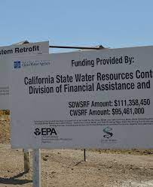
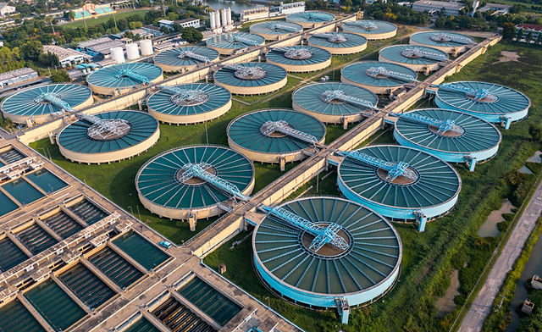
Water Funding – State Revolving Funds
DRINKING WATER AND CLEAN WATER STATE REVOLVING FUNDS (SRF) - $11.7 billion each
$170 Million DWSRF MN | $204 Million CWSRF MN
49% as forgivable loans/grants; state match required (20%)
LEAD SERVICE LINE REPLACEMENT - $15 Billion
$217 Million DWSRF MN, 49% as forgivable loans/grants
PFAS AND OTHER CONTAMINANTS - $10 Billion
$1 billion through CWSRF/100% grants
$4 billion through DWSRF/100% grants
$5 billion through states for underserved communities
MINNESOTA UPDATE:
2023 CWSRF IUP Approved Dec. 2022
2023 DWSRF IUP Approved Dec. 2022
Projects are not fundable at this time due to the lack of State matching funds

Slide 18
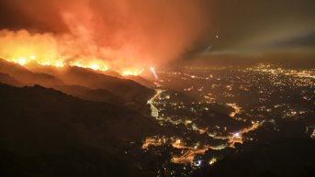
DISASTER MITIGATION & RESILENCY
FEMA
Flood Mitigation
$3.5 billion (states and local govts)
Buyouts, elevating, other activities
BRIC
$1 billion (states and local govts)
Pre-disaster mitigation projects
STORM Act
$500 million (states)
Aids states in establishing revolving loan funds for mitigation projects.

Slide 19
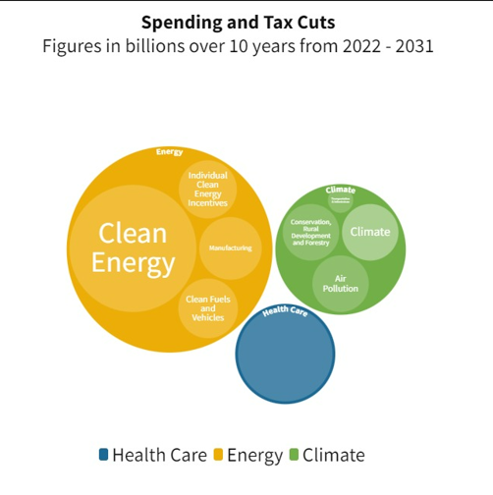
Inflation Reduction Act
Lowering the Cost of Healthcare
Tax credits for health insurance
Limiting the cost of prescription drugs
Recalibration of American Energy Policy
Combination of tax credits and spending
Aimed at increasing ALL energy production
Corporate tax law changes

Slide 20
Inflation Reduction Act
Tax Credits
Industrial Tax Credits
Consumer: Electric Vehicles
Consumer: Home Energy Upgrades
High-Efficiency Electric Home Rebate Program - $4.3B
Heat pumps and water heaters, electric stove and other electrical upgrades
Home Energy Performance-Based, Whole-House Rebates- $4.3B
Rebates for energy-saving projects
Increased rebates for LMI, rebates available for multifamily
$200 million to train workforce
A true ALL of the above – solar, wind, nuclear, fossil w/carbon capture, geothermal, biofuels, hydrogen
PTC & ITC annual tax credit extension to 10 years
85% increase in carbon capture credit
Nuclear production tax credit and clean hydrogen tax credit
Eliminates 200k cap and adds credit for new and used vehicles within income limits
Batteries:
100% battery assembly in North America by 2029
80% of Critical mineral components of battery from country with U.S. free trade agreement by 2027
Department of Energy sends $$ to States

Slide 21
IRA: Energy Loans & Other Provisions
Loans Authority
Transmission & Siting Changes
Energy Investment Reinvestment Financing - $5 billion for $250 billion
Supports energy infrastructure reinvestment which avoids, reduces, or sequesters GHG.
DOE Loans Program Office - $3.6 billion for $40 billion
Supports innovative clean energy projects including carbon capture, nuclear, critical minerals recycling and more.
Transmission Facility Financing - $2 billion
Advanced Industrial Deployment Program - $5.8 billion
Loams to support industrial facilities in emissions intensive sectors to reduce GHG.
$3 billion in loans for advanced manufacturing of vehicles
Offshore Wind Leasing Authority
Lifts September 2020 moratorium on offshore wind leasing off Carolinas, Georgia and Florida.
Requires DOI BOEM to hold offshore oil and gas lease sale, if they are to hold offshore wind energy lease sale.
OCS Leasing Program
Reinstates 2021 Gulf of Mexico Oil and Gas Lease Sale, requires additional lease sales in the Gulf.
Transmission Facilities
Upgrade “National Interest” facilities via siting loans.

Slide 22
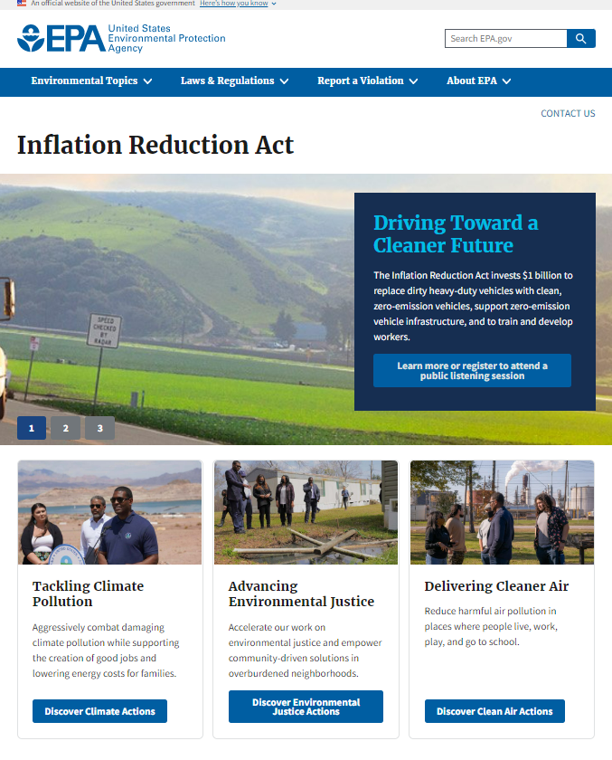
Environmental & Climate Provisions
98% of EPA’s funding is for new programs:
Greenhouse Gas Reduction Fund - $27 billion
States eligible for $7 billion in competitive grants which finance clean energy and climate projects that reduce GHG emissions in low income and disadvantaged communities.
Climate Pollution Reduction Grants - $5 billion
To aid states develop and implement GHG reduction plans.
Environmental and Climate Justice Block Grants - $3 billon
Port Air Pollution Reduction Grants - $3 billion
Methane Emissions Reduction Program - $1.55 billion
Clean Heavy Duty Vehicles Grants - $1 billion
$400 million to areas in nonattainment.
Some of these programs build on existing programs, but will still need time to start up. Consultation time is now.

Slide 23
Possible Next Steps for State Legislatures: IRA & IIJA
Review Guidance
Develop Legislative Priorities
Legislative Approval and Matching Funds
Congressional Delegation
NCSL Resources

Slide 24
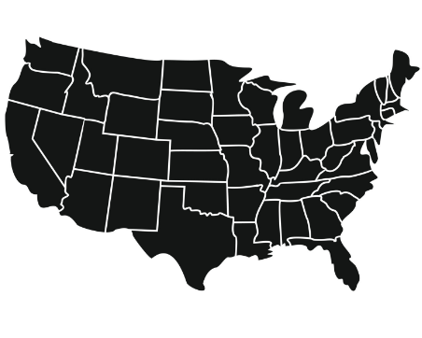
Suggestions for Engagement & Collaboration
Infrastructure Coordinator
Interagency Collaboration
Interstate Collaboration
Elevate the role of your Infrastructure Coordinator
Ensure your agencies, and the legislature, is working together – example is Michigan’s Infrastructure Council
Consider collaborating across state lines on infrastructure projects and regional priorities

Slide 25
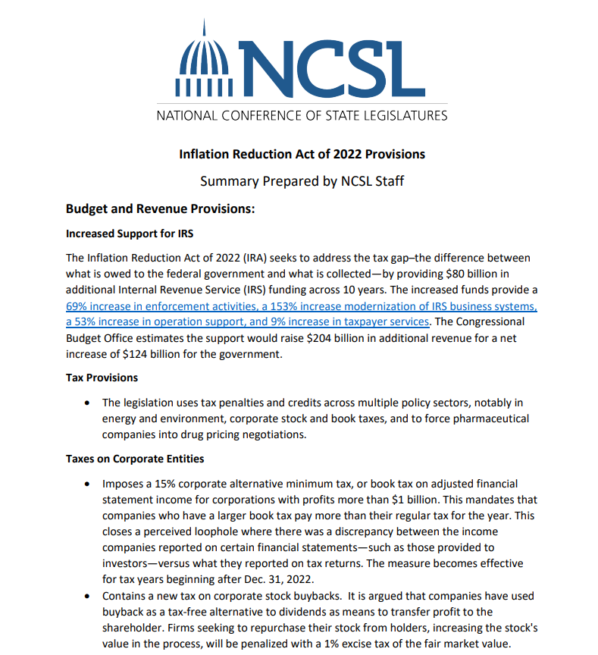
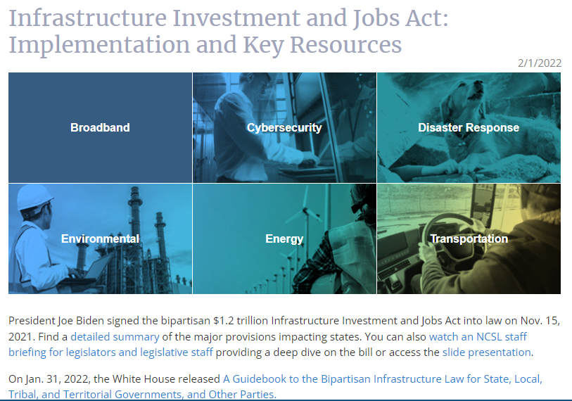
IIJA & IRA Implementation Resources
Infrastructure Investment & Jobs Act
White House
State Fact Sheets
U.S. Dept. Of Transportation
U.S. Environmental Protection Agency
U.S. Department of Energy
NCSL Resources
IIJA Implementation & Key Resources
Explainer for States
Inflation Reduction Act
White House
IRA Guidebook, Dec 2022
DOE | EPA | USDA
NCSL Resources
Explainer for States

Slide 26
QUESTIONS?
Kristen Hildreth
Senior Legislative Director, Natural Resources & Infrastructure
kristen.hildreth@ncsl.org
Aaron Ray
Associate Director, Energy Program
aaron.ray@ncsl.org

