Slide 1
HF 2: Zero-based budgeting and sunset review board
MN House State Govt Operations
26 January 2011

Slide 2
Bill has three portions, two articles
Zero-based budgeting (ZBB) provisions provided
Passing zero based budgeting requires a change in how one forecasts expenditures
Sunset review panel creates a means of updating agencies, encouraging efficiencies.

Slide 3
Fundamentals of ZBB
It is activity based
Focuses on a decision package.
Name or title, function and description
Will include identifying legal basis for performing activity.
Three levels of activity
Asks to consider benefits and costs of incremental change
Measure of cost-effectiveness and comparative measures to other states.

Slide 4
What a decision package could look like
Name or title, etc.
Levels of output
Materials
Labor
Overheads
Capital budgets

Slide 5
Packages move bottom up
Input at each stage for which level of service to provide.
Higher level managers can see both the selected and unselected levels.

Slide 6
Advantages of ZBB
Activity- or service-based
Focuses on the resources needed to deliver an activity or service to clients.
Allows one to see efficiencies
Should be more user-friendly to both administration and legislature
Detailed information on activities, easier to see redundancies and overlaps

Slide 7
Other advantages
Adaptive
Better resource allocation
Bottom-up approach engages managers with better, more local information.

Slide 8
Disadvantages addressed
Potential issue
Proposed remedy
Costly to implement
Finding good performance measures
Uncertain about other options
Phased in over two biennia, with group to move first determined by Governor.
Suggests comparisons to other states, encourages search for best practices.
Encourages three options, that allow for consideration of a step up or down in resource provision.

Slide 9
Zero base and budget forecasts
Language currently allows for a forecasted base level of all spending.
Zero base means just that, you have a zero forecasted base.
Therefore we would remove the level of forecasted spending from the next biennium
Still forecast current biennium spending.

Slide 10
Sunset review
Passed U.S. Senate (S.F. 2) in 1977 on 87-1 vote. Authored by Muskie, co-authors McGovern and Goldwater.
"I regard the sunset concept as one of the most imaginative and innovative approaches to government reform that has been proposed in many years." Edward Kennedy

Slide 11
How it works
12 member commission
6 from House, 6 from Senate. One member from each side to be public member, rest legislators. No more than 3 of 5 from majority party.
Two year terms.
Staff from LCC.
All agencies are scheduled.

Slide 12
How it works, 2
Hearings held in fall and winter of odd-numbered year.
Report on Feb 1 of even-numbered years.
Choices to continue, abolish or reorganize.
Creates legislation to continue or reorganize the agencies so decided.
Default is sunset – agency expires on June 30 of following year.

Slide 13
Hearing questions asked
Is the agency operated efficiently and effectively?
How successful has the agency been in achieving its mission, goals, and objectives?
Does the agency perform any duties that are not statutorily authorized? If so, what is the authority for those activities and are they necessary?
What authority does the agency have related to fees, inspections, enforcement, and penalties?
In what ways could the agency’s functions/operations be less burdensome or restrictive and still adequately protect and serve the public?
How much do the agency’s programs and jurisdiction duplicate those of other agencies and how well does the agency coordinate with those agencies?
To what extent does the agency encourage and use public participation when making rules and decisions?
Would abolishing the agency cause federal government intervention or loss of federal funds?

Slide 14
Advantages
Updates government
Provides certainty on continuation of agencies
Provisions to renew agencies permit a 12-year term
Modeled on the Texas Sunset Advisory Commission, which has existed since 1977.
58 agencies abolished (as of end 2009) and another 12 consolidated

Slide 15
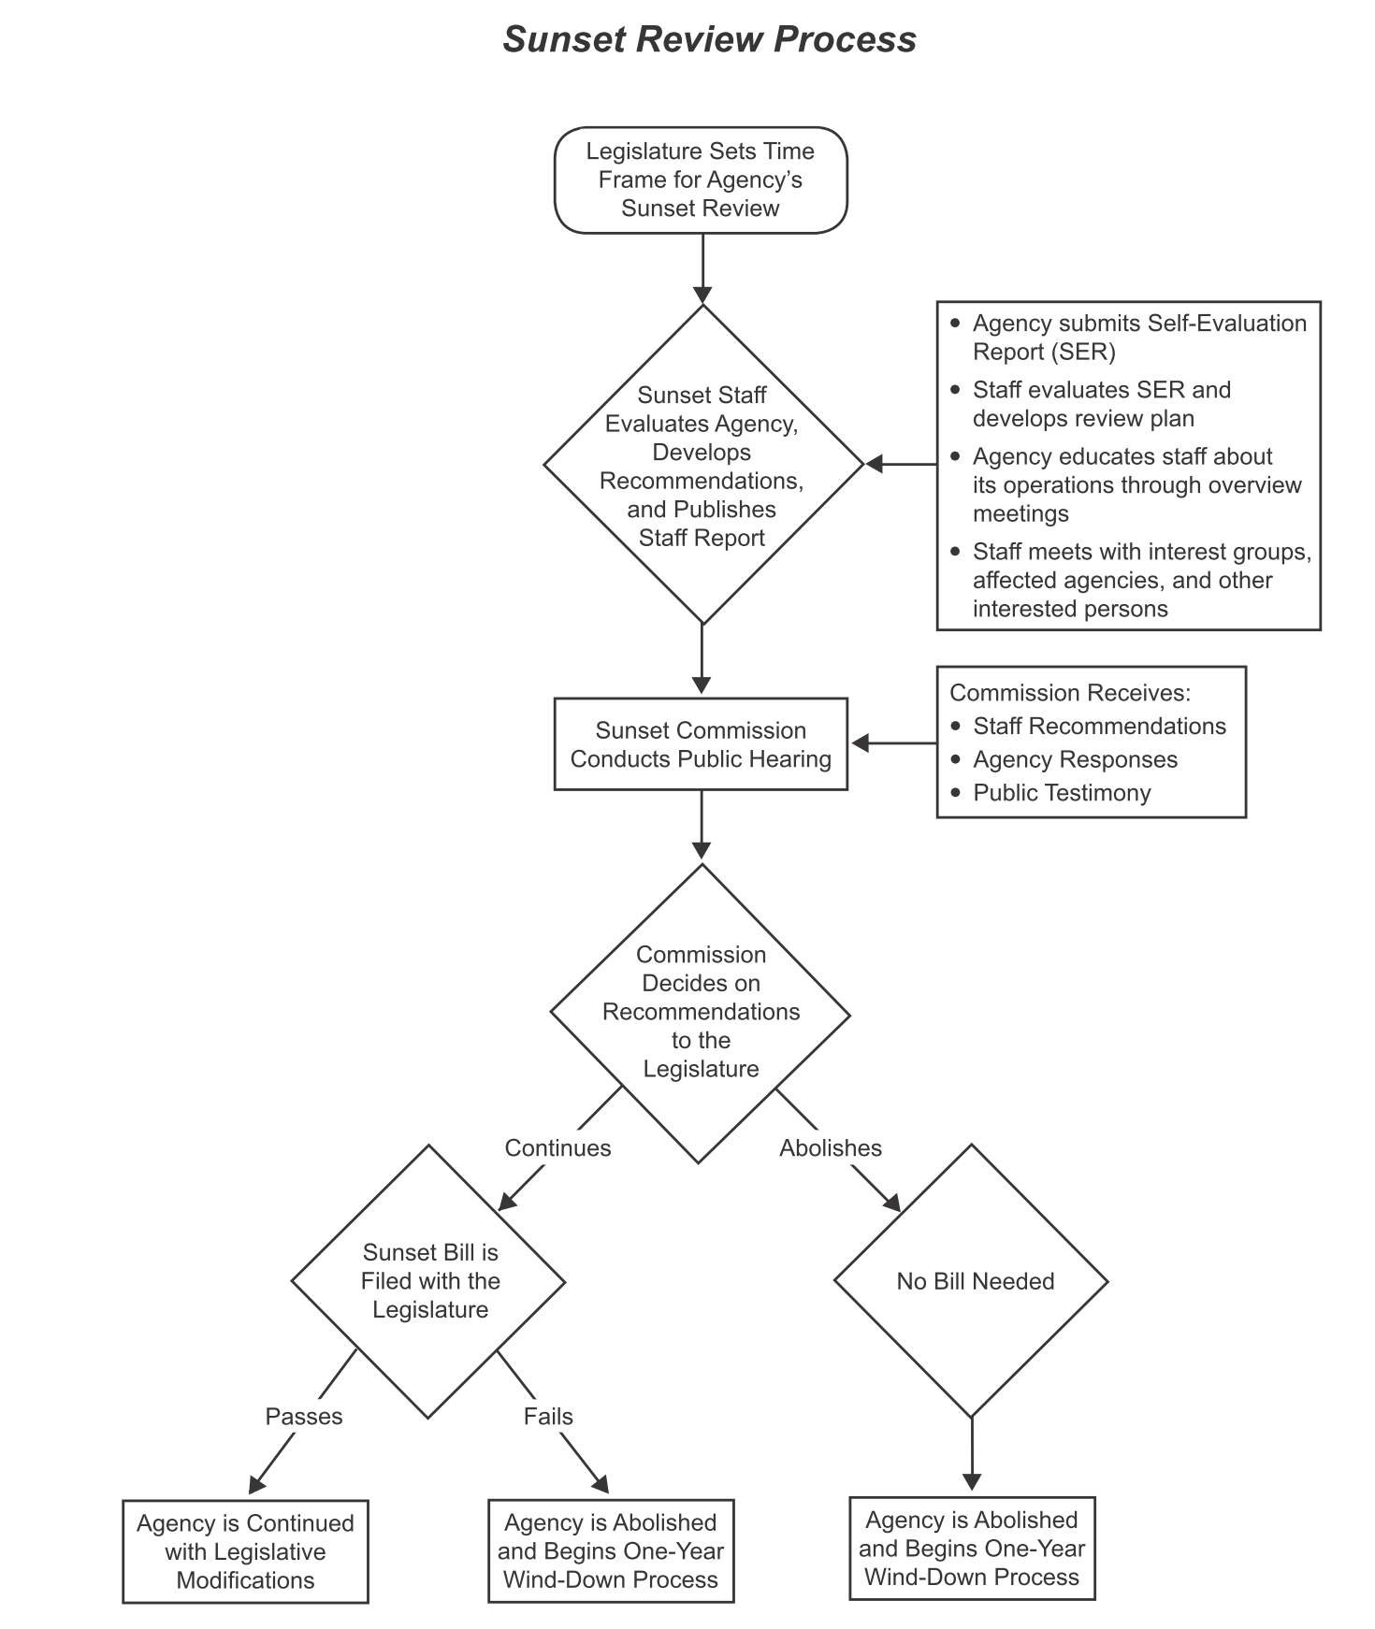

Slide 16
We cannot forecast expenditures with an agency that sunsets
So for this reason as well, need to have fix to forecasting base expenditures.
Argue for not forecasting future base.

