Slide 1
Department of Public Safety Bonding Request 2012
Kris A. Eide
Director
HSEM

Slide 2
Project Scope
State Emergency Operations Center (SEOC)
Activated for 92 days in 2009-10
Activated 45 days in 2011
Activated 1 day in 2012
State agencies staff the facility during activation
HSEM permanent offices
75 full time employees
Possible co-location of two other DPS functions
Minnesota Duty Officer
Minnesota Joint Analysis Center
Notes:
SEOC activated an average of 45 days a year over last three.
5 January 2012 activation in response to alert at PINGP.
Could “bring home” HSEM function of all-hazards MDO (originated in DEM/HSEM, now shared with BCA).
MNJAC is offsite because of facility/security shortfalls.
Currently paying for leased space that is inadequate, as we’ll explain.

Slide 3
Role of the SEOC
Coordinate state agency response
Communicate with local EOCs, the scene, and the federal government
Provide support to the scene
Coordinate public information
Notes:
Key function is to understand what is happening and coordinate state government support to locals during emergencies.
Joint information center is critical during emergency – the public expects to be told (1) what happened, (2) what we know, (3) what we’ve done/are doing, (4) what we need them to do, (5) what we will do next.
This is a truly inherent/fundamental state government role/function

Slide 4
Characteristics
Survivability
Security
Sustainability
Interoperability
Flexibility
Notes:
DHS standards/core capabilities.
Current facility fails all these standards. Documented by National Guard security/facility professional evaluation.

Slide 5
The Need
Per Homeland Security requirements, each state must have a primary and alternate Emergency Operations Center to act as state’s command center
Current location and facility (Town Square, downtown St. Paul) does not meet core capabilities for Department of Homeland Security purposes
Notes:
In basement of Capitol until late 1990s; floods of 1997 clearly demonstrated need; have been making do with leased space since while trying to achieve a permanent solution.
National issue – many states do not meet post-9/11 requirements.
National trend – move SEOC away from capitol complex and downtown areas for dispersion and survivability reasons. Many relocating to National Guard installations.
Current alternate is New Brighton Public Safety Center, will reevaluate after relocation to Arden Hills. EMTC?

Slide 6
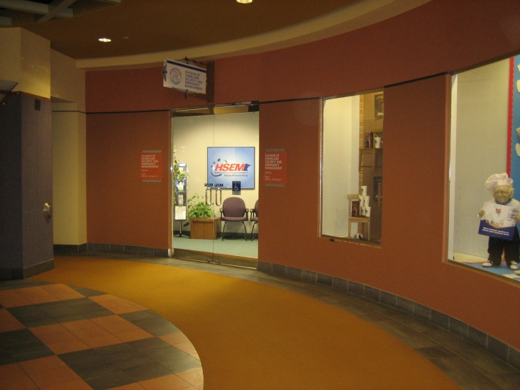
MN Shortfalls - Survivability
High risk area
High traffic area
Adjacent to high rises
Notes:
Again, trend is to move SEOCs out of urban, densely populated areas.

Slide 7
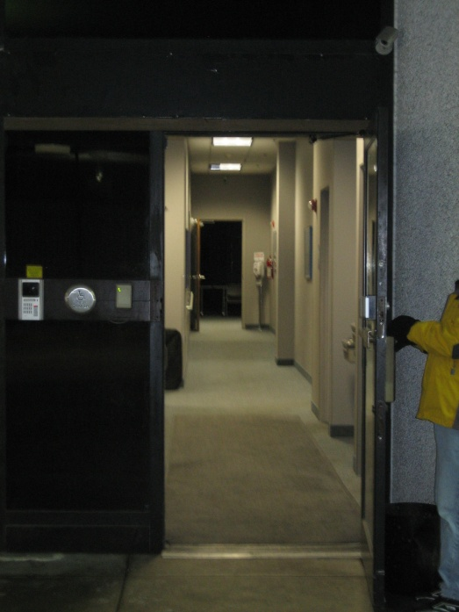
MN Shortfalls - Security
Above ground
Inadequate security
Direct entry
Above parking ramp
Notes:
Very vulnerable to attack/indirect effects.
Command/coordination/communications centers and other critical nodes are targets – cut off “the head” and compromise ability to respond, support, and inform.
SEOC is not be a public venue. Must have controlled access, secure perimeter, etc.

Slide 8
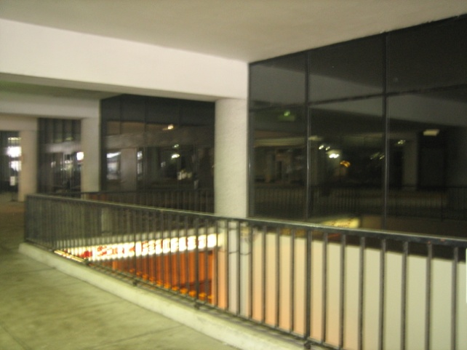
MN Shortfalls - Sustainability
Leased space
Landlord controls HVAC
No air filtration possible
Only 1 telecomm entry
Weekday only food service
Notes:
Significant chemical/biological attack risk.
Communications failure (no backup) not an option.
Onsite food service is important to staff performance and endurance,.

Slide 9
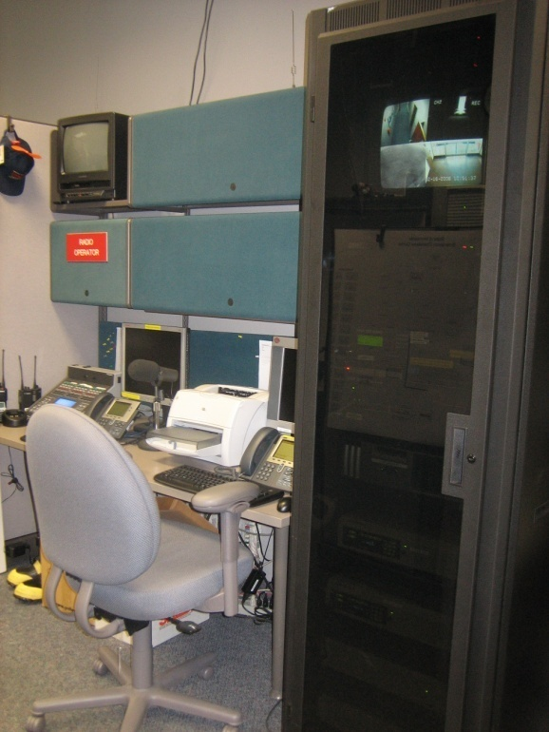
MN Shortfalls - Interoperability
Communication dead spots
Relay to DOT building
Notes:
Terrible line of site communications, which serve as primary backup means.

Slide 10
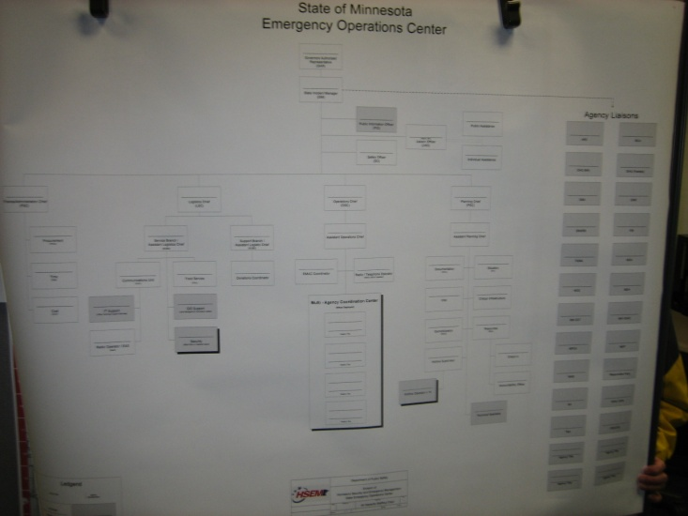
MN Shortfalls - Flexibility
Shared as training/conference rooms
Inadequate space
Notes:
SEOC should be mission ready at all times.
Inadequate coordination spaces adjacent to SEOC main floor, secure work areas, planning space, JIC, etc.
Have done the best we can with remodel, but basic capacity isn’t available.

Slide 11
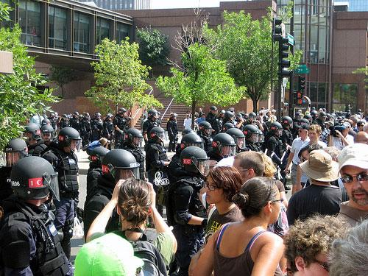
Vulnerability
Notes:
2008 RNC

Slide 12
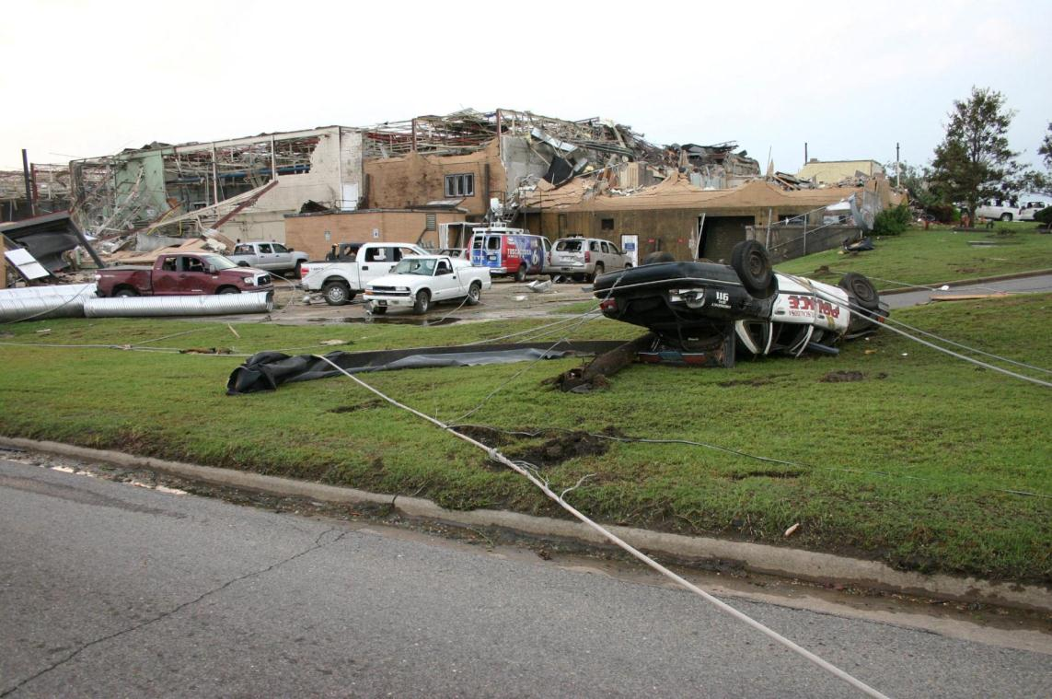
Vulnerability
Notes:
Tuscaloosa EMA/public safety facility (just six months in “soft” facility)
Impacted first responders, support to incident commanders, emergency management, scene support/coordination, and public information

Slide 13
Current Status
Pre-design/Design appropriation of $2,250,000 (Gov’s Rec; 2010 bonding bill)
Traffic study conducted
Pre-design completed
Received required recommendations from House Ways and Senate Finance Committees
Construction manager selected
Notes:
Working final site selection (4 options) before proceeding with full design.

Slide 14
Pre-Design
52,200 square feet
15 – 20 acres needed
Parking for 180 cars
Controlled access
Hardened mission critical areas
Robust IT and AV
Redundant power and communications
Leveraging the use of other nearby facilities resulting in the reduction of 13,000 square feet during pre-design
Heated storage
Vehicle storage
Commercial Kitchen
Fitness center
Showers
Notes:
National survey of new SEOC projects
Relatively modest – middle third
Conservative main EOC room
Scaled back because of adjacent National Guard support
Potential opportunities for other state agencies on Site 4

Slide 15
Request
Total Request - $26,000,000
Typical Office building
$8,500,000
Sustainability
$700,000
Hardening and Redundancy
$10,300,000
Technology
$3,500,000
Miscellaneous Construction Related Costs
$3,000,000
Notes:
Basic building ~$163/sq ft
Hardening and redundancy of mission critical areas only
Technology – EOCs are “fueled” by information
Miscellaneous – site prep, contingencies, inflation, etc.
$26,000,000 is a lot of money, but we’re paying ~$900,000/year for undersized and poorly functioning leased space. For a modest increase of $120,000 ($1,020,000/year), we would have a secure, compliant, and fully functional space that is 230% larger (+32,000 square feet) than what we have now.

Slide 16
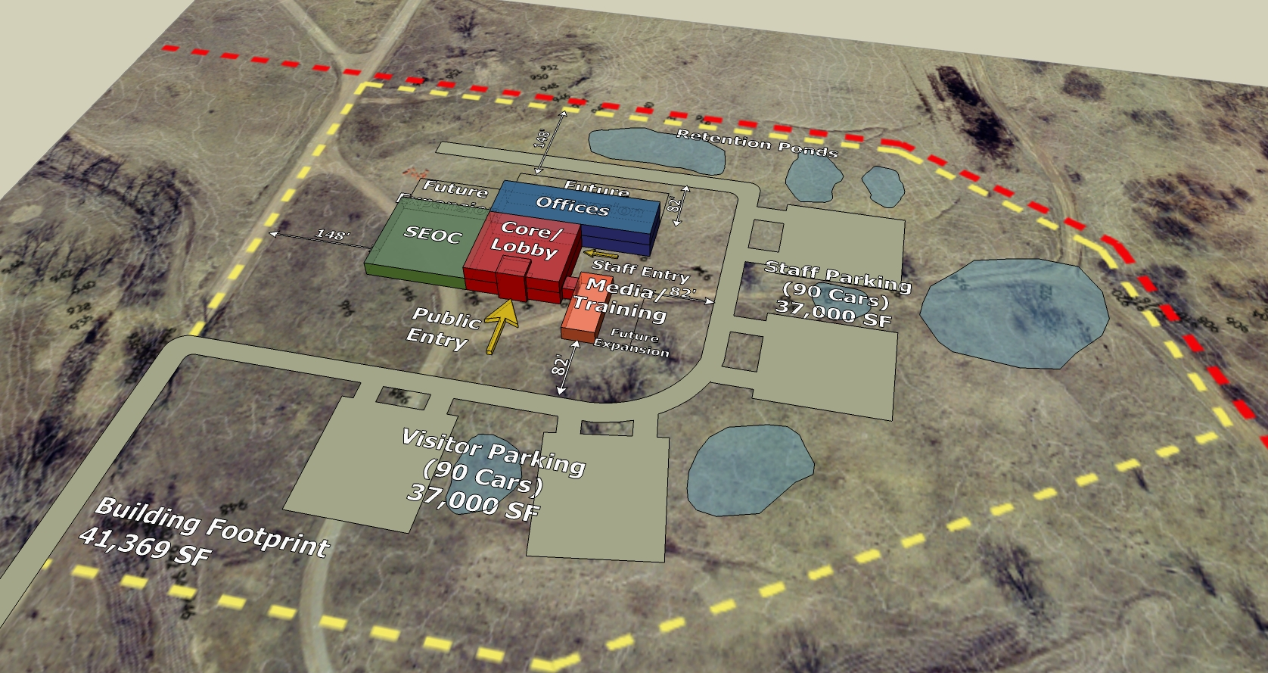
Space Plan

Slide 17
Impact of not funding
Continued risks posed by location of existing facility
Continued failure to achieve federal requirements
Limited capability to respond to terrorism event
Potential impact on grant funding and opportunities
Notes:
Limited ability to respond to terrorism or other mass affect incident (refer back to vulnerability slides) – we know the risk is there, we should not ignore it and have Minnesota pay the price in the future.

Slide 18
Questions?
Kris Eide, Director HSEM
651 201-7404
Kris.eide@state.mn.us

