Slide 1
Department of Administration
Agency Overview
Ryan Church, Acting Commissioner
January 27, 2011

Slide 2
Who we are
Created to reform and professionalize state government administrative services
Enterprise activities leverage economies of scale and specialized experience
Operates as fee-for-service businesses
1

Slide 3
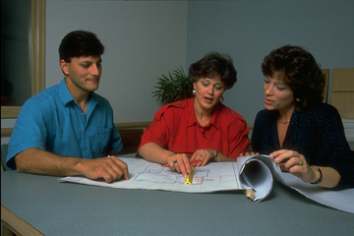
Our Mission
To help our customers succeed

Slide 4
Our Goals
To provide our customers with valuable services, products, advice and expertise
To be recognized for our innovation and efficiency
To reduce costs by working across government
To offer a safe environment where people thrive and enjoy their work

Slide 5
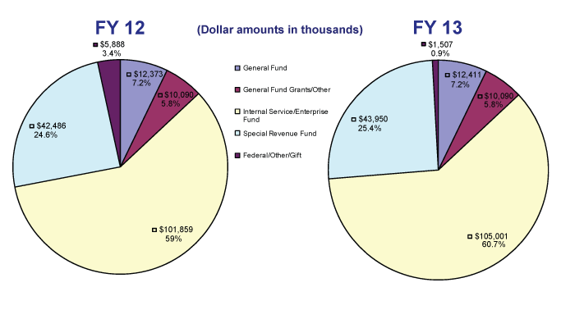
FY12-13 Base Funding

Slide 6
Managing Performance
Business-specific objectives
Decisions based on data: costs, performance, customer surveys
Quarterly reviews
Support a continuous improvement culture
Notes:
6

Slide 7
Examples
Approach/innovation
Results
Moving forward
Notes:
7

Slide 8
Purchasing

Slide 9
Purchasing
Mission: Acquire goods and services for state government using methods that support:
Best value for taxpayers’ dollars
Highest ethical standards
Legislative and executive priorities
Central procurement office role:
Goods and general services
Professional/technical contracts
Cooperative purchasing
$2.1 billion annual average state spend
Statutory overhauls in 1998, 2007
Notes:
9

Slide 10
Strategic procurement
Theme of 2007 statutory changes
Best practices from private sector, other states:
Enterprise focus
Product standardization
Aggregating demand
Negotiations
Minimum weight for price
Cooperative purchasing across jurisdictions
Spend analysis
Savings and cost avoidance
Notes:
10

Slide 11
Procurement innovation
National recognition
Pew Center on the States
“Grading the States”
Cronin excellence awards ’97 & ’10
New/pending innovations
SWIFT system
Enterprise contracts
Local government contracts
Accessibility implementation
Future opportunities
Notes:
11

Slide 12
Energy conservation

Slide 13
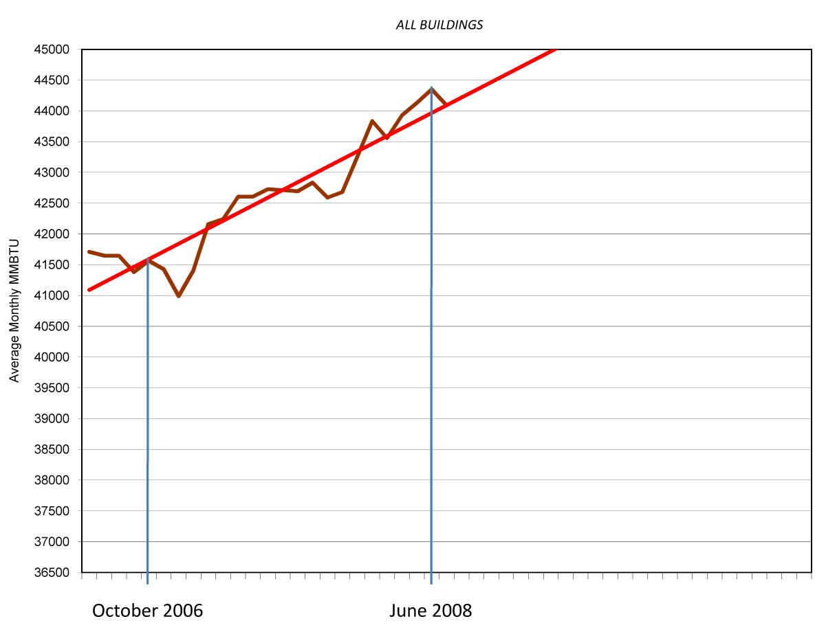
Energy consumption
12-month moving average, Admin buildings
Notes:
13

Slide 14
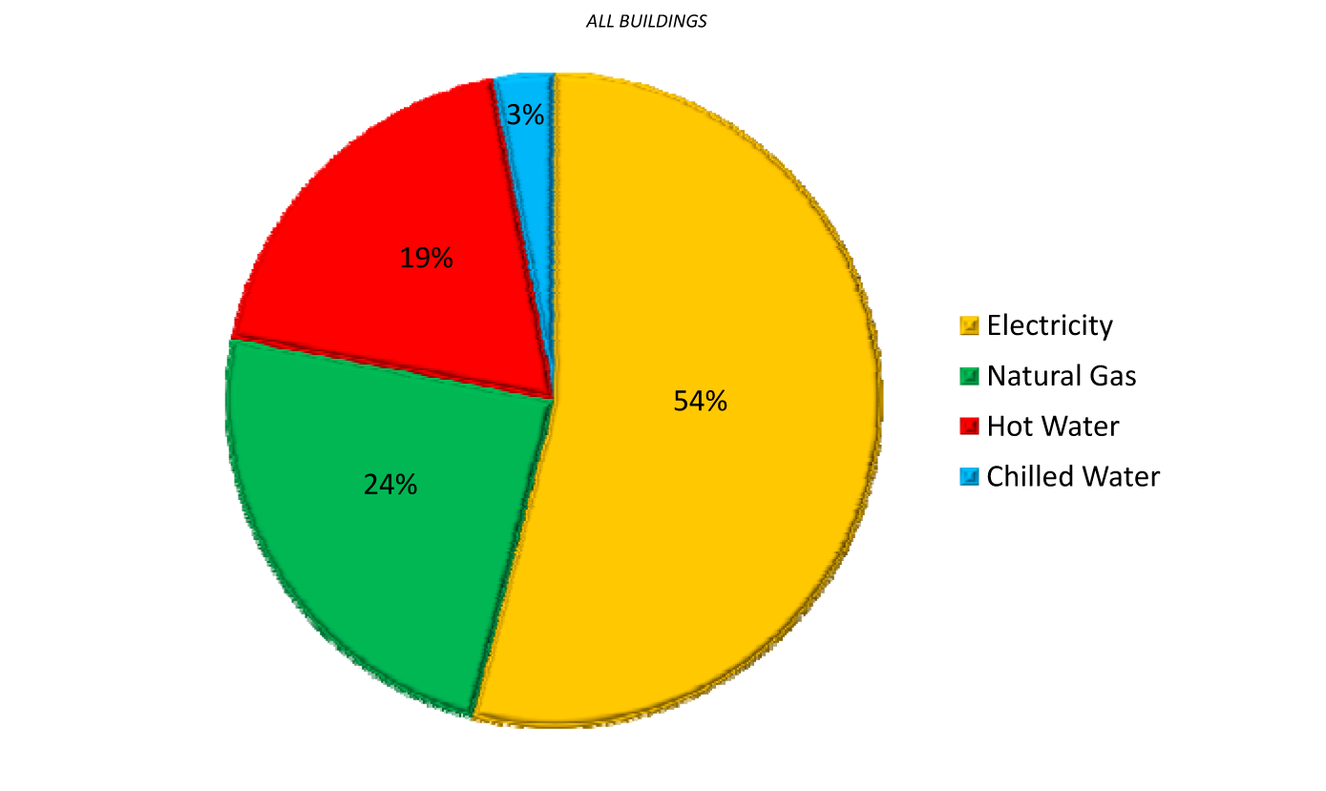
Energy consumption by type
FY2010
Notes:
14

Slide 15
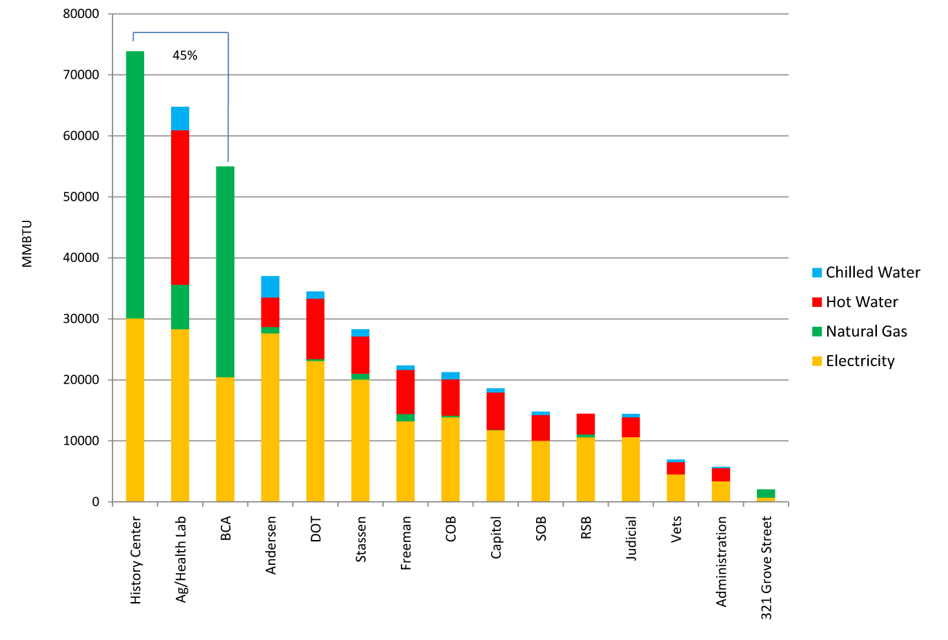
Energy consumption
By type of building
Notes:
15

Slide 16
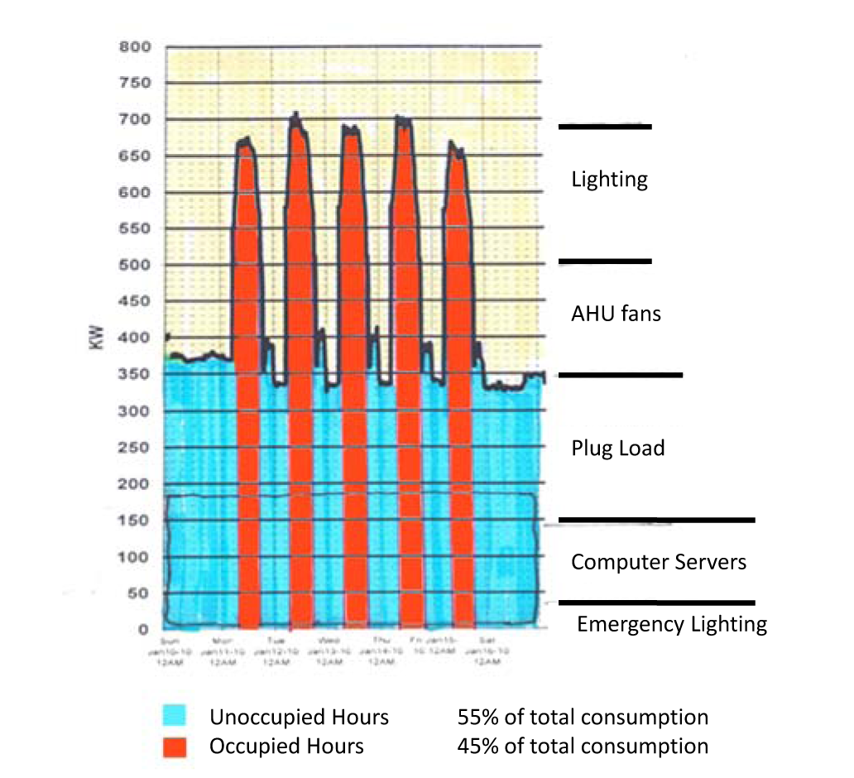
Electrical demand (kW) profile
Notes:
16

Slide 17
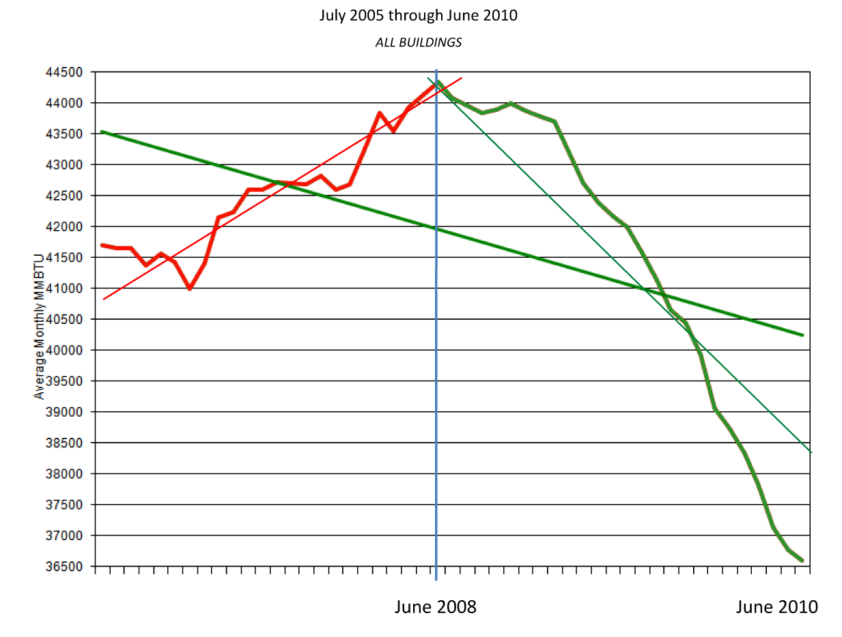
Energy consumption
12-month moving average
Notes:
17

Slide 18
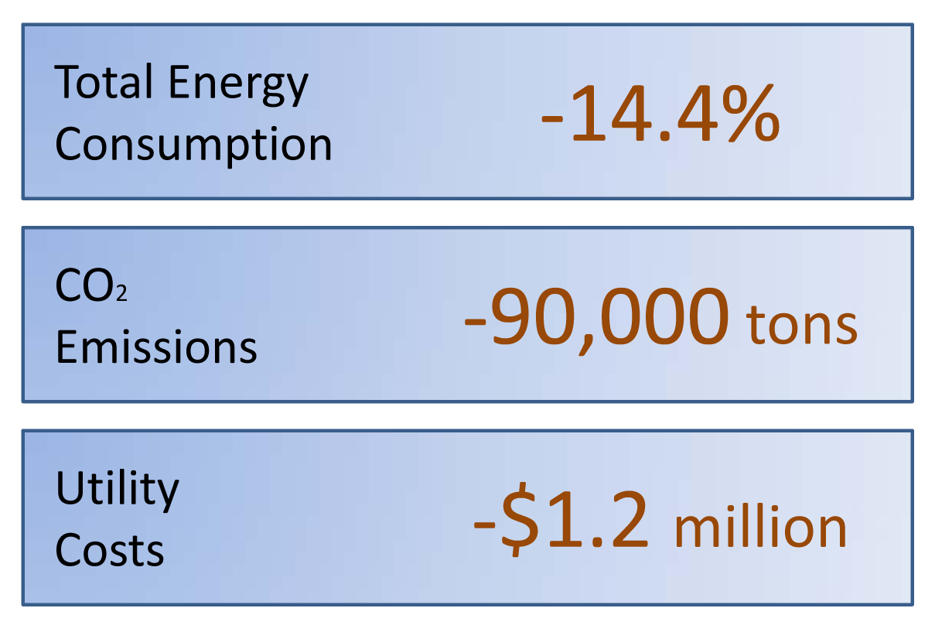
Energy conservation impact
FY2010 vs. FY2008
Notes:
18

Slide 19
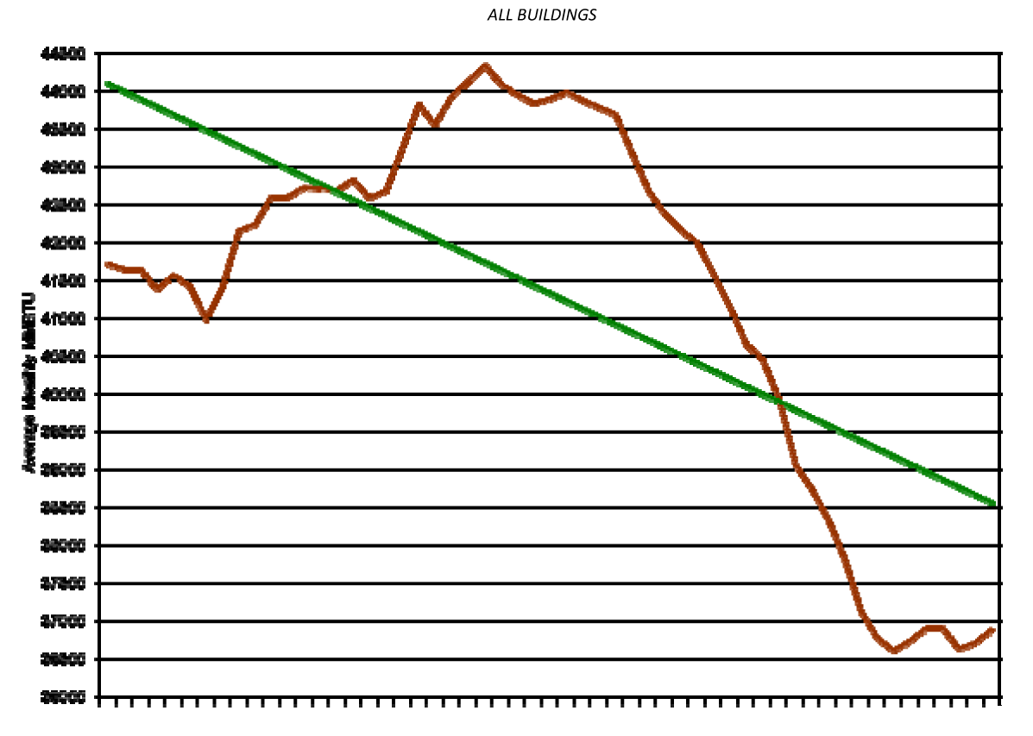
Energy consumption
12-month moving average – July 2005-December 2010
Notes:
19

Slide 20
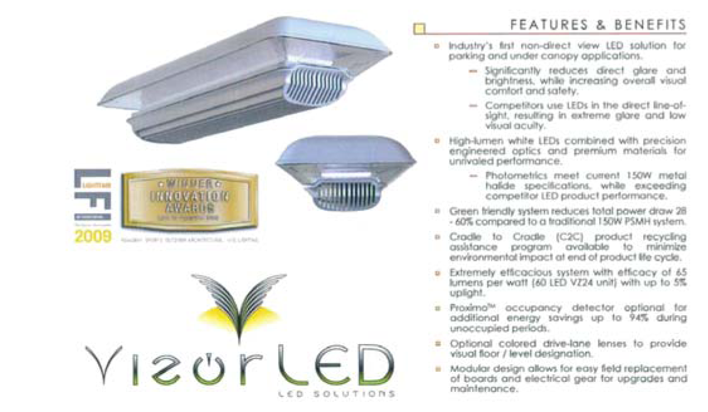
FY2011 project priorities
LED lighting – Parking ramps and lots
Achieves 90% reduction in electrical consumption; improves lighting quality
Notes:
20

Slide 21
FY2011 project priorities
Centralize building lighting control
Fiber-optic network upgrade
Honeywell Enterprise Buildings Integrator
Group relamping
New 800 series fluorescent lamps
Transportation Building
PBEEEP energy studies
Minnesota History Center
Andersen Building
Stassen Building
BCA building
State Office Building
Notes:
21

Slide 22
Real estate leasing

Slide 23
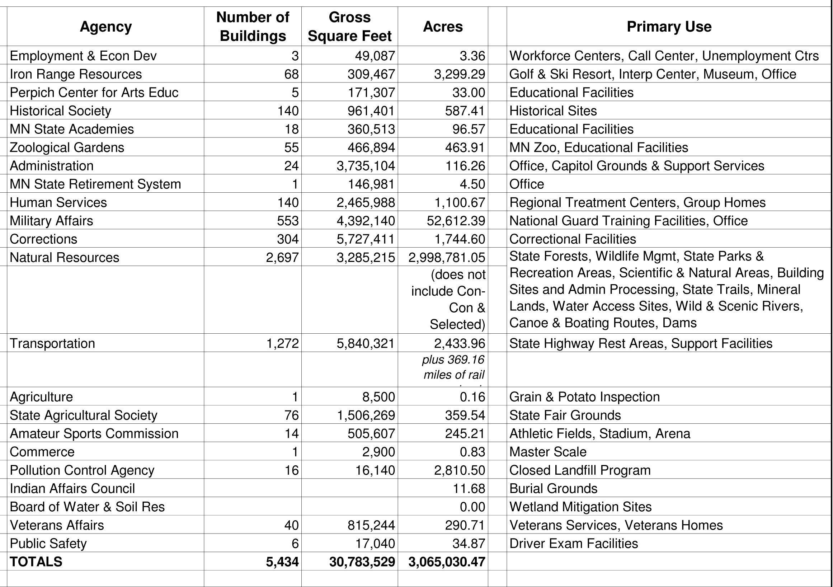
Custodial agencies

Slide 24
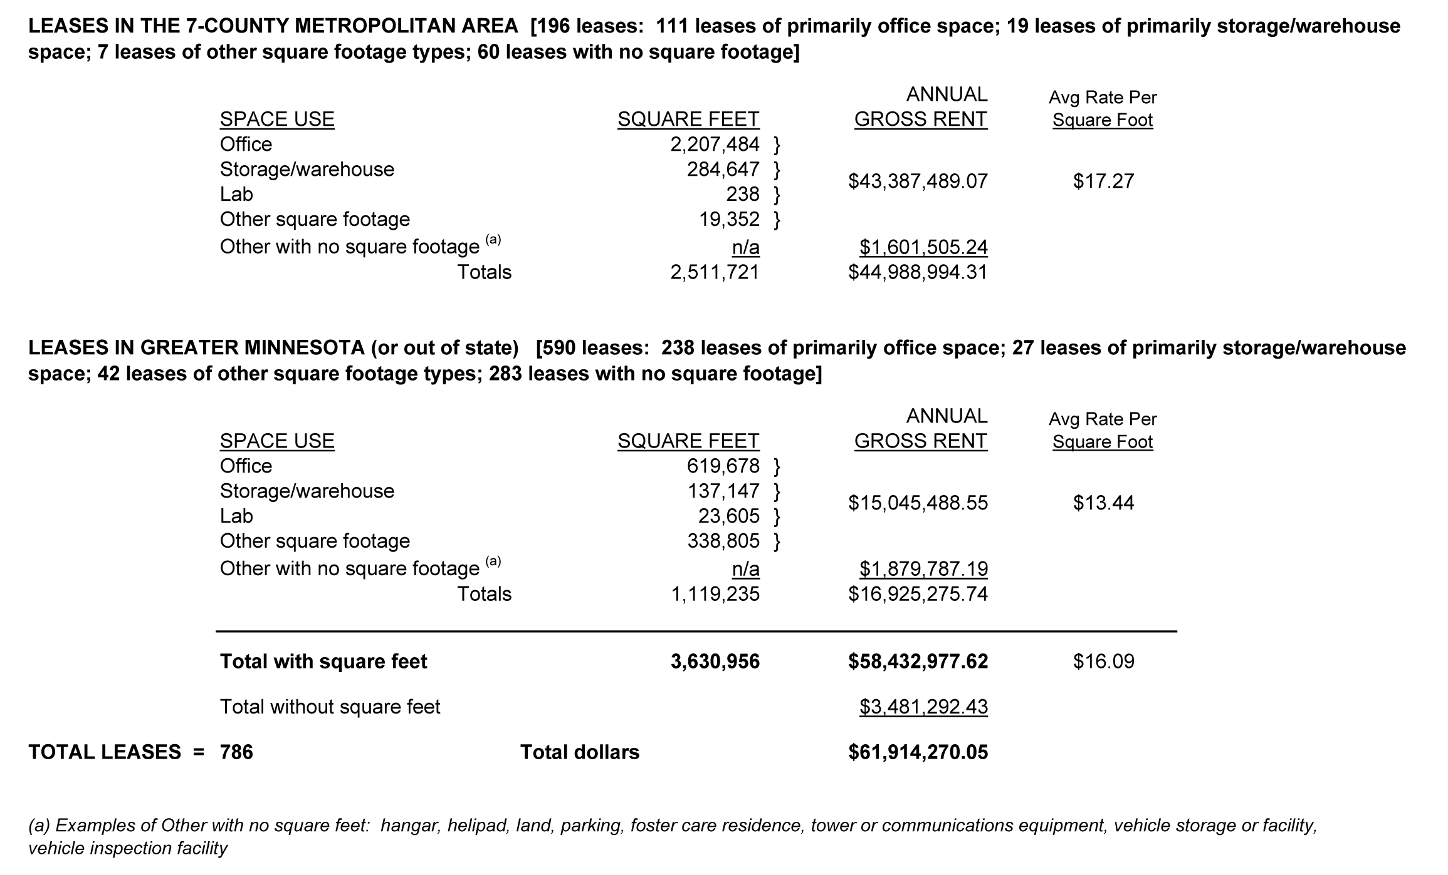
Commercial leases
$15,045,488.55 $13.44
Notes:
24

Slide 25
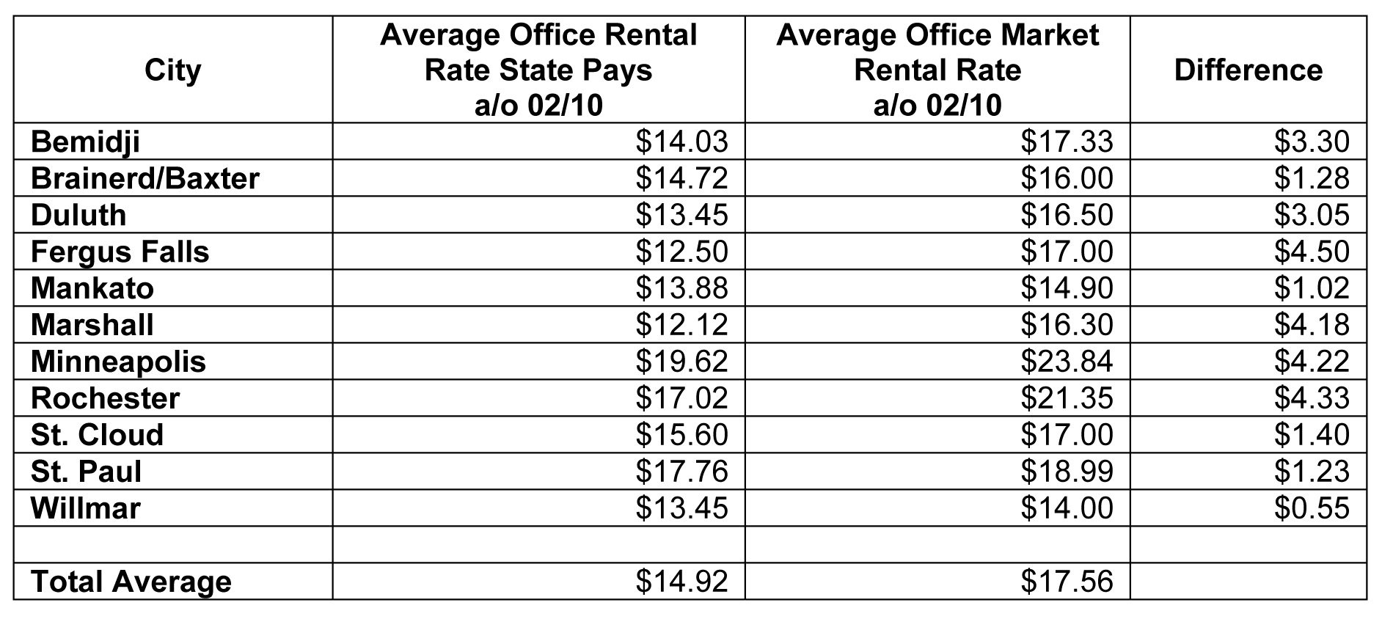
Rental rates
State lease rates are based on gross rent per usable square foot
Notes:
25

Slide 26
Enterprise Lean

Slide 27
Enterprise Lean
Began in late 2007
Goal is a continuous process improvement program throughout state government
Core approach uses Lean tools, methods
Notes:
27

Slide 28
The Lean approach
Laser focus on process improvement
Eliminate waste
Engage people who do the work
Invite other public entities
Involve the private sector
Notes:
28

Slide 29
Results
66% average reduction in elapsed/lead time
45% reduction in task time
$90,000 average cost avoidance
80% implementation/sustainment level
One of three states nationwide
Minnesota’s Lean journey
Notes:
29

