Slide 1
Minnesota’s Demographic and Census Overview for 2020 Redistricting
Susan Brower, Minnesota State Demographer
August 18, 2021

Slide 2
Minnesota grew by 7.6% between 2010 and 2020
Minnesota’s April 1, 2020 Population
5,706,494
Source: U.S. Census Bureau, 2020 Census

Slide 3
Population growth fully attributable to BIPOC groups
Population Change by Major Race Groups, 2010-2020
 | 2010 | 2020 | Change 2010-2010
Total population | 5,303,925 | 5,706,494 | 402,569
White non-Hispanic | 4,405,142 | 4,353,880 | (51,262)
American Indian non-Hispanic | 55,421 | 57,046 | 1,625
Asian/Pacific Islander non-Hispanic | 214,856 | 300,081 | 85,225
Black/African American non-Hispanic | 269,141 | 392,850 | 123,709
Hispanic/Latino (any race) | 250,258 | 345,640 | 95,382
Other race non-Hispanic | 5,947 | 20,963 | 15,016
Two or more races non-Hispanic | 103,160 | 236,034 | 132,874
Source: U.S. Census Bureau, 2010 and 2020 Censuses

Slide 4
Minnesota residents belonging to BIPOC race groups are a growing share of the population
White non-Hispanic population declined by 51,000 residents
BIPOC populations grew by 454,000 jointly, now making up 23.7% of the state’s population
Source: U.S. Census Bureau, 2020 Census

Slide 5
Growth of BIPOC race groups in Minnesota
Source: U.S. Census Bureau, 2010 and 2020 Censuses

Slide 6
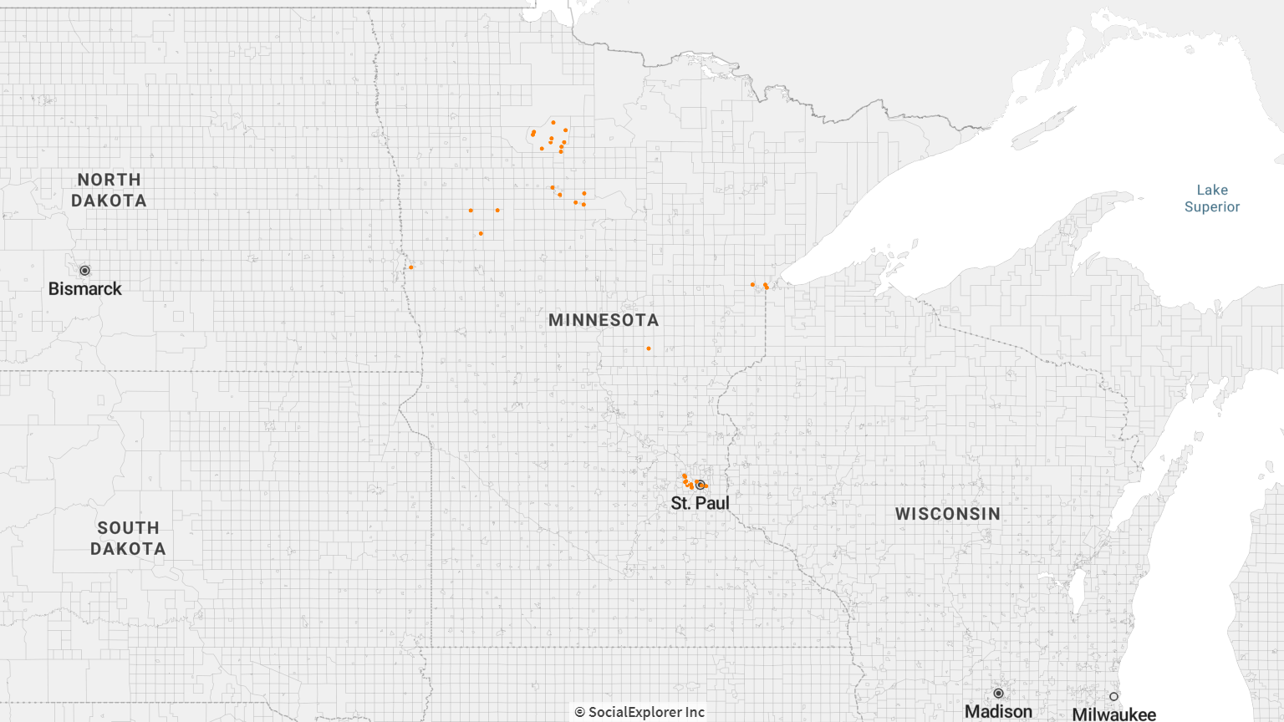
American Indian Population, 2015-2019
Each dot represents 500 people
Source: Social Explorer, American Community Survey data 2015-2019

Slide 7
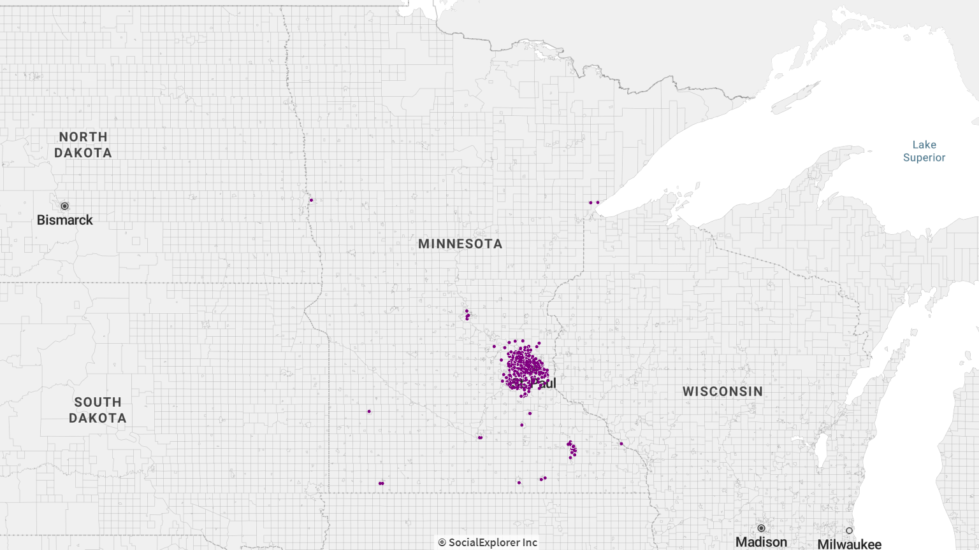
Asian Population, 2015-2019
Each dot represents 500 people
Source: Social Explorer, American Community Survey data 2015-2019

Slide 8
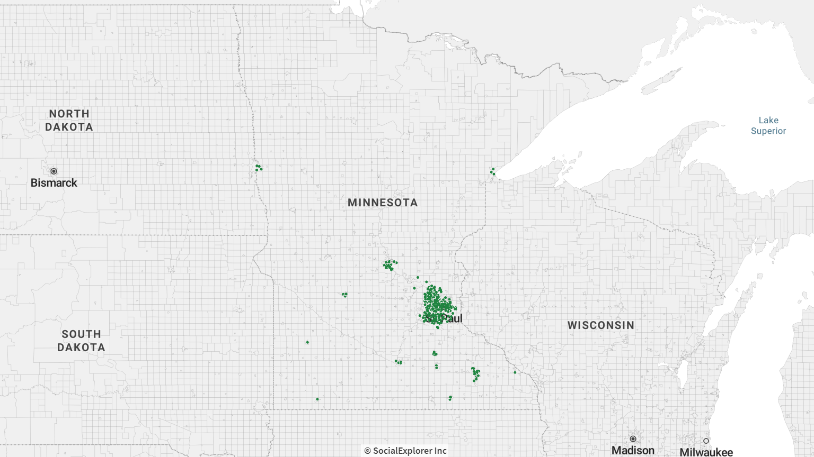
Black/African-American Population, 2015-2019
Each dot represents 500 people
Source: Social Explorer, American Community Survey data 2015-2019

Slide 9
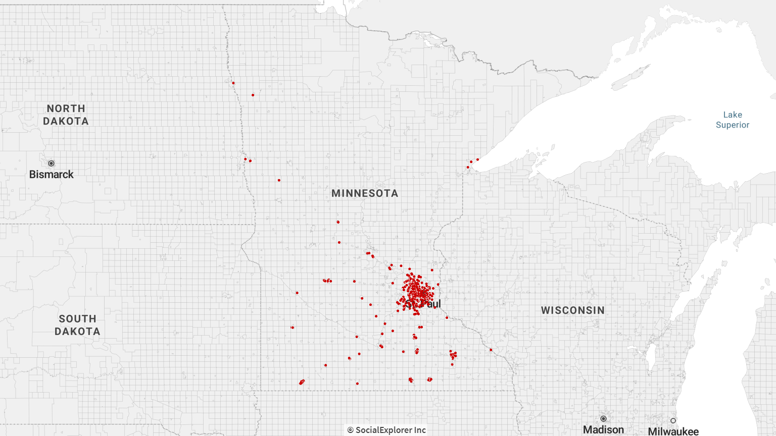
Hispanic/Latino Population, 2015-2019
Each dot represents 500 people
Source: Social Explorer, American Community Survey data 2015-2019

Slide 10
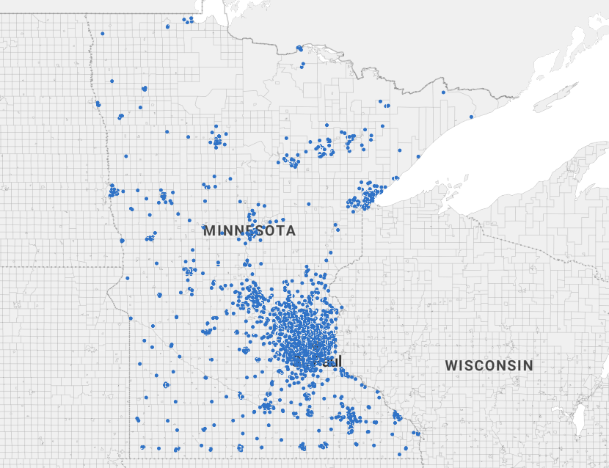
White non-Hispanic Population, 2015-2019
Each dot represents 500 people
Source: Social Explorer, American Community Survey data 2015-2019

Slide 11
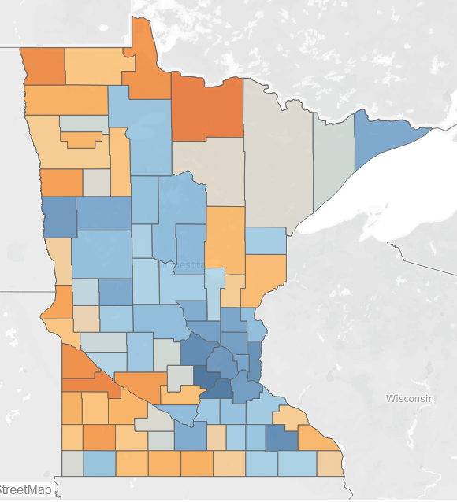
Percent Change, Total Population, 2010-2020
Largest Gains (Percentage)
Largest Losses (Percentage)
Source: U.S. Census Bureau, 2010 and 2020 Censuses

Slide 12
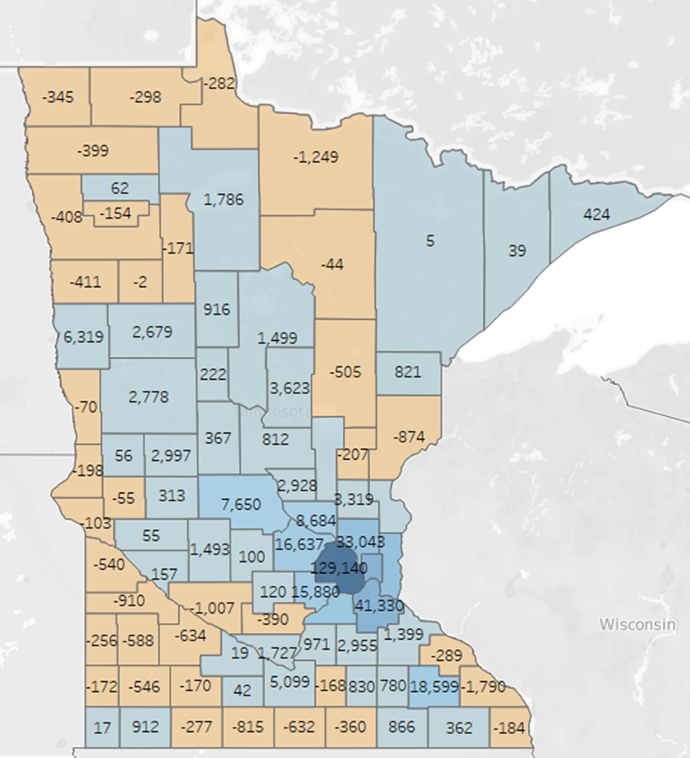
Numeric Change, Total Population, 2010-2020
Largest Gains (Numeric)
Largest Losses (Numeric)
Source: U.S. Census Bureau, 2010 and 2020 Censuses

Slide 13
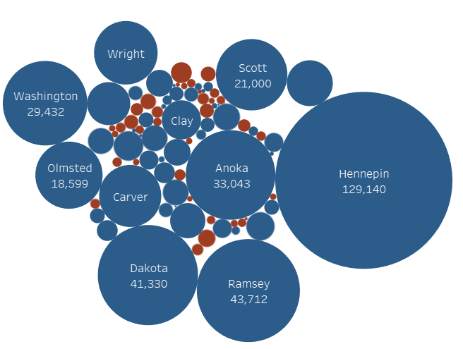
Population change by county (numeric), 2010-2020
51 counties gained population.
36 counties lost population.
The 7-county Twin Cities metro added 313,537 people, 78% of the state’s growth.
Source: U.S. Census Bureau, 2010 and 2020 Censuses

Slide 14
Minnesota’s fastest growing cities, 2010-2020
Rank | City | Population added 2010-2020
1 | Minneapolis | 47,376
2 | St. Paul | 26,459
3 | Rochester | 14,626
4 | Lakeville | 13,536
5 | Woodbury | 13,141
6 | Blaine | 13,036
7 | Brooklyn Park | 10,697
8 | Plymouth | 10,450
9 | Maple Grove | 8,686
10 | Apple Valley | 7,290
11 | Bloomington | 7,094
12 | Shakopee | 6,622
13 | Moorhead | 6,440
14 | Otsego | 6,395
15 | Savage | 5,554
16 | Edina | 5,553
17 | Mankato | 5,179
18 | Prior Lake | 4,821
19 | St. Louis Park | 4,760
20 | Rogers | 4,698
Source: U.S. Census Bureau, 2010 and 2020 Censuses

Slide 15
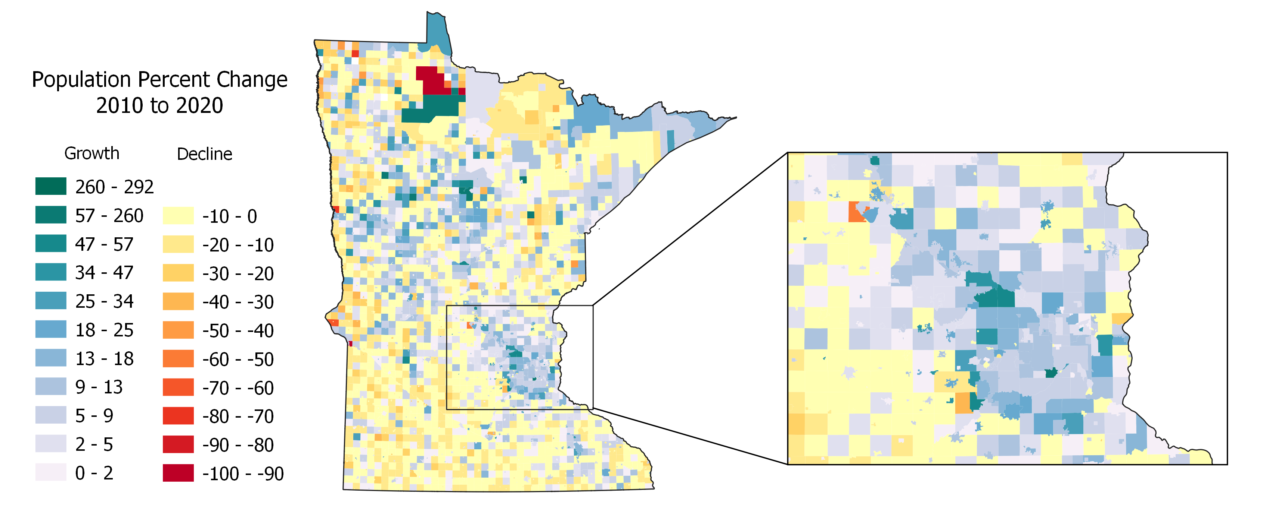
Change in Total Population by City and Township (Percent), 2010-2020
Source: U.S. Census Bureau, 2010 and 2020 Censuses

Slide 16
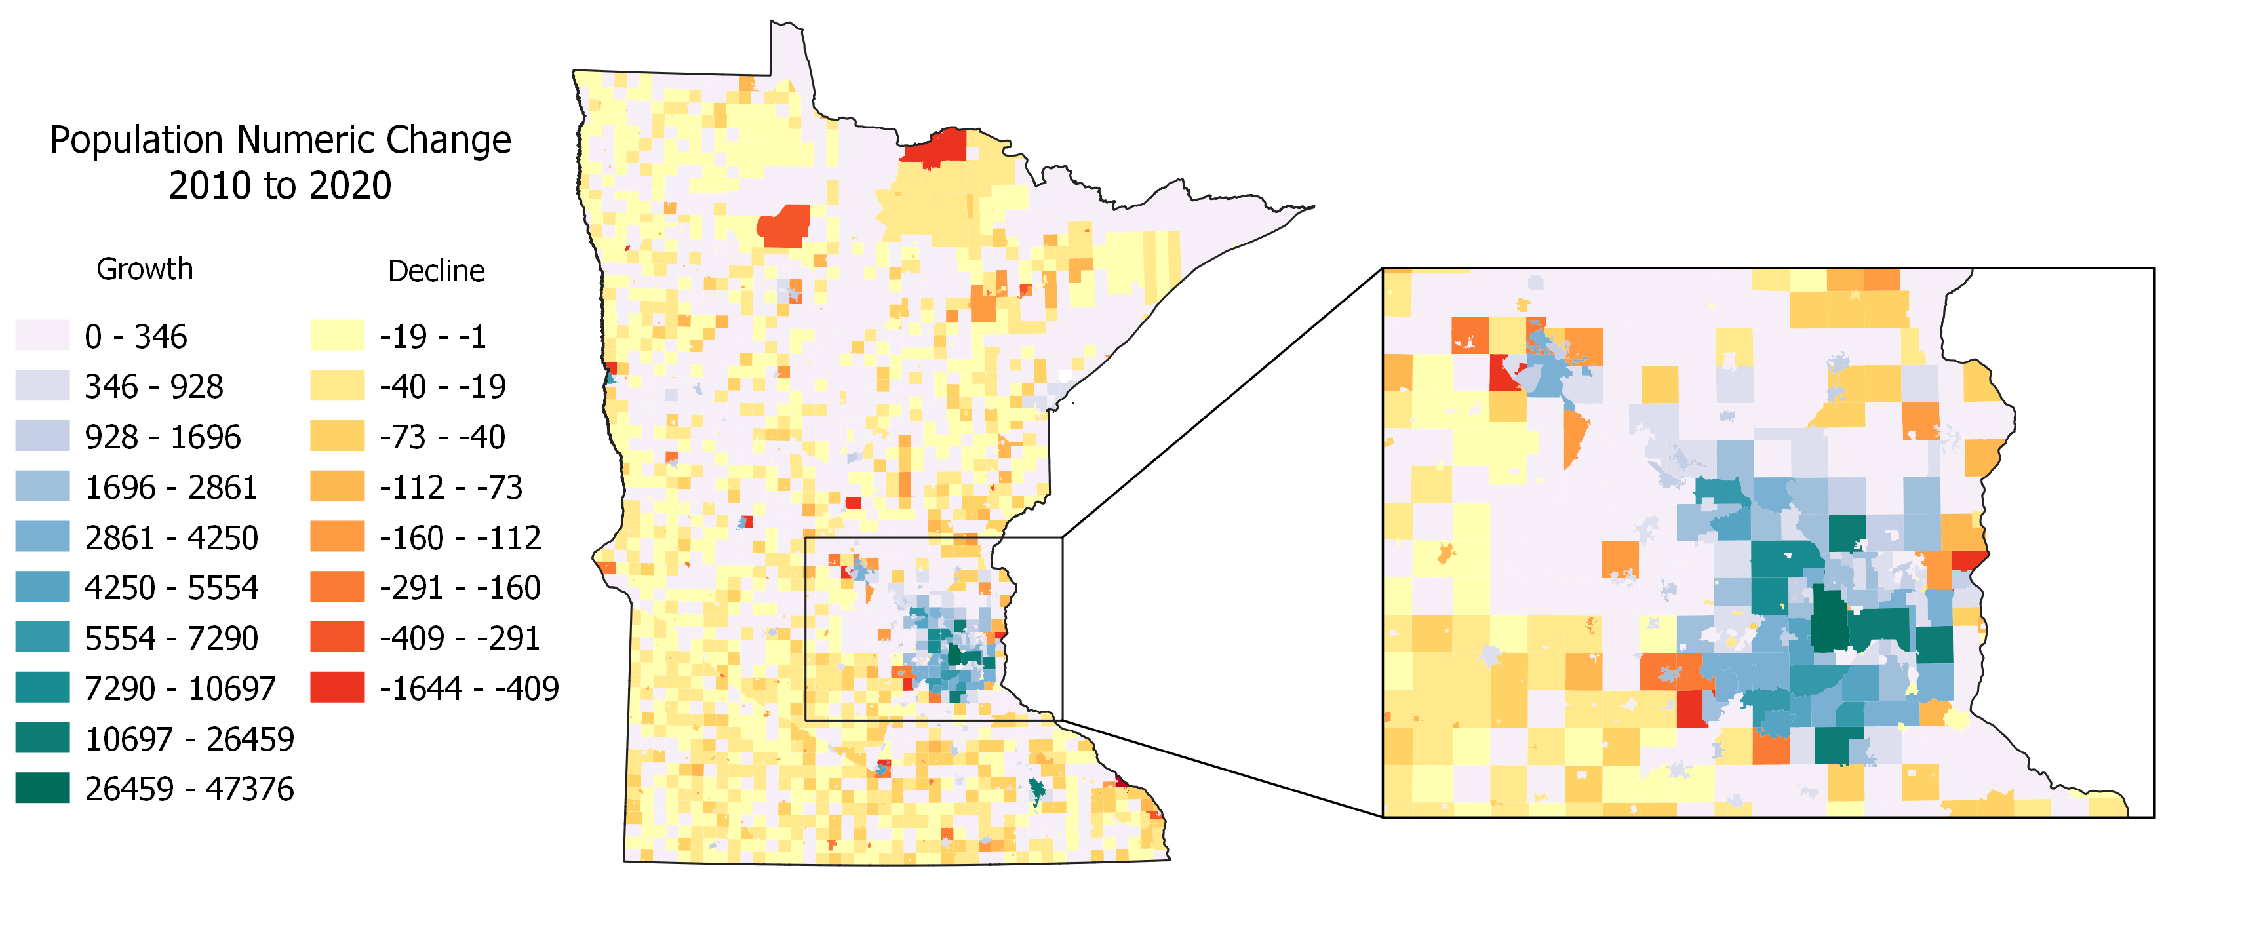
Change in Total Population by City and Township (Numeric), 2010-2020
Source: U.S. Census Bureau, 2010 and 2020 Censuses

Slide 17
Growth in Minnesota’s U.S. Congressional Districts
Ideal population size
2020: 713,312
2010: 662,991
Source: U.S. Census Bureau, 2010 and 2020 Censuses

Slide 18
Change in State Senate Districts, 2010-2020
Ideal population size
2020: 85,172
2010: 79,163
Source: U.S. Census Bureau, 2010 and 2020 Censuses

Slide 19
What is Differential Privacy?
A new method the U.S. Census Bureau has used in the 2020 census data to protect the privacy of individual respondents.
The U.S. Census Bureau has had a longstanding requirement to ensure that the data from individuals and individual households remains confidential.
With the vast amounts of data available and greater computing power available to more people, the Census Bureau now believes that individuals’ characteristics (race, age, location, etc.) provide enough of a re-identification risk that they need to be protected.
Differential Privacy injects “noise”—or random people—into the data so that real information about an individual or household cannot be discerned through database reconstruction and linkage attacks.
Notes:
The problem from privacy perspective, is with every table that is published at very fine geographic levels, the possible ways that data can be arranged to result in the collection of tables becomes more limited. With the vast amounts of computing power and data available, the Bureau believes that malicious actors can reconstruct the confidential dataset and accurately identify a portion of the population.
The Bureau’s internal tests allowed them to simulate this type of exercise and they show that they could accurately identify about 17% percent of respondents when they linked records to data they purchased commercially.

Slide 20
What Data Are Affected?
All published data directly from or derived from the 2020 Census will have differential privacy applied except for a select few items that will remain the same as the actual 2020 Census count.
The items that are NOT affected by DP are:
State Total populations (required for apportionment)
Block level housing unit counts
Block level group quarters unit counts by type
Notes:
Add a note early on that we don’t have the final demonstration data to be able to say exactly what we think the impact are. Explain this is because the Census Bureau has changed its plans about how it will be applied as recently as last month.

Slide 21
What Data Are Affected? (Continued)
Variables that will have noise injected:
All race and ethnicity
Over/under 18 years of age
Location (block)
Status of housing units (occupied/vacant)

Slide 22
Impact of Differential Privacy on Congressional Districts (2010)
Source: NHGIS Privacy Protected Microdata File, University of Minnesota, from U.S. Census Bureau data

Slide 23
Impact of Differential Privacy on House Legislative Districts (2010)
Source: NHGIS Privacy Protected Microdata File, University of Minnesota, from U.S. Census Bureau data

Slide 24
A note about census blocks
Census blocks are the basic geographic units from which political districts and other geographies are built.
Blocks range in size from 0 to 3,011 people.
~260,000 blocks in Minnesota.
The accuracy of census blocks that have been made differentially private is very, very low.

Slide 25
Examples of DP-protected census blocks
 | Ramsey Co. Census Tract 407.05, Block 1008 |  |  |  |  | Hennepin Co. Census Tract 1048, Block 4000
 | 2010 Summary File | 2010 Differentially Private Data | Difference |  |  | 2010 Summary File | 2010 Differentially Private Data | Difference
White NH | 34 | 39 | 5 |  | White NH | 79 | 76 | -3
Black NH | 8 | 2 | -6 |  | Black NH | 2,644 | 2,640 | -4
Hispanic/Latino | 10 | 0 | -10 |  | Hispanic/Latino | 93 | 98 | 5
Asian NH | 0 | 5 | 5 |  | Asian NH | 183 | 185 | 2
Am. Indian NH | 3 | 0 | -3 |  | Am. Indian NH | 3 | 5 | 2
Pacific Islander NH | 0 | 0 | 0 |  | Pacific Islander NH | 0 | 0 | 0
Other Race NH | 0 | 0 | 0 |  | Other Race NH | 0 | 1 | 1
Two or more races NH | 0 | 2 | 2 |  | Two or more races NH | 9 | 38 | 29
Total | 55 | 48 | -7 |  | Total | 3,011 | 3,043 | 32

Slide 26
Thank you
Email: susan.brower@state.mn.us
General questions can be directed to: demography.helpline@state.mn.us
Website: mn.gov/demography

