Slide 1
101
OVERVIEW
PRIORITIES
UNITS
BUDGET
MINNESOTA NATIONAL GUARD
Department of Military Affairs

Slide 2
GUARD 101 CONTENTS
01
02
OVERVIEW
PRIORITIES
03
04
UNITS
Budget and Impact
OVERVIEW
PRIORITIES
UNITS
BUDGET
Minnesota
National Guard
People, Modernization
and Partnerships
Major Subordinate Commands
Current and Ongoing

Slide 3
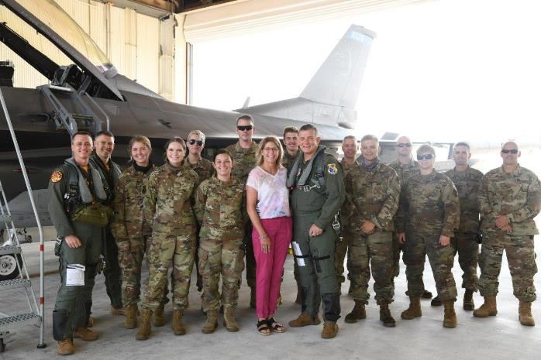
01
OVERVIEW OF THE MINNESOTA NATIONAL GUARD
OVERVIEW
PRIORITIES
UNITS
BUDGET

Slide 4
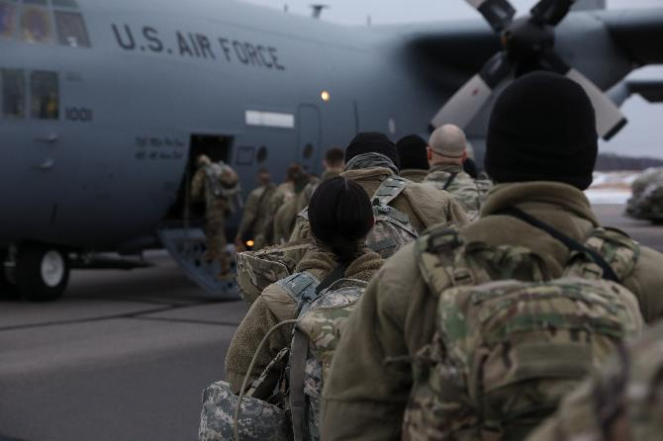
13,000 SOLDIERS & AIRMEN
OVERVIEW
PRIORITIES
UNITS
BUDGET
Soldiers and Airmen, from communities across the state of Minnesota, serve in a variety of full and part-time roles and stand ready to support a wide range of global and state missions.

Slide 5
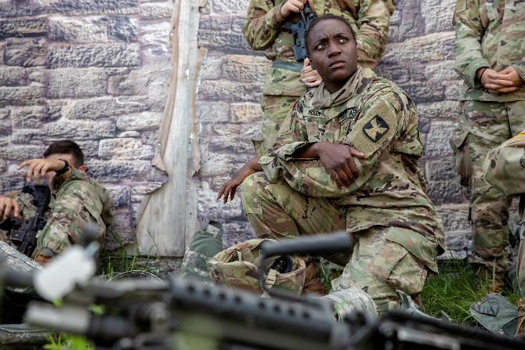
DUAL MISSION
OVERVIEW
PRIORITIES
UNITS
BUDGET
+
Members of the Minnesota National Guard swear an oath to both the President of the United States and the Governor of Minnesota. So, we have both a federal mission and a state mission.

Slide 6
Leadership
OVERVIEW
PRIORITIES
UNITS
BUDGET
TAG
MG Manke
(State Military)
Director, Joint Staff
(Federal Military)
Executive Director
(State Civilian)
ARNG Units
(Federal Military)
Camp Ripley Training Center
ANG Units
(Federal Military)
ARNG Staff Element
Army Manning,
Army Training,
Army Logistics,
Communications & Army Network Support
(Federal Mil/Civ)
Joint Staff Element
Support to Civil Authorities, Domestic Operations &Plans, Intelligence, Joint Logistics, Legal Oversight, Human Resources (Federal Mil/Civ)
ANG Staff Element
AF Manning
AF Training, AF Logistics,
Communications and Network Support (Federal Mil/Civ)
Sustainment
Finance, HR, Payroll , Military Incentives, P & C, Internal Audit, Safety & Health, Quartermaster,
MSABC
State Mil/Civ)
Operations
Military Outreach,
Support to Military Operations, Quartermaster, Plans, Facility Security, Fire Protection, ATFP, ESS, Air Traffic
(State Mil/Civ)

Slide 7
Full Time Staff
OVERVIEW
PRIORITIES
UNITS
BUDGET
Full Time Staff
Citizen Soldiers and Airmen
State
Employees
+
Federal
Army National Guard
Full Time Staff are only a small portion of the overall Minnesota National Guard They enable the readiness of the units and equipment.
Federal
Air National Guard
= 100

Slide 8
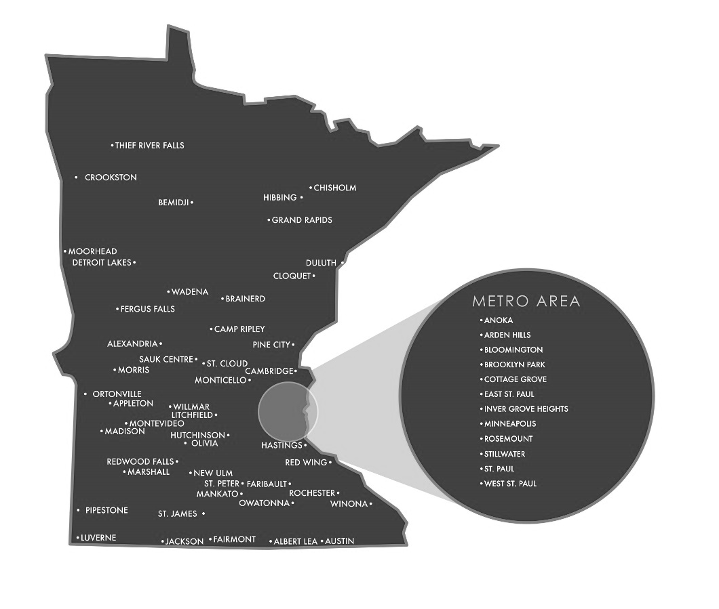
LOCATED ACROSS MINNESOTA
OVERVIEW
PRIORITIES
UNITS
BUDGET
The Minnesota National Guard operates out of facilities in more than 50 communities throughout our state. We are continually optimizing the physical capabilities at each location to meet mission requirements and enhance local community partnerships.

Slide 9
OVERVIEW
PRIORITIES
UNITS
BUDGET
Citizen-Soldiers and Airmen capable of fighting our nation’s wars, protecting our country, and responding to our state’s emergencies while remaining the most trusted institution in Minnesota.
— MN NATIONAL GUARD VISION

Slide 10
OVERVIEW
PRIORITIES
UNITS
BUDGET
02
PRIORITIES OF THE MINNESOTA NATIONAL GUARD

Slide 11
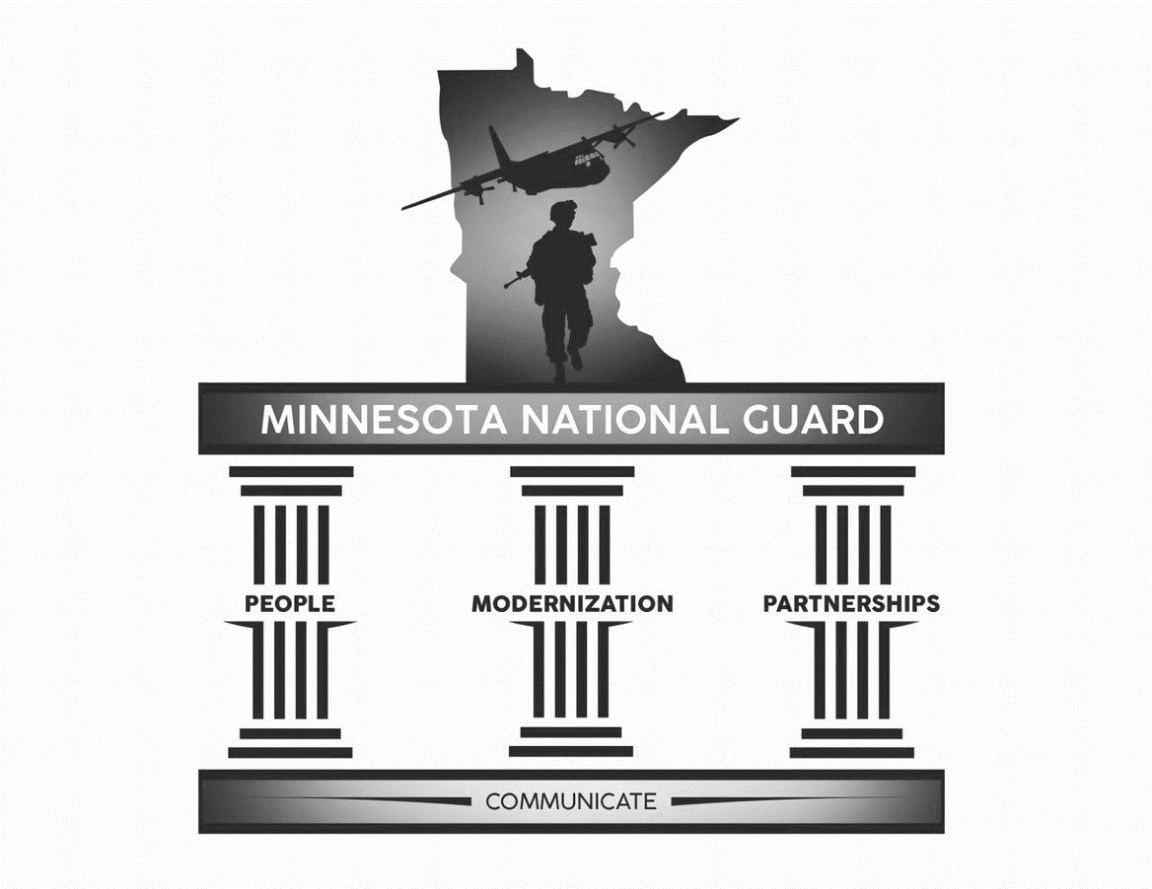
OVERVIEW
PRIORITIES
UNITS
BUDGET
OUR PRIORITIES
+ Lines of Effort
PEOPLE
MODERNIZATION
PARTNERSHIPS
Enabling
People and
Enabling Units
Optimizing
Capabilities and
Securing the Force
Relationships that Support and Communicate our Story

Slide 12
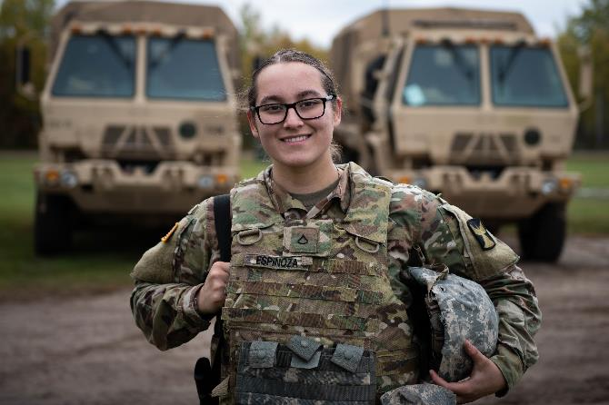
PEOPLE
OVERVIEW
PRIORITIES
UNITS
BUDGET
People are at the center of any successful organization. Investment in our Soldiers, Airmen, and civilian employees give our organization the means to tackle the challenges our state and nation face and promote the value of choosing to serve as citizen-Soldiers and Airmen.

Slide 13
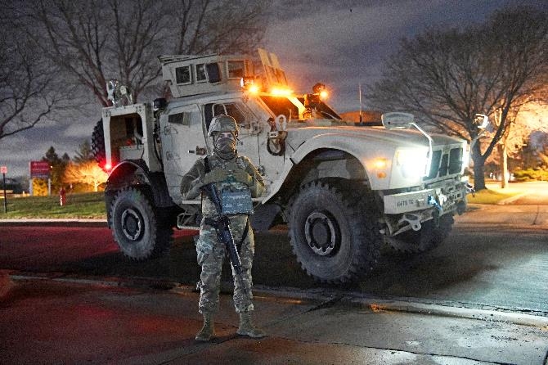
MODERNIZATION
OVERVIEW
PRIORITIES
UNITS
BUDGET
Modernization ensures we have the right forces, infrastructure, training spaces, and systems for our current and future missions. As our challenges and adversaries change, we require forces, equipment, and training to ensure our state and national security.

Slide 14
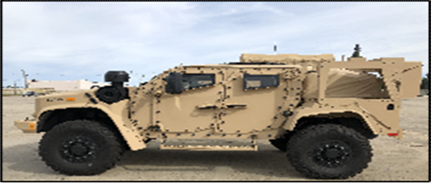
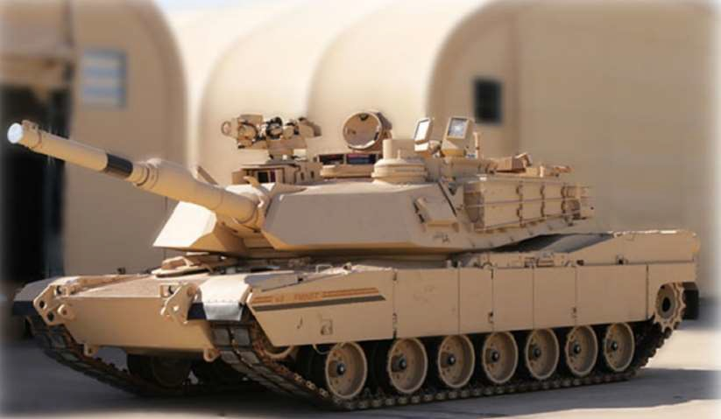
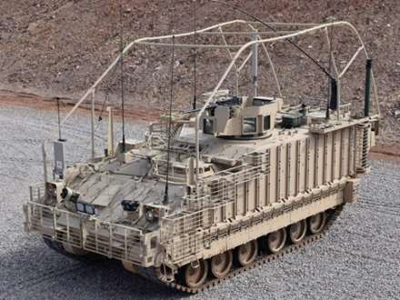
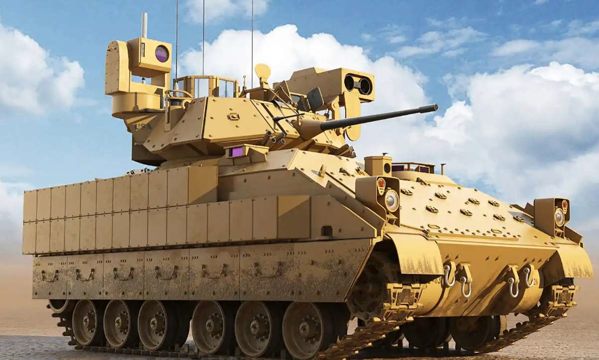
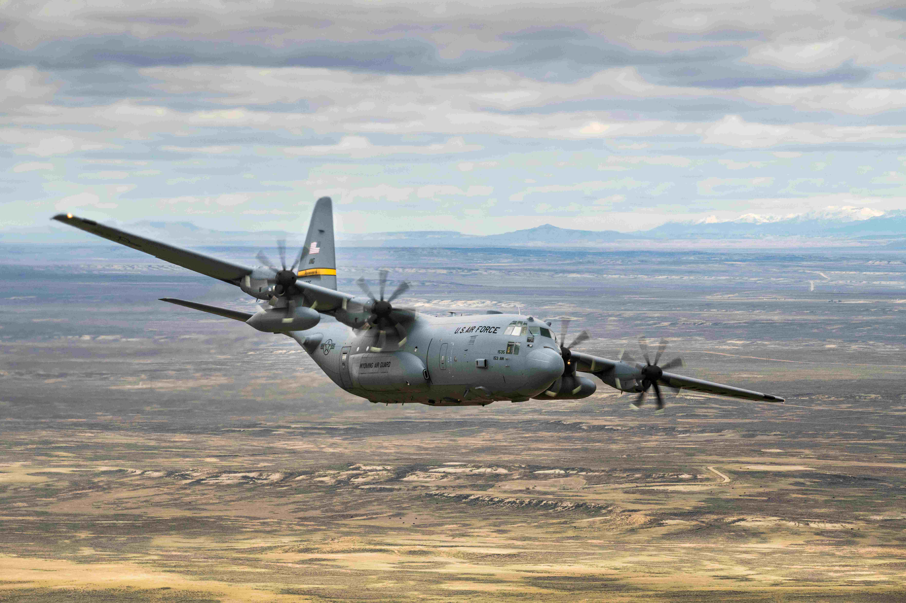
OVERVIEW
PRIORITIES
UNITS
BUDGET
$2.443 Billion Federal Investment in Modernization
Platform | Joint Light Tactical Vehicle (JLTV) | Abrams M1A2 SEPv3 Main Battle Tank | Armored Multi-Purpose Vehicle (AMPV) | M2A3 Bradley Fighting Vehicle (BFV) | C-130J Super Hercules
Quantity | 345 (304-MN, 41-Ohio) | 87 (58-MN, 29-Ohio) | 131 | 138 (117-MN, 21-Ohio) | 8
QTY Received (as of 4 Jan) | 265 (41 Ohio, 224 MN) | 0 | 0 | 36 (MN) | 0
Cost/Item | $290K - $306K | $4.9 million | $3.1 million | $4.4 million (M2A3) | $112.5 million
Variants | GP, Utility, Heavy Gun Carrier | N/A | MC, GP, Med Evac, Med Treatment, Mortar Carrier | M2A3 BFV (125) / M3A3 BFIST (13) | GP
Fielding Timeframe | Complete | Q2 FY25 - Q1 FY26 (TBD) | Q3 FY25 | Complete | FY26-28
System | Cost/Item | Quantity
C-130J | $ 112,500,000 | 8 | $ 900,000,000
M1 Abrams Main Battle Tank | $ 4,900,000 | 87 | $ 426,300,000
M2 Bradley Infantry Fighting Vehicle | $ 4,400,000 | 138 | $ 607,200,000
Joint Light Tactical Vehicle | $ 300,000 | 345 | $ 103,500,000
Armored Multi-Purpose Vehicle (AMPV) | $ 3,100,000 | 131 | $ 406,100,000
 |  |  | $ 2,443,100,000

Slide 15
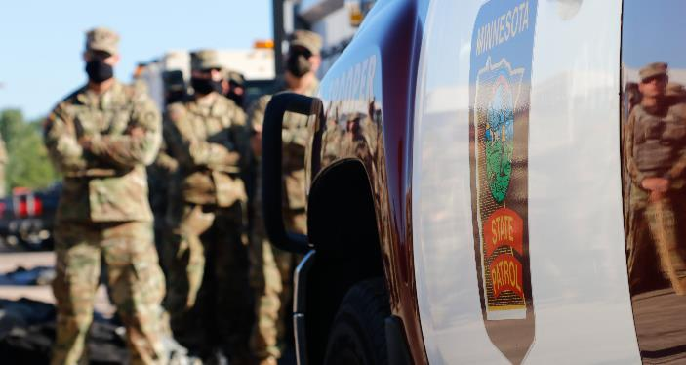
PARTNERSHIPS
OVERVIEW
PRIORITIES
UNITS
BUDGET
We value relationships with a wide range of partners, including local community groups, state agencies and civil authorities, national departments and institutions, and international organizations and allies. We strive to foster relationships that help us to better serve our communities, state, and nation.
PARTNER ORGANIZATIONS
...AND MANY MORE.

Slide 16
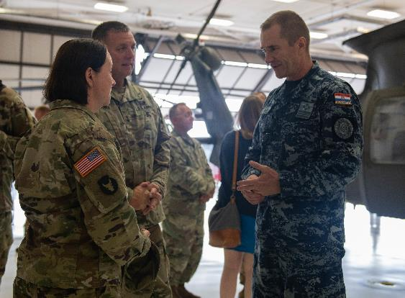
OVERVIEW
PRIORITIES
UNITS
BUDGET
PARTNERSHIP SPOTLIGHT: CROATIA
State Partnership Program
Since 1996, leaders and members of the Minnesota National Guard and the nation of Croatia have been collaborating and building relationships within the framework of the National Guard Bureau's State Partnership Program (SPP). The SPP, which links a state's National Guard with the armed forces or equivalent of a partner country in a cooperative, mutually beneficial relationship. The program encourages the development of economic, political and military connections between the states and partner nations.

Slide 17
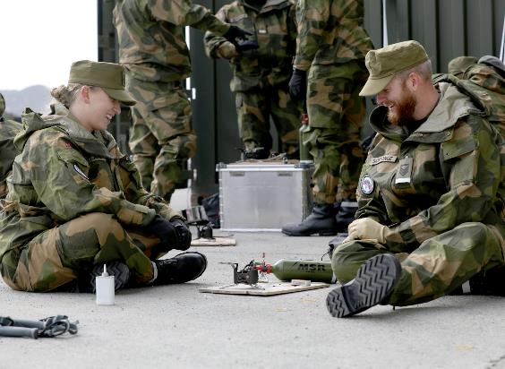
OVERVIEW
PRIORITIES
UNITS
BUDGET
PARTNERSHIP SPOTLIGHT: NORWAY
U.S. - Norway Reciprocal Troop Exchange
and State Partnership Program
The Minnesota National Guard continues to execute the country's longest-running troop exchange with the Norwegian Home Guard, a partnership initiative that started in 1974.
Soldiers and Airmen trade places to experience each other’s training, military lifestyle and culture.
The exchange, a tradition spanning nearly five decades, reinforces the positive working relationships between allied services and highlights the strong lineage many Minnesotans share with the Scandinavian culture.

Slide 18
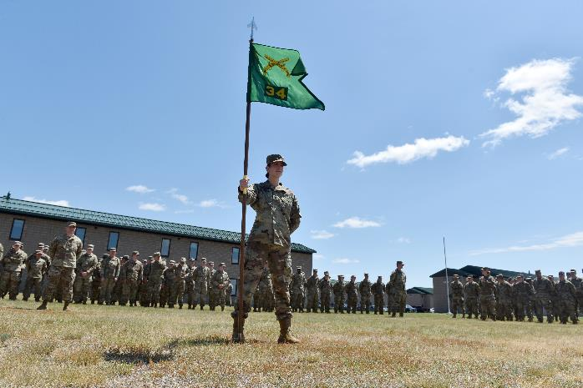
03
UNITS OF THE MINNESOTA NATIONAL GUARD
OVERVIEW
PRIORITIES
UNITS
BUDGET

Slide 19
OVERVIEW
PRIORITIES
UNITS
BUDGET
MAJOR SUBORDINATE COMMANDS
Joint Force
Headquarters
Camp Ripley
Training Center
133rd
Airlift Wing
148th
Fighter Wing
34th Red Bull
Infantry Division
1st Armored Brigade
Combat Team
34th Expeditionary
Combat Aviation Brigade
347th Regional
Support Group
84th Troop
Command
175th Regional
Training Institute

Slide 20
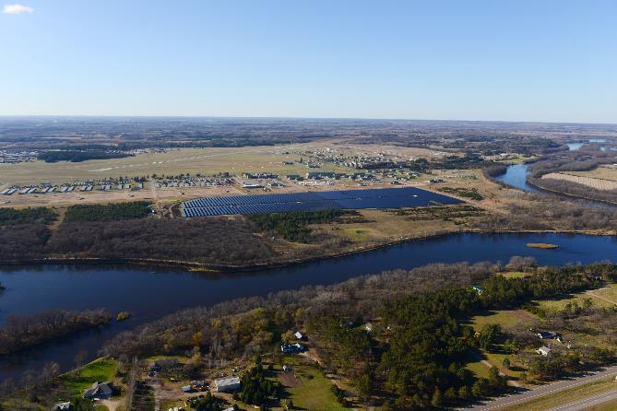
CAMP RIPLEY TRAINING CENTER
OVERVIEW
PRIORITIES
UNITS
BUDGET
Camp Ripley, located near Little Falls, Minnesota, is a 53,000-acre regional training center hosting numerous ranges and state-of-the-art facilities to support the training requirements of military and civilian agencies. The training center provides services, resources, and facilities that empower organizations to conduct essential training. Supporting a wide range of customers, from local law enforcement agencies to all branches of the Department of Defense, Camp Ripley is a primary training facility for Minnesota National Guard units.

Slide 21
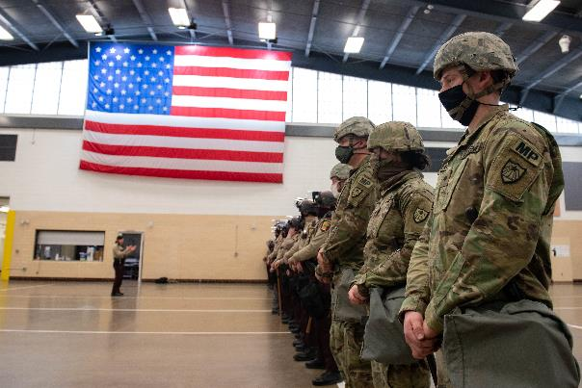
OVERVIEW
PRIORITIES
UNITS
BUDGET
THE DEPARTMENT OF MILITARY AFFAIRS
The Department of Military Affairs (DMA) is the state agency that oversees and supports the military operations of the Minnesota National Guard when it is operating under state control by the authority of title 32, U.S. Code.
HEADQUARTERS
Saint Paul, Minnesota
COMMISSIONER
Maj. Gen. Shawn Manke
EXECUTIVE DIRECTOR
Don Kerr
EMPLOYEES
350 Employees

Slide 22
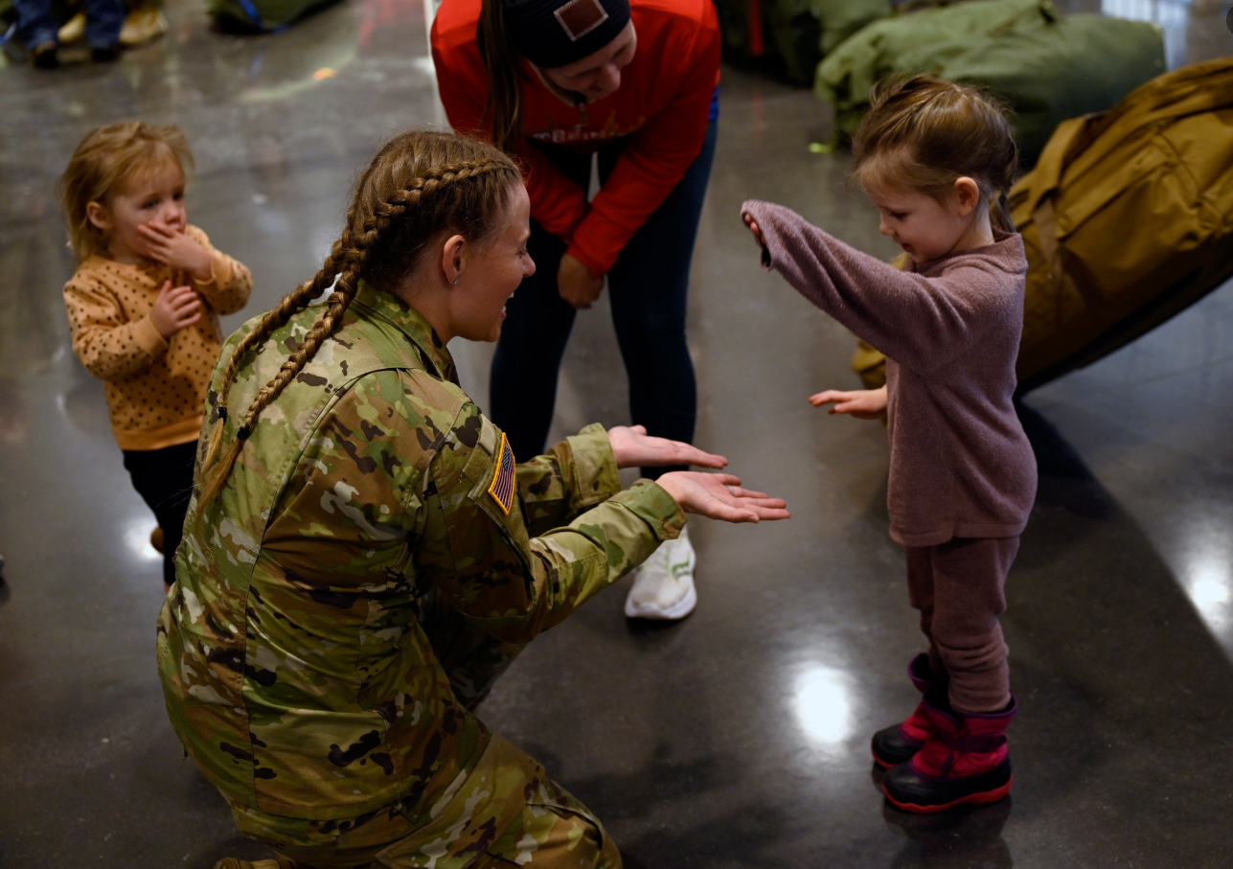
OVERVIEW
PRIORITIES
UNITS
BUDGET
34th Infantry Division Deployment
More than 550 Soldiers of the 34th ID “Red Bulls” deployed to the Middle East for a 10-month rotation.
Soldiers come from more than 200 communities throughout Minnesota, Iowa, Wisconsin, North and South Dakota, and several other states.
The 34th Infantry Division Headquarters provided command and control of Task Force Spartan from Kuwait, deployed across seven partner nations.

Slide 23
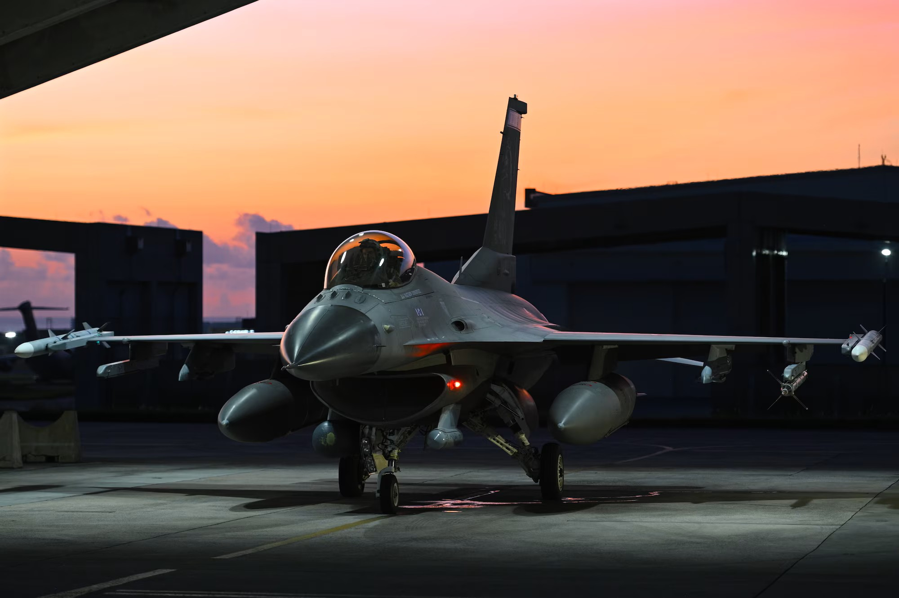
OVERVIEW
PRIORITIES
UNITS
BUDGET
148th Fighter Wing Deployment
Members and F-16 Fighting Falcons assigned to the 148th Fighter Wing, Minnesota Air National Guard deployed to the 18th Wing at Kadena Air Base, Okinawa, Japan from July to October 2024.
The 148th Fighter Wing provided a dynamic force employment package to the 18th Wing to provide combat air power adding an additional deterrence factor to the area of operations.

Slide 24
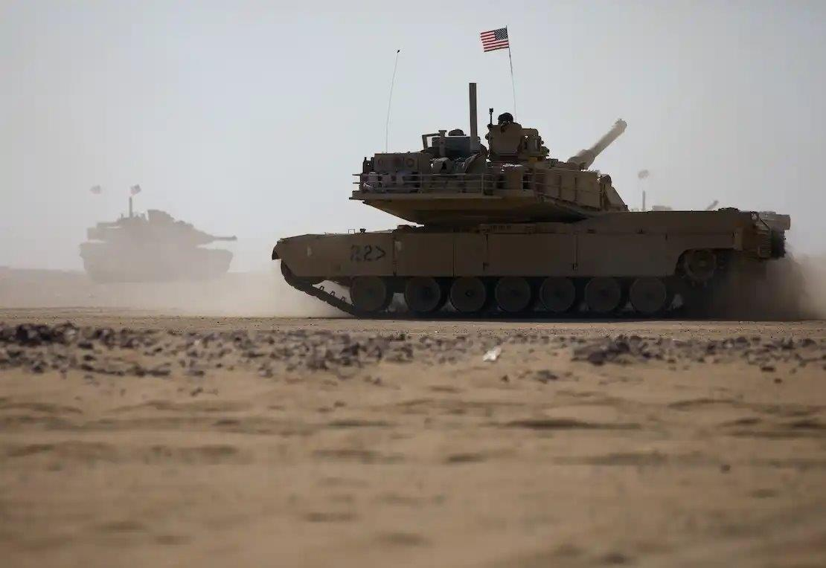
OVERVIEW
PRIORITIES
UNITS
BUDGET
Future Deployments
34th MP Company (159 Soldiers) to Kuwait – January 2026
434th Chem Company (148 Soldiers) to Kuwait – October 2026
1/34 ABCT Task Force #1 (1128 Soldiers) to Kuwait – July 2027
1/34 ABCT Task Force #2 (1128 Soldiers) to Kuwait – April 2028
Multiple smaller deployments and individual augmentees spread throughout the next five years.

Slide 25
State Active Duty History
OVERVIEW
PRIORITIES
UNITS
BUDGET
2006
Flood fight
Wildfire suppression 1,282
2007
Fire operations in Boundary Waters Canoe Area
Southern Minnesota Blizzard
UND Plane Crash Recovery
Flood fight in southern Minnesota 1,091
2008
Winter Storm
Search for Body in Lake Mille Lacs 40
2009
Flood response
Support for Presidential Inauguration 14,546
2010
Flood response in Red River Valley and Southern MN
Fire Operations in Northern Minnesota 3,976
2011
Flood fight in RRV, North & South Dakota Support
Tornado in Minneapolis, Search Mission in Duluth 6,808
2012
Flood response in Duluth
Fire Operations in Northern Minnesota 143
2013
Winter Storm Response
Fire Operations in Northern Minnesota 96
2014
Winter Storms in Albert Lea, Olivia and Owatonna
Flood response in Sibley and Koochiching Counties 130
2015
Winter storm support
Wildfire response in state and EMAC to Washington
Avian Influenza response 469
2016
Wildfire response Hubbard and St. Louis counties 88
2017
Hurricane Support - Texas, Florida, Puerto Rico
Super Bowl 52 4,931
2018
Flood Response & Winter Storm Response 143
2019
Flood Response & Winter Storm Response 913
2020 Civil Unrest
COVID Response 82,912
2021
Operation Safety Net
COVID Response 59,497
2022
Flood Response – International Falls and Red River Valley
Flood EMAC to North Dakota 3,392
2023
Winter Storm Response 34
2024
BWCA Search and Rescue Support
Republican National Convention – Wisconsin EMAC
SW Minnesota Floods
Hurricanes Helene and Milton (NC/FL EMAC) 2,280

Slide 26
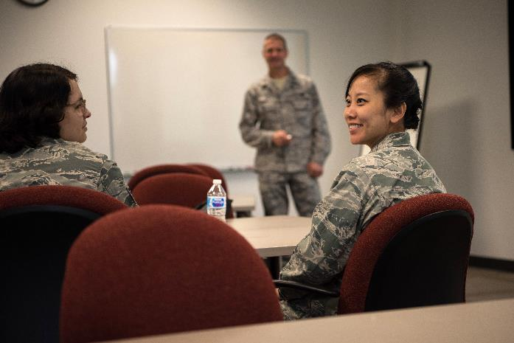
OVERVIEW
PRIORITIES
UNITS
BUDGET
04
Budget and Financial Impact

Slide 27
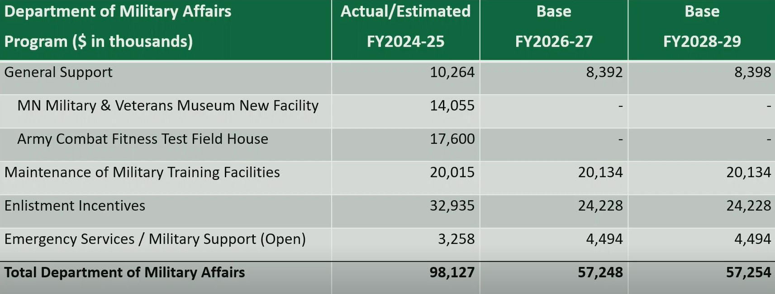
OVERVIEW
PRIORITIES
UNITS
BUDGET
General Fund Summary

Slide 28
OVERVIEW
PRIORITIES
UNITS
BUDGET
2026-2027 Budget Request
Enlistment Incentives:
Request a $2M increase in SFY2026 and a $6M increase in SFY2027 to support State Tuition Reimbursement and for costs incurred for the State Reenlistment Bonuses.
General Support:
Cyber Coordination Cell:
Request a $353k increase in SFY2026 and $397k increase in SFY2027 to sustain the Cyber Coordination Cell.
Holistic Health and Fitness:
Request a $800k increase in SFY2026 to sustain the Holistic Health and Fitness team. It is anticipated that the federal government will begin to fund the program during SFY2027.
Operating Adjustment:
Request a $198k increase in SFY2026 and $401k increase in 2027 to sustain operating increases at the Department of Military Affairs.

Slide 29
OVERVIEW
PRIORITIES
UNITS
BUDGET
2026-2027 Budget Request
Appropriations: SFY2026 SFY2027
Total Appropriation: $30,025,000 $33,478,000
Maintenance of Training Facilities $10,067,000 $10,067,000
General Support $5,544,000 $4,997,000
Enlistment Incentives: $14,114,000 $18,114,000
Emergency Services: $300,000 $300,000

Slide 30
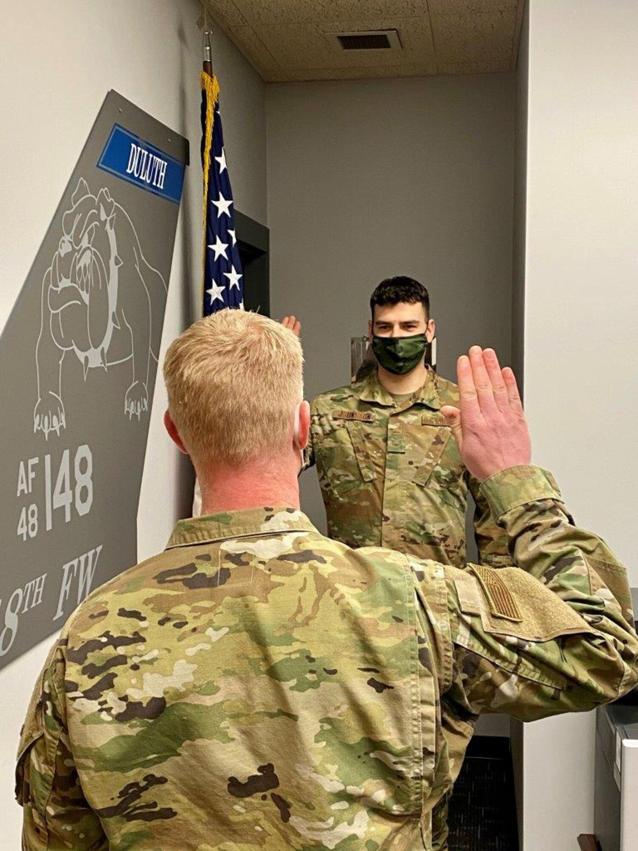
OVERVIEW
PRIORITIES
UNITS
BUDGET
Incentives
The Governor recommends additional funding for the Department of Military Affairs Enlistment Incentives program. This funding will go toward state tuition reimbursement and enlistment incentives for service members.
Current programs include:
State Tuition Reimbursement
State Reenlistment Bonus (expanded on next slide)
Reclassification Bonus
Medic Recertification Bonus

Slide 31
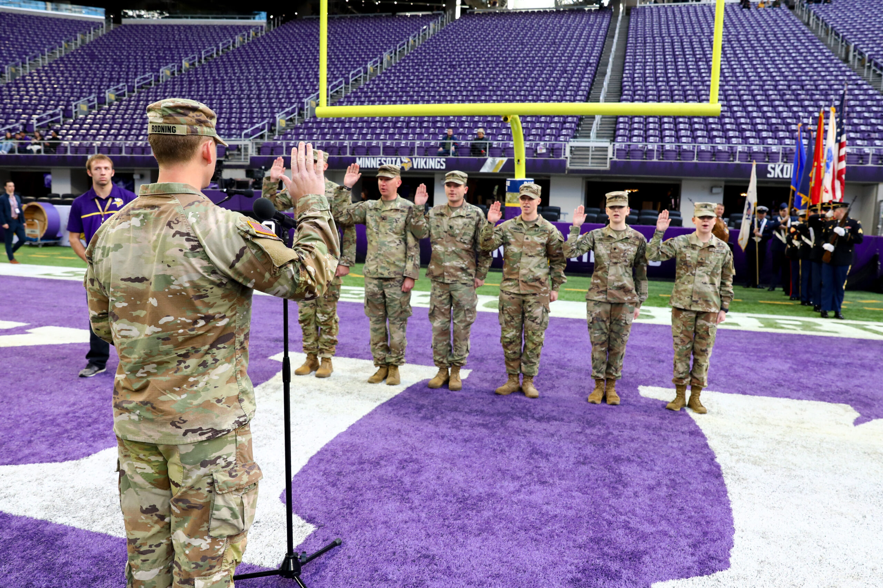
OVERVIEW
PRIORITIES
UNITS
BUDGET
State Reenlistment Bonus (SRB)
Bonus Type | SFY22 | SFY23 | SFY24 | SFY25
3yr – ANG | 0 | 0 | 9 | 14
4yr – ANG | 1 | 12 | 2 | 0
6yr – ANG | 28 | 196 | 202 | 34
3yr – ARNG | 0 | 0 | 264 | 114
4yr - ARNG | 7 | 75 | 40 | 0
6yr - ARNG | 113 | 552 | 524 | 121
TOTAL per SFY | 149 | 835 | 1041 | 283
Notes:
All numbers as of 31 October 2024.
3 Year - $4,500
4 Year – $6,000
6 Year - $15,000

Slide 32
OVERVIEW
PRIORITIES
UNITS
BUDGET
Cyber Coordination Cell (C3)
National programming for National Guard units do not provide adequate federal manning authorizations to operate and manage a comprehensive Cyber readiness program.
The legislature authorized the creation of the C3 in the SFY2024-2005 biennium. For SFY2026-2027 the program would become a part of the General Support Appropriation.
The C3 has made significant progress in the cyber realm including:
Hired four cyber employees to develop the coordination cell and provide outreach with interface with federal, state, and local resources and cyber teams
Integrated and rehearsed cyber response incorporating the activation of a Cyber Protection Team (CPT) for a state level response with HSEM and MN.IT.
Developed and procured cyber response kits that allow for timely response to an activation
Won several state awards including the “MNIT Team of the Year” for the collaborate work done as part of the Whole of State Cybersecurity plan.

Slide 33
OVERVIEW
PRIORITIES
UNITS
BUDGET
Holistic Health and Fitness (H2F)
H2F is investment in service members long-term health outcomes. Soldiers and Airmen that are ready physically and mentally, are prepared to fight and win our nation’s wars.
H2F covers five domains: physical, mental, nutrition, spiritual, and sleep
H2F is fully implemented in the active component, usually with two dozen or more staff members per army Brigade (~5,000).
Minnesota’s H2F program delivers a range of services including:
Individual fitness, nutritional, and spiritual consultations for all Minnesota National Guard service members
Group courses and clinics focusing on exercise and nutrition
Holistic health education, distributed via individual or group instructions and through videos and apps
DMA maintains five H2F state employees supplemented by two H2F temporary federal positions.
In SFY2027, it is anticipated that the program is funded federally.

Slide 34
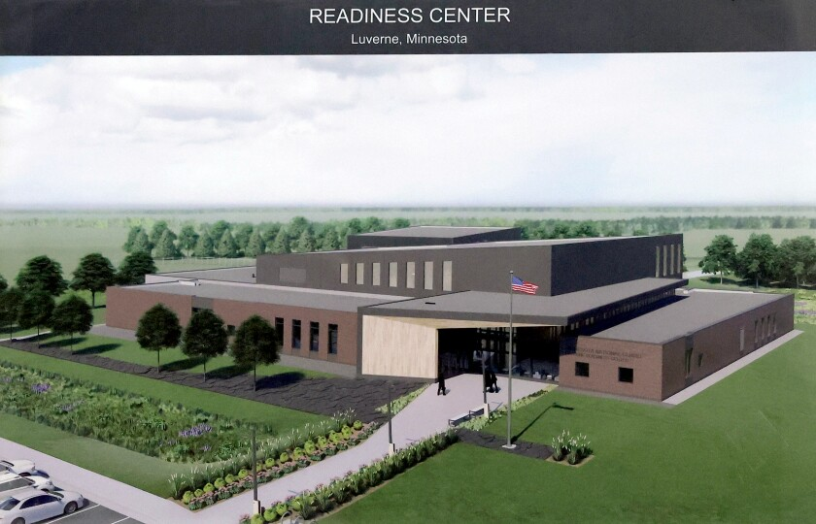
OVERVIEW
PRIORITIES
UNITS
BUDGET
Policy
Increase Minnesota State Armory Building Commission (MSABC) Bonding Authority
The Governor recommends increasing the bonding authority of the MSABC from $15M to $45M. The aim of the increased authority tis to allow the agency to better compete for and match federal funding for armory projects.
New armory projects generally require a 25% state investment. New armories cost between $40-60M. MSABC’s current bonding authority does not allow more than one project every twenty years.

Slide 35
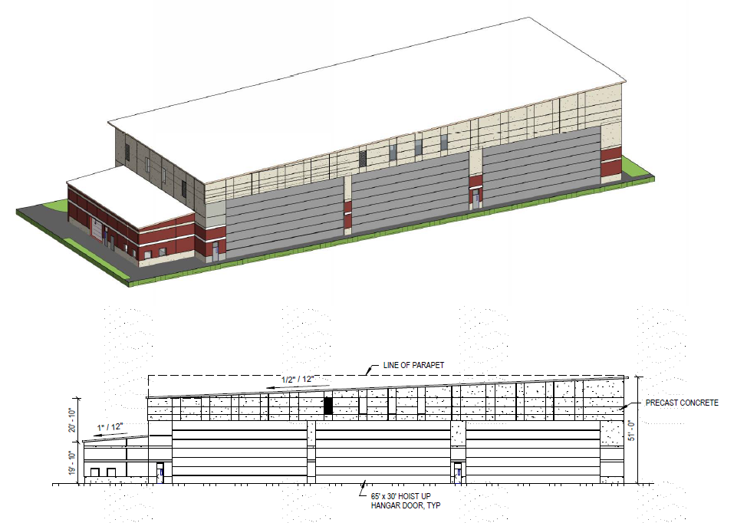
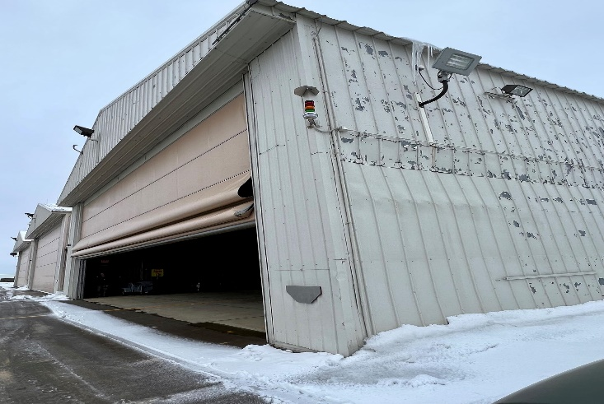
OVERVIEW
PRIORITIES
UNITS
BUDGET
Capital Budget Request
The Governor recommends $3.0M capital funding to design a ready hangar at the 148th Fighter Wing in Duluth, MN. It is anticipated that the federal government will fund the cost of construction of the hangar which is estimated at ~$30M.

Slide 36
THANK YOU
OVERVIEW
PRIORITIES
UNITS
INITIATIVES
from the MINNESOTA NATIONAL GUARD

