Slide 1
Minnesota House of Representatives
Preventing Homelessness
Committee meeting: March 16, 2022
Michelle Decker Gerrard
Study Director

Slide 2
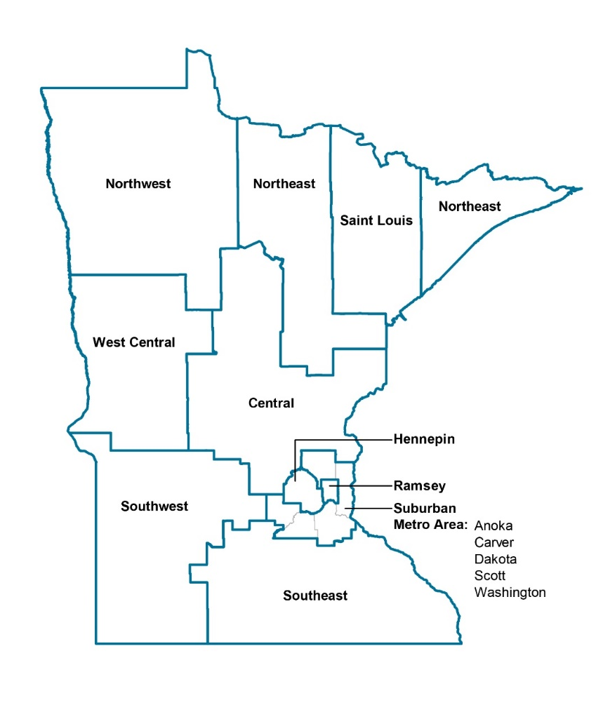
Study background
When?
  Every 3 years since 1991
  Interviews (45 min.)
  Census count
Who?
  In shelter
  Not in formal shelter system
  Companion study in partnership
  with 6 Ojibwe Tribes
Continuum of Care regions
Notes:
Statewide study
2018 had 1200 volunteers, 300+ interview locations in emergency shelters, transitional housing, domestic violence shelters, and outreach (outside or doubled up)
INTERVIEWS: 45-60 minutes, ask about a broad range of topics including housing history, physical health, MH, childhood experiences, systems involvement
COUNTS: Count of all people identified as homeless on October 25th including those interviewed as well as those not.
NUMBERS ARE ALWAYS AN UNDERCOUNT

Slide 3
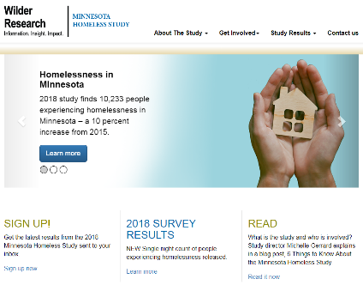
Study background
October 25, 2018
  1,200 volunteers
  400 sites
Reporting
  Data tables
  Reports
Notes:
Statewide study
2018 had 1200 volunteers, 300+ interview locations in emergency shelters, transitional housing, domestic violence shelters, and outreach (outside or doubled up)
INTERVIEWS: 45-60 minutes, ask about a broad range of topics including housing history, physical health, MH, childhood experiences, systems involvement
COUNTS: Count of all people identified as homeless on October 25th including those interviewed as well as those not.
NUMBERS ARE ALWAYS AN UNDERCOUNT

Slide 4
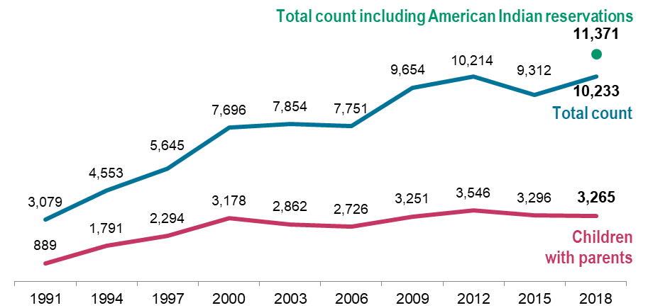
Homelessness in Minnesota
After leveling off in the early 2000s, homelessness in Minnesota has been increasing
Wilder Research, 2018 Statewide Homeless Study count
Notes:
MICHELLE
After a decline between 2012 and 2015, the overall number of people experiencing homelessness increased to peak 2012 levels (up 10% over 2015).
When we add the numbers counted on American Indian Reservations = ADD.

Slide 5
Wilder Research estimates:
Many more people face homelessness than what we can count
on the night of the survey
19,600
people experience homelessness on any given night in Minnesota
… and …
50,600
people experience homelessness during an entire year in Minnesota
Wilder Research, 2018
Statewide Homeless Study estimate

Slide 6
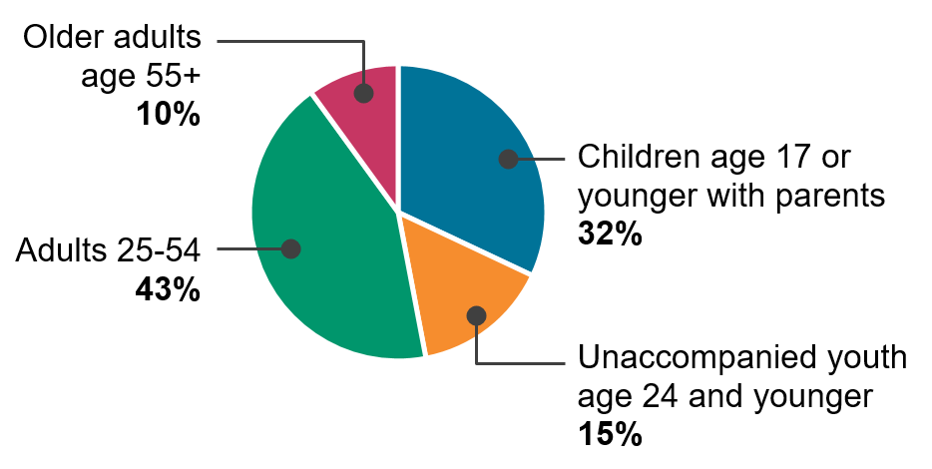
Children and youth make up almost half of our homeless population
Wilder Research, 2018 Statewide Homeless Study count
Notes:
MICHELLE
And older adults are one of our fastest growing populations

Slide 7

Key Findings

Slide 8
Incomes of homeless adults
versus
housing costs
1
There is not enough affordable housing
Median income: $550 per month
Median rent:
$906 per month
Wilder Research, 2018
Statewide Homeless Study survey
HUD, FY2018 Fair Market Rent Documentation System
Notes:
Twin Cities FMR for a 1 bedroom. : 50% are on a waiting list for subsidized housing.

Slide 9
On wait list for
subsidized housing
1
50%
of homeless adults
There is not enough affordable housing
No housing they can afford
56% of homeless adults
(this is the highest among 12 reasons they were asked about)
Wilder Research, 2018
Statewide Homeless Study survey
Notes:
MICHELLE

Slide 10
2
62% increase over 2015
32% of adults turned away from a shelter in the last 3 months due to lack of space
More people staying outside of a formal shelter setting
Wilder Research, 2018
Statewide Homeless Study survey
Notes:
NOTE: The numbers dropped in 2015; it’s a 21% increase from 2012
Cite the numbers who had spent time outside in the past 30 days.

Slide 11
2
Spent more than 1 week outside
in past month
27% of adults compared to 18% in 2015
22% of youth (age 24 and younger)
Spent more than 1 week doubled-up in past month
17% of adults compared to 16% in 2015
38% of youth (age 24 and younger)
More people staying outside of a formal shelter setting
Wilder Research, 2018
Statewide Homeless Study survey

Slide 12
Chronic health conditions of homeless adults
3
Many homeless people face obstacles to getting & keeping housing
Serious mental
illness
(64%)
Chronic health
conditions
(57%)
Substance abuse disorder
(24%)
Any of these conditions: 81%
Multiple conditions: 50%
All three: 14%
Wilder Research, 2018
Statewide Homeless Study survey
Notes:
MICHELLE
CH&MI – 28%
Youth: 64% Mental, 39% physical, and 16% substance (71% any)

Slide 13
3
Many homeless people face obstacles to getting & keeping housing
37% of women left
their last housing
because of abuse
Wilder Research, 2018
Statewide Homeless Study survey
Notes:
MICHELLE
This has steadily increased in the past several studies
Mention other violence and exploitation.

Slide 14
Age first homeless by ACE
4
Average age if ACE present
Overall average age (27.6)
Average age if ACE not present
Homelessness is often preceded by childhood trauma and abuse
Wilder Research, 2018
Statewide Homeless Study survey
Notes:
About half of homeless adults have experienced 3 or more Adverse Childhood Experiences.
Homeless adults who experience childhood trauma or abuse are younger when they first experience homelessness
Adults (18 or older)
Youth (24 or younger)
At least one ACE
73%
84%
Three or more ACEs
46%
59%
Parent abused alcohol
or drugs
52%
61%
Witnessed abuse in home
51%
60%
Parent with mental
health issues
43%
59%
Experienced physical abuse
42%
48%
Experienced sexual abuse
28%
31%
Experienced neglect
22%
31%
Parent served time in prison
20%
41%

Slide 15
5
There are ripple effects from discriminatory practices
Wilder Research, 2018
Statewide Homeless Study survey
Notes:
000000000000000.6MICHELLE
This is also true in 2018
When we see inequitable outcomes, we must look at the systems.
We must look at the underlying infrastructure that has made it easier for White residents to have enough money to put food on the table, and more difficult for BIPOC residents. The long-lasting impacts of racism and discriminatory policies that disadvantage BIPOC communities have led to differences in opportunities for education, employment, homeownership, and wealth generation. For example:
Racial covenants in the first half of the 20th century, preventing non-White Minnesotans from purchasing homes in specific neighborhoods, significantly limited homeownership and wealth creation for Minnesotans of color. These policies also concentrated residents of color into specific neighborhoods, promoting further disinvestment.
Policies such as the GI Bill and several New Deal programs created new economic opportunities for White Americans that were not fully available to communities of color.
Welfare reform policies in the 1990s placed new immigration restrictions on who was eligible for SNAP, and undocumented immigrants have always been excluded from the program.
Today we continue to see impacts of these policies. As of 2018, the average household income for White residents was $71,400 compared to $48,000 for residents of color. Likewise, 20% of Minnesotans of color lived below the poverty line, compared with 7% of White Americans. This can have a critical impact on a family's ability to put food on the table. There is also evidence that some of these disparities may be widening during COVID, with Black workers disproportionately impacted by job losses since the beginning of the pandemic.
Where do we go from here?
The COVID-19 pandemic and our nation’s current reckoning with racial injustice have brought new attention to long-standing disparities and the health impacts of unjust systems. The economic downturn caused by the pandemic has both deepened inequities and increased demand on shelters and other safety net programs with more Minnesotans of all races and ethnicities.
We need action on multiple levels to meet the immediate needs of residents, as well as to change policies, practices, and systems that have contributed to disparities in homelessness..
Homeless adults
10% are LGBTQ
Homeless youth
22% are LGBTQ

Slide 16
Racial/ethnic background: Metro & Greater MN
 | Homeless Adults
 | Greater MN | Metro
American Indian (not including Reservation study) | 17% | 11%
Asian American | 1% | 2%
Black/African American | 17% | 47%
White | 55% | 26%
Multi-racial | 7% | 8%
Hispanic | 8% | 8%
Notes:
MICHELLE

Slide 17

Homeless Study Data: What’s Available?
Tables and reports at mnhomeless.org
  Data tables detailing counts of those experiencing homelessness, by CoC region
  Data tables detailing face-to-face interview responses, by CoC region
  Overall report on homelessness in Minnesota
  Topic- and region-specific reports
Data requests and special analyses
Questions? michelle.gerrard@wilder.org

