Slide 1
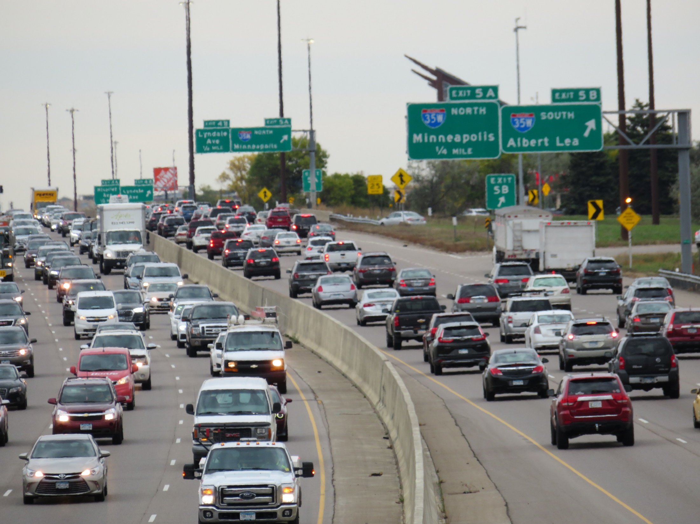


The I-494 Corridor Commission’s Strategies for Reducing Traffic Congestion

Slide 2
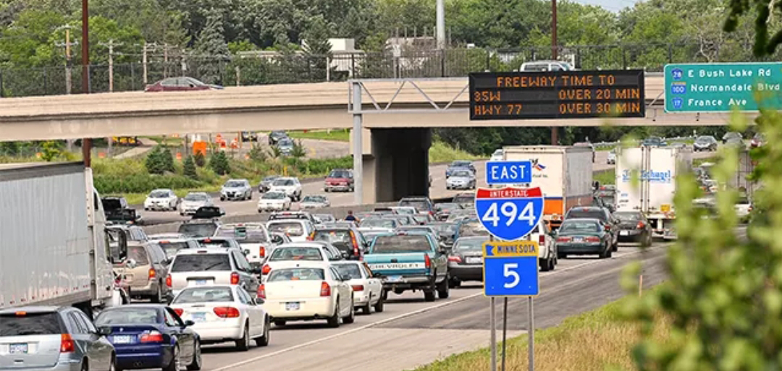

Working Jointly on Transportation Improvements
The I-494 Corridor Commission formed in 1986 when the cities of Bloomington, Richfield, Edina, Eden Prairie and Minnetonka formed to jointly work on transportation improvements on I-494

Slide 3
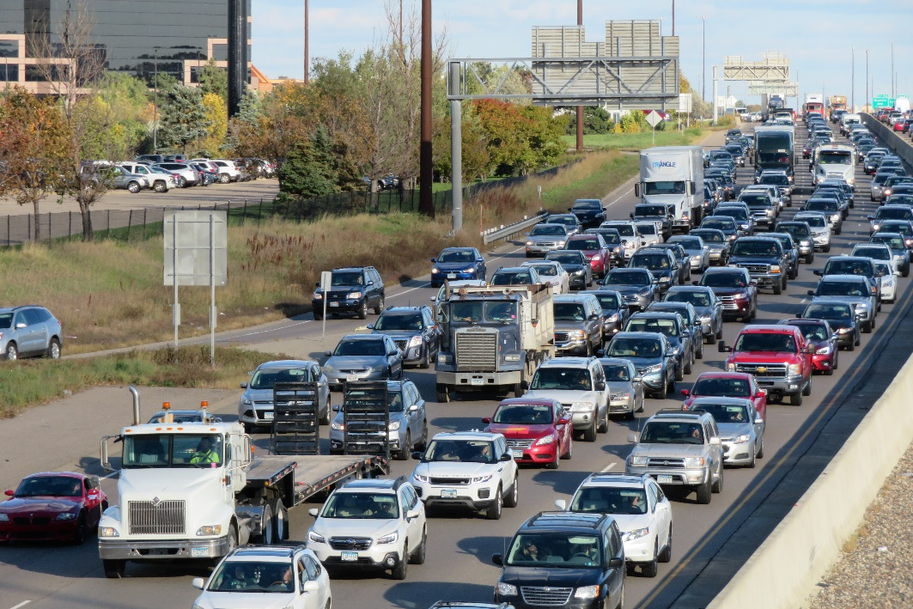
The I-494 Corridor
19% of metro area population lives along corridor
21% of metro area jobs are located on/near corridor
Over 313,696 jobs near the corridor compared with
216,000 jobs in downtown Minneapolis
44,687 jobs in downtown St. Paul

Slide 4
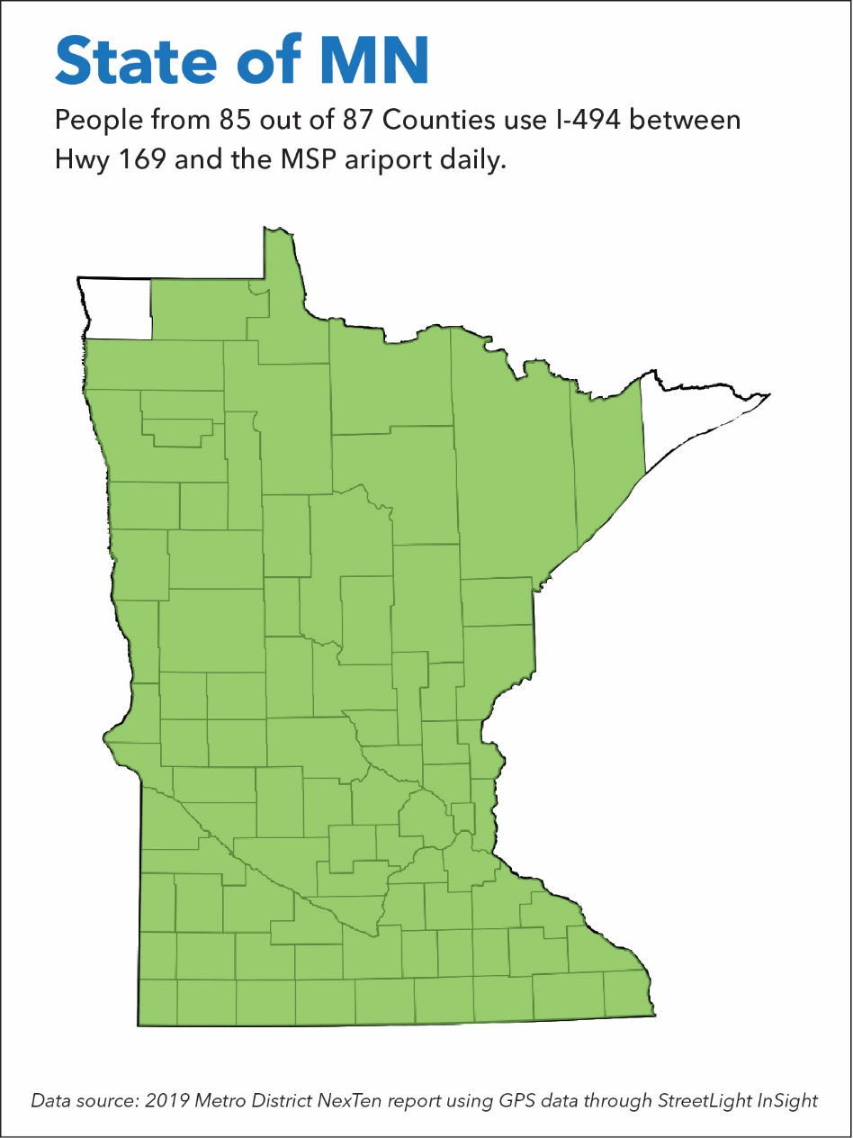

Slide 5

Study of Commute Behavior on I-494
95% drive alone
4% carpool
1% bicycle and take transit
One-third have “seriously considered changing jobs due to commuting hassles”
30% are willing to try transit
30% open to carpooling

Slide 6
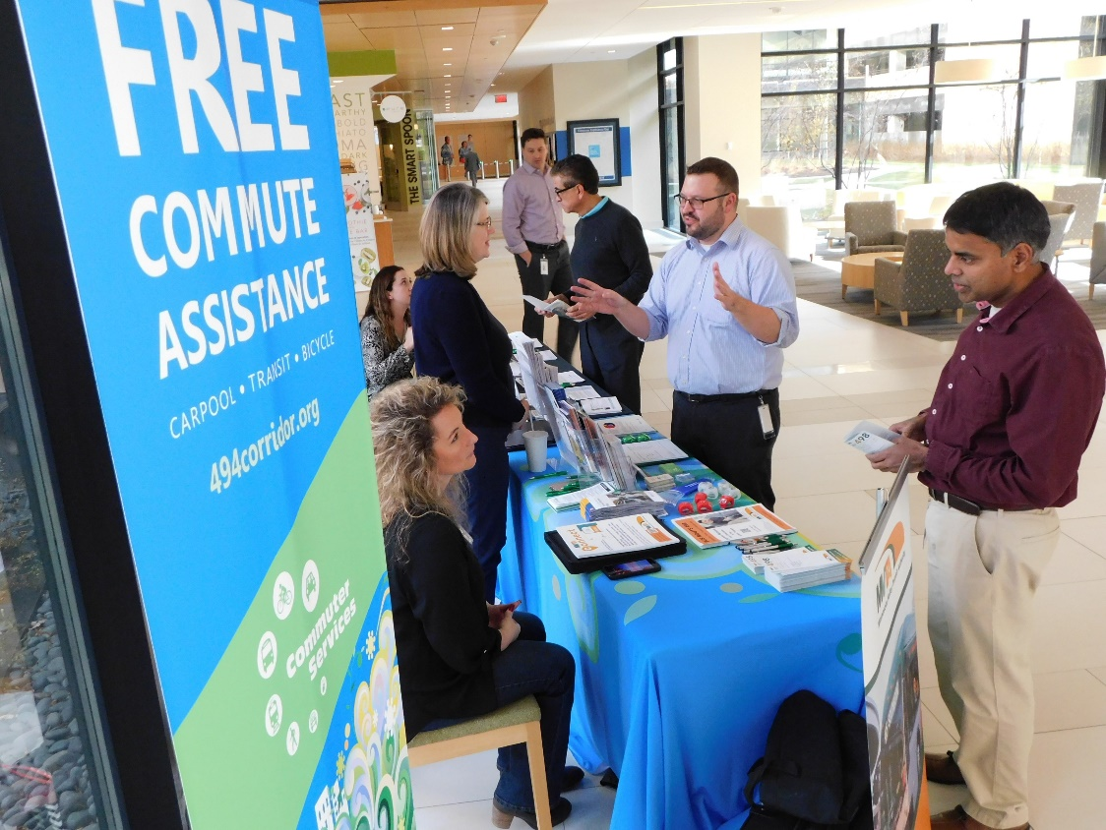
Commuter Services Staff
In 2001 the Commission hired staff to work with employers to reach employees with resources to shift drive alone commuters into a sustainable mode

Slide 7
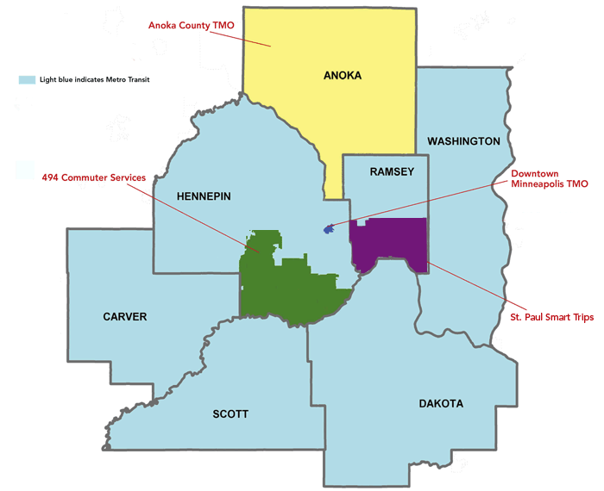
Transportation Management Organizations
Light blue indicates Metro Transit

Slide 8
Twin City CMAQ Funding for TDM
 | Annually
CMAQ Grant | $3.8 Million
MetCouncil/Metro Transit | 62%
Anoka County TMO | 6%
Move Minnesota (St. Paul) TMO | 9%
494 TMO | 11%
Move Minneapolis TMO | 12%
 | 100%

Slide 9
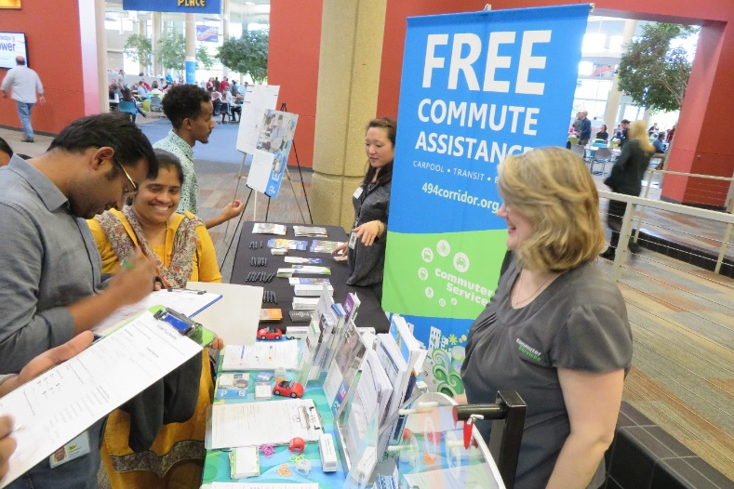
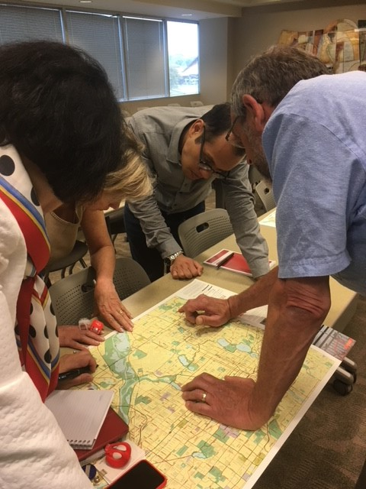
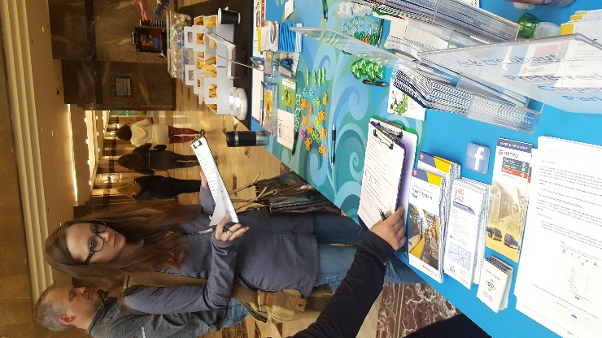
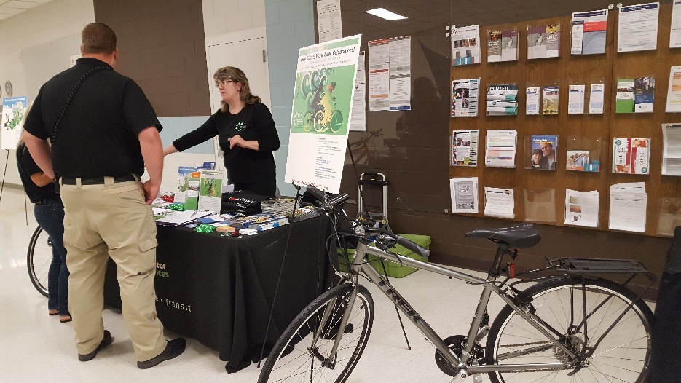
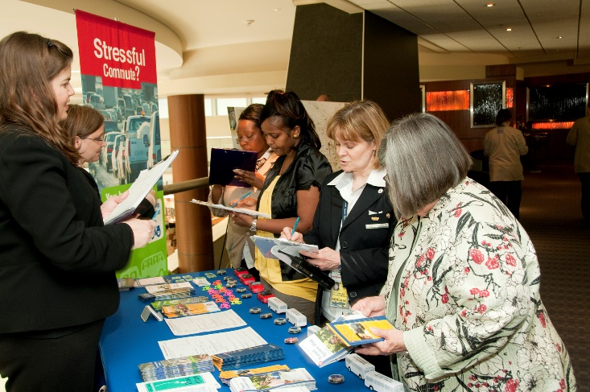
Working Through Employers to Reach Commuters

Slide 10
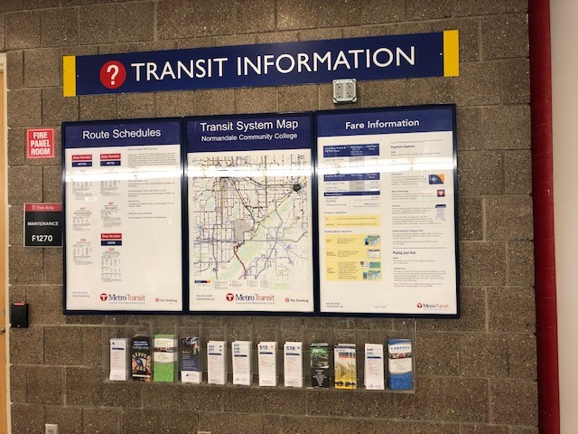
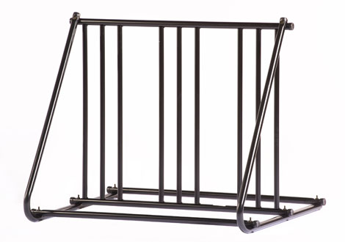
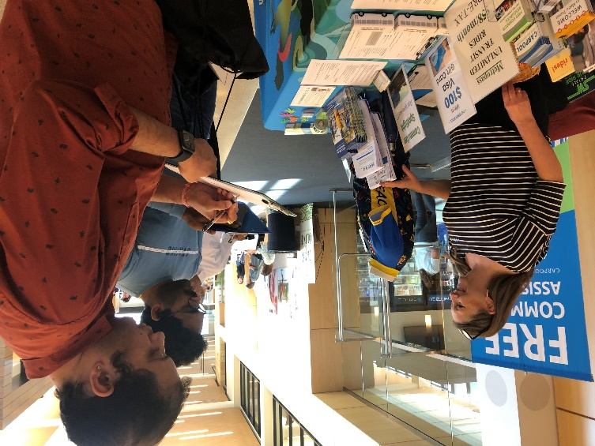

Resources for Employers to Help Employees Commute Sustainably
Displays – with transit routes serving that employer, bicycle commuting tips, carpool and Guaranteed Ride Home information
A Free Outdoor Bike Rack – for companies that agree to promote bicycle commuting
Preferential Carpool Parking – management of carpool parking
Commuter Fairs
Lunch & Learns – construction projects, how to bike in traffic, updates on transit projects
Telework/Hybrid resources

Slide 11
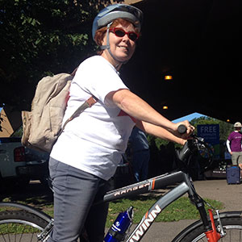
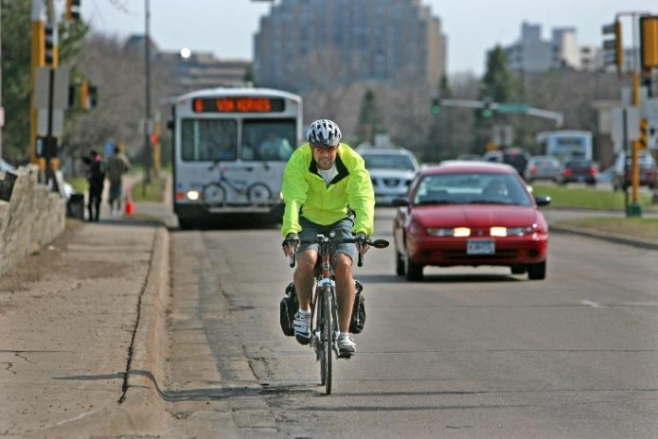


Individualized Commute Assistance Commute Concierge
Ridematching – individuals with a similar work trip who are interested in sharing the ride for carpooling or vanpooling
Customized Transit information – personalized trip itinerary, schedules for bus or train, 2 free passes to try it
Bike commuting resources – customized route plan from employee home to work, a map and bicycle commuting tips and the MN bike laws
Guaranteed Ride Home
Telework/Hybrid resources

Slide 12

Commuter Services Average Annual Results by Mode
1,887 new transit riders
1,635 new carpoolers
1,254 new bicycle commuters
937 new teleworkers
61 new vanpoolers in 5 vanpools
5,774 Drive alone commuters switch to using a sustainable commute mode (three or more days per week) after receiving customized assistance from Commuter Services staff

Slide 13
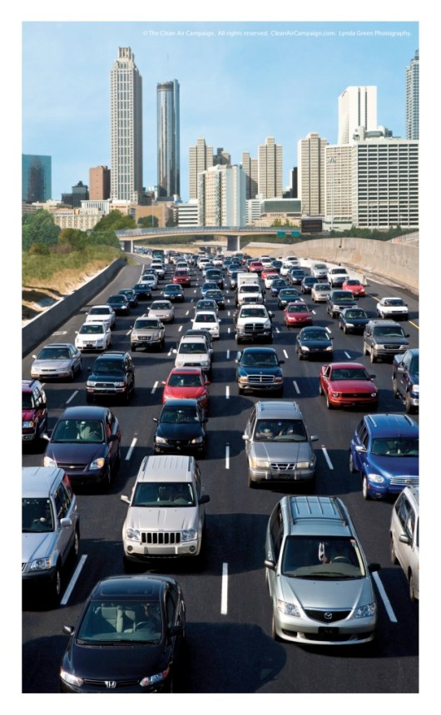
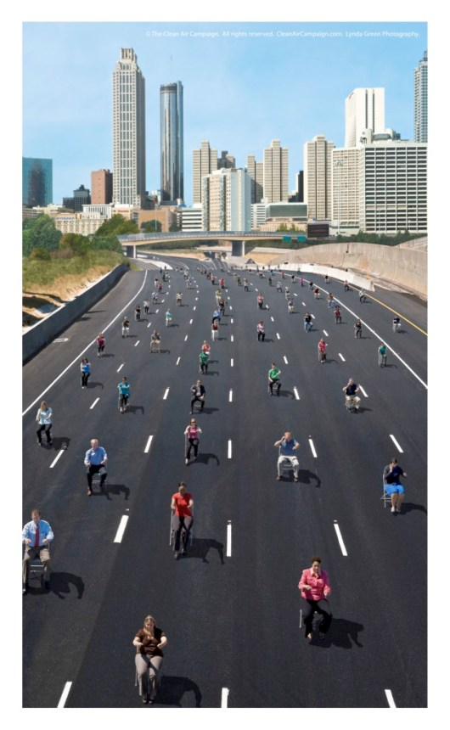
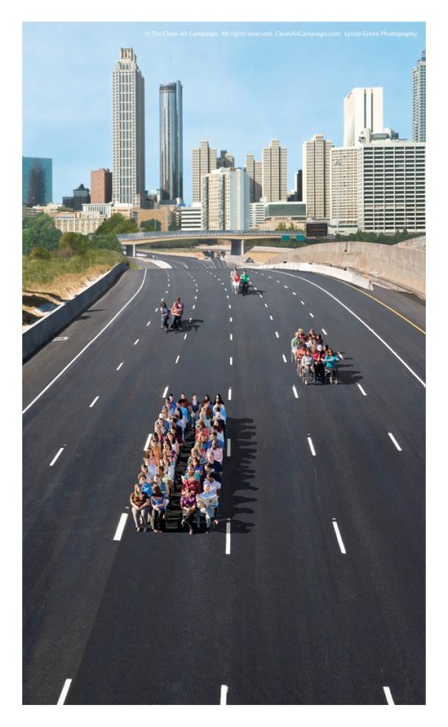
Resulting in an estimated 56 Million vehicle miles avoided as a direct result of Commuter Services outreach

Slide 14

Annual Report Summary
56 million vehicle miles avoided is 23,234 metric tons of CO2 emissions saved

Slide 15

Annual Report Summary
It takes 1,161,692 million mature trees to reduce the same amount of CO2 emissions

Slide 16


Telework
as a Business Strategy

Slide 17
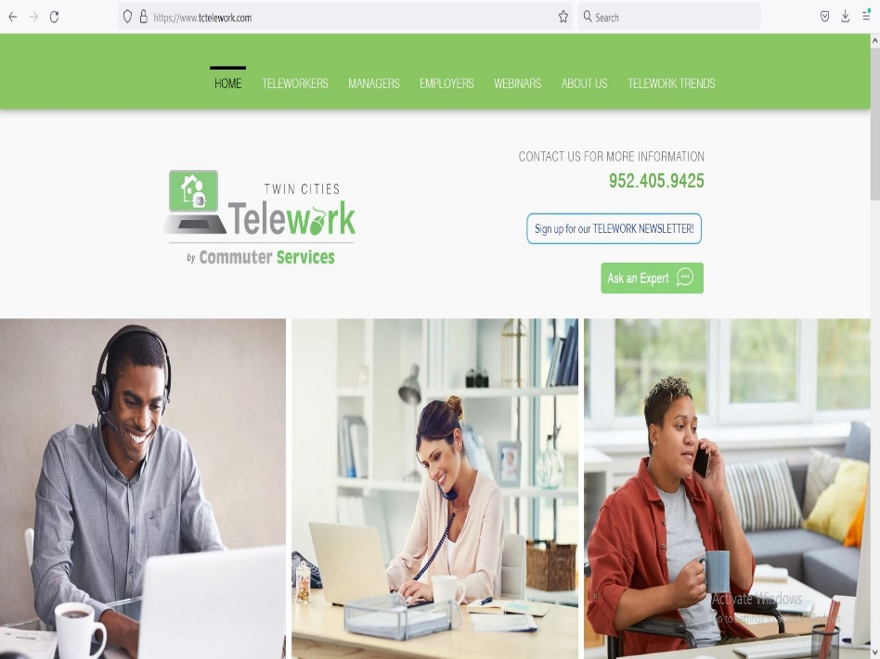

With the $300,000 Telework Appropriation
Twin Cities Telework Website
Webinars
Ask an Expert
Newsletter
Telework/Hybrid
Resources for
Employers
Managers of Teleworkers
Teleworkers
Hybrid Teams

Slide 18



Employers Asked for
Training for Managers to manage remote workers and hybrid teams
Webinars
22 Tips for Manager Success
How to Measure Productivity
Ergonomic and home office recommendations
Webinar
Home Office Ergonomics and Safety Guide
Mental Health Tips for Teleworkers
Multiple Mental Health Resources

Slide 19
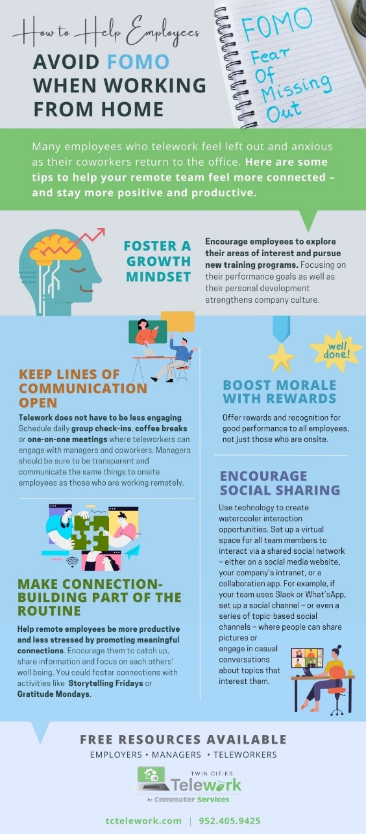
Retaining Company Culture
Combating Digital Exhaustion
Burnout
Fear Of Missing Out- FOMO
Building Connection on Your Hybrid Team
Overcoming Challenges
Evaluation

Slide 20
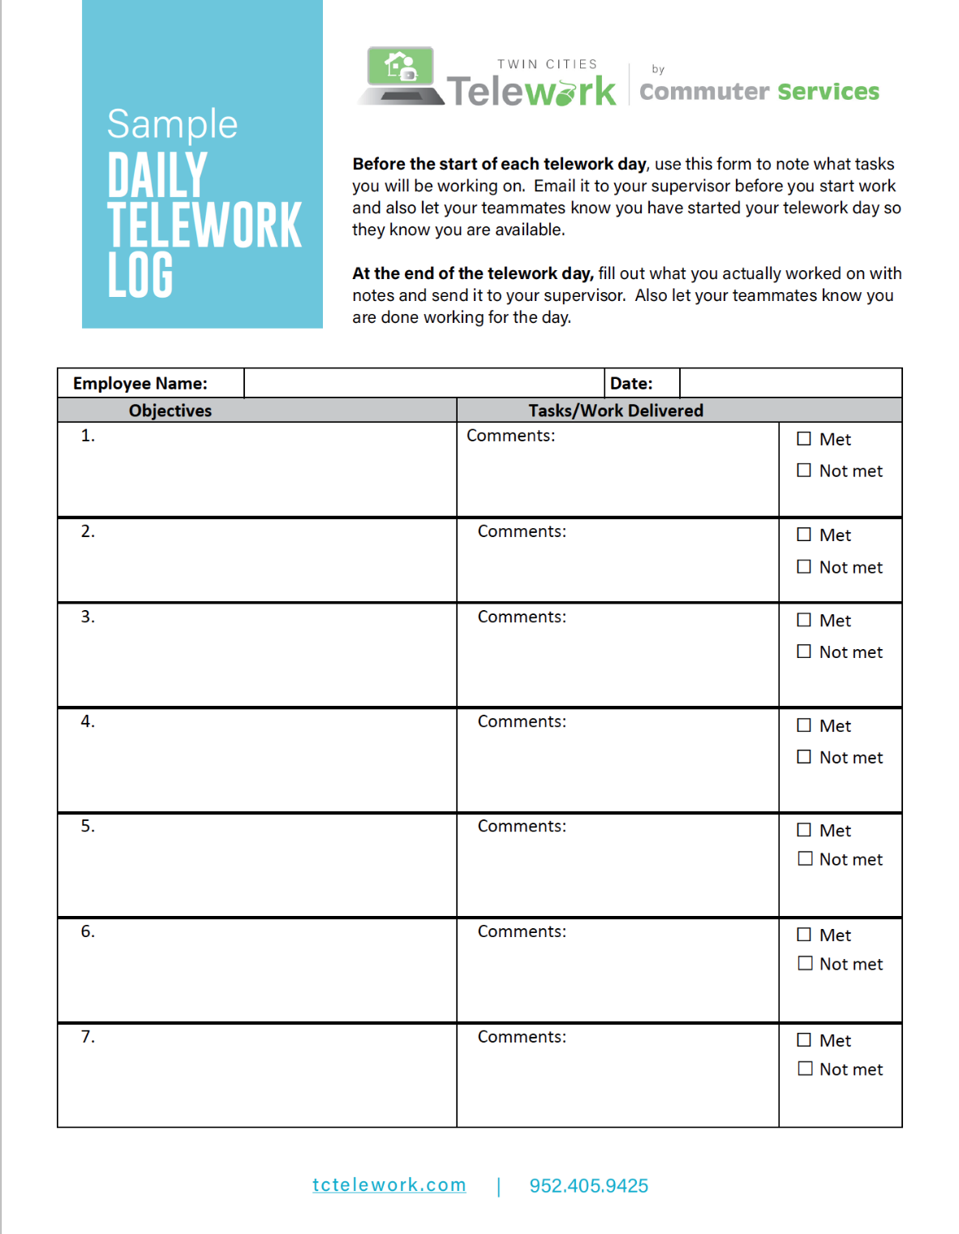

Slide 21
Twin Cities Telework assisted
331 employers statewide
with telework and hybrid work resources in 2022

Slide 22
Michelle Leonard
Commuter Services

Slide 23
The Changing Commute of 2022:
A Compilation of Employer and Commuter/Telework Survey Results

Slide 24
The return to the worksite

Slide 27
October commute exceeds earlier projections

Slide 28
October commute exceeds earlier projections

Slide 29
For more information: Contact Melissa Madison melissa@494corridor.org; or, Michelle Leonard mleonard@494corridor.org

