Slide 1


Slide 2








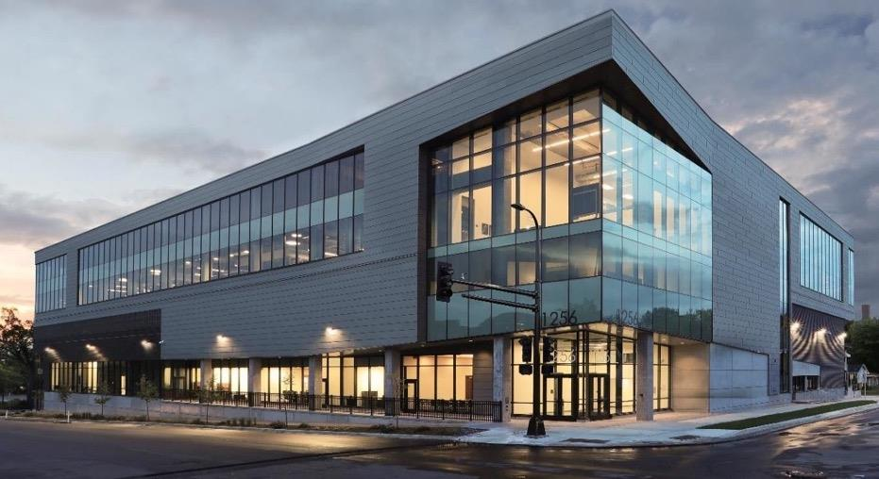
SUMMIT 2025: INVESTMENT IN TALENT & PARTNERSHIP
The North Star Innovation Center, located in North Minneapolis
Accredited CTE
Over 1,000 students enroll annually
Recognized by the New York Times as a leader in training and workforce development (Business Day, February 23, 2018 )
Largest construction training provider awarding short-term certificates in the Twin Cities (RealTime Talent)
For every dollar invested in Summit, the ROI is $7.52 as reported by the Constellation Fund
Information Technology
Service Desk Technician (2018)
Cybersecurity (2020)
Application Development (2020)
Financial Services
Construction
Electrician
Carpentry
Solar Energy
Project Management
Healthcare
Medical Administrative Assistant
Health Informatics
Medical Assistance (Clinical)
Accelerated GED

Slide 3
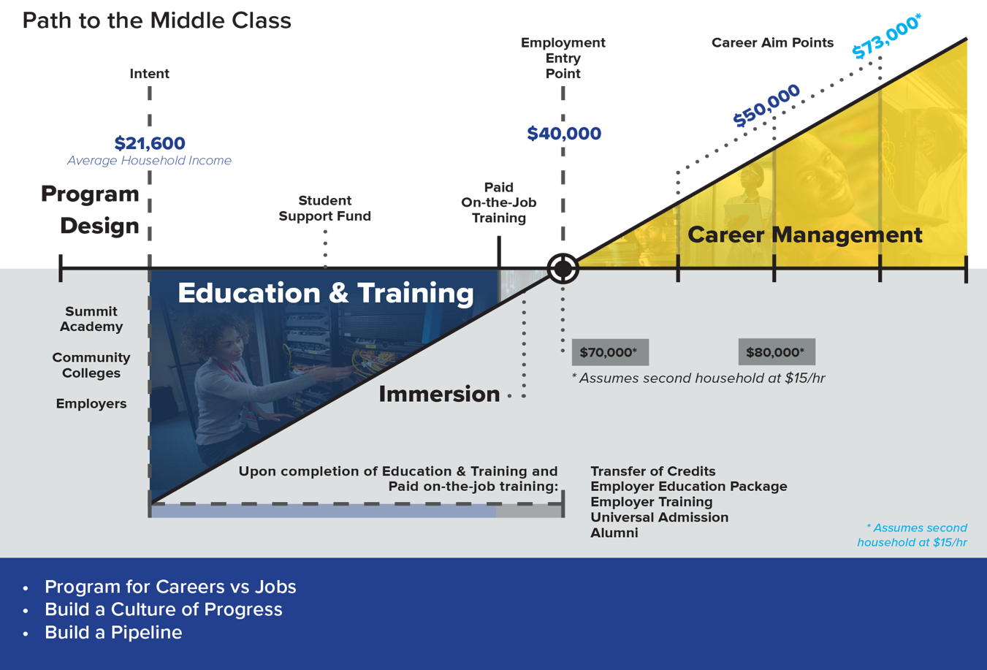
CREATING THE CAREER GLIDEPATH TO $70,000 >

Slide 4
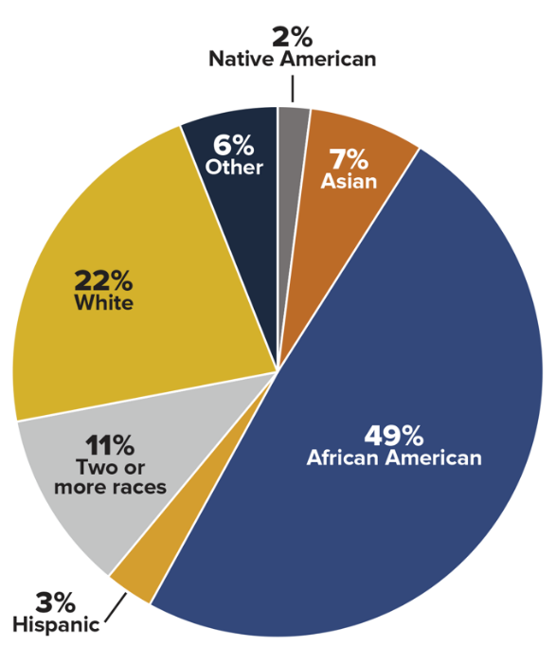
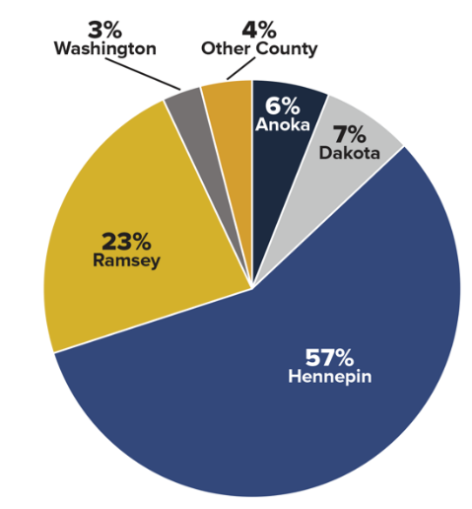
STUDENT DEMOGRAPHICS (FY21)
Student Demographics (FY21)
County of Residence (FY21)
49%
Black
Income Level | FY21
Unemployed | 45%
Below 100% FPG | 36%
Below 200% FPG | 69%
No income info | 7%

Slide 5
EMPLOYMENT OUTCOMES - BY PROGRAM
CONSTRUCTION
 | Placed | Average Wage | In Field | Full Time
FY22 YTD* | 121 | $20.73 | 99% | 98%
FY21 | 122 | $18.48 | 98% | 93%
FY20 | 144 | $18.16 | 99% | 92%
FY19 | 264 | $17.05 | 94% | 94%
INFORMATION TECHNOLOGY
 | Placed | Average Wage | In Field | Full Time
FY22 YTD* | 80 | $20.32 | 98% | 98%
FY21 | 37 | $17.26 | 100% | 97%
FY20 | 48 | $16.89 | 100% | 96%
FY19 | 14 | $17.00 | 100% | 100%
HEALTHCARE
 | Placed | Average Wage | In Field | Full Time
FY22 YTD* | 44 | $18.52 | 100% | 92%
FY21 | 45 | $17.14 | 98% | 78%
FY20 | 95 | $16.25 | 100% | 76%
FY19 | 146 | $15.48 | 99% | 73%
*July 1 2021 – March 8, 2022
Notes:
Do we need to update this slide? Also, should we have average salary numbers for each industry rather than an average of all of them?

Slide 6
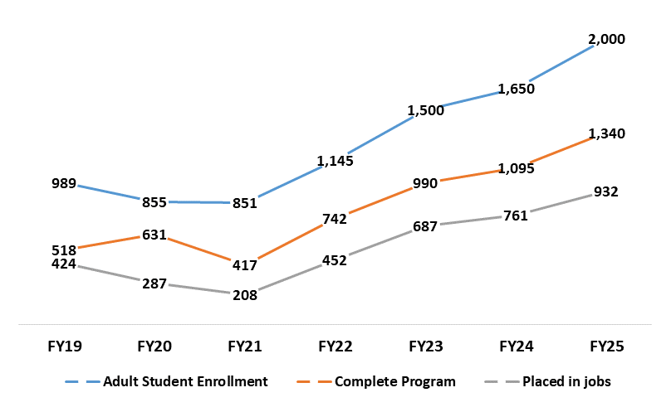
SUMMIT PERFORMANCE & GROWTH
Actual
Actual
Actual
Goal
Goal
Goal
Goal
Notes:
Do we need to update this slide? Also, should we have average salary numbers for each industry rather than an average of all of them?

Slide 7
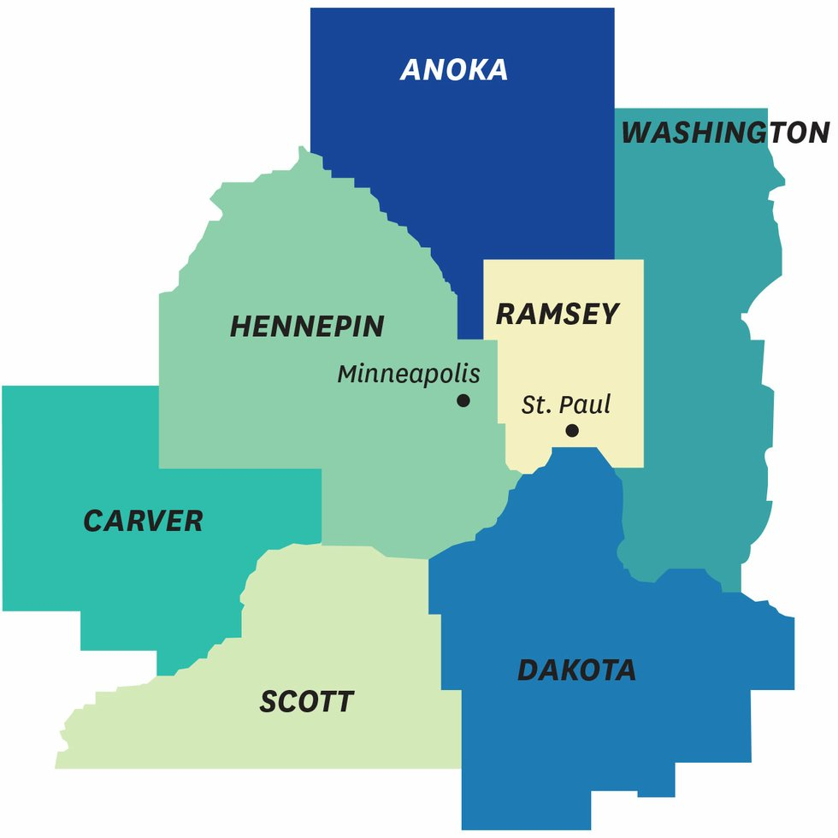
THE METRO WIDE VIRTUAL NETWORK
A local virtual network will connect low-income communities of color to in-demand, high-wage IT occupations and employers.
Summit Academy OIC will expand accredited training offerings to broader metro area, at no out-of-pocket costs to the enrolled students.

Slide 8
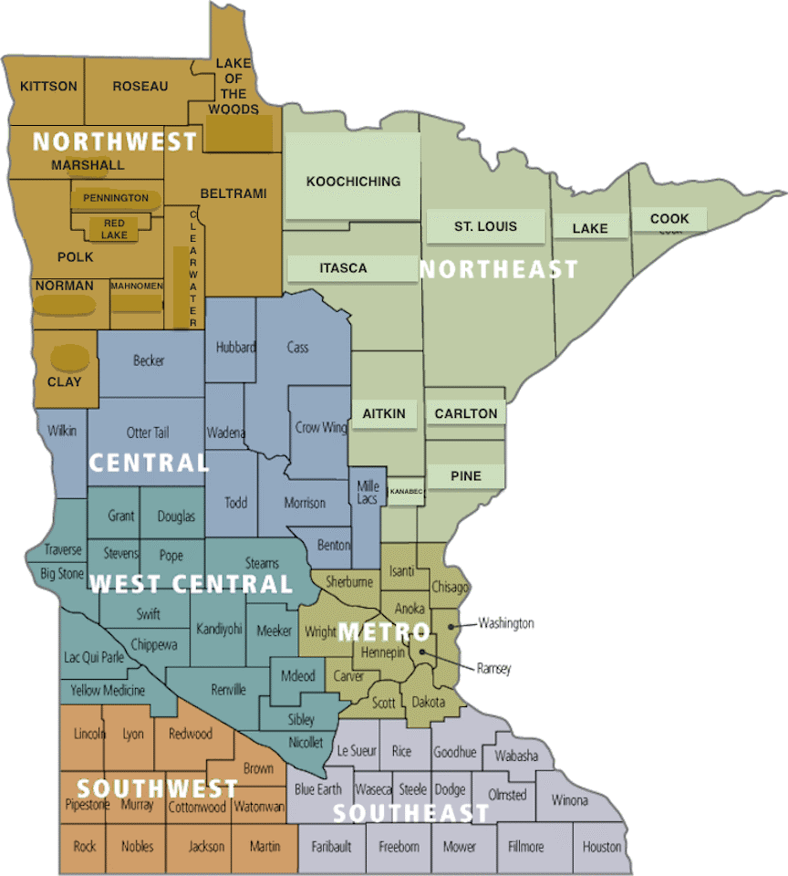



SUMMIT 2025: INVESTMENT IN THE FUTURE
STATEWIDE REGIONAL VIRTUAL NETWORK
Expansion of local virtual delivery system to reach communities statewide.
EMPLOYER
&
COMMUNITY PARTNERS
FEDERAL & STATE GUIDANCE
PEER INSTITUTION ADVISORY COMMITTEE

Slide 9
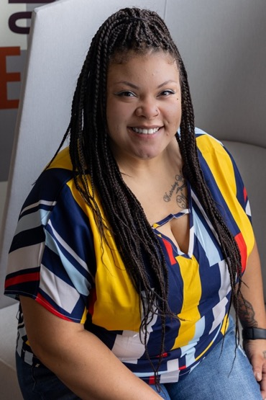
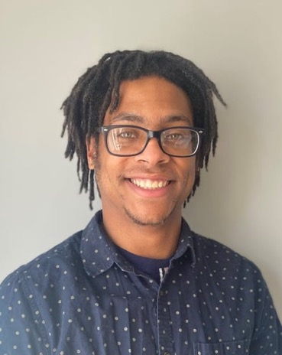
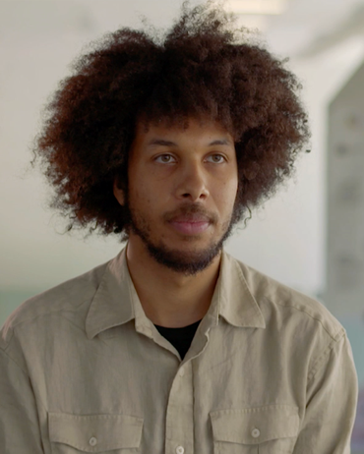
STUDENT SUCCESS
Gerald Graffunder
2021 Graduate
Service Desk Technician at Atomic Data
Gerald enrolled at Summit when his job in special education was eliminated when the pandemic began.
Angel Morris
2020 Graduate
Service Desk Technician at Atomic Data
Angel enrolled when she was let go from her retail job at the start of the pandemic.
Azra Jones
2021 Graduate
Software Enterprise Apprentice at U.S. Bank
Azra left his part-time, low-wage job as a grocery store clerk to enroll at Summit.
Notes:
New slide: Highlight stories for two graduates – one from US Bank and one from Atomic Data.

Slide 10

INVESTMENT IN THE FUTURE
Summit has received direct appropriations from the legislature since 2017
These investments have allowed Summit to strategically expand our offerings to meet growing employer demand
As a result, Summit’s placement ratio far exceeds industry standards
Reliable, predictable state funding allows us to grow to meet employer needs in an ever-changing economy
Request to move Summit funding to the General Fund base and expand funding to implement metro and statewide virtual networks
Notes:
New slide – problem/solution: state appropriates funding from workforce development fund just two years at a time (no permanent funding). Solution: Summit needs a stable General Fund appropriation.

Slide 11
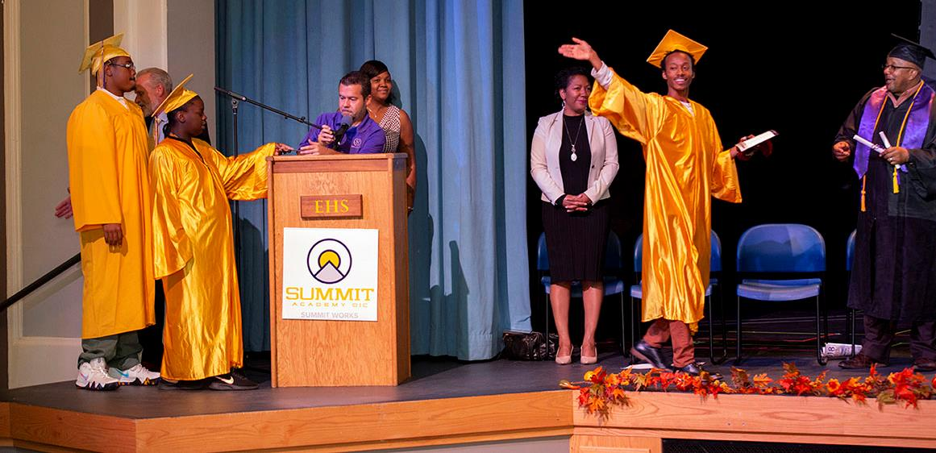

Contact:
Leroy West, President
lwest@saoic.org
Tel: 612.278.5240
Notes:
New slide – add contact information for Summit Academy

