Slide 1

Can Minnesotans afford to go where they need to go?
A financial perspective on transportation equity
Will Schroeer
House Transportation Finance and Policy Committee
February 2, 2023

Slide 2

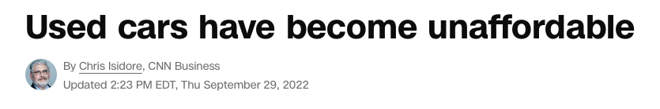
In 2022:
“Americans needed to work five weeks more on average to afford a used car in 2021”
www.cnn.com/2022/01/20/economy/used-car-prices/index.html

Slide 3
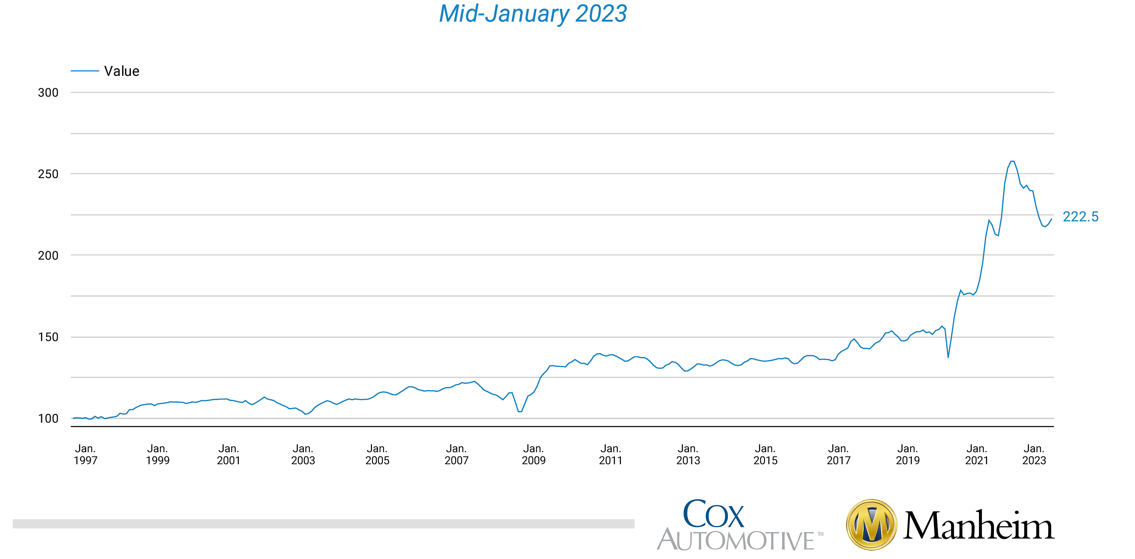
How about today?
Manheim: “Wholesale Used-Vehicle Prices See Another Increase in First Half of January”
Source: https://publish.manheim.com/content/dam/consulting/ManheimUsedVehicleValueIndex-LineGraph.png

Slide 4
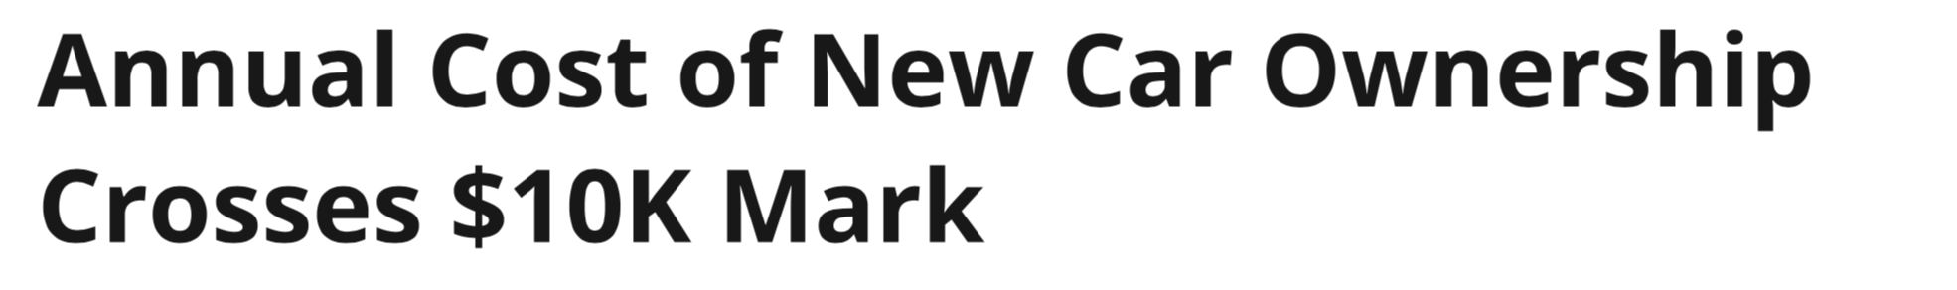

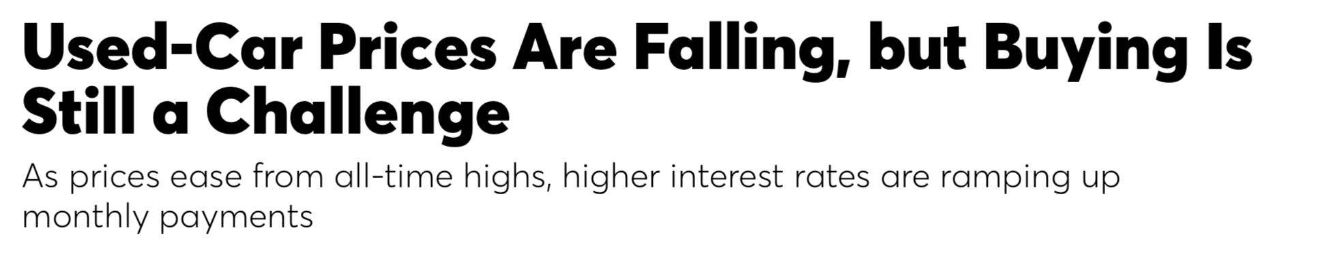
Can Minnesotans afford a car now?
Average car payments in the U.S. increased year-over-year by double-digit percentages.
13.3% for new vehicles,
11.2% for used vehicles
Average monthly car payments at $700 & $525, respectively.
(No gas, no insurance, no maintenance. (Lending Tree: “Auto loan statistics 2023”)

Slide 5


Can’t spend $6,000 - $10,000 a year? Have better uses for that money?
Do Minnesotans have options?
In the metro region
  The region’s economic development lead,
  GreaterMSP, identifies “Percent of population
  living within 30 minutes of 100,000 jobs by transit
  or walking” as a critical indicator of economic and social health.
  Since 2016: GreaterMSP’s critical transportation indicator has fallen from 6.0% to 4.9%.
In Greater Minnesota
  “MnDOT projects that transit need will grow from approximately 15 million to 20 million passenger trips per year between 2021 and 2030. To meet this need, Greater Minnesota public transit systems would need to provide approximately
  2 million hours of service hours of service in 2030.”
  Table 7: Projected Operating & Capital Needs vs. Projected
  Revenues for Greater Minnesota Transit: 2021 to 2026
  Unfunded need: $349.8 million

Slide 6
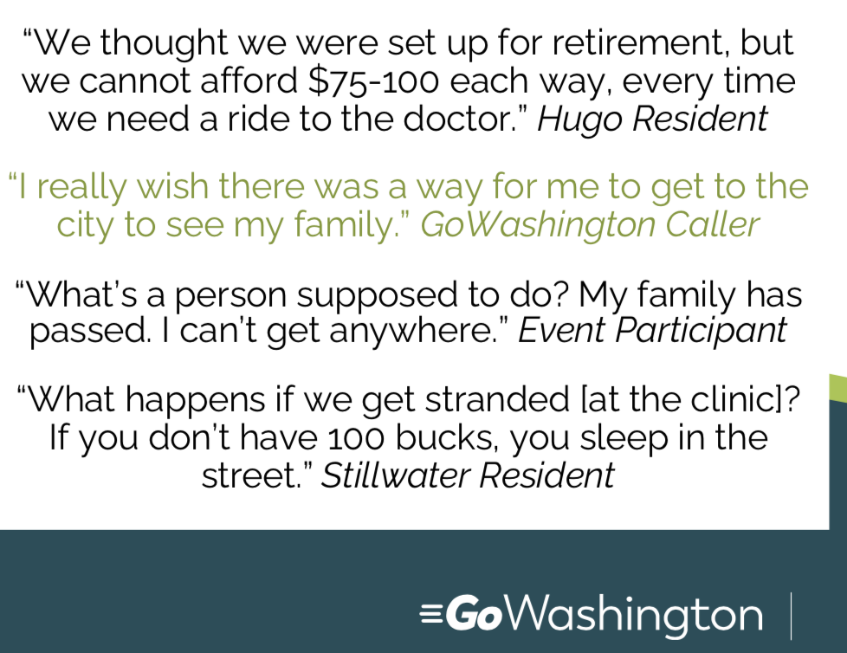
Impacts

Slide 7
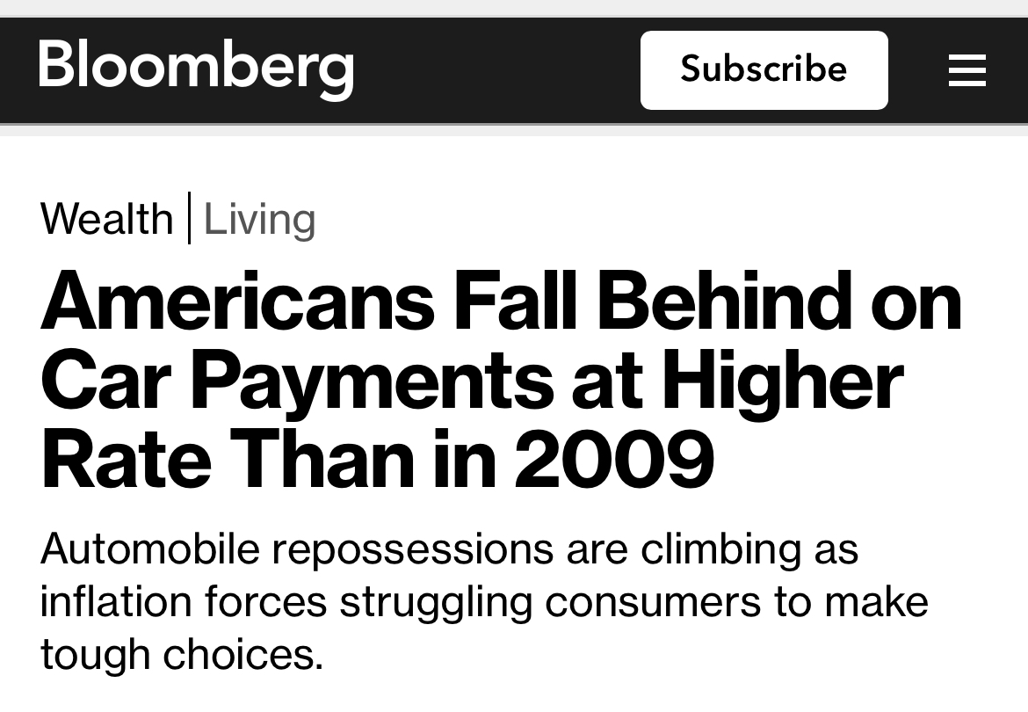
Impacts /2

Slide 8
Can Minnesotans get where they need to go?
They spend more on cars, or on taxis, than they can afford.
For many Minnesotans, the answer is “No”. So:
Or, they can't get to work, to the doctor, to school
That inequity exists across Minnesota
Notes:
Auto loan debt is the third-largest debt category behind mortgages and student loans.

Slide 9
Thank you
will@eastmetrostrong.com

