Slide 1
Human Services Finance and Policy Committee Hearing. MN House of Representatives
Presentation by the Ombudsman Office for Long-Term Care.
Cheryl Hennen State Long-Term Care Ombudsman
January 14, 2021

Slide 2
Office of Ombudsman for Long-Term Care Mission statement:
OOLTC works to enhance the quality of life and quality of services for long-term care consumers through advocacy, education and empowerment.

Slide 3
History
The term Ombudsman was originally coined by members of the Swedish government dating back to 1809. An official of high esteem that would intercede as a highly-regarded voice for citizens with complaints and work to resolve concerns.
The Ombudsman for persons in nursing homes was prompted by Dr. Arthur S. Flemming, who served as the Commissioner on Aging to the office of President Richard Nixon
Started as a demonstration project in 1974 in four States
Success of the program shifted from establishment to expansion.
An amendment was added to the Older Americans Act in 1978 mandating every state provide ombudsman services .

Slide 4
Legal Authority and Governance
The Older Americans Act (OAA) established the Ombudsman Program. Older Americans Act of 1965. Section 712
45 CFR Part 1321 and 1324 LTCO Program
MN Statute 256.9742 DUTIES AND POWERS OF THE OFFICE.
Administered through the Minnesota Board on Aging since 1980
Central Office in St. Paul
Regional Offices throughout Minnesota
Certified trained volunteers statewide.

Slide 5
Program Funding

Slide 6
Person-centered Client Advocacy
The Office of Ombudsman for Long-Term Care serves adults seeking or receiving licensed long-term care services and supports in Minnesota. - No income screening - No citizenship requirement - No referral requirement - Calls welcome from residents, family, friends, facility staff, others - Free service
Advocates for residents of nursing homes, board and care homes, assisted living facilities, and other similar adult care facilities
Ombudsmen always work from the perspective of the resident, advocating for the resident’s requests.
Investigate and resolve complaints that relate to the health, safety, welfare, and rights of residents
Educates residents, their family, and facility staff about residents’ rights, good care practices, and similar long-term services and supports resources
Provides technical support for the development of resident and family councils
Make recommendations to state and federal agencies, to the Legislature, to Congress, and to others to improve the quality of life of residents.

Slide 7
Facts:
Regional Ombudsmen do not:
Conduct licensing and regulatory inspections or investigations;
Perform Adult Protective Services (APS) investigations; or
Provide direct care for residents.
Right to Confidentiality
Strict federal requirements regarding disclosure of Ombudsman program information.
Resident-identifying information cannot be disclosed without resident consent, the consent of the resident representative, or a court order.
These disclosure requirements prohibit Ombudsman programs from being mandatory reporters of suspected abuse

Slide 8
Elder Care and Vulnerable Adult Protection Act 2019
May 22, 2019: Governor Walz signed Elder Care and Vulnerable Adult Protection Act of 2019
Bill established funding for an increase of 17 OOLTC staff
Increase regional staff, Deputy, 6 additional support staff
1 FTE Electronic Monitoring
Region ombudsmen (RO) serve residents in geographic regions around the state. Call the central intake line at 651-431-2555 to find your regional ombudsman.

Slide 9
Pre Budget Appropriation – Greater MN

Slide 10
Metro area (pre)

Slide 11
Current: Greater MN

Slide 12
Current: Metro

Slide 13
Change (?)
March 2020 Temporary transformation of Ombudsmen Services to virtual presence
What Did Not Change:
Right people have to expect quality individualized care
Ombudsmen Office Mission
Role and Responsibilities of Ombudsmen staff
Receiving Resident experiences
Tracking and Recording Emerging trends

Slide 14
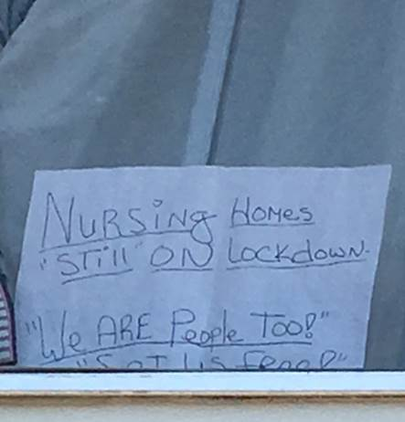

Slide 15
Top Issues/Trends
Restrictions on Visitation:
Comparison: Pre-COVID vs Post-COVID
Pandemic of isolation
Transfer/Discharge:
Emergency Executive Order
Complaint comparisons : from 10/01/2019-09/30/2020=445 increase from 178 over last year. 244 of the 445 occurred since COVID. Another 70 discharge complaints received from 10/01/20 – Dec. 2020
Staffing:
Inadequate staffing
LTC workers need improved support

Slide 16
Conclusion
Organize our care systems around the people who live & work in long-term care settings to enhance quality of life; focus on equity and inclusion free of discrimination.
Support and allow Residents of Long-Term Care settings Regular In-Person Contact with loved ones of choice during the COVID-19 Pandemic
Staffing : COVID-19 exposed long-standing weaknesses of inadequate staffing in our Long-Term Care System. We need to work together and invest in the LTC work-force in sustainable ways.
Assure access to Adequate PPE and COVID Testing.
Uphold commitment to transparency and regular communication

Slide 17
Glimmer of Hope
Role out of vaccine
Priority given to residents in Long-Term Care settings and staff
Information on supply and distribution is constantly changing
Positive resident feedback
Ombudsmen staff resume in-person presence

Slide 18
Thank you
Cheryl Hennen, State Long-Term Care Ombudsman
cheryl.Hennen@state.mn.us

