Slide 1
ADOS Youth Pathway Center
The Young People’s Task Force

Slide 2
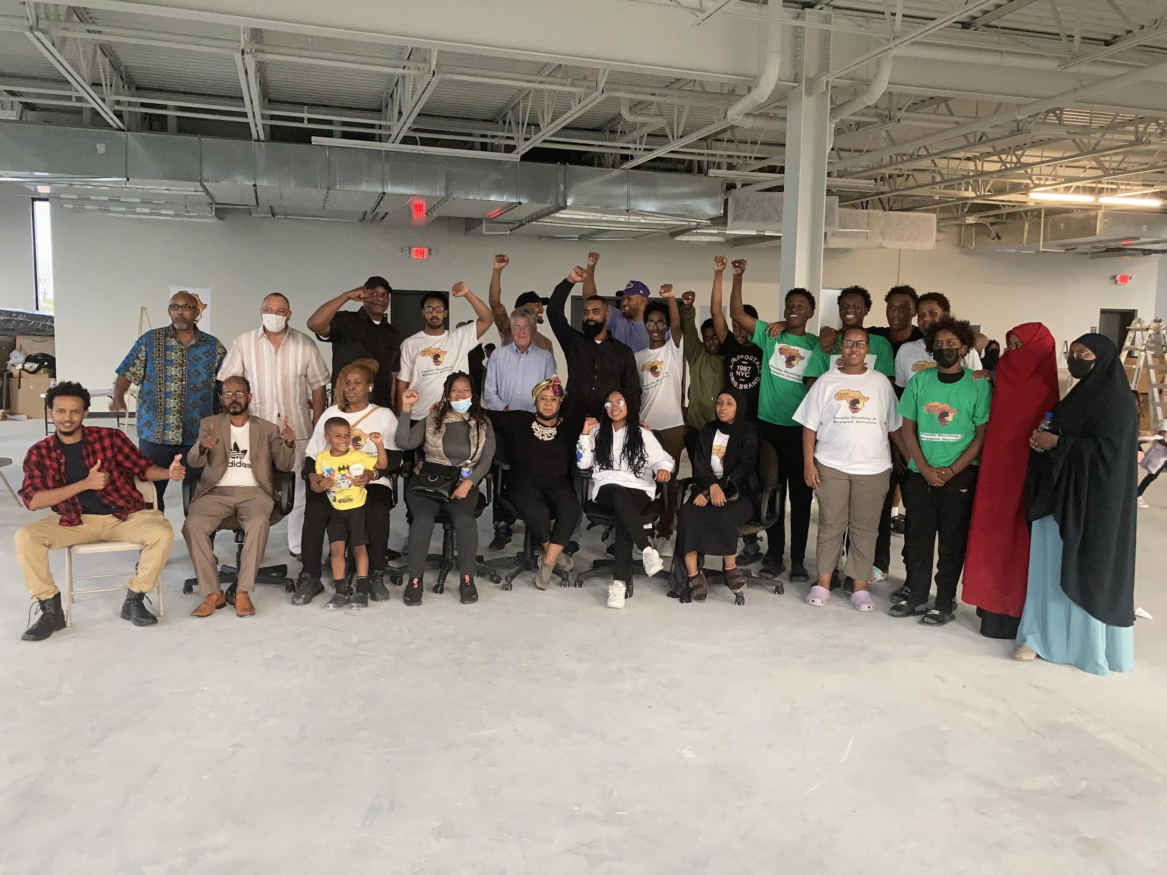
The Young People’s Task Force
Formed in September of 2020 under the Unity Community Mediation Team.
Since formed, we have made it a focal point to elevate, connect, and collaborate the young people of Minneapolis with city leaders to magnify youth voices, initiatives, and ideas.
The Young People’s Task Force has hosted a Series of Community Conversations centered around Public Safety and Community Development.
The overwhelming outcome of the conversations, was the need for an oasis that the young people and various communities throughout Minneapolis can call their own.

Slide 3
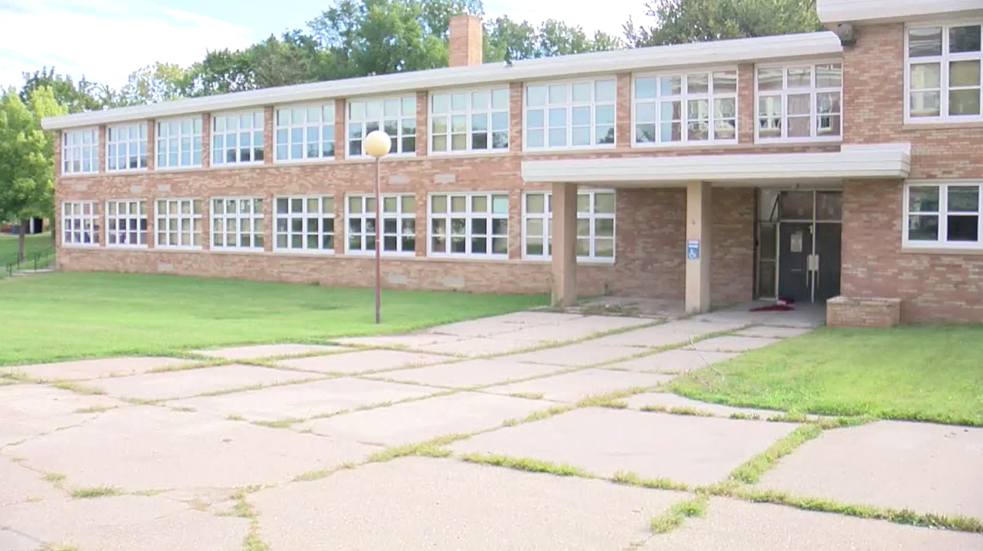
The Gordon Center
2200 16th Ave N. Minneapolis, MN 55411
Located in the Willard Hay Neighborhood
Approximately 22,000 sq. ft in space
Vacant since 2005
Owned by Minneapolis Public Schools
Located less than 1 mile from North Point
Located in one of the highest crime and poverty areas in Minneapolis

Slide 4
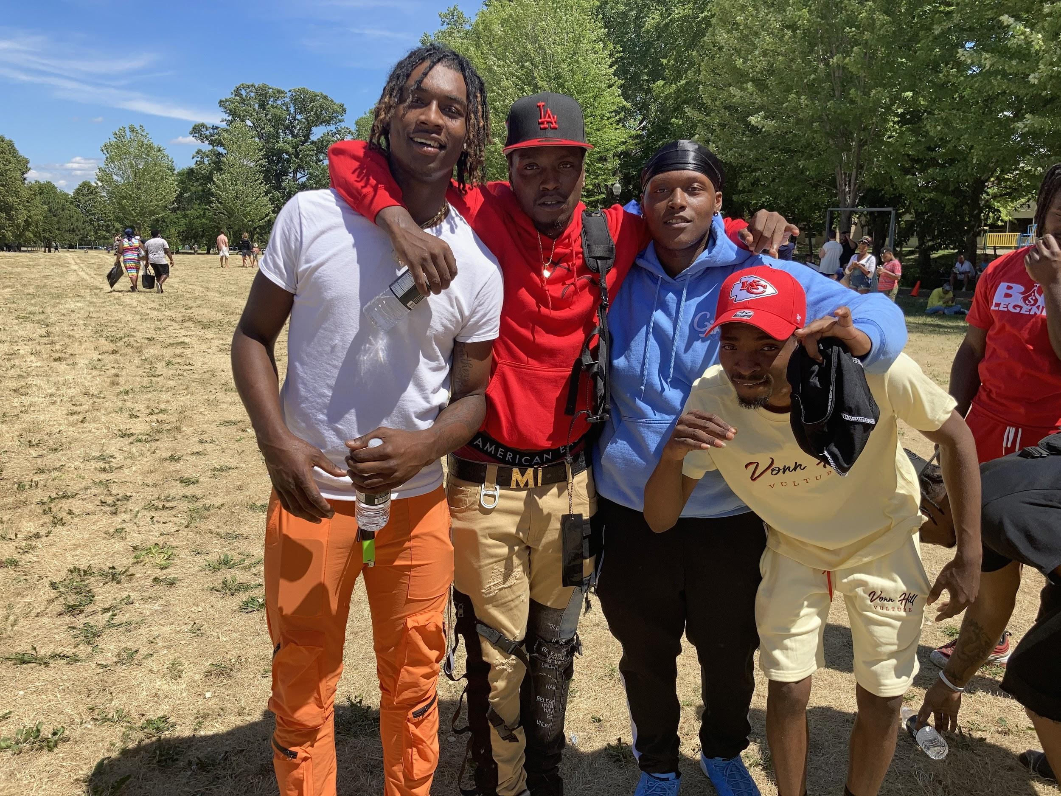
Our Vision
Creating a center of safety and refuge where equity and reconciliation are standards.
Youth aspirations are cultivated and celebrated and ADOS youth are inspired, encouraged, and guided to holistic, self-sustaining futures of economic opportunity and stability.

Slide 5
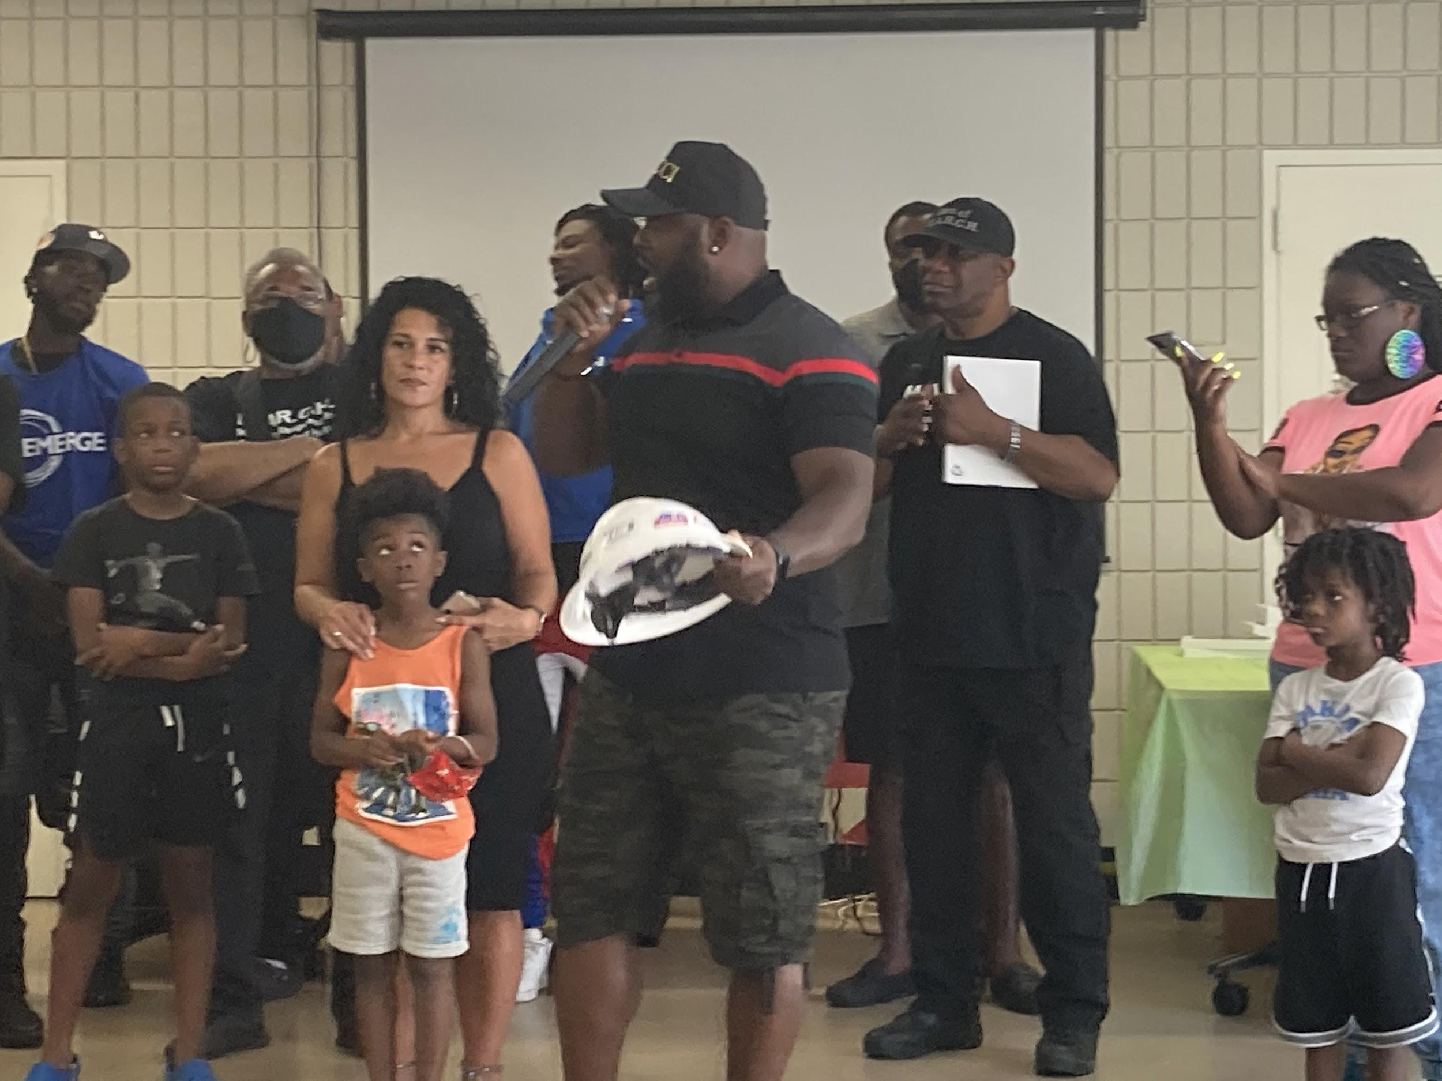
Mission
ADOS youth are empowered and armed with long-term tools needed to thrive as leaders and ambassadors of community peace and transformation, along with the self-sustaining capacity to achieve economic self-sufficiency and entrepreneurial independence

Slide 6

Service Components
Self Actualization
Reconciliation, inclusion, mediation
Economic Development
Education
Recreation, creative expression and music
Leadership/center management
Holistic, Health, Wellness, and Safety

Slide 7
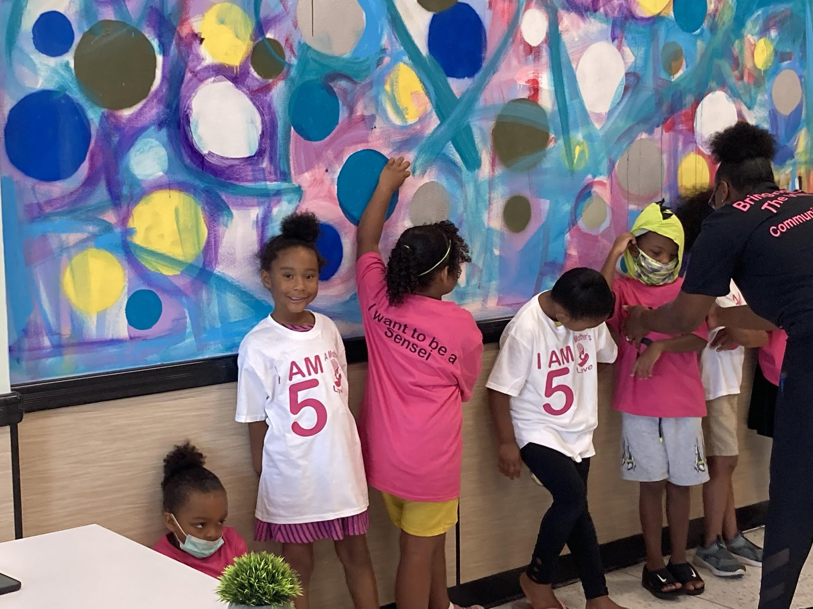
Self-Actualization
Belief in self, who I am, my culture , self identity
Having the desire to be the best one can be.
Understanding significance, fulfillment and
achievement starts from inside-out
Realizing the highest level of potential
is within the capacity of self

Slide 8
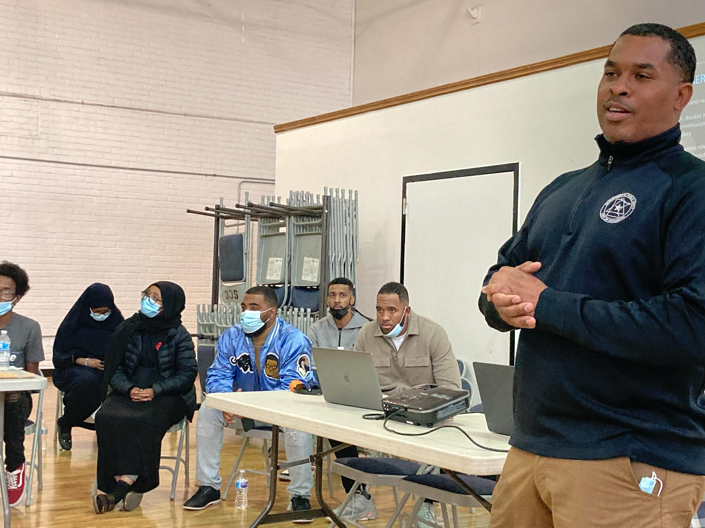
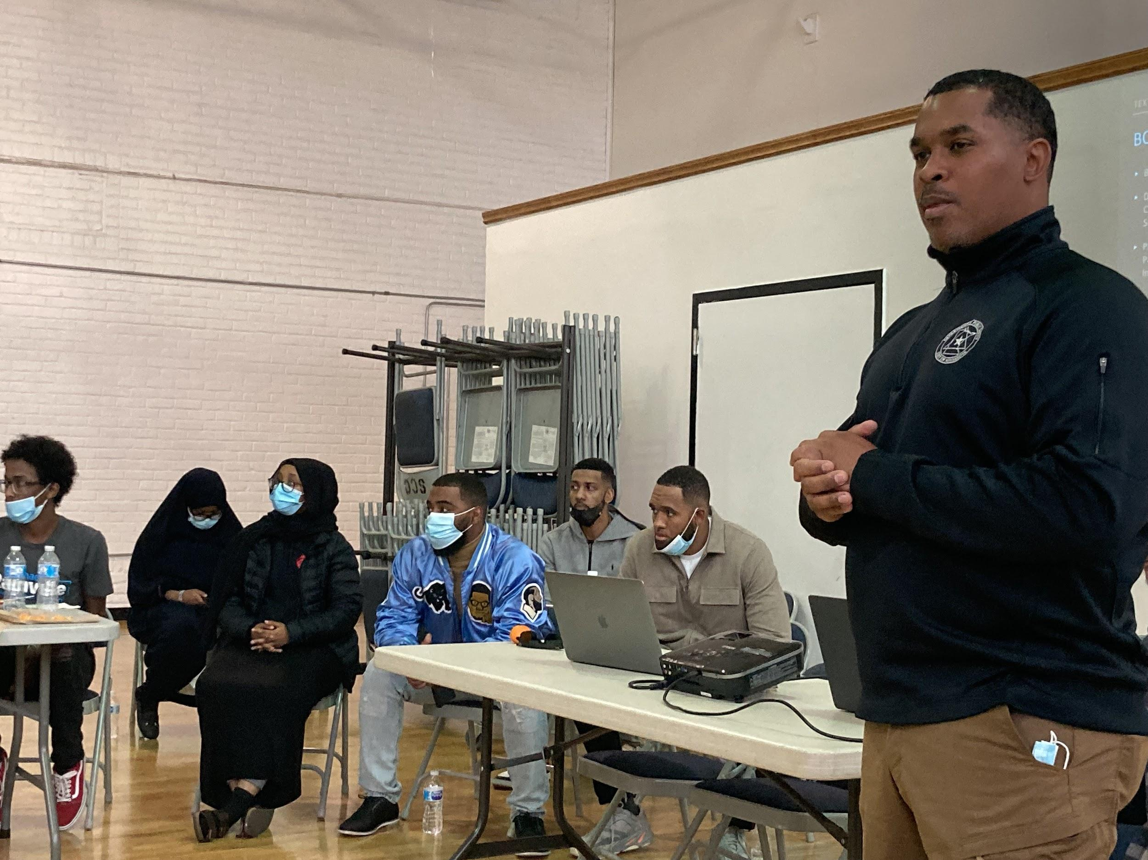
Reconciliation and Mediation
Rebuilding the connection and chemistry with law enforcement and community.
Understanding the importance of taking ownership for wrong behaviors and actions.
Using our different mediation organizational groups to make peace with both community members and peace officers.
Crime prevention, intervention and rehabilitation help coming from, and being for, the community.
Transforming the MPD and its officers within the department to bring back trust, integrity, honesty and love back to the community.

Slide 9

Economic Development
Job readiness
Resumes
Internship
Shadowing mentors
Job carpool program

Slide 10
Education
Diploma/GED assistance
Credit repair
Tutoring
Library access
Stem programming
Skill Building
Enrichment Camps

Slide 11
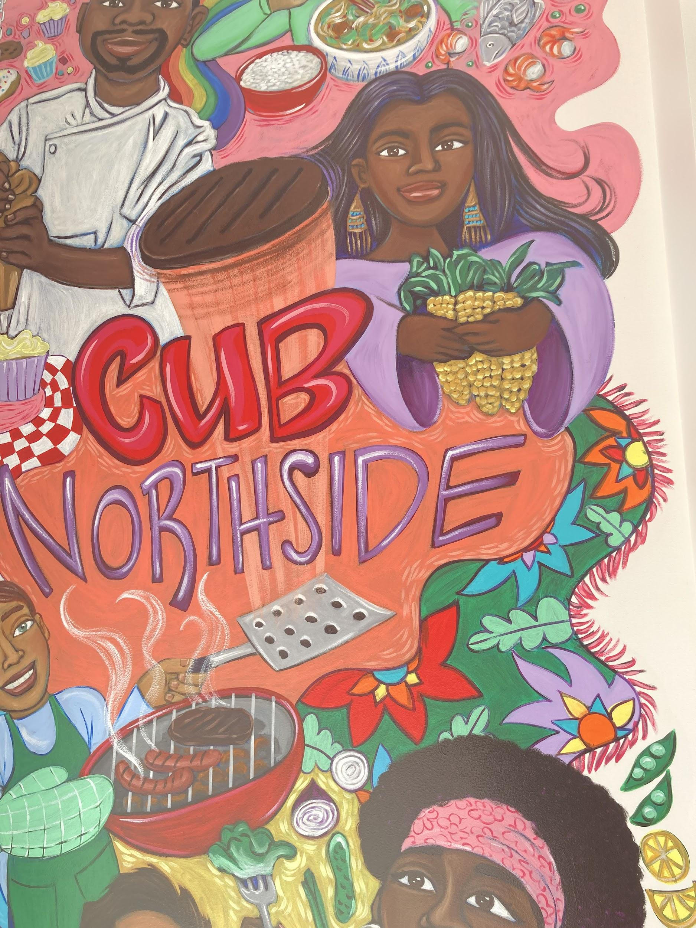
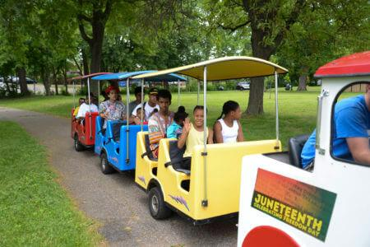
Recreation, Creative Expression, and Music
Youth identified recreation needs
Dance
Self-expression
Creative drama
Sports Fundamentals
Recording Studio
Artist Development

Slide 12
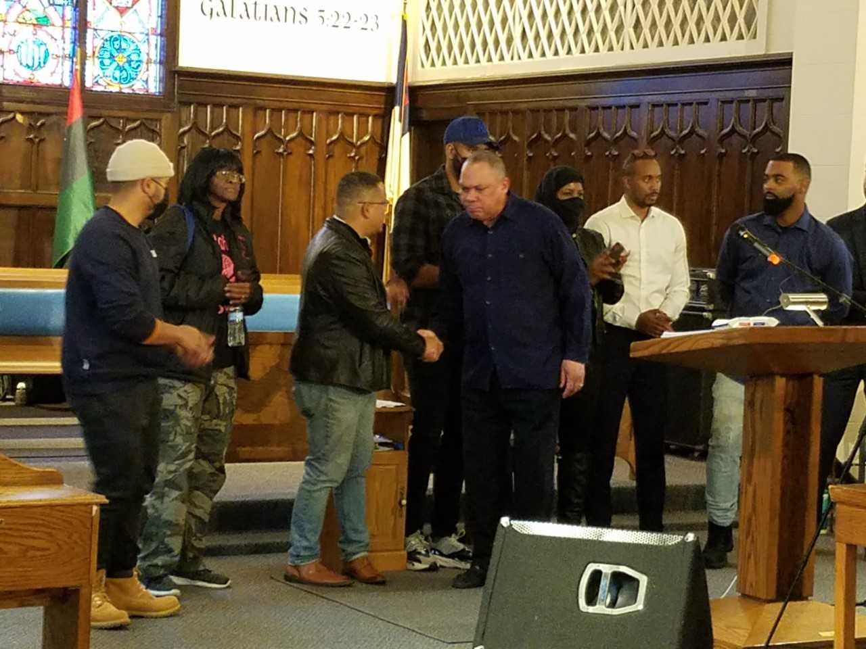
Leadership
Mentorship
Administration position grooming
Peer to Peer engagement
Operations internships
Media engagement

Slide 13
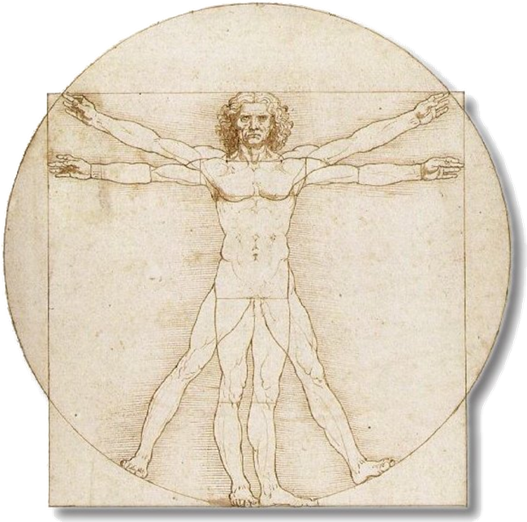
Holistic Health and Safety
Spirit, Spiritual Self
Mind, Mental Self
Heart, Emotional Self
Body, Physical Self

Slide 14
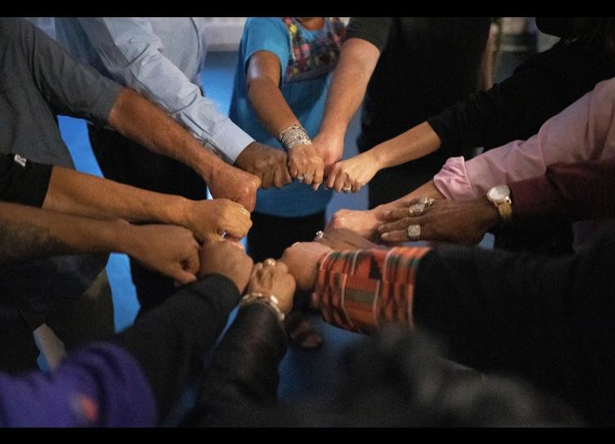
Center Principles
Youth Centered and Youth Focused
Positive Youth Development
Strengths Based
Trauma-Informed
Trusting Adult Relationships
Community Involvement and Collaboration
Diversity, Equity, History, and Inclusion
Reconciliation and Mediation
Pathway and Journey
Integrative

Slide 15
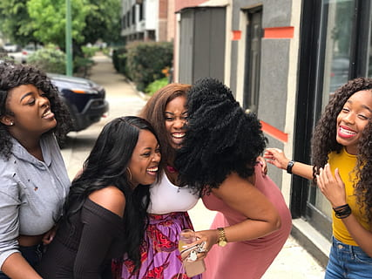
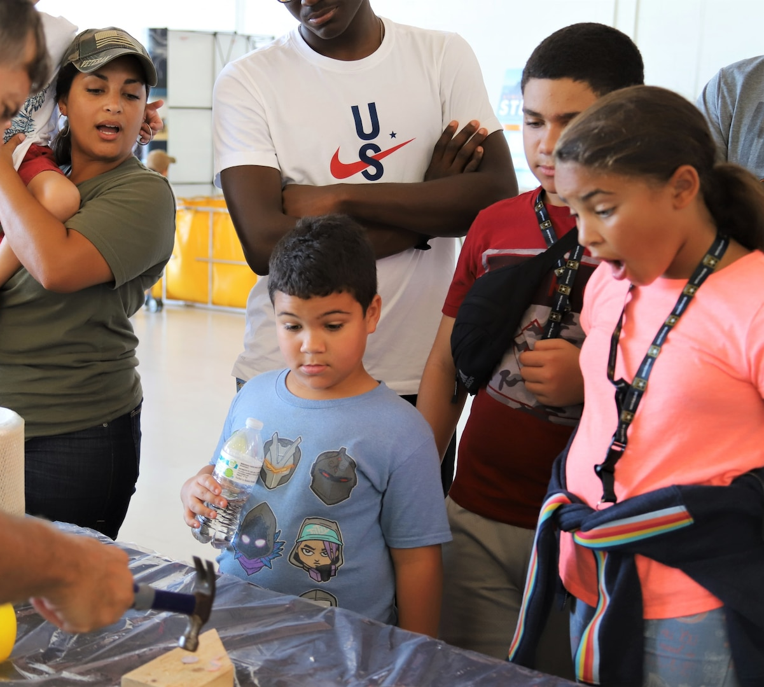

Outcome

