Slide 1
House Human Services Policy 3.11.24

Slide 2
Overview:
State of the State for SUD
Program closure data
SUD workforce survey data
Policy development survey and legislative proposals
Policy Proposals SF3984 / HF4149
Budget Proposals SF4276 / HF4190

Slide 3
SUD treatment landscape
DHS Licensing Information Lookup (does not include tribally licensed programs)
https://licensinglookup.dhs.state.mn.us/search.aspx
417 active 245G Licenses (as of 3.8.24)
12 active Withdrawal Management programs
18 active Detoxification programs

Slide 4
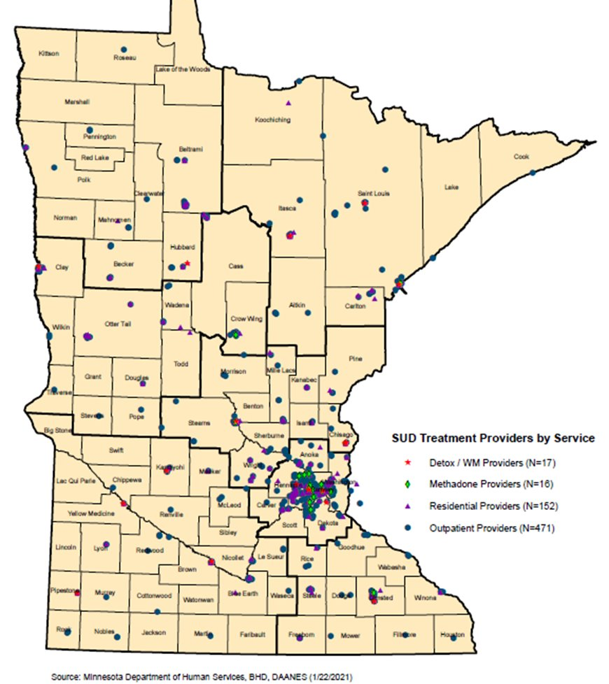
SUD treatment landscape
As of 1.26.24, 50 of MN’s 87 counties have a DHS licensed program physically in their county.

Slide 5
DHS Licensing Data 2022
Information based on Active Licenses on This Date | Total Count of All SUD Tx Licenses | Total Residential Capacity of All Programs | Count of Residential SUD Tx Only Licenses | Count of Licenses Dually Licensed as Residential & Non-Residential | Count of Non-Residential SUD Tx Only Licenses
1/1/2022 | 461 | 3,651 | 66 | 49 | 346
Calendar Year | SUD Tx License Type | Licenses Active on Jan. 1st | Licenses Opened During Calendar Year | Licenses Closed During Calendar Year | Net Change Number of Licenses in Calendar Year
2022 | All SUD Tx Licenses | 461 | 33 | 58 | -25
2022 | Non-Residential SUD Tx Only | 346 | 31 | 49 | -18
2022 | Programs Dually Licensed as Residential & Non-Residential | 49 | 1 | - | 1
2022 | Residential SUD Tx Only | 66 |  | 9 | -8
Notes:
Data received from DHS licensing on 2.16.24.

Slide 6
DHS Licensing Data 2023
Information based on Active Licenses on This Date | Total Count of All SUD Tx Licenses | Total Residential Capacity of All Programs | Count of Residential SUD Tx Only Licenses | Count of Licenses Dually Licensed as Residential & Non-Residential | Count of Non-Residential SUD Tx Only Licenses
1/1/2023 | 434 | 3,658 | 58 | 50 | 326
Calendar Year | SUD Tx License Type | Licenses Active on Jan. 1st | Licenses Opened During Calendar Year | Licenses Closed During Calendar Year | Net Change Number of Licenses in Calendar Year
2023 | All SUD Tx Licenses | 434 | 38 | 58 | -20
2023 | Non-Residential SUD Tx Only | 326 | 30 | 41 | -11
2023 | Programs Dually Licensed as Residential & Non-Residential | 50 | 3 | 5 | -2
2023 | Residential SUD Tx Only | 58 | 5 | 12 | -7

Slide 7
SUD treatment landscape
45 net closures in two years (116 licenses closed, 71 opened)
Legacy Programs Closed
2 programs opened in the 1970’s; 5 programs opened in the 1980’s
Adolescent Programs
At least 6 have closed in the last two years
Impact on Greater MN
2022
42% of full closures were outside of the 7 county metro area
2023
41% of full closures were outside of the 7 county metro area
63% (5 of 8) of full Residential closures were outside of the 7 county metro area

Slide 8
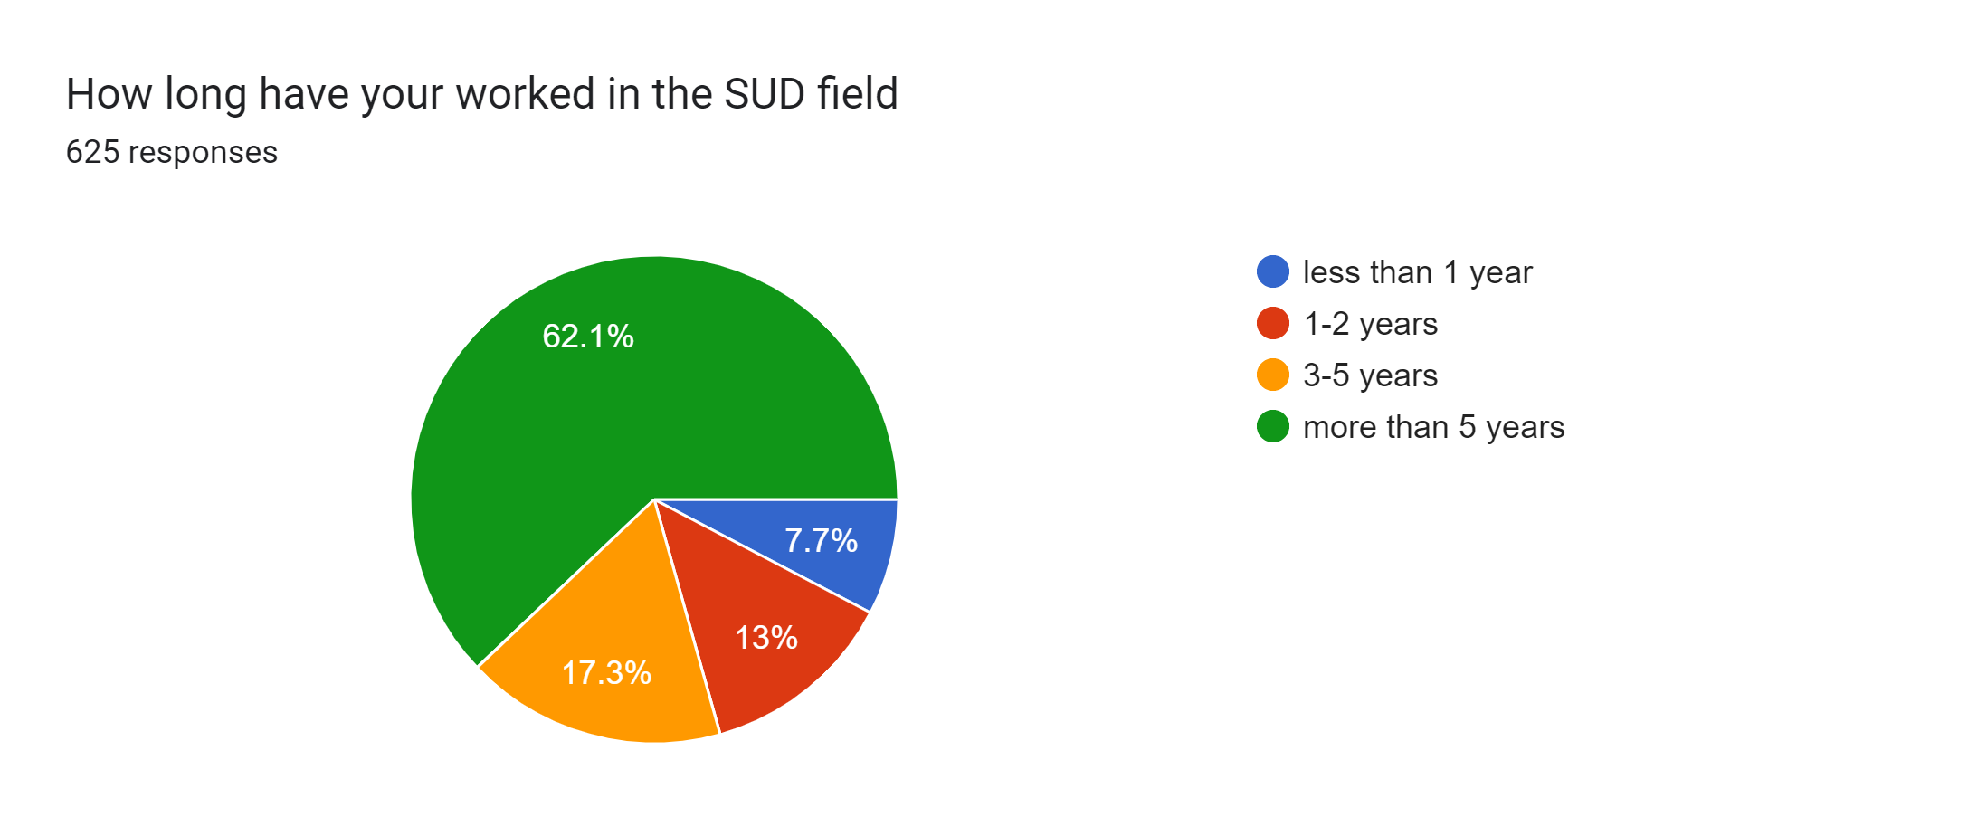
Join the conversation: SUD workforce Survey.
Collected responses from 627 people that work in Substance Use Disorder treatment and recovery in MN.
Responses from 137 different zip codes
77% of respondents were direct care staff (counselors, nurses, techs, etc)

Slide 9
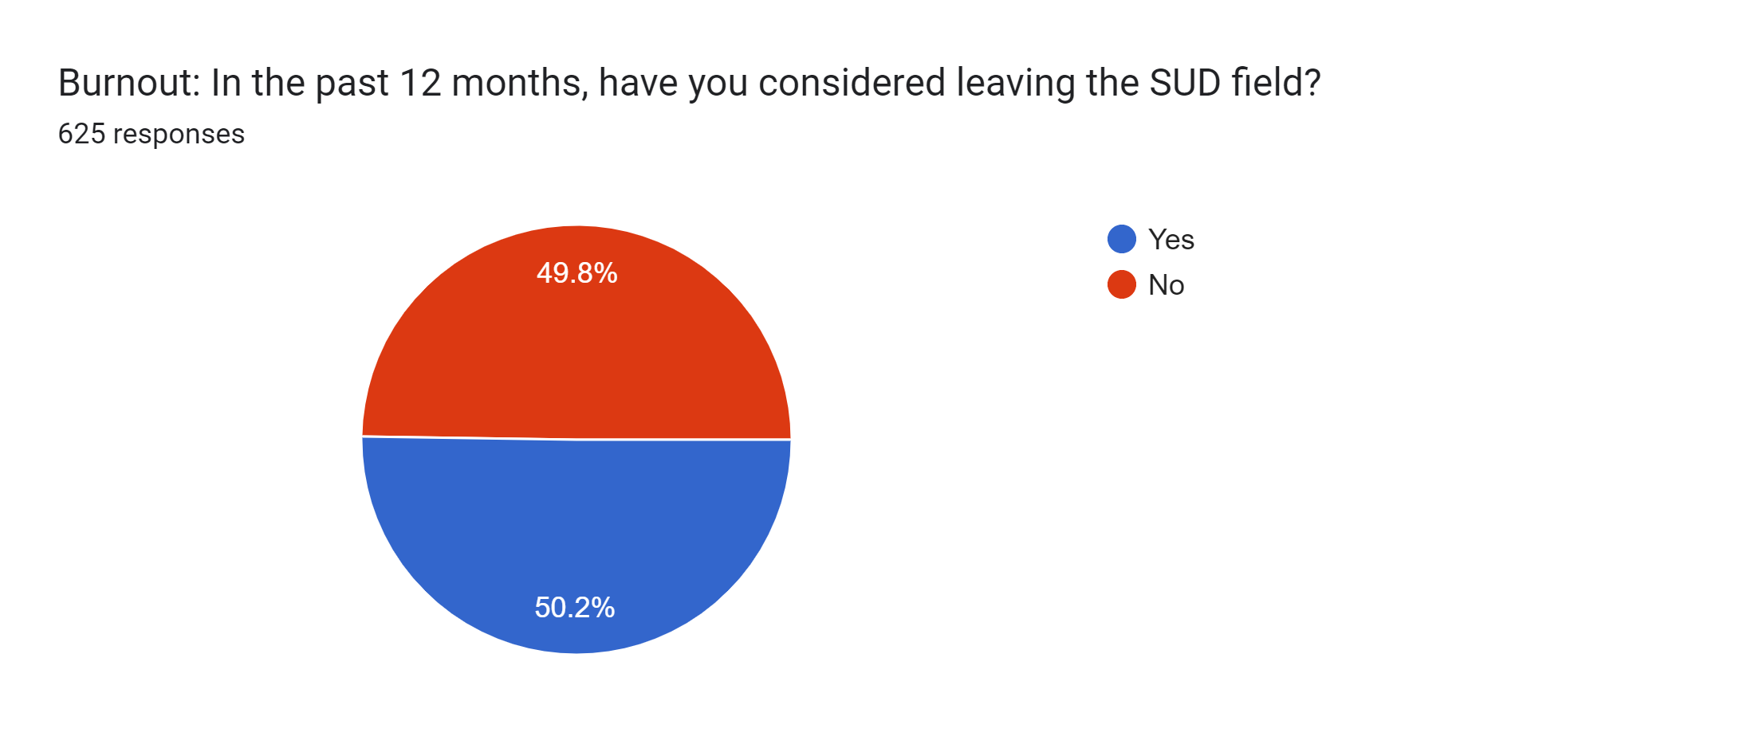
SUD workforce Survey: Burnout
How likely are you to leave in the next 12 months?
75% will not, probably won’t leave
25% will, probably will leave

Slide 10
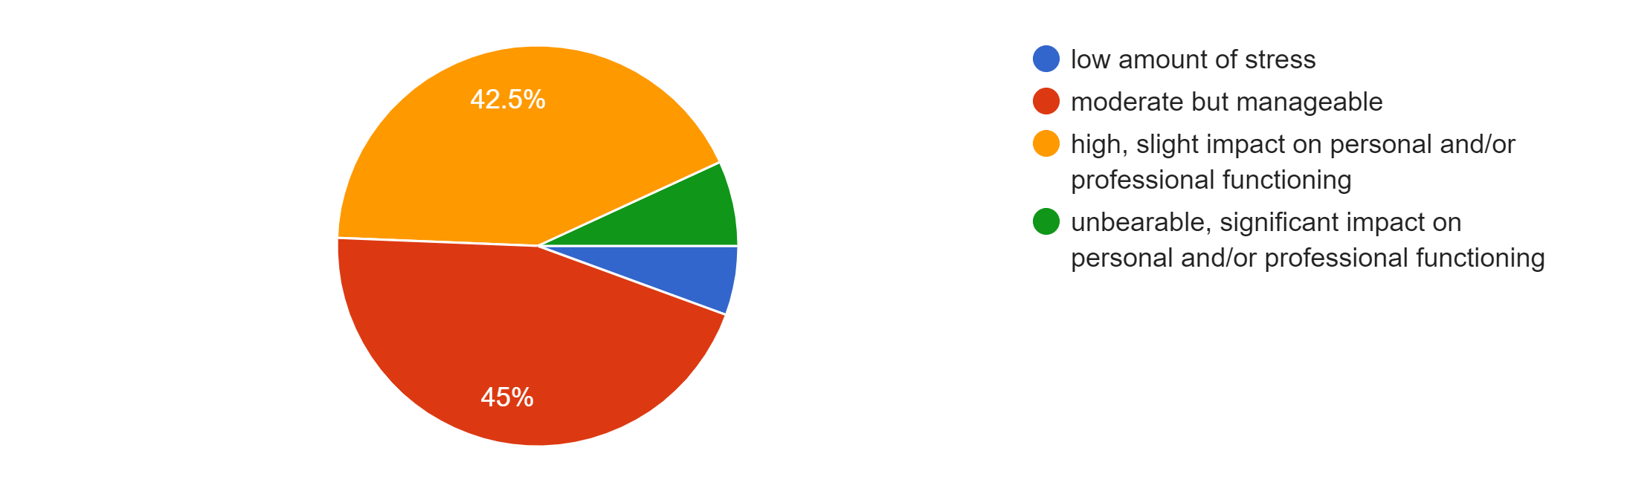
SUD workforce Survey: Stress
When asked what the one thing is that causes the most stress, the top 4 answers were:
Caseload/Program needs
Paperwork
Not enough staff/inexperienced
Client Acuity

Slide 11
SUD workforce Survey: Hope
Nearly 80% of responses were moderately to very hopeful for the future of SUD in the coming years
Our workers are a resilient group!
Immediate and long-term structural changes are needed from both a policy and funding standpoint

Slide 12
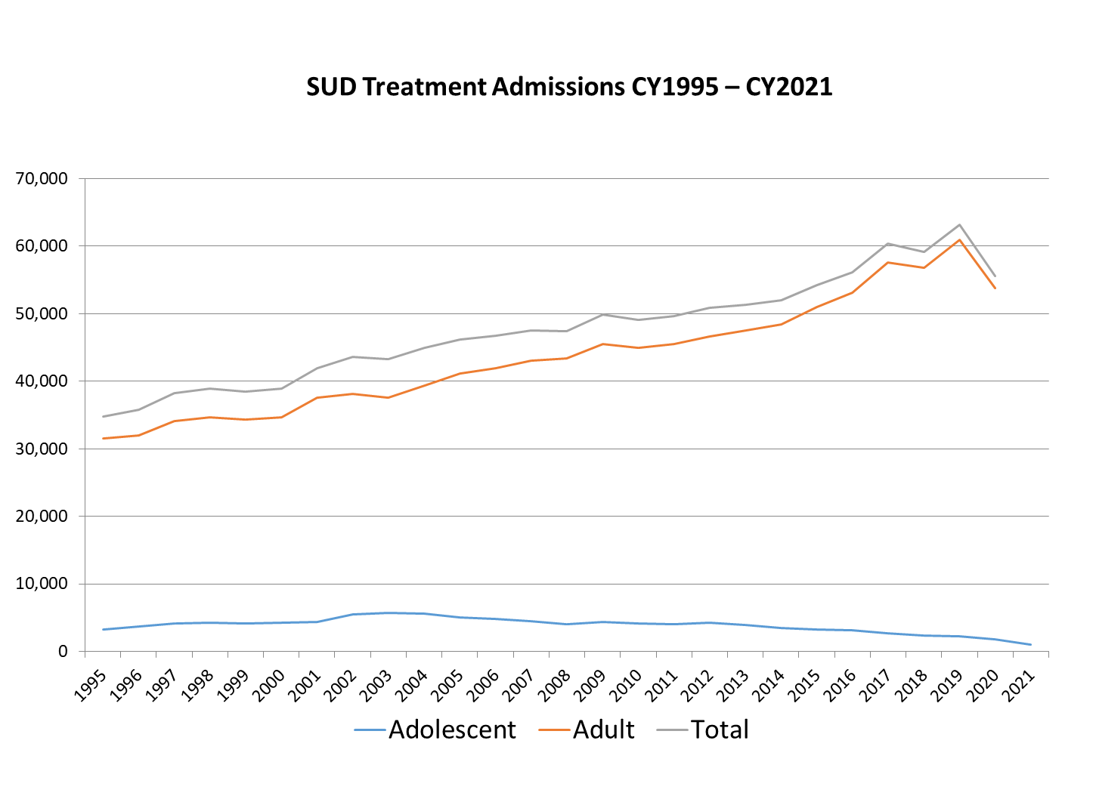
SUD Treatment Admissions CY1995-CY2021
Notes:
Slide courtesy of Rick Moldenhauer: MN DHS

Slide 13
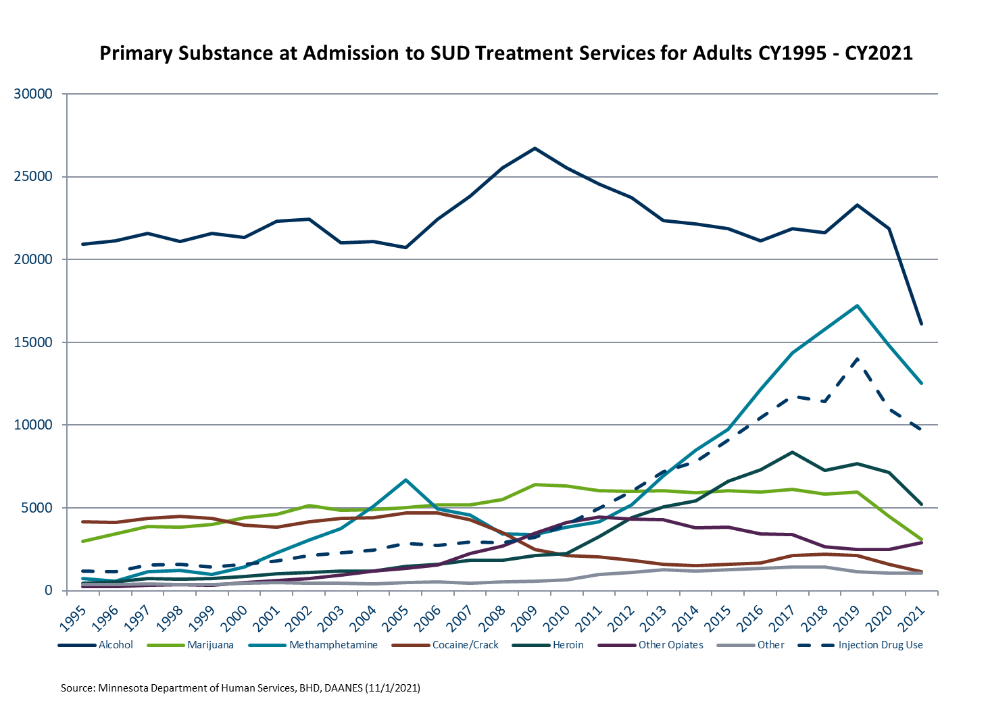
Primary Substance at Admission to SUD Treatment Services for Adults CY1995-CY2021
Notes:
Slide courtesy of Rick Moldenhauer: MN DHS

Slide 14
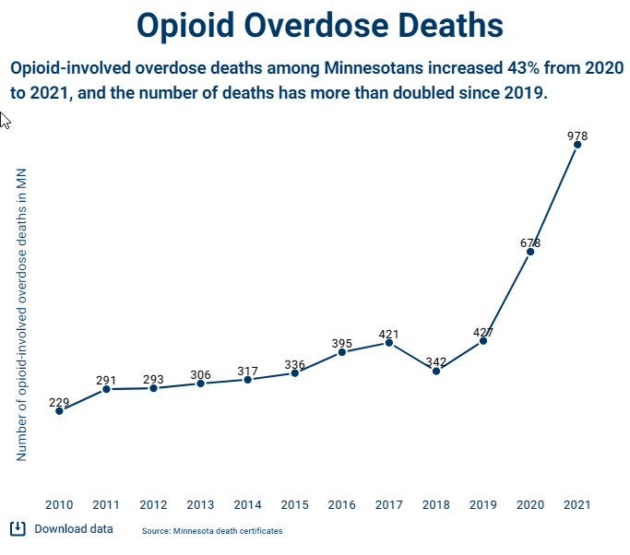
Minnesota Overdose Deaths Increased 43% between 2020 and 2021
Notes:
Slide courtesy of Rick Moldenhauer: MN DHS

Slide 15
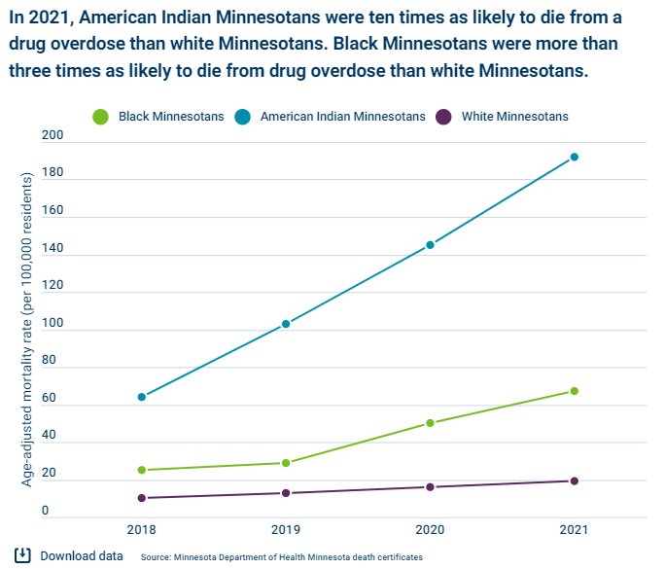
In 2021, American Indians were 10X as likely to die from an overdose, Black Minnesotans 3x….
Notes:
Slide courtesy of Rick Moldenhauer: MN DHS

Slide 16
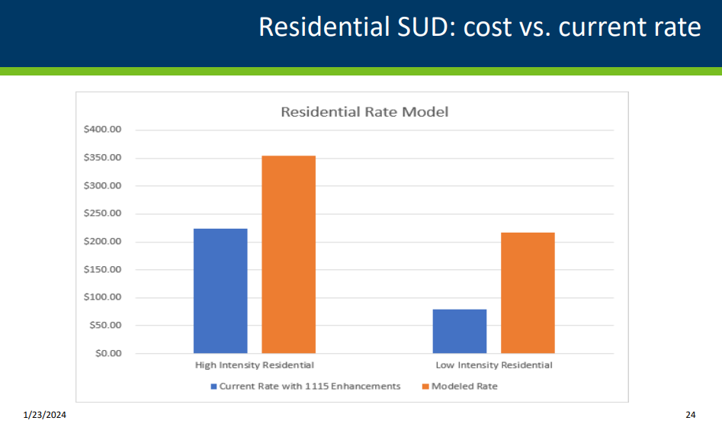
SUD reimbursement rates
Notes:
DHS Presentation to MN House on the Rate Study:
https://www.house.mn.gov/comm/docs/yeDIqCG8x0O4_-owmyCalg.pdf

Slide 17
The ASAM Criteria Continuum of Care – Adult
Level 4: Inpatient
4
Medically Managed Inpatient
3.1
Clinically Managed
Low-Intensity Residential
3.5
Clinically Managed
High-Intensity Residential
3.7
Medically Managed Residential
Level 3: Residential
BIO
Level 2: Intensive Outpatient
Intensive Outpatient
High Intensity Outpatient
Medically Managed Intensive Outpatient
2.1
2.5
2.7
Level 1: Outpatient
1.0
Long term remission monitoring
1.5
Outpatient Therapy
1.7
Medically Managed Outpatient
Recovery Residence
RR
Recovery Residence*
Co-occurring enhanced care (COE) Standards Defined for x.5, x.7, and Level 4
Notes:
The ASAM Criteria continuum of care includes four broad treatment levels (1 through 4). Within these four broad levels of care, decimal numbers express further gradations of intensity and types of care provided. The continuum of care also includes programs with enhanced biomedical capabilities (ie, Level 3.7 BIO) and with enhanced capabilities for treating patients with co-occurring mental health conditions (i.e., co‑occurring enhanced (COE) levels of care including Levels 1.5 COE, 1.7 COE, 2.5 COE, 2.7 COE, 3.5 COE, 3.7 COE, and 4 Psychiatric). The ASAM Criteria Dimensional Admission Criteria may recommend a recovery residence in addition to an outpatient level of care.
In the 3rd edition Level 3.7 was named residential/inpatient – in reality mostly delivered in residential settings – need for clear standards and to specify admission criteria that align with resources in a residential setting

Slide 18
SUD reimbursement rates
Rates—you get what you pay for
To develop a continuum based on ASAM, investments are needed.
Since 2011, SUD base rates have increased 3%
The 20% and 25% increase for 1115 enrollment has not covered the cost to deliver the service
SUD rate study recommendations identify an average increase of more than 65%
We need both immediate and long-term structural improvements made
These policy and budget proposals were identified and developed by more than 240 SUD professionals across the state. They know what is needed, now we need action!

Slide 19
Policy Proposals SF3984 / HF4149
Expand alternative paths to licensure [Section 1]
ASAM certification/Alternative Licensing Inspections [Section 2]
Eliminate ratios to align with ASAM [Sections 3 and 5]
Medical and mental health staffing
Residential engagement documentation
Federal holidays off for counselors

Slide 20
Policy Proposals SF3984 / HF4149
County Affidavit for BHF [Section 4]
Hard deadline for paperwork reduction of December 2024 [Section 6]

Slide 21
Budget Proposals SF4276 / HF4190
Waiving Fees for IDs (Sections 1, 2, and 3)
Birth certificate and driver's license/ID card
SUD rates
Develop group peer rate (section 4 and 5)
"Unstrike" SUD and be included in 3% increase effective Jan. 1, 2024 (section 7)
Auto inflation adjustment (section 7)
Implement rate methodology recommendations ASAP (section 11)
Hold harmless WM 3.2; maintain clients with children enhancement until a cost based rate is established.

Slide 22
Budget Proposals SF4276 / HF4190
SUD Treatment Effectiveness (Section 6)
Create an SUD data dashboard
Extend rate study to include adolescent SUD (residential/non-residential, Withdrawal Management) and Room and Board payments (section 8)

Slide 23
Budget Proposals SF4276 / HF4190
1115 Waiver for Incarceration (section 9)
Transition Support Workgroup (Section 10)
Develop recommendations related to housing, food support, childcare, and transportation services for people transitioning out of SUD services

Slide 24
SUD Resources: webpages, reports
MARRCH links and resources
https://www.marrch.org/page/links
Rural Chemical Health Disparities Report
https://cdn.ymaws.com/www.marrch.org/resource/resmgr/docs/Rural-Chemical-Health-Dispar.pdf
ASAM 4th Edition Presentation (Dr. Waller) at 2023 MARRCH fall conference
MARRCH 2023 Conference Keynote Corey Waller (youtube.com)
DHS Behavioral Health: Program overviews:
https://mn.gov/dhs/partners-and-providers/program-overviews/behavioral-health/

Slide 25
SUD Resources: webpages, reports
DHS Presentation to MN House on the Rate Study:
https://www.house.mn.gov/comm/docs/yeDIqCG8x0O4_-owmyCalg.pdf
Rate Study report recommendations:
https://www.house.mn.gov/comm/docs/2EalZUA_kEWBU-ZWWr2L5Q.pdf
MN Department of Health
LADC workforce report 2019
https://www.health.state.mn.us/data/workforce/mh/docs/cbladc.pdf
Drug Overdose Dashboard
https://www.health.state.mn.us/communities/opioids/opioid-dashboard/index.html#:~:text=The%20Minnesota%20Injury%20Data%20Access%20System%20%28MIDAS%29.%20allows,level%2C%20by%20age%20and%20gender%2C%20and%20by%20rate
MN Management and Budget: Results First study for SUD
https://mn.gov/mmb/results-first/substance-use-disorder/

