Slide 1

Minnesota Department of Veterans Affairs
House State Government Finance Committee
February 24, 2011

Slide 2
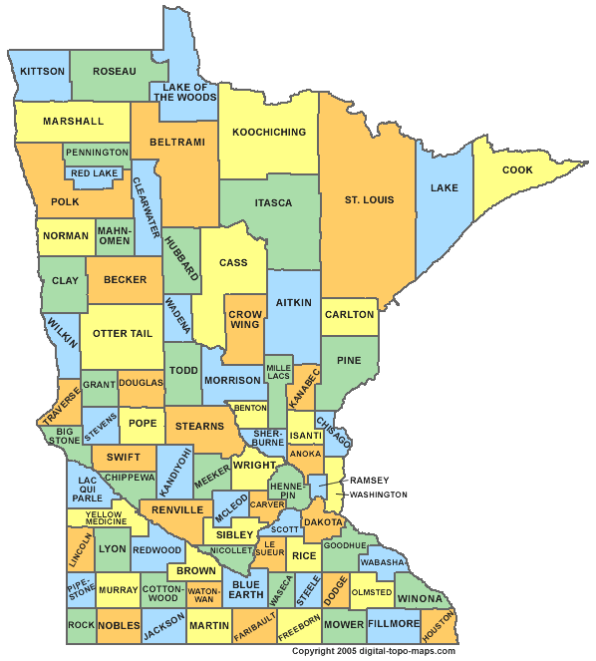
Minnesota Department of
Veterans Affairs
Comprehensive Five Year Strategic Plan, with 2010 Update http://www.mdva.state.mn.us/reports/index.htm#StrategicPlan
Approximately 400,000
Veterans in Minnesota
Serving Veterans in all 87 counties

Slide 3
Minnesota Department of
Veterans Affairs
Commissioner
Deputy Commissioner of Programs and Services
Senior Director of Programs and Services
Deputy Commissioner of Veteran Health Care
Senior Director of Veteran Health Care

Slide 4
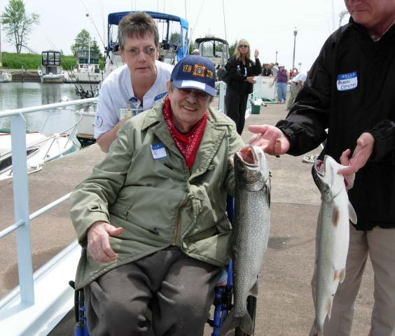
Minnesota Department of
Veterans Affairs – Veterans Homes
Minnesota has five State Veterans Homes; Fergus Falls, Hastings, Luverne, Minneapolis and Silver Bay
  Resident Characteristics for Skilled Nursing Care
    Average age 78
    Male
    WWII Veteran
    Top 3 Types of Care:
      Alzheimer’s disease
      Dementia w/behavioral disturbances
      Organic brain syndrome (chronic)
    Multiple nursing home stays before admission to
    Veterans Homes
  Resident Characteristics for Domiciliary Care
  Average age 58
  Male
  Vietnam Veteran
  Top 3 Types of Care:
      Alcohol dependence syndrome
      Schizophrenic disorders
      Affective psychoses/depression
  Often homeless

Slide 5
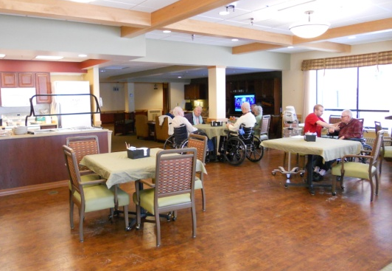
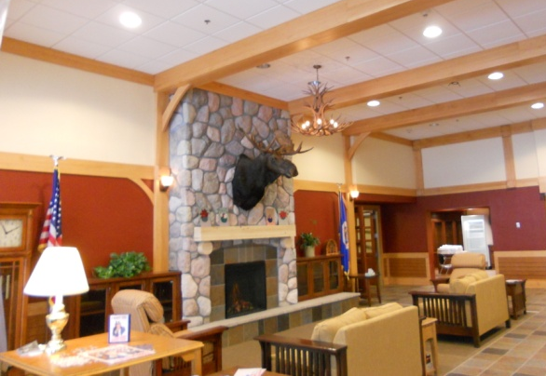
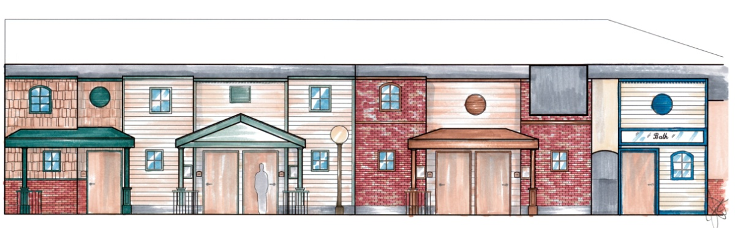
Minnesota Department of
Veterans Affairs – Veterans Homes
Focused on Quality Care for Minnesota’s Heroes
  Person-Centered Care
    National industry standard
    Allows Residents and families to be involved
    in their care plans
  “Pods” or “Communities” of Care
    Fosters close relationship with caregivers
    and provides continuity of staff
    Food is prepared and served in family setting
    Home-like environment with “town center”
  Construction Update
    Silver Bay
    Fergus Falls
    Minneapolis
    Future vision for Hastings

Slide 6
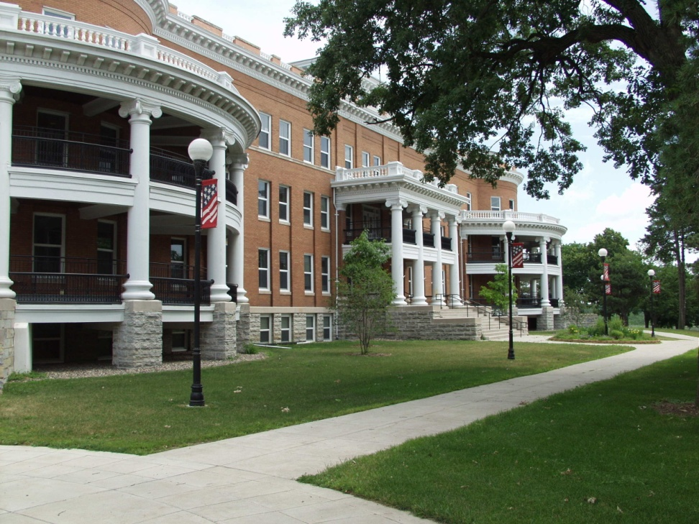
Minnesota Department of
Veterans Affairs – Veterans Homes
 | Minneapolis Established 1887 341 skilled beds 61 domiciliary beds 18 buildings on 51 acres Private and semi-private rooms Administrator, Shelley Kendrick

Slide 7
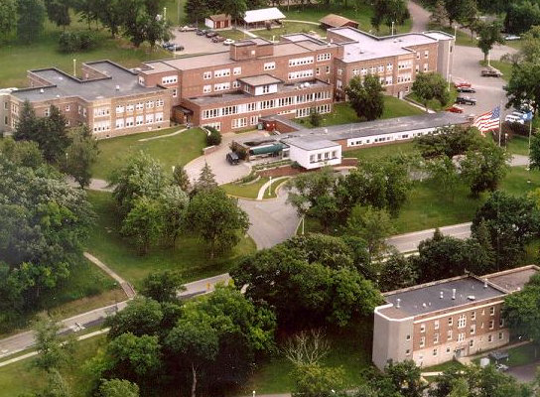
Minnesota Department of
Veterans Affairs – Veterans Homes
Hastings
Established 1978
200 domiciliary beds
128 acre campus
CD Counseling
Vocational Rehab
Wood Shop
Interim Administrator Robin Gaustad

Slide 8
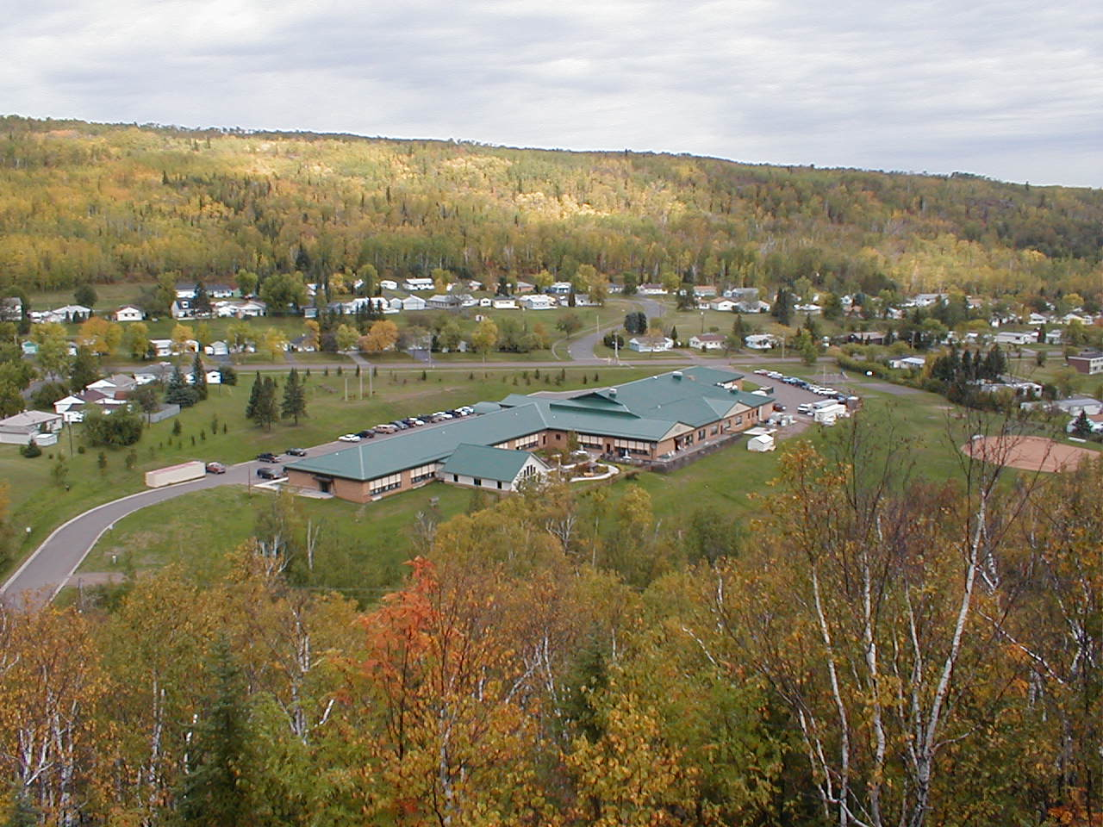
Minnesota Department of
Veterans Affairs – Veterans Homes
 | Silver Bay Established 1991 83 skilled beds Dementia unit (25 beds) 50 miles N.E. of Duluth Administrator, Carol Gilbertson

Slide 9
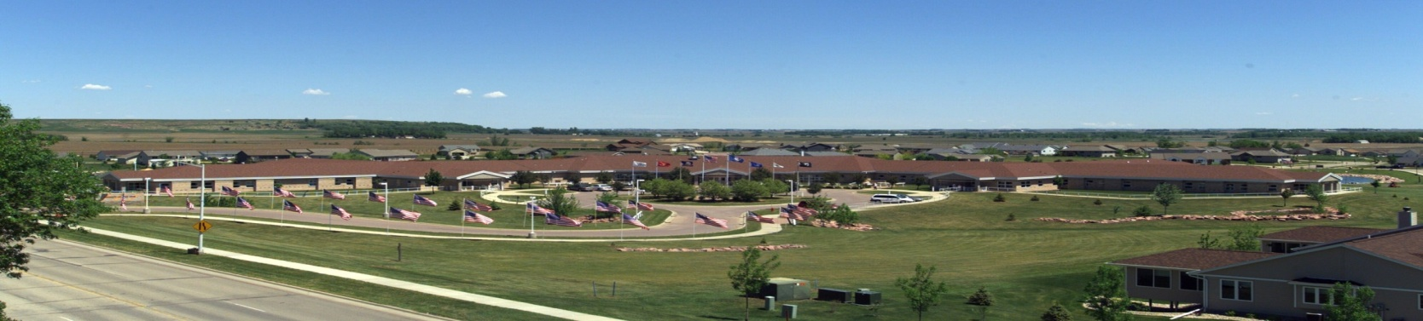
Minnesota Department of
Veterans Affairs – Veterans Homes
Luverne
Established 1994
85 skilled beds
Wander unit (dementia)
Administrator, Michael Bond

Slide 10
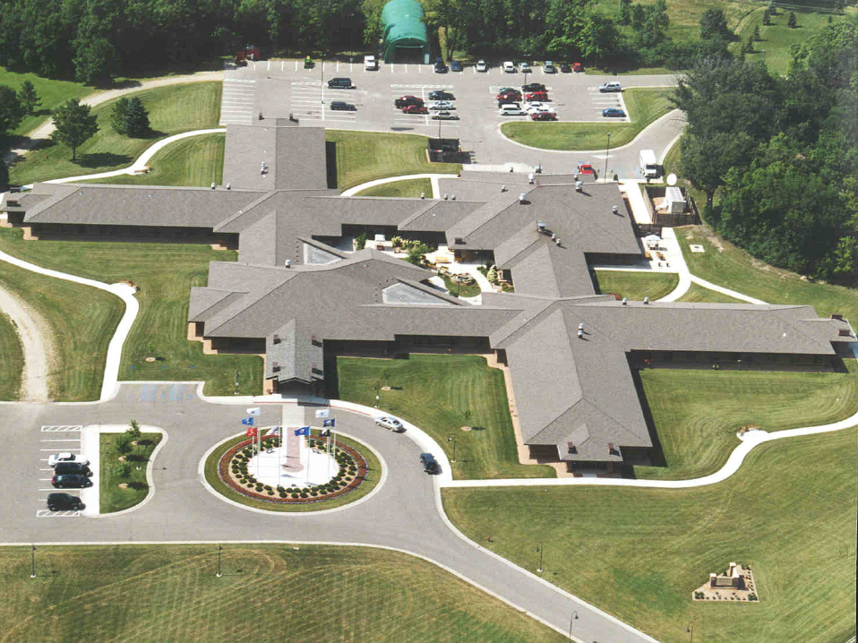
Minnesota Department of
Veterans Affairs – Veterans Homes
Fergus Falls
Established 1997
85 skilled beds
CBOC within complex
Interior open-air recreational area
Award-winning Nursing Care approaches
Administrator, Jon Skillingstad

Slide 11

Minnesota Department of
Veterans Affairs – Veterans Homes
Active Waiting Lists – As of January 3, 2011
  Fergus Falls - 154
  Hastings
    Domiciliary – 0
    Supportive Housing – 0
  Luverne - 88
  Minneapolis
    Domiciliary – 0
    Skilled Care – 207
  Silver Bay - 66

Slide 12
Minnesota Department of
Veterans Affairs – Programs & Services
Programs & Services provided by MDVA (16 Program/Service Areas)
  State Soldiers Assistance Program
  LinkVet
  Veterans Preference Enforcement
  State Approving Agency
  Apprenticeship and On-the-Job Training
  Higher Education Veterans Program
  Minnesota GI Education Bill
  War Survivor Education Benefits
  Claims and Outreach
  Tribal Veteran Service Officers
  Minnesota Service C.O.R.E.
  State Veterans Cemetery
  Recently Separated Veterans Program
  County Veteran Service Organization Enhancement Grants
  Veteran Service Organizations
  RSVP Program

Slide 13
Minnesota Department of
Veterans Affairs – Programs & Services
State Soldiers Assistance Program
  Provides direct or emergency financial assistance to Veterans, dependents and survivors
  Assistance may include: shelter & utilities; optical & dental; cash grants; education benefits for Veterans and war orphans; and special needs cases
  8,563 transactions processed in FY2009 and 8,923 in FY2010
  84 of 87 counties served
LinkVet 1-888-LinkVet
  Nation leading program provides information on Veterans’ benefits, health care, education and reintegration
  The phone line is managed by trained Minnesota Online staff during business hours
  204,884 telephone and website contacts in a year
  Website visits from a unique IP address
    70,657 visits from 120 countries world-wide
    68,140 visits from 3,341 cities in the United States
    36,798 visits from 316 cities in Minnesota

Slide 14
Minnesota Department of
Veterans Affairs – Programs & Services
State Approving Agency (SAA)
  Provides administrative oversight of the federal G.I Bill’s Education and Training programs
  Before Veterans receive their G.I Bill education benefits, the education or training program in which they intend to enroll must be pre-approved by SAA
  7,526 approved programs within 262 schools through Minnesota’s higher educational institutions.
  As of December 2010, 11,648 students participate the approved programs
OJT and Apprenticeship Program
  Transferred to MDVA from DOLI on October 1, 2008
  Provides increased opportunities for Veterans to use their earned educational benefits for on-the-job and apprenticeship training
  91% increase in approved OJT and Apprenticeships since MDVA took over the program

Slide 15

Minnesota Department of
Veterans Affairs-Programs
& Services
Higher Education Veterans Program- “Building the Innovators of Tomorrow”
  Supports Veterans, current military members and families at Minnesota colleges and universities
  Provides on-campus Veterans Resource Centers, comprehensive information about benefits and resources as well as institutional readiness in support of the unique needs of these students
The program has grown steadily since its inception in late 2006. It is important to note that each individual is only counted once, even though a student may return for help multiple times. Due to this, the impact of the Higher Education Veterans Program is actually higher than reflected in the graph.

Slide 16
Minnesota Department of
Veterans Affairs – Programs & Services
Minnesota G.I. Bill
  Provides postsecondary educational assistance to eligible Minnesota Veterans, military members and the children and spouses of deceased or severely disabled Minnesota Veterans
  “Last Dollar In” Program
Surviving Spouse/Dependent Education Benefit (War Survivor)
  Provided to survivors of Minnesota Veterans who died as a result of a service connected injury or disease
Veterans Preference Act (VPA)
  Ensures that state granted Veterans preference rights are upheld and enforced

Slide 17
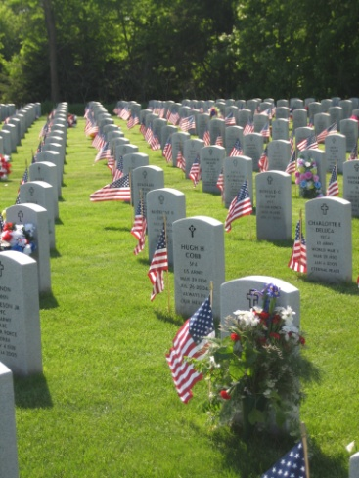
Minnesota Department of
Veterans Affairs – Programs & Services
Minnesota State Veterans Cemetery
  Located in Little Falls
  Provides dignified burial services to Veterans and
  their eligible dependents
The State Veterans Cemetery has grown steadily since opening in June 1994. This greater than 375% increase in annual burials since 1994 not only represents an dramatic increase in burial workload, but also a substantial annual increase in the number of occupied gravesites that must be maintained to a level of national shrine status that the families we serve have come to expect.

Slide 18
Minnesota Department of
Veterans Affairs – Programs & Services
Federal Claims Assistance, St. Paul and Fargo
    MDVA staff represent Veterans, their dependents and survivors seeking benefits from USDVA
    Responsibilities: claims development, submittal of evidence in support of service-connection claims, pension assistance, evaluation of VA decisions and assisting Veterans and dependents with appeals processes up to and including federal hearings
Outreach & Women Veterans Program
    Helps locate and assist minorities, female and homeless Veterans
    Advocates on behalf of Veterans having claims with the USDVA
    Acts as liaison to various state and federal programs that provide Veterans benefits including health care programs, substance abuse programs and housing
    Responds to the gender specific needs of women Veterans
Tribal Veteran Service Officers (TVSO)
  Provides community outreach to Minnesota’s tribes
  Serve as the Native American Veteran advocate
  Monitors both federal and state benefits claims

Slide 19
Minnesota Department of
Veterans Affairs – Programs & Services
Minnesota Service C.O.R.E.
  Serves Veterans, current military & their families through Case Management, Outreach, Referral & Education
  New, nation-leading program
  Designed to bring community-based services directly to Veterans, service members and families at no cost
  Partnered with Lutheran Social Service of Minnesota (LSS)
  Services include individual and family counseling, financial counseling, debt management, addiction counseling, disability services and in-home counseling
  Program initiated September 2009
  2,777 Veterans and their families received client services in the first year
  11% increase in services during the current fiscal year (FY2011)

Slide 20
Minnesota Department of
Veterans Affairs – Programs & Services
Recently Separated Veterans Program (RSVP)
  Assists Veterans who have identified Minnesota as their home of record
  Upon receipt of a DD-214, MDVA mails a “Welcome Home” letter to the Veteran
  Letter contains relevant transitional information and directs them to their local County Veterans Service Officer (CVSO) for available services
Enhancement Grants
  Grants are used to enhance the benefits, programs, and services provided to Veterans
  The programmatic goals under which CVSOs may apply are:
    Outreach to Veterans
    Reintegration of combat Veterans
    Collaboration with social service agencies; educational institutions; and other relevant community resource
    Reduction of homelessness among Veterans
    Digital records management
    Transportation program
    Marketing/advertising
    Staff management and training
Notes:
.

Slide 21

Minnesota Department of Veterans Affairs Governor’s Recommendation

Slide 22
Minnesota Department of Veterans Affairs Governor’s Recommendation
MN Department of Veterans Affairs FY2012-13
$223.2 million biennial budget all funds
  $2.6 million general fund open appropriation and $200,000 general fund direct appropriation for the MN GI Bill
    100% transfers to Office of Higher Education for grant awards and administration
  $116.1 million general fund expenditures
  $104.3 million other funds expenditures:
    Miscellaneous special revenue $35.6 million
    Federal funds $63.8 million
    Miscellaneous Agency (100% resident trust accounts) $3.6 million
    Gift or Donations $1.3 million
  1,128.8 FTE or 1,448 people

Slide 23
Minnesota Department of Veterans Affairs Governor’s Recommendation
MN Department of Veterans Affairs FY2012-13

Slide 24
Minnesota Department of Veterans Affairs Governor’s Recommendation
Veterans Programs & Services FY2012-13
$32.2 million budget all funds
  $2.6 million general fund open appropriation and $200,000 general fund direct appropriation
    100% transfers to Office of Higher Education for grant awards and administration
  $27.4 million general fund direct appropriation expenditures, including the following change item:
    $945,000 each year for continued operation of the Higher Education Veterans Assistance Program (budget pages 11-12)
    HF384 proposes removing the sunset date
  $2 million other funds expenditures

Slide 25
Minnesota Department of Veterans Affairs Governor’s Recommendation
Veterans Programs & Services FY2012-13
89 FTE
Budget Activities
  Veterans Services Operations $5.2 million and 21.7 FTE
    Core Services: veterans services administration, Department leadership and strategic planning, recently separated veterans program, veterans preference act, bronze star markers, Department-wide IT initiatives
  Benefits and Services $15 million and 19.6 FTE
    Core Services: State Soldiers Assistance Program (SSAP), MN Service C.O.R.E., LinkVet Call Center, State Cemetery, State Approving Agency Apprenticeship and On-the-Job Training Program, MN GI Bill
  Claims and Outreach $9.13 million and 46.5 FTE
    Core Services: Claims Office, Veterans Outreach, Tribal Veterans Service Offices, Women Veterans Program, Higher Education Veterans Assistance, County Veteran Service Office Grants, MN Assistance Council for Veterans, Veterans Service Organization Grants, Support Our Troops

Slide 26
Minnesota Department of Veterans Affairs Governor’s Recommendation
Veterans Programs & Services FY2012-13

Slide 27
Minnesota Department of Veterans Affairs Governor’s Recommendation

Slide 28
Minnesota Department of Veterans Affairs Governor’s Recommendation
Veterans Health Care (Homes) FY2012-13
$191.1 million budget all funds
$88.7 million general fund, including $500,000 in each year for repairs and betterments and the following change items:
  $738,000 in FY2013 and $842,000 in FY2014 ongoing for operations of the new Fergus Falls 21-bed Alzheimer’s unit (page 7)
    Bonding Laws of 2008, Ch 179, Sec 19, Subd 3
  $162,000 in FY2013 and $232,000 in FY2014 ongoing for operations of the new Mpls adult day care unit (page 8)
    Bonding Laws of 2006, Ch 20, Art 1, Sec 21, Subd 4

Slide 29
Minnesota Department of Veterans Affairs Governor’s Recommendation
Veterans Health Care (Homes) FY2012-13
Non-general fund change items
  Change earmarks established under Laws of 2010, Chapter 215, Article 6, Section 4 (budget page 9)
    Redirect carry forward earmark of $200,000 from Fergus Falls Veterans Home to Mpls Veterans Home for the adult day care start-up
  Veterans Home Service Redesign (budget page 10)
    The Homes program will create operating efficiencies and explore alternative revenue sources to provide sufficient funding to support the operational needs of the five state veterans homes
      Adjust operating costs to non-general fund resources $551,000 in FY2012 and $801,000 in FY2013
      Recognize salary and operating expenditures reductions $321,000 each year

Slide 30
Minnesota Department of Veterans Affairs Governor’s Recommendation
Veterans Health Care (Homes) FY2012-13
1,041 FTE in FY2012 and 1,005 in FY2013
  Increase 31.5 FTE for the operations of the Fergus Falls Veterans Home’s new Alzheimer’s unit
  Increase 13.5 FTE for the operations of the Mpls Veterans Home’s new adult day care unit
  FTE decline in FY2013 is a result of the net shortfall of $556,000
    Fully implement Medicare Part D prescription drug program
    Potentially begin billing for Medicare Part A and B (inpatient and outpatient care)
      Mitigating factors must be in place – such as receiving certification from CMS, staff training, resolution of life safety issues and an adequate billing system.

Slide 31
Minnesota Department of Veterans Affairs Governor’s Recommendation
Veterans Health Care (Homes) FY2012-13
Budget Activities:
  Veterans Health Care Administration $4.6 million and 18.1 FTE
  Mpls Veterans Home, including new adult day care $108.5 million and 548.3 FTE
  Hastings Veterans Home $19.3 million and 106.7 FTE
  Silver Bay Veterans Home $18.6 million and 113.4 FTE
  Luverne Veterans Home $17.9 million and 109.1 FTE
  Fergus Falls Veterans Home, including new 21-bed Alzheimer’s unit $22.1 million and 145.7 FTE
Core Services: nursing care, rehabilitation services, dietetic and nutritional services, restorative care, recreational therapy, social services, pharmaceutical services, transportation, spiritual care, medical services, mental health program, resident work therapy, annual dental exam, and domiciliary program.
The revenue from the federal VA per diem payments and resident maintenance charges, when combined with the general fund appropriation, finance the operations of the five state Veterans Homes.

Slide 32
Minnesota Department of Veterans Affairs Governor’s Recommendation
Veterans Health Care (Homes) FY2012-13

Slide 33
Minnesota Department of Veterans Affairs Governor’s Recommendation
Veterans Health Care (Homes) FY2012-13

Slide 34
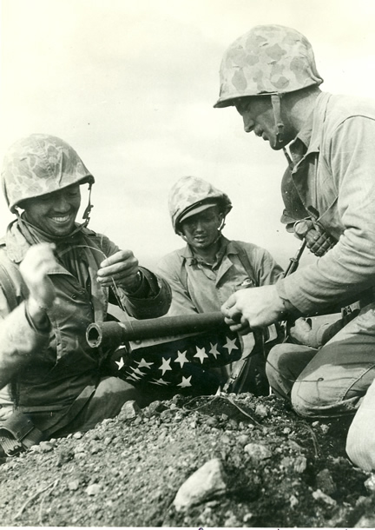
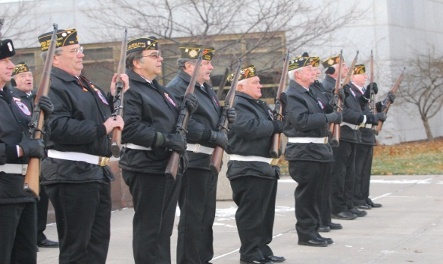

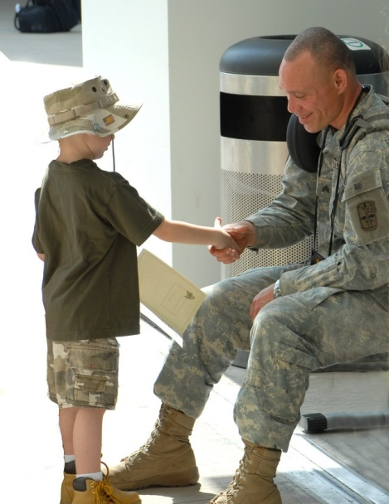
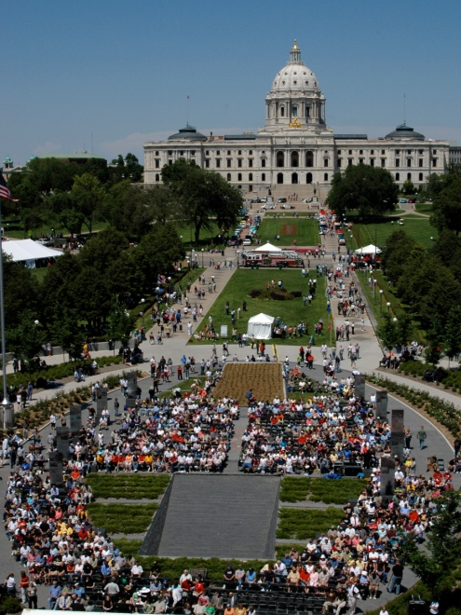
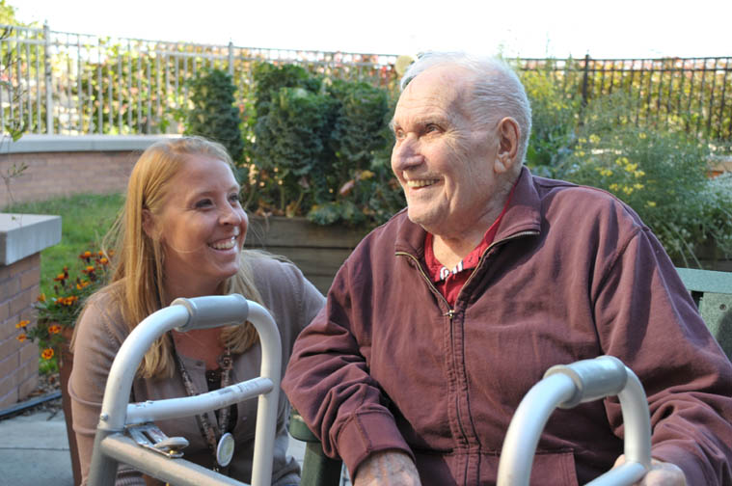
“Dedicated to serving Minnesota Veterans and their families”

