Slide 1
FY 2012-13 Biennial Budget Presentation
Jim Schowalter, Commissioner
March 8, 2011

Slide 2
MMB’s mission is to increase state government’s capacity to manage and utilize financial, human, information and analytical resources to ensure exceptional service and value for Minnesota’s citizens.

Slide 3
Minnesota Management & Budget
Division | FTEs | General Fund Spending | Other Funds Spending | Total Spending
Accounting Services | 44.7 | $3.8M | $0.3M | $4.1M
Budget Services | 22.8 | $3.7M | $0 | $3.7M
Economic Analysis | 4.0 | $.5M | $0 | $.5M
Information Systems | 43.4 | $3.6M | $6.7M | $10.3M
Treasury | 14.0 | $1.9M | $0 | $1.9M
Management Analysis | 15.4 | $.3M | $2M | $2.3M
Human Resource Mgmt | 29.1 | $2.3M | $.6M | $2.9M
Labor Relations | 8.0 | $.8M | $0.3M | $1.1M
Agency Administration | 22.9 | $3.7M | $0 | $3.7M
Employee Insurance | 47.3 | $0 | $773.8M | $773.8M
Total | 251.6 | $20.6M | $783.7M | $804.4M
SWIFT Project | 57.0 | $0 | $45.3M | $45.3M

Slide 4
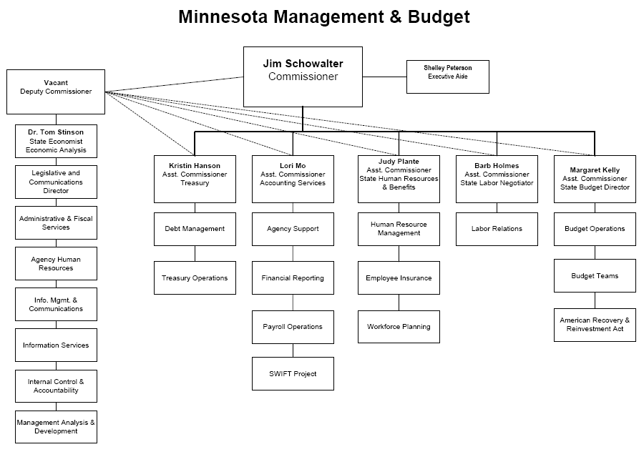

Slide 5
Economic Forecasts and Updates
10 Websites
SEMA4,
SWIFT
MAPS,
IA Warehouse
Statewide financial code of conduct enforcement
Agency audit monitoring
Agency training
Statewide organizational consulting

Slide 6
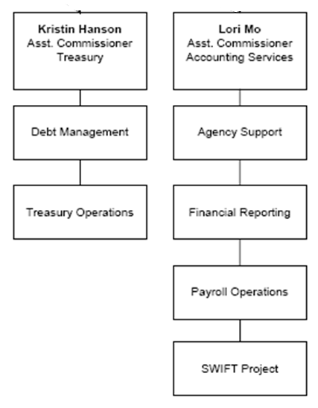
G.O. and other
bond management
State agency
accounting support
Compliance with
SEC & IRS regulations
State General Accounting
Comprehensive Annual
Financial Report (CAFR)
Statewide cash
management
State payroll
Processing – over
50,000 every 2 weeks
Process 4 million
Checks (warrants) each year
New Accounting &
Procurement system
- launches 7/1/2011
Manage 600 accounts at
banks across the state

Slide 7
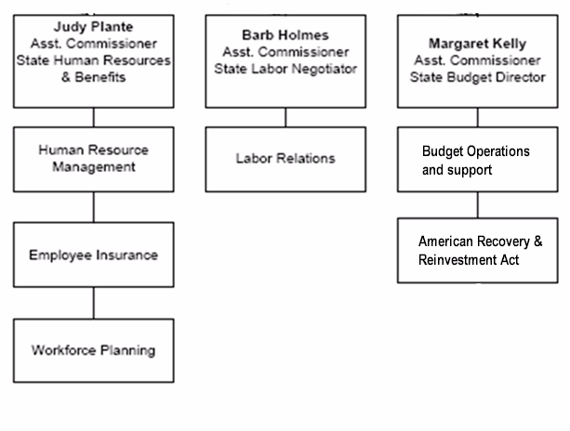
State HR policies
Employee and Applicant Systems
Compliance with state and federal laws
Agency
fiscal analysis
Fiscal Notes
Legislative
fiscal support
SEGIP – Healthcare
Insurance for all
branches of state
government
Governor’s
budget
development
Labor contract
negotiations
Arbitrations
Grievance consultation
Statewide disaster preparedness
Quarterly reporting
On federal ARRA program
Compliance with state and federal diversity requirements
Long term workforce strategy

Slide 8
What We Do
Manage the state’s $59.8 billion biennial budget
Manage 4.9 million expenditure transactions every year, 1.1 million cash deposits and 1.2 million payments
Manage statewide banking operations daily
Coordinate & analyze 1,000 fiscal notes each year
Conduct bond sales, with $5.7 billion in outstanding general obligation debt
Negotiate 9 bargaining agreements & operate 2 compensation plans
Manage insurance benefits for 120,000 individuals
Process nearly 90,000 applicant resumes every year
Pay over 50,000 employees from all three branches of state government and MnSCU every two weeks

Slide 9
Since 2000, appropriations have been reduced by 25 percent
Notes:
Increase in 2001 was due to Finance merger with Treasurer’s office and the addition of 12 Treasurer’s office staff.

Slide 10
FTEs have been reduced by 34 percent (127 FTEs) since 2000
 | 2000 | 2001 | 2002 | 2003 | 2004 | 2005 | 2006 | 2007 | 2008 | 2009 | 2010 | 2011
Department of Finance | 180.3 | 183.3 | 175.7 | 171.2 | 157.0 | 152.4 | 146.7 | 140.6 | 146.6
Department of Employee Relations | 198.9 | 210.5 | 201.8 | 176.9 | 148.5 | 144.3 | 138.9 | 133.9 | 116.1
SWIFT Project |  |  |  |  |  |  |  |  |  |  | 57.0 | 57.0
Total | 379.2 | 393.8 | 377.5 | 348.1 | 305.5 | 296.7 | 285.6 | 274.5 | 262.7 | 260.1 | 247.0 | 251.6
Notes:
Increase in 2001 was due to Finance merger with Treasurer’s office and the addition of 12 Treasurer’s office staff.

Slide 11
Agency Change Item
Change item: Results Management
Fiscal Impact ($000s) | FY 2012 | FY 2013 | FY 2014 | FY2015
General Fund
Expenditures | $250 | $250 | $250 | $250
Revenues | $0 | $0 | $0 | $0
Net Fiscal Impact | $250 | $250 | $250 | $250
Creates a data driven process to ensure agencies are accountable for critical initiatives
Collaborative effort of Governor’s Office, Admin, OET, and MMB
Based on well-demonstrated efforts at many local units of government

Slide 12
Agency Change Item
Change item: Task Force on Small Agencies & Boards
Fiscal Impact ($000s) | FY 2012 | FY 2013 | FY 2014 | FY2015
General Fund
Expenditures | $50 | $0 | $0 | $0
Revenues | $0 | $0 | $0 | $0
Net Fiscal Impact | $50 | $0 | $0 | $0
Mission: to review the operations of the smallest state agencies, boards, and commissions. The task force will accomplish that by:
Identifying and describing the purpose of each entity with 10 or fewer FTE’s
Reviewing the mission, services, and operations of each entity
Making recommendations on potential elimination, merger, or other changes to ensure adequate operational capacity and value to the public

Slide 13
Agency Change Item
Change item: Operating Budget Reduction
Fiscal Impact ($000s) | FY 2012 | FY 2013 | FY 2014 | FY2015
General Fund
Expenditures | ($957) | $957 | $957 | $957
Revenues | $0 | $0 | $0 | $0
Net Fiscal Impact | ($957) | ($957) | ($957) | ($957)
5% cut, equates to elimination of 11 FTE’s through layoff and attrition
All areas of the department will be impacted

Slide 14
Agency Change Item
Change item: Statewide Systems Billing Authority
Fiscal Impact ($000s) | FY 2012 | FY 2013 | FY 2014 | FY2015
Other Fund
Expenditures | $0 | $0 | $2,480 | $2,480
Revenues | $0 | $0 | $2,480 | $2,480
Net Fiscal Impact | $0 | $0 | $2,480 | $2,480
Increase billing authority by 33%, to a total of $10 million
Needed to support the expected increase in operating costs of statewide systems

Slide 15
Thank You!
FY 2012-13 Biennial Budget Presentation
Jim Schowalter, Commissioner
March 8, 2011

