Slide 1
Minnesota Department of Public Safety
Agency Overview
Transportation Divisions

Slide 2
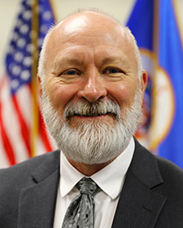
Minnesota Department of Public Safety
Commissioner Bob Jacobson
Appointed in January 2023, he is the 15th commissioner of DPS.
Mission
Serving all communities to build a safer Minnesota.
Minnesota Statutes, Chapter 299A

Slide 3
Department of Public Safety
Transportation
Policy and Finance Committees
Public Safety Policy and Finance Committees
Minnesota State Patrol
Alcohol and Gambling Enforcement
Fire Marshal Division
Office of Traffic Safety
Office of Justice Programs
Driver and Vehicle Services
Emergency Communication Networks
Office of Pipeline Safety
Homeland Security and Emergency Management
Administration and Related Services
Bureau of Criminal Apprehension

Slide 4
Department of Public Safety
Timeline
1929 Minnesota Highway Patrol is created. The first force consists of nine men.
1934 Patrol is authorized to enforce speed limits on trunk highways.
1951 Minnesota creates its Department of Civil Defense.
1957 Highway Patrol purchases two fixed-wing aircraft.
1966 The Office of Traffic Safety (OTS) is created under the Federal Highway Act.
1969 The Department of Public Safety is created.
1972 The Driver’s License Division of the Highway Department joins DPS.
1974 Highway Patrol is reorganized; official name changed to “Minnesota State Patrol.”
1987 The Minnesota Office of Pipeline Safety (MNOPS) is created.
1994 First drug detection dog begins work for the State Patrol.
2003 OTS and the Minnesota Departments of Transportation and Health establish the Toward Zero Deaths (TZD) Program.

Slide 5
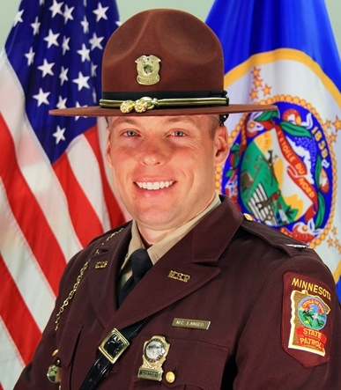
Minnesota State Patrol
Minnesota Department of Public Safety
Mission
Protect and serve all people in the state through assistance, education, and enforcement; provide support to allied agencies; and provide for the safe, efficient movement of traffic on Minnesota’s roadways.
Vision
To eliminate vehicle crashes in Minnesota through highly professional service and the implementation of evolving best practices.
Colonel Matt Langer

Slide 6
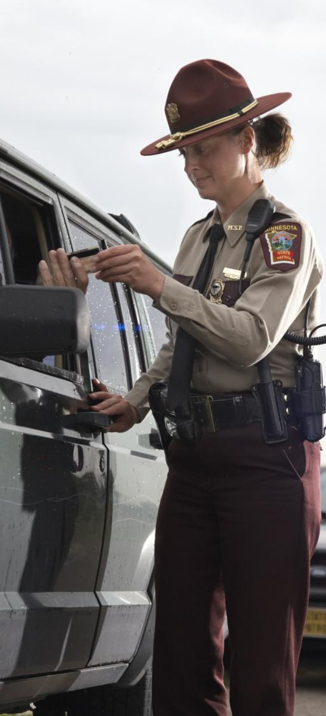
Minnesota State Patrol
Minnesota Department of Public Safety
Aviation
K-9 Program
Capitol Security
Commercial Vehicle Enforcement
Crash reconstruction
Crowd control & civil unrest
DWI enforcement
Executive protection
Federal programs
Fleet management
Investigative services
Public information
Radio communications
Special Response Team
Traffic law enforcement
Training academy
Vehicle Crimes Unit
State Patrol Services

Slide 7
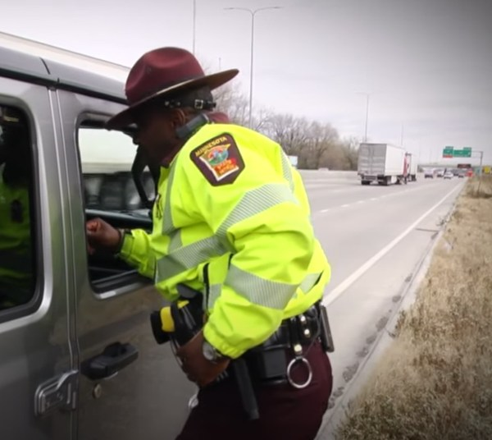
Minnesota State Patrol
Minnesota Department of Public Safety
Achievements
2022 statistics:
344,000 traffic stops
22,100 seat belt stops
5,434 DWI arrests
37,947 distracted driving-related traffic stops
76,638 motorist assists
25,779 crashes investigated
1,151 citations for speeds greater than 100 mph
47 cadets graduated from two academies in 2022
36 cadets are projected to graduate from two academies in 2023
HEAT Enforcement
Street Racing Response
Project 20(22)

Slide 8
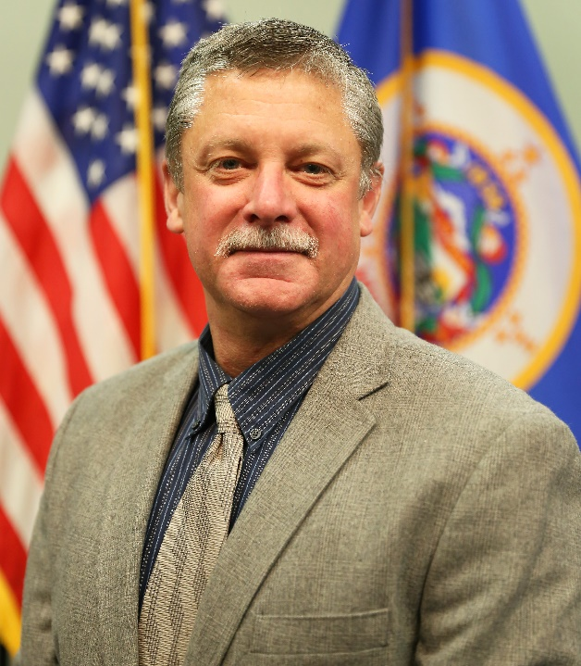
Office of Traffic Safety
Minnesota Department of Public Safety
Mission
To prevent traffic deaths and serious injuries by changing human behavior in Minnesota through policy development and support, stakeholder engagement, program delivery, leadership, and research and evaluation.
Director Mike Hanson

Slide 9
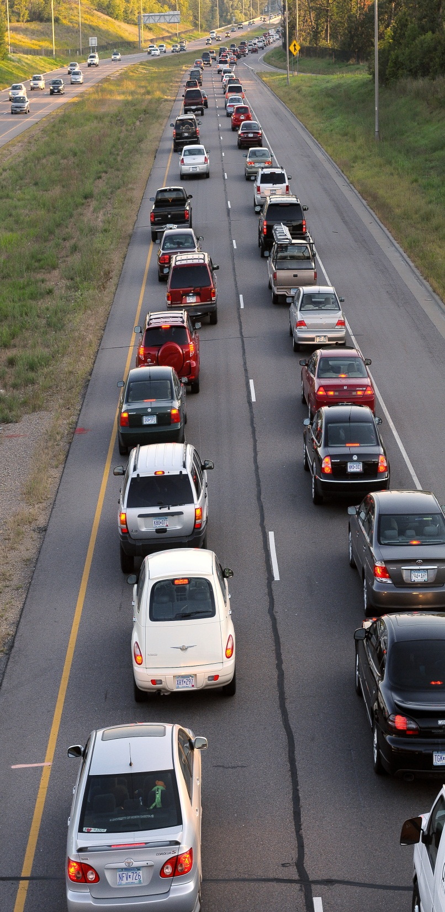
Office of Traffic Safety
Minnesota Department of Public Safety
Services
Traffic safety outreach
Impaired driving prevention
Seat belt use
Child passenger safety
Traffic records/data systems
Safe road coalitions
Motorcycle safety
Teen drivers
Illegal/unsafe speed
Distracted driving
Traffic safety research and analysis
Fatality Analysis Records System

Slide 10
Office of Traffic Safety
Minnesota Department of Public Safety
Highlights
Fatal crashes were down 10% in 2022 from 2021.
Co-chair for the Statewide Towards Zero Deaths Program.
Over $10 million in school bus stop arm camera grants.
Annually partners with over 300 city, county and tribal law enforcement agencies focusing on traffic safety initiatives.
25 DWI/traffic safety officers across the state. These 25 officers and deputies made nearly 2,000 impaired driving arrests in 2022.

Slide 11
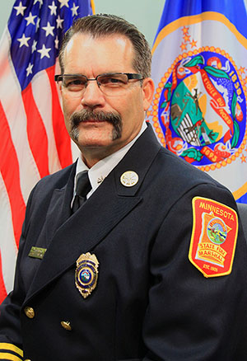
Office of Pipeline Safety
Minnesota Department of Public Safety
Mission
To protect lives, property, and the environment through the implementation of a program of gas and hazardous liquid pipeline inspections, enforcement, accident and incident investigations, and education.
Fire Marshal Jim Smith

Slide 12
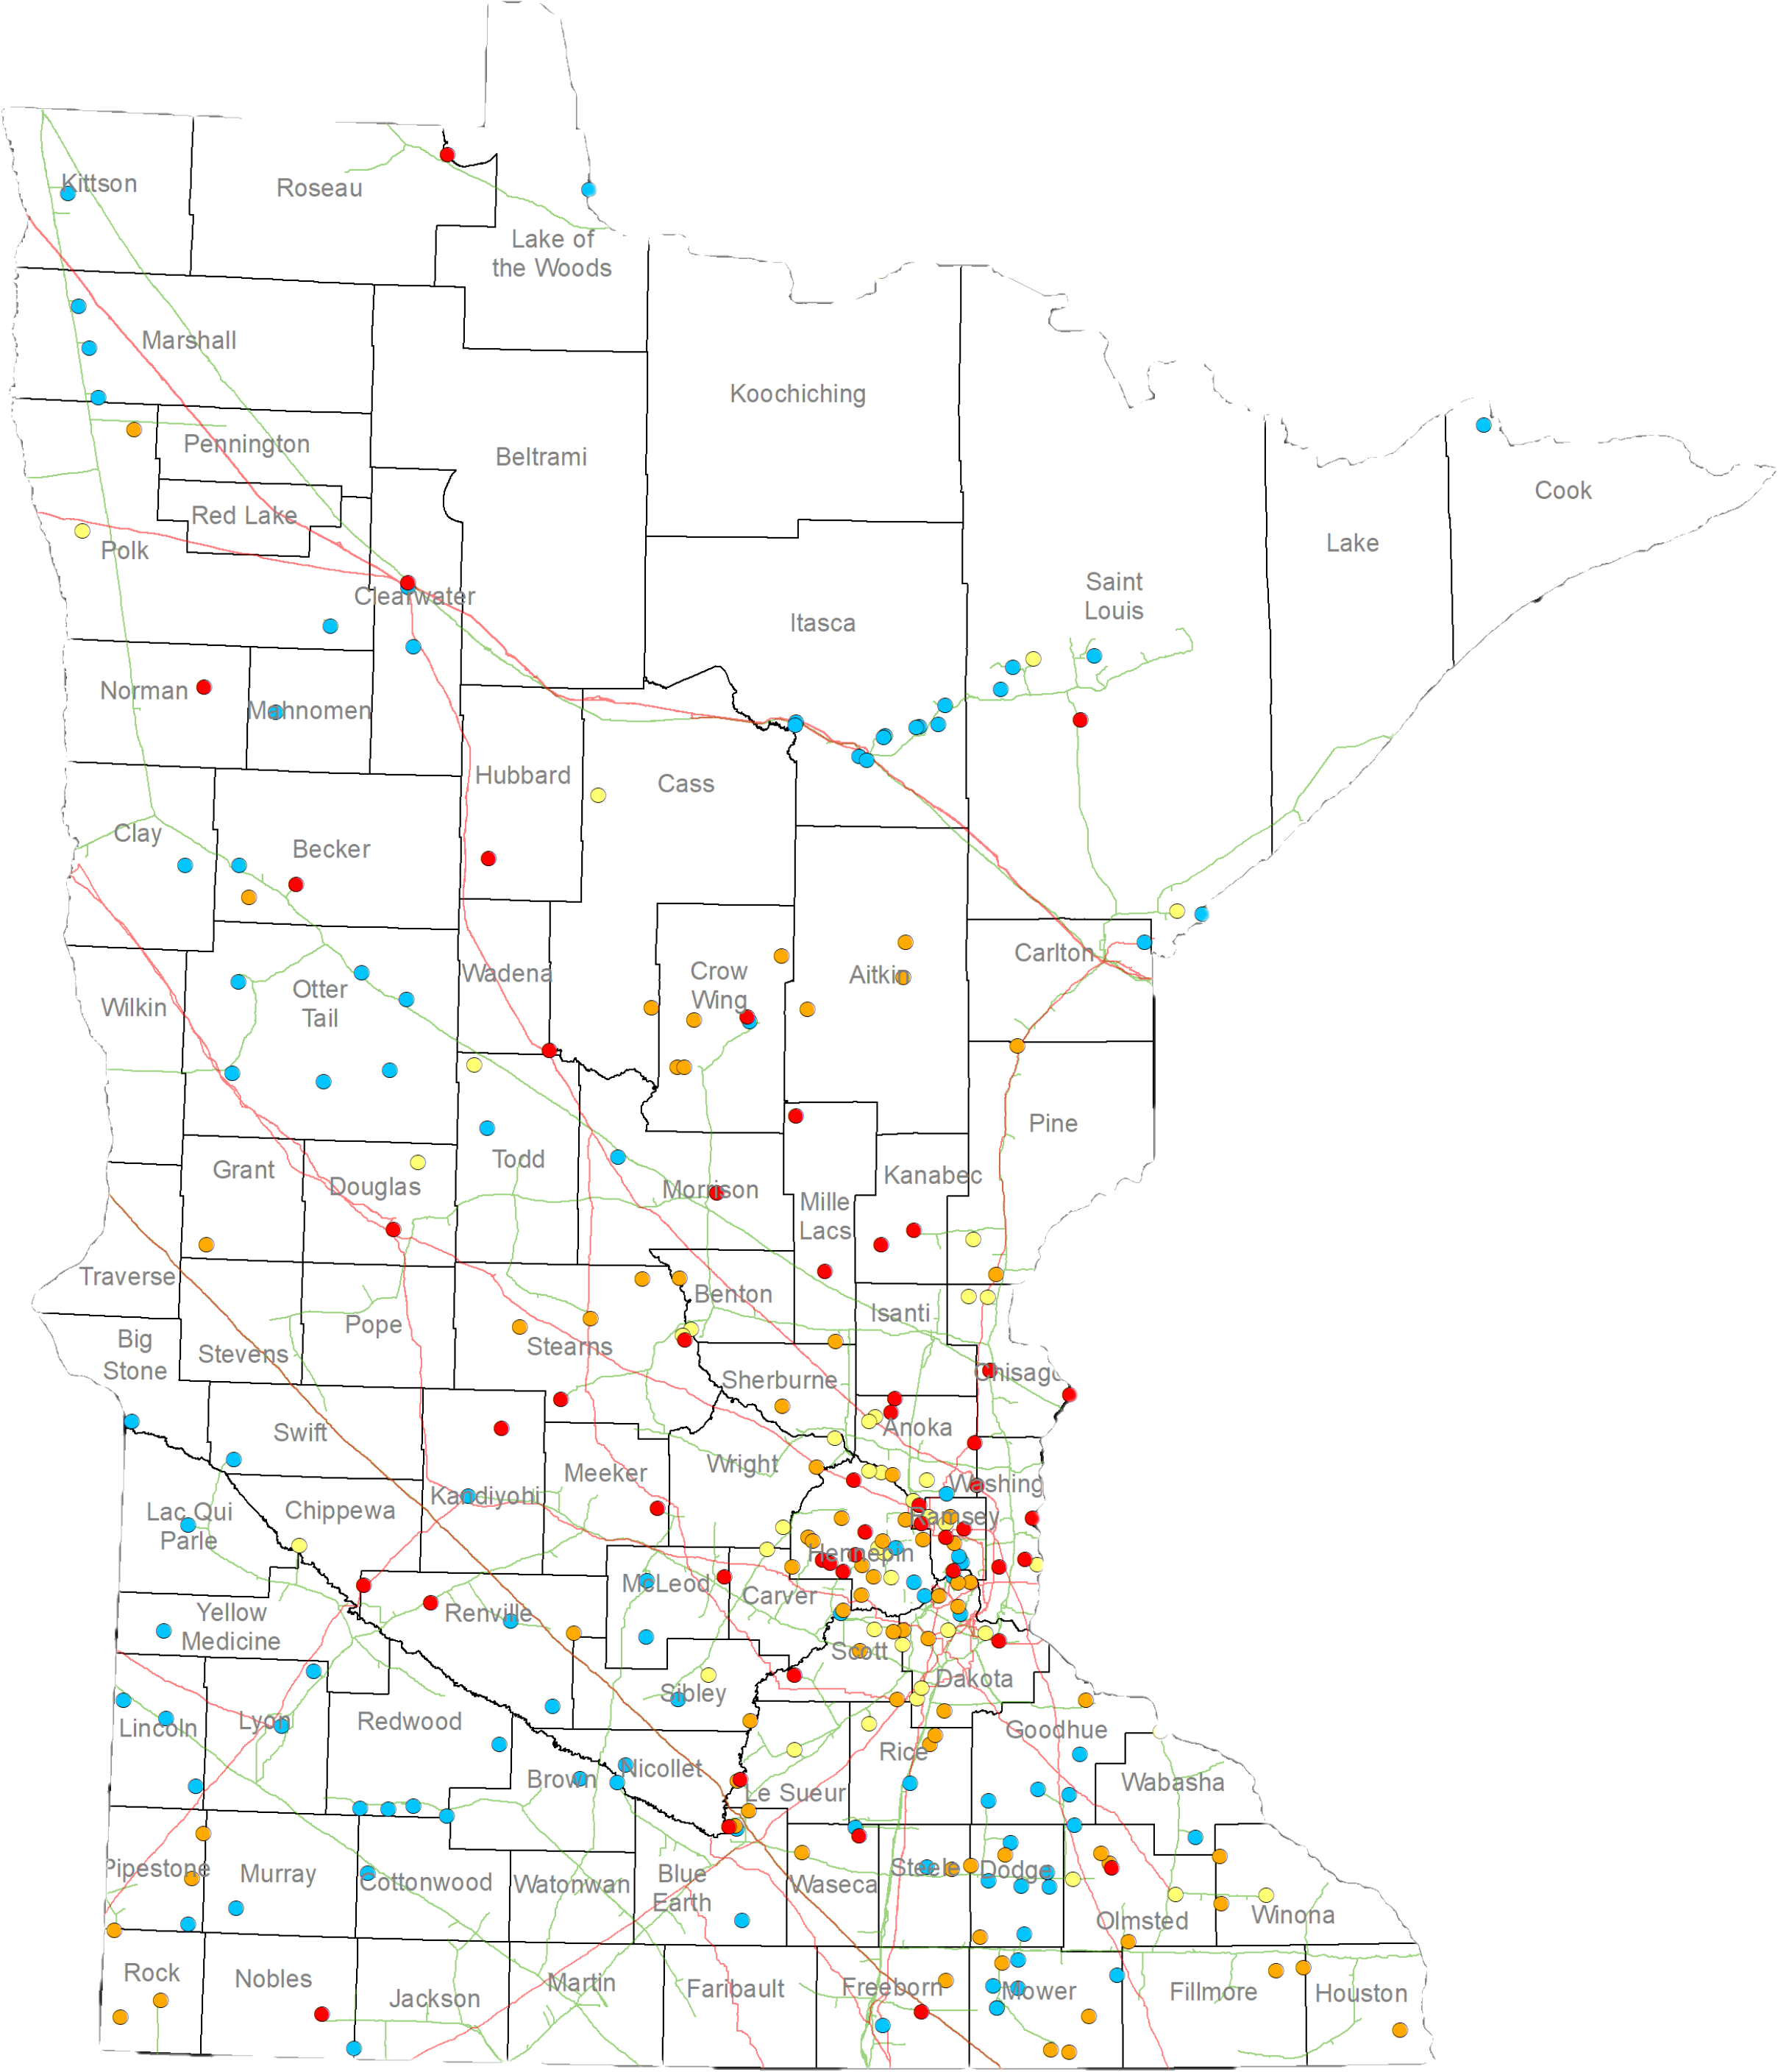
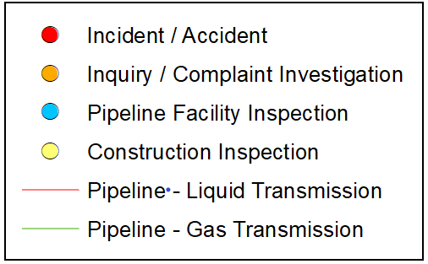
Office of Pipeline Safety
Minnesota Department of Public Safety
Responsibilities
Inspection Program
Routine inspection of natural gas and hazardous liquid pipeline operations and maintenance.
Pipeline construction inspections.
Accident investigations.
Damage Prevention Program
“Call-Before-You-Dig” education and investigations.
2020 Inspections & Investigations

Slide 13
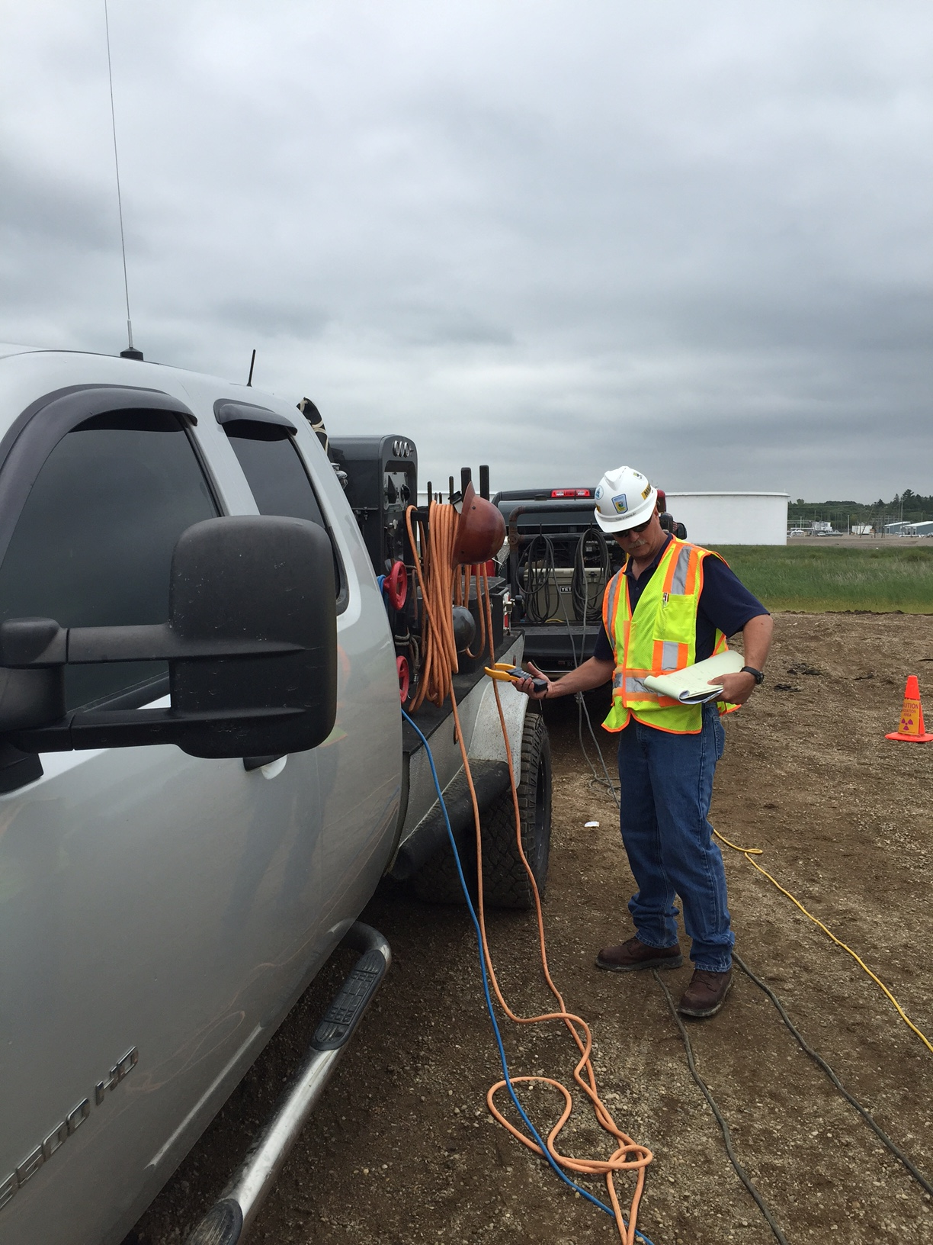
Office of Pipeline Safety
Minnesota Department of Public Safety
Highlights
Over 2,300 hours of damage prevention related investigation and training.
Over 1,100 hours of pipeline safety inspections.
Over 68,000 miles of pipeline in Minnesota.

Slide 14
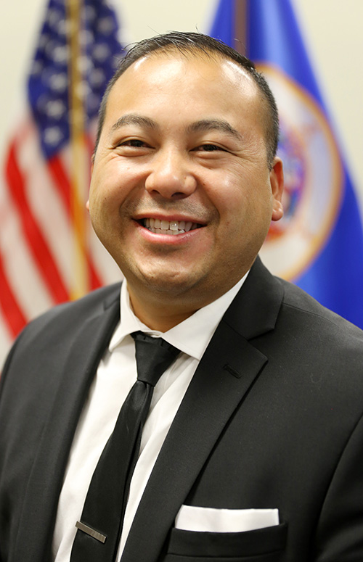
Driver and Vehicle Services
Minnesota Department of Public Safety
Mission
Deliver customer focused driver and vehicle services by optimizing technology and building efficiencies that value employees, support business partners and earn the trust of all Minnesotans.
Director Pong Xiong

Slide 15
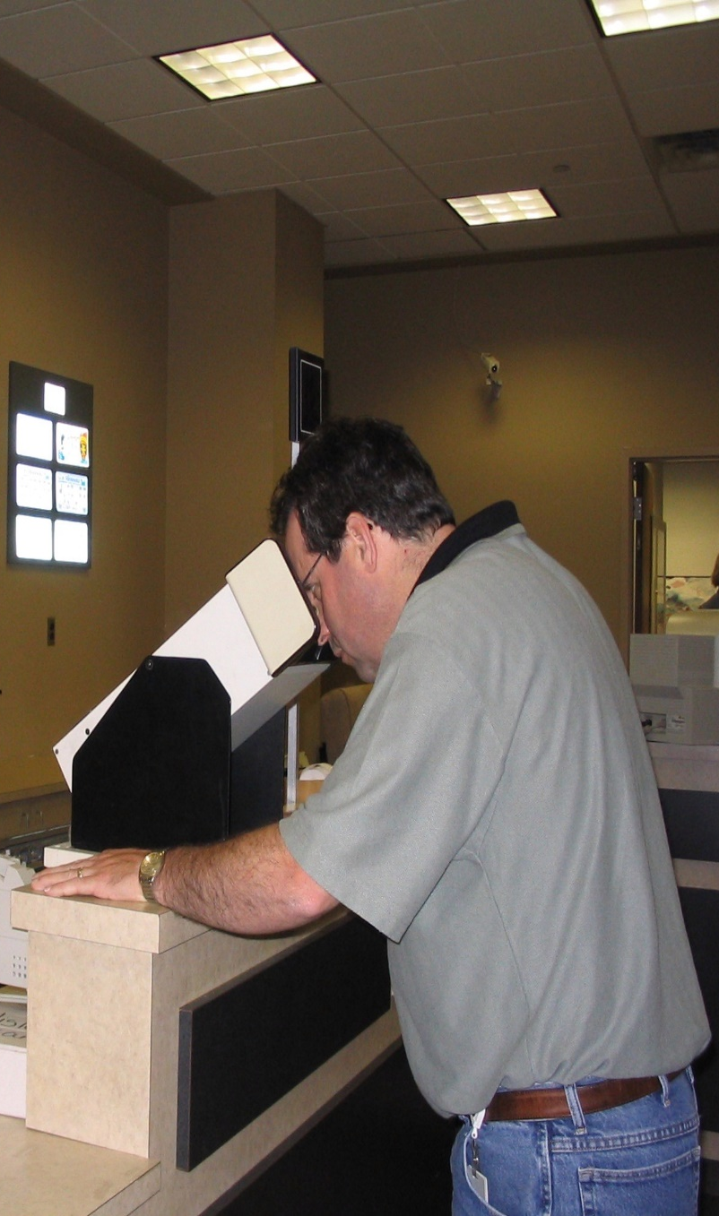
Driver and Vehicle Services
Minnesota Department of Public Safety
DVS Services
Title and registration
Driver license and identification card issuing
Driver knowledge and skill examinations
Driver compliance
Interstate trucking and registration
Auto dealer licensing and inspection
Public Information Center
Disability license plates and parking certificates
Salvage and reconstructed vehicle inspections
Support for deputy registrars and driver's license agents

Slide 16
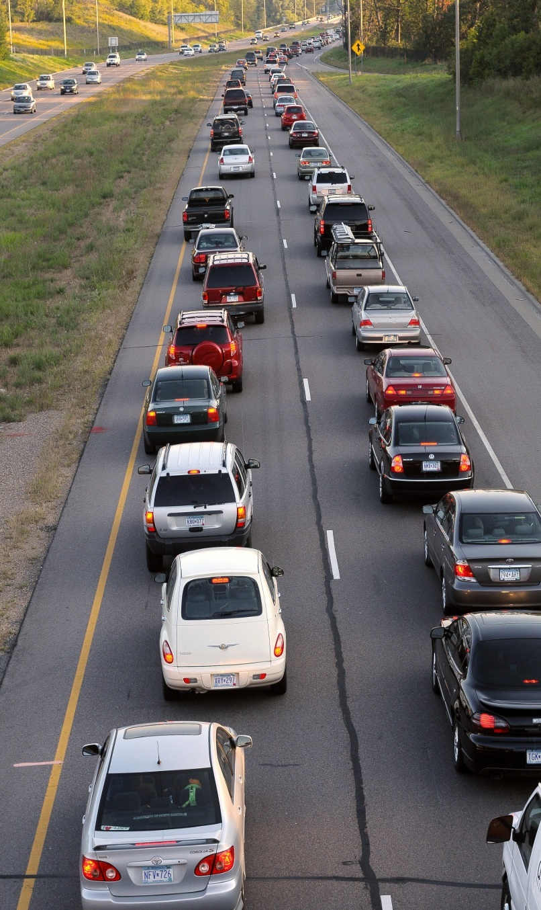
Driver and Vehicle Services
Minnesota Department of Public Safety
2021-2022 Highlights
Reopened all 93 exam stations.
Created waitlist notification option for exam appointment scheduling.
5,462 same-day licenses and IDs since Oct. 3.
Enhanced online services including online renewals, appointments, knowledge testing and virtual lobbies.
Processed 1.5 million vehicle titles, 5.5 million vehicle registrations.

Slide 17
Driver and Vehicle Services
Minnesota Department of Public Safety
Exams Administered | 2021 | 2022
Knowledge | 398,074 | 389,022
Road | 161,271 | 175,893
Notes:
Note: the decrease in knowledge tests administered by DVS in 2022 is believed to be a result of the increased use of third party proctors administering the exam. In 2022, 83 third party proctors administered at least one exam. Currently, there are 75 locations currently proctoring knowledge exams. Online knowledge test was also available at home until July 2, 2021.

Slide 18
Minnesota Department of Public Safety
Fiscal and Administrative Services
Provides budgeting, general accounting, financial reporting, payroll coordination, accounts payable, purchasing coordination, grant and contract management, and administrative support services.
Office of Communications
Provides public information to media, promotes department programming and initiatives, prepares public education campaigns and material, and manages website content and social media.
Human Resources
Strive to develop and deliver innovative human resource programs and services designed to increase the performance of the DPS workforce.
Internal Affairs
Independent division that receives and investigates all complaints regarding DPS employees.

Slide 19
Minnesota Department of Public Safety ​
Questions?
Jordan Haltaufderheid
Director of Legislative Affairs
Jordan.Haltaufderheid@state.mn.us
612-749-0049

