Slide 1
Office of Enterprise Technology Agency Overview
House State Government
Finance Committee
February 2, 2011

Slide 2
Agenda
Introduction
Agency Overview
Governance and Oversight
Security
Technology Services
Data Center Co-location
Enterprise Utility Communications and Collaboration
Closing Comments and Questions

Slide 3
Agency Overview

Slide 4
OET’s Mission
OET’s mission is to provide the leadership and services that improve government through the effective use of information technology.
Our vision is to be the trusted leader in enterprise information technology for the State of Minnesota…and the provider of choice for IT services, direction, investments and standards for government IT.

Slide 5
What Do We Do?
Office of Enterprise Technology’s responsibility and activity fall into two broad categories
Governance and Oversight
Leadership: IT policy, enterprise planning and governance
Enterprise Security: policies, standards and tools
Compliance and standards: IT architecture, products and standards; contracts and vendor management; portfolio management; and project/investment oversight
Technology Services
Utility Services: IT services that are common to all and for which agencies are required to participate
Market Services: Shared IT services offered to agencies and other governments on a competitive and optional basis

Slide 6
Scope of Our Activities
The scope of OET’s activities is illustrated in the distribution of the agency’s budget
6% of OET’s budget is general fund dollars for governance, oversight and security
94% of OET’s budget comes from customer rates for technical services, based on usage

Slide 7
Our Customers
Governance and Oversight
State of Minnesota executive branch, required
Other Minnesota governments, optional
Technology Services
Executive branch
Counties
Minnesota State Colleges and Universities
University of Minnesota
Cities
K12 schools / districts / consortia
Other

Slide 8
Customer Breakdown – Technology Services

Slide 9
Governance

Slide 10
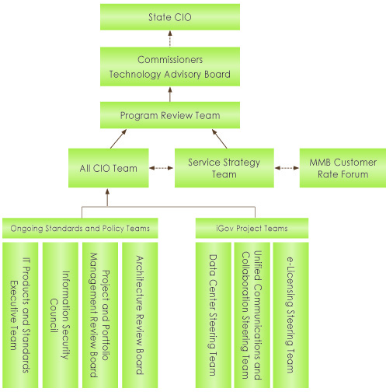
Enterprise IT Governance

Slide 11
Enterprise Security– Protecting the State
We are a part of the national security fabric that links federal, state and local governments
Federal Government
(Homeland Security & US-CERT)
Threat Advisories
State Government
(Executive, Legislative, Judicial, & Higher Education)
Threat Advisories
Incident Assistance
Local Government
(Cities, Counties, & School Districts)

Slide 12
Security Risks
Cyber attacks on government systems
Deny access to or disable critical services
Sabotage by hate groups or others with political agendas
Loss of sensitive data
Thefts for financial or political gain
Employee errors
Disasters that impact critical government systems

Slide 13
Conceptual Roles
Provide planning and policy direction
Investigate security breaches
Support shared security tools
Serve as security information broker
Architect security controls in new systems and applications
Ensure recoverability of state systems in times of crisis

Slide 14
Enterprise Security Activities
Security Activity | Status/Accomplishments
Planning and Governance | Enterprise strategic and tactical plans in place. Coordinate ongoing meetings with Information Security Council members and agency IT leaders
Policies and Standards | Published 4 overarching security policies and numerous implementing standards to secure the State’s physical environment and information assets
Incident Response and Computer Forensics | Assist state and local government entities with numerous security incidents each month. Provide forensic services to determine root cause and damage assessments of serious incidents
Vulnerability and Threat Management | Provide tools for continuous assessments of all computers in the Executive Branch and MnSCU. Provide timely security threat advisories and mitigation advice to all state and local government stakeholders
Security Monitoring | Monitor state systems for signs of attack

Slide 15
Enterprise Security Activities
Security Activity | Status/Accomplishments
Identity and Access Management | Developing enterprise-wide service to provide more effective and secure access to Executive Branch computer systems. Initial agencies will include the Department of Human Services, the Department of Health, and the Office of Enterprise Technology
Training & Awareness | Conduct ongoing security awareness activities. Provide targeted security training courses to state government information technology professionals
Continuity of Operations | Support agencies in developing reasonable and sustainable COOP plans. Provide assistance with exercising disaster recovery capabilities
Security Architecture | Provide assistance to incorporate security controls in major state government computer systems and technology projects
Compliance | Compile metrics to help agency leaders gauge the effectiveness of their security controls

Slide 16
Technology Services

Slide 17
State IT Services
We provide the following technology services to Minnesota government customers
Enterprise Applications
Communications
Data Center Services
Desktop
Network
Professional Services
Security
Standard Products
Web
Key Enterprise Service Initiatives
Data Center Co-Location
Enterprise Unified Communications and Collaboration

Slide 18
Data Centers: The Problem
The executive branch has 36+ data centers, 70+ “type” facilities
Excessive locations based upon the number of state servers, applications and requirements
Too costly to maintain and operate
Hard to protect against hackers and disasters
Three times more square footage than required
Built to 40 year old guidelines
Current state data centers are:
Extremely complex
Difficult to maintain
High risk
Increasing in cost

Slide 19
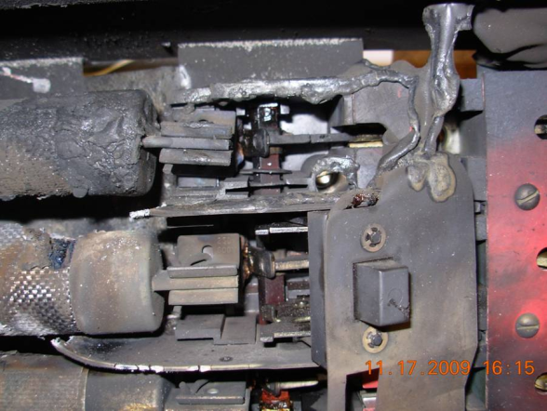
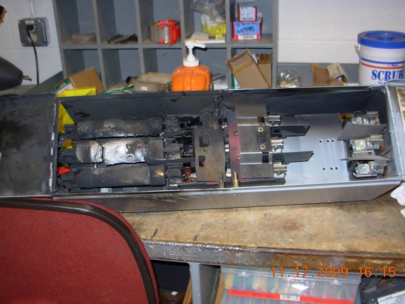
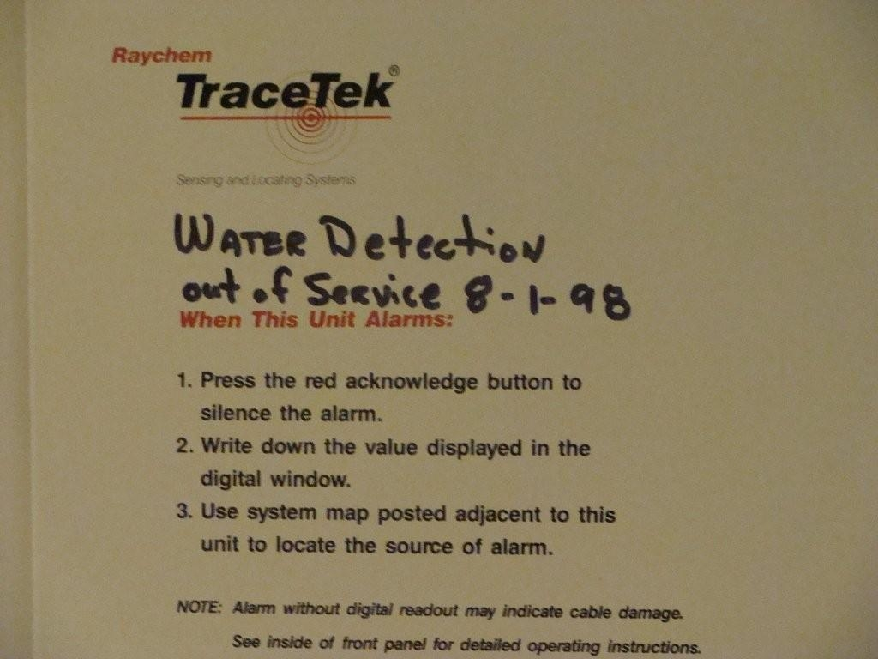
Deteriorating Facilities
Outdated facility’s equipment caused fire on 11/17/09
Program services were unavailable for nearly 24 hours
Antiquated (1960’s) generator
This water detection system has not functioned for a decade

Slide 20
What is Co-location?
Agencies locate their data center servers, network, and storage equipment alongside other agencies in a shared facility
Facility’s building, power, and network bandwidth is provided
Co-location / facility is managed by OET
Agencies manage their own equipment/systems or hire those services from OET

Slide 21
The Data Center Co-Location Plan
Priority Systems
3 & 4 (65%)
Priority Systems
1 & 2 (35%)
EDC 4
EDC 1
Over next 3-5 years
Over next two years
Priority 1 & 2
EDC 2
Third-party Facility
Upgraded State Facilities
EDC 3
Tier III
Priority 1: Recovery time of 24 hours or less; impacts the public’s safety
Priority 2: Recovery time 24 hours -5 days; impacts the public’s safety, health or trust
Tier II
Priority 3: Recovery time 6 - 30 days; impacts key business delivery
Priority 4: Recovery time 30+ days and any business delivery

Slide 22
Current Project Status
Agencies
Priority systems identified
1st iteration of co-location plans
Enterprise Planning (OET)
Currently reviewing agency plans
EDC4
RFP, November 2010
Currently evaluating responses
EDC 4
EDC 1
Upgraded State Facilities
EDC1
Planning the upgrade
Third-party Facility
EDC 2
EDC 3
EDC2 & EDC3
Awaiting enterprise planning

Slide 23
Co-Location Benefits
Clear & Consistent DC Strategy: Significant consolidation of most vital systems, 5-year strategy in place
Addresses Risks: Space and move priority given to current data centers most at risk
Minimized Costs: Recognize difficult financial times
Equipment refresh plans offset move costs
Infrastructure investments in limited to state facility upgrades
Elevates Other Opportunities: Gradual standardization & co-location sets the State up for more efficiencies in future (virtualization, cloud computing opportunities, etc.)

Slide 24
Enterprise Unified Communications & Collaboration (EUCC)
What is EUCC?
A Unified Communications and Collaboration (UCC) strategy and infrastructure promotes the effective use of various communication services and collaborative, web-based work spaces. The ability to communicate and collaborate with a broad range of interested parties is a key efficiency and productivity differentiator for state agencies.
Email
Web collaboration
Conferencing

Slide 25
Enterprise Email By the Numbers
Minnesota is the first state to implement a single enterprise email system for the entire executive branch
Total email mailboxes: 38,250
Total BlackBerry devices: 2,400
Number of messages within Enterprise Email:
Sent: 255,000/day, 7.65M/month
Received: 825,000/day, 24.9M/month
12 month average service availability: 99.932%
Number of messages per month scanned for spam and viruses: 275 million
Percent of mail discarded because of spam or virus: 96.5%

Slide 26
Enterprise Email Benefits
Cost Avoidance: Avoid ongoing costs of 36 email systems on 4 separate platforms; automatic upgrades with no individual investments
Better Security: Single set of security standards built in
Better Communications: Single directory and calendaring for all executive branch

Slide 27
Enterprise Email Implementation
2007
2008
2009
2010
2011
RPF to select standard platform. Microsoft selected
Email declared a utility service
Enterprise Email system built
1st agency migrated
Full migration complete
Enterprise license agreement with Microsoft

Slide 28
Additional EUCC Milestones
2007
2008
2009
2010
2011
RPF to select standard platform. Microsoft selected
Email declared a utility service
Enterprise Email system built
1st agency migrated
Full email migration complete
Enterprise license agreement with Microsoft
SharePoint declared utility services
BPOS-D agreement with Microsoft
Next step: Cloud management of email and other utility communications applications

Slide 29
EUCC Service Benefits
Increased efficiency of state workers (state, county, city, etc.)
Addresses business needs of state workers
Enables cross-organization collaboration
Creates a common toolset across State

Slide 30
Questions?

